Slide 1
Labour Data in Canada: the good, the bad, and the maybe
Michael Haan
Western University
mhaan2@uwo.ca

Slide 2
The Good: The Interest in Data Development Remains Strong (too strong?)
Several federal (IRCC, ESDC, etc.) and provincial departments remain heavily invested in providing data, funding development, and pushing for linkages.
In 2024 alone, Statistics Canada approved more than 20 unique microdata linkages.
Several linkages (BEAM, ELMLP) now include information on corporations.
It is possible to identify movement within and across firms.
Some linkages have become so extensive that they are now referred to as data ‘environments’.
Academic researchers have access to more data than ever.

Slide 3
Overview of the LISE
Longitudinal Immigration
Statistical
Environment
(LISE)
Health
Data
Ontario Mental Health Reporting System (OMHRS)
Longitudinal Immigration Database (IMDB)
National Ambulatory Care Reporting System (NACRS)
Annual personal tax data 1982-
Longitudinal immigration admin. file
Discharge Abstract Database
(DAD)
T1FF
Immigration data 1952-
Education
Data
Registered Apprenticeship Information System (RAIS)
Tax files (e.g. T4)
Temporary resident permits 1980-
Post-Secondary Information System (PSIS)
Records for children
Citizenship records 2005-
2016 Census
Mortality records
Settlement Services Data
Longitudinal Administrative Databank (LAD)
Future Linkages
Notes:
Social Data Linkage Environment (SDLE) responsible for the provision of integration keys.
STC maintains a data depot integrating multiple administrative and survey files to a central repository (Derived Record Depository [DRD]).
Integration keys must be cleaned and de-duplicated.
SDLE integrates data files (IMDB/DAD/Census/etc.) to the DRD; the files are not directly integrated to each other.
Cleaning and deduplication refers to creating unique combinations for populations of interest (immigrants on the IMDB, persons on the LAD).
As the project involves integrating 9 different datasets to both the IMDB and the LAD, this process had to be done 18 times.

Slide 4
The Bad: Data are ‘half-developed’ with several gaps
Documentation is scarce
It is difficult to know if these data are being adequately used
There were 5 teams using iCARE-IMDB in July 2024.
All of the files are several years old.
For IMDB, T4s run to 2023; T1FF is 2022.
Our most recent population count is from 2021 (!).
Many new files contain incomplete and missing data.
Gaps remain around vacancies, appropriate employment, etc.

Slide 5
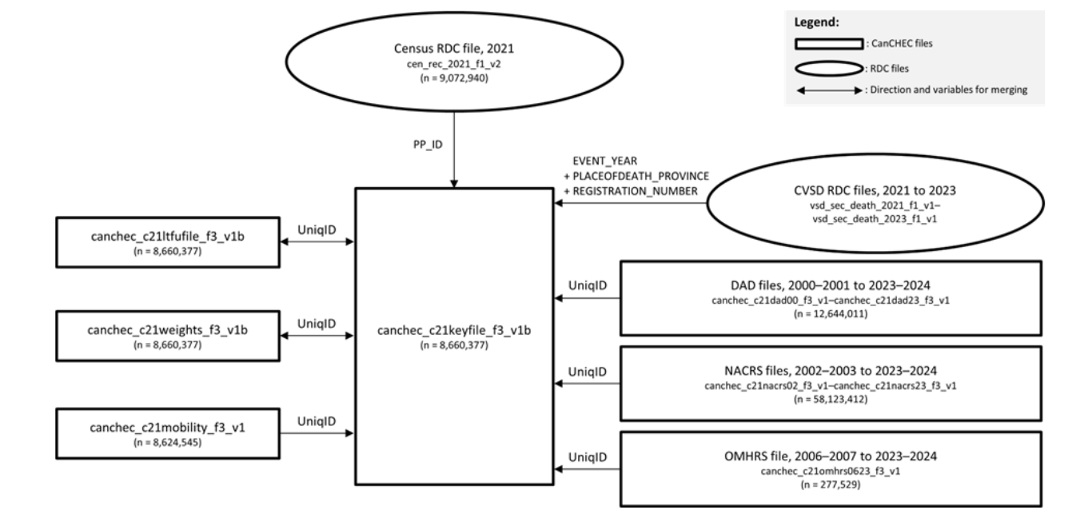
Example 1: CanCHEC 2021

Slide 6
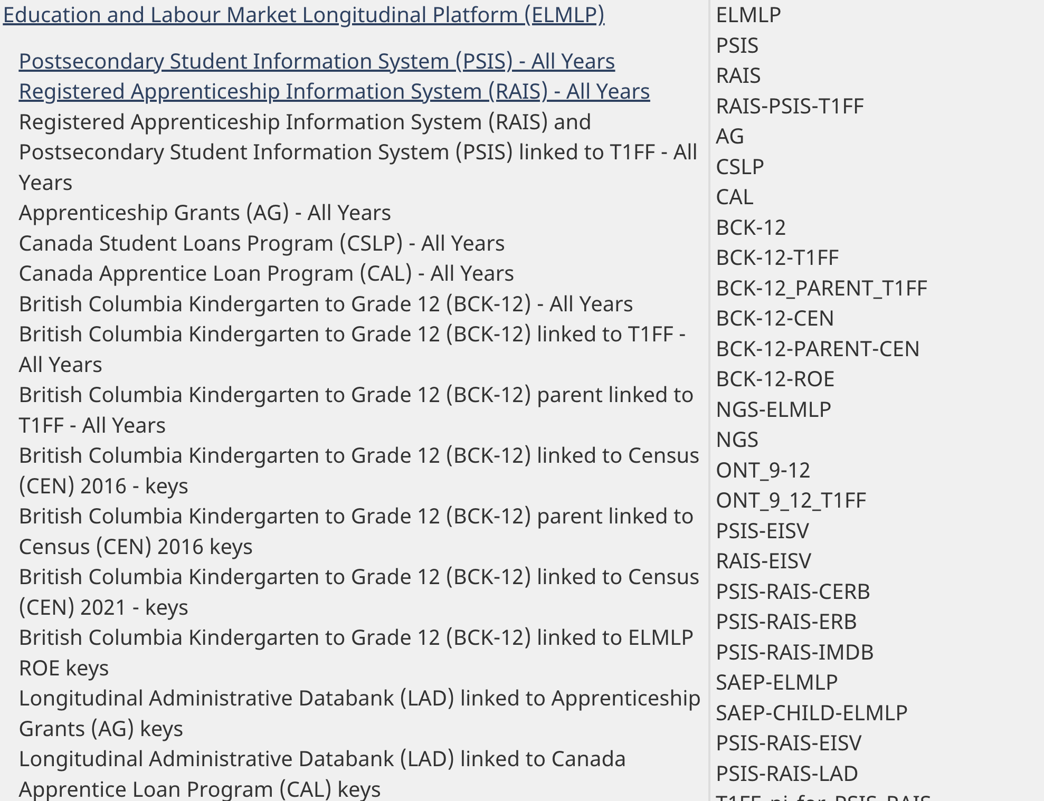
Example 2: ELMLP

Slide 7
The Maybe
Use non-traditional data to fill gaps.
Our most current population count is from 2021 (!)
International researchers are using social media, mobile phone data to estimate where populations are.
More training and synthetic data to help researchers before they enter the RDC.
User support groups for complex linkages.
This helps data users and providers alike (iCARE-IMDB).

Slide 8
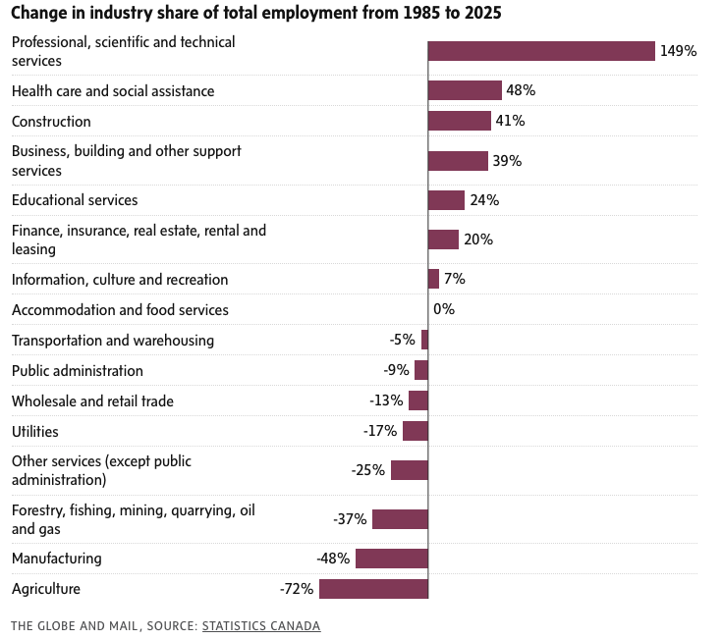
A Shifting Labour Market

