Slide 1

DARPA project
Zhaoliang Zheng
LEMUR
Jan. 29th , 2020

Slide 2

DARPA CREATE project introduction
DARPA stands for Defense Advanced Research Projects Agency
CREATE is Context Reasoning for Autonomous Teaming
CREATE seeks to develop the theoretical foundations of autonomous AI teaming to enable a system of heterogeneous, contextually-aware agents to act in a decentralized manner and satisfy multiple, simultaneous and unplanned missions goals.
Our proposal: Decentralized Optimized Context-aware Teaming
Team lead: Ankur Mehta
Team members:
Daniel Selva(TAMU), Yizhou Sun(UCLA), Hadas Kress-Gazit(Cornell)

Slide 3
Proposal Summary
Mosaic systems: networked, heterogeneous, time-varing collections of agents.
These agents have their original deployment and applications.
The general resource in these agents can be leveraged for new missions, which required individual expert design.
We proposed unclassified fundamental research to develop a system whereby agents independently choose whether and how to respond to a new mission through context-awareness.

Slide 4
Goals
Agents in our system can dynamically respond to new and unexpected mission.
To apply context to imbue agents with “machine understanding ” as they relate to incoming task requests.

Slide 5
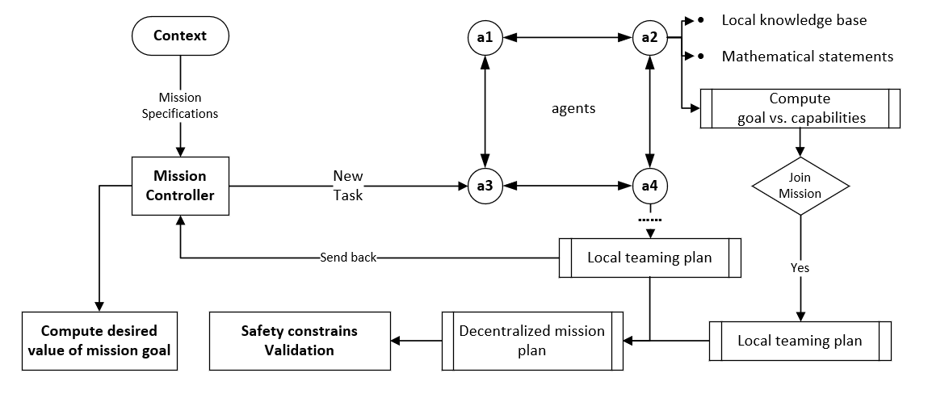
Functionality

Slide 6
Challenge problems
(1) To detect single instance of a rocket launch
To detect helicopter take-off
To detect earthquake
(2) To continuously track a specified vehicle
To track a specified person
To allocate traffic resource if a car accidence happens

Slide 7
Technical plan: Context representation
Context representation: including methods to collect and parse of existing corpora then decomposing into local knowledge bases
Knowledge graph specification
Knowledge graph decomposition
Knowledge graph updates
Corpus retrieval

Slide 8
Technical plan: Capability reasoning for contextually-aware agents
Capability reasoning for contextually-aware agents:
Including algorithms to
understand mission
specifications and resolve effects of agent operations
Embedding model training
Score function design
Score function interpretation
Aggregate score function approximation
Constraint and uncertainty characterization
Algorithm characterization

Slide 9
Technical plan: Local planning for decentralized decision making
Local planning for decentralized decision making: including design problem optimization formulation, decentralized approximations, and performance evaluation
Decentralized formulation of teaming algorithm
Oracel-based context enhancements
Parameter assignment based on score
function
Optimization-based teaming problem
formulation
Quantification of context impact

Slide 10
Technical plan: Mission specification and verification
Mission specification and verification: including the development of a high-level language to specify the desired taks, then ensuring the success of the resulting mission plan
Specification language formulation
Knowledge graph decomposition of mission speficition
Challenge problem formulation
Compilation of local agents plans into aggregate mission plan
Verification and validation algorithms

Slide 11
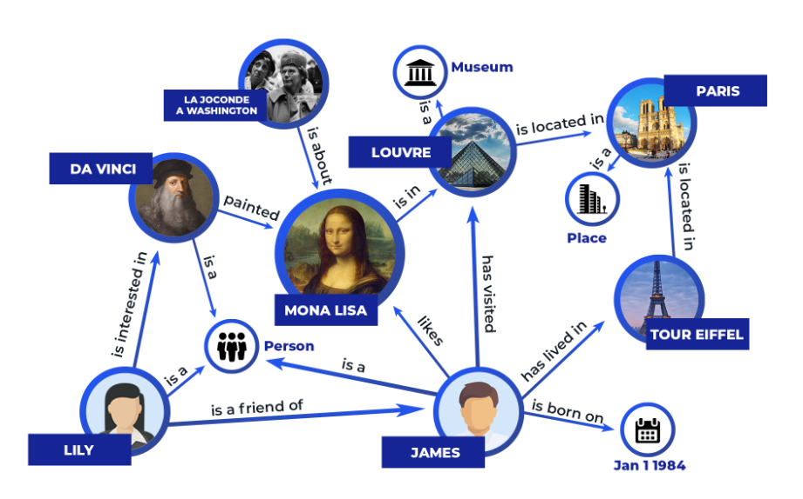
Knowledge Graph
A Knowledge Graph is a model of a knowledge domain created with the help of intelligent machine learning algorithms. It provides a structure and common interface for all of your data and enables the creation of smart multilateral relations throughout your databases.
Entities
E.g., Da Vinci, Mona Lisa
Relations
E.g., painted
Triples
E.g., (Da Vinci, painted, Mona Lisa)
A knowledge graph is a collection of triples

Slide 12
Why Knowledge Graph
1. Combine Disparate Data Silos
2. Bring Together Structured
and Unstructured Data
3. Make Better Decisions by
Finding Things Faster

Slide 13
Knowledge Graph
We can only collect small
amount of knowledge
How to infer missing
knowledge based on the
observed triples?
Knowledge graph
Embedding

