Slide 1
Cornell Team
Agent 1
(a₁)
Agent 2
(a₂)
Goal:
Generate temporal specifications over a knowledge graph
Sensor 1
(s₁)
Sensor 2
(s₂)
Sensor 3
(s₃)
P₁
P₂
Measurement 1
(m₁)
Measurement 2
(m₂)
P₃

Slide 2
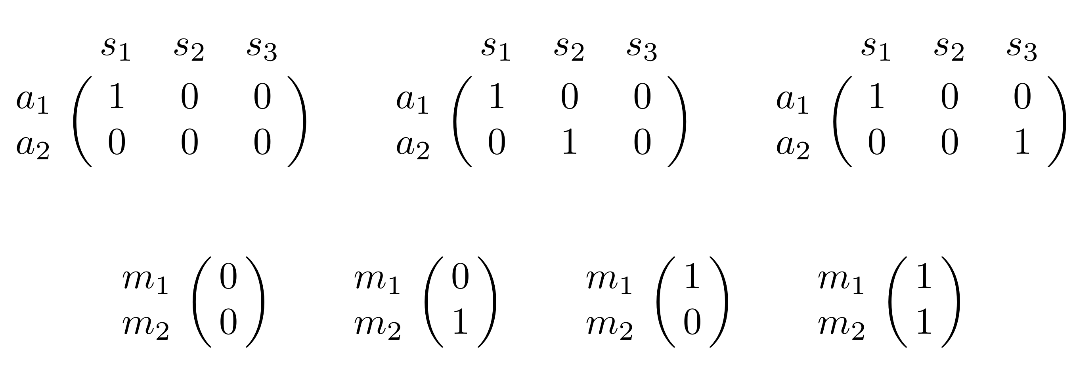

a₁
a₂
(Portion of) MDP
actions
p₁
s₁
s₂
s₃
(1-p₁)(1-p₂)
P₁
P₂
TO_A1S1_A1S2
TO_A1S1
TO_A1S1_A1S2
m₁
m₂
(1-p₁)p₂
P₃
TO_A1S1_A2S3
Knowledge Graph
p₁p₃
TO_A1S1_A1S2
p₁p₂
1-p₁
TO_A1S1
p₁(1-p₂)
TO_A1S1_A1S2

Slide 3
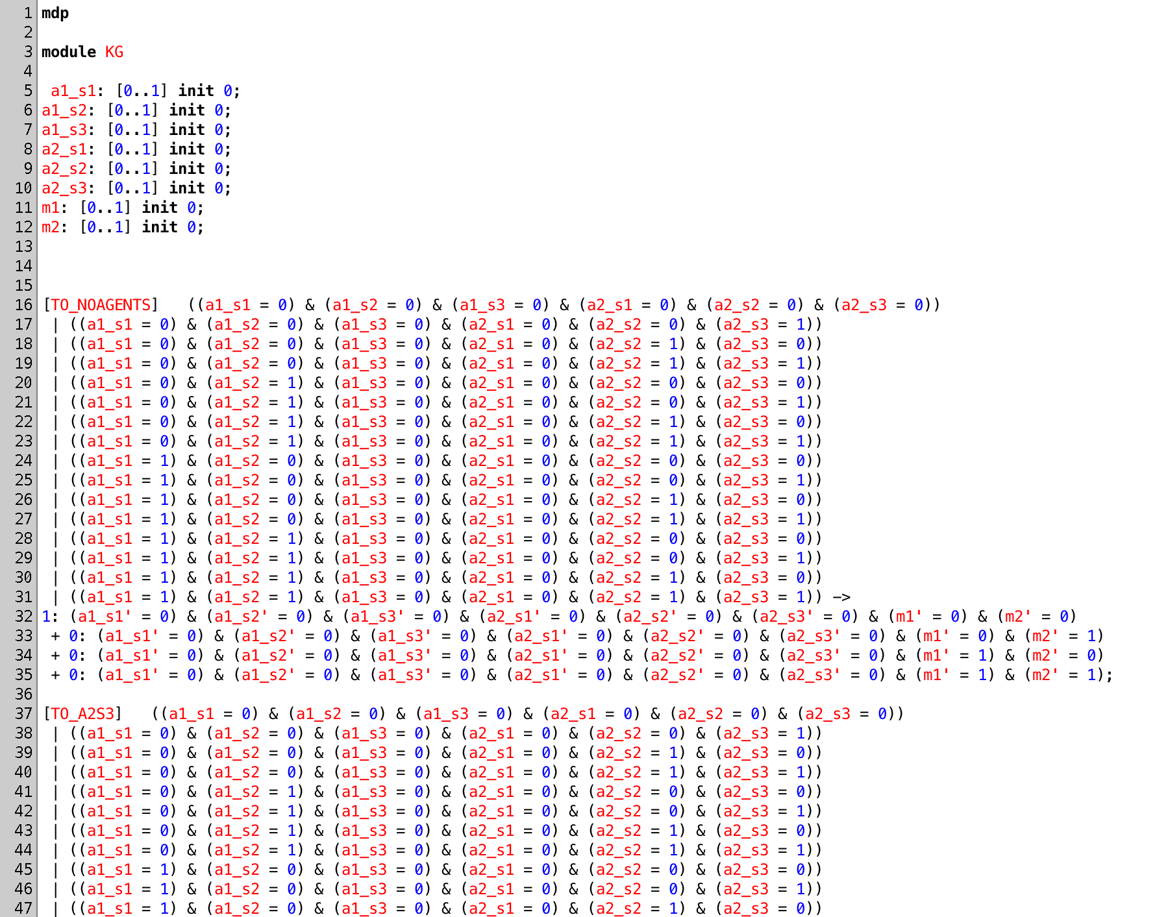
PRISM Simulation
PRISM: probabilistic model checker
actions
probabilities of next states

Slide 4
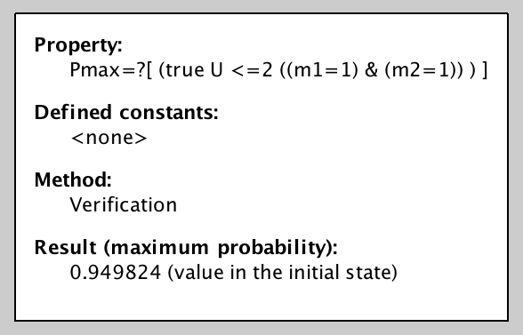
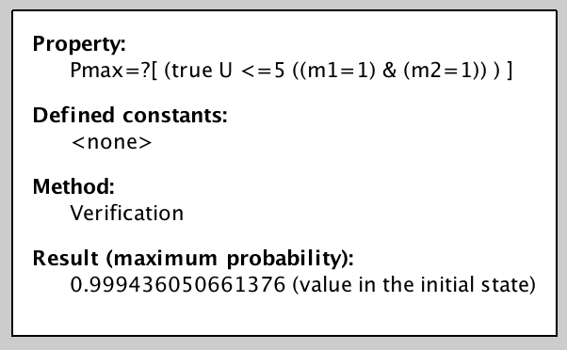
Mission Specification
Probabilistic Computation Tree Logic (PCTL)
Current specification is a “bounded always”
Next step: generate more complex MDPs and specifications

