Slide 1
Local planning and State estimation

Slide 2
Work done so far
Survey on different state estimation methods like: Bayes filter, particle filter, Kalman Filter
Survey on different data fusion methods like: Covariance Intersection KF, Multi-Bayes estimation, fuzzy logic, AI neuro network.
Based on Knowledge Graph and capability reasoning, to decide what is needed for state estimation and how to corelate those variables to autonomously generate a proper decentralized teaming plan.

Slide 3
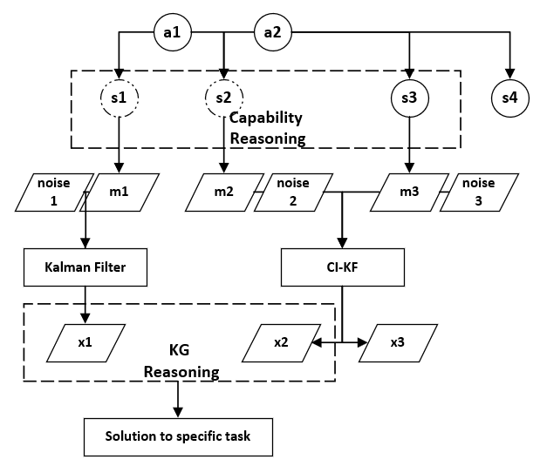
Workflow
Goal:
To create a autonomous Kalman Filter framework which could autonomously sensing the real state of our sensors based on KG, Markov logic network (context-aware).

Slide 4
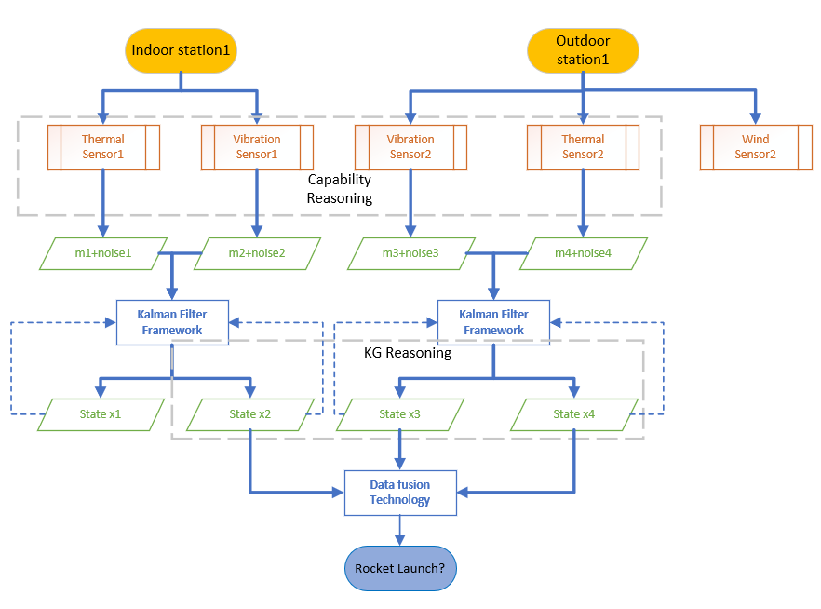
Example
Capability reasoning would determine whether a sensor has the ability of joining this mission and give out its measurement along with noise.
KF is a powerful tool to estimate the state of a sensor based on its observation and previous states.
KG reasoning can determine if the output from KF framework is really helpful to our mission.

Slide 5
KF Framework
Advantages:
It is fast, for both propagate and update step. (recursion attribute)
Estimation is accurate.(considering the noise)
It is computational low cost.(only storage last cov and state)
It can be used for data fusion.
Next step:
To specify what variables are needed to feed into KF framework from capability reasoning and how to smartly proceed.
To determine data fusion process in KF framework.

