Slide 1

CREATE-Table-Top-Challenge
Group 1 – Team Members:
Ramtin Mojtahedi
Zhendong Sha
Mahdi Gilany
Group Mentor: Dr. Amoon Jamzad
May 06, 2022
Notes:
Thank all organizers specially Rebecca

Slide 2
Completed Tasks
Highlights:
Task 1
Filtering Data
Changing model
Backbone neural net
Overall pipeline
Task 3
Data Filtering
Changing backbone neural net
1/7
Notes:
These are overall highlights
We did task 1 and task 3
For task 1 we worked on both data and model. We filtered data which I will talk about in the next slide. And we also changed the model both backbone neural net and overall pipeline.

Slide 3
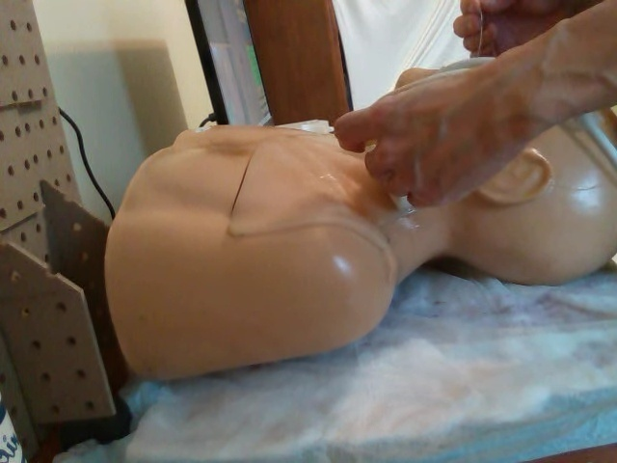
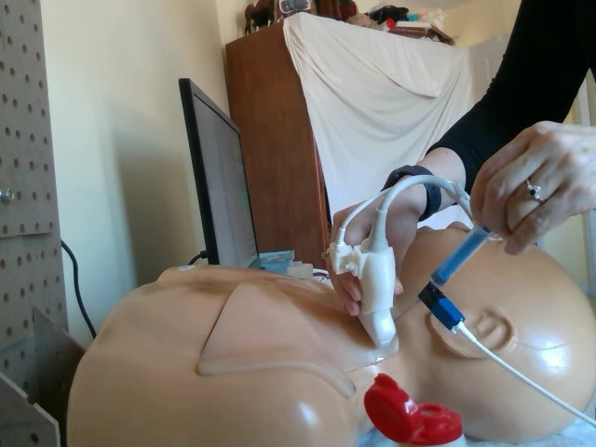
Data Filtering – Task 1
Not visible ultrasound
Two present tools in hands
2/7
Notes:
As we know task 1 is for active tool recognition.
Baseline model uses a CNN network to predict active tool from only one image frame.
Based on this assumption, we realized that some frames might be misleading for the model and worsen our training phase.
Based on our investigation in the data set, we found some tools that are labeled as active are not visible in their corresponding frames as seen in the left image. So we filtered them from training set.
The right image on the other hand shows that two tools in the operator’s hands are visible in the image which makes the dataset inherently noisy and the best way to deal with this issue is to use multiple frames instead of just one frame.

Slide 4
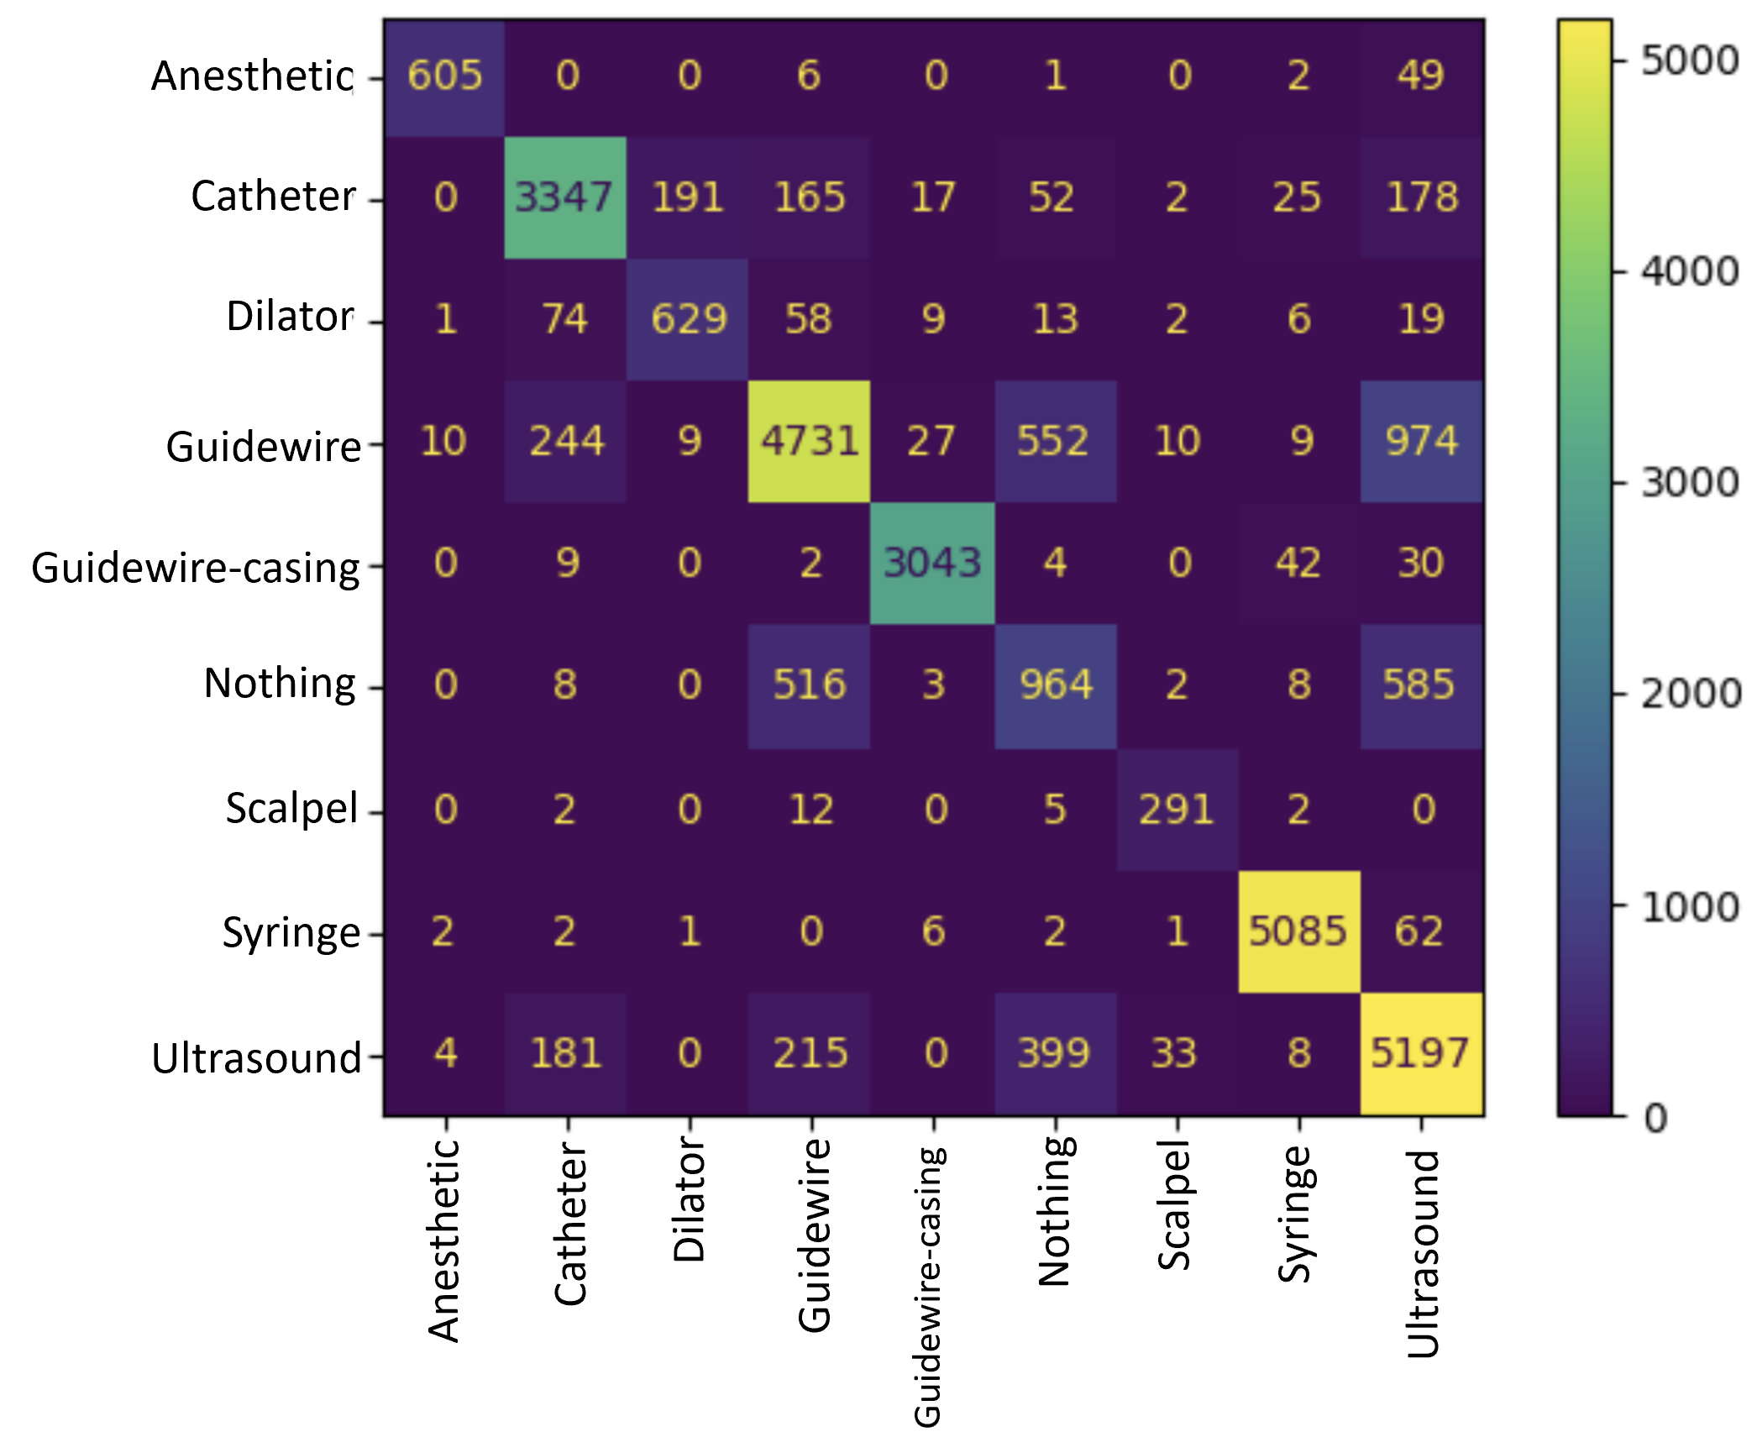
Experimented Models and Results – Task 1
With Filtering Data
Experiment | Val Accuracy [%] | Val Recall [%] | Val Precision [%]
ResNet50 | 82.92 | 82.92 | 82.83
EfficientNetB4 | 81.3 | 81.3 | 84.64
ResNet 101 | 80.98 | 80.98 | 84.9
ViT | 66.3 | 66.3 | 72.89
Multi-frame Resnet50-LSTM | 0.96 | N/A | N/A
Code of task 3 but labels of task 1
Without Filtering Data
Experiment | Val Accuracy [%] | Val Recall [%] | Val Precision [%]
Baseline-ResNet50 | 78.42 | 78.42 | 75.73
ResNet50 – Balanced Data | 71.55 | 71.55 | 77.28
EfficientNetB4 | 65.03 | 65.03 | 65.92
ResNet 101 | 81.3 | 81.3 | 84.64
3/7
Notes:
Here these are our results and experiments that we did with filtered data and without that.
Filtering Data helps if we compare experiments in red.
Confusion matrix of the above experiment is shown at the right. We can see that most of the tools are correctly classified.
In the last row of first table. We can see enabling multi-frame analysis boosts the performance by a lot.

Slide 5
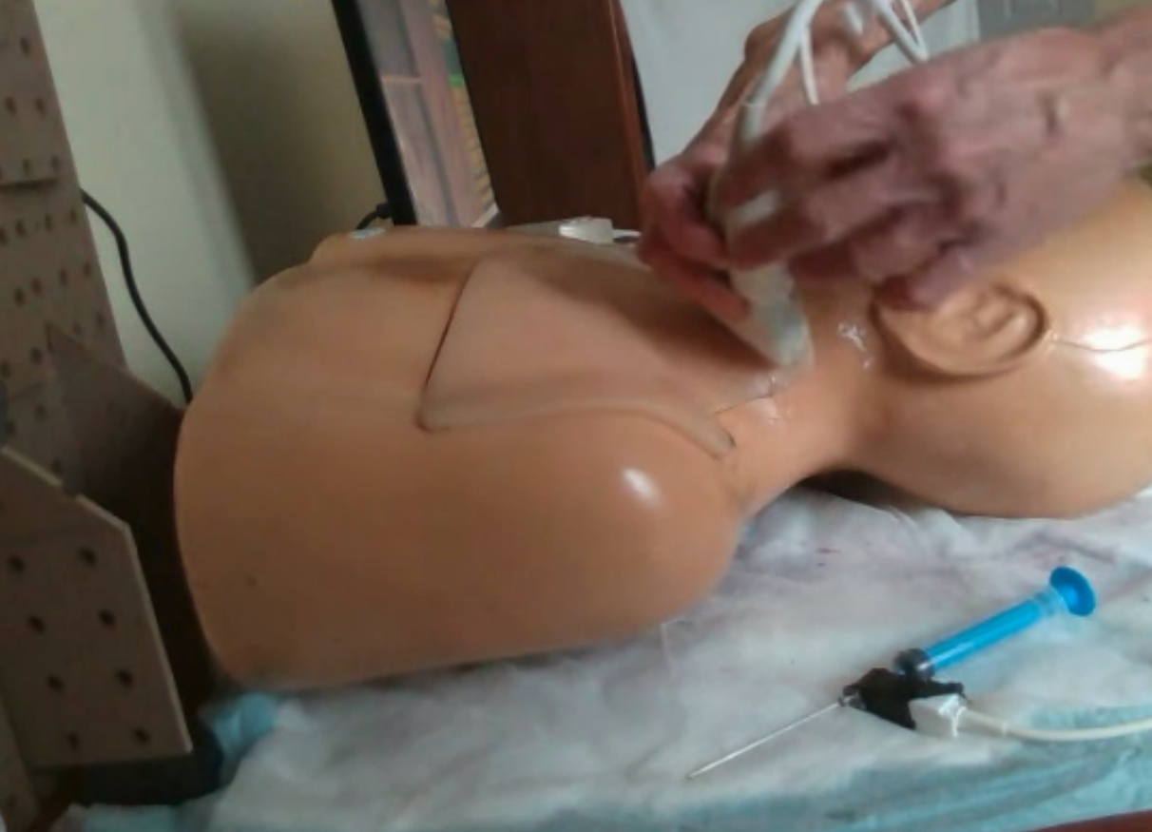
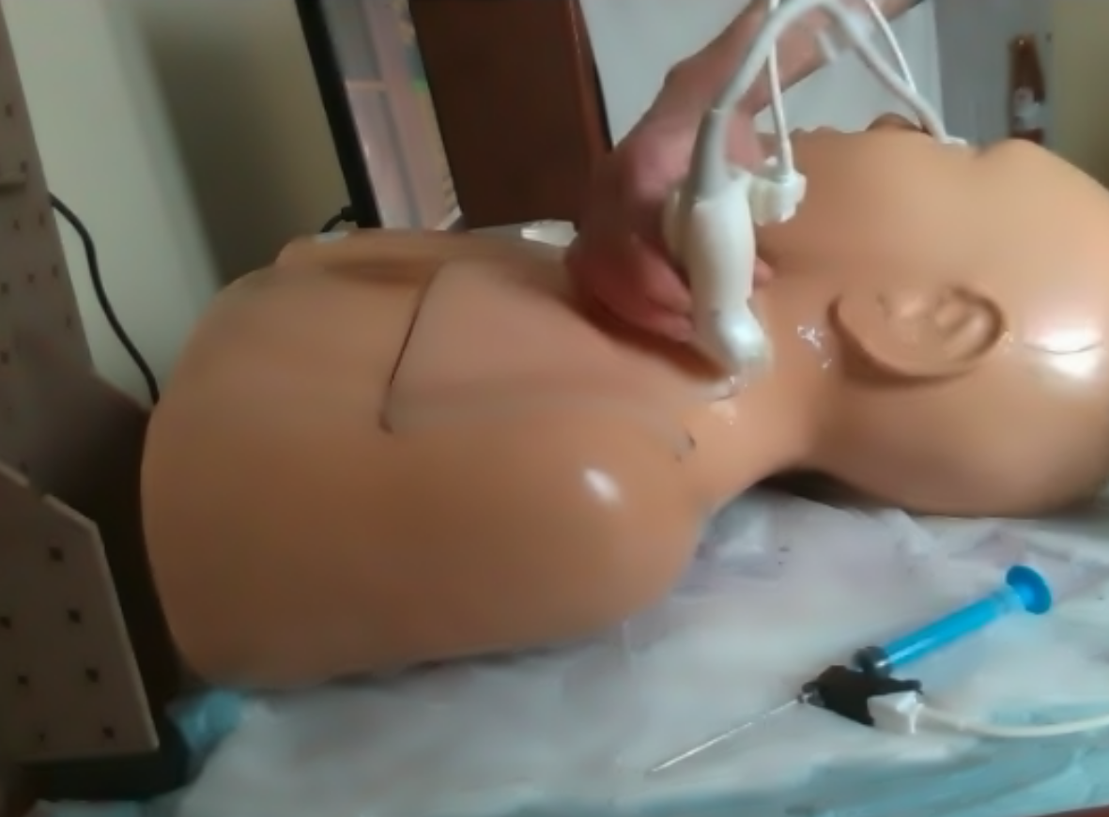
Experimented Approaches and Results – Task 3
ResNet50
ResNet50
LSTM
ResNet50
ResNet50
ResNet50
GRU
ResNet50
5/7
Data – Frame Sequences
Experiments

Slide 6
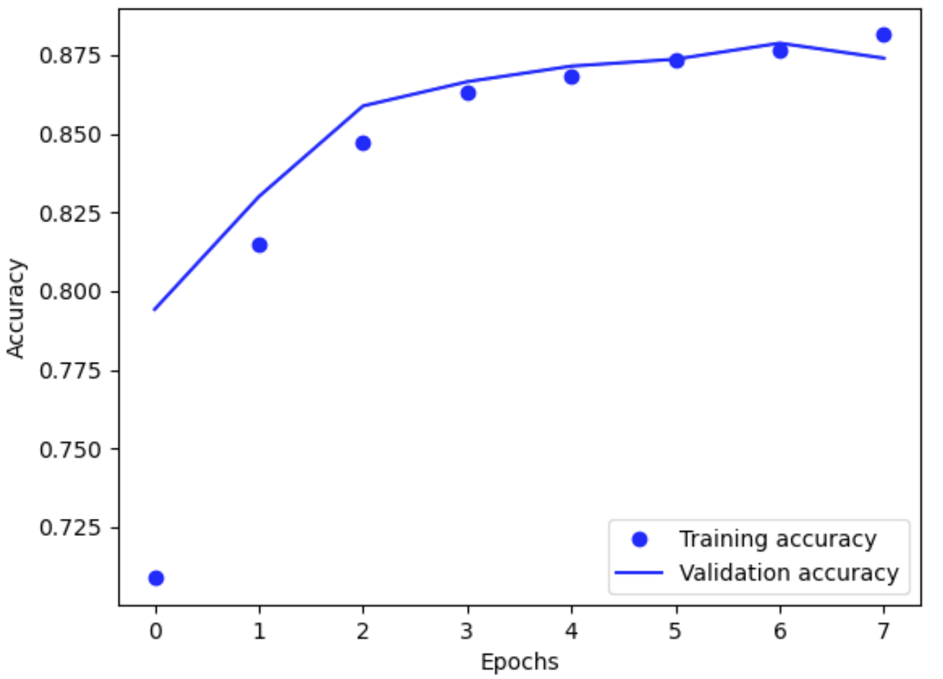
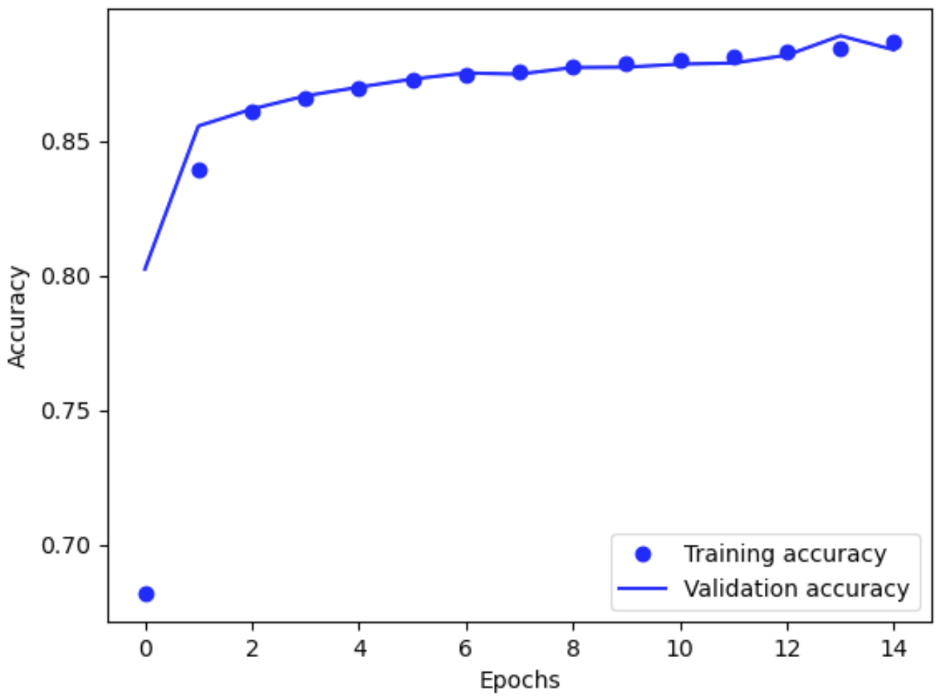
Experimented Approaches and Results – Task 3
With Pre-processing
Experiment | Validation Accuracy [%] | Training Accuracy [%] | Validation Loss | Training Loss
Baseline–ResNet50 + GRU | 88.4 | 88.73 | 0.31 | 0.3
Baseline–ResNet50 + LSTM | 87.4 | 88.14 | 0.32 | 0.32
LSTM
GRU
6/7

Slide 7
Reflection and Future Directions
We did well for task 1 by using multi-frame analysis.
Future Directions:
Use YOLO v5 for the second task
Make the third task as a single End2End architecture
Expand hyper-parameter tuning, particularly on the following parameters:
Number of Sequences
Kernel Initialization: He
Learning Rate
Optimizer: SGD with momentum
Activation Function
7/7

