Slide 1
TaazaTokari
V1 Master Blueprint & Product Architecture
Customer App • Delivery Partner App • Admin Dashboard
PASS + LOCKED
Farm-to-home fresh produce ordering, next-morning delivery, area-wise partner assignment, procurement consolidation and COD settlement.
Prepared from the finalized V1 decisions

Slide 2
Executive Summary
TaazaTokari V1 is designed around a simple order-first procurement model.
Customer App
Delivery App
Admin Panel
Payment
4 tabs
3 tabs
10 modules
COD only
Home • Orders • Cart • Profile
Assigned Orders • History • Profile
Operational control center
Online payments deferred
Core business model
V1 design principles
Customer orders first
Procurement from mandi/farmers after order aggregation
Delivery next scheduled morning
Fresh produce does not require conventional stock tracking
Simple before sophisticated
Operational clarity over feature count
Familiar Blinkit/Zepto-like UX
Future-ready architecture without V1 complexity

Slide 3
System Architecture
Three connected surfaces with Admin as the operational control center.
Admin Dashboard
Customer App
Orders & auto-assignment
Purchase requirements
Products/categories/users
Partner payments & settings
Delivery Partner App
Browse/search products
Cart & checkout
Orders & profile
Notifications
Order + customer context
Assignment + settlement
Assigned orders
Navigation & delivery
COD collection
History & earnings

Slide 4
Locked Business Rules
Core commercial and operational rules for V1.
Order cutoff
Delivery
Minimum order
Delivery fee
Payment
11:00 PM
7:00–9:30 AM
₹50
₹20
COD
Orders before cutoff → next eligible morning
Fixed morning window
Checkout blocked below ₹50
₹50–₹99; free at ₹100+
V1 only
Cancellation
Freshness model
Customer can self-cancel only before 11:00 PM. After cutoff the cancellation window is closed.
Fresh fruits/vegetables are procured after order aggregation, so standard inventory quantity tracking is not mandatory for core fresh produce.

Slide 5
01
Customer App
Complete shopping journey: discover → order → track → manage profile.

Slide 6
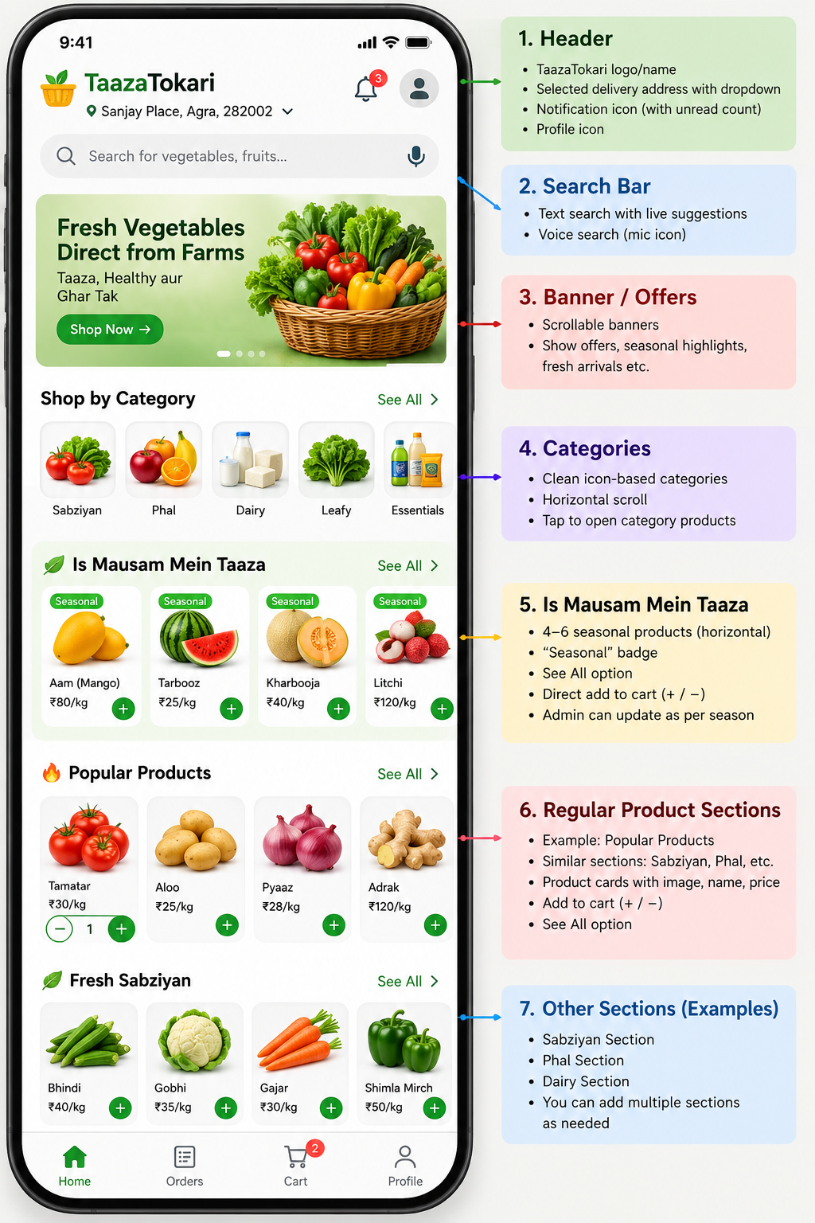
Customer App — Home
The locked home hierarchy keeps shopping fast and the freshness proposition visible.
Header & Search
Discovery
Logo/name
Selected address + dropdown
Notification + profile shortcut
Text + live suggestions
Voice product search
Medium scrollable banner
6 category icons in 2 rows
“Is Mausam Mein Taaza”
Regular product sections
Six default categories
Sabziyan
Phal
Pooja Samagri
Dairy Products
Seasonal Phal
Seasonal Sabziyan

Slide 7
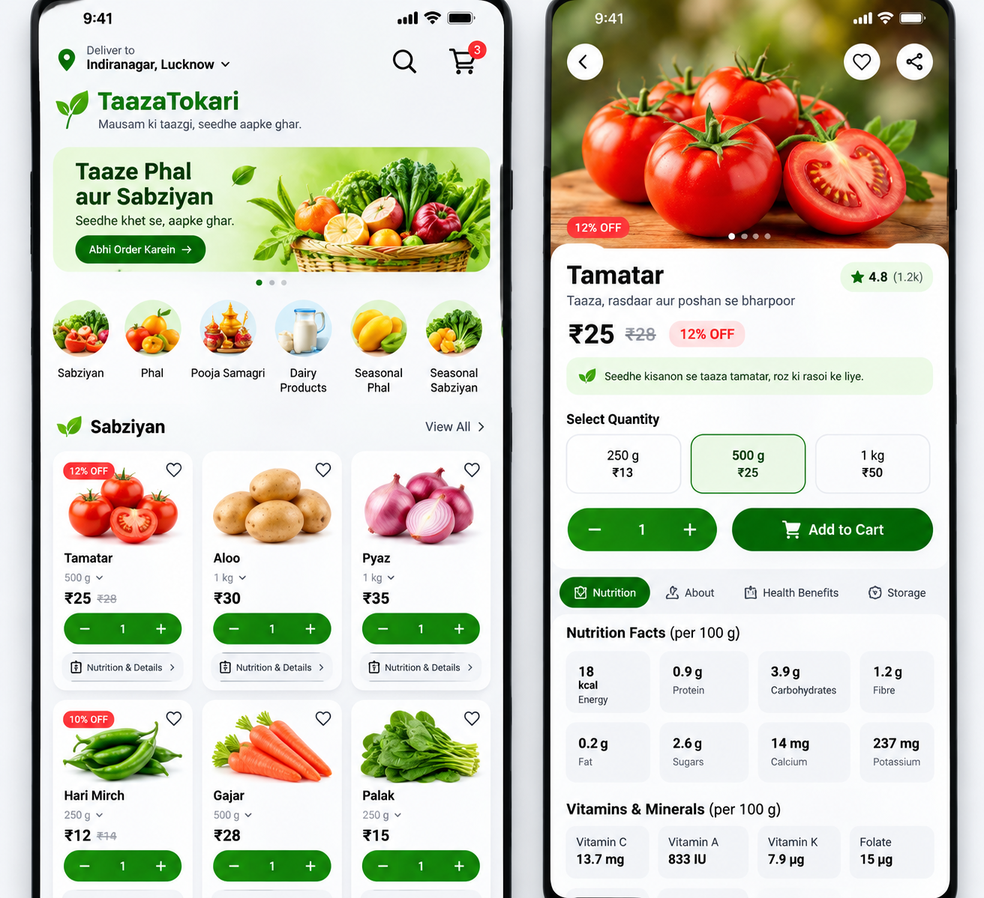
Customer App — Product & Cart
Familiar quick-commerce product cards with richer nutrition details.
Product Card
Product Details
Image + name
Unit + price
+/− quantity
Nutrition & Details
Out-of-stock state when applicable
Full screen
Nutrition per 100 g
Vitamins/minerals
Season/source info
Sticky Add to Cart
Cart rules
Address preview
Instant quantity/total updates
Items Total → Delivery Charge → Discount → Grand Total
Proceed to Checkout
No wallet/rewards/platform-fee clutter

Slide 8
Customer App — Checkout to Delivery
A short, deterministic order flow with no manual approval step.
Checkout
Save order
Order ID
Confirmation
Delivery
1
2
3
4
5
Address • date • COD
Database first
Generated after save
View Order / Continue
7:00–9:30 AM
Order Confirmation
Failure protection
Order ID, expected delivery date/window, COD, final payable amount, View Order and Continue Shopping. Full item list is not repeated.
If database save fails, success is never shown. Order confirmation means the order was successfully received and recorded.

Slide 9
Customer App — Orders, Notifications & Profile
Simple self-service after checkout.
My Orders
Notifications
Profile
Active Orders / Past Orders
Order cards with status + short preview
Order Details with full bill/address
Progress: Placed → Confirmed → Out for Delivery → Delivered
Order updates
Cancellation/refund when applicable
Offers & seasonal alerts
Service updates
Unread badge + deep link
Basic profile
Saved addresses
Help & Support
Settings
Logout
Saved Address
Help & Support
Home/Work/Other • default badge • sector/block selection • landmark • one optional landmark photo • Edit/Delete/Add New
Call + WhatsApp + order-related help + FAQ. No live chat or heavy ticket workflow in V1.

Slide 10
02
Delivery Partner App
Minimal operations app for assigned deliveries, cash collection and partner earnings.

Slide 11
Delivery Partner App — Core Flow
Admin-created accounts, three-tab navigation and action-focused delivery details.
Login
Assigned Orders
Order Details
Admin creates/approves partner
Registered Mobile + OTP
No public signup
Unknown numbers blocked
Total Assigned / Pending / Delivered Today
Order cards sorted by earliest priority
View Order + optional Call Customer
Full address + landmark/photo
Call Customer
Open in Maps
COD amount
Short item list
Assigned
Out for Delivery
Delivered
Delivered requires confirmation: “Payment received and order delivered?”

Slide 12
Delivery Partner App — Exceptions, History & Earnings
Only the minimum operational states needed for V1.
Unable to Deliver
History
Earning
Call Customer first
Choose reason: unavailable / not reachable / address issue / refused / other
Optional short note
Submit → Admin Review
Total Assigned
Delivered
Cancelled
Payable Deliveries
Filters: All / Delivered / Cancelled
Delivered Orders
Payable Deliveries
Per Delivery Rate
Estimated Payable
Paid / Pending
COD Settlement
Explicitly out of V1
COD Collected Today • Pending to Submit • Settled. Partner submits cash offline/manual; Admin marks settlement.
No delivery OTP, signature, photo proof, masked calling, wallet, withdrawals, bonus graphs or complex payout history.

Slide 13
03
Admin Dashboard
Desktop operational control center for orders, procurement, catalog, partners and settlement.

Slide 14
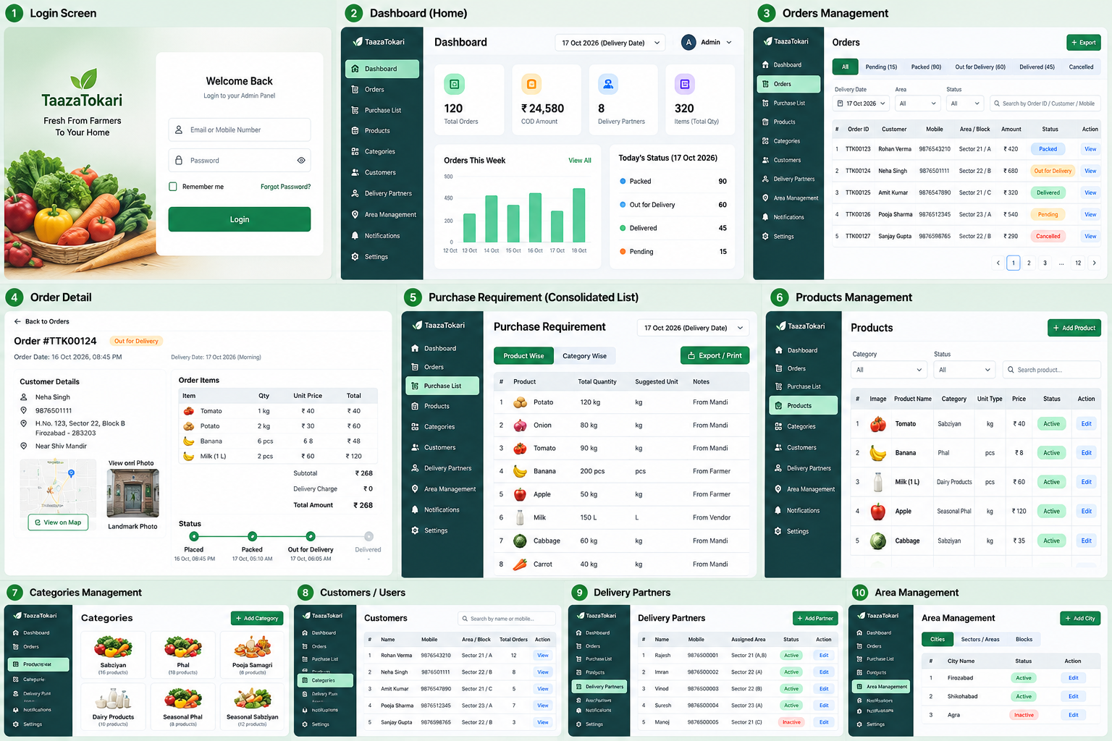
Admin Dashboard — Visual Direction
Clean green-accented desktop UI with sidebar, filters, tables and status badges.

Slide 15
Admin Dashboard — V1 Modules
Dashboard home stays lightweight; deep management lives in dedicated modules.
Dashboard
Orders
Daily snapshot + shortcuts
Order operations + assignment
Purchase Requirement
Products / Inventory
Consolidated procurement list
Fresh + inventory-based catalog
Categories
Customers
Main + optional subcategories
User details + account status
Delivery Partners
COD & Partner Payment
Partner setup + area mapping
Cash settlement + payouts
Notifications / Offers
Settings
Banners + notifications + offers
Business rules + areas + admin

Slide 16
Admin Orders & Auto Assignment
Orders are assigned by structured delivery geography, with manual override only when needed.
Area hierarchy
Order matching
Fallback
City
→ Sector / Area
→ Block
→ 1 primary active delivery partner
Customer saved address uses dropdown/select
System reads Sector + Block
Mapped partner auto-assigned
No mapping → Unassigned
Shows in Attention Required
Admin can Assign / Change Partner
Orders screen
Filters: status, Sector, Block, Delivery Partner, Delivery Date • Table: Order ID, Customer, Delivery Date/Time, Amount, COD, Sector/Block, Assigned Partner, Status, View Details

Slide 17
Purchase Requirement
Customer orders become a procurement-ready consolidated list.
Input
Aggregation
Output
Delivery Date selector
Relevant customer orders
System-calculated only
Category-wise grouping
Product total quantity
Unit preserved
Number of orders
View Related Orders
Procurement-friendly Print
CSV/Excel Export
Key rule
Privacy
Incompatible units never merge. Manual quantity editing is not allowed because requirements are derived from actual orders.
Printed procurement lists contain date, category and product totals only—no customer personal details.

Slide 18
Catalog, Categories & Customers
Simple management surfaces that support the locked customer experience.
Products / Inventory
Categories
Customers
Image • name • category • unit • price
Fresh vs Inventory-based
Available / Out of Stock
Active / Inactive
Nutrition • seasonal • source/origin
Stock quantity only when Inventory-based
6 default categories
Add/Edit/Rename
Image/Icon
Reorder
Active/Inactive
Optional subcategories
Prefer Inactive over hard delete
Search Name/Mobile
All/Active/Blocked/New
Default area + order counts
Saved addresses + history
Admin mainly View + Active/Blocked

Slide 19
Delivery Partners, Earnings & COD
Partner operations and settlement stay connected but intentionally simple.
Partner Management
Partner Payment
COD Settlement
Name / Mobile / Partner ID
Sector + Block assignment
1 primary partner per Block
Active orders + delivery counts
Change Area • Active/Inactive
Payable Deliveries × Per Delivery Rate
Estimated payable
Paid / Pending
Admin marks Paid
COD Collected − Submitted = Pending
Pending / Settled
Cash handover can be manual
Admin marks Settled
No partial settlement • no wallet • no automatic payout • no bank reconciliation in V1

Slide 20
Notifications, Settings & Admin Access
Business controls only—technical controls stay out of the V1 UI.
Notifications / Offers
Settings
Admin Access
Banners
Manual promotional / seasonal / service notifications
Simple offers
All customers or specific area
Order-status notifications remain system-driven
Business
Orders
Delivery
Payment
Notifications
Admin Account / Security
Email or Mobile + Password
Forgot Password
Multiple Admin accounts allowed
Single Admin role in V1
No Super Admin discussion in V1
Area Management
Settings → Delivery Settings → City → Sector/Area → Block. Admin can add/edit/activate/deactivate and see/change mapped delivery partner. Customer address selection uses the same master data.

Slide 21
End-to-End Operating Flow
How the three systems work together on a normal delivery day.
Customer orders
Order saved + ID
Partner auto-assigned
Purchase requirement
Mandi/Farmer procurement
Out for delivery
COD delivered
Settlement + history
1
2
3
4
5
6
7
8
Procurement loop
Cash/payment loop
Orders → delivery date → category/product aggregation → print/export → procurement
Delivered COD → partner collection → cash submission → Admin settlement + partner payment

Slide 22
V1 Scope Guardrails
Items intentionally excluded to protect simplicity and speed.
Not in Customer V1
Not in Delivery V1
Not in Admin V1
Online payments
Rewards/wallet
Complex onboarding
Voice order commands
Heavy health claims
Advanced tax configuration
Masked calling
OTP/photo/signature delivery proof
Attendance/rating
Wallet/withdrawal
Bonus/incentive graphs
Complex ticketing
Super Admin role
Advanced CRM
Marketing automation / A/B tests
Complex settlement/reconciliation
Technical API/server controls
Heavy analytics dashboards

Slide 23
V1 Readiness & Next Phase
Functional planning is complete; the next phase is design specification and implementation planning.
Customer App
Delivery App
Admin Panel
PASS + LOCKED
PASS + LOCKED
PASS + LOCKED
Functional blueprint complete
Functional blueprint complete
Functional blueprint complete
Recommended next deliverables
Implementation principle
High-fidelity UI screens
API & database design
User stories / development backlog
Test cases / UAT checklist
Do not reopen locked V1 decisions unless a real technical, legal or operational constraint requires a deliberate change.

