Slide 1
Exhibition System
<<Extend>>
Create a new exhibition
List existing exhibitions
Make a list of exhibitions
<<Include>>
Update an existing exhibition
<< Extend >>
View the exhibitions
<<Include>>
Administrator
Normal User
Cancel exhibition
Deactivate exhibition
<< Extend >>
<<Include>>
View exhibition statistics
List exhibits purchases
Create a new purchase
Buy tickets
User
Authorized User
<<Include>>

Slide 2
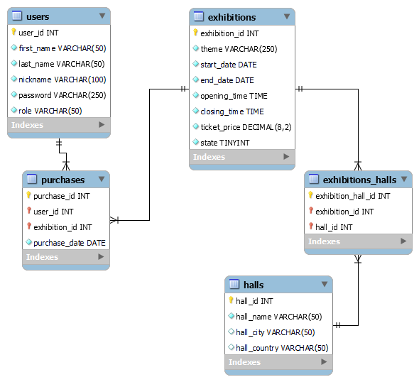
Exhibitions_project DB

Slide 3
Administrator
Exhibitions
Statistics
Theme | Start date | End date | Opening time | Closing time | Halls | Tickets sold
 |  |  |  |  |  |  | Update | Cancel (or Activate)
 |  |  |  |  |  |  | Update | Cancel (or Activate)
Add

Slide 4
Administrator
Statistics
Exhibitions
Theme
User | Tickets Purchased
Theme
User | Tickets Purchased

Slide 5
Normal User
Exhibitions
Theme | Start date | End date | Opening time | Closing time | Halls

Slide 6
Authorized User
Exhibitions
Theme | Start date | End date | Opening time | Closing time | Halls
 |  |  |  |  |  | Buy
 |  |  |  |  |  | Buy

