Slide 1

Flight Satisfaction
By Akinyemi Adetunji, Josie Jin,
Minkyong Kim, Colleen Fitzgerald
Notes:
Colleen

Slide 2

Introduction
Background
Process
Results
Table of Contents
Notes:
Colleen

Slide 3



Background

Slide 4
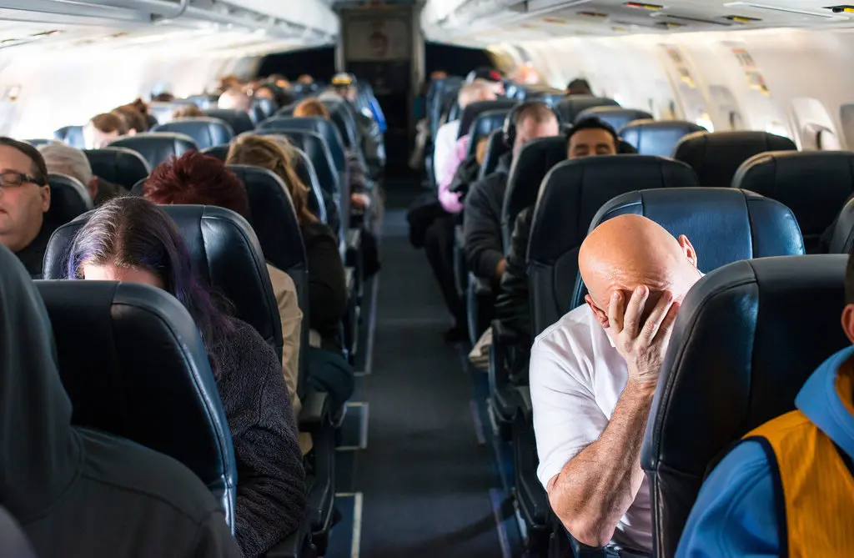
Objectives
Flights can be rough, from flight delays to uncomfortable seating. How can we make the flight experience more satisfying?
Using a dataset containing customer ratings of various factors related to flights, e.g. inflight service, and their overall satisfaction with the flight, we sought to test whether we could train a machine learning model to predict customer satisfaction/dissatisfaction.
Notes:
Colleen

Slide 5

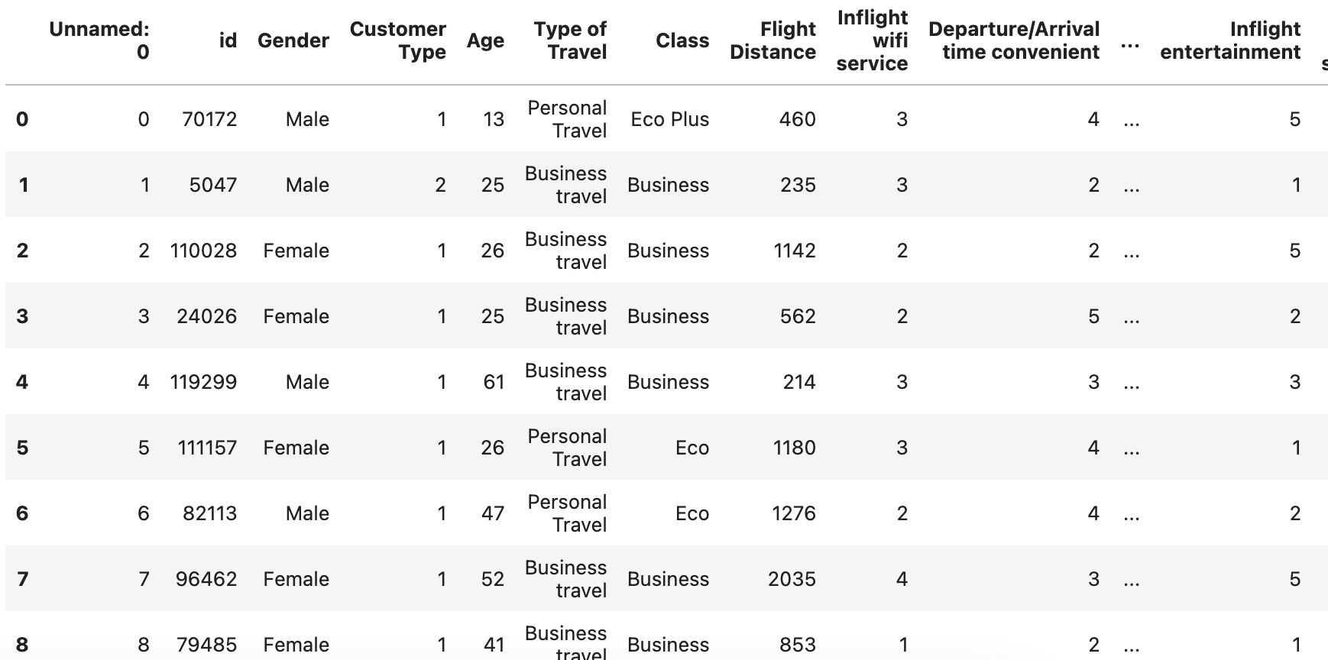


Description of the dataset
Source: Kaggle
Over 100k rows!
Feature variables:
Class, Flight Distance, Inflight wifi service, etc. (21 total)
All discrete values
Target variable:
Satisfied/Not Satisfied - binary
Notes:
Colleen

Slide 6

Process
Notes:
Colleen hand-off to MK

Slide 7

Data Cleaning
We dropped unnecessary variables that would create noise in the data
E.g. identification and index variables
Because many of our variables were also categorical, e.g. flight class: economy, business, etc. we used get_dummies to convert them into numerical values.
Notes:
MK
First step: dropped the unnecessary variables that would create noise in the data and confuse the model. One of the first ones to drop: identification and index variables. Second key step: lots of categorical variables, e.g. flight class. Want to convert categorical variables to numerical values using get_dummies.

Slide 8
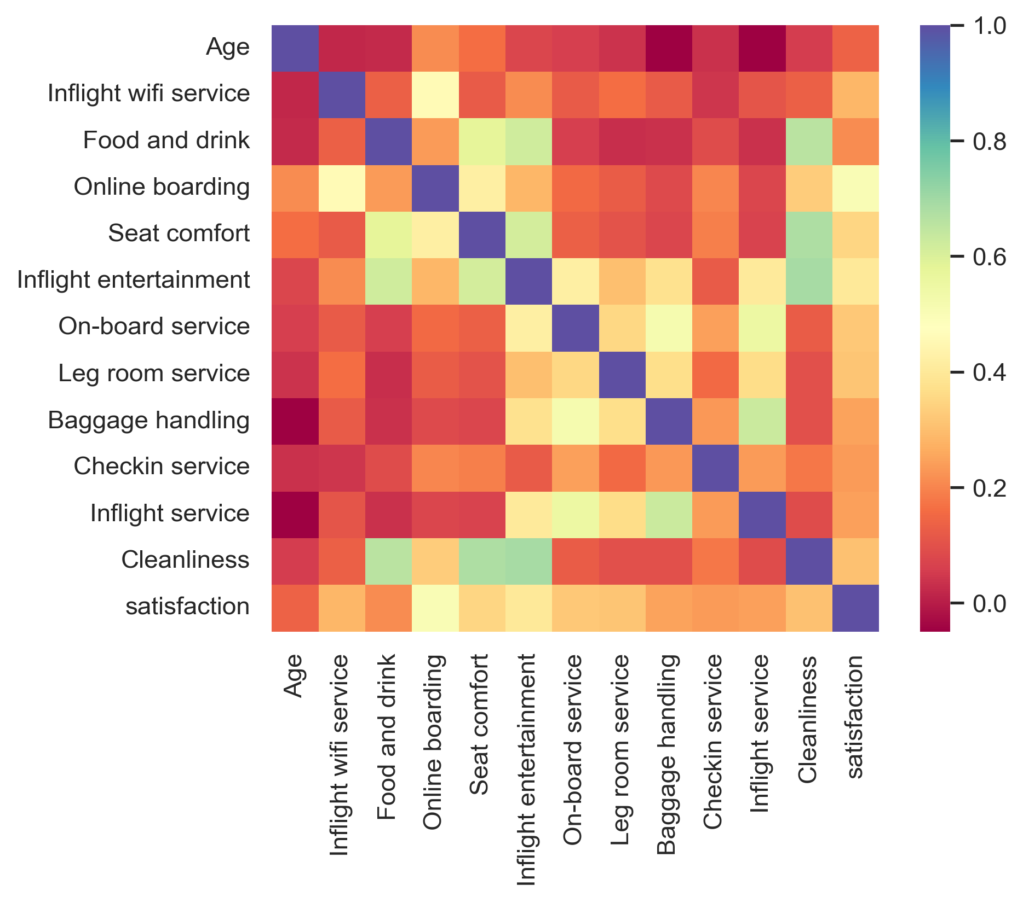
Correlation of feature variables
Notes:
MK
Correlate the feature variables to see if we could find a group that was particularly well correlated with satisfaction, and see if we could drop those with low correlation. No variables were particularly strongly correlated with satisfaction - most of them were at around the middle.

Slide 9
Supervised Learning Models Used
01
K-Nearest Neighbors
Uses proximity to make classifications, i.e. how are the “nearest neighbors” classified
Typically used for classification problems
Simple and easy to use, but struggles with high-dimensional data
02
Naive Bayes
Also used for classification problems, calculates probability
Good with categorical input variables in particular
Assumes independent features (unrealistic)
03
Logistic Regression
Model of best fit to describe the relationship between dependent and independent variable
Assumes response variable is binary, features are independent
Doesn’t work well with small datasets
04
Decision Tree
Tree structure classifier
Splits based on importance of feature
Prone to overfitting, struggles with high-dimensionality
05
Random Forest
Essentially a collection of decision trees
Learns from a random sample and random set of features
Reduces overfitting
Notes:
MK + Josie
Trained on five different supervised learning models. Description of model used + characteristics to help see the differences between models

Slide 10
Results

Slide 11

Accuracy Stats:
************Random Forest Test************
Test Classification accuracy: 0.9405877069164635
************Decision Tree Test************
Test Classification accuracy: 0.9360644167842936
************Logistic Regression Test************
Test Classification accuracy: 0.85993840626203
************KNN Test************
Test Classification accuracy: 0.9074489926857436
************Naive Bayes Test************
Test Classification accuracy: 0.8424868471705377
Notes:
Josie

Slide 12
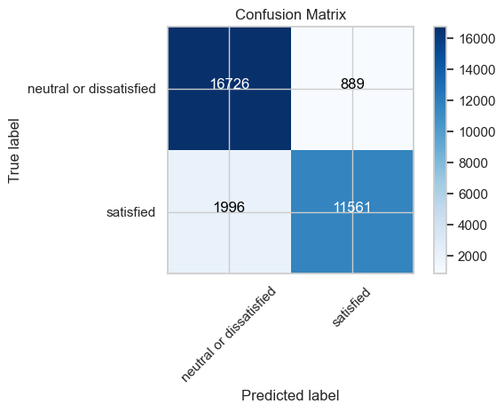




Confusion Matrix
KNN
Logistic Regression
Naive Bayes
Decision Tree
Random Forest
Notes:
Josie

Slide 13
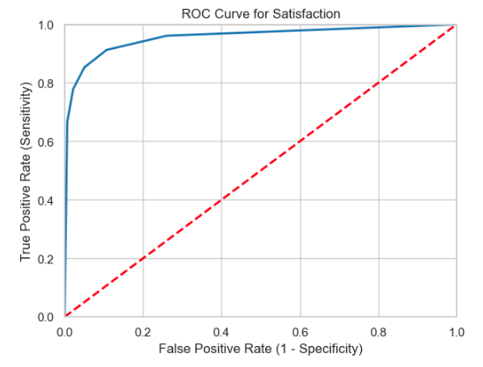
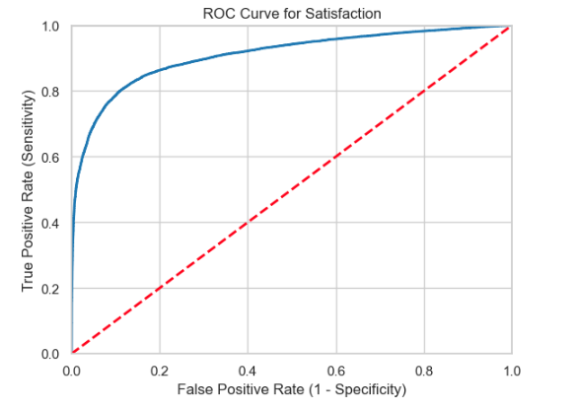
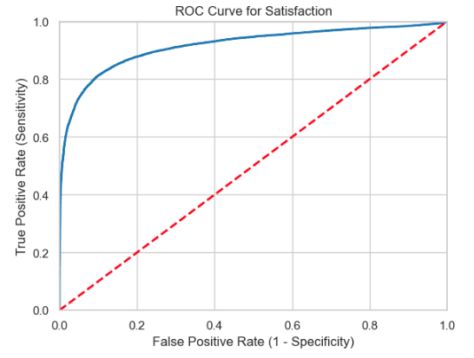
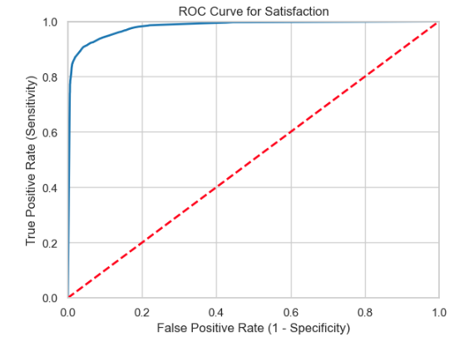
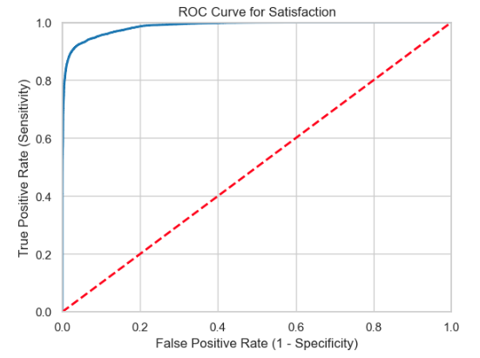
ROC Curve:
– higher AUC(Area Under the Curve) indicates better classifier
KNN AUC: 0.9552061542
Naive Bayes AUC: 0.9090453819
Logistic Regression AUC: 0.9162432329
Decision Tree AUC: 0.9809018538
Random Forest AUC: 0.9863605356
Notes:
Josie

Slide 14
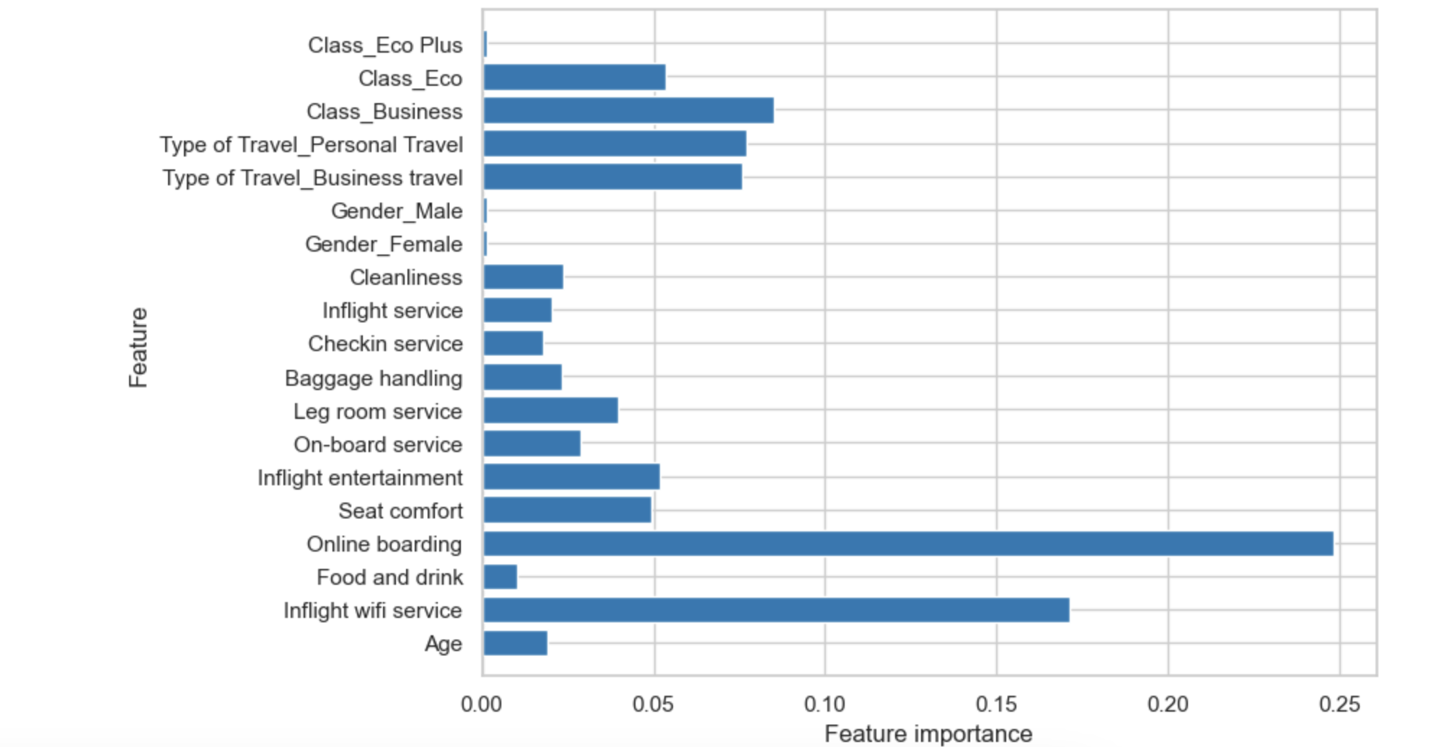

Key Takeaways
Out of all the models trained, the Random Forest model performed the best.
One of the key benefits of Random Forest is that it is easy to evaluate variable importance (or contribution) to the model. →
Online boarding experience and Inflight wifi contribute the most in determining satisfaction. Gender contributes the least.
Notes:
Yemi: The random forest model can help us predict customer prediction pretty accurately!
Gender and seat class don’t influence satisfaction.
The two main features that influence satisfaction are online boarding and inflight wifi service.

Slide 15
Limitations
Finding direct correlation with such a large dataset (100k rows).
Dataset needs to be pruned to get useable visualizations.
The source of the dataset is ambiguous.
Challenging to test accuracy.
Notes:
Yemi *where/when is the dataset from? What airline?

Slide 16


Thank you!
Questions?
Notes:
Yemi

