Slide 1
Scottish Database Use Group June 2023 Update

Slide 2
Optimize data movement to the cloud with Db2 Data Gate
Business Analysts
End Users (App)
…
IBM Cloud Pak for Data
Db2
transactional app
Db2 for z/OS
Query Acceleration
Partition Archival
Db2 Warehouse
analytical app
Integrated Synchronization
Data Gate
private cloud, public cloud, IBM Z & x86
Db2 z/OS Data Gate is a service in IBM Cloud Pak for Data, which loads and replicates Db2 z/OS data to:
the Db2 service in Cloud Pak for data (and / or)
the Db2 Warehouse service in Cloud Pak for data
Apps (mobile workload, spiky workload, analytics workload) directly connect to the Cloud Pak databases
Data Gate uses the same Integrated Synchronization as IBM Db2 Analytics Accelerator
Extremely low latency, very high throughput, very low z/OS CPU overhead
Also supports the WAIT FOR DATA protocol for optimized data consistency
Db2 WH w/ Data Gate provides Db2 Query Acceleration (NEW)
Notes:
So, this hybrid cloud copy of data as explained as option B from the previous slide brings us to Data Gate that was introduced a couple of years ago, in the last few months we have had several customers seem to have picked up on the announcement, so we are getting a lot of activity in this area.
Data Gate is a service that runs on IBM CP4D, i.e. it operates within the cloud pak envelope as such. Through this service you can create copies of selected tables from Db2 for z/OS into a cloud based target. Db2 data gate runs wherever cp4d runs which is wherever red hat openshift can run which can be on-prem, on a private cloud, IBM cloud, Amazon, Microsoft Azure so a wide range of target environments. We have replication technology to keep it in sync with the source data. You can replicate that data to a couple of different flavours of data gate, one uses the Db2 advanced enterprise server edition which is often referred to these days as just Db2 for transactional access, high volume access; the other flavour is Db2 warehouse – which is also what is under the covers for the analytics accelerator, the in-memory columnar data store which offers a tremendous performance for analytical queries. You can use either or both of those. The applications then can directly access the data on the cloud either for transactional or analytical workloads
The replication technology is the same as used for the IDAA so we have extremely low latency, a change of data on z/OS is usually reflected on Data Gate within a second or 2 and the overhead is extremely low, especially on general purpose CPUs unlike traditional CDC. On top of that , if instead of LOW latency you want zero latency then we have the WIAT FOR DATA protocol that enables your application to say that it wants the same data as if the query was run on Db2 for z/OS at the penalty of a potential small wait – which you control.
Generally use cases for Data Gate are for read-only access which seems to be what most customers say that they want.
Complement option (B) from the previous slide with IBM Db2 Analytics Accelerator:
Many customers today create read caches of systems of records data for new applications based on cloud technology. Drivers are:
I want to have my own data (even if it is only a copy)
I want to shield my backbone from spiky workloads (e.g., mobile workload)
I want to leverage fancy analytical and AI services in IBM Cloud Pak but I have no data
My new applications run in the public cloud, and my provider cannot guarantee the network performance that I need.
The physical distance between the public cloud and the backbone in the private computing center is just too large for sufficient performance
To replicate data to the cloud caches has some challenges:
The cache needs to be kept in synch (data replication)
Replication solutions have setup and operational cost
Custom built replication solutions have a higher cost compared to standard technologies
Data might become out of synch in case the latency of the replication mechanism is high
Rarely applications only read data. They need to write data back to the core applications / databases which needs to be addressed
Db2 for z/OS Data Gate addresses most of the requirements and leverages synergies with the IBM Db2 Analytics Accelerator:
Same Integrated Synchronization with low footprint on z/OS and optimal performance and latency
Easy setup
Provides data to Db2 for OLTP target applications and to Db2 Warehouse for optimal analytics performance
Supports the WAIT FOR DATA protocol (same as IDAA) to defer the query execution until all data has been replicated up to the timestamp of the query invocation

Slide 3

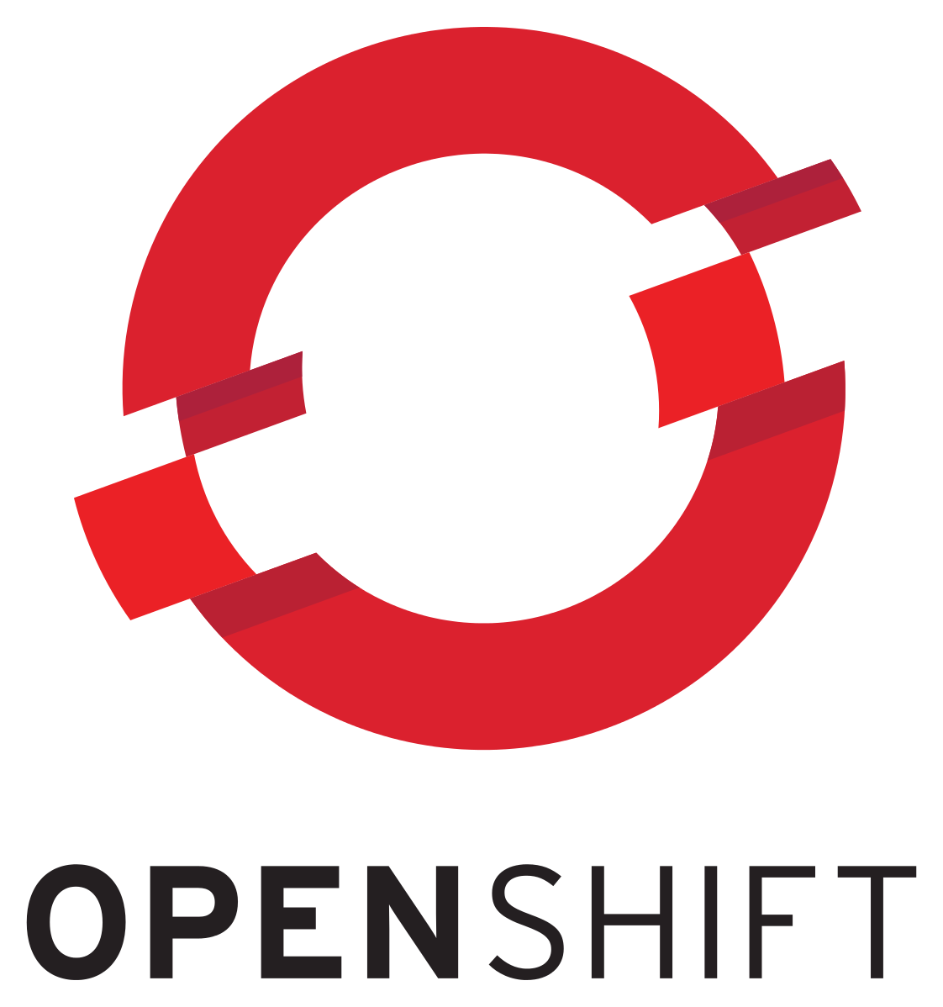



Landscape for handling increased SOR interaction
Today’s challenges:
Stale information
Spikey System of Record (SOR) impacts
Limited eventing
Inability to separate query & update traffic
Cannot obtain needed information
Applications in hybrid clouds of choice
Access or move raw data
Direct APIs to individual core systems each time information is needed
System of Record: Transactional & batch applications
ETL & CDC
Raw transaction / core systems data
Warehouses, Data Lakes, other full copies of raw data or Kafka topics
TXNS
ACH
Member
...
Card
Notes:
Let’s look at the landscape for handling increased interaction with Systems or Record (SORs) which typically run on z/OS.
Clients typically run significant amounts of transactional processing and applications (based in CICS or IMS) as well as batch applications on z/OS. All of these produce a significant amount of high value data in various formats and data models.
As clients build applications in the cloud, using what’s there today, the capabilities include the option to access or move all of that raw data to the cloud or to initiate APIs to the core transactional systems to retrieve that data.
Clients have in place many different tools and processes for moving that raw data via extract, transform, load (ETL) pipelines or replication to warehouses, data lakes, and other full copies of raw data. Some applications do require access to the scope of all of that raw data for capabilities like reporting or machine learning model training. However, there are often latency issues for high transactional volumes and composed information such as account balances are often not actually available in the raw data. In addition, it's often true that only a small percentage of that data is regularly moved is used - meaning a lot of effort has gone into moving data off the platform and a small subset is used. Lastly, with ETL & Change Data Capture (CDC) is often challenging to ensure correct ordering of transactions.
Hybrid cloud applications can also interact directly with core systems through direct API calls each time the application needs information. Each direct API call to core system does mean that the transactional systems need to be invoked to service the API call — even if the information hasn’t changed – which may result in unpredictable traffic to SORs as well as MIPS impact. An additional challenge is that sometimes the information that needs to be surfaced cannot be obtained from an individual core system, but rather is needed from a blend of environments (for example, transactional and batch) or a blend of information from across core system applications.
Clients say that there are challenges in terms of what they need and what is available today, specifically those challenges include:
-Information provided to downstream consumers is stale when what is needed is more current information
-The consuming applications are not even able to obtain the information they need
-Current methodologies results in spiky impacts to the Systems of Record
-There is limited “eventing” available
-Clients are unable to separate out query processing (what is my account balance) from update traffic (moving money from one account to another)
IBM Z Digital Integration Hub (zDIH) was created to address these existing gaps.
-----------
At the bottom, we have the core systems of record that have the highly valuable core business applications which run the client's business and then at the top we have the hybrid cloud applications. The existing methodologies for those hybrid cloud applications to interact with the systems of record are shown on the right. Now, these are very valid approaches, but what we hear from clients is that, depending on the use case, there may be challenges with these existing approaches.
For example, if you are ETL’ing or CDC’ing the data off to a data lake or warehouse and you have the systems of record that want to access or in some cases move that raw data into a hybrid cloud some of those challenges might be that the data is not as current as you would like it to be. It is stale. Some clients find that the raw data is not very consumable for the hybrid cloud applications, they say it’s like getting data fragments and they need the context to be able to make use of that raw data. Or the information that the hybrid cloud needs is not even there, it is understood in the core application and is not extrernalized to a data store.
And, of course, there is cost associated with this, especially if you are moving high volumes of data off the Z platform.
The second existing way of interacting with the systems of record is via a direct API. Now, this way you can get real-time information, but again, depending on the use case, but you would have that API interaction regardless of whether it is update or inquiry traffic and it is a call and response interaction so there is no eventing which could be a gap for some use cases. Each time you call down to the core system, even if the underlying information has not changed, that will drive work and MIPS to service that API. This can result in spiky workloads on the system of record.
----
Let’s look at the landscape for handling increased interaction with Systems or Record (SORs) which typically run on z/OS.
Clients typically run on z/OS significant amounts of transactional processing and applications (based in CICS or IMS) as well as batch applications. All of these produce a significant amount of high value data in various formats and data models.
As clients build applications in the cloud, using what’s there today, the capabilities include the option to access or move all of that raw data to the cloud or to initiate APIs to the core transactional systems to retrieve that data.
Clients have in place many different tools and processes for moving that raw data via extract, transform, load (ETL) pipelines or replication to warehouses, data lakes, and other full copies of raw data. Some applications do require access to the scope of all of that raw data for capabilities like reporting or machine learning model training. However, there are often latency issues for high transactional volumes and composed information such as account balances are often not actually available in the raw data. In addition, it's often true that only a small percentage of that data is regularly moved is used - meaning a lot of effort has gone into moving data off the platform and a small subset is used. Lastly, with ETL & Change Data Capture (CDC) is often challenging to ensure correct ordering of transactions.
Hybrid cloud applications can also interact directly with core systems through direct API calls each time the application needs information. Each direct API call to core system does mean that the transactional systems need to be invoked to service the API call — even if the information hasn’t changed – which may result in unpredictable traffic to SORs as well as MIPS impact. An additional challenge is that sometimes the information that needs to be surfaced cannot be obtained from an individual core system, but rather is needed from a blend of environments (for example, transactional and batch) or a blend of information from across core system applications.
Clients say that there are challenges in terms of what they need and what is available today, specifically those challenges include:
-Information provided to downstream consumers is stale when what is needed is more current information
-The consuming applications are not even able to obtain the information they need
-Current methodologies results in spiky impacts to the Systems of Record
-There is limited “eventing” available
-Clients are unable to separate out query processing (what is my account balance) from update traffic (moving money from one account to another)
IBM Z Digital Integration Hub (zDIH) was created to address these existing gaps.
Acronyms
CICS - Customer Information Control System
IMS - Information Management System
ETL – Extract, Transform, Load
CDC – Change Data Capture
API – Application Programming Interface
MIPS - Millions of Instructions Per Second
AWS - Amazon Web Services

Slide 4

Optimized SOR interaction with Z Digital Integration Hub
Challenges addressed:
Stale information
Spikey Systems of Record (SOR) impacts
Limited eventing
Inability to separate query & update traffic
Cannot obtain needed information
Applications in hybrid clouds of choice
Access or move raw data
Computed Information
Standards based interfaces
IBM Z Digital Integration Hub provides:
Real-time information
SOR protection from unpredictable inquiries
Flexible information model
Composed information
TCO advantage
Direct APIs to individual core systems each time information is needed
IBM Z Digital Integration Hub (zDIH)
Information is computed, composed & derived from data and applications across multiple environments
Subset of raw data & events
Application & data integration
System of Record: Transactional & batch applications
ETL & CDC
Raw Transaction / core systems data
Warehouses, Data Lakes, Other Full Copies of Raw Data or Kafka topics
TXNS
ACH
Member
...
Card
Notes:
So, how does zDIH address some of those challenges…
zDIH has efficient integration with those core systems and it can take a subset of the raw data and events, so just the relevant information, and it can populate zDIH and keep that current throughout the day. So, it has that real-time information, that can then be shared from zDIH to the hybrid cloud via standard interfaces. zDIH provides that real-time information via an alternate mechanism whereby the hybrid cloud applications can go to zDIH instead of directly down to the systems of record. This way you can protect the systems of record from that unpredictable inquiry traffic.
zDIH has a flexible information model and so it does not need to be directly tied one to one to the information model of the systems of record or core applications. Often, you will need an SME of a particular core system application to understand the data model completely, zDIH can have a different information model, it can aggregate, it can compute, it can provide composed and derived data, and can enrich the information so that it can be much more consumable by hybrid cloud applications.
And, there are TCO advantages.
------
IBM Z Digital Integration Hub (zDIH) provides, efficient real-time information flow between core systems and hybrid cloud applications and does it in such a way that minimizes impacts to Systems of Record (SORs).
With zDIH, clients can also present information in ways that are usable and consumable — and can be in a different information model from the originating core system. IBM zDIH means client can share composed information to downstream consumers for faster time to value — application developers don’t have to embed the business logic to create the information they need into each and every application to be able to convert the raw data into usable information.
zDIH also provides the ability to separate inquiry traffic from transaction processing for cost optimization. Clients tell IBM that over 70% of the traffic to core systems is for inquiry purposes, so they can optimize for costs by separating inquiry traffic from update traffic.
Acronyms
TCO – Total Cost of Ownership
AWS - Amazon Web Services

Slide 5
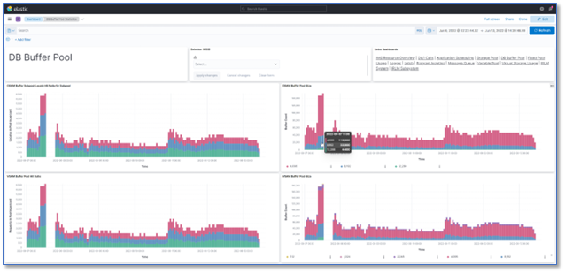
IMS Performance Analyzer
APAR PH51237 delivered in March 2023 enables the ability to transfer report data from IMS PA to Elasticsearch and view with Kibana using an enhancement to the IMS PA Internal Resource Usage Report which:
allow extracts to be formatted as CSV or JSON Lines.
allow extracts to be written to z/OS data sets or to z/OS UNIX files.
allow forwarding of extracts as JSON Lines to a TCP/IP listener.
This enhancement was implemented to meet RFE# 153385.
Notes:
With this feature, you can easily create interactive dashboards, slice, and dice data, set up alerts, and collaborate with your team. The implementation process is straightforward, and the result is a visually appealing, data-driven IMS performance monitoring center.

Slide 6
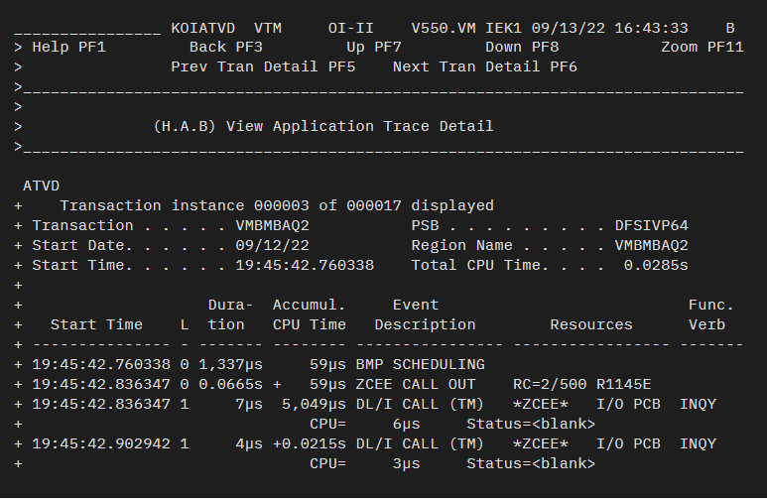
OMEGAMON for IMS
The OMEGAMON for IMS team has been working recently to bring the first round of support for z/OS Connect.
With PTF UJ09389 the OMEGAMON for IMS Application Trace Facility has been enhanced so that it now reports details of z/OS Connect (zCEE) outbound API calls, including return code, status code, and error message number
Notes:
In this example, a zCEE API call has a description ZCEE CALL OUT, Return Code 2, Status code 500, and Status Error Message BAQR1145E (although the‘BAQ’ prefix is dropped, which is a constant for all outbound API messages).

Slide 7
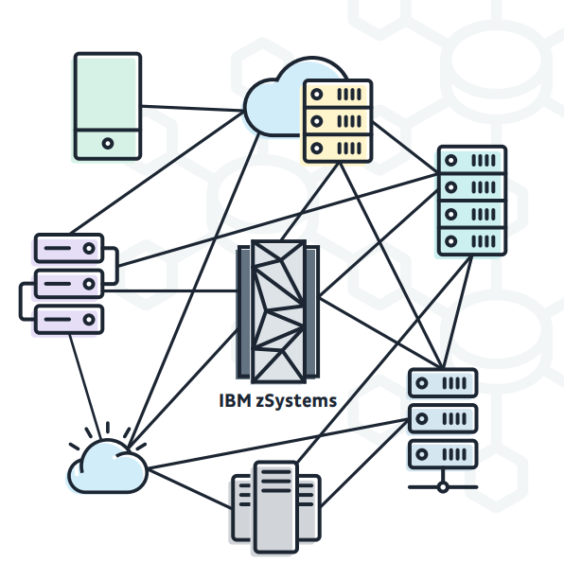
Instana continues to evolve with OMEGAMON
To date, CICS, Db2, z/OS, MQ and JVM infrastructure have been made available through Instana.
Now you can add support for the following OMEGAMON agents:
OMEGAMON for MQ: APAR OA63963, PTF UJ09793
OMEGAMON for JVM: APAR OA63898, PTF UJ09673
OMEGAMON Data Provider: OA64177, PTF UJ92106
OMEGAMON Monitor for z/OS: APAR OA63776, PTF UJ92041
Notes:
There are eight OMEGAMON agents running natively on z/OS. With the latest addition of starter dashboards for Networks and Storage, all agents have starter dashboards
Instana is a hybrid cloud application performance monitor (APM). When run alongside OMEGAMON, there are enhancements available within Instana to better understand z/OS infrastructure.
These additions to Instana make true end to end APM possible, from desktops and mobile through back-end transaction processing.
The integration occurs through a new component known as the OMEGAMON Data Provider. The OMEGAMON Data Provider component gathers selected attributes directly from agents running on z/OS LPARs and streams them to an Instana proxy agent. With both tracing and metric information available in a single dashboard, hybrid application issues that drive z/OS-based workloads do not lack visibility into the mainframe when attempting to isolate the source of the problem.

Slide 8
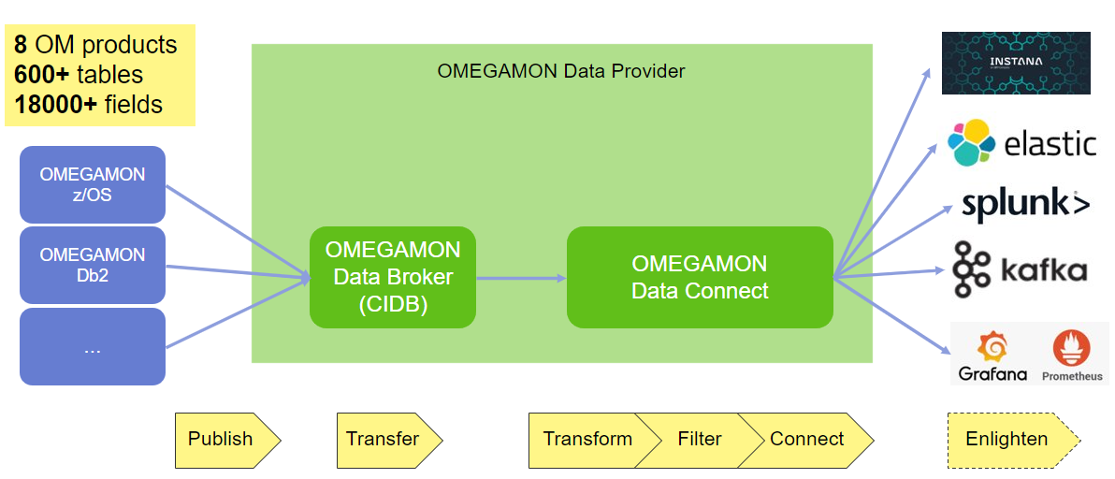

OMEGAMON Data Provider
SMSz Suite (all agents + contents of ZIO) Nov 2020
IZMS Suite (all agents) Nov 2020
IBM zSystem Integration for Observability (ZIO) CDP/Kafka, ODP, Discovery Services, ChatOps, SMU, etc March 2023
Db2 Performance Solution Pack (OMPE and QM) March 2023
Keep up-to-date with ODP developments with this QR Code ➔
Notes:
As an IT manager looking to improve operational observability, it is important for you to bring insights across mainframe and distributed platforms under one user experience.
IBM zSystems Integration for Observability delivers core infrastructure which makes it possible for IBM OMEGAMON clients who are not currently entitled to the IBM Z® Monitoring Suite or IBM® Z® Service Management Suite.
You can leverage this data ecosystem to stream OMEGAMON data into a single service management dashboard and make it available to other observability tools without upgrading to a suite.
This will help you maximize the impact of your AIOps integration for observability across hybrid cloud.

