Slide 1

Modelling acoustic backscattering by herring
Babak Khodabandeloo¹, Yngve Heggelund², Bjørnar Ystad², Geir Pedersen¹
¹ Acoustics and Observation Methodologies Research Group, Institute of Marine Research, Bergen, Norway
² NORCE Norwegian Research Centre AS, Bergen, Norway
CRIMAC annual meeting - UiB - 3-4 Nov 2025

Slide 2
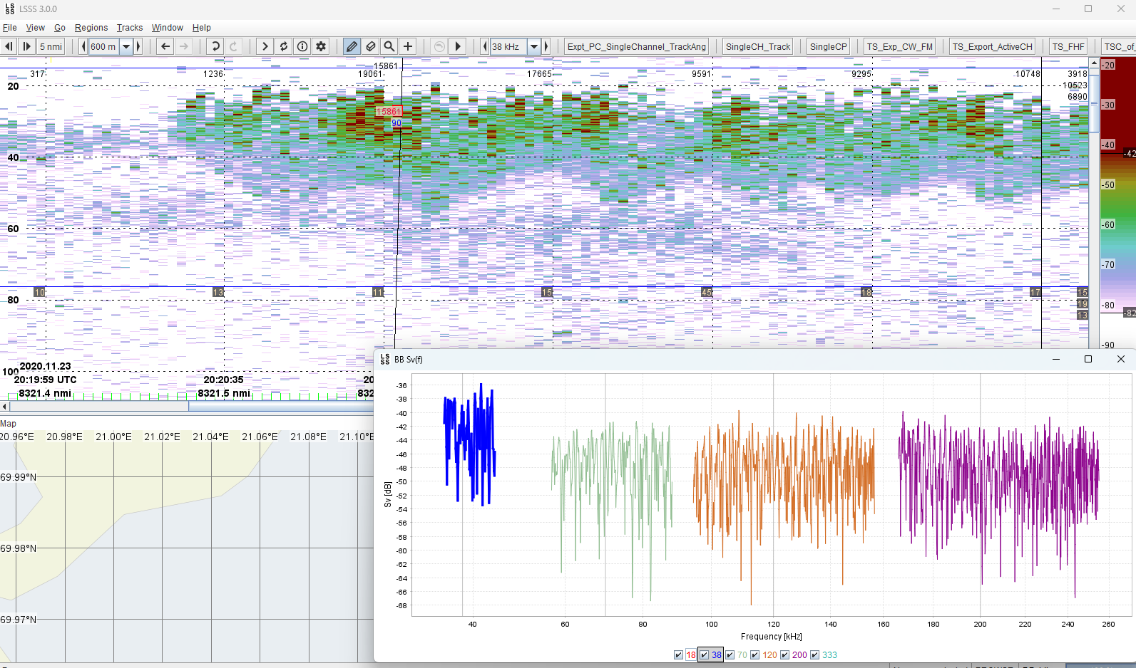
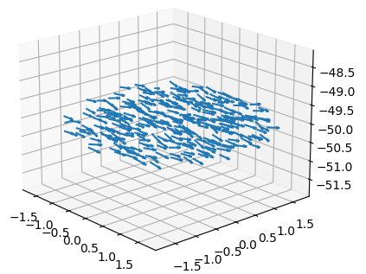
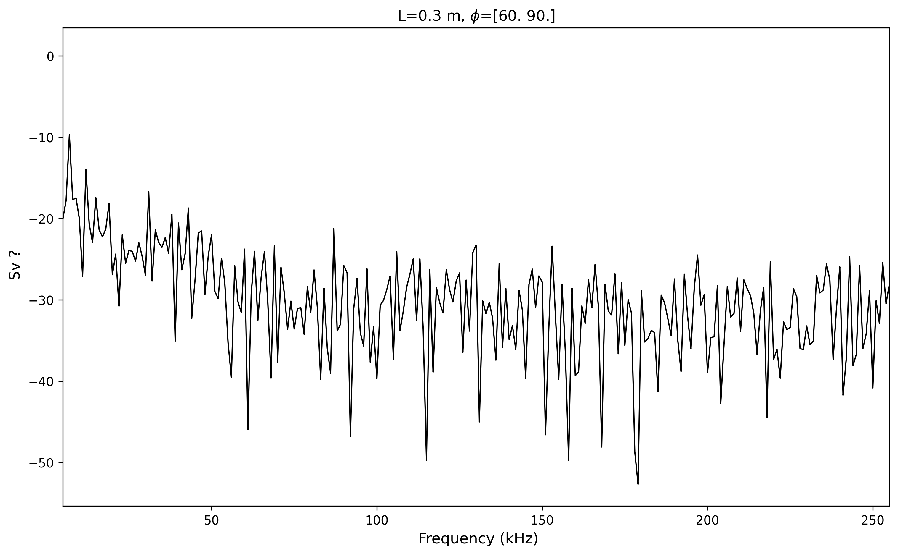
Broadband Herring school (Sv(f))
(0, 0, 0)
Field measurement
Modeled:
Can we model broadband backscattering from Herring school?

Slide 3
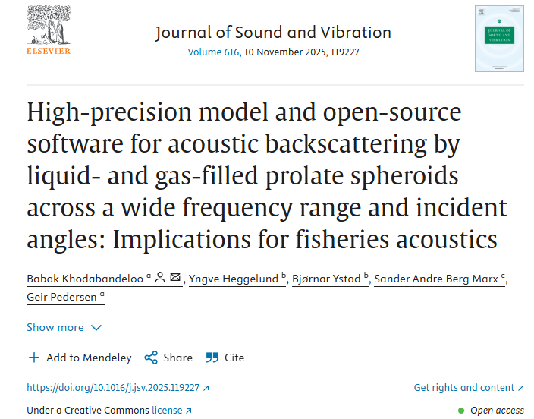
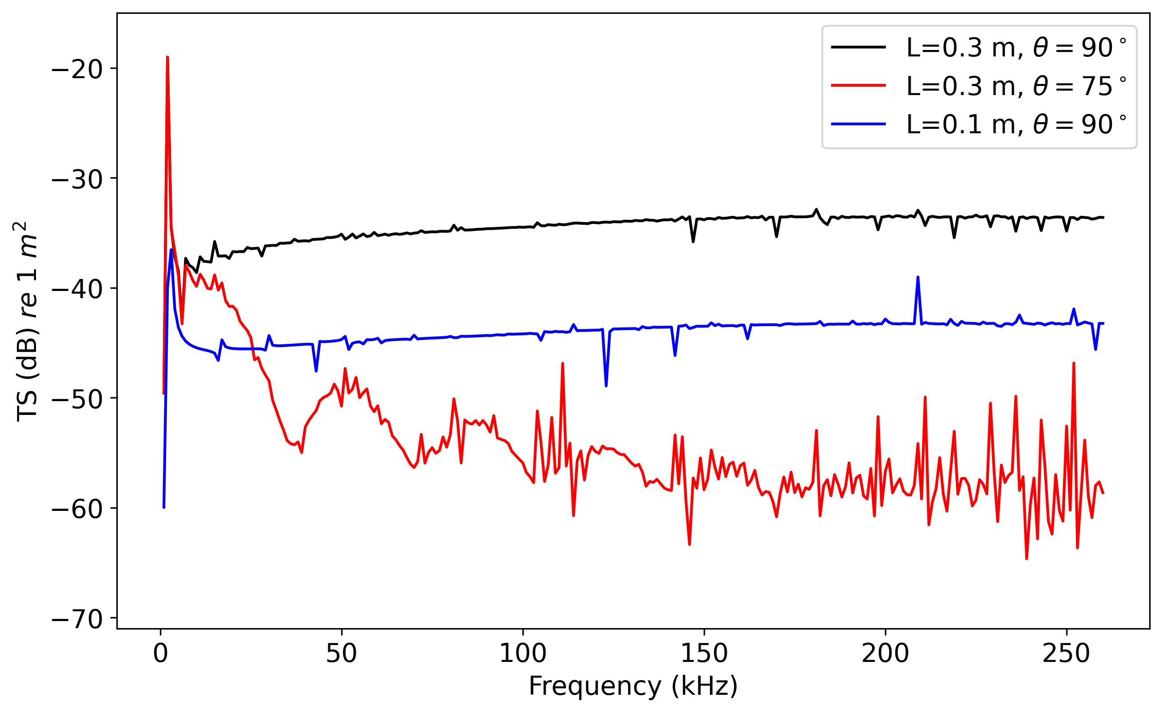
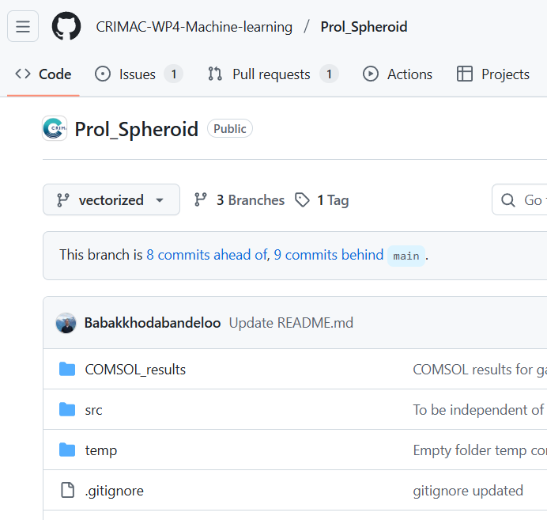


TS from swimbladder modeled as a prolate spheroid
Publication
Incident wave
$$φ$$
High accuracy for all angles: 0$°<φ≤90°$
Open-source software:

Slide 4
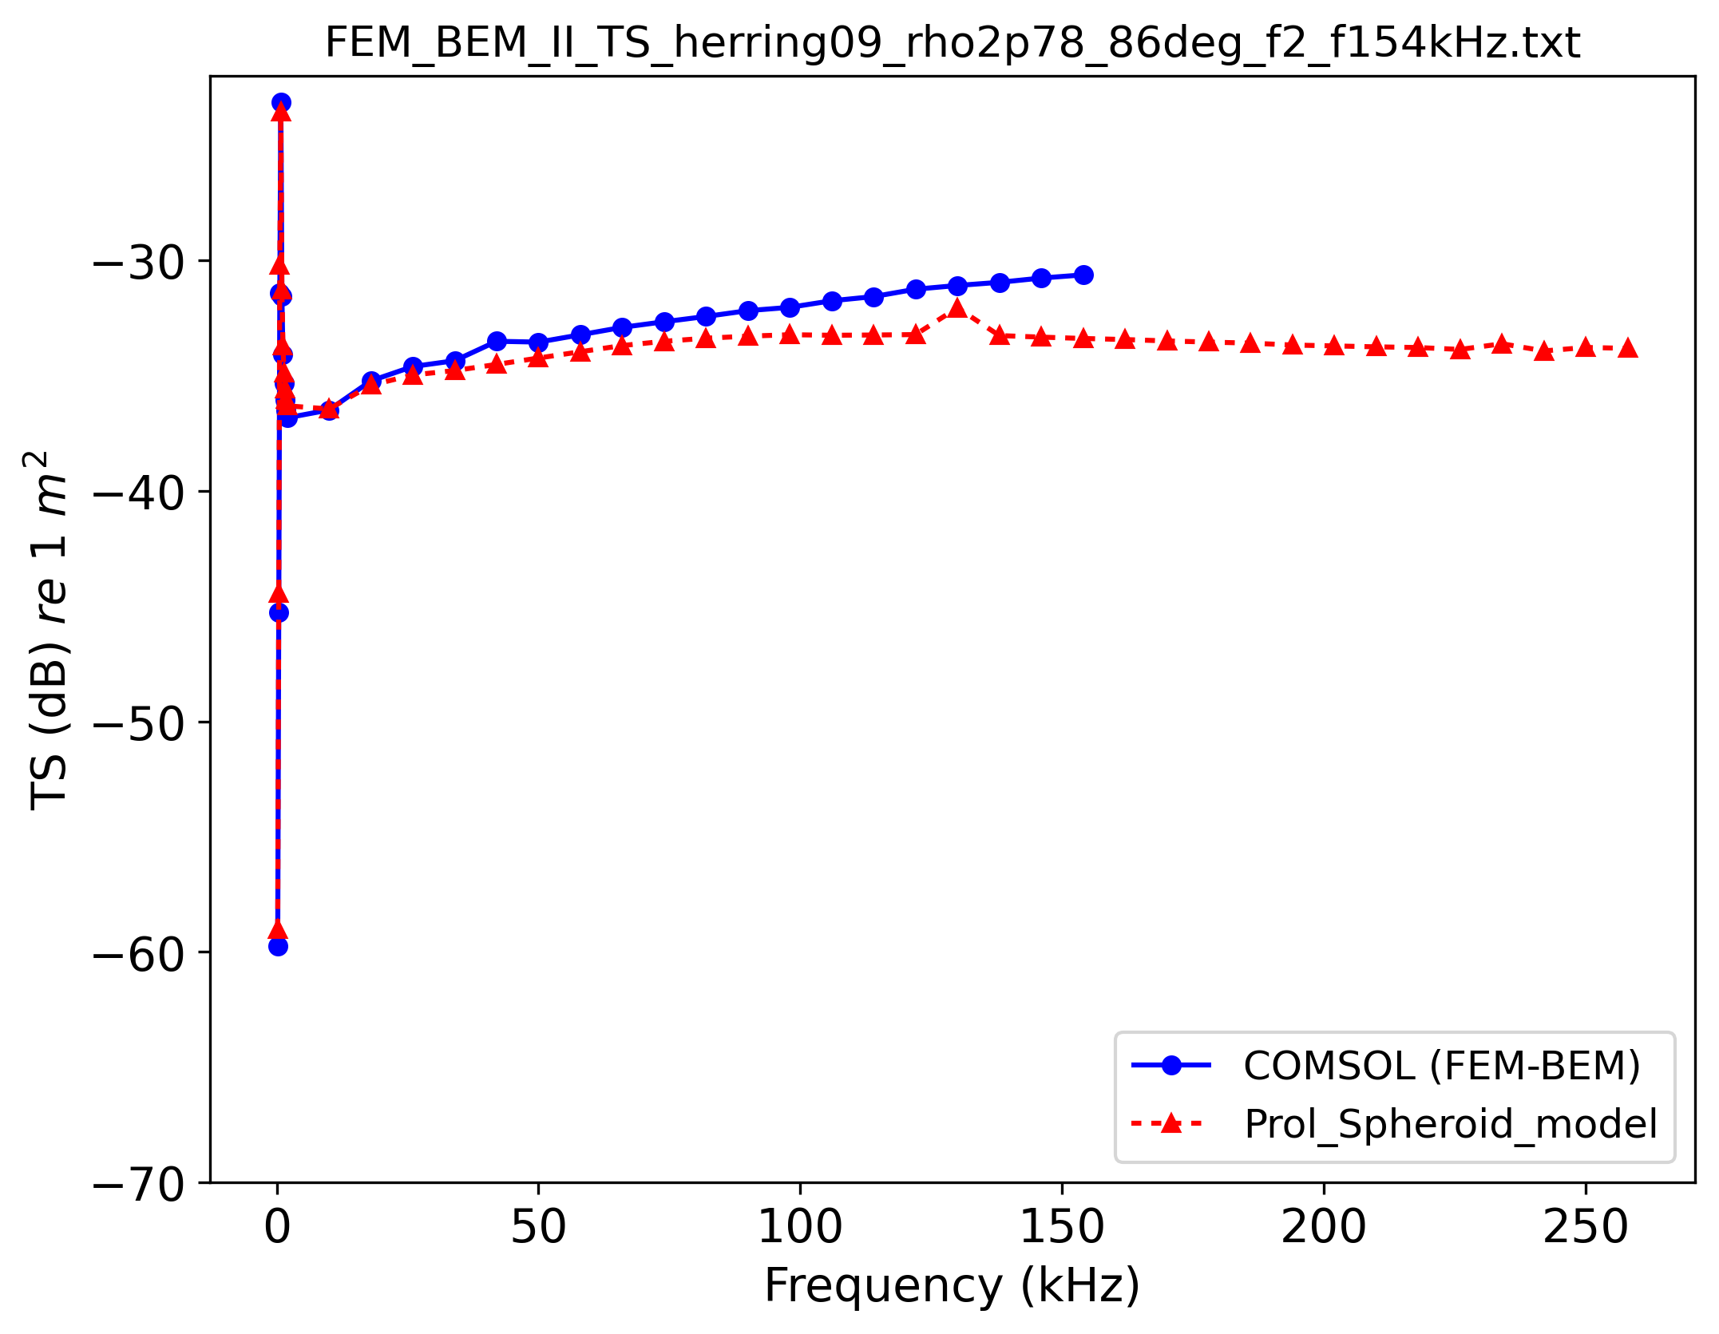
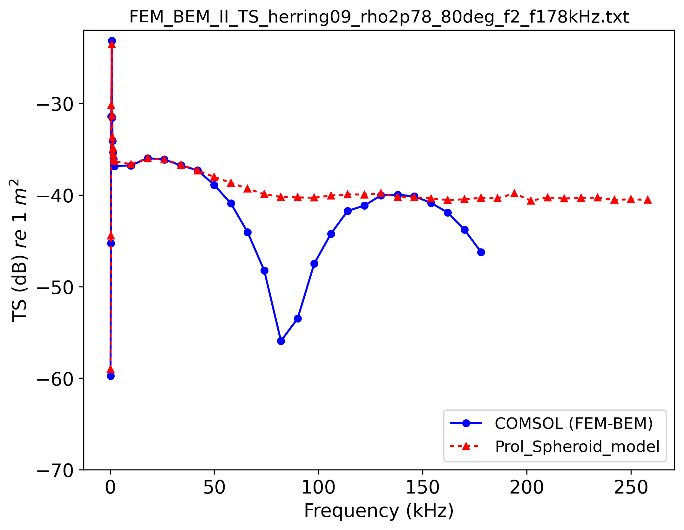
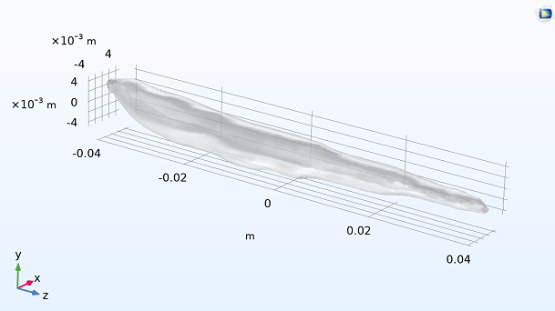
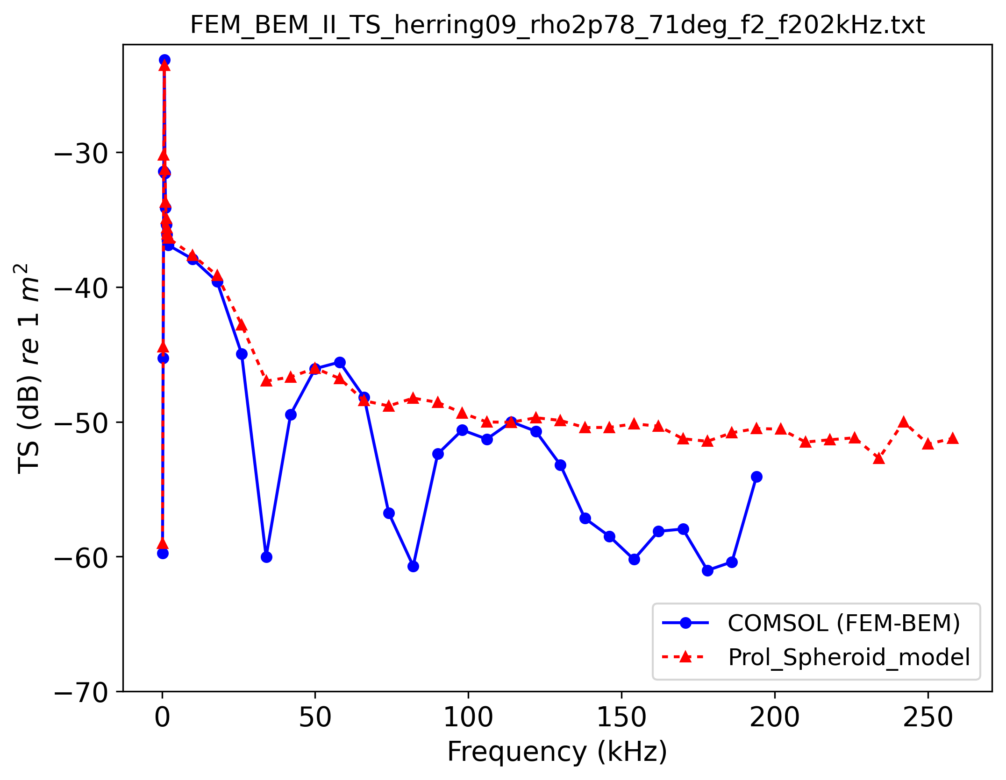
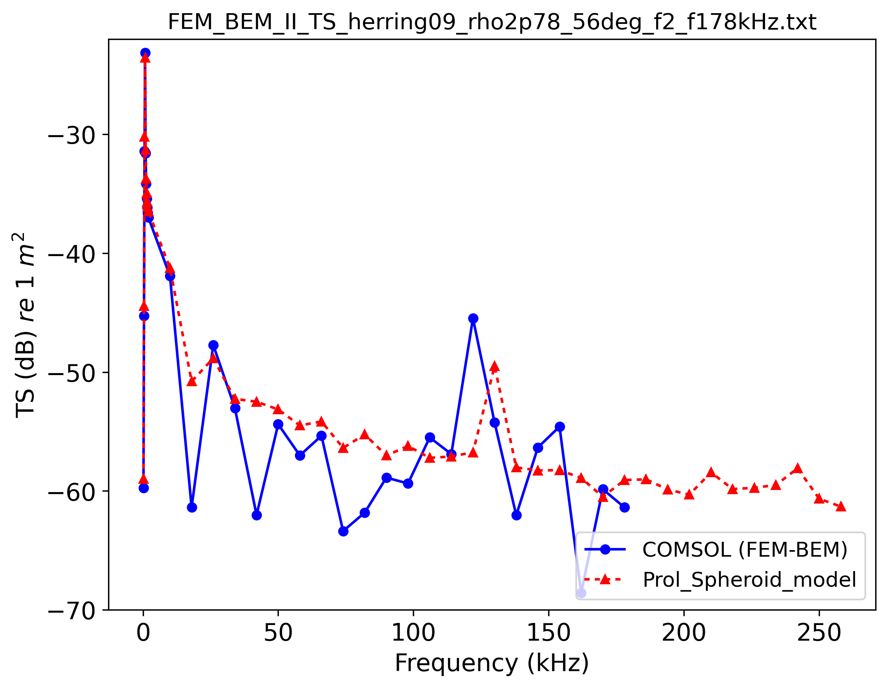
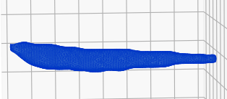






Can a Prolate Spheroid Acoustically Represent the Herring Swimbladder?
$$φ=90°$$
$$φ=84°$$
CT scan of herring swimbladder
$$φ=75°$$
$$φ=60°$$
Incident wave
$$φ$$
With same volume and length as the scanned swimbladder:
a=0.0407 m
b=0.0039 m
Incident wave
$$φ$$
Prolate spheroid provides a good approximation of TS magnitude for different tilt angles.
$$2b$$
$$2a$$

Slide 5

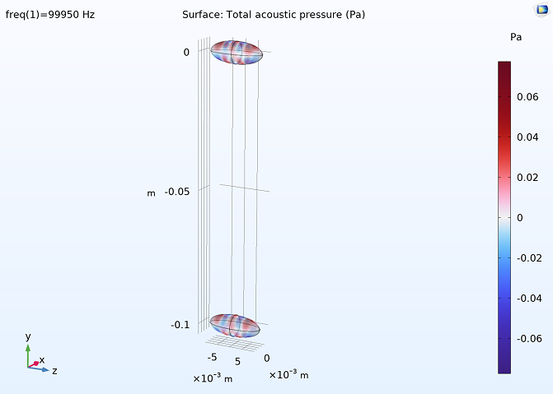
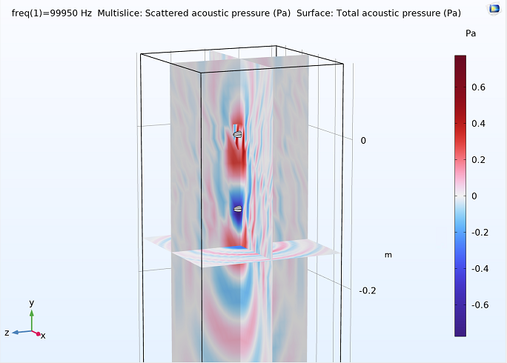
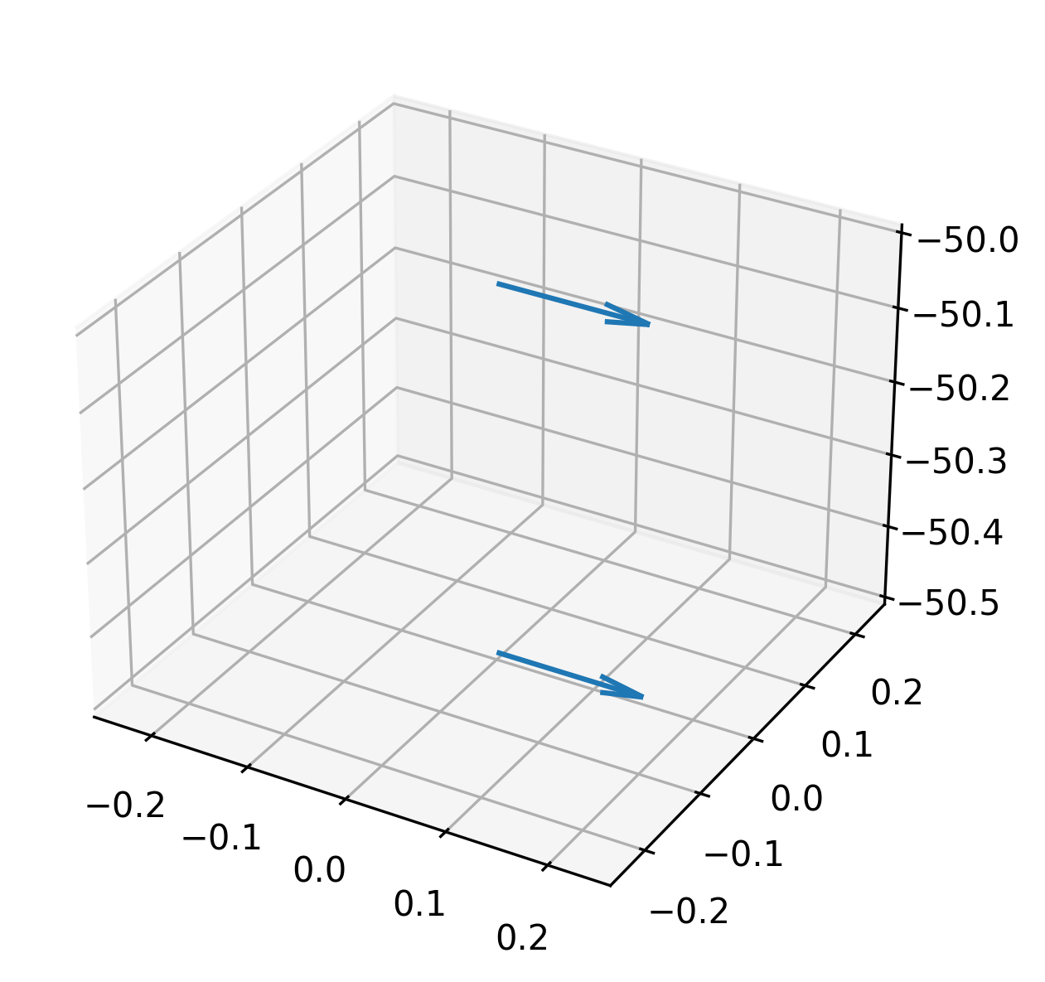

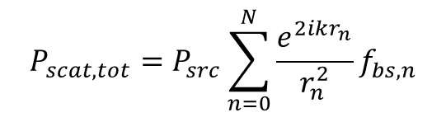

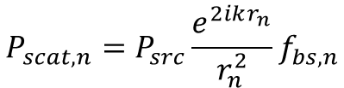

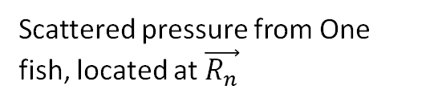
Superposition for modeling fish school
(0, 0, 0)
Scattered pressure from many (N) fish:
(0, 0, 0)
Scattered pressure from One fish, located at $\vec{R_{n}}$
$$\vec{R_{n}}$$
$$P_{scat, tot}=P_{src}\sum_{n=0}^{N}{\frac{e^{2ikr_{n}}}{r_{n}^{2}}f_{bs,n}}$$
$$\vec{R_{n}}$$
$$P_{scat,n}=P_{src}\frac{e^{2ikr_{n}}}{r_{n}^{2}}f_{bs,n}$$
$$(x_{n},y_{n},z_{n})$$
Validity and accuracy of Superposition approach:
Finite Element / Boundary Element Method (FEM–BEM) can solve the full acoustic scattering problem, including multiple scattering effects.
Superposition method assumes that each target scatters acoustic waves independently, without interaction with other targets.

Slide 6
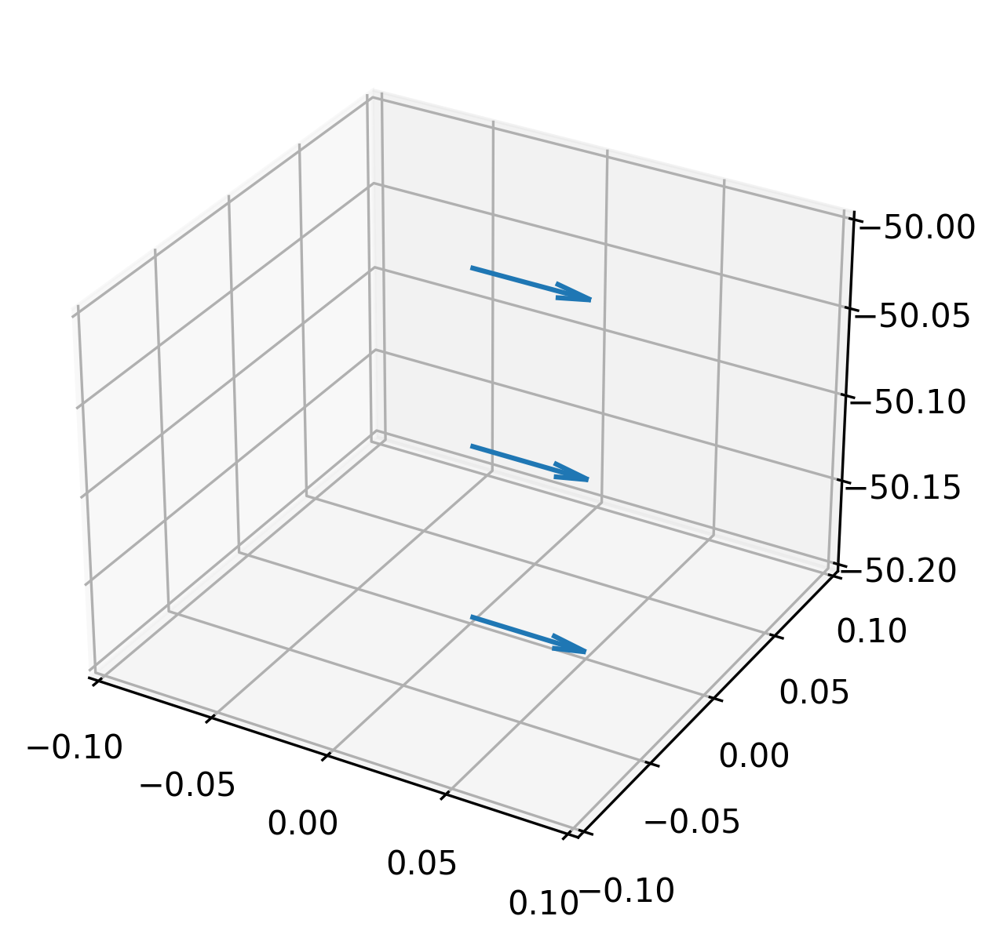
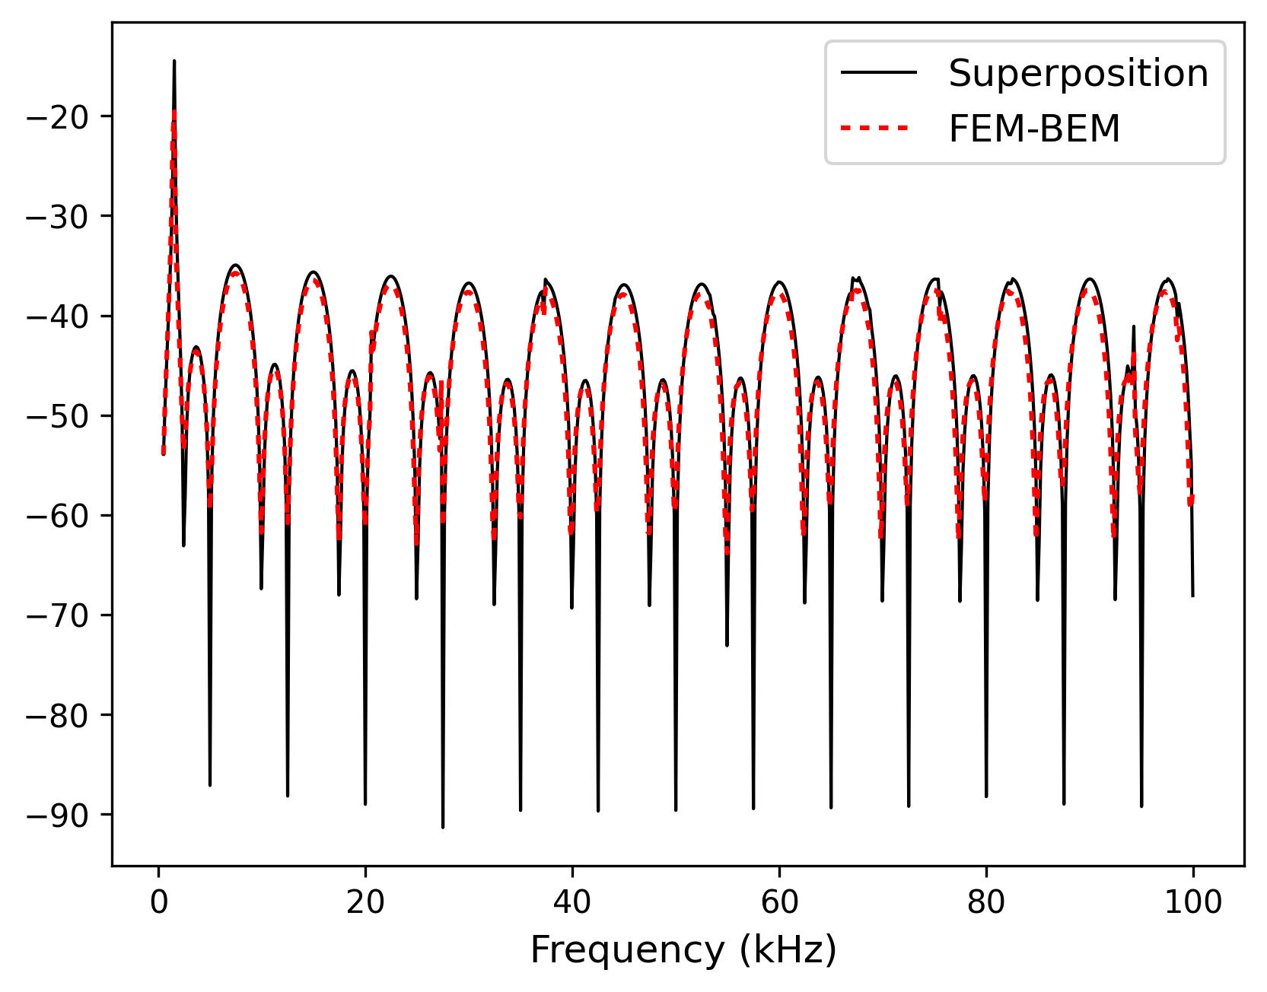
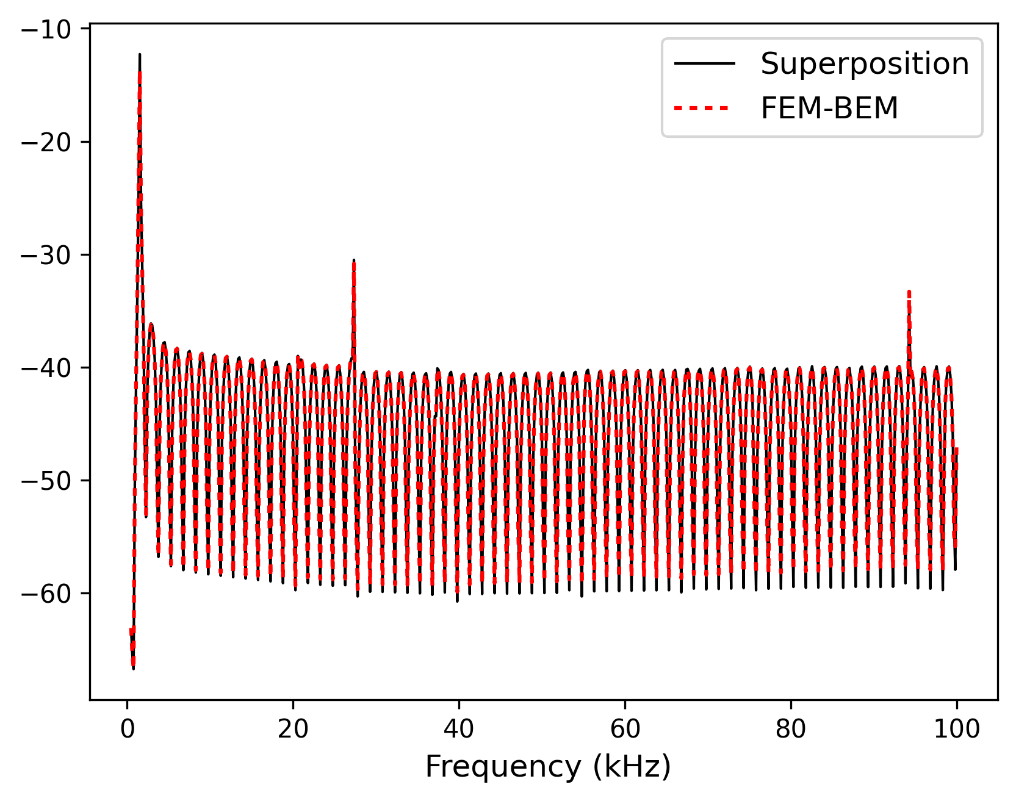
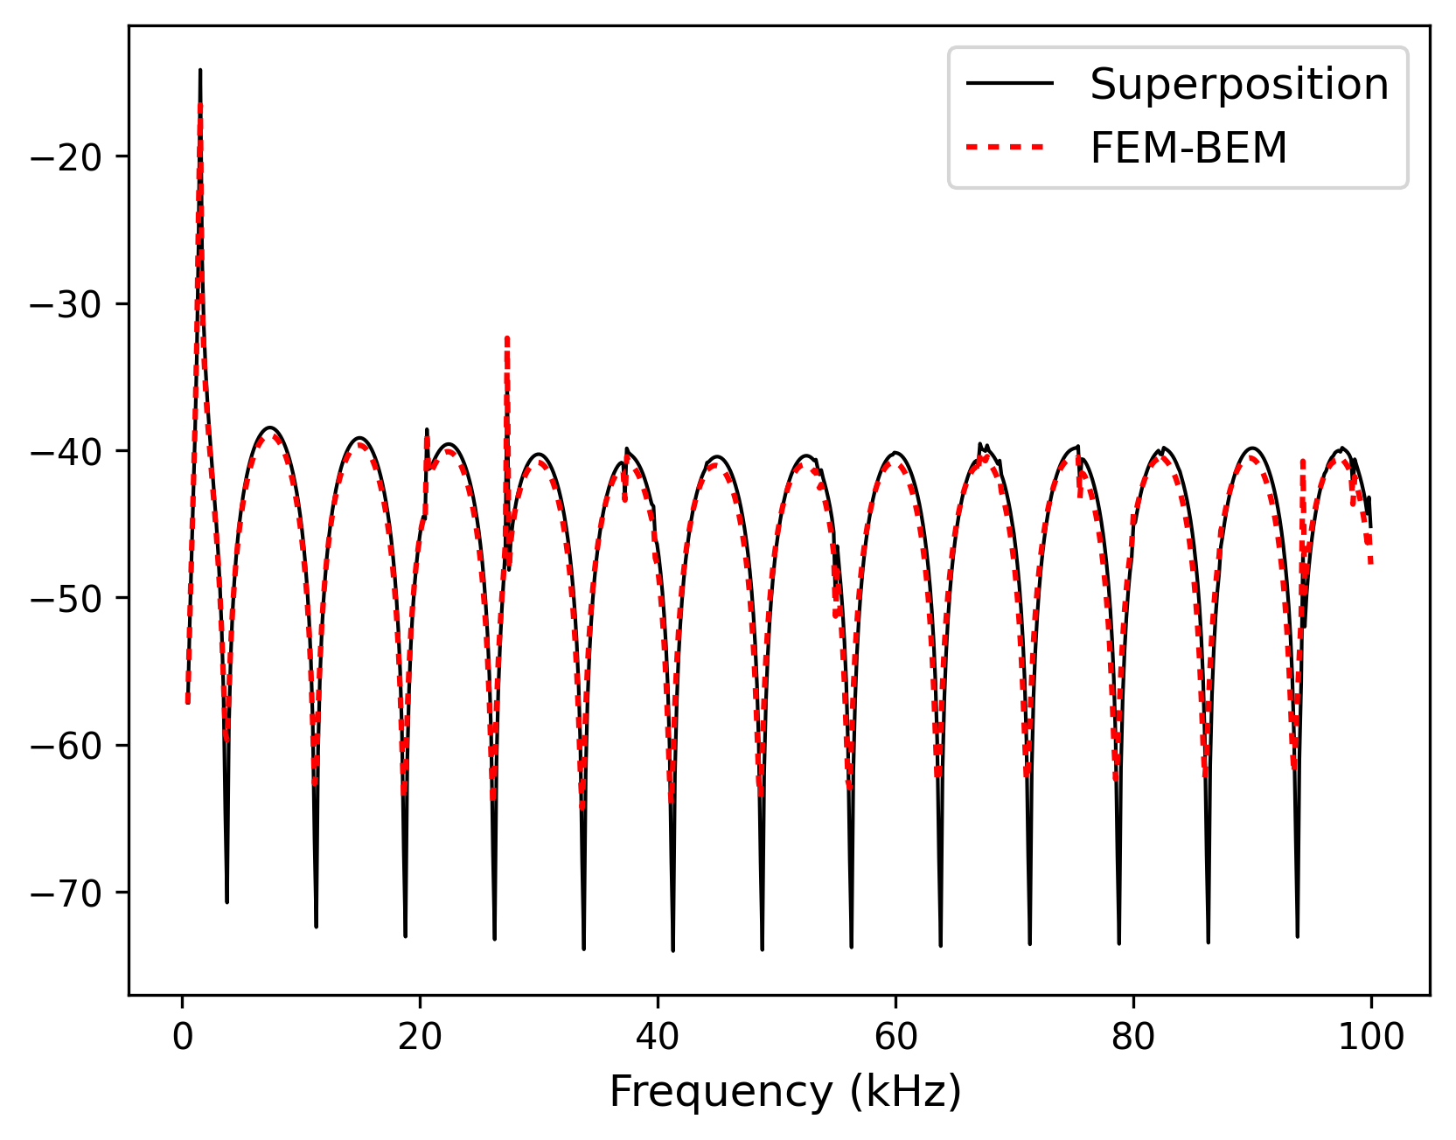
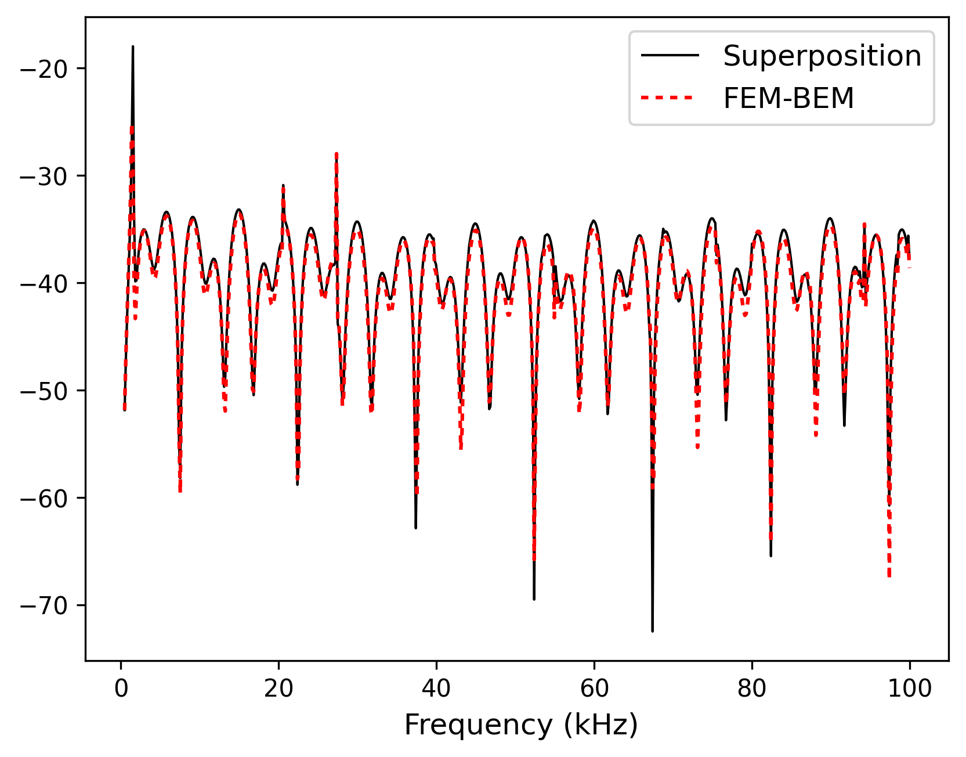
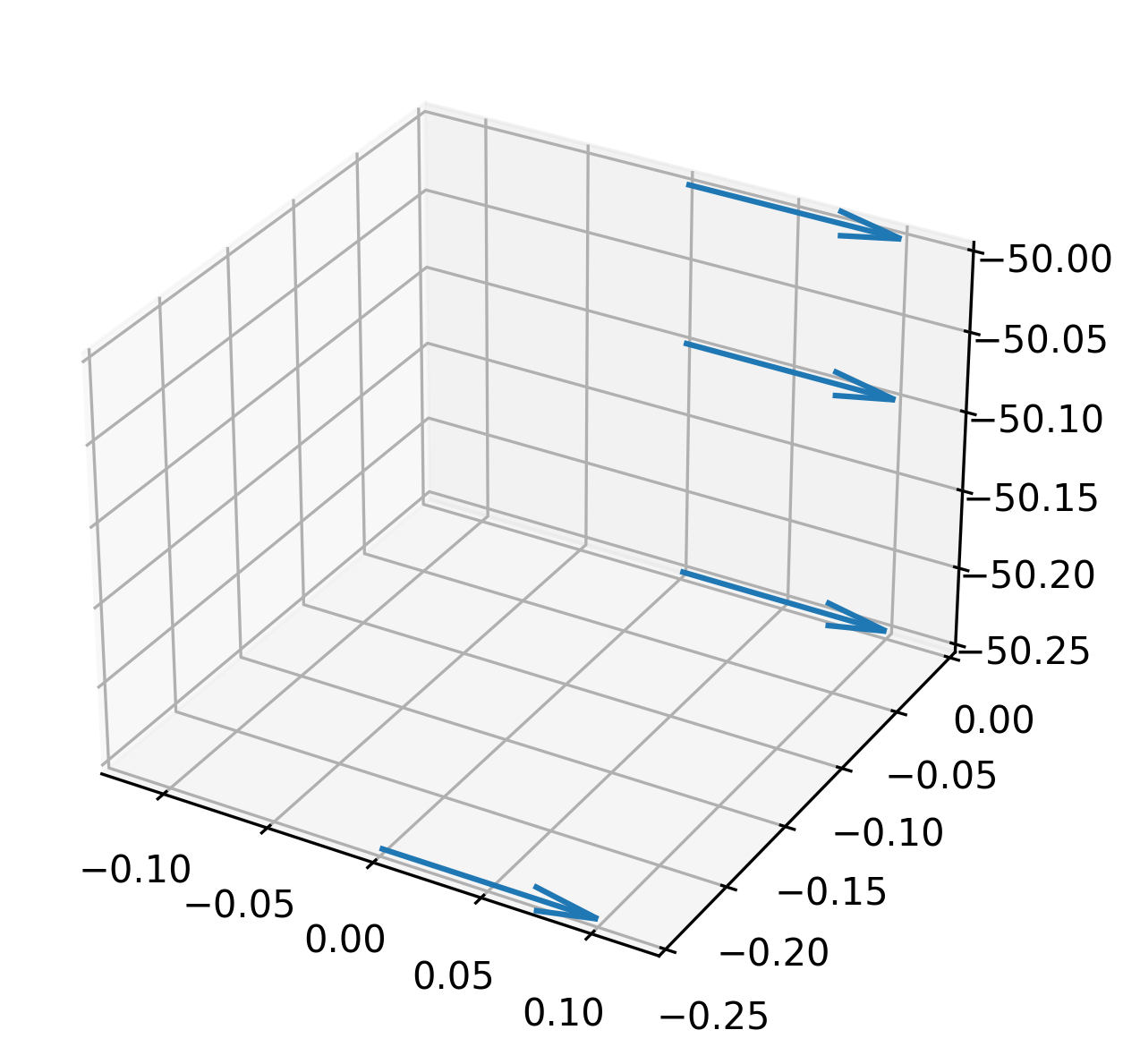
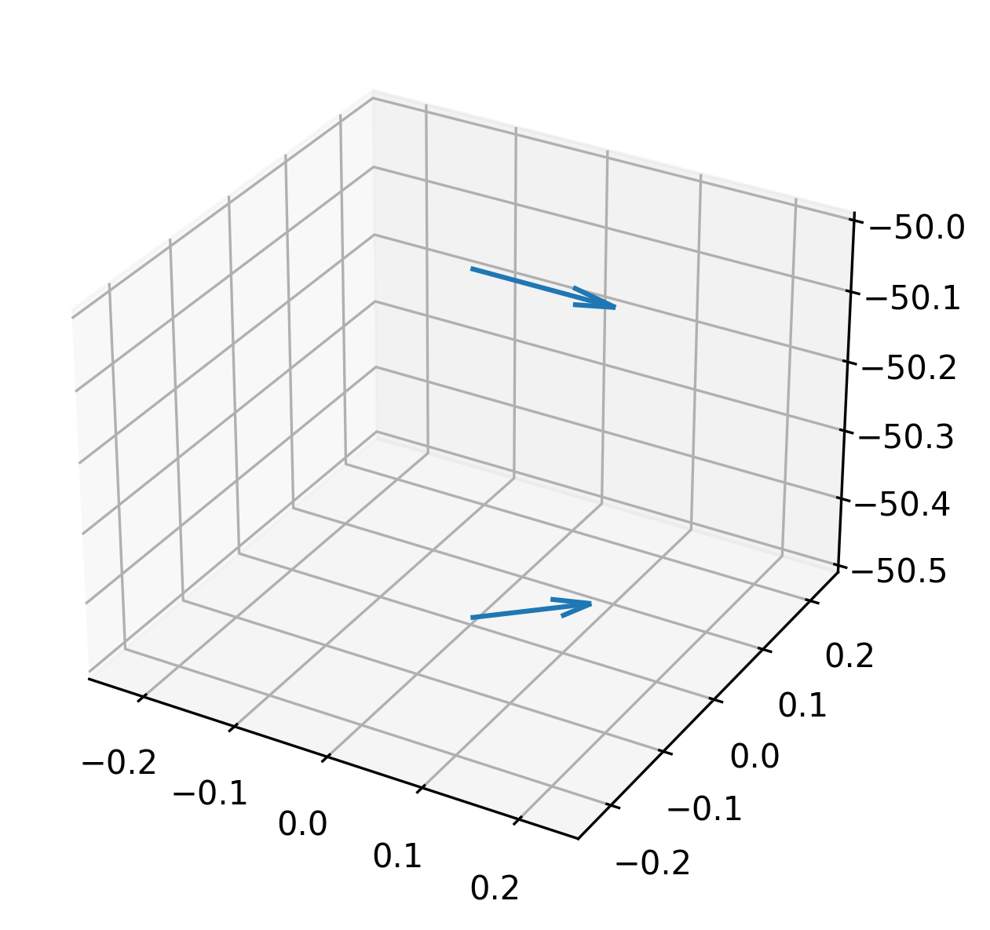
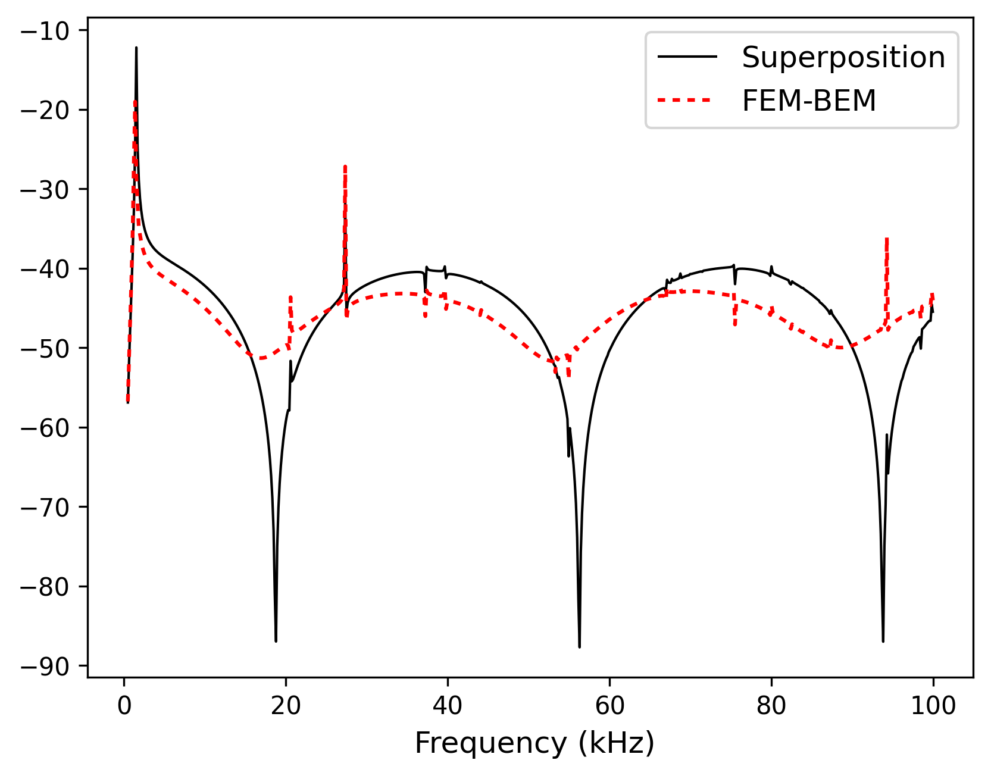
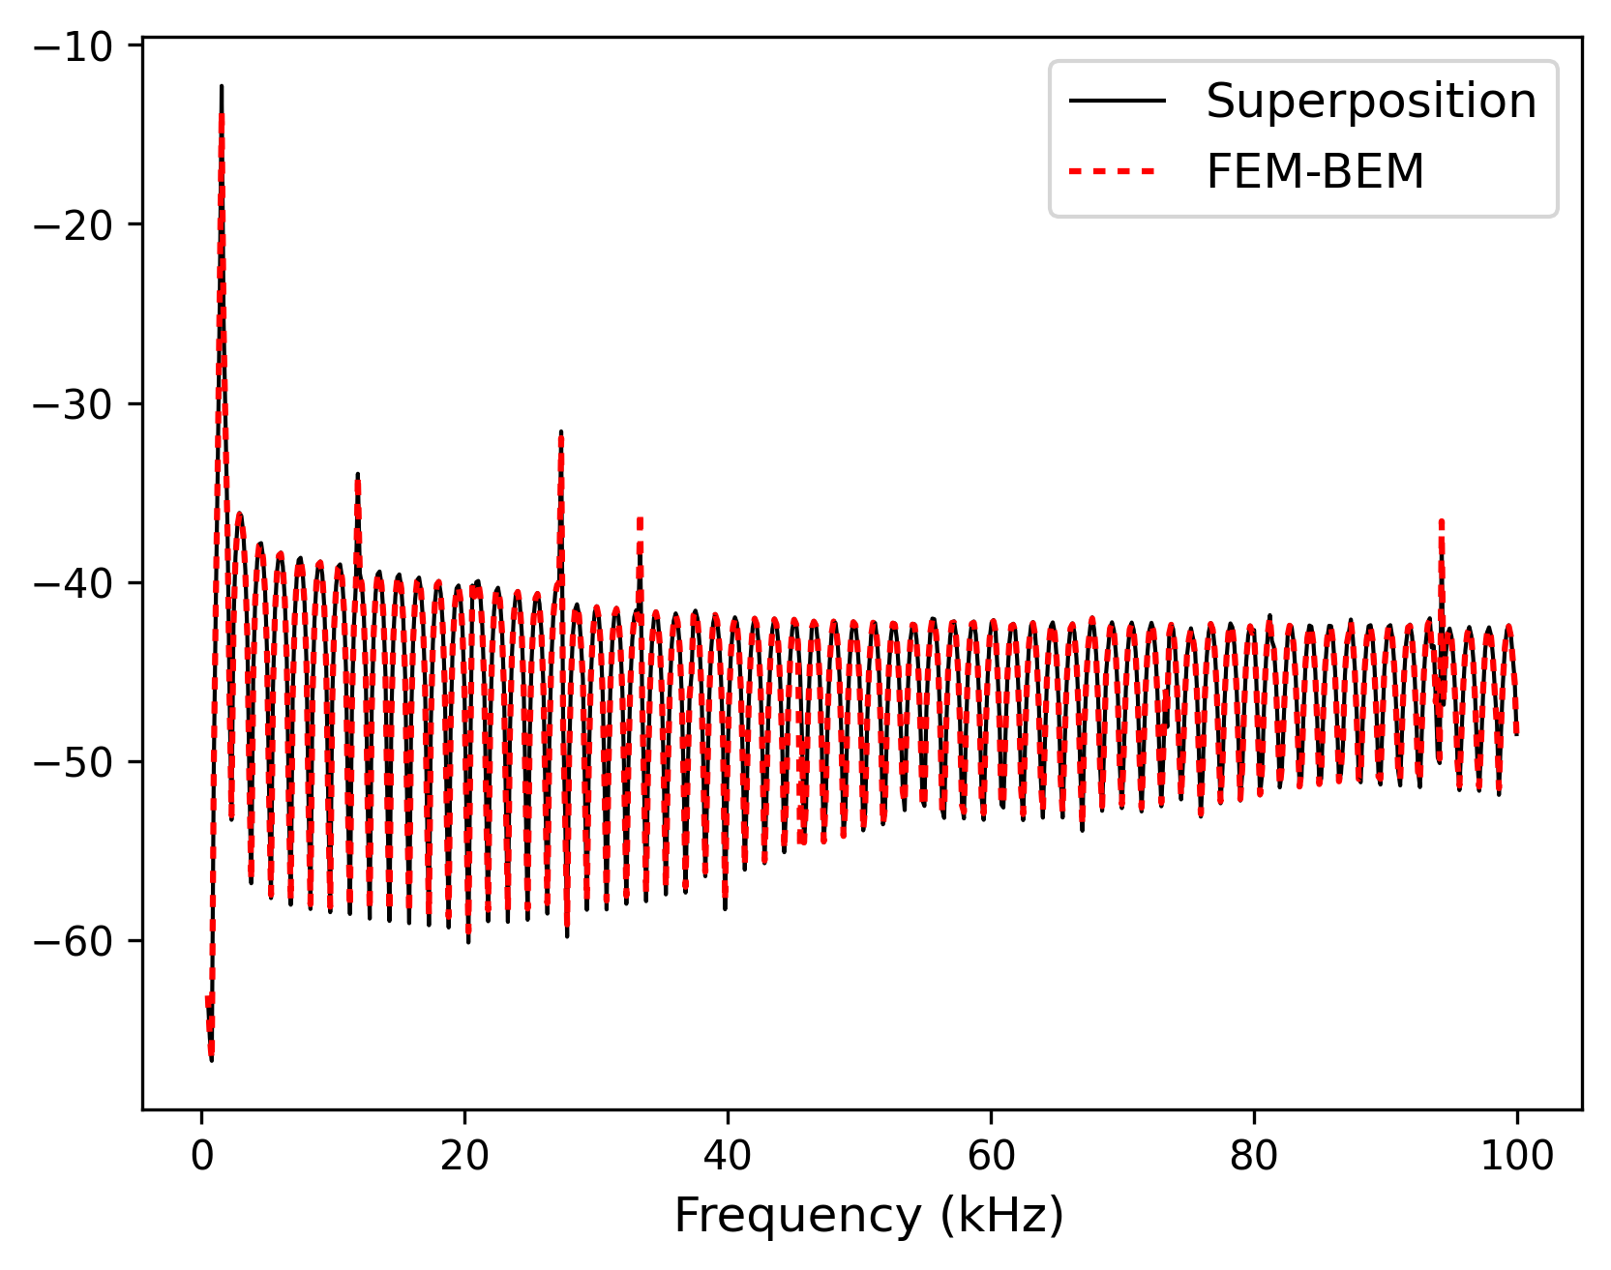





Superposition vs. Full Scattering (FEM–BEM): Two, Three, and Four Fish
$Δ_{1}=$0.1 m
$Δ_{2}=$0.1 m
$Δ=$0.5 m
$Δ=$0.1 m
$Δ=$0.02 m
$Δ=$0.5 m, 2nd tilted
The superposition method provides reliable estimates of multiple-fish backscattering, provided the fish are not too close or too densely packed.

Slide 7
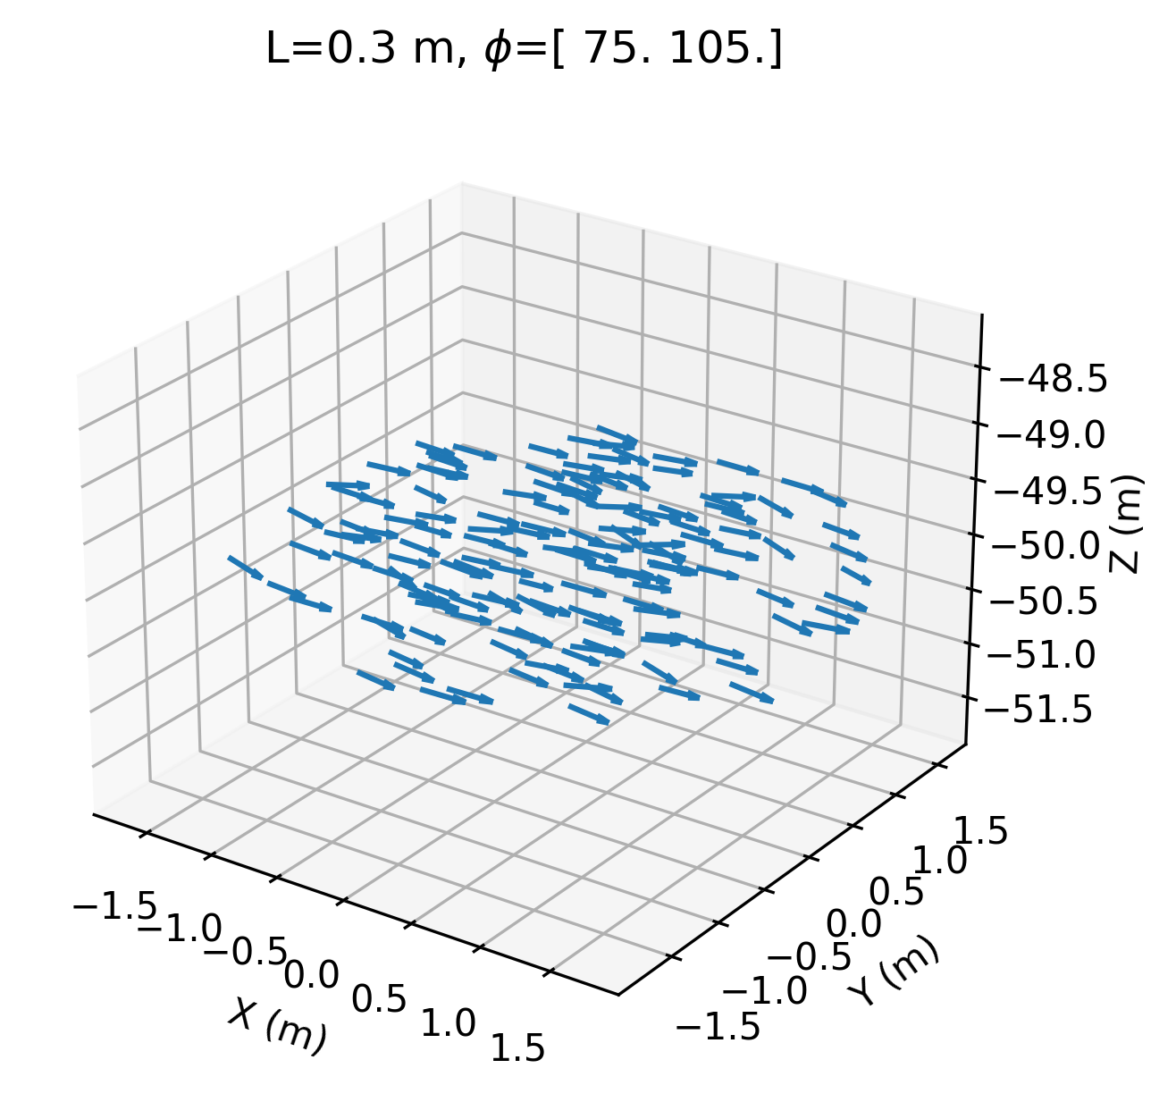
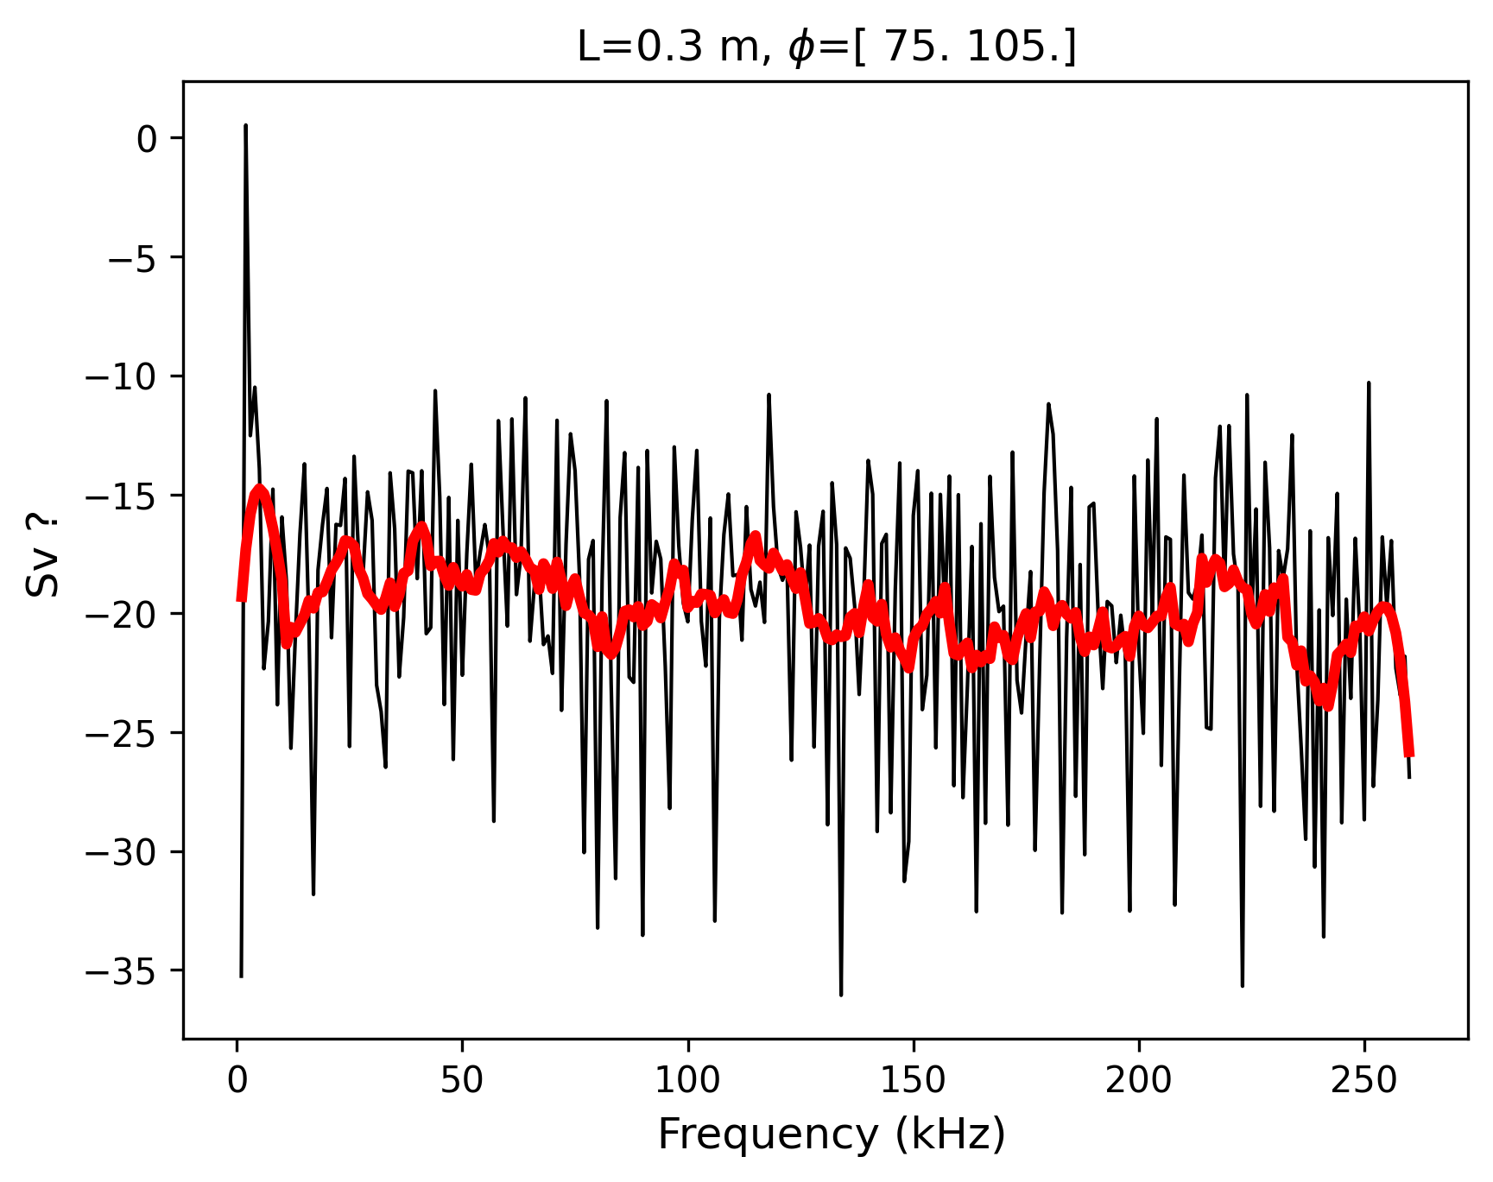
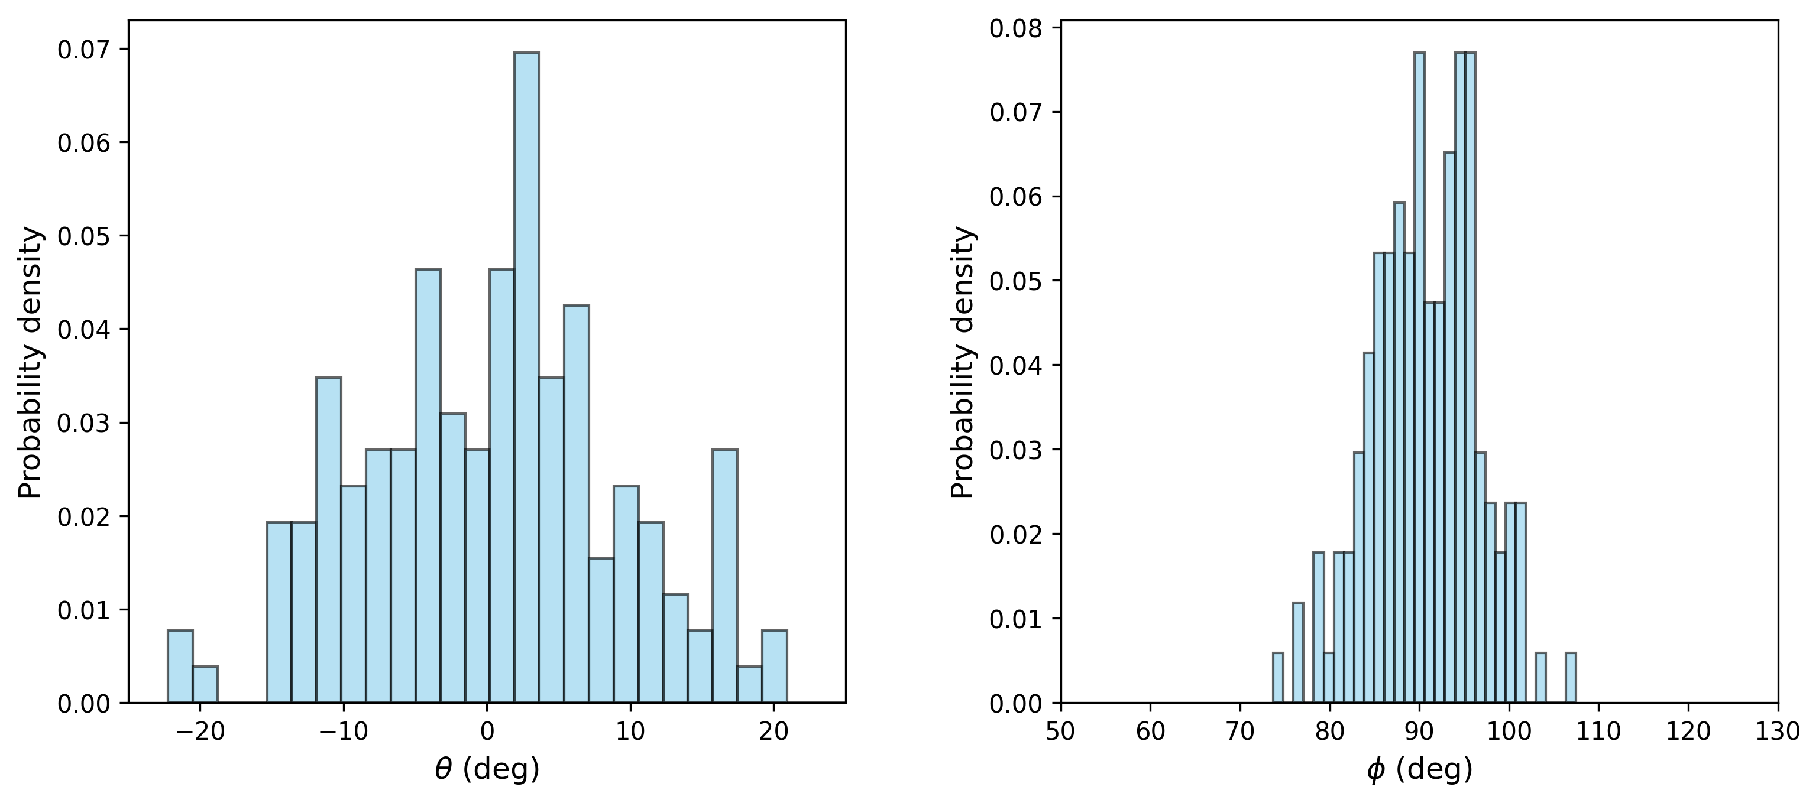
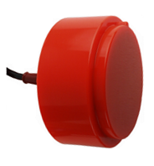
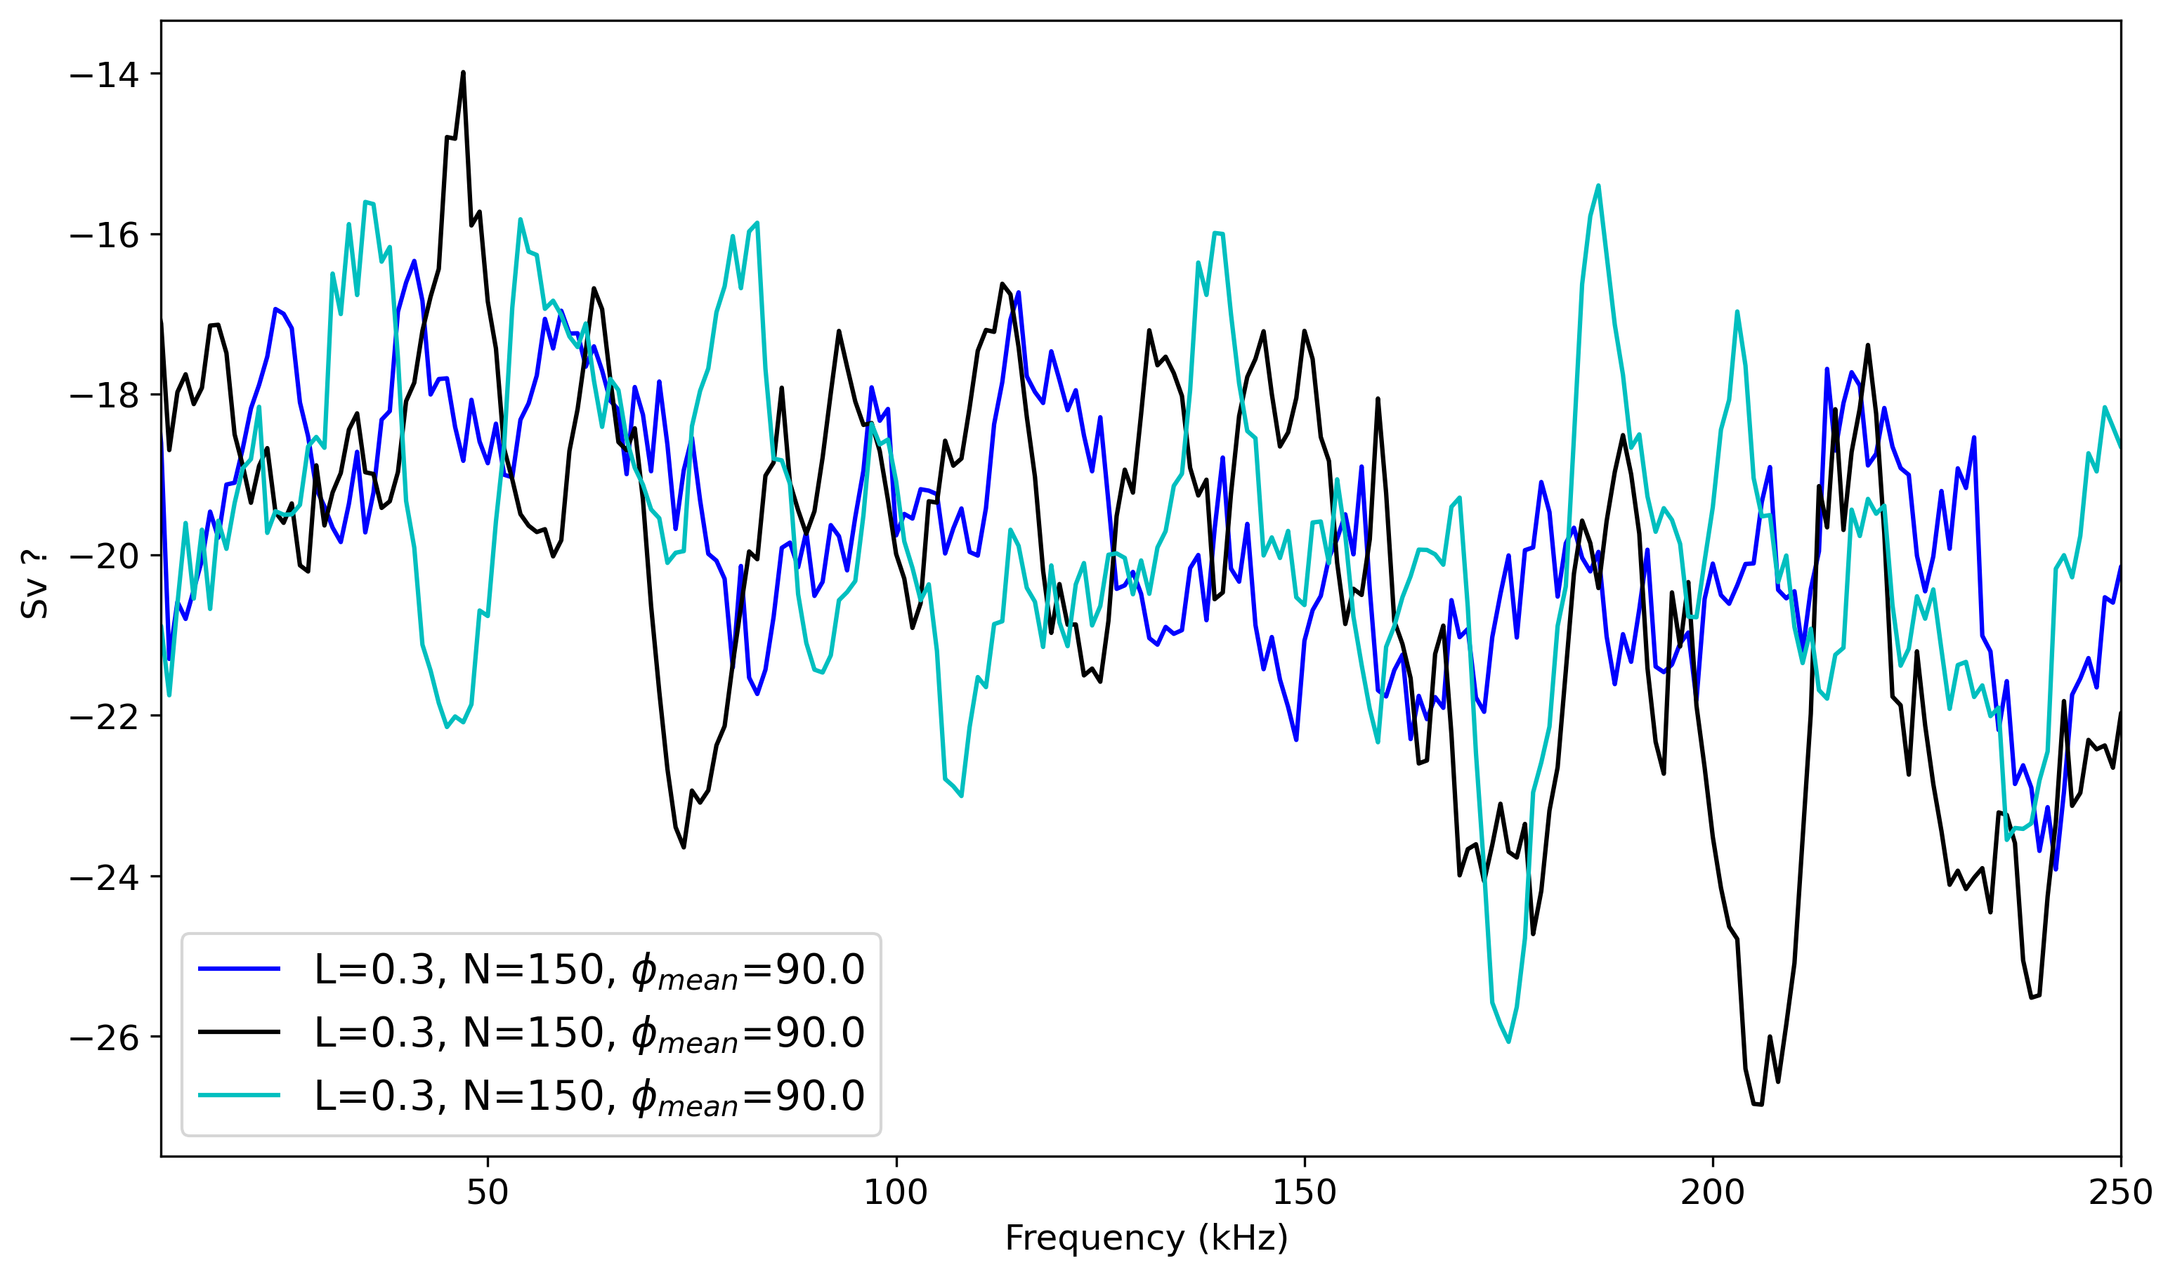





L = 0.3 m, N = 150
Modelled Sv (black) and its smoothed (red):
Orientation Distribution of N fish:
Smoothed curves of modeled Sv for different distribution of N fish:
z
$$θ$$
$$φ$$
y
$$θ$$
x
$φ=9$0

Slide 8
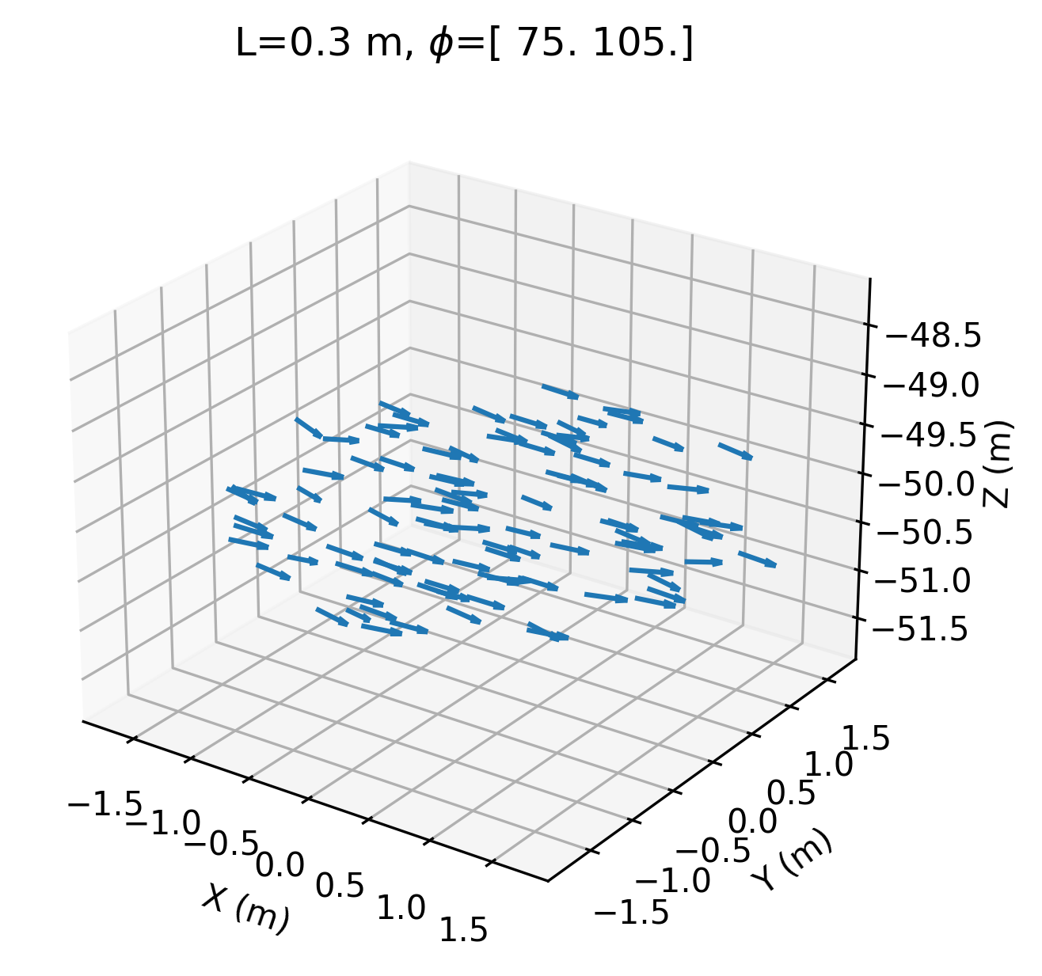
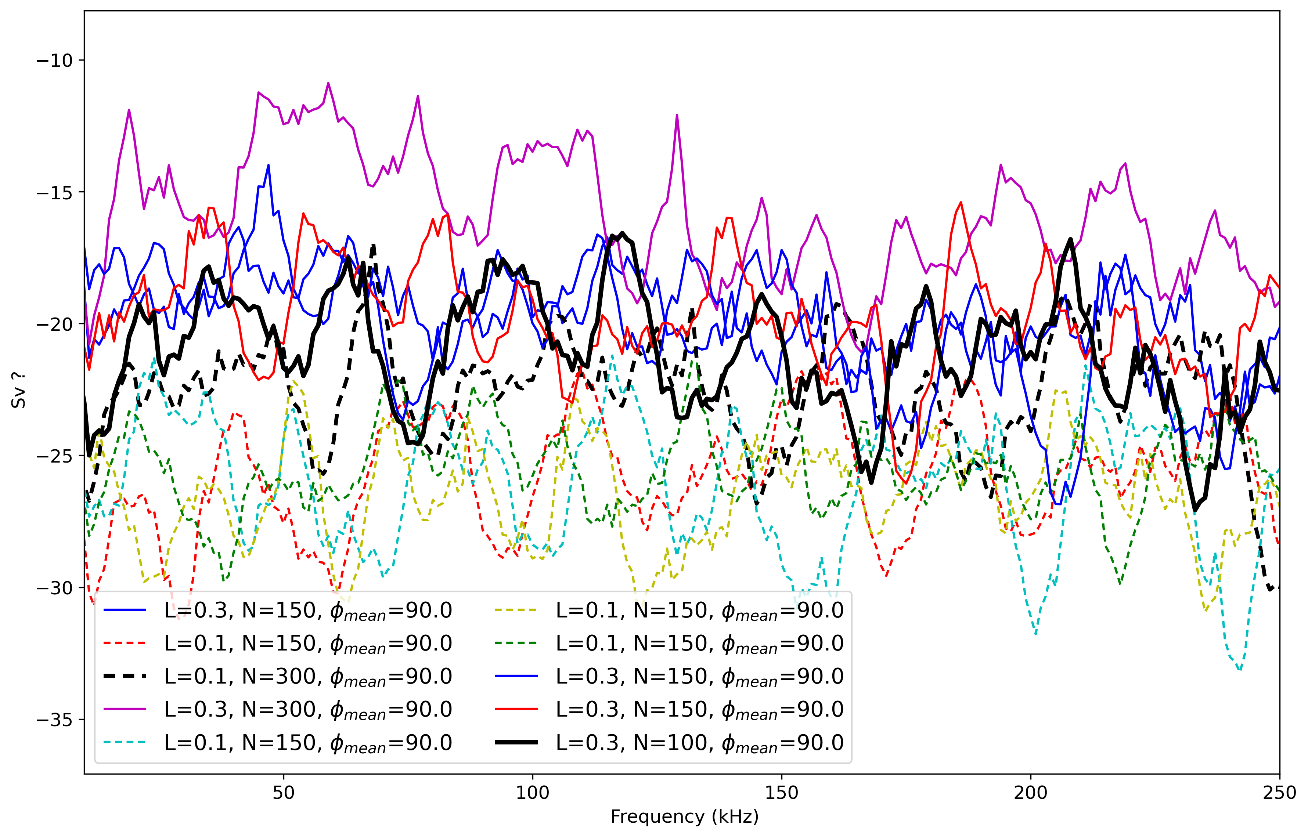
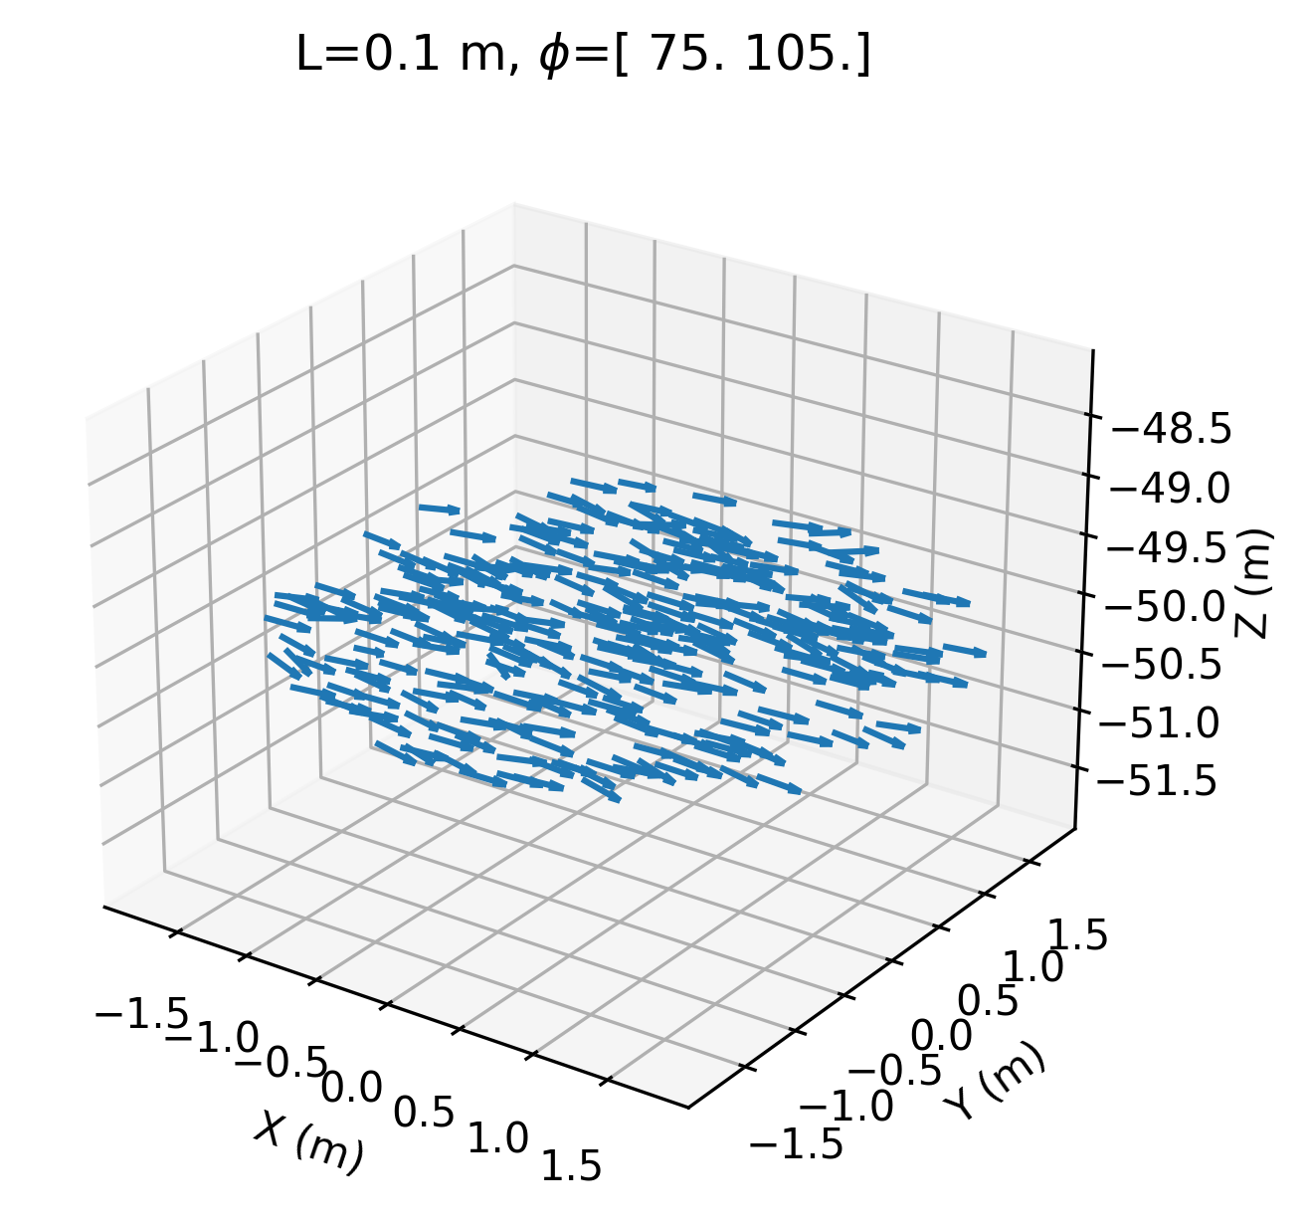
Effect of fish number (N) and size (L) for average tilt angle of 90 (Broadside):
Smoothed curves of modeled Sv under different scenarios
For average tilt of $90°$ it is challenging to distinguish between size (L) and fish number (N)!

Slide 9
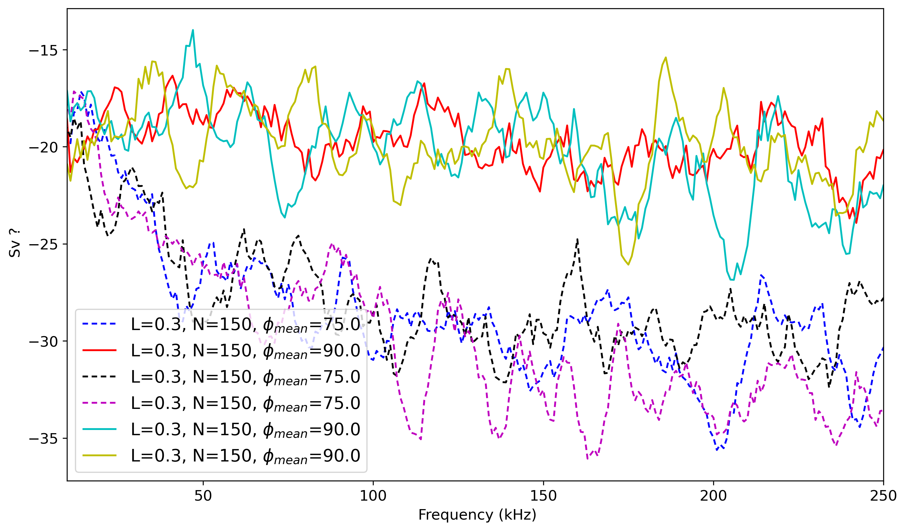
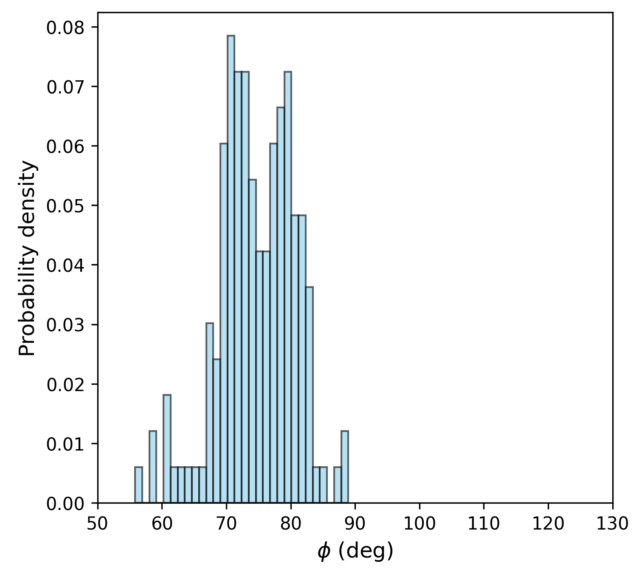


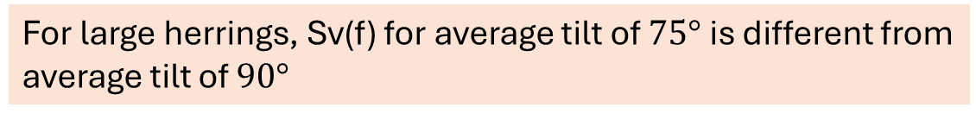
Effect of average tilt angle for large herring: (L fish = 0.3 m)
$$φ=90$$
For large herrings, Sv(f) for average tilt of $75°$ is different from average tilt of $90°$
$$φ=75$$

Slide 10
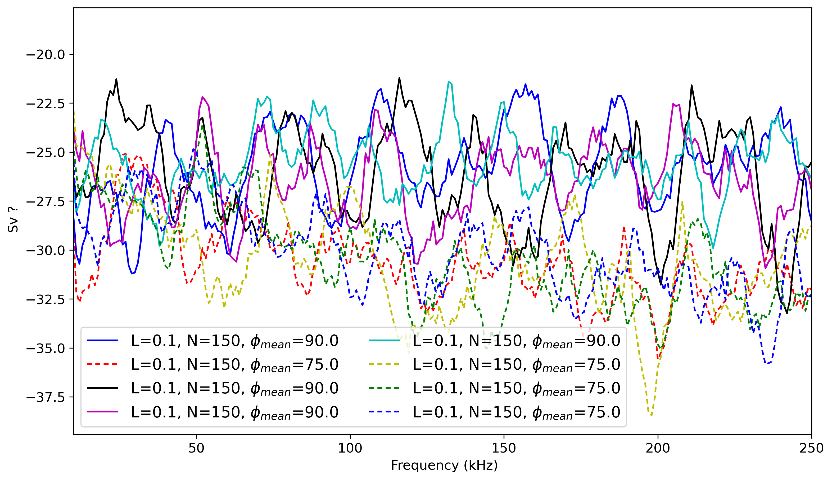
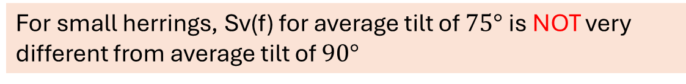
Effect of average tilt angle for small herring: (L fish = 0.1 m)
$$φ=90$$
For small herrings, Sv(f) for average tilt of $75°$ is NOT very different from average tilt of $90°$
$$φ=75$$

Slide 11
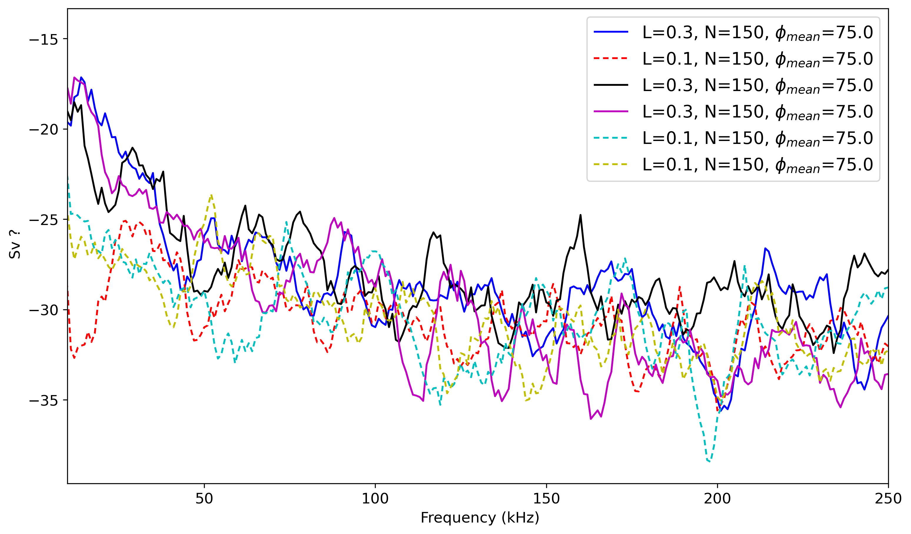

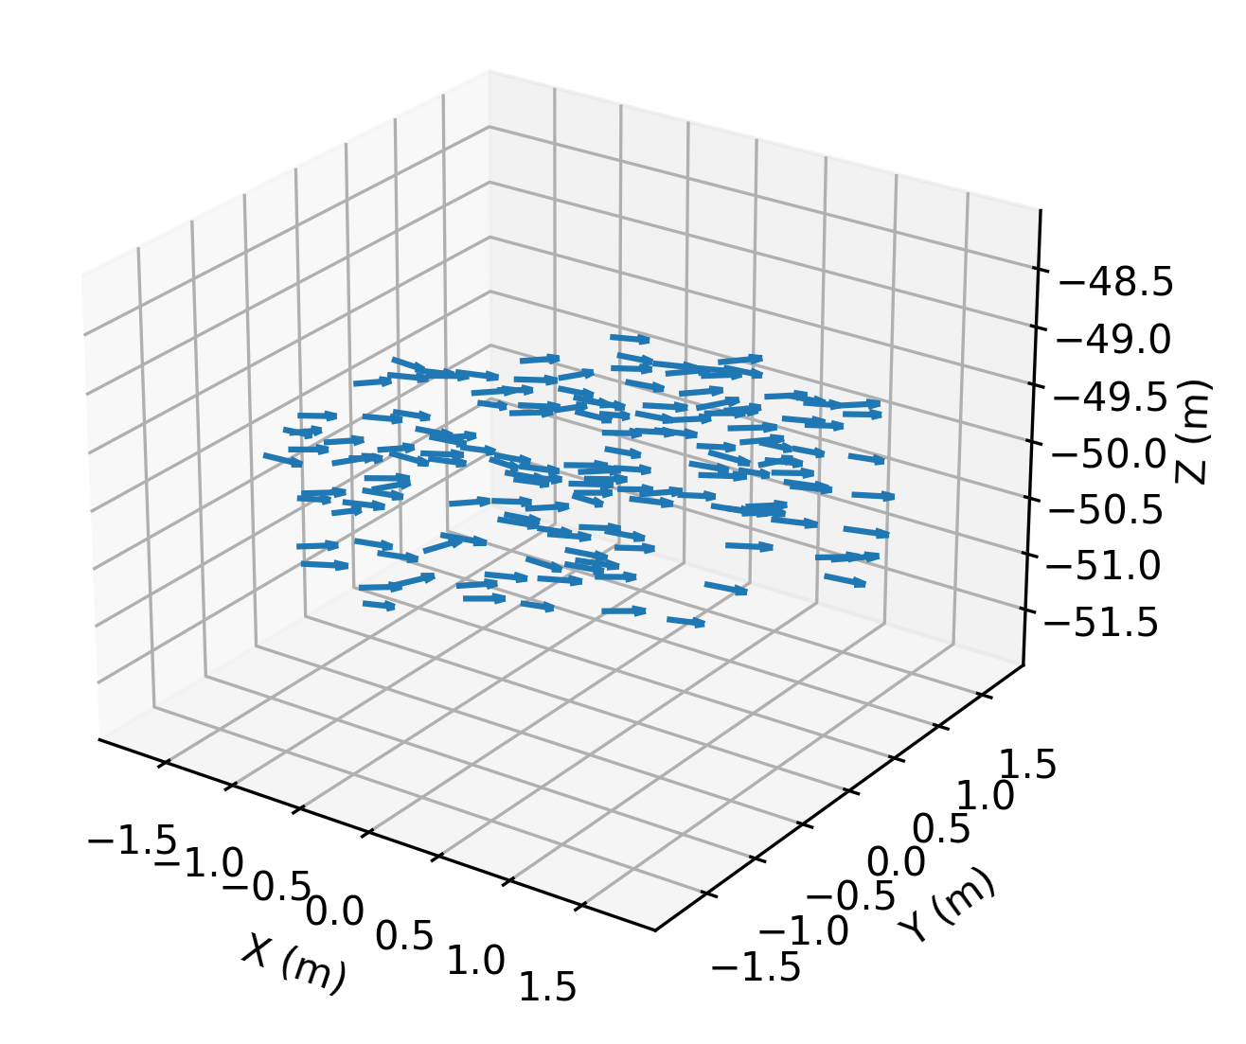


Sv(f) for small and large herring when the average tilt is less than 90
$$φ=75$$
At lower frequencies (10–30 kHz), schools can be better distinguished when the average tilt is less than 90°

Slide 12
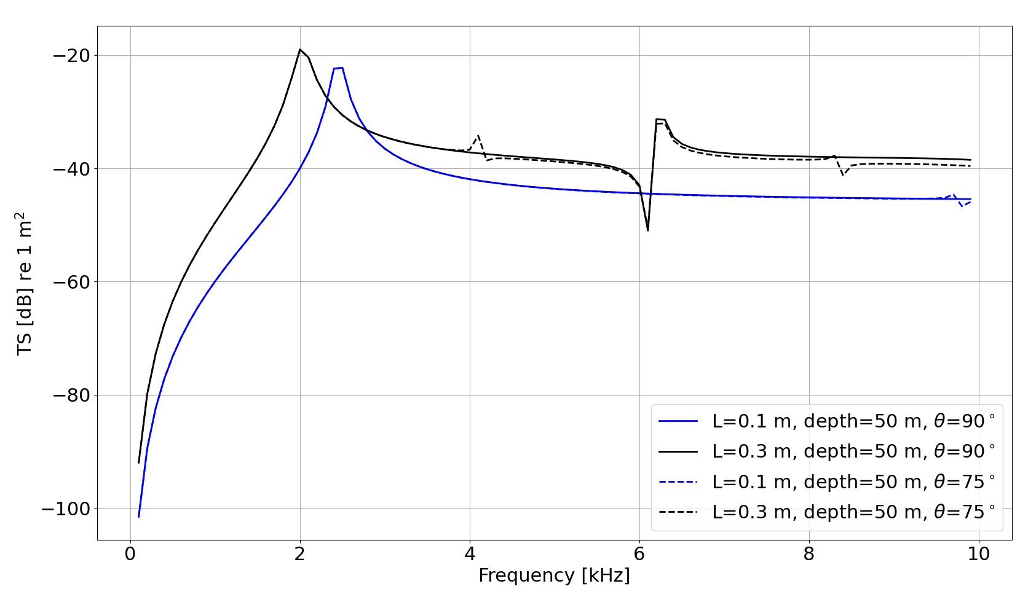
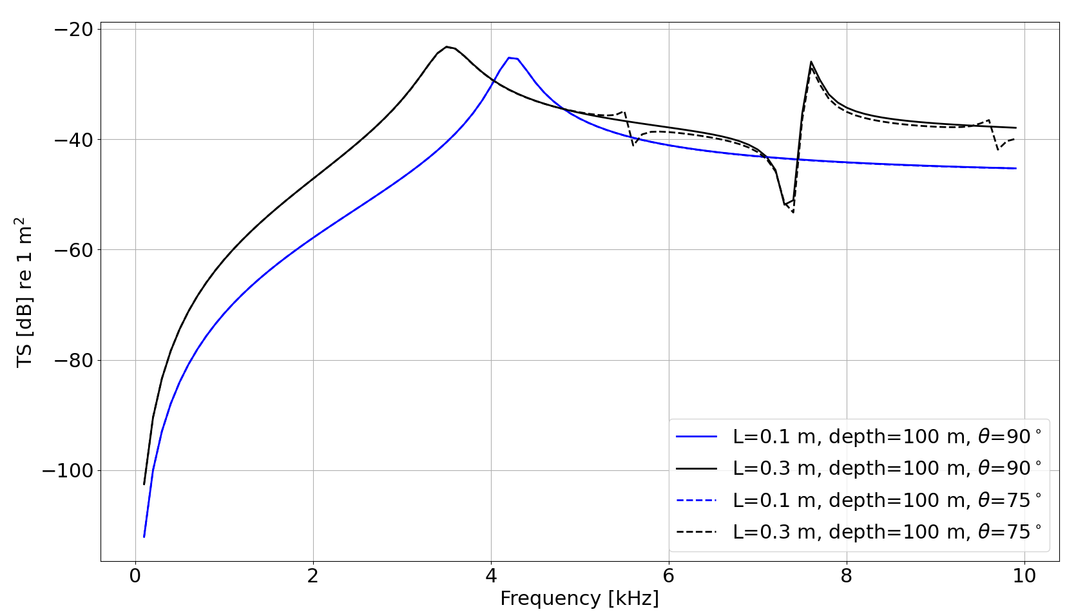
Low frequency resonance peaks
50 m depth
100 m depth

Slide 13
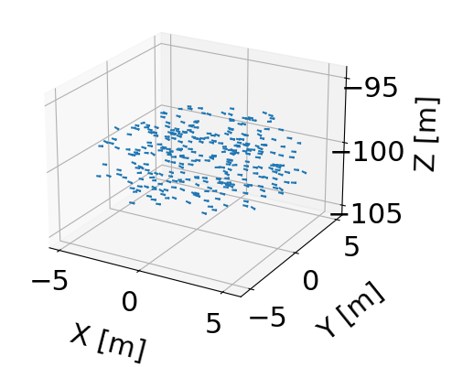
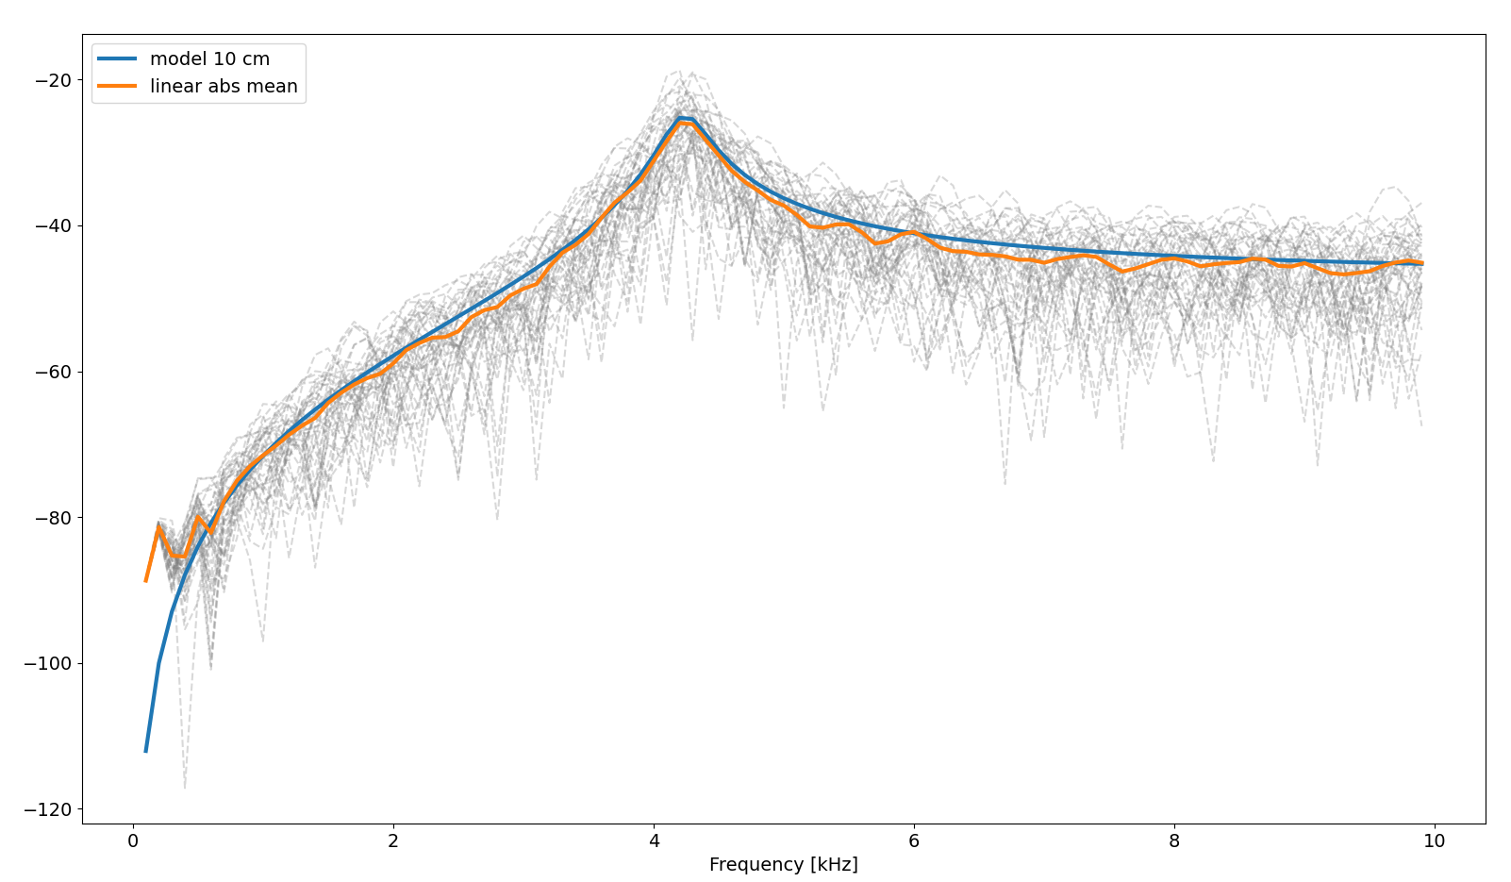
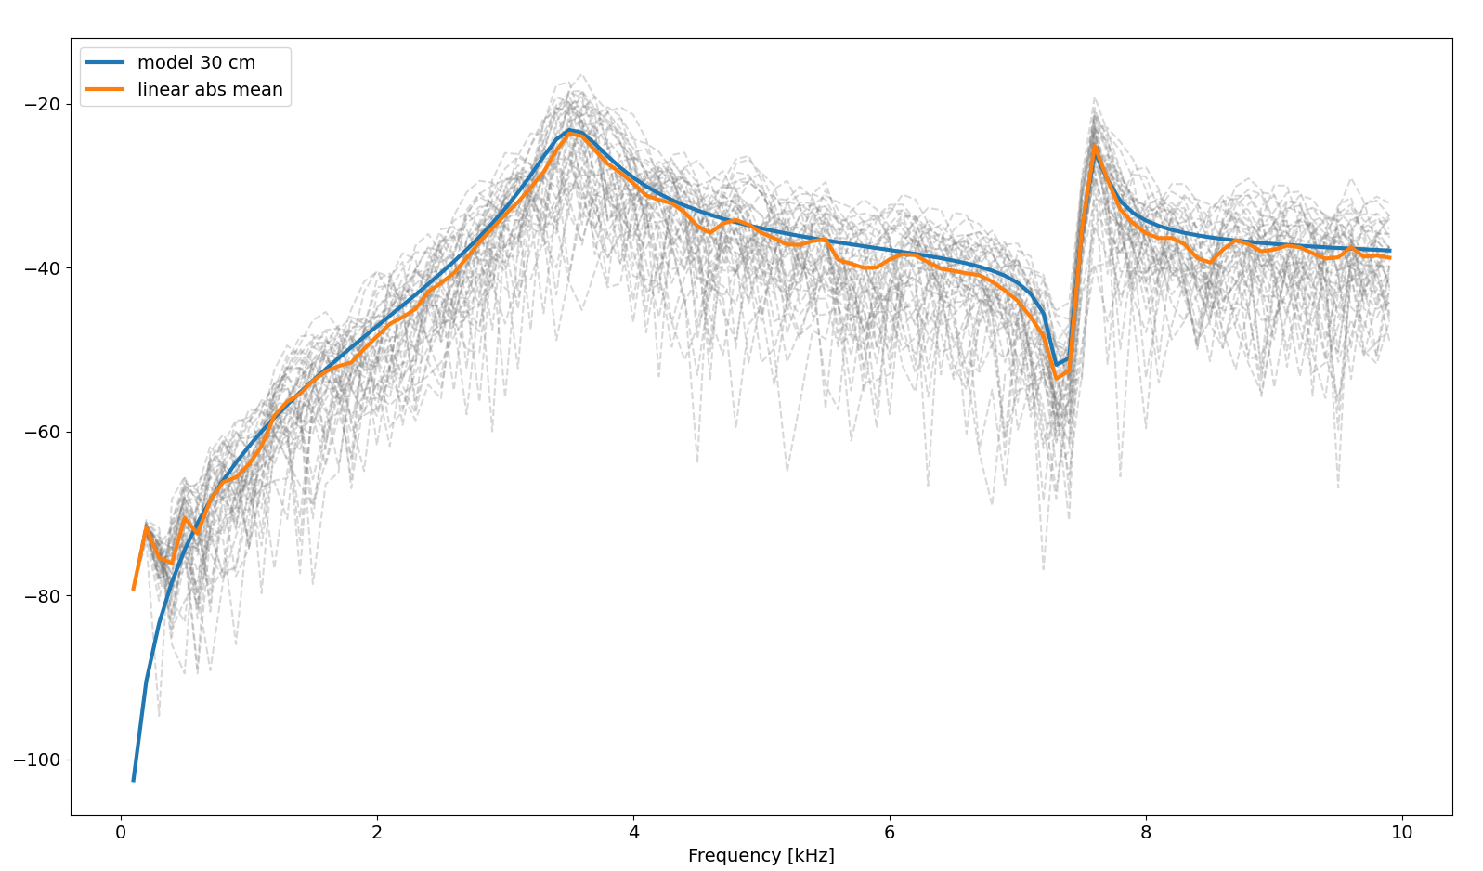
Can the resonance peaks be detected from multiple observations of the same aggregation?
10 cm herring
30 cm herring

Slide 14
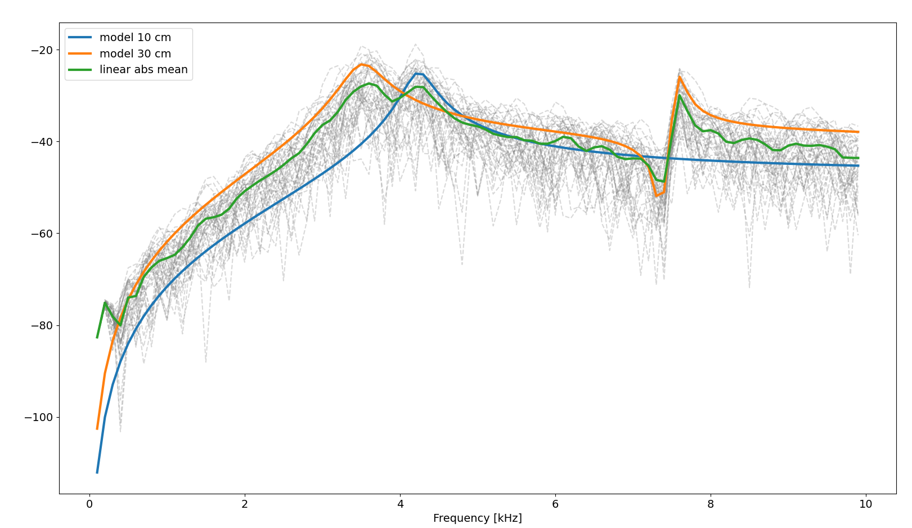
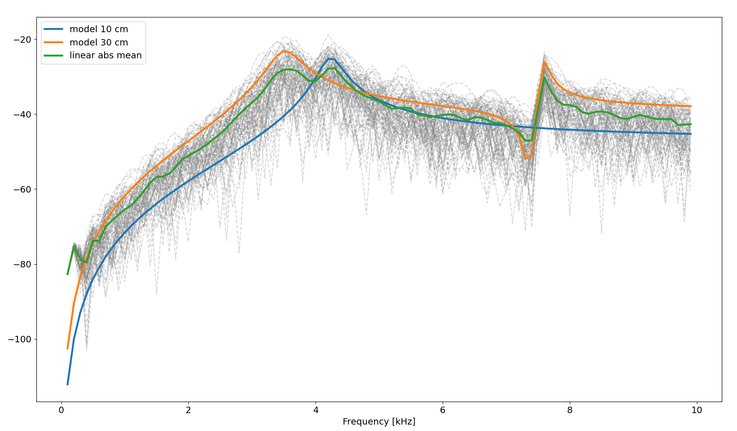
Can we detect mixed sized aggregations?
40 observations
80 observations
50/50 mix

Slide 15
Concluding remarks
The prolate spheroid is a good approximation for the swimbladder
Super positioning principle works
There is large variability in the backscatter for aggregations in the high frequencies
Including the 10–30 kHz band has potential for school sizing under certain conditions (average tilt different from 90).
There may be a potential to differentiate size in the low resonance peak range

Slide 16
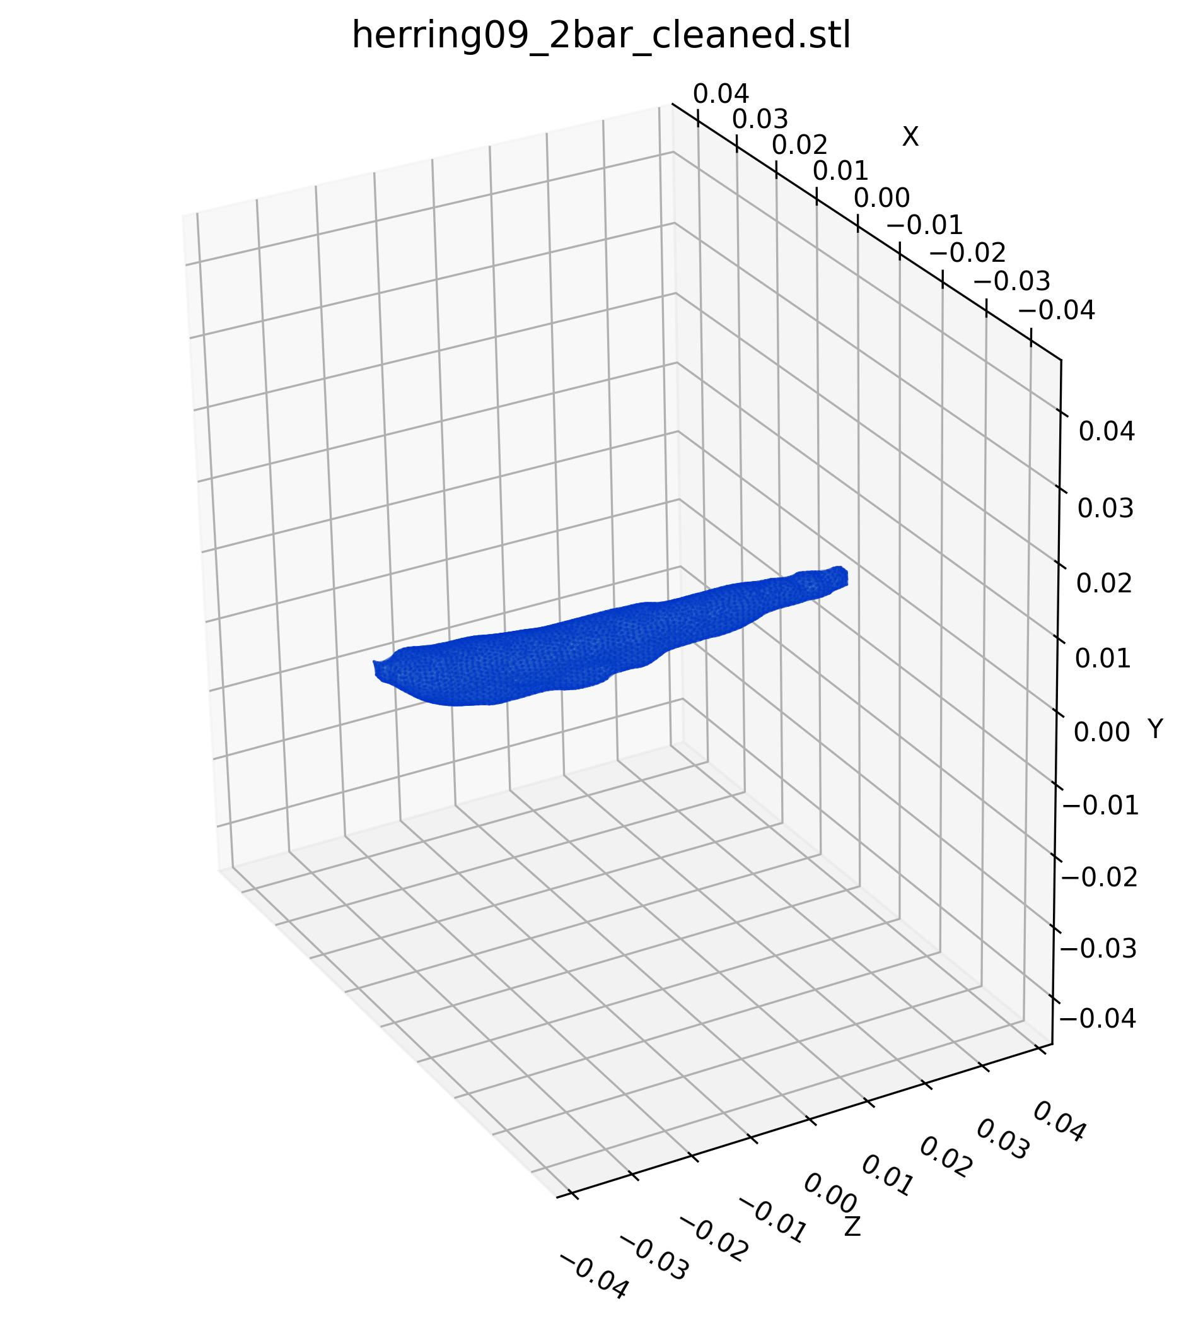






Can a Prolate Spheroid Acoustically Represent the Herring Swimbladder?
Incident wave
$$φ$$
Broadside incidence $φ=90°$
$$V_{tot}=2.62189×{10}^{−6} m^{3}$$
With same volume and length as the scanned swimbladder:
a=0.0407 m
b=0.0039 m
$$2a$$
$$b$$

Slide 17








Can a Prolate Spheroid Acoustically Represent the Herring Swimbladder? Backscattering from CT geometry
Incident wave
$$φ$$
$$V_{tot}=2.62189×{10}^{−6} m^{3}$$
With same volume and length as the scanned swimbladder:
a=0.0407 m
b=0.0039 m
$$2a$$
$$b$$

Slide 18


L = 0.3 m, N = 150 vs. N = 300

Slide 19




Superposition vs. Full Scattering (FEM–BEM): Four Fish
$Δ_{1}=$0.1 m
$Δ_{2}=$0.15 m
$Δ_{2}=$0.20 m

