Slide 1

Ecommerce Admin
A small store-management app, taken from a laptop to a monitored, cloud-ready system
DevOps & Cloud capstone | Naverdo Sandeep
Notes:
Hi, this is Ecommerce Admin. It is a small web app a shop owner uses to manage products, customers and orders. The interesting part is everything around the app: how it is tested, packaged, secured, deployed and watched.

Slide 2



One place to run an online store
Products and stock
Prices, items, what is running low
Customers and orders
Orders update stock automatically
Sales dashboard
Revenue and best sellers at a glance
Why: one simple screen instead of spreadsheets
Notes:
A shop owner needs to know what they sell and how much is left, who their customers are and what they ordered, and how the business is doing. The app puts all three on one screen, and it works on a phone too. Why build it? Because spreadsheets get messy fast.

Slide 3












The tech stack
The app
What the shop owner uses
React
FastAPI
PostgreSQL
Nginx
Delivery
Getting it live and keeping it healthy
Docker
GitHub Actions
Trivy
Terraform
Kubernetes
Helm
Prometheus
Grafana
Notes:
The app itself uses React for the screen, FastAPI for the logic, PostgreSQL for storage and Nginx to serve the page. Around it: Docker packages it, GitHub Actions automates it, Trivy scans for security problems, Terraform describes the cloud setup, Kubernetes and Helm run it, and Prometheus and Grafana watch it.

Slide 4


How the pieces fit together
What you see
The doorman
The brain
The memory
The web page
Passes requests on
Rules for stock and orders
Stores everything
React
Nginx
FastAPI
PostgreSQL
Each part runs in its own container.
Notes:
Think of a restaurant. The web page is the menu you read. Nginx is the doorman who passes your order on. FastAPI is the kitchen that applies the rules. PostgreSQL is the pantry book that remembers everything. Each one runs in its own container, so any one can be changed without touching the others.

Slide 5






How we built it
Build the app
Test it
Save the history
Screen, brain, memory
31 automatic checks
Git and GitHub
Package it
Automate it
Scan for risks
Docker containers
Runs on every push
Trivy
Plan the cloud
Run it
Watch it
Terraform
Kubernetes and Helm
Prometheus and Grafana
Notes:
We built it in this order. First the app, then tests so we can trust it, then Git so every change is recorded. Containers make it run the same everywhere. A pipeline tests and builds on every push, and a scanner checks for security problems. Terraform describes the cloud setup, Kubernetes runs it, and Prometheus with Grafana lets us watch it.

Slide 6
Why these choices?
We chose | Instead of | Because
Separate screen and brain | One big app | Each part changes on its own
Kubernetes | Docker Compose alone | It heals itself and scales
GitHub Actions | A Jenkins server | Nothing extra to run
Alpine images | Full Debian images | Far fewer security holes
Notes:
These were the main decisions and what we passed on. Splitting the screen and the brain lets each change independently. Compose is fine on one laptop, but Kubernetes restarts failures and scales. GitHub Actions needs no extra server. And slim Alpine images removed dozens of security findings.

Slide 7
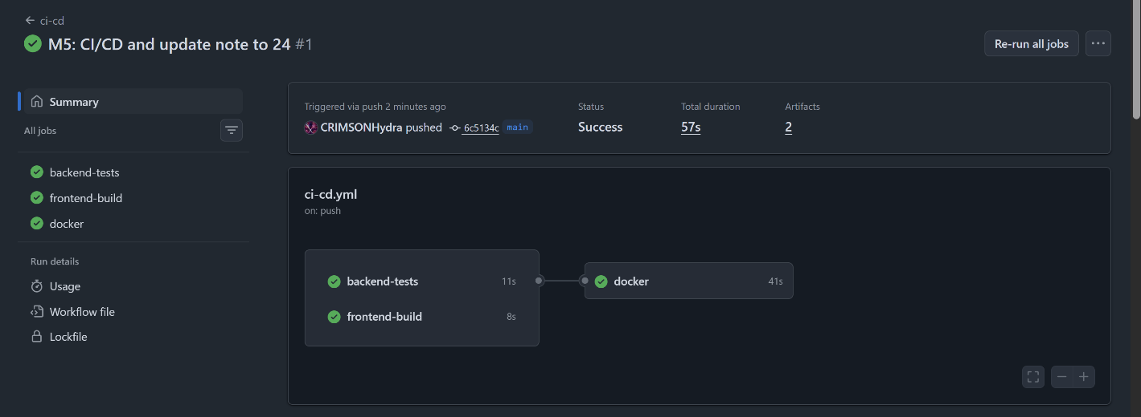
Proof 1: the automatic pipeline
All green: tests and build first, then the images are published.
Notes:
This is GitHub Actions after a push to main. Tests and the frontend build run first. Only if they pass do the Docker images get built and published, each tagged with the commit it came from.

Slide 8
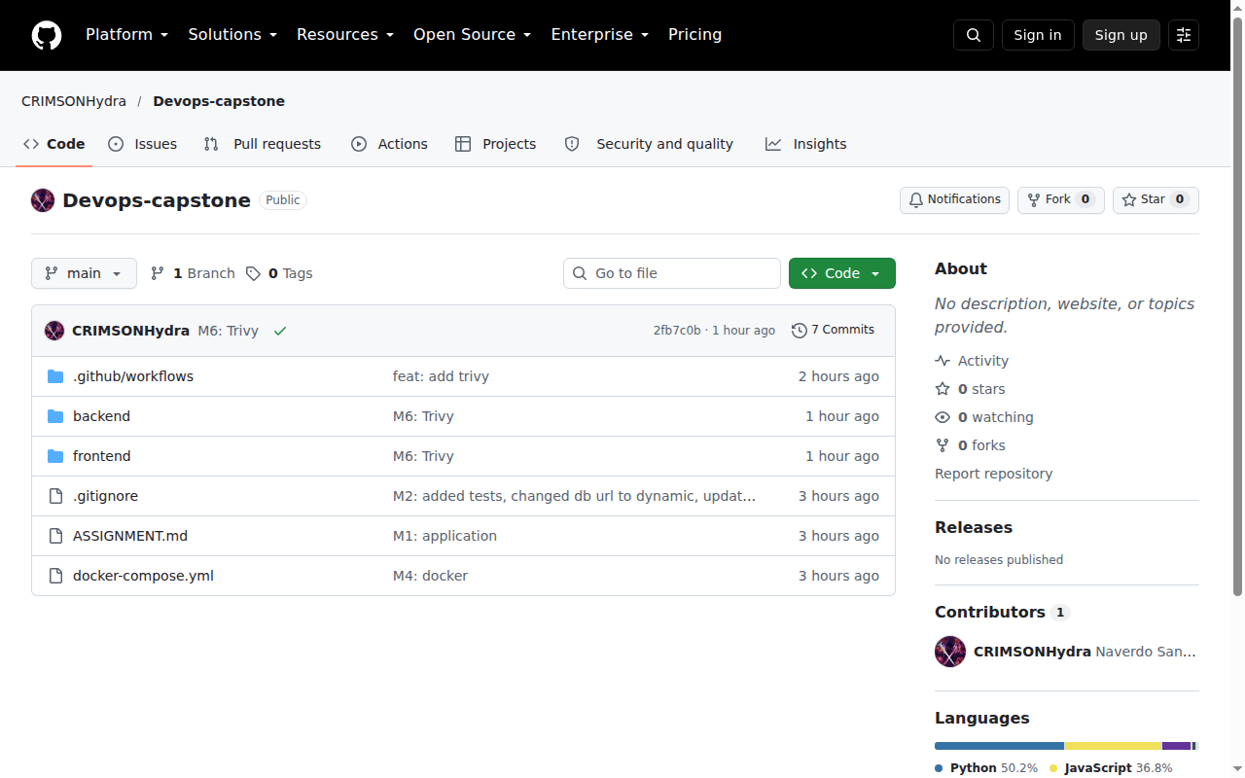
Proof 2: the code on GitHub
One public repo
Frontend, backend and deploy files
Every change is a commit
Notes:
Everything is in one public GitHub repository: the frontend, the backend, the pipeline and the deployment files. Each milestone is its own commit, so the history shows how the project grew.

Slide 9
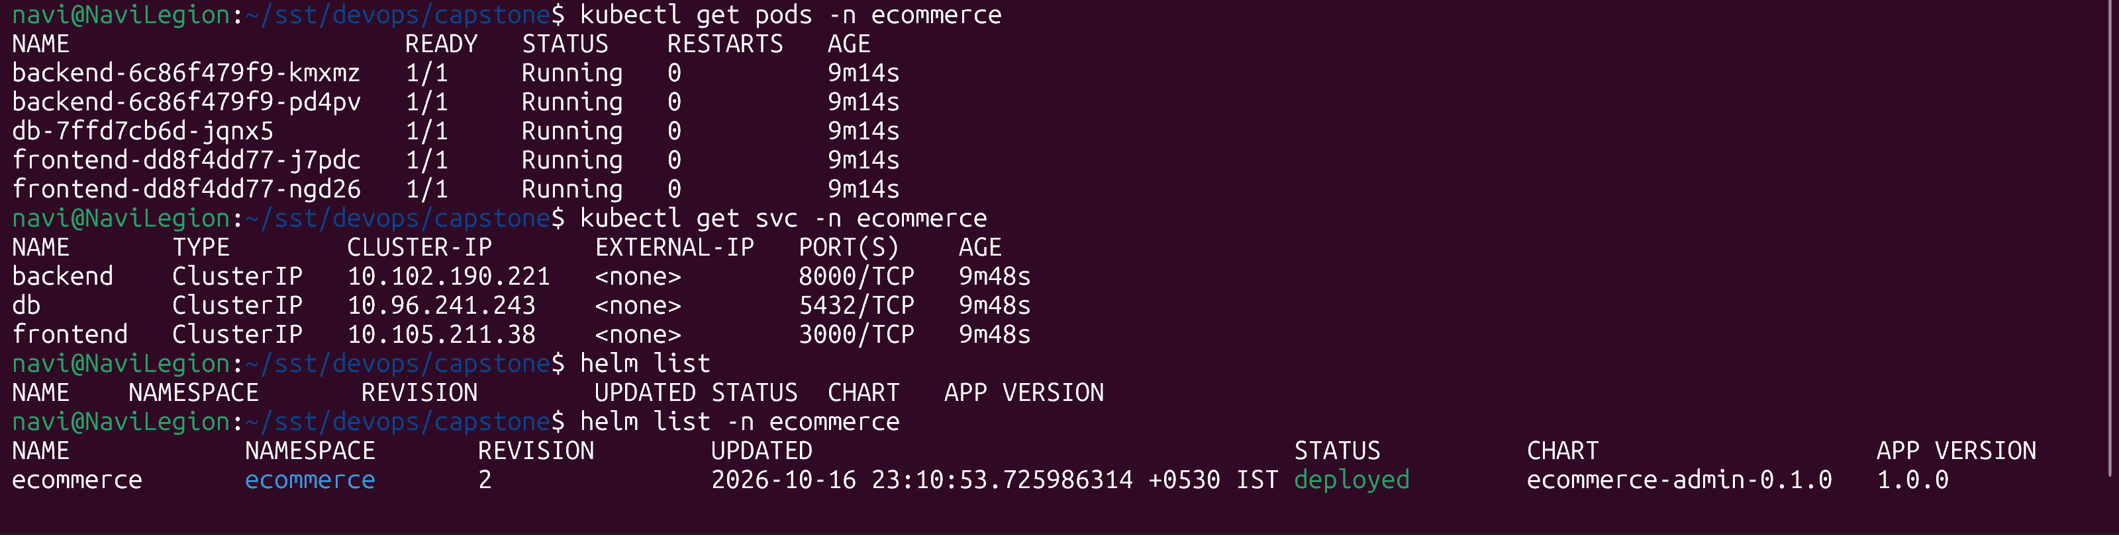
Proof 3: running on Kubernetes
5
pods Running
2
copies each of frontend and backend
0
restarts
Notes:
Here the app runs on a local Kubernetes cluster, installed with one Helm command. Five pods, all Running. The frontend and backend each have two copies, so if one fails the other keeps serving.

Slide 10
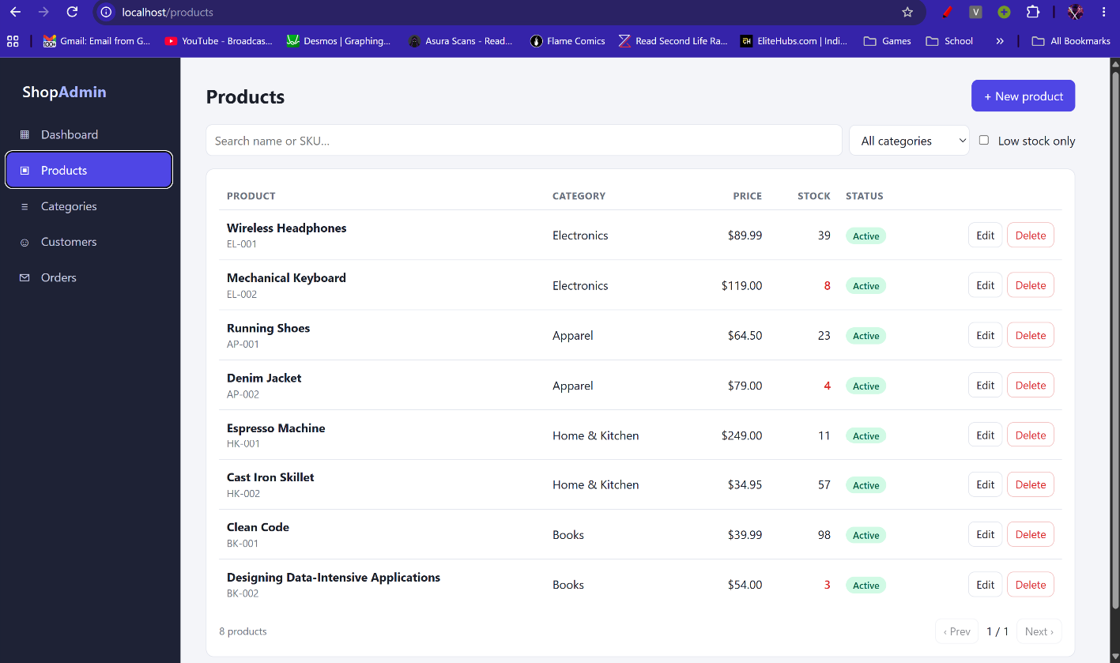

The app, served by Kubernetes
The front door
Opened through the cluster's Ingress
Same app, now run by Kubernetes
Notes:
The same app, opened through the cluster's front door, called an Ingress. Requests for the page go to the frontend, and requests starting with slash api go to the backend.

Slide 11
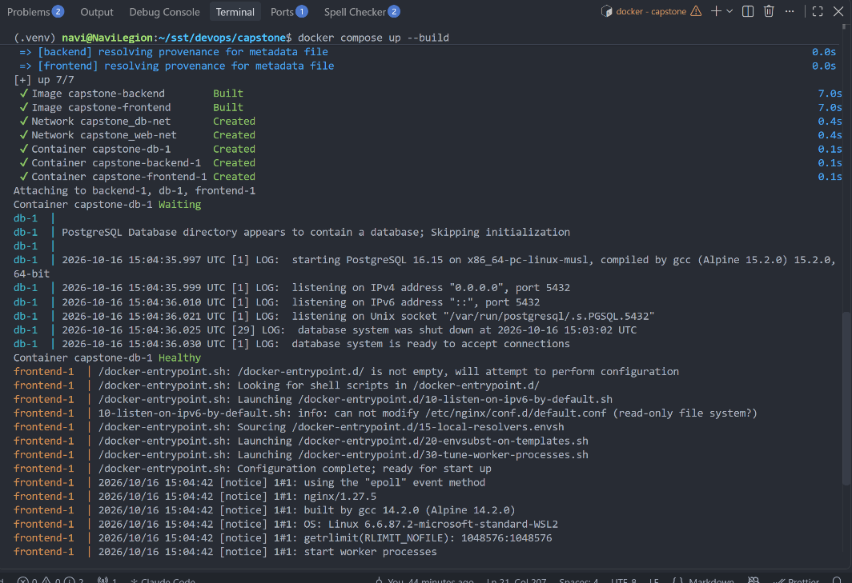
Proof 4: Docker Compose
docker compose ps
backend Up port 8000
db Up (healthy) private
frontend Up port 3000
One command starts all three
The database stays private
Notes:
On one machine, a single command, docker compose up, starts the database, backend and frontend. The database sits on a private network that the frontend cannot reach.

Slide 12
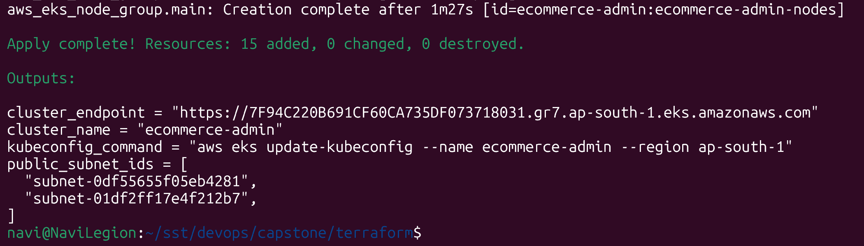
The cloud, described as code
15
cloud resources created
2
public subnets in the network
1
Kubernetes cluster on AWS
Notes:
Terraform describes the AWS setup as code: a private network with two public subnets and a Kubernetes cluster called EKS. One command created all fifteen resources, and the same code can remove them again, so nothing is left running up a bill.

Slide 13
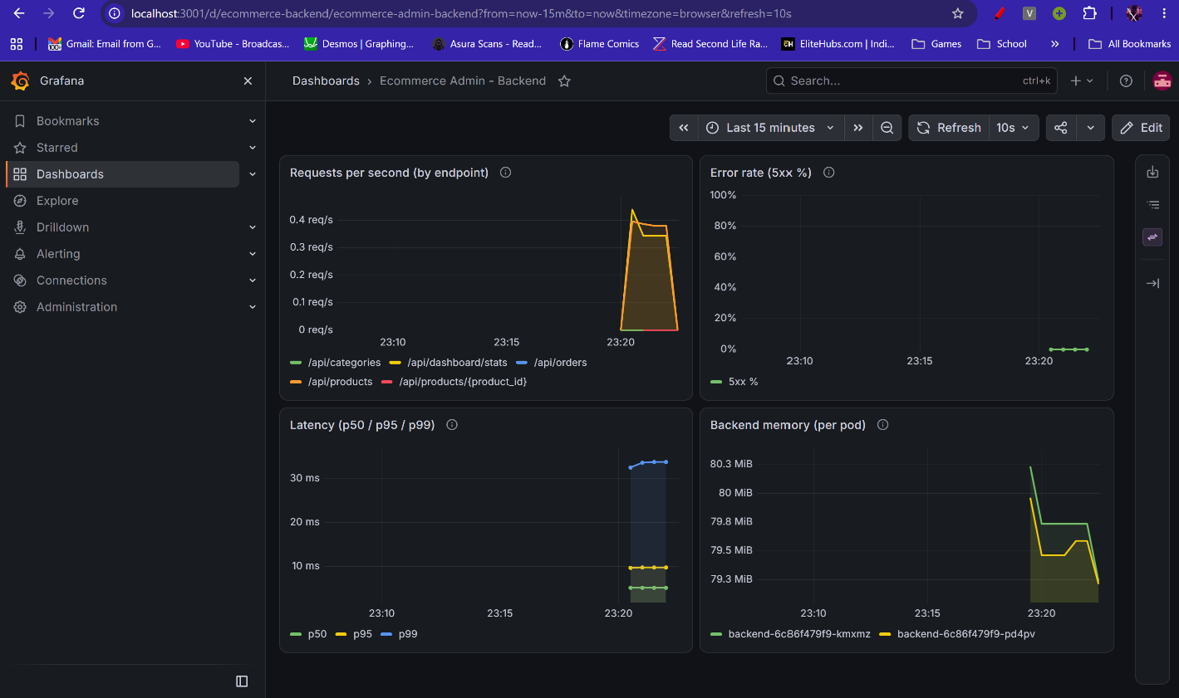
Watching it live
Live graphs
Requests, errors, speed, memory
Refreshes every 10 seconds
Notes:
Prometheus collects numbers from the backend every few seconds and Grafana draws them. This dashboard shows traffic, errors, speed and memory, so we can spot problems as they start.

Slide 14
Safety nets built in
31
88 to 0
2
automatic tests
serious security findings
copies of the app
Must pass before anything is built
Found by Trivy, then fixed
If one crashes, the other serves
Notes:
Three safety nets. Thirty-one automatic tests gate every change. The security scanner found 88 serious issues across the two images, and we fixed them all. And Kubernetes keeps two copies of the frontend and backend, so one crash does not take the app down.

Slide 15
From laptop to the cloud
Push code: it is tested, scanned and published. Then it is deployed and watched.
Next: automatic deploys and a staging environment.
Thank you
Notes:
To recap: a developer pushes code, the pipeline tests and scans it and publishes images, we deploy them to Kubernetes, and Grafana shows how it is doing. Next steps would be automatic deploys and a staging environment. Thank you.

