Slide 1
Distributed Learning Through Unity ML-Agents
By Christian Johnston
Distributed Computing CPSC 4387
Fall 2024

Slide 2
TABLE OF CONTENTS
01
02
ML-Agents Overview
Distributed Learning
03
04
Project Development
Presentation
What is ML-Agents?
What is Reinforcement Learning?
Algorithms in ML-Agents
Sentis
Distributed Learning Environments
Project Choice
Early Troubleshooting
Shader Issues with URP
Coding and Adjustments
Training
Tensorflow Results

Slide 3
01 ML-Agents Overview
What is ML-Agents?
What is Reinforcement Learning?
Algorithms used in ML-Agents

Slide 4

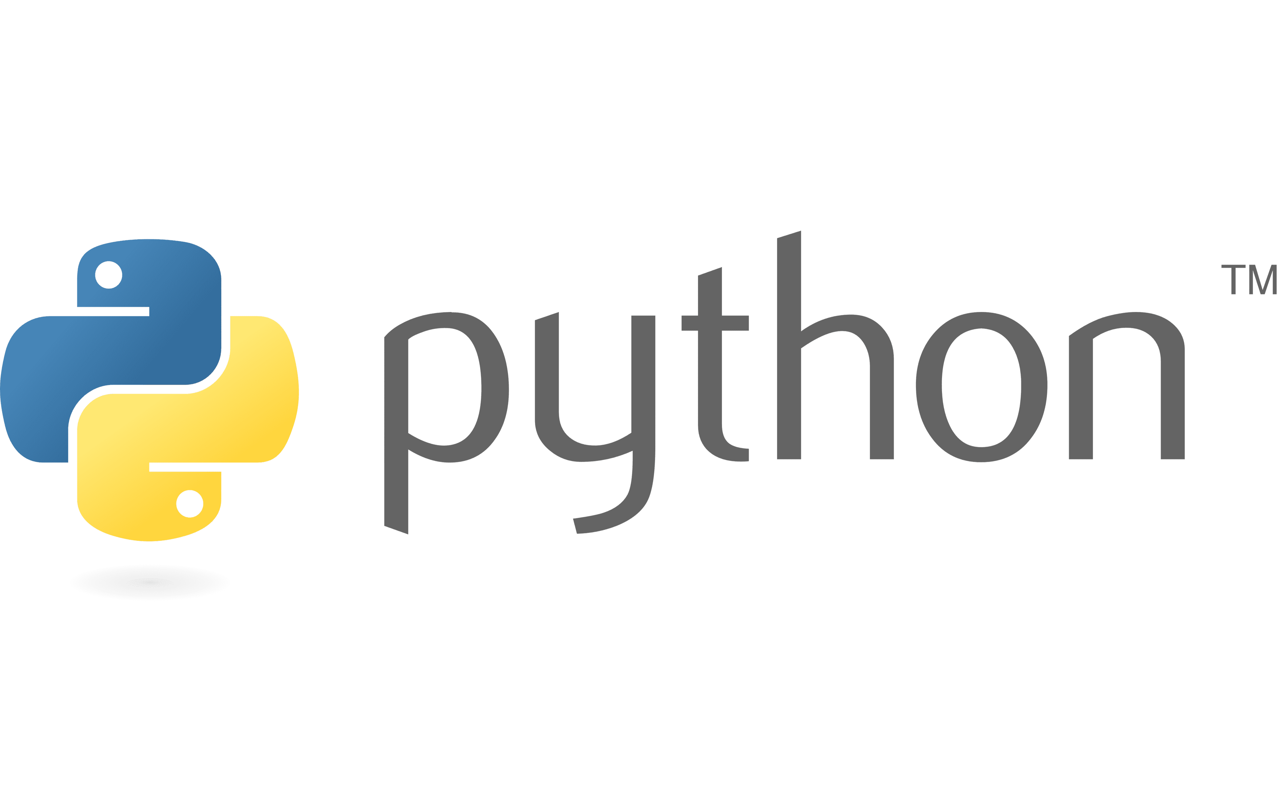
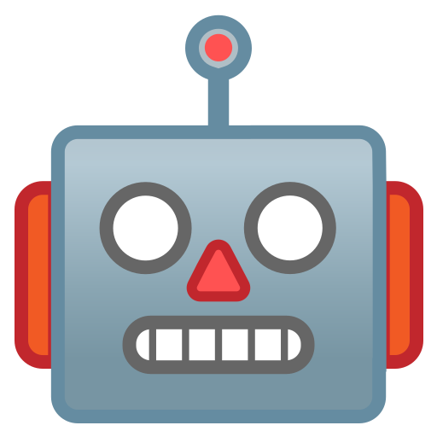
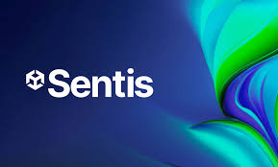
What is Unity ML-Agents?
Unity ML-Agents is a toolkit for training and deploying intelligent agents in a simulated environment.
These agents can be utilized to perform actions within their environment. In unity and game design,
these actions can represent the decisions made by an NPC (Non-Player Character).
Another use for ML-Agents could be automated testing of environmental features (jumping, interaction, etc.)
Key Components: Learning Environment, Python Low-Level API, External Communicator, Python Trainer, Gym Wrapper, PettingZoo Wrapper.

Slide 5
What is Reinforcement Learning?
In Reinforcement Learning, an “agent” makes decisions based on cumulative rewards assigned throughout
the training simulation.
Based on Trial and Error, the agent takes actions within the environment, receives a reward or penalty,
and adjusts its behavior based on which action was taken in that “state”.
There are several elements to an RL Process: Policy, Reward Function, Value Function,
and an Environment Model.
Using a greedy strategy, the agent starts with an input or initial state, chooses an output or new state, and
submits the output for analysis. The user or trainer will then reward or punish the model based on the output.
Then, the model logs that information and compares it with other outputs it has attempted. The agent then
will make future decisions based on maximizing the reward values.

Slide 6
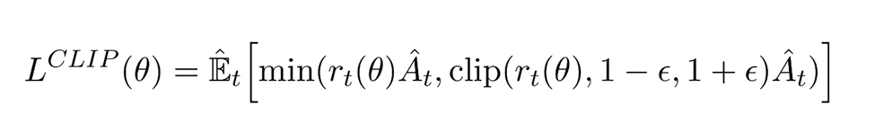
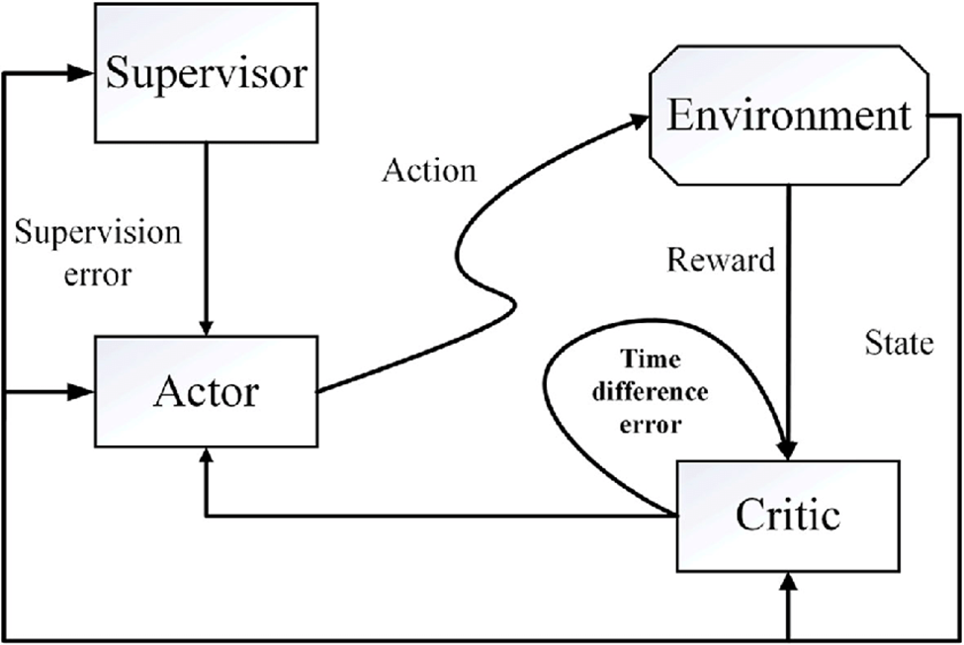
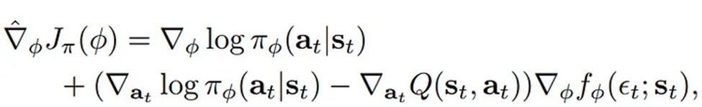
Algorithms used in ML-Agents
PPO: Proximal Policy Optimization. A policy is a set of rules an agent follows.
PPO is a policy gradient in that it takes small steps to gradually reach an optimum.
Algorithm is then clipped to prevent too much wander between iterations (proximal).
SAC: Soft Actor-Critic. In SAC, the algorithm utilizes entropy and a temporal difference policy gradient
to make decisions after consulting a “critic”. Think of it as an actor making a decision, and the critic informs
the actor how good the action was and how it should adjust its decisions.

Slide 7
02 Distributed Learning
Sentis
Distributed Learning Environments

Slide 8
What is Sentis?
Sentis is a neural network library framework in Unity that allows pre-trained models to utilize a neural
network designed to run off of either CPU or GPU threads to enhance inference in machine learning
operations.
Sentis uses Open Neural Network Exchange (ONNX) file formats to maximize efficiency through thread
optimization. This enables the unity environment to utilize graphical shaders to run the policy algorithms
within the training environment.
For the purposes of ML-Agents and the python environments, Sentis acts as a controller for the neural
interface and regulates receiving training data from python, applying it to the neural net of the actor in the
scene, and after training sends the information back to the python environment using a network component.

Slide 9
Distributed Learning in ML-Agents
In machine learning, there are two ways we can utilize distributed systems to improve efficiency: Data
Parallelism and Model Parallelism.
In data parallelism, data is divided based on the number of worker nodes. Think of it asassigning the same
task to many different individual agents or workers and accumulating their learning in one environment.
In model parallelism, the model is distributed to different systems, where they learn individually in their own
environments, and then accumulate their results together after training.
Data Parallelism: One environment, many actors.
Model Parallelism: One actor, many environments.

Slide 10
03 Project Development
Project Choice
Early Troubleshooting
Shader Issues with URP
Coding and Adjustments

Slide 11
Choosing The Project
To demonstrate different methods of distributed computing, I chose to show how by utilizing distributed
systems, a machine learning agent can improve its learning accuracy and performance over time.
I chose to use the ml-agents package because of its ease of access and available resources. Unity has
many resources through ml-agents including Sentis to handle policies of machine learning agents in a Unity
environment.
While there are several sample environments deployed with the ml-agents package, I utilized the simplest
option to ensure proper operation. I will be using the 3DBall balancing environment to demonstrate concepts.
The ML-Agents unity package is open source and is run through repositories on Github, so there may be
additional concerns regarding compatibility and version control.

Slide 12
Early Troubleshooting
Installation: Python package compatibility, Unity compatibility, ML-Agents test environments missing code
Python compatibility: Because the ml-agents python package utilizes many individual resources in its
operation there were compatibility issues between numpy and tensorflow. Solution: Through trial and error,
it was determined that a private python environment utilizing custom versions of each package was the best
option. A package environment ensured all packages used in this environment were compatible.
Unity version compatibility: I was using an older version of unity that may not have had the proper
implementations and installations. Solution: I upgraded unity to unity 6, and I was able to get the packages to
properly implement within the unity environment.
Because open source projects are constantly under production, there may be bugs that will arise when new
commits are pushed to the repository and I encountered many files with missing code or scripts.
Solution: I made sure that when downloading the project I used the latest stable version instead of bleeding
edge. This solved issues with missing files although some of the other environments were still missing code.

Slide 13
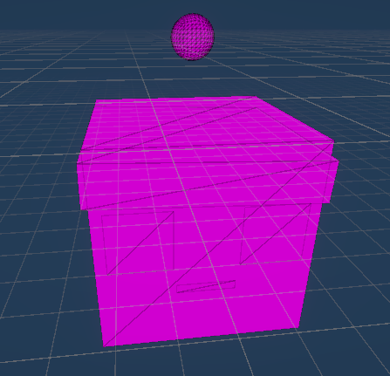
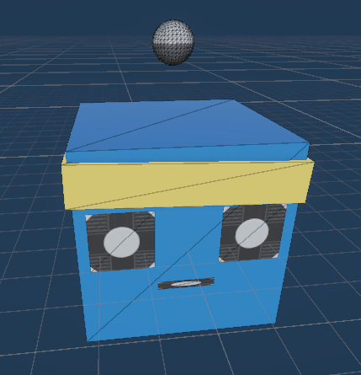
Shader Issues with URP
The URP is the Universal Render Pipeline, which is a scripting resource built
upon Unity’s Scriptable Render Pipeline (SRP) framework.
While impressive and containing many resources for rendering and shaders,
I found it to change how my unity environments rendered textures and I was unable
to utilize the resources in their default state.
The solution was to check all of the shader options until I found that Autodesk Interactive shaders were
compatible with the environment and textures but had to be utilized through the URP.

Slide 14
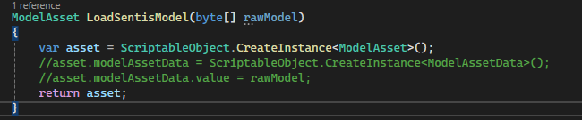
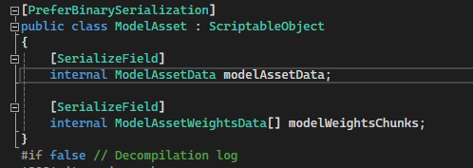
Coding Adjustments
Because of the issues inherent in the open source repository, there were several issues that had to be
addressed.
In the ModelOverrider script there was an error with loading the model asset data through Sentis, and
because Sentis is not open source, I was unable to edit and fix where the error was. The issue arose from
one of the class definitions being an internal class rather than a public class, and therefore was unaccessible.
The solution seemed to be to remove the access to the Sentis model data through that particular function and
operation resumed.

Slide 15
04 Project Presentation
Training
Tensorflow Report

Slide 16
Training The Model
For the purposes of this demonstration we will specify the training parameters as the default parameters:
(these are the ones we should be concerned with)
learning rate: 0.0003
Epochs: 3
Max Steps: 500000
Reward value: 1.0

Slide 17
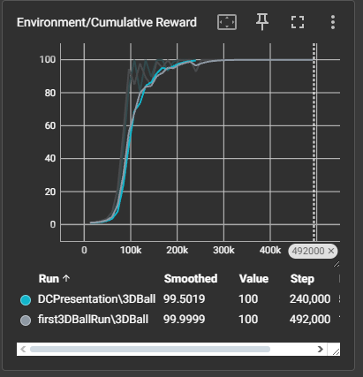
Tensorflow Report

Slide 18
THANKS!

Slide 19
Fonts & colors used
This presentation has been made using the following fonts:
Roboto Squada One
(https://fonts.google.com/specimen/Squada+One?selection.family=Squada+One)
Roboto Condensed
(https://fonts.google.com/specimen/Roboto+Condensed)
#e5b2ca
#073763
#613fb8
#0b5394
#ffffff
#3d85c6
#efefef
#9ba2ff
#d9d9d9
#00d6c0
#cccccc

Slide 20


