Slide 1
Decision Trees
By: Christian Johnston
Artificial Intelligence, CPSC 4383, Fall 2023

Slide 2
Table of contents
Introduction and Terminology
Greedy Algorithm
Entropy
Information Gain
Construction
Pruning
Conclusion

Slide 3
Introduction

Slide 4
What is Decision Tree Learning?
A supervised learning approach that uses entropy to make decisions on features of
a binary tree constructed so that the internal nodes are labeled with input features, the
arcs of the nodes labeled with an input feature have each of the possible values of the
target feature or the arc leads to a subordinate decision node on a different input feature.
For discrete domains, there is a single target feature called the “Classification”.
Built by splitting the source set (the root node) into subsets based on rules determined
by classification features. This is repeated on each subset through a process called
Recursive Partitioning. The process is complete when the subset at a node has all the
same values as the target variable or when splitting no longer adds value to predictions.

Slide 5
Common Terms
Supervised vs Unsupervised Learning
Classification vs Regression and CART
Features
Entropy
Information Gain
Purity

Slide 6
Supervised vs Unsupervised
Supervised Learning - Defined by the use of labeled datasets to train algorithms to classify data or predict outcomes accurately.
Unsupervised learning - Uses machine learning to analyze and cluster unlabeled datasets by discovering patterns or data groupings without the need for human intervention.
Decision Trees are a type of Supervised Learning.

Slide 7
Classification vs Regression
Classification Trees: Analyzes when the predicted outcome is the class to which
the data belongs. Deals with discrete data.
Regression Trees: Analyzes when the predicted outcome is generally a real target.
Example: Pricing indexes, growth, length of visits, etc. Deals with continuous data.
CART: An anagram for Classification And Regression Trees used as a blanket term
to describe both types of trees. It is important to note that while construction is similar,
there are also differences between the two to account for such as where to split.

Slide 8
Common Terms Continued
Features – An individual measurable property or characteristic of a phenomenon.
Entropy – A measure of disorder or impurity in a given dataset. In decision trees, messy data is split based on values of the feature vector associated with each data point.
Information Gain – Measures expected reduction of entropy in decisions. Entropy measures impurity, Information Gain measures reduction of impurity.

Slide 9
Common Terms Continued
Purity – The class homogeneity of a node in the decision tree. If a node has an even split in classifications of data, the node is 100% impure. If a node has 100% of a classes features, then that node is 100% pure.
Example:
Say we have 6 features in a node. 2 features belong to class A, 1 feature belongs to class B, and 3 features belong to class C.
Class A’s purity in this node is 2/6 or ~33%. Class B’s purity is 1/6 or ~17%. Class C’s purity is 3/6 or 50%.

Slide 10
Greedy Algorithm

Slide 11
What is a Greedy Algorithm?
A Greedy algorithm is an approach for solving a problem by selecting the best option
available in the moment regardless of overall results. Working in a top down approach it
selects nodes quickly without much computation making it a good choice for performance.
A greedy algorithm does not backtrack after moving to a new node, it is always seeking
the best option until an end condition is reached.
While computationally cheap and easy to follow, a greedy algorithm doesn’t always
choose the most optimal approach.
Optimal substructure occurs when the optimal overall solution to the problem
Corresponds to the optimal solution for each of its sub-problems.

Slide 12
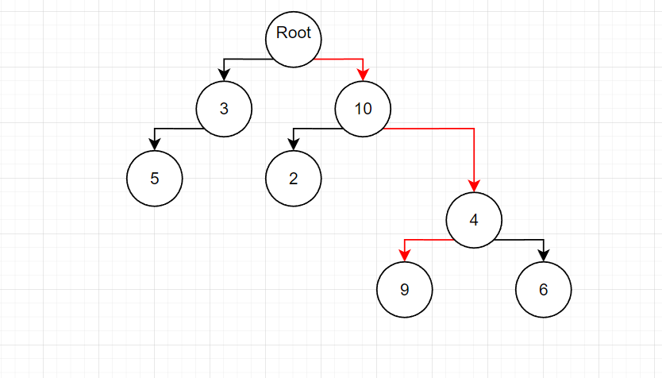
Greedy Algorithm Example:
This example shows a path followed by a greedy algorithm. It will always pick
the greatest number between the options given.

Slide 13
Entropy

Slide 14
What is Entropy?
Entropy is basically the amount of impurity in a set of features.
Say we have a set of examples of some feature that are either
positive or negative. If all the examples are positive, then for each
example, we gain 0 new information about the feature because
every value will be positive for every example.
What if, though, the feature separates the examples into 50%
positive, and 50% negative? In this case, the amount of entropy
is at a maximum and that feature is very useful to examine because
we gain the most information from the value of that feature.

Slide 15
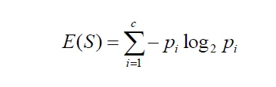
Calculating Entropy
Entropy has a pretty simple calculation to determine the amount in a feature:
This basically states that entropy is the sum of each of the negatives of the
frequentist probabilities of class i times the log base 2 of that probability.

Slide 16

Calculating Entropy Continued
Lets calculate our example from the purity definition.
Remember, for this feature class A had a probability of 2/6, class B had a probability of 1/6,
and class C had a probability of 3/6.
Our equation looks like this:
And the answer is: ~
This is a pretty high amount of entropy but this makes sense from the information of our data.

Slide 17
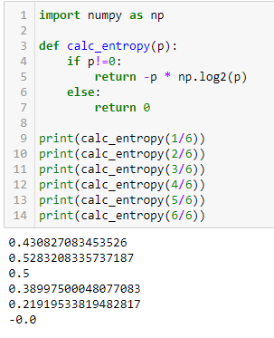
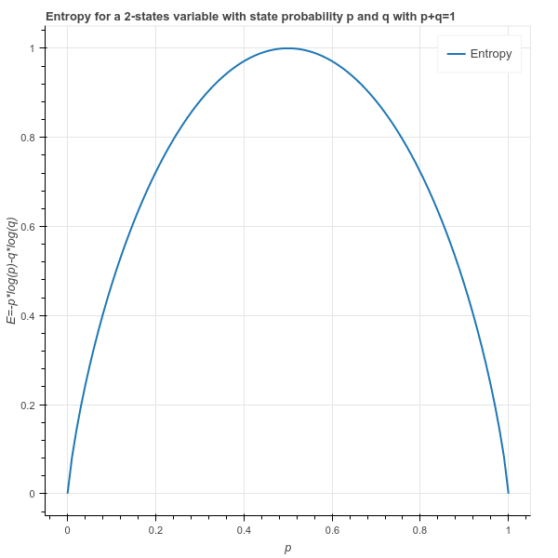
Implementation:
Entropy is fairly easy to implement in python, here is a short example of an entropy
calculation from Marsland’s Machine Learning book:
As can be seen by the example reference values, the entropy increases as we near 50% and decreases as it gets further away.
Here we can see a graph of the entropy of
a 2 state system that shows the curve of the
function.

Slide 18
Information Gain

Slide 19
What is Information Gain?
Information Gain is defined as the entropy of the whole set minus the entropy of
when a particular feature is chosen.
It will help the algorithm calculate how much entropy the system loses after
each feature selection.

Slide 20

Calculating Information Gain
Like entropy, Information Gain is relatively easy to calculate, it just needs
a bit more data and the calculations from entropy to be applied.
T: measure of the target population prior to the split T=∑ {all splits},
the total number of observation before splitting.
Entropy(T): measure of disorder before the split. Level of uncertainty.
s{i}: The number of observations on the ith split.
Entropy(s{i}): measures the disorder for the target variable on split s{i}.

Slide 21
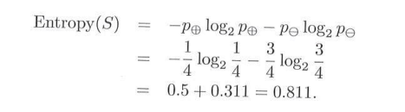
Calculating Information Gain Ctd.
Marsland’s book gives a good example we can use to help us visualize information gain:
(in the previous example of the algorithm, T was used instead of S, and X instead of F)
“Suppose that we have data (with outcomes) S = {s1 = true, s2 = false, s3 = false,
s4 = false} and one feature F that can have values {f1, f2, and f3}. In the example, the
feature value for s1 could be f2, for s2 it could be f2, for s3, f3 and for s4, f1 then we can
calculate the entropy of S as (where ⊕ means true, of which we have one example, and ⊖
means false, of which we have three examples):”

Slide 22
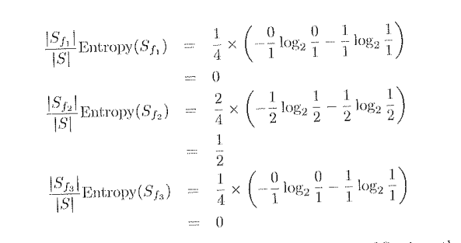
Calculating Information Gain Ctd.
From that, we can get:
The information gain is the entropy of S minus the sum of the information gain values.
So the final calculation is: Gain(S, F) = 0.811 – (0 + 0.5 + 0) = 0.311

Slide 23
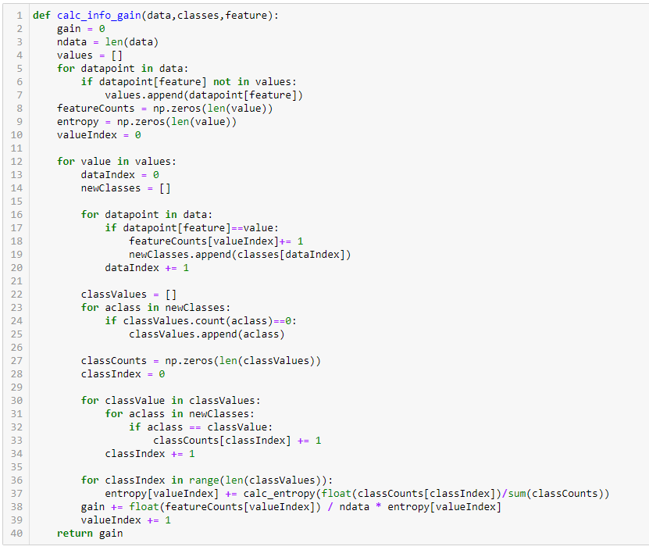
Implementation
Here is an example of python code from Marsland’s book that calculates information gain:
This gain value is calculated
by the ID3 algorithm and
used to determine which
feature has the highest
value.

Slide 24
Construction

Slide 25
ID3 Algorithm
The ID3 (Iterative Dichotomiser 3) is a popular algorithm for using information gain to
iterate through a dataset and generate a decision tree.
There are a few steps to go through for the ID3:
If all examples have the same label:
-return a leaf with that label.
Else if there are no features left to test:
-return a leaf with the most common label.
Else:
-choose the feature F’ that maximizes the information gain of S to be the next
node using the information gain equation.
-add a branch from the node for each possible value f in F’
-for each branch:
-calculate S{f} by removing F’ from the set of features
-recursively call the algorithm with S{f}, to compute the gain
relative to the current set of values.

Slide 26
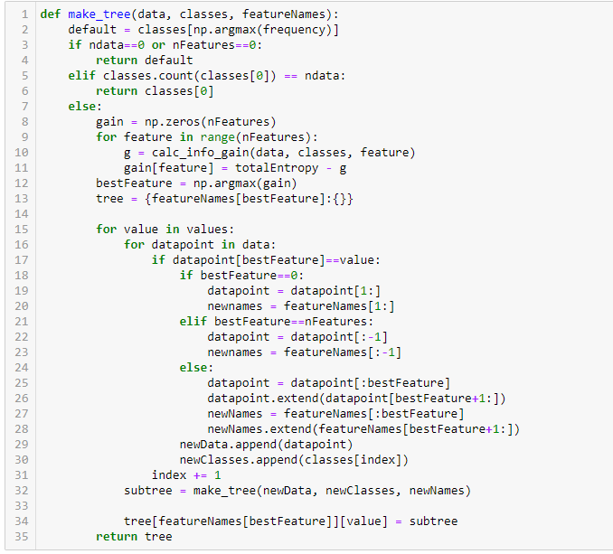
ID3 Implementation
Now that we have the outline lets implement it using python:
Something to note is that
this algorithm also uses the
previous algorithms of
calc_info_gain and
calc_entropy.

Slide 27
Pruning

Slide 28
What is Pruning?
Sometimes a dataset can have more information than is necessary to make a decision.
This extra data can be prone to overfitting so some branches of the tree must be trimmed.
This is done through “pruning”.
There are 2 kinds of pruning:
Pre-Pruning: Tunes the hyperparameters of the data prior to training.
This stops the building process to avoid producing leaves with
small samples. We need to calculate the cross-validation error
and monitor it during each stage of the splitting. If the value of
the error does not decrease anymore the growth of the tree is
stopped. This is a heuristic known as Early Stopping.
The Hyperparameters that can be tuned for early stopping are:
max_depth, min_samples_leaf, and min_samples_split.
Be warned that early stopping can lead to underfitting.

Slide 29
What is Pruning? Continued
The Second kind of pruning is known as post-pruning.
This does the opposite of pre-pruning and allows the tree to grow to its full depth.
Once the model is at full depth, branches are trimmed to prevent overfitting.
An algorithm that implements post-pruning is Cost Complexity Pruning, or CCP.
This uses a hyperparameter called ccp_alpha. a higher value of ccp_alpha will
lead to an increase in the number of nodes pruned.
There are a few steps involved with cost complexity pruning:
1. Train the decision tree to its full depth.
2. Compute the ccp_alphas value using cost_complexity_pruning_path()
3. Train your decision tree model with different ccp_alphas values and
compute train and test performance scores.
4. Plot the train and test scores for each value of ccp_alphas values.

Slide 30
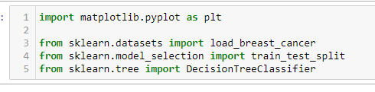
CCP Implementation
The Following is an implementation of cost complexity pruning using
an example dataset contained in sklearn and example code from:
https://scikit-learn.org/stable/auto_examples/tree/plot_cost_complexity_pruning.html
For the example, we first need our tools:

Slide 31
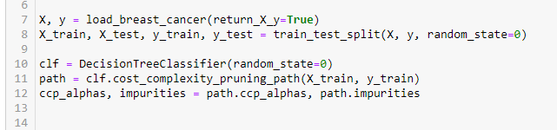
CCP Implementation Ctd.
Minimal Cost Complexity Pruning recursively find the nodes with the weakest link. This is characterized
by an effective alpha, where the smallest effective alpha are pruned first.
By using the function DecisionTreeClassifier.cost_complexity_pruning_path we can get the effective
alphas and the corresponding total leaf impurities at each step of the process. As alpha increases,
more of the tree is pruned, which increases the total impurity of the leaves.

Slide 32
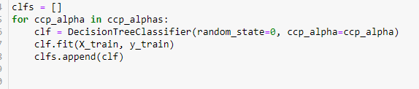
CCP Implementation Ctd.
Next, a decision tree is trained using the effective alphas. The last value in ccp_alphas is the
value that prunes the whole tree, leaving the tree clfs[-1] with one node.

Slide 33
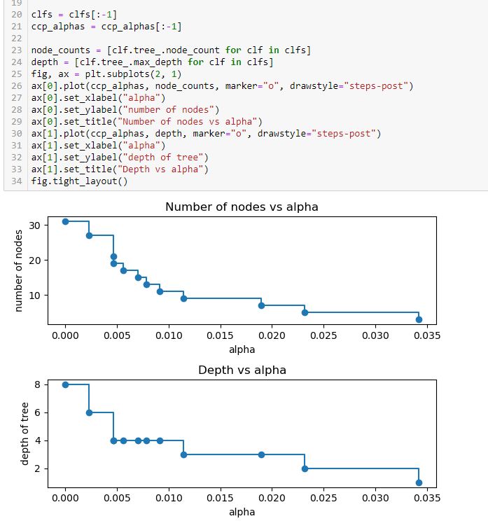
CCP Implementation Ctd.
Finally, we remove the last element in clfs and ccp_alphas, because it is the trivial solution containing only 1 node. Included are graphs indicating the number of nodes and how tree depth decreases as the alpha increases.

Slide 34
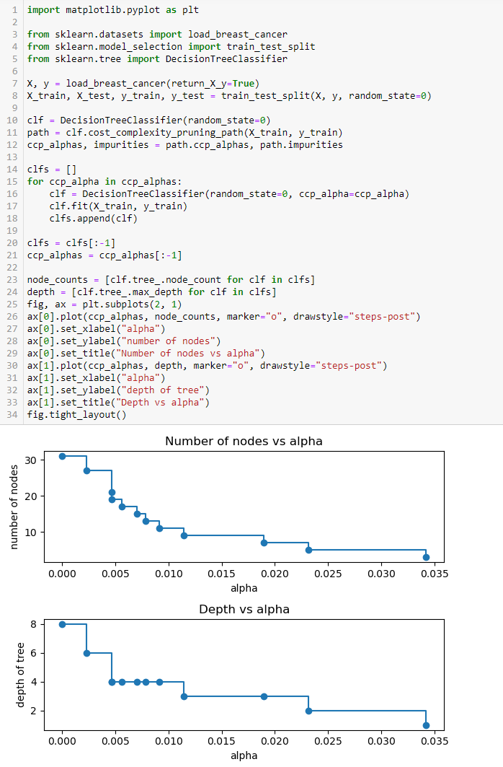
CCP Implementation Ctd.
Here is the full code of the CCP implementation on an example dataset:

Slide 35
Conclusion

Slide 36
Conclusion
Decision Trees are a quick and easy way to implement a machine learning algorithm for choices between features of nodes to classify datasets.
Some Pros for decision trees are:
Less Effort for data preparation in pre-processing.
Decision Trees do not require a normalization of the data.
Decision Trees do not require scaling of the data.
Missing values do not affect the process of building the tree to any considerable extent.
The model is very intuitive and easy to implement and explain.
Some Cons of decision trees are:
A small change in the data can cause a large change in the structure of the decision tree, causing instability.
For a decision tree sometimes calculation can be more complex compared to other algorithms.
Decision Trees usually require more time to train the model.
Decision Tree training is relatively expensive as time and complexity increase.
Some decision tree algorithms like ID3 do not perform regression and predict continuous values.

Slide 37
Questions?

Slide 38
References:
Marsland, S., 2014, Machine Learning: An Algorithmic Perspective, 2nd Edition, CRC Press, Chapman and Hall.
Shivani, May 14, 2023, The Role of Cost Functions in Machine Learning: Types, Significance, and Impact on Model Performance,
{ https://ai.plainenglish.io/the-role-of-cost-functions-in-machine-learning-types-significance-and-impact-on-model-db1ebb92557e }
Sharma, A., May 31, 2023, Decision Tree Introduction with Example,
{ https://www.geeksforgeeks.org/decision-tree-introduction-example/ }
4. Arya, N., September 2, 2022, Decision Tree Pruning: The Hows and Whys,
{ https://www.kdnuggets.com/2022/09/decision-tree-pruning-hows-whys.html }
Krishnan, S., August 26, 2021, Decision Tree for Classification, Entropy, and Information Gain,
{ https://medium.com/codex/decision-tree-for-classification-entropy-and-information-gain-cd9f99a26e0d }
Wikipedia, Decision Tree Learning, { https://en.wikipedia.org/wiki/Decision_tree_learning }
IBM, Decision Trees, {https://www.ibm.com/topics/decision-trees }
T., Sam, January 10, 2019, Entropy: How Decision Trees Make Decisions,
{ https://towardsdatascience.com/entropy-how-decision-trees-make-decisions-2946b9c18c8 }

Slide 39
References Continued:
9. Recaud, B., August 27, 2017, A Simple Explanation of Entropy in Decision Trees,
{ https://bricaud.github.io/personal-blog/entropy-in-decision-trees/ }
Loaiza, S., May 24, 2020, Entropy and Information Gain,
{ https://towardsdatascience.com/entropy-and-information-gain-b738ca8abd2a }
Wikipedia, ID3 Algorithm, { https://en.wikipedia.org/wiki/ID3_algorithm }
Scikit Learn, Post Pruning Decision Trees with Cost Complexity Pruning,
{ https://scikit-learn.org/stable/auto_examples/tree/plot_cost_complexity_pruning.html }
Dhiraj, K, May 26, 2019, Top 5 Advantages and Disadvantages of Decision Tree Algorithm,
{ https://dhirajkumarblog.medium.com/top-5-advantages-and-disadvantages-of-decision-tree-algorithm-428ebd199d9a }

Slide 40
Thanks!
Please keep this slide for attribution

Slide 41
Fonts & colors used
This presentation has been made using the following fonts:
Roboto Mono
(https://fonts.google.com/specimen/Roboto+Mono)
Lato
(https://fonts.google.com/specimen/Lato)
#ffffff
#cbe125
#110a52
#6ff0eb
#db25e1

Slide 42


