Slide 1

FYP 1682 Driver Drowsiness Detection
Joshuaa Chales Roy 1171100243
Supervised by: Dr. Linda Chua
Moderated By: Mr. Yoong Yih Jian

Slide 2
Abstract
Driver drowsiness is an issue faced by the average road user. Not only does it jeopardize the driver itself, but as well as other road users.
The creation of a detection system to detect drowsiness and to warn the users will be able to mitigate this problem. In this study, drowsiness detection will be looked at as a whole, and a prototype system will be proposed.
Experiments will also be carried out to test and analyze the components of this prototype in order to fully understand its functionality and to increase its performance.

Slide 3
Problem Statement
Driver sleepiness is a common cause for road accidents. Therefore, by developing a detector for drowsiness, it could be used as a potential security feature for many modern automobiles to reduce the rate of road accidents caused by driver drowsiness.

Slide 4
Objectives
To perform a background study on the current implementations of driver drowsiness detection.
To study and classify the facial features required to be learned by machine learning for driver drowsiness detection

Slide 5
Literature Review

Slide 6
Research Methodology

Slide 7
Implementation & Evaluation

Slide 8
Experiment 1
A CNN blink detector was compared to an EAR blink detector to observe their performances against each other
Blink detection is tested because in this implementation as it is the core function of a drowsiness detector.
A CNN blink detector is built based on a CNN eye state classifier
An EAR blink detector is built based on observing the current Eye-Aspect Ratio (EAR) from the video feed

Slide 9
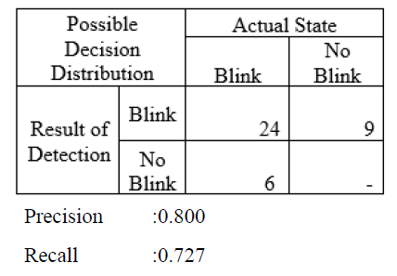
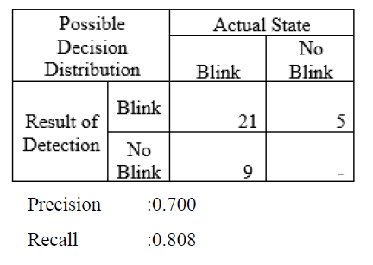
Results
CNN Blink Detection
EAR Blink Detection

Slide 10
Experiment 2
The blink detectors were tested using video feeds at different camera angles to observe any changes in performance.

Slide 11
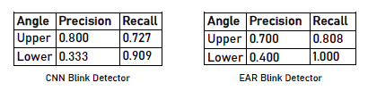
Results

Slide 12
Experiment 3
The model training was repeated with varying training set samples sizes to observe the changes in accuracy and loss.
This experiment was done to observe a point where the size of the training set does not seem to improve the performance by a large enough margin

Slide 13
Results

Slide 14
Conclusion
Limitations
The prototype is highly reliant on preset constants, making it static
Future Work
To replace the static elements of the current prototype with more complex operations, to allow the application to function more dynamically.

Slide 15
Thank You

