Slide 1
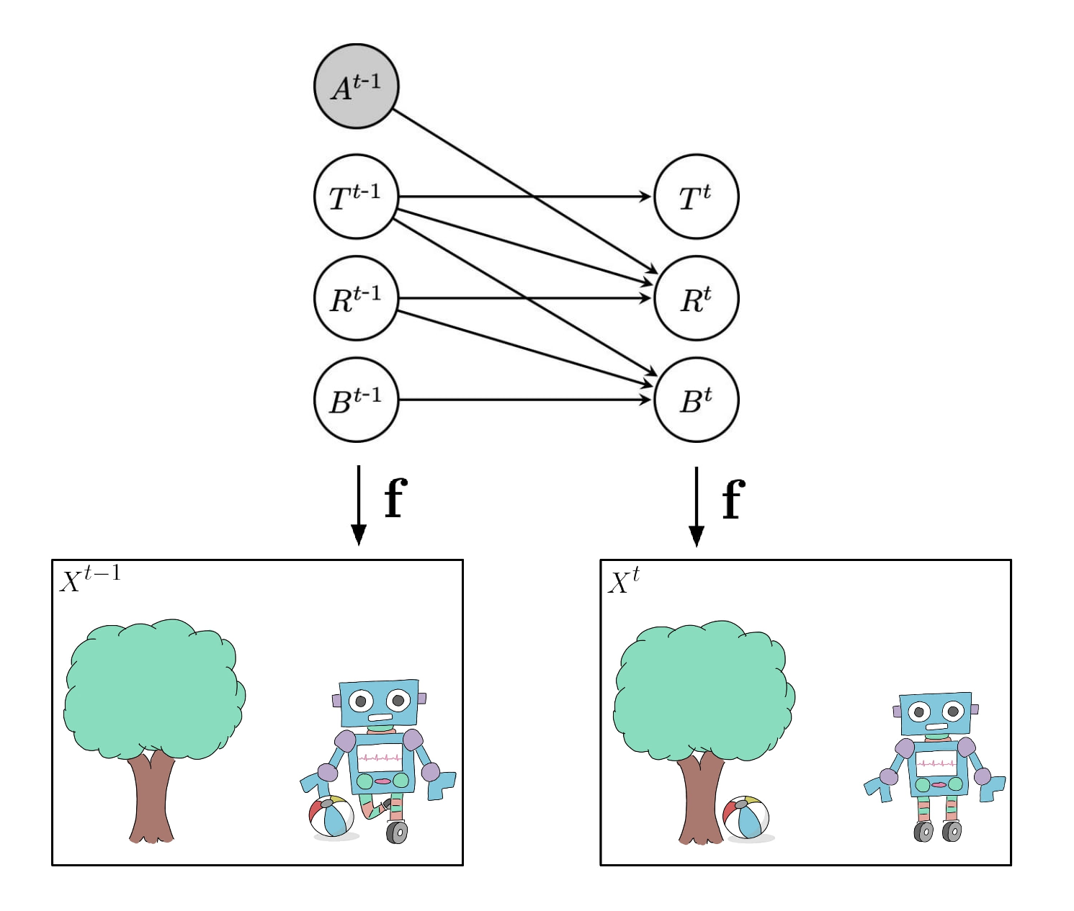

Partial Disentanglement via Mechanism Sparsity
Sébastien Lachapelle and Simon Lacoste-Julien

Slide 2
(Action)
We extend Lachapelle et al. (CLeaR 2022)
Sparse action
effect
(Latent factors)
(Past factors)
(Tree position)
Disentanglement is the problem of recovering the latent factors without supervision, i.e. from p(x)
(Robot position)
(Ball position)
Sparse
temporal
dependencies
(Nonlinear decoder)
Identifiable
from p(x)?
Their identifiability theory shows how to use this sparsity to disentangle the latent factors
via a sparsity regularization
(High-dim.observation)
S. Lachapelle, P. Rodríguez López, Y. Sharma, K. Everett, R. Le Priol, A. Lacoste, S. Lacoste-Julien. Disentanglement via Mechanism Sparsity Regularization: A New Principle for Nonlinear ICA. CLeaR 2022.
Mention multiple models can express the same distributions, but might have different representation!! Mention “causal representation learning”

Slide 3




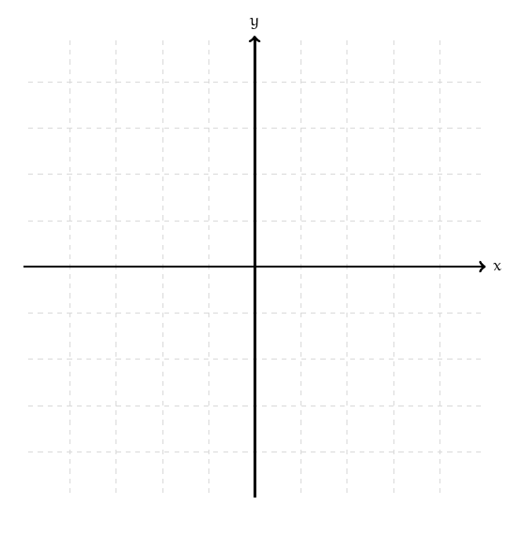




What is disentanglement?
(Ground-truth)
(Learned)
Model isn’t disentangled!
Model is disentangled!
(Ground-truth decoder)
(Learned decoder)
…
(Data manifold)
(Observation space)

Slide 4

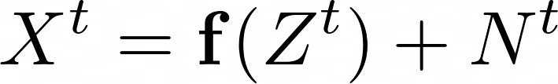
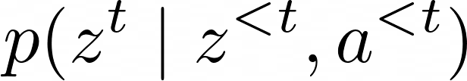

Bird’s-eye view of the approach
Given sequential data, must learn
a decoder (diffeomorphism) ( )
A latent transition model
Causal graph over the latents/actions
Learned using VAE framework
Lachapelle et al. (CLeaR 2022) showed how regularizing to be sparse leads to identifying the latent variables, given the ground-truth graph G satisfies some technical criterion.
This work generalizes Lachapelle et al. by removing the graphical criterion.
S. Lachapelle et al. Disentanglement via Mechanism Sparsity Regularization. CLeaR 2022.

Slide 5
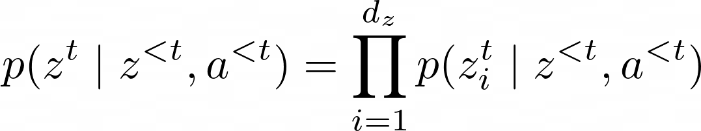
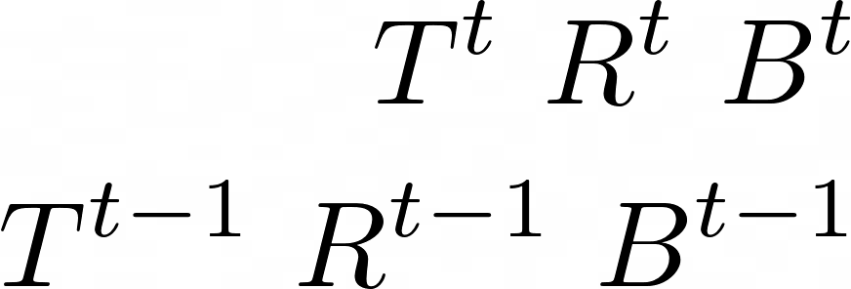

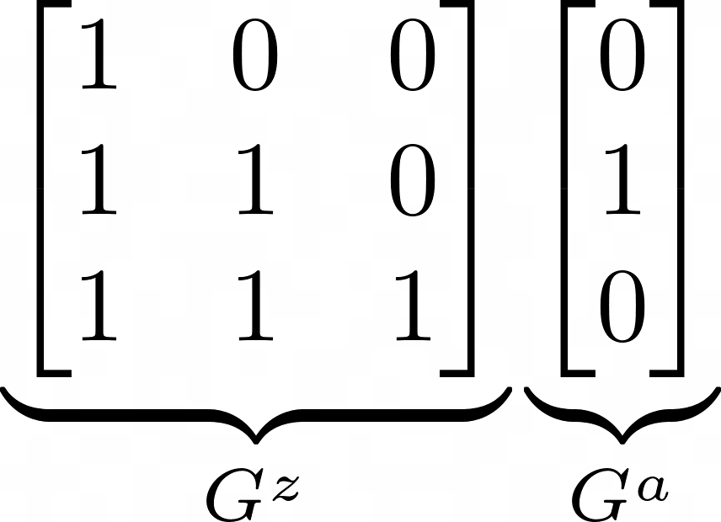
Latent transition model
Assume conditional independence of the latents given the past:
Assume each factor is Gaussian with variance = 1
Transition function/mechanism E.g. parameterized by NN
Binary adjacency matrices removing dependencies (causal graph)
Our theory is more general, it applies to exponential family distributions with a 1D monotonic sufficient statistic (not covered by Khemakhem et al. (2020)).
I. Khemakhem et al. Variational autoencoders and nonlinear ICA: A unifying framework. AISTATS 2020.

Slide 6
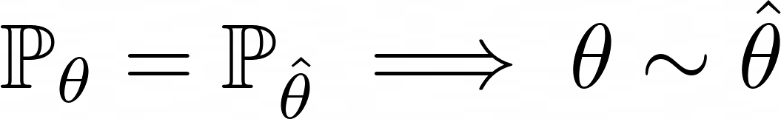

High-level anatomy of an identifiability result
Assumptions about the ground-truth model
Equivalence relation depends on how strong the assumptions are

Slide 7
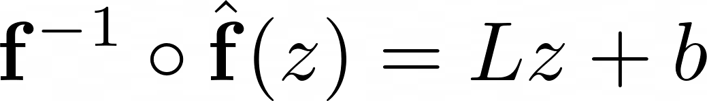
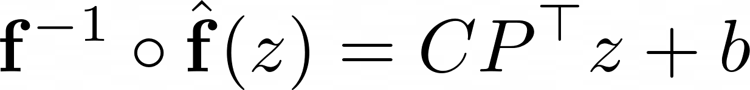
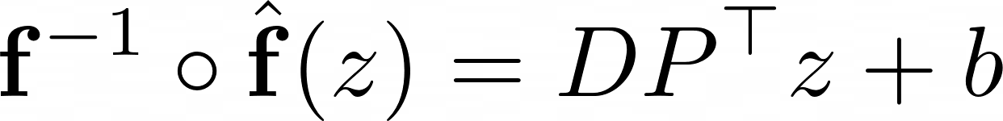
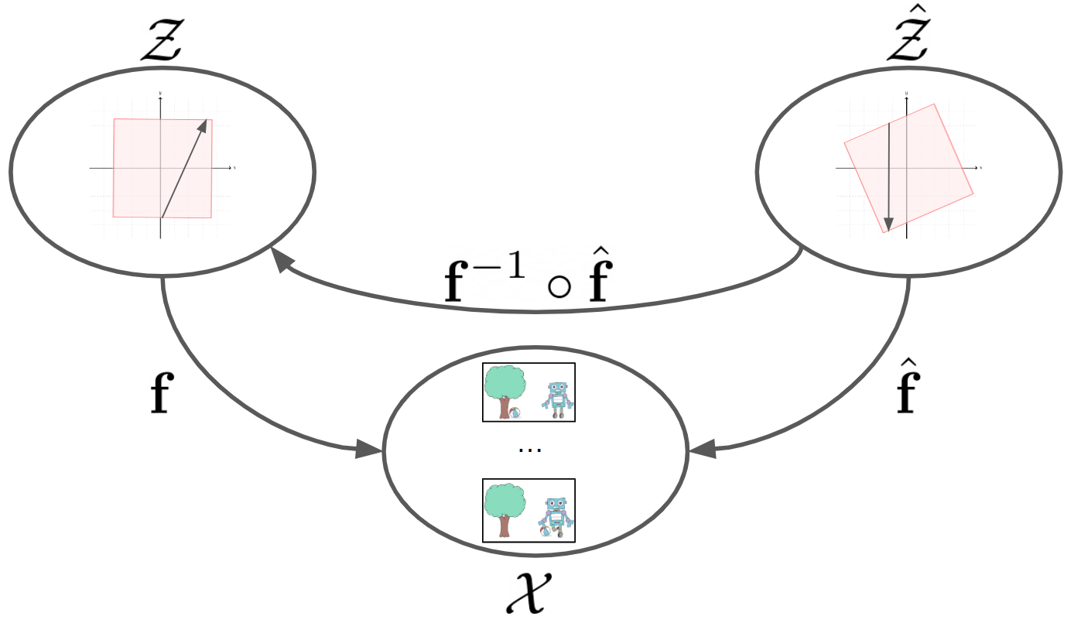
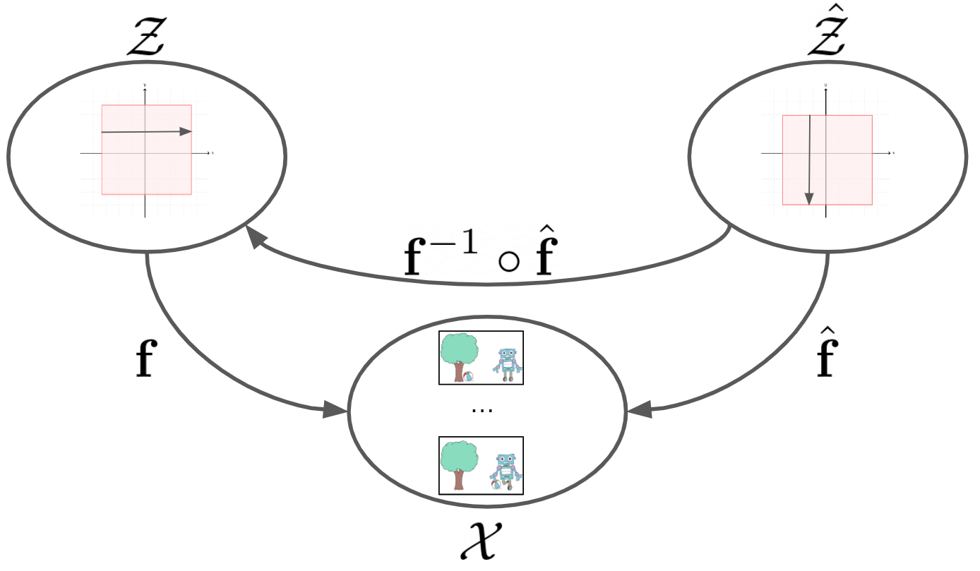



Continuum of equivalence relations
Our work!
Permutation equivalence/
Complete disentanglement
Khemakhem et al. (2020)
Lachapelle et al. (CLeaR 2022)
Linear equivalence
Khemakhem et al. (2020)
Consistency relation/
Partial disentanglement
Invertible matrix
Permutation matrix
Invertible diagonal matrix
Permutation matrix
How sparse C is depends on the ground-truth graph G (see next slide)
Denser (less disentangled)
Sparser (more disentangled)
I. Khemakhem et al. Variational autoencoders and nonlinear ICA: A unifying framework. AISTATS 2020. S. Lachapelle et al. Disentanglement via Mechanism Sparsity Regularization. CLeaR 2022.

Slide 8




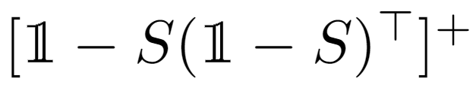
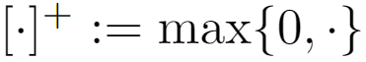
Partial disentanglement via mechanism sparsity
We showed that invertible S-consistent matrices form a group under matrix multiplication, allowing us to show that this is an equivalence relation
We give conditions such that
is a permutation of
Two models represent the same distribution over observations
The learned graph is as sparse as the ground-truth graph
C matrix contains “many” zeros, depending on the ground-truth graph G
Link between zeros of C and the ground-truth graph G is given by S-consistency
Permutation matrix
Definition: Given a binary matrix S, a matrix C is S-consistent when C has the same zeroes as , where .

Slide 9
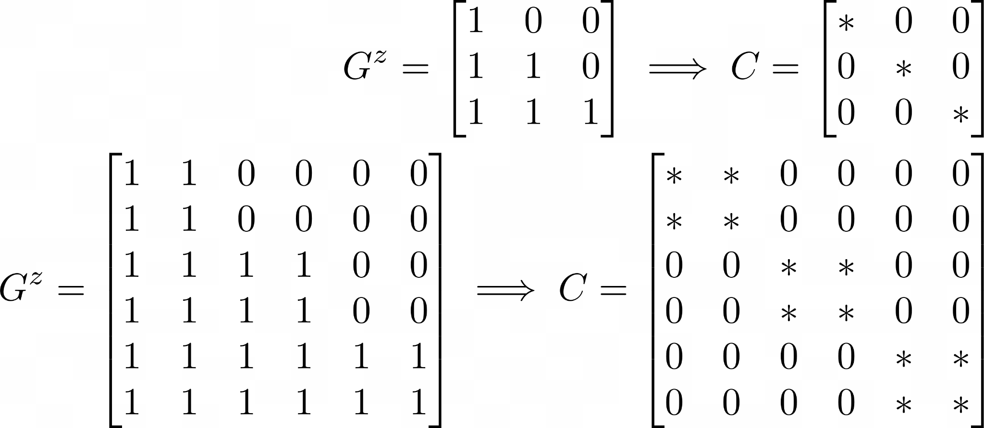
Examples
Some blocks of variables might remain entangled (Similar in spirit to
Lippe et al. [2022] and Von Kügelgen et al. [2021])
P. Lippe et al. CITRIS: Causal Identifiability from Temporal Intervened Sequences. ICML 2022 J. Von Kügelgen et al. Self-supervised learning with data augmentations provably isolates content from style. NeurIPS 2021.

Slide 10
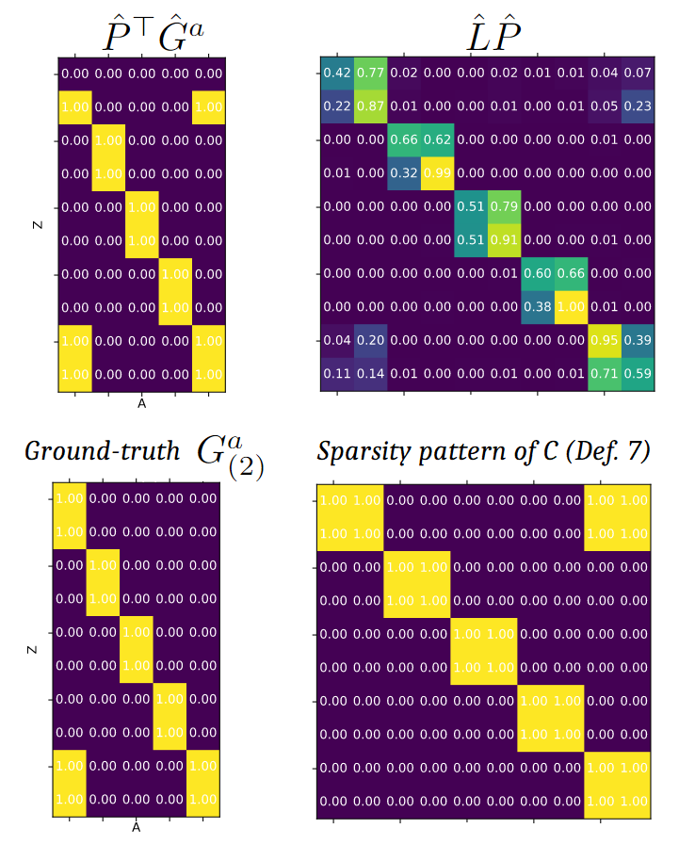
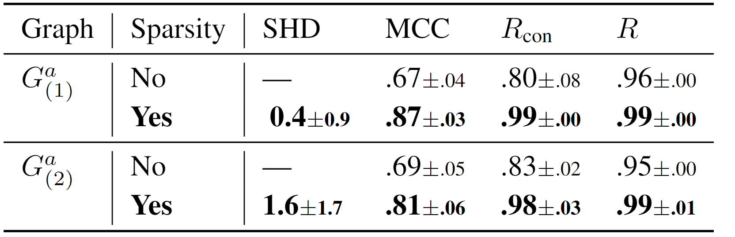


Experiments (more in the paper)
Partial disent. metric
Number of mistaken edges
Complete disent. metric
Linear equivalence metric
Come to our poster to learn more! :D

Slide 11


Transition function/mechanism
Decoder
Dependency/causal graph
Learnable parameters:
Useful to think of
= parameter of the ground-truth model
or = parameter of the learned model

Slide 12
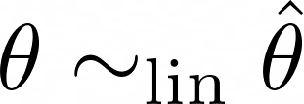
Identifiability “up to linear transformation”
Khemakhem et al. (2020) and Lachapelle et al. (2022) gave conditions s.t.
Two models represent the same distribution over observations
Models are “linearly equivalent”, denoted .
Remark: This form of identifiability does not correspond to our intuitive definition of disentanglement, since the matrix L can still “mix up” latent factors.
I. Khemakhem et al. Variational autoencoders and nonlinear ICA: A unifying framework. AISTATS 2020. S. Lachapelle et al. Disentanglement via Mechanism Sparsity Regularization. CLeaR 2022.

Slide 13

Complete disentanglement
We say a learned model is completely disentangled w.r.t. to a ground-truth model when
Permutation-scaling matrix
i.e.
Invertible diagonal matrix
Permutation matrix

Slide 14
How to go from “linear identifiability” to “disentanglement”?
Khemakhem et al. (2020) provided conditions to obtain complete disentanglement, but doesn’t hold for our Gaussian case with fixed variance.
Lachapelle et al. (2022) introduced mechanism sparsity regularization to obtain complete disentanglement, given some technical condition on the ground-truth graph is satisfied.
In this work, we generalize the latter by relaxing its assumptions about the ground-truth graph, and guarantee only partial disentanglement
I. Khemakhem et al. Variational autoencoders and nonlinear ICA: A unifying framework. AISTATS 2020. S. Lachapelle et al. Disentanglement via Mechanism Sparsity Regularization. CLeaR 2022.

Slide 15
Our identifiability theory shows:
Possible to learn the dependency graph G
Doing so can (partially) disentangle the latent factors
Intuition behind theory :
Sparse ground-truth graph
Entangled representations require a denser graph
Graph sparsity constraint pushes factors to be disentangled

Slide 16
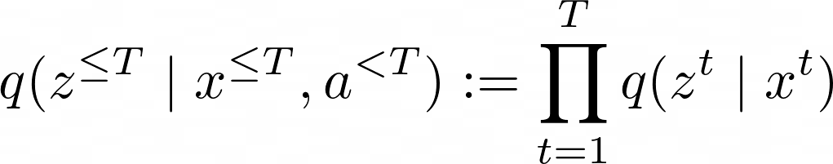
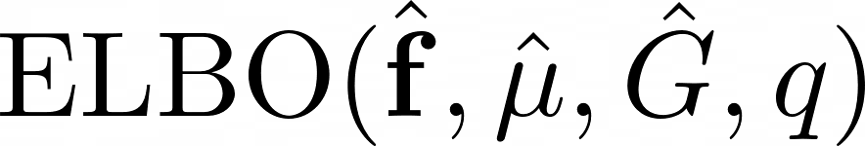
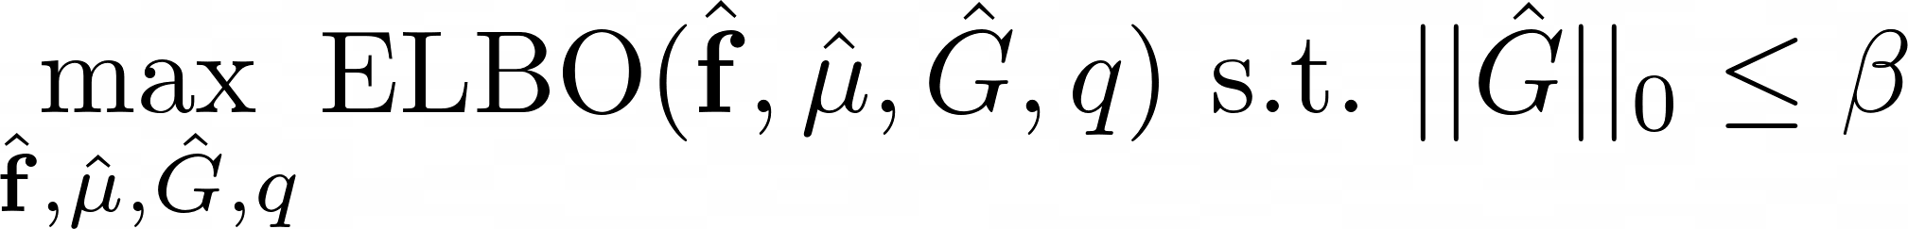
Constrained estimation
Based on VAEs.
Variational posterior:
Resulting ELBO:
Let be the above ELBO averaged over the whole dataset
Our objective is then
Using a constraint instead of regularization, following Gallego-Posada et al. (2021)
G is discrete, so use Gumbel-Softmax trick to allow gradient-based optimization
J. Gallego-Posada et al. Flexible Learning of Sparse Neural Networks via Constrained L0 Regularization. NeurIPS 2021 LatinX in AI Workshop, 2021.

