Slide 1
GRAPHULATOR: Between Dimensions

Slide 2

Little History
Graphing calculators first came on the market in the 1980s. They replaced basic calculators with more or less numerical function – early calculators and adding machines had a numeric keypad and buttons for operators for addition, subtraction, multiplication and division, and dealt exclusively with whole numbers and fractions.

Slide 3
Basic Overview
Graphulator is a graphing calculator.
”Plots 3D graphs".
It comes in handy when you have to visualize graphs of complex equations.
Graphulator will automate the graphs for you.
“Sophisticated than Basic Calculators”
Main Features:
-User can add custom graphs
-Differentiate negative region
-Scale/Rotate the graph
Thanks to Desmos for the inspiration,
https://www.desmos.com/calculator

Slide 4

Let’s see a demo now
To see how it works

Slide 5
The best way to have a good idea is to have lots of ideas.

Slide 6
The concept
First we had the idea of creating a calculator that solves equations and also shows 2D graphs. Later, we left the 2D part and scaled it to 3D only.

Slide 7

Library, Methods & IDEs:
Graphics Library used : OpenGL (GLUT)
Method used to parse equation : Reverse Polish Notation & Stack Method
IDE used: Clion(For Linux and Windows ) & Xcode (For macOS)

Slide 8

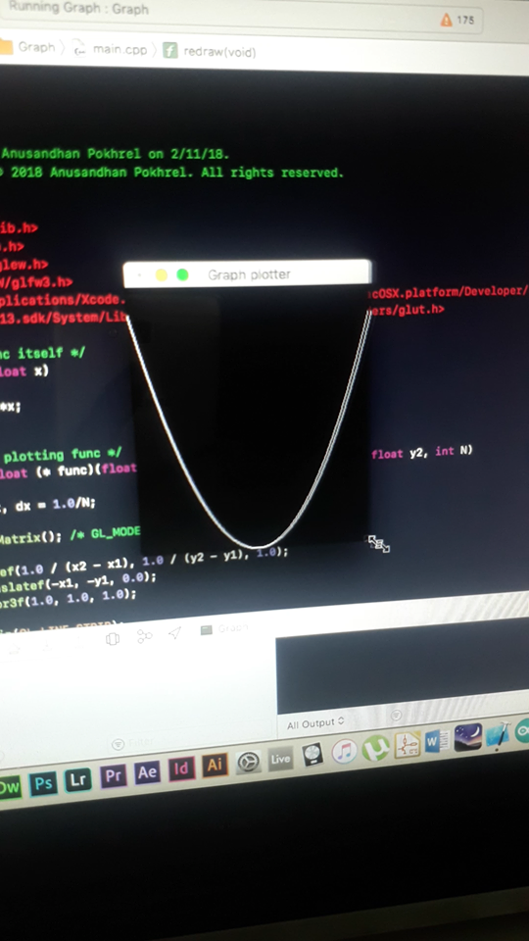
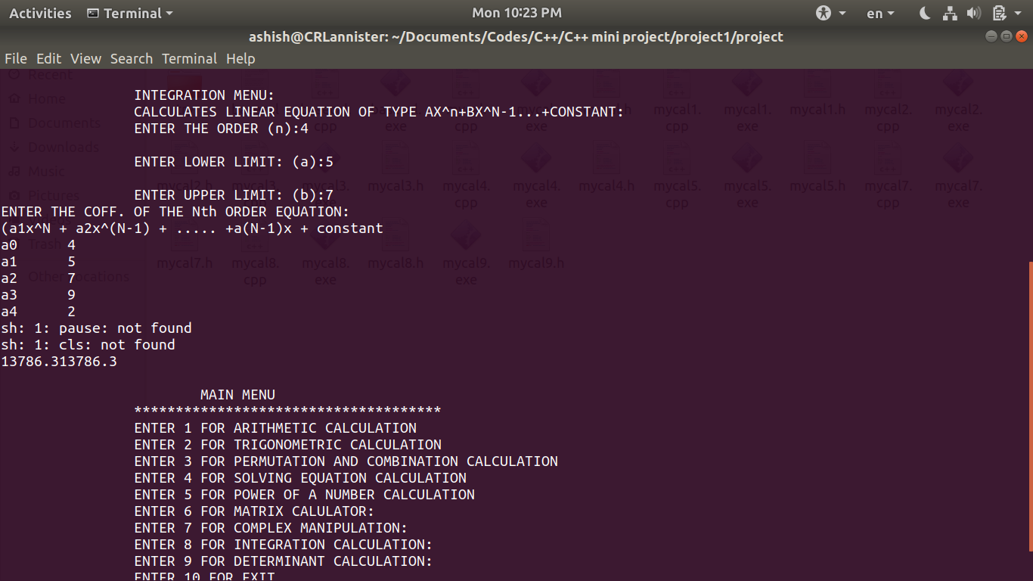
The development phases

Slide 9
How we used the graphics library?
The OpenGL Utility Toolkit (GLUT) is a library of utilities for OpenGL programs, which primarily perform system-level I/O with the host OS. We used it for functions like window definition, window control,(rendering characters) and monitoring of keyboard and mouse input, which includes almost everything for the project.

Slide 10
RPN & Stack Method (Shunting Yard Algorithm)
Reverse Polish notation (RPN), also known as Polish postfix notation or simply postfix notation, is a mathematical notation in which operators follow their operands.
E.g: a+b*c in RPN is a b c * +

Slide 11

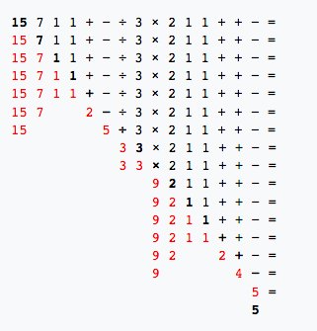
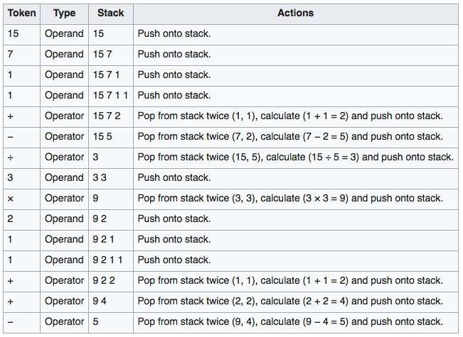
Algorithm

Slide 12
Work Flow
Read
Generate Points
Plot
Interact
Reads Equation
Pass x & y
Plot Points
Monitors User’s Input
Generate height(z) using Prefix Expression
Then converts into prefix (using rpnbuilder.h, token.h and headers from expressions folder)
Starts Plotting From Negative Region to Positive Region (The Curve is just a cloud of points)
Generates Output on Window according to the user;s choice
The no. of points it generates depends upon the res. of graph frame , if it is 400(for eg) the iteration will be done from -200 to 200

Slide 13
Features used to enhance program
Toggle Axis Frame & Invert Negatives
Move Camera & Zoom
Surf Between Different
Functions
Increase/Decrease Point Size

Slide 14
Limitations of the product
Should have used GLFW since it is advanced and with which a far better GUI could be developed.
Still buggy due to lack of proper memory management
Sometimes problem may arise while plotting some of the custom functions
Lack of 2D/3D switch mode
Cannot plot 2 different graphs in a single time (to find intersecting planes, etc)
Cannot take input function in polar form

Slide 15
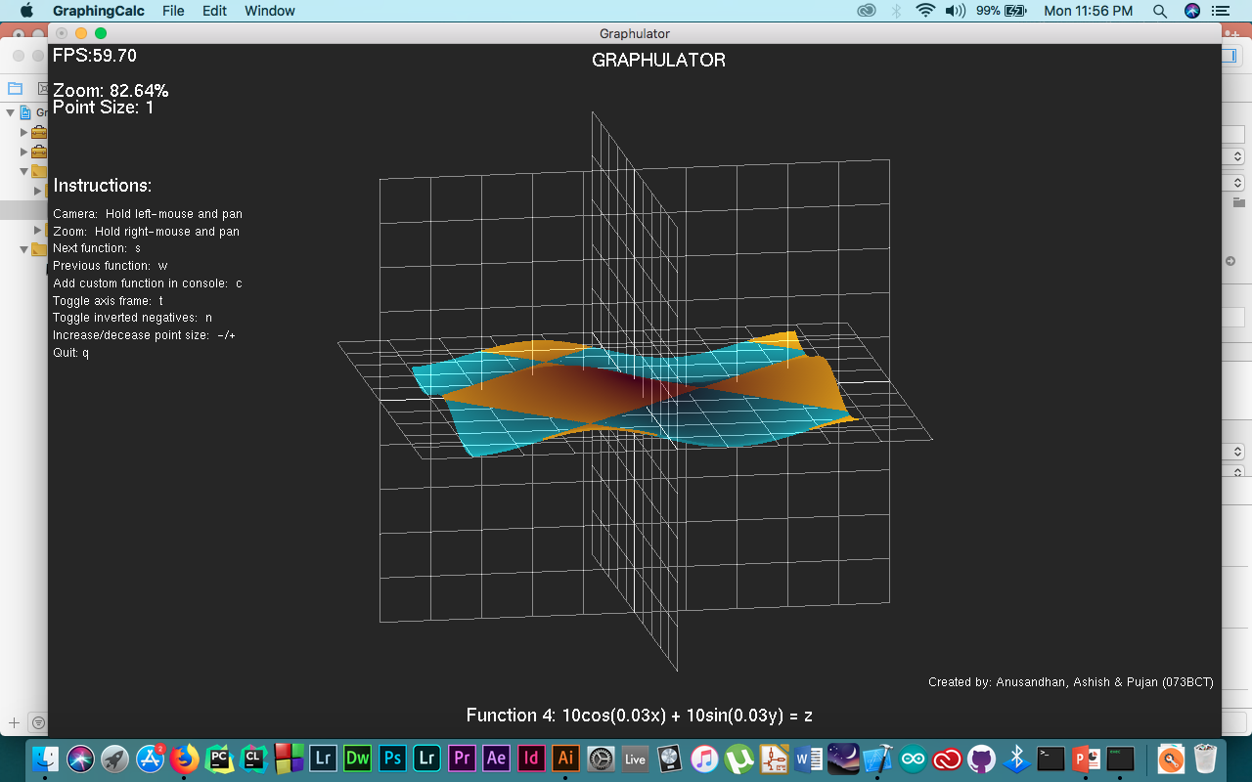
Final Product
Still a prototype.
We wish to develop it further in future..
Place your screenshot here

Slide 16
References
https://en.wikipedia.org/wiki/OpenGL_Utility_Toolkit
https://github.com/olegskl/rpn-calculator (for the RPN algorithm code)
https://en.wikipedia.org/wiki/Shunting-yard_algorithm
https://www.youtube.com/channel/UCiFAmp2Crv66cQA-9SPje1A
https://www.youtube.com/user/sonarsystemslimited
https://www.youtube.com/user/iamdavidwparker
And Google ☺

Slide 17



Thank you!
From the developers’ team.
Any questions?

