Slide 1



AINT512: Science and Technology of Human-Robot Interaction
14 February 2017
Bahar İrfan

Slide 2
Learning Outcomes
By the end of this session, you should be able to:
Create a program using Choregraphe software
Run the program in the virtual environment
Run the program on the Nao robot

Slide 3
Installing the Software
Create a free SoftBank Robotics account here:
https://store.aldebaran.com/default/customer/account/create/
Go to the Community -> Resources -> Software page or simply this link:
https://community.ald.softbankrobotics.com/en/resources/software/language/en-gb
Under Pepper Software Suite 2.4.3, click Choregraphe License Key to get your Choregraphe Key
Download Choregraphe 2.1.4 (NOT the other version), instructions: http://doc.aldebaran.com/2-4/software/choregraphe/installing.html#desktop-installation
Start Choregraphe and enter license key
Test the software at least once before coming to the class!
Any problems? Send a mail to: bahar.irfan@plymouth.ac.uk

Slide 4

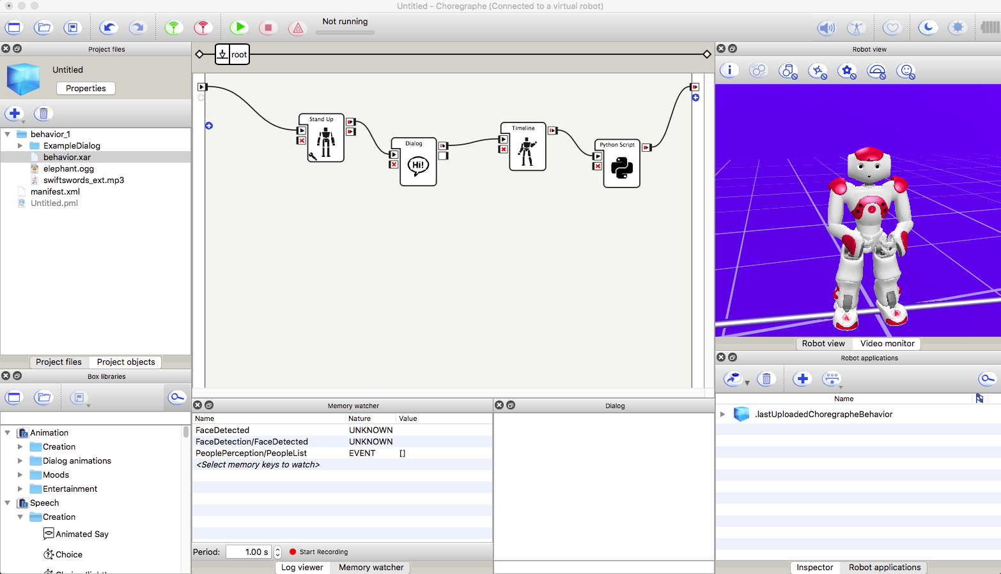
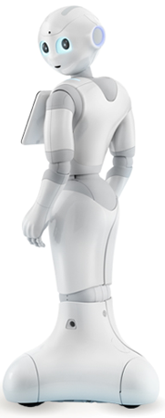
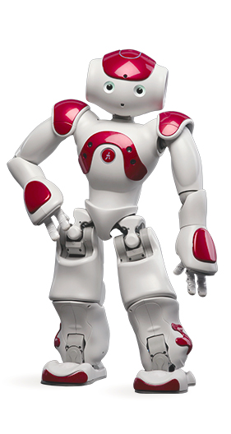
horegraphe
Nao
Pepper
Nao and Pepper pictures are from: SoftBank Robotics Europe (Aldebaran)

Slide 5
Customise Your View
Go to the toolbar -> View
Tick (choose):
Box libraries
Project files
Inspector
Project objects
Dialog
Memory watcher
Robot view
(Optional) For the actual robot: Robot applications and Video monitor

Slide 6
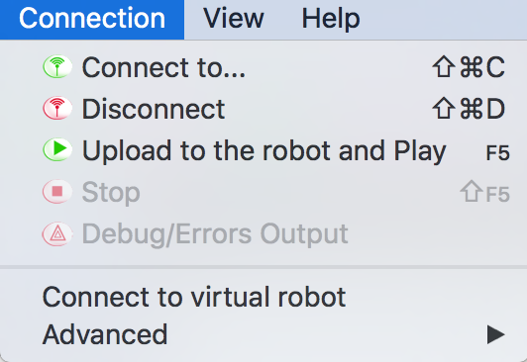
Connect to the Robot
Connect to a virtual robot:
Connect to the robot:

Slide 7
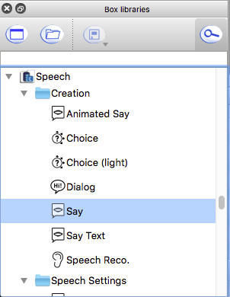
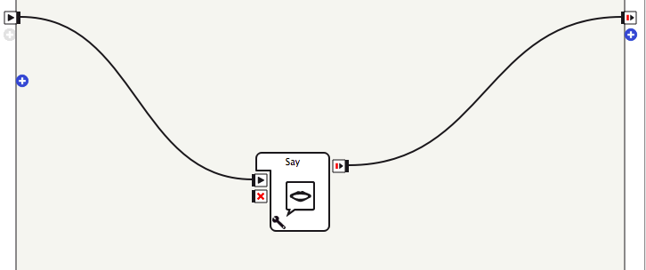
Task 1: Hello World!
onStart
Flow Diagram Panel
onStopped
Drag and drop
Double click “Say” to edit the text to be said
Upload to the robot and play

Slide 8
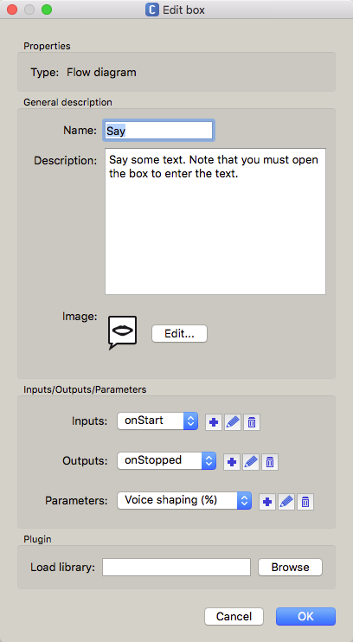
Boxes
Double click on the box:
If Python code: Script Editor will show the code
If Diagram or complex behaviour (e.g. “Say”): Flow diagram will show intern flow diagrams
If Timeline: Timeline panel will be visible
Right click on “Say” box -> Edit box
Edit the properties of the box (name, description, image)
Add/delete/edit inputs/outputs/parameters
Load a library

Slide 9
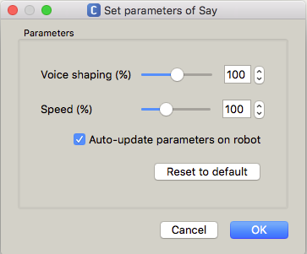
Boxes
Click wrench symbol at the corner of the box (e.g. “Say”) or right click on the box and choose “Set Parameters”

Slide 10
Task 1-b: Animated Say (Robot Only)
For a natural interaction, movement is essential.
Choose “Animated Say” box from Speech->Creation in Box Libraries (or search in the bar)
Set parameters of the box:
Speaking movement mode:
Disabled: Same as “Say”, i.e. no movement
Random: Randomly launched short neutral animations
Contextual: Specific animations are launched when keywords such as ‘I’, ‘you’ or ‘all’ are detected in an appropriate grammatical context (e.g. pointing at himself when he talks about himself).

Slide 11
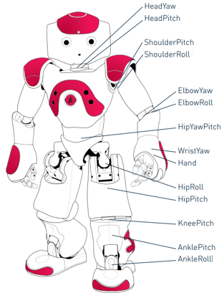

Kinematics
Nao is a bipedal humanoid robot
25 degrees of freedom (DOF)
In Choregraphe:
Press “Wake up” to turn the stiffness on for the motors (“Rest” would release the stiffness)
Double click on the right arm of the robot in Robot View
Look at the Inspector window
Change joint angles to see the robot move
Choose “Tai Chi Chuan” from Box Libraries under Entertainment->Dances->NAO
Rest
Wake up
Nao kinematics picture from: SoftBank Robotics Europe (Aldebaran)

Slide 12
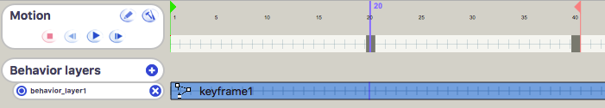
Timeline
“Timeline” is used for creating animations
Drag and drop “Timeline” from Box Libraries under Animation->Creation
Double click to reveal Timeline panel
Click “Wake up” to turn on stiffness of all motors (NECESSARY TO DO ANY KIND OF MOTION!)
Edit Properties
Start Frame
Key frame
End Frame
Editor
Play motion
Step forward
Add behaviour layers

Slide 13
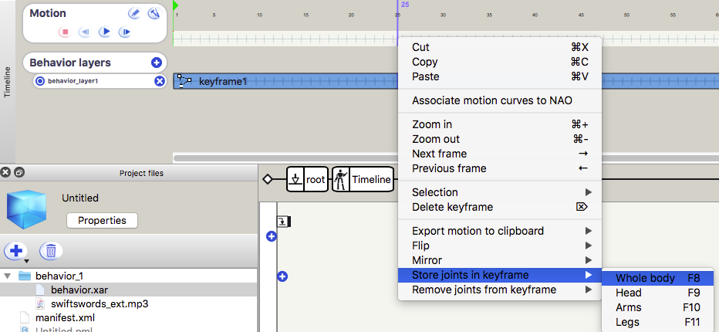
Timeline
Edit Properties allows to set:
Frame per Second (FPS) rate (i.e. 25 FPS means 25 frames equal to 1 second)
Mode: Passive (motion will be done if it can be done), waiting (motion will be done as soon as joints are available), aggressive (motion will be done anyway)
Resources
Right click on the timeline and choose Store joints in keyframe -> Whole body

Slide 14
Task 2: Create an Animation
Create a waving gesture using right arm
Hint: Use Inspector window to change arm angles

Slide 15
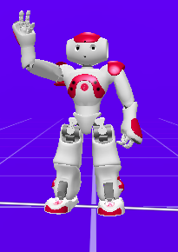
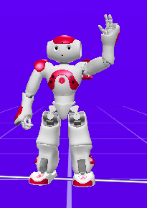
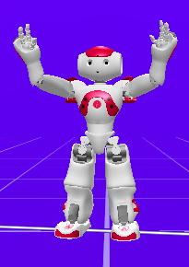
Task 2: Create an Animation
Right arm wave
Flip
Mirror

Slide 16
Export Animation
To export an animation to C++ or Python code:
Right click on the timeline, and select Export motion to clipboard
Select a language (C++ or Python) and a mode (Bezier or simplified)
Paste it into your code or in a text editor

Slide 17
Sensors
Contact and Tactile sensors:
Head: Front, middle, rear
Hand: Left, back, right
Foot bumper: left of foot, right of foot
Chest button
Force Sensitive Resistors: under the feet
Sonars: on the chest (transmitters at the top, receivers at the bottom)
IMU (accelerometer and gyrometer) and joint position sensors
Microphones: on top of the head
Cameras: Top and bottom (not the eyes!)
Speakers: on the ears

Slide 18
Task 3: Subscribe to Event (Robot Only)
Choose “Subscribe to Event” from Programming -> Memory in Box libraries
Find event to subscribe to:
In Memory Watcher window, double click on Select memory keys to watch
Choose “FrontTactilTouched” (Front of the head is touched)
Click set parameters of the box and enter event: FrontTactilTouched
TASK: When the front of the head is touched, wave right arm

Slide 19
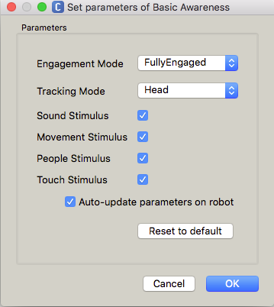
Task 4: Basic Awareness (Robot Only)
Choose “Basic Awareness” from Sensing -> Vision -> Surroundings
Engagement mode: when engaged with a person,
“Unengaged”: (Default mode) robot can be distracted by other stimulus and get engaged with another person
“FullyEngaged”: stops listening other stimuli
“SemiEngaged”: turn to the stimuli, but go back to the person engaged with
Tracking Mode: tracks a person with
“Head”: only the head
“BodyRotation”: the head and the rotation of the body
“WholeBody”: the whole body, but doesn’t rotate the body
Stimulus: “Sound”, “Movement”, “People”, “Touch”

Slide 20
Task 5: Autonomous Life (Robot Only)
Autonomous Life mode = Basic Awareness + Breathing (the continuous movement of the body) + Speech Recognition (listening to speech) + Animated Say (replying to speech)
Speech recognition and replies are limited to “dictionary” of the robot
Turn on/off autonomous life:
States (can be set through programming):
“disabled”: turns off autonomous life
“safeguard”: (only for Softbank, i.e. don’t use it) turns off everything to handle a reflex then restarts the autonomous life
“interactive”: one-to-one interaction with the engaged person
“solitary”: listening and responding to stimulus from the environment

Slide 21
Task 5: Python Programming
Possible to do anything (within the capabilities of the robot)!
Import python libraries, edit parameters, write your own code, etc.
Choose “Python Script” under Programming -> Templates in Box libraries

Slide 22
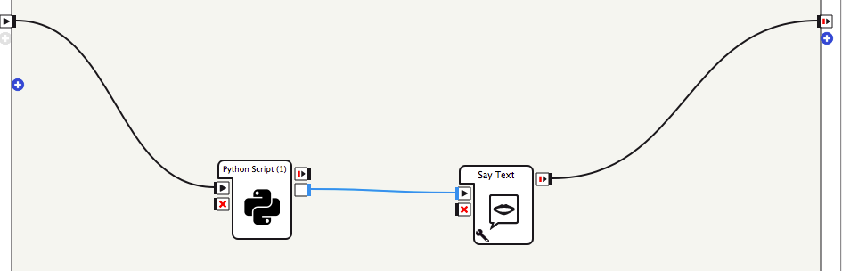
Task 5: Python Programming
Edit “Python Script” box to add onDate output as String type and punctual
Add “Say Text” box and connect onDate with onStart of “Say Text” box
Change the “Python Script” box code to the example code: PythonAndSayTextBox.py

Slide 23
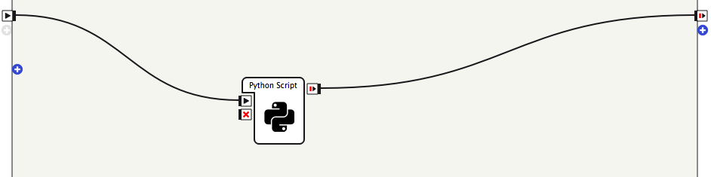
Task 5: Python Programming
Add another “Python Script” box
Change the code to the example code: PythonBox.py

Slide 24
Beyond Choregraphe
You can use Python or C++ for programming using Naoqi:
Download Python 2.7 SDK 2.1.4 and C++ SDK 2.1.4 according to your system requirements, instructions: http://doc.aldebaran.com/2-4/dev/community_software.html#retrieving-software
Python tutorials (use 2.4 instead of 2.1 documentation, as services are used instead of proxy for connecting to the Naoqi modules)
Example code for saying the current date: PythonDate.py
Run the code (from a terminal):
$ python PythonDate.py --ip ROBOT_IP
(ROBOT_IP should be replaced with the IP of your robot if running code remotely, i.e. from your computer)

Slide 25
Further Information
For more information on Choregraphe and Python Programming: tutorials

Slide 26
Dialog Manager
QiChat is the “programming language” for the dialog manager
Search “Dialog” in Box libraries (under Speech -> Creation)
Under Project files click ExampleDialog -> ExampleDialog_enu.top
Script editor will show the code for the dialog
The ExampleDialog_enu.top file contains examples of most of the important concepts for QiChat, use it as a guide

Slide 27
QiChat
topic: defines a list of concepts, user rules and proposals
topic: ~introduction()
language: language of the topic (enu for English)
language: enu
concept: defines a list of items corresponding to a concept
concept:(hello) [hello hey ”good morning” greetings]
user rule: defined by a human input and a robot output
u:(~hello) ~hello
u:(how are you) I am good, and you?
name
choice (written in [])
phrase (written in “”)
human input
robot output

Slide 28
QiChat
user subrule: allows creating several conversational contexts. Rules are activated if a main user rule or proposal has previously matched
u:(talk about animals) do you have a cat or a dog?
u1:(dog) is it a big dog? ^stayInScope
u2:(yes) make sure he has enough space to run
u2:(no) it is so cute
u1:(cat) I love cats! ^stayInScope
^stayInScope allows to have multiple answers to the same question (e.g. the person might have a cat and a dog)
proposal: is a robot output (NOT triggered by a human input)
by default a proposal can be said only once
can be triggered with ^nextProposal, ^previousProposal, ^sameProposal, ^goto(tagName), ^gotoRandom(tagName), ^gotoReactivate(tagName), ^topicTag(topic,tagName)
proposal: Hello stranger
u:(hello) ^nextProposal
scope of rule u
scope of rule u1

Slide 29
Animations
You can use behaviours or animations along side/during speech
^start: starts behaviour or animation
^wait: waits until a running behaviour or an animation has finished
^run: stops the speech, runs an animation and resumes the speech
u:(~hello) ^start(animations/Stand/Gestures/Hey_1) ~hello ^wait(animations/Stand/Gestures/Hey_1)

Slide 30
Special Characters
Input storing _: allows storing a word/phrase from human input.
$1 is the first caught word, $2 is the second,...
Wildcard *: matches any word or phrase
Optional part { }: optional word or phrase in human input.
u:(my {first} name is _*) nice to meet you $1
u:(I like _[chocolate cheese]) do you want to eat $1 now?
Tag %: identify one or more proposal(s) or rule(s) by a tag. Tags can be activated or deactivated. If deactivated, then the sentence is false and will not be said.
Forbidden word !: allows to define a word that should not be in human input
u:(sing a song) %song OK, do you want a new one?
u:(I !don't want a new one) %song sure, I'll sing Everything is Awesome!
u:(I don't want a new one) %song As usual then, perfect, Here Comes the Sun!

Slide 31
Rule Functions
^first: when used before a choice, the first “valid” output will be used instead of using each answer sequentially
u:(input) ^first[answer1 answer2]
^rand: when used before a choice, a random output will be used
u:(input) ^rand[answer1 answer2]
^repeat: allows the recognition of human input, if one or several word(s) among the list are said, regardless of the order.
u:(^repeat[word1 word2 word3]) answer
^private: comes before a human input. The private user rule is only active when its corresponding topic has the focus (containing the last triggered rule).
focus on topic: sport
u:^private(what are we talking about) we are talking about sports
focus on topic: food
if you hear from the user: “what are we talking about” robot will not give an answer.

Slide 32
Variables
A value can be stored in a variable ($variableName)
Variables are global
They can be used for both human input and robot output
They don’t have a type and don’t need to be declared
For each variable $variableName, an event e:variableName is also available (and vice versa). Variable are stored in ALMemory
NOTE: variables don’t get cleared in Choregraphe (i.e. retain their value) after stopping and rerunning the code.
^clear(variableName): Cleared variables or a sentence with a cleared variable cannot be said. A condition with cleared variable is always false.
u:(I am _*) Hello $1 . $name=$1
u:(I want some _[chocolate cheese]) Sure, $name ! $askedFood=$1
u:(what did I ask) ^first["you asked $askedFood" "I don't know"]

Slide 33
Events
Events (e:eventName) allows to catch:
Naoqi events related to the robot (movement, battery, face detected information, etc.)
ALDialog events
The events raised each time a value is assigned to a variable.
# will answer whenever the event "event" is raised
u:(e:FrontTactilTouched) You touched my head!
# will answer whenever the event "event" is raised or the sentence is said
u:([e:Dialog/Answered next]) Continue with mixing the dough
# will answer whenever the event "event" is raised and then the sentence is said (the event must be raised before saying the sentence)
u:("e:askedFood more") Eating too many $askedFood is not good
Events and input/output of a box can have the same name. If an event has the same name with a box input/output, the variable is only linked to the box and is not anymore usable with ALMemory.
u:(bye) Bye $onStopped=1

Slide 34
Conditions
A condition can be placed in a human input or robot output, and it would:
trigger the rule if true,
block the rule if false.
The condition ordering does not matter.
If condition is false anywhere in quote, then the sentence in quote will not be said.

Slide 35
Conditions
u:(i want _[chocolate cheese]) Sure! Do you like it? $askedFood=$1 $askedChocolateNum=1
condition on variable (in human input and/or robot output):
u:("I love it $askedFood==chocolate") I love chocolate as well!
( Try: u:($askedFood==chocolate) That is a good choice! )
answer if variable < value:
u:(more) $askedChocolateNum<2 Sure, have more! $askedChocolateNum=2
answer if variable > value :
u:(more) Too much $askedFood is not good! $askedChocolateNum>2
answer if variable different from value :
u:(can I have _*) Sorry, I don’t have $1 . $1<>chocolate
combining them:
u:("more $askedFood==chocolate") ^first["$askedChocolateNum<2 Sure, have more! $askedChocolateNum=2" "$askedChocolateNum>1 Too much $askedFood is not good"]

Slide 36
Transformation Rules
Skin (s:(Answer) Modifications) allows to apply modifications to a rule
^addword : adds a word/phrase in one or more previous robot output(s) at a specified position
if you want to modify all rules, then * can be used instead of a robot output
Syntax: s:(robot output) ^addword(Expression, Position, Frequency)
Frequency represents the probability of the skin to be applied (1:always apply, 0:never apply)
u:(hello) hello human
s:(hello human) ^addword(I am your father, end, 1)
^replace : replaces a word/phrase in one or more previous robot output(s)
Syntax: s:(robot output) ^replace(Expression, Position, Frequency)
u:(what do you like to do) I like to speak with you human
s:({*} human {*}) ^replace(human, Michael, 1)

Slide 37
Rule Activation
All the rules of a deactivated topic are also deactivated
All the rules of an activated topic are activated, UNLESS the rule
is a user subrule and is not connected to the last triggered rule,
is an already executed proposal,
has a deactivated tag,
has the ^private function, while its topic does not have the focus (containing the last triggered rule)

Slide 38
Further Information
QiChat has an extensive documentation with more functions

