Slide 1
HIDE & SEEK: EXPLORING STEGANOGRAPHY
Team members:
PUSHKAL KHURANA
AKHILESHKUMAR SAHANI
AKSHAY B.R.
GOWDA VISHAL KRISHNA
under the guidance of:
MISS YESHASWINI B.R.

Slide 2
INTRODUCTION
STEGANOGRAPHY??
Cryptography Aims At Rendering The Message Unreadable
Steganography Aims At Hiding The Existence Of The Message Itself..

Slide 3
OBJECTIVES
Successfully implement various steganographical techniques
Provide an easy-to-use interface to use them
Implement other supporting techniques such as Erasure-encoding ,etc...

Slide 4
Information Hiding
Concealing the existence of messages
Related to Cryptography..
Employs technologies from: Digital signal processing, Cryptography, Information/Coding theory, Data compression, Visual/Auditory perception
Has four primary sub-disciplines: Steganography, Watermarking, Covert channels, Anonymity...

Slide 5
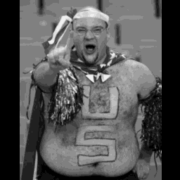
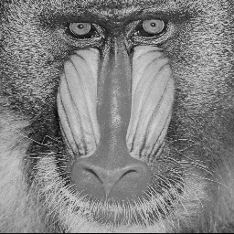
EXAMPLE SCENARIO:
Carol
Message
interception
Stego-obj
Alice
Comm channel
Bob
cover

Slide 6

EXAMPLE:
COVER/CARRIER FILE
STEGO-OBJECT
STEGO-MESSAGE

Slide 7
TERMINOLOGY
COVER
STEGO-OBJECT
STEGO-ENCODER
COMM..
CHANNEL
MESSAGE
KEY
STEGO-DECODER
MESSAGE

Slide 8
APPLICATIONS
Covert Military/Police communications
Digital Rights Management
Embedding textual data in medical images

Slide 9
APPLICATIONS
Tamper Proofing
Communication in an oppressive country w/o free speech..
Keeping track of classified data/documents..

Slide 10
Steganographic Techniques
Substitution
Spread Spectrum Techniques
Statistical Methods
Distortion Techniques
Cover generation techniques

Slide 11
Existing Systems..
Steganos, JPhide, S-tools(gif,jpeg), StegHide(wav, bmb) ,etc..
Focus on particular formats.
Require you to install the software

Slide 12
Proposed System
Focus on multiple formats , including audio and video...
Just need an internet connection and browser
Easy to use ... and always available..

Slide 13
Software/Tools used..
Frontend
  HTML
  CSS
  JavaScript
Backend
  Ruby
  Ruby on Rails
  Any Supporting server(Apache, nginx)

Slide 14
THANK YOU.
ANY
QUESTIONS??
OR
SUGGESTIONS !..

