Slide 1
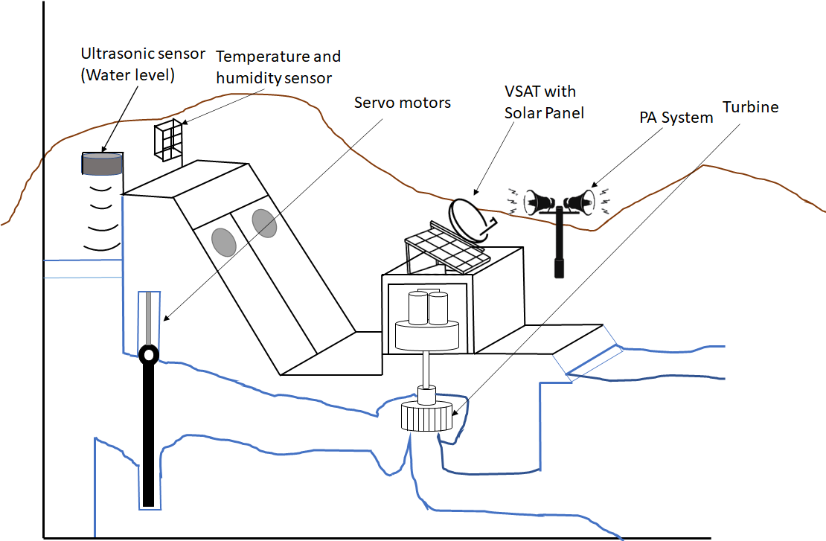
Dam Model
Land

Slide 2
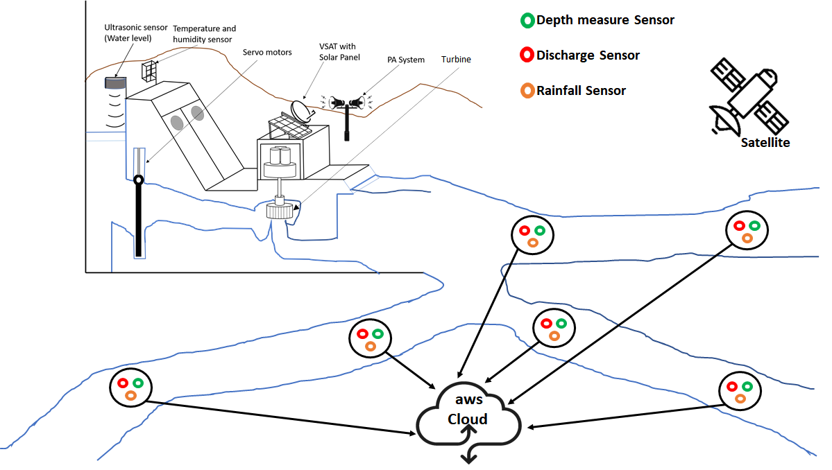
#Final diagram
Land

Slide 3
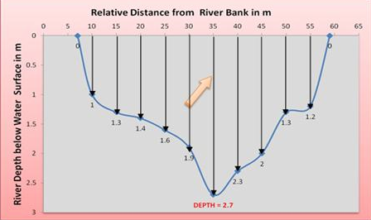
Mathematical Model

Slide 4
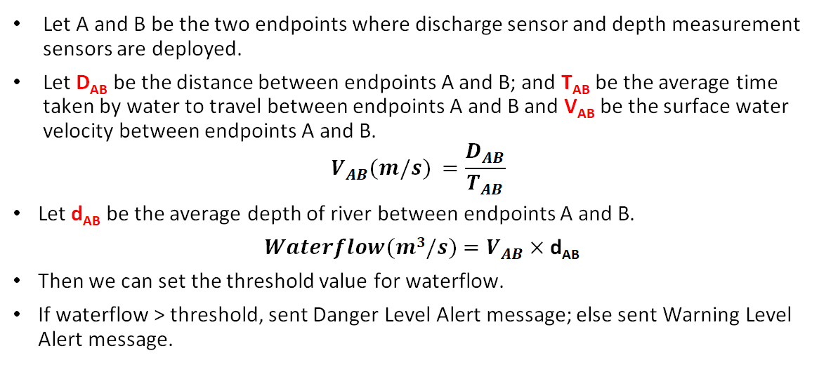
Mathematical Model Contd.

Slide 5
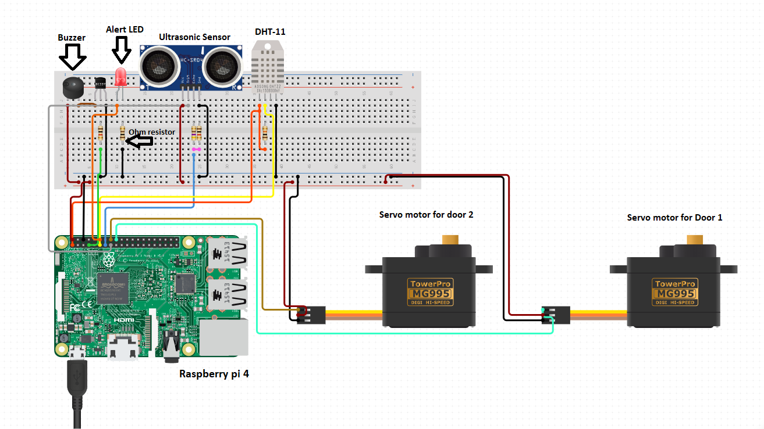
Hardware Model

