Slide 1

IBM [Watson] Data Science Certification
LAS VEGAS nightlife.
A Foursquare Project
Celio Oliveira
Data Scientist Researcher
MAY.2020

Slide 2
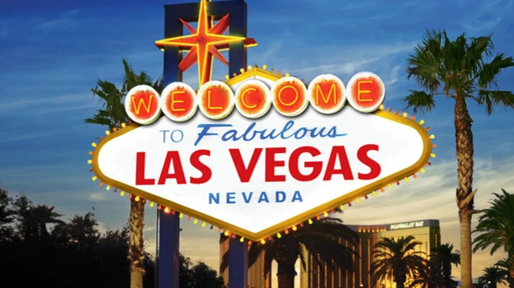
OBJECTIVE
This project is aimed to make your travel experience to Las Vegas Simple by Providing all nearby locations of nightlife fun spots with help of Foursquare datasets.

Slide 3
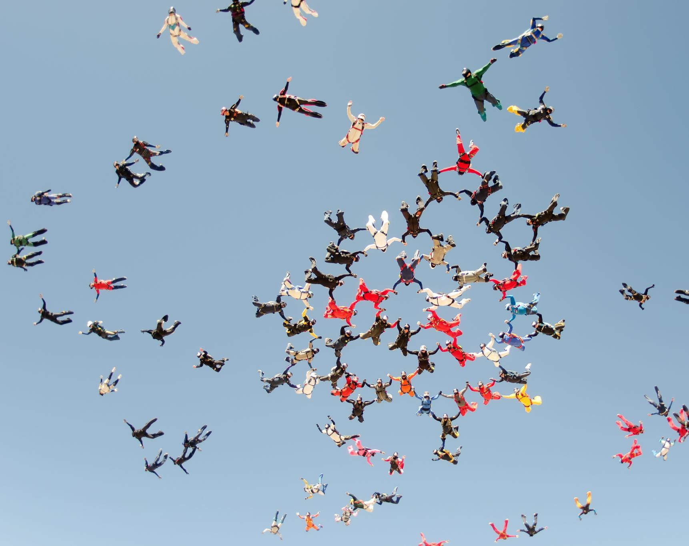
Problem Statement
Many people come to Las Vegas each day and have trouble in choosing between the best and the not so known night out places. Here I and other foursquare users would try and help them with their tips and ratings for each place and help people enjoy most of their time rather fear losing something in the fake casinos

Slide 4
Pipeline
1. Geojson data for Las Vegas's neighborhood,
2. Analyze the data using the Foursquare API,
3. K-Means clustering to identify areas and its categories.
Foursquare is a technology company that uses location intelligence to build meaningful consumer experiences and business solutions.

Slide 5
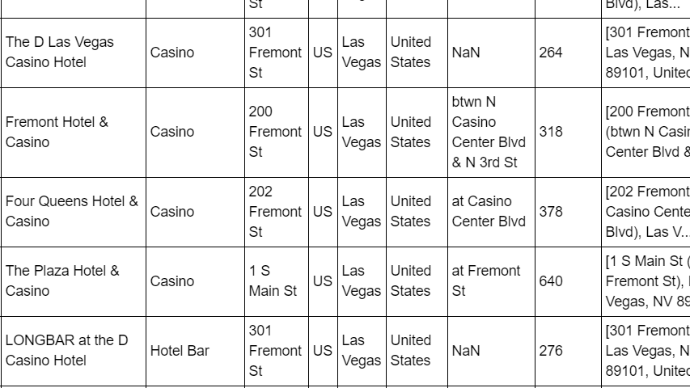
Data set preprocessed

Slide 6
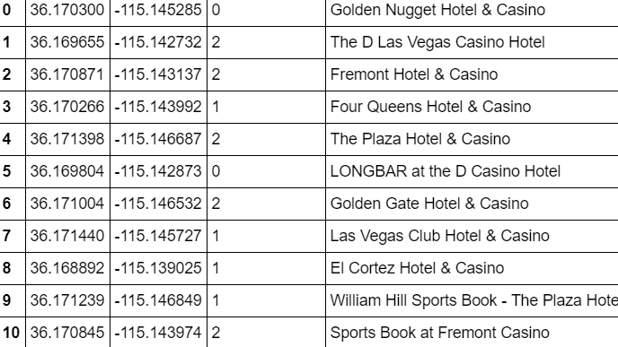
Data set processed for clustering

Slide 7

We built a project with the help of Foursquare quality to allow tourists to easily decide where to go when they are in a specific city.
Using Foursquare data set I have successfully created a way to know all the location information handy, information such as casinos, cafes and hotels, venues are easily accessible using data science methodology.
Conclusion

