Slide 1
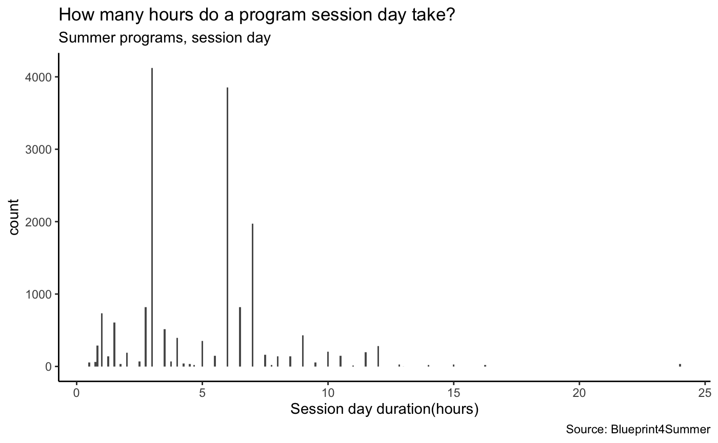
3 hours
4124 counts
24%
6 hours
3855 counts
22%
7 hours
1970 counts
11%

Slide 2
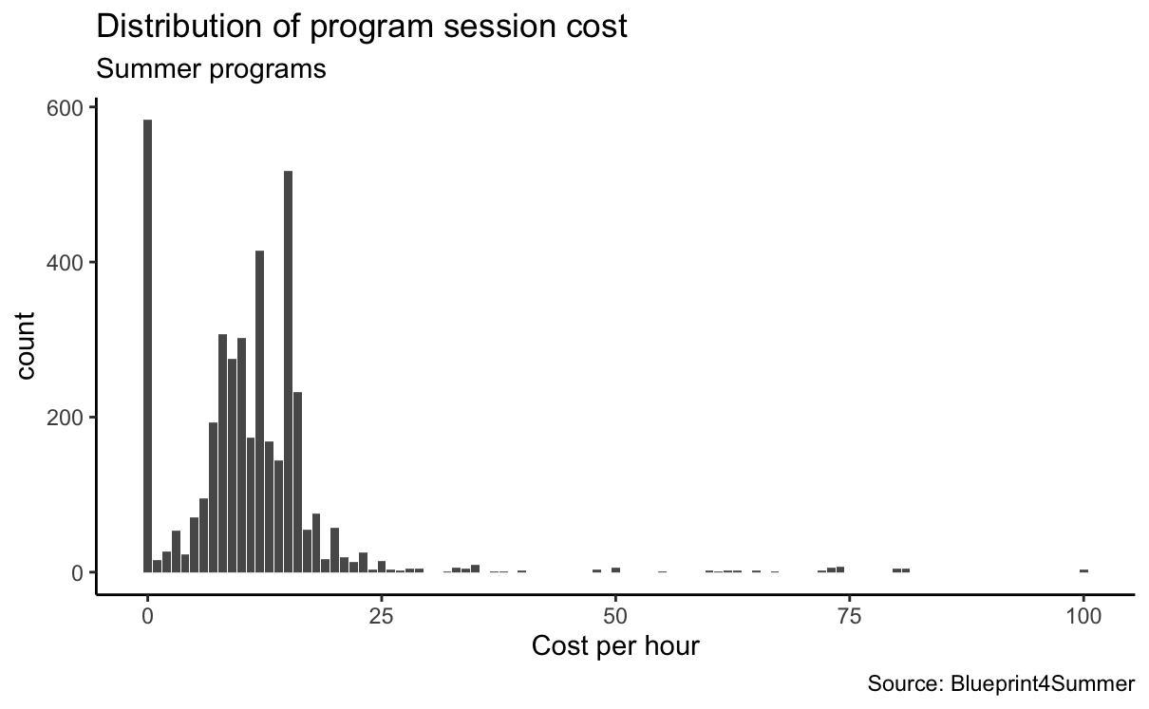
$0
583 counts,
14.7%
$12
414 counts,
10%
$15
517 counts,
13%

Slide 3
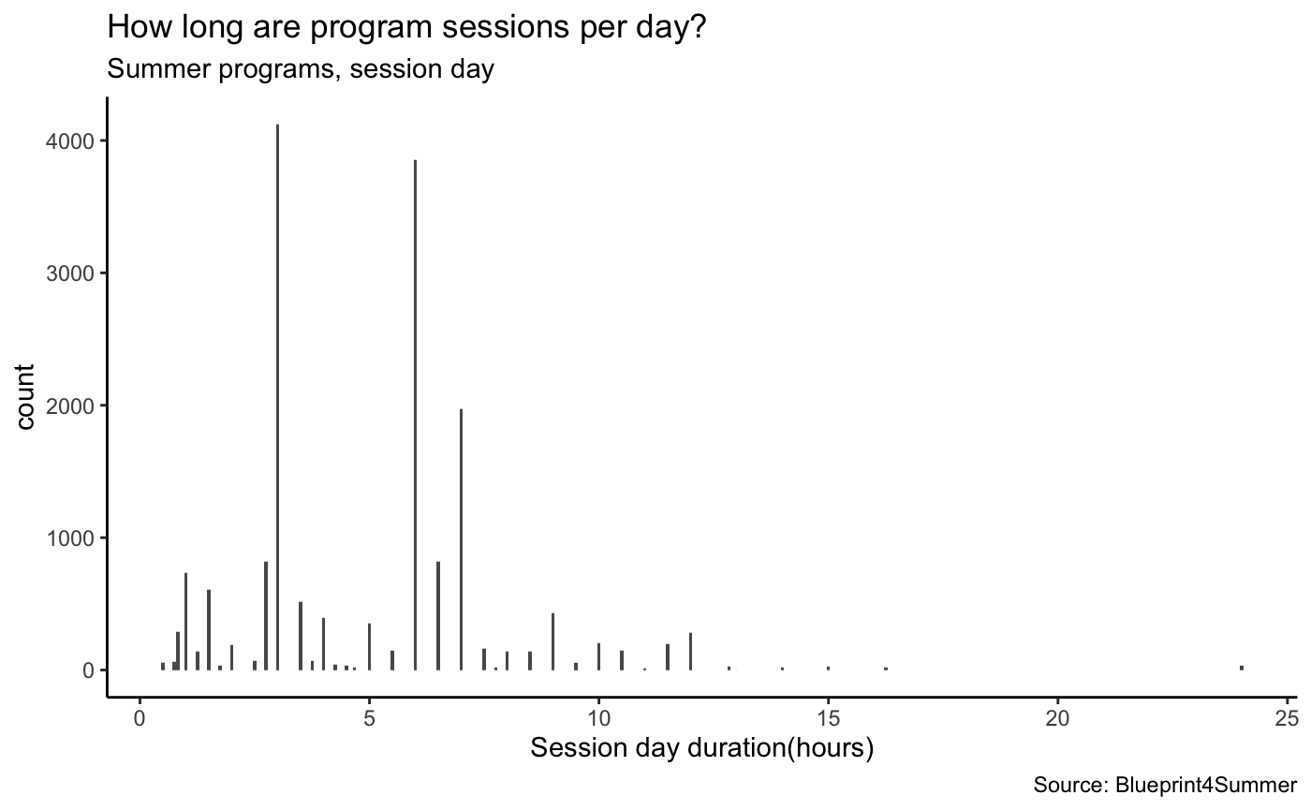
3 hours
4124 counts
24%
6 hours
3855 counts
22%
7 hours
1970 counts
11%

