Slide 1

SACF Project Enhancements
Prepared By: Ilamaran Raju
PA14
S10257054C

Slide 2





So what have we done so far
NP NEWS
We have set up an instance that hosts both a database and a web server, running the NP News website on WordPress

Slide 3

Problems We Face
A single EC2 instance cannot handle high traffic efficiently.
Even if we had multiple instances, traffic cannot be distributed evenly.
There is no backup for posts if they become corrupted.
Scalable storage is essential for future growth.

Slide 4

Solution?
Elastic Load Balancing
Elastic Block store
S3 storage
Auto Scaling

Slide 5
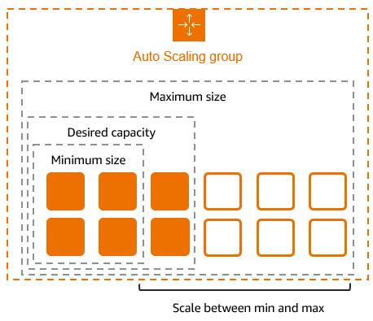
Auto Scaling
Automatic Scaling – New EC2 instances are launched when CPU usage increases.
Cost Efficiency – Shuts down unused instances during off-peak hours.
High Availability – Ensures the application remains accessible at all times.
Fault Tolerance – Replaces failed EC2 instances automatically.
Seamless Load Balancing – Works with ELB to distribute traffic evenly.
Works with Cloud watch to create alerts
Notes:
First, Automatic Scaling ensures that new EC2 instances are launched when CPU usage increases, maintaining performance during high-demand periods. At the same time, Cost Efficiency is achieved by shutting down unused instances during off-peak hours, reducing operational costs.
High Availability is a key benefit, ensuring that applications remain accessible at all times. If an EC2 instance fails, Auto Scaling provides Fault Tolerance by automatically replacing the failed instance, minimizing disruptions.
Additionally, Seamless Load Balancing is achieved by integrating with Elastic Load Balancer (ELB), which distributes traffic evenly across healthy instances, preventing overload on any single server.
To monitor system performance, AWS CloudWatch is used to create alerts based on real-time metrics such as CPU usage, memory utilization, and network traffic. If resource usage exceeds a predefined threshold, CloudWatch triggers an Auto Scaling action to launch new instances, ensuring smooth operation.
By leveraging Auto Scaling, ELB, and CloudWatch together, businesses can create a highly resilient, scalable, and cost-effective cloud infrastructure.

Slide 6


How it was implemented
NP NEWS

Slide 7
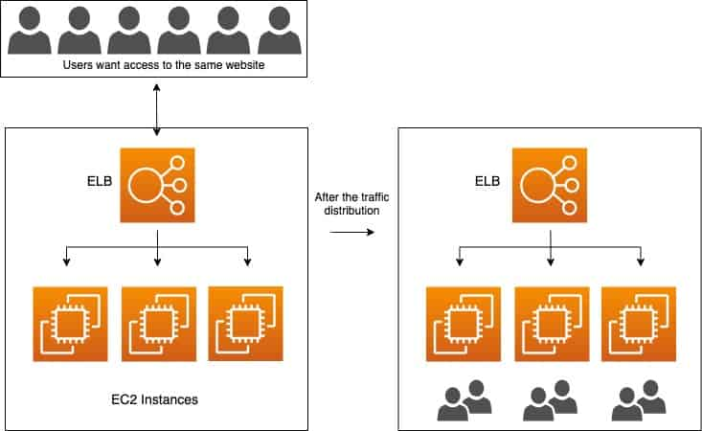
Elastic Load Balancer
High Availability & Fault Tolerance – Distributes traffic across multiple targets, ensuring minimal downtime.
Scalability – Automatically adjusts to handle increased or decreased traffic loads.
Improved Performance – Optimizes request routing to the healthiest targets.
Security Integration – Supports SSL/TLS encryption and integrates with AWS WAF for protection.
Cost Efficiency – Reduces the need for over-provisioning resources.
Supports Multiple Protocols – Works with HTTP, HTTPS, TCP, and UDP.
Health Monitoring – Continuously checks target health and reroutes traffic if a failure is detected.
Automatic Scaling – Works with AWS Auto Scaling to adjust resources as needed.
Notes:
First, ELB ensures high availability and fault tolerance by distributing traffic across multiple instances, preventing downtime. It also scales dynamically, adjusting resources based on incoming traffic demands.
In terms of performance, ELB routes requests efficiently to the healthiest and most responsive targets. Security is another key aspect—it supports SSL/TLS encryption and integrates with AWS Web Application Firewall for protection against attacks.
Additionally, ELB is cost-effective, as it eliminates the need for over-provisioning resources. It supports multiple protocols, including HTTP, HTTPS, and TCP, ensuring flexibility for different applications.
To maintain stability, ELB provides health monitoring, detecting unresponsive targets and rerouting traffic automatically.
Finally, ELB works in sync with AWS Auto Scaling, enabling automatic adjustments to resource allocation based on real-time demand.
Overall, Elastic Load Balancing is a powerful tool for improving system performance, reliability, and security in cloud environments."*

Slide 8
How it was implemented
NP NEWS

Slide 9
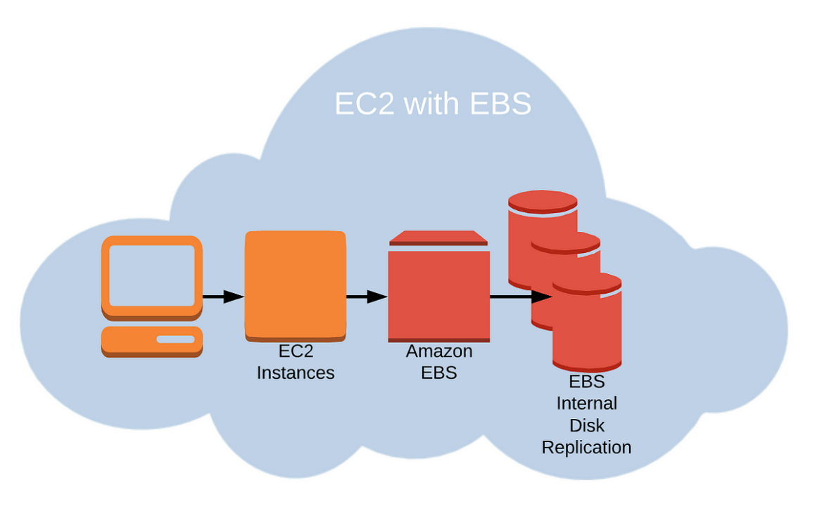
Elastic Block Store
Persistent Storage – Data remains intact even after EC2 instances are stopped or restarted.
High Performance – Provides fast, low-latency storage, suitable for databases and applications.
Scalability – Easily increase volume size or change performance settings without downtime.
Data Backup & Recovery – Supports automated EBS Snapshots for backups and disaster recovery.
Multiple Volume Types – Choose from SSD (GP3, IO2) for speed or HDD (ST1, SC1) for cost efficiency.

Slide 10

How it was implemented
NP NEWS
20GB
20GB
20GB

Slide 11


Why do these 3 work together
NP NEWS
20GB
20GB
20GB

Slide 12

High Availability – Ensures access to critical content even if the primary site goes down.
Cost-Effective – Pay only for storage and bandwidth, no need for server maintenance.
Scalability – Easily handles sudden traffic spikes without performance issues.
Durability & Reliability – S3 provides 99.999999999% (11 nines) durability for stored data.
Fast Content Delivery – Can be integrated with Amazon CloudFront for low-latency access.
Simplified Disaster Recovery – Acts as an emergency fallback in case of outages.
Easy Deployment & Management – No need for complex server configurations.
Secure & Controlled Access – Supports encryption, access controls, and versioning.
Global Accessibility – Users can access the site from anywhere with minimal latency.

Slide 13
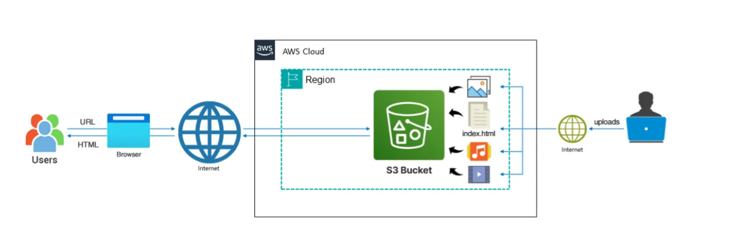
How it was implemented

Slide 14

Thank you

