Slide 1

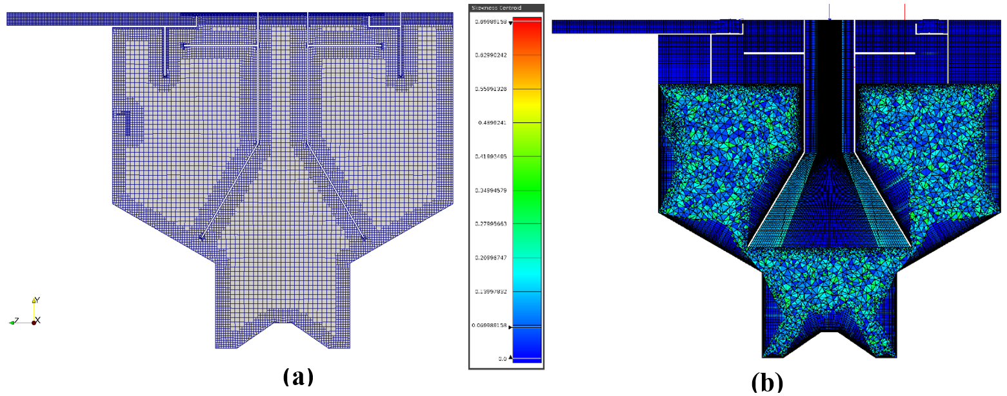
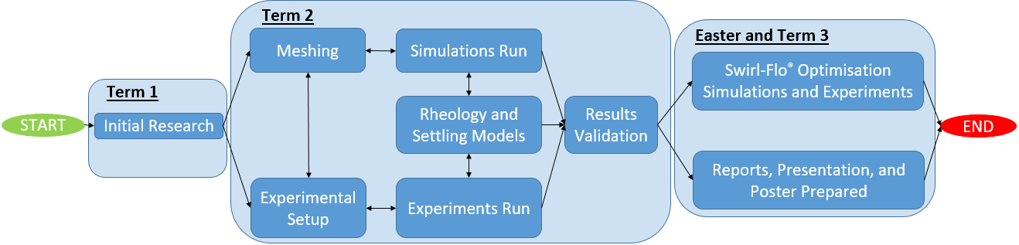
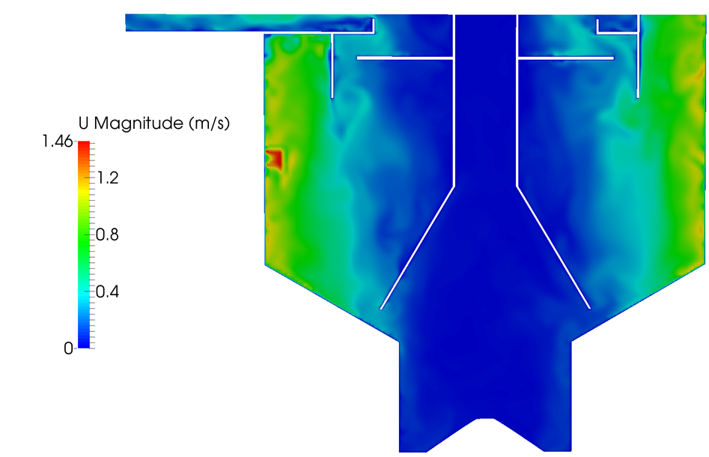
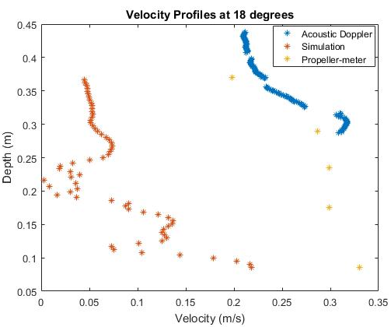

Please keep same distance at the top and bottom
Experimental and Numerical Investigation into the use of Olive Stone Powder as a Substitute for Primary Sludge Modelling
A. Baker, R. Bentley, J. Lowe, M. Mendoza, T. Russell, T. Scobell, and A. Wye
Introduction
In wastewater treatment, sedimentation tanks are used to separate out solid particulates. The efficiency of said devices can be improved by implementing various modifications. Using a validated Computational Fluid Dynamics (CFD) model, the need for resource intensive experimental work would be made redundant within the iterative design process.
Results
An extensive study into various meshing techniques was carried out using snappyHexMesh and Pointwise®. Figure 2 shows two example meshes of the Swirl-Flo® produced using the two software packages.
p
Figure 2: (a) Mesh created using snappyHexMesh. (b) Mesh created using Pointwise®.
These meshes were used in the simulations in conjunction with mathematical models produced for the rheology and settling behaviour of the OSP. A comparison of simulated and empirical results was performed in an attempt to validate the CFD model. Figures 3 and 4 show an example velocity contour and a comparison plot of the simulated and experimental velocity profiles respectively.
p
p
p
Project Aim
The aim of the project was to create a validated CFD model in OpenFOAM® for a Swirl-Flo® separator using a wastewater substitute: Olive Stone Powder (OSP). This was to be achieved by developing models of the rheology and settling behaviour of the OSP. High quality meshes and efficient simulation case files were to be created, parallel to empirical studies on laboratory scale tanks.
Method
p
Figure 1: Image showing the simplified workflow chart for the project
p
The methodology for the project is shown visually in Figure 1. The work was subdivided into three sub-groups: Meshing, Simulation, and Experimental.
p
The Meshing sub-group covered:
Geometry creation and volume discretisation using snappyHexMesh and Pointwise®.
p
The Simulation sub-group covered:
Research into Drift Flux equations and MULES.
OpenFOAM® simulations on the rectangular tank and Swirl-Flo®.
p
The Experimental sub-group covered:
Modelling of rheology and settling behaviour of the OSP.
Empirical results for comparisons with CFD results.
Figure 3: Example of a velocity contour plot from the Swirl-Flo® simulation
Figure 4: Example of a velocity comparison plot for the Swirl-Flo®
Conclusions and Further Work
The Swirl-Flo® simulations were not run to convergence due to limited computational time. The settling model was found to overestimate the OSP velocities. This combined with lack of mesh boundary layers and simulated turbulence reduced model validity. Suggested further work includes:
p
Run simulations to convergence.
Integrate turbulence models into driftFluxFoam.
Further development of slower settling models.
Increase mesh boundary layer resolution.
Improve efficiency of non-Newtonian viscosity model.
Please keep same distance at the top and bottom
Supervisors: Prof G. Tabor, and S. Grossberg
Sponsors:
Notes:
<number>

