Slide 1

Ignytion io
IGNYTION IO · TECHNICAL LAB NOTE
From APB Writes
to an Analogue Voltage
Recorded RTL PWM driving an ideal RC filter in ngspice
A pulse-width-modulated signal alternates between two voltage levels. An RC filter smooths that waveform into a voltage whose settled mean depends on duty cycle. This experiment controls the PWM through an APB register interface, records its actual RTL output, and uses that record to drive ngspice. An independent RC solution checks the analogue waveform.
Ignytion IO · ignytion.io
CRUCIBLE PLATFORM SERIES · OCTOBER 2026

Slide 2
APB PWM TO RC FILTER · TECHNICAL LAB NOTE
Ignytion io
SECTION 01
A checked signal path across two simulators
The digital run passes 102,898 comparisons. Five duty settings produce the expected settled mean voltages, and the complete analogue responses agree with the declared RC reference tolerance.
DUTY
TARGET MEAN
OBSERVED MEAN
0%
0.00 V
0.000000 V
25%
0.45 V
0.450000 V
50%
0.90 V
0.900000 V
75%
1.35 V
1.350000 V
100%
1.80 V
1.800000 V
The simulator interface is explicit
This is a recorded, feed-forward PWL interface. RTL finishes first; ngspice then reads its voltage waveform. There is no live shared-library connection, two-way analogue feedback, or transistor-level output driver in this experiment.
Crucible is beta. The project environment binds Icarus Verilog 14.0.0 and ngspice 46. A project-local FFTW runtime enables the installed simulator payload; the local reproduction dependency remains visible.
© 2026 Ignytion IO · ignytion.io
October 2026 · Version 1.0
02 / 09

Slide 3
APB PWM TO RC FILTER · TECHNICAL LAB NOTE
Ignytion io
SECTION 02
Control a digital PWM over APB
The slave implements setup and access phases without wait states. Writes take effect when selection and enable are both asserted.
ADDRESS
REGISTER
BEHAVIOUR
0x00
Enable
Bit 0 enables PWM; disable drives low
0x04
Duty
Integer 0..256 · readback supported
Other
Error
Unknown/unaligned access reports error
The counter has 256 clock states. The output is high when the unsigned counter is less than duty. Duty zero stays low; duty 256 stays high. A 1 MHz test clock gives a 256 µs PWM period.
Reset clears enable, duty, and counter. A duty write restarts the counter. Writes above 256 report an error and retain the old duty. These choices define a small control peripheral; glitch-free updates during an active period are not claimed.
The test holds a setup phase across several edges and checks that it cannot write a register. It also checks readback, rejected writes, invalid addresses, disable, and reset.
© 2026 Ignytion IO · ignytion.io
October 2026 · Version 1.0
03 / 09

Slide 4
APB PWM TO RC FILTER · TECHNICAL LAB NOTE
Ignytion io
SECTION 03
Translate the recorded signal accurately
The test records one digital value per clock for 80 complete periods at each duty. PWM changes only on clock edges, so the samples retain every level transition in these static-duty tests.
BOUNDARY
DECLARED MAPPING
Digital low / high
0 V / 1.8 V
Recorded time
Nanoseconds converted to seconds
Transition shape
1 ns linear voltage ramp
Initial condition
Capacitor voltage starts at zero
Recorded duration
80 × 256 µs = 20.48 ms per case
The bridge compresses repeated levels into a piecewise-linear (PWL) voltage source. Every source is checked against the original digital record for level, transition count, transition time, and ramp duration.
A half-amplitude source is deliberately passed to the same mapping observer. It fails the level comparison. This checks that a successful ngspice launch cannot hide an incorrect logic-to-voltage conversion.
Sampling defines the time reference
Each capture starts a local time axis at its first sample. The example preserves duty and period; it does not measure latency from an APB write to an analogue output transition.
© 2026 Ignytion IO · ignytion.io
October 2026 · Version 1.0
04 / 09

Slide 5
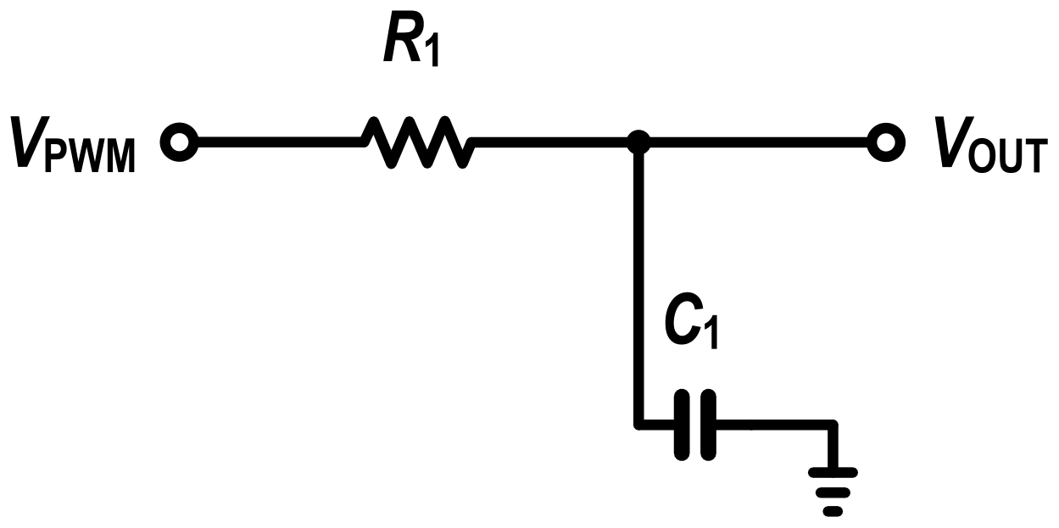
APB PWM TO RC FILTER · TECHNICAL LAB NOTE
Ignytion io
SECTION 04
Understand the RC filter
A 10 kΩ resistor feeds a 100 nF capacitor to ground. The time constant is τ = RC = 1 ms. The voltage source is the recorded PWM waveform.
Figure 1 · Ideal first-order RC filter · R1 = 10 kΩ · C1 = 100 nF
The capacitor charges towards the source voltage and discharges when the source goes low. Because the PWM period is shorter than τ, the output changes more slowly than the input and retains visible ripple.
I N D E P E N D E N T R E F E R E N C E
For a constant source, v(t) = u + [v(0) − u] exp(−t/τ). The verifier extends this exact solution to each linear PWL segment, including the 1 ns ramps, and compares it at every saved ngspice time point.
The acceptance limit is 0.5 mV maximum pointwise error. This measures solver agreement for an ideal linear circuit. It does not establish component tolerance, model accuracy, or hardware error.
© 2026 Ignytion IO · ignytion.io
October 2026 · Version 1.0
05 / 09

Slide 6
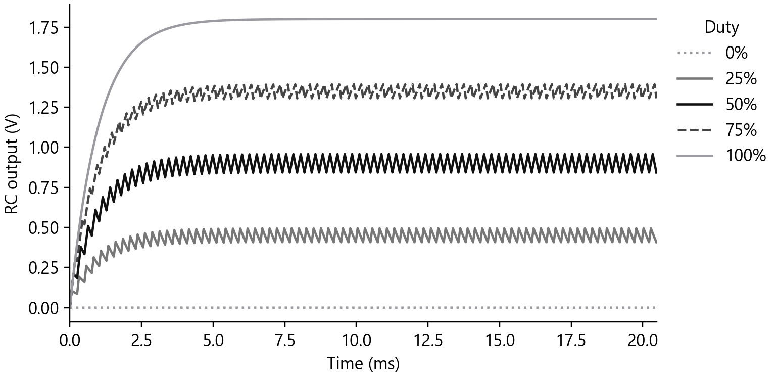
APB PWM TO RC FILTER · TECHNICAL LAB NOTE
Ignytion io
SECTION 05
Observe settling and mean voltage
The capacitor begins at zero volts in each separate case. The five simulations cover 0%, 25%, 50%, 75%, and 100% duty.
N G S P I C E O U T P U T · F I V E R E C O R D E D D U T Y S E T T I N G S
The settled mean is measured over the last 20 complete PWM periods, from 15.36 ms to 20.48 ms. Integrating over whole periods avoids selecting an arbitrary ripple phase.
The declared mean target is 1.8 V × duty/256, with a 5 mV tolerance. All five cases pass. The displayed decimal places describe deterministic simulation output; they are not a statement of analogue accuracy on a board.
© 2026 Ignytion IO · ignytion.io
October 2026 · Version 1.0
06 / 09

Slide 7
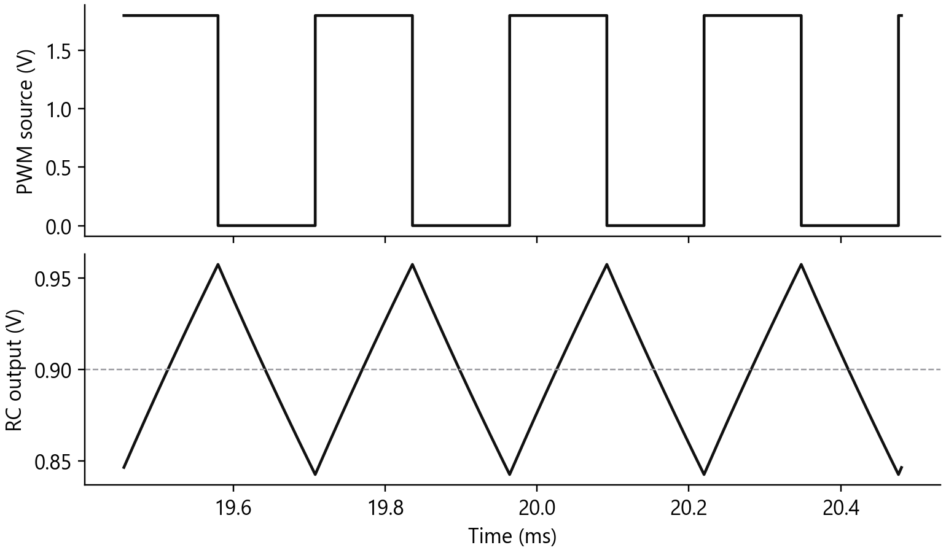
APB PWM TO RC FILTER · TECHNICAL LAB NOTE
Ignytion io
SECTION 06
Mean voltage does not remove ripple
At 50% duty, the mean is approximately 0.9 V, while the waveform still rises and falls within each PWM period.
F I N A L F O U R P W M P E R I O D S · H A L F - S C A L E D U T Y
The measured settled ripple at 50% duty is 115.043 mV peak-to-peak. The 25% and 75% cases each have about 86.3 mV peak-to-peak ripple under these ideal conditions.
The selected RC is a visible demonstration of averaging. A tighter ripple requirement would require a different filter or PWM rate and its own settling-time check.
© 2026 Ignytion IO · ignytion.io
October 2026 · Version 1.0
07 / 09

Slide 8
APB PWM TO RC FILTER · TECHNICAL LAB NOTE
Ignytion io
SECTION 07
Verify the result and reject corrupt data
The checker examines digital records, voltage sources, and analogue tables. Each boundary needs its own check.
BOUNDARY
CHECKED OBSERVATION
RTL
All 80 periods per case have exact high counts
Bridge
Recorded levels and transitions are preserved
Analogue mean
Five targets each meet the 5 mV limit
Analogue shape
Exact RC solution agrees within 0.5 mV
Negative mapping
Half-amplitude bridge is rejected
Negative response
Flat output at midscale is rejected
APB_PWM_DIGITAL_PASS checks=102898
APB_PWM_BRIDGE_AND_RC_REFERENCE_VERIFIED
The analogue observer receives a deliberately flattened midscale output and rejects it. Every positive ngspice log must also show normal completion without a fatal or error line. No physical prototype is used.
© 2026 Ignytion IO · ignytion.io
October 2026 · Version 1.0
08 / 09

Slide 9
APB PWM TO RC FILTER · TECHNICAL LAB NOTE
Ignytion io
SECTION 08
Reproduce, inspect, and extend
Run the simulator stages from the AMS_PWM_RC workspace in WSL. The scripts explicitly select the project environment.
igny init
bash scripts/run.sh digital
bash scripts/run.sh analogue
On the Windows host with NumPy installed, run python scripts/verify.py. The raw CSV files, generated PWL netlists, ngspice tables, and summary retain the evidence. The FFTW library is copied from the preceding amplifier project; a fresh machine needs that runtime dependency.
L I M I T S
The RC components and PWM voltage source are ideal. No transistor-level driver, source impedance, load current, resistor/capacitor tolerance, PVT, noise, feedback, APB latency, physical FPGA demonstration, or signoff claim is made. APB checks cover the declared local contract, not exhaustive protocol certification.
ngspice manual · independent sources and transient analysis
https://ngspice.sourceforge.io/docs/ngspice-manual.pdf
Arm · setup and access phase discussion
https://community.arm.com/forums/f/soc-design-and-simulation-forum/45648/question-related-to-phases-in-apb
Icarus Verilog documentation
https://steveicarus.github.io/iverilog/
© 2026 Ignytion IO · ignytion.io
October 2026 · Version 1.0
09 / 09

