Slide 1

Ignytion io
IGNYTION IO · TECHNICAL LAB NOTE
Compile a Sobel Kernel
from C to SKY130
Actual Bambu RTL, APB integration, routed timing, and independent layout checks
A small image-gradient kernel provides a traceable path from C behaviour to a routed digital core. PandA Bambu generates the arithmetic RTL. An APB wrapper supplies pixels and captures the result. Independent numerical checks, gate simulations, extracted timing, Magic DRC, and Netgen LVS test the implementation at their stated scope.
Ignytion IO · ignytion.io
CRUCIBLE PLATFORM SERIES · OCTOBER 2026

Slide 2
SOBEL HLS TO SKY130 · TECHNICAL LAB NOTE
Ignytion io
SECTION 01
What the local result establishes
The C kernel, generated core, and APB-controlled implementation agree on 5,162 frozen test windows. The routed candidate also meets its declared nominal timing and electrical checks.
CHECK
MEASURED RESULT
STATE
C and generated RTL
5,162 directed/deterministic windows
✓ PASS
APB and gate netlists
67,124 checks per APB run
✓ PASS
TT extracted setup / hold
+11.72 / +0.12 ns at 20 ns
✓ PASS
Slew / capacitance / fanout
Zero reported violations
✓ PASS
Magic / hierarchical LVS
0 DRC errors · 874 devices / 921 nets match
✓ PASS
Negative controls
Wrong result, broken net, and 1 ns target rejected
✓ PASS
Crucible is beta. It supplies the versioned tool environment for the local flow. The SKY130 PDK and native host/runtime dependencies remain explicit prerequisites.
A bounded engineering result
Vector agreement is sampled functional evidence. Timing covers TT, 25 °C, 1.80 V and nominal extracted RC. This result does not establish exhaustive equivalence, other corners, physical FPGA operation, or manufacturing signoff.
© 2026 Ignytion IO · ignytion.io
October 2026 · Version 1.0
02 / 12

Slide 3
SOBEL HLS TO SKY130 · TECHNICAL LAB NOTE
Ignytion io
SECTION 02
Freeze the numerical contract
Each request supplies a complete 3 × 3 window of unsigned eight-bit pixels. The centre pixel is p4; the input bytes run from p0 to p8 in row-major order.
WINDOW ROW
GX COEFFICIENTS
GY COEFFICIENTS
p0, p1, p2
−1, 0, +1
−1, −2, −1
p3, p4, p5
−2, 0, +2
0, 0, 0
p6, p7, p8
−1, 0, +1
+1, +2, +1
The output is min(255, |gx| + |gy|). Signed C integer intermediates hold each gradient, whose magnitude is at most 1,020 for eight-bit pixels. The result is saturated before conversion to an unsigned byte.
This is the L1 gradient approximation. It does not compute a square root. The caller supplies all nine pixels, so image-border handling, line buffering, frame storage and image transport remain outside this window kernel.
Type identity was checked
The freestanding interface uses built-in unsigned char rather than a libc typedef. The compiled C reference is compared independently, the frozen vector hash is enforced, and the actual generated input/output ports are checked to be eight bits wide.
© 2026 Ignytion IO · ignytion.io
October 2026 · Version 1.0
03 / 12

Slide 4
SOBEL HLS TO SKY130 · TECHNICAL LAB NOTE
Ignytion io
SECTION 03
Inspect what Bambu generated
PandA Bambu 2024.10 compiled the actual C kernel to Verilog. The generated file retains its compiler revision and IP-library notices; its arithmetic is used directly in the implementation.
cd build/hls
igny run --env hls-sobel bambu ../../src/sobel.c \
--top-fname=sobel3x3 --clock-period=20
PORT OR PROPERTY
OBSERVED GENERATION
p0 through p8
Nine unsigned 8-bit inputs
return_port
Unsigned 8-bit output
reset
Synchronous, active low
start_port / done_port
Done follows start in the generated single-state controller
Arithmetic datapath
Combinational; Bambu reports zero datapath flip-flops
The core adapter only maps ports and byte order. It does not reimplement Sobel arithmetic. The core test observes completion at its first sampled edge after applying start and compares the result with the frozen byte.
That handshake observation is not a general promise about HLS latency. This particular generated controller has one state; a different kernel or Bambu configuration may produce a multi-cycle interface.
© 2026 Ignytion IO · ignytion.io
October 2026 · Version 1.0
04 / 12

Slide 5
SOBEL HLS TO SKY130 · TECHNICAL LAB NOTE
Ignytion io
SECTION 04
Make the result accessible over APB
The wrapper owns pixel storage, start, busy, sticky done and the captured result. It uses one clock and an active-low reset, with zero-wait APB accesses.
OFFSET
REGISTER
CONTRACT
0x00
Control
Write bit 0 to start; read returns zero
0x04
Status
Read bit 0 = busy; bit 1 = done
0x08
Result
Read the saturated result in bits 7:0
0x10
Pixels 0–3
Four bytes; p0 is the least significant byte
0x14
Pixels 4–7
Four bytes; p4 is the least significant byte
0x18
Pixel 8
p8 is in bits 7:0; all 32 bits read back
A completed start write sets busy and clears done. The following core-completion edge captures the output, clears busy, and sets done. Reset clears all storage. Setup phases have no write side effects.
Unmapped or unaligned addresses and writes to status/result return an error. Busy writes are guarded in the wrapper, but the combinational core finishes before the next legal APB access; the suite does not claim a multi-cycle backpressure demonstration.
© 2026 Ignytion IO · ignytion.io
October 2026 · Version 1.0
05 / 12

Slide 6
SOBEL HLS TO SKY130 · TECHNICAL LAB NOTE
Ignytion io
SECTION 05
Use an independent numerical observer
A Python matrix-kernel calculation is compared with the compiled C function before the resulting windows and expected bytes are frozen for RTL simulation.
VECTOR CLASS
COUNT OR OBSERVATION
Directed constant / impulse / edge cases
42 windows
Low-range deterministic random pixels
4,096 windows · values 0–31
Full-byte deterministic random pixels
1,024 windows · values 0–255
Output diversity
126 distinct result bytes
Unsaturated results
4,382 windows
Frozen seed
0x50BE1
The low-range cases exercise arithmetic below the saturation limit. Constant, impulse and directional-edge cases test zero response, pixel position and gradient orientation. Both positive and negative gradients occur.
The same frozen vectors drive the generated core, APB wrapper, mapped netlist and routed netlist. Four-state comparisons reject unknown results. Watchdogs convert a stalled test into a fatal error.
SOBEL_GENERATED_CORE_PASS vectors=5162 max_cycles=1
SOBEL_APB_PASS vectors=5162 checks=67124 max_polls=1
© 2026 Ignytion IO · ignytion.io
October 2026 · Version 1.0
06 / 12

Slide 7
SOBEL HLS TO SKY130 · TECHNICAL LAB NOTE
Ignytion io
SECTION 06
Require the observers to reject faults
A positive run is paired with deliberate, causal failures. Golden RTL, constraints and layout remain intact while scratch inputs or comparison references are corrupted.
CONTROL
EXPECTED OBSERVATION
MEASURED OUTCOME
Wrong expected byte
Zero window should return zero
Expected 1, observed 0; exit 1
Disconnected result-Q net
Disconnect differs from layout
Netgen reports netlists do not match
1 ns clock constraint
Route misses the target
-7.2826 ns setup slack; violated
The runner checks both a nonzero simulator exit and the causal mismatch for the corrupted byte. LVS success is read from the comparison result, because Netgen process exit alone does not establish a match.
The timing control reuses the routed OpenDB and extracted SPEF, then replaces only the analysis clock with 1 ns. It leaves the implemented design and saved 20 ns SDC unchanged.
Limits of these controls
The controls show that these observers can discriminate the injected faults. They do not measure structural fault coverage or prove that every possible design bug would be detected.
© 2026 Ignytion IO · ignytion.io
October 2026 · Version 1.0
07 / 12

Slide 8
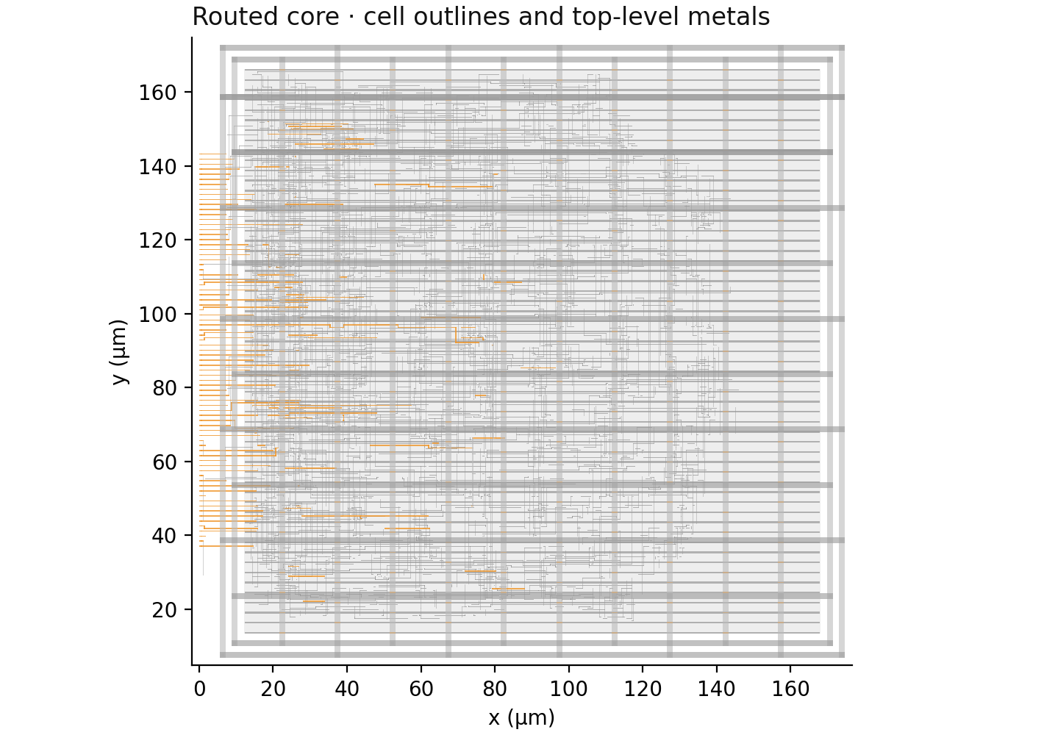
SOBEL HLS TO SKY130 · TECHNICAL LAB NOTE
Ignytion io
SECTION 07
Implement a real routed core
Yosys maps the unchanged arithmetic and APB RTL to SKY130 HD cells. OpenROAD performs floorplanning, taps, PDN, placement, electrical repair, CTS, hold repair and routing.
A C T U A L G D S G E O M E T R Y
Figure 1 · Top-level metal geometry and instance outlines decoded from the streamed GDS. Metal 3 is orange; other routing and power-grid geometry are grey. The DEF die target is 180 × 180 µm.
The GDS stream uses actual standard-cell mask views and an explicit SKY130 layer map. Supply ports carry names on metal 5, so independent extraction can compare VPWR and VGND as top-level pins.
© 2026 Ignytion IO · ignytion.io
October 2026 · Version 1.0
08 / 12

Slide 9
SOBEL HLS TO SKY130 · TECHNICAL LAB NOTE
Ignytion io
SECTION 08
Check timing and electrical limits together
OpenRCX SPEF and propagated clocks feed the final nominal analysis. Meeting setup and hold is accompanied by explicit slew, capacitance and fanout checks.
ASSUMPTION OR RESULT
VALUE
Clock period / uncertainty
20 ns / 0.1 ns
Data input delay · maximum / minimum
2.0 ns / 0.2 ns
Data input transition / output load
0.1 ns / 0.005 pF
Fanout limit
32
Library / extraction
TT 25 °C, 1.80 V / nominal OpenRCX rules
Extracted setup / hold worst slack
+11.72 ns / +0.12 ns
Slew, capacitance, fanout violations
0 reported
Placement-based repair first left one high-fanout address-select net above its routed electrical limit. A 30% slew/capacitance repair margin and 0.1 ns hold-planning margin address the measured estimate-to-route shift. Final checks use extracted results.
Reset is explicitly false-pathed. Its recovery/removal and distribution remain outside this timing claim. Other PVT corners, RC corners, antenna, density, IR drop and electromigration require separate analysis.
© 2026 Ignytion IO · ignytion.io
October 2026 · Version 1.0
09 / 12

Slide 10
SOBEL HLS TO SKY130 · TECHNICAL LAB NOTE
Ignytion io
SECTION 09
Compare independent layout evidence
Magic reads the streamed GDS, runs the installed SKY130 rule checks, and extracts connectivity. Netgen compares that extraction with the routed reference netlist.
EVIDENCE
OBSERVATION
TritonRoute report
Present and empty · routing checker scope
Magic DRC
Total DRC errors found: 0
Hierarchical Netgen match
874 devices and 921 nets on each side
Top-level supply pins
VPWR and VGND match by name
Disconnected result output
Netlists do not match
The comparison retains power and body pins. Physical filler/tap classes are exempted by the PDK setup. This is a hierarchical standard-cell connectivity comparison; it is not a flat transistor-level proof of every library cell.
The independent checks cover the actual GDS geometry, not only DEF generation. The tested tool versions and PDK files are recorded with hashes. Library geometry, extraction warnings and modelling limits remain part of the evidence.
No manufacturing qualification
Zero reported DRC errors and a unique LVS match are useful local evidence. Foundry acceptance, package/IO/ESD integration, complete signoff and silicon behaviour remain unestablished.
© 2026 Ignytion IO · ignytion.io
October 2026 · Version 1.0
10 / 12

Slide 11
SOBEL HLS TO SKY130 · TECHNICAL LAB NOTE
Ignytion io
SECTION 10
Reproduce the staged flow
Use the HLS_Sobel workspace in Linux/WSL, its pinned Crucible tools, a complete SKY130 HD PDK, and a host C compiler/Python environment for the numerical reference.
igny init
igny workspace sync
bash scripts/reference.sh
bash scripts/run.sh hls
bash scripts/run.sh core
bash scripts/run.sh apb
bash scripts/run.sh synth
bash scripts/run.sh mapped
bash scripts/run.sh physical
bash scripts/run.sh stream
bash scripts/run.sh routed
bash scripts/physical_verify.sh
bash scripts/controls.sh
python3 scripts/verify.py
Set PDKPATH if the PDK is outside the default Ciel location. KLayout Python bindings are needed by the final observer. Bambu’s packaged archive is approximately 1.39 GB; workspace sync may acquire it when absent. Native runtime dependencies must also resolve.
Builds and raw logs are regenerated locally. The repository keeps compact measured summaries and the final whitepaper in docs/. Independent clean-machine reproduction has not been demonstrated.
© 2026 Ignytion IO · ignytion.io
October 2026 · Version 1.0
11 / 12

Slide 12
SOBEL HLS TO SKY130 · TECHNICAL LAB NOTE
Ignytion io
SECTION 11
Scope, provenance and source notes
This note demonstrates one window kernel and one APB wrapper. Its measured implementation is a nominal SKY130 digital-core candidate.
It does not include image line buffers, frame memory, DMA, video timing, exhaustive APB conformance, exhaustive numerical equivalence, SDF simulation, multiple clock domains, other PVT/RC corners, or FPGA board verification. GDS generation and local checks do not establish tapeout readiness.
P R I M A R Y T O O L A N D P D K R E F E R E N C E S
PandA Bambu · C-to-Verilog tutorial
https://panda.deib.polimi.it/?page_id=555
OpenROAD · Gate Resizer
https://openroad.readthedocs.io/en/latest/main/src/rsz/README.html
SKY130 · foundry-provided standard-cell libraries
https://skywater-pdk.readthedocs.io/en/main/contents/libraries/foundry-provided.html
Measurements are from the local runs through 29 October 2026. Bambu 2024.10, Yosys 0.63, OpenROAD 26Q3-771, Icarus 14, Magic 8.3.682, Netgen 1.5.323 and KLayout 0.30.10 retain their upstream credit. Exact artifact identities are in the project lock and evidence manifests. No endorsement is implied.
© 2026 Ignytion IO · ignytion.io
October 2026 · Version 1.0
12 / 12

