Slide 1

Ignytion io
IGNYTION IO · TECHNICAL LAB NOTE
Analog CMOS
Experiments on a
Reproducible Workbench
MOS device modelling, logic, amplification and oscillation - end-to-end on Crucible
Six self-contained analog CMOS experiments, each combining a Python design-equation check with a SPICE simulation deck - every step driven by the Crucible CLI (igny), in reproducible workspaces, with no manual EDA installation.
# | EXPERIMENT | TOOLS (VIA igny) | RESULT
1–6 | MOS modeling → logic → amplifiers → oscillator | ngspice, Python | ✓ ALL PASS
Ignytion IO · ignytion.io
CRUCIBLE PLATFORM SERIES · JULY 2026

Slide 2
ANALOG CMOS EXPERIMENTS · TECHNICAL LAB NOTE
Ignytion io
OVERVIEW
Toolchain & Contents
Each experiment pairs a compact analytical verification flow with a SPICE deck. The Python script checks the design equations, sizing and operating-point assumptions; the SPICE deck confirms them through the Crucible-managed ngspice tool. Environments and workspaces are created once and bound per experiment. All tool execution runs through igny run.
TOOLCHAIN USED
ROLE | TOOL
Interface | Crucible CLI by Ignytion IO
Workbench | Crucible, Community tier
Simulator | Ngspice 46
Analytical checks | Python + Matplotlib
CONTENTS
01
MOSFET Parameter Extraction
02
Short-Channel nMOSFET Bias
03
CMOS & Pseudo-nMOS NAND
04
Common-Source Amplifier
05
CMOS Differential Amplifier
06
Op-Amp Square-Wave Generator
© 2026 Ignytion IO · ignytion.io
July 2026 · Version 1.0
02 / 16

Slide 3
ANALOG CMOS EXPERIMENTS · TECHNICAL LAB NOTE
Ignytion io
SECTION 1
Crucible Workspace Setup
One environment for the whole lab. Create it once, install the tools once, then bind each experiment to a workspace. Every command below runs through igny.
SETUP COMMAND PATTERN
# launch Crucible
igny init
# one-time environment + tools
igny env create analog_experiments
igny workspace create --path analog_demo --env analog_experiments
cd analog_demo
igny tool install ngspice
igny tool install matplotlib
# per experiment (run from its folder)
igny run script .\scripts\run_analysis.py
igny run ngspice –b -o build/spice.log spice/design.cir
type .\build\spice.log
How the two checks differ
• The Python script is the analytical check, it verifies the design equations and prints a PASS line, independent of the simulator.
• The SPICE deck is the simulator-backed check. Use -b (batch) for DC operating-point decks; drop -b only when a transient waveform should open in the ngspice GUI (Experiment 6).
© 2026 Ignytion IO · ignytion.io
July 2026 · Version 1.0
03 / 16

Slide 4
EXPERIMENT 1 · MOSFET PARAMETER EXTRACTION
Ignytion io
EXPERIMENT 01 · DEVICE MODELING
MOSFET Parameter Extraction
AIM
Calculate representative MOSFET parameters - oxide capacitance, mobility-derived process gain, transconductance, output resistance and threshold voltages - for a first-order MOS process.
THEORY
Oxide capacitance per unit area is set by oxide permittivity and thickness. Mobility, oxide capacitance and geometry fix the process-gain terms used in first-order MOS design.
With a chosen overdrive, the flow estimates drain current, transconductance and output resistance, and confirms the parameters are positive and internally consistent.
DESIGN RELATION
APPARATUS
Cox = εox / tox
kn = μn·Cox·(W/L)
kp = μp·Cox·(W/L)
run_analysis.py
design.cir
ngspice
PROCEDURE
cd experiment_folder
igny workspace create --env analog_experiments
igny run script run_analysis.py
igny run ngspice -b -o build/spice.log spice/design.cir
type .\build\spice.log
ANALYTICAL VERIFICATION
SPICE RUN
$ igny run script .\scripts\run_analysis.py
Cox=7.458e-03 F/m^2 kn=3.356e-04 A/V^2
kp=1.193e-04 A/V^2
PASS mosfet_parameter_extraction
$ igny run ngspice -b -o build/spice.log spice/design.cir
v(dn) = 1.560617e+00
v(dp) = 8.539634e-02
Tool 'ngspice' completed successfully
© 2026 Ignytion IO · ignytion.io
July 2026 · Version 1.0
04 / 16

Slide 5
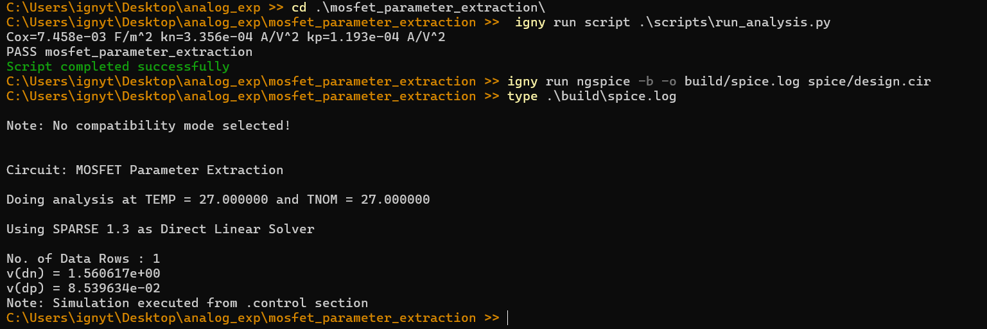
EXPERIMENT 1 · MOSFET PARAMETER EXTRACTION
Ignytion io
EXPERIMENT 01 · (contd.)
CRUCIBLE EXECUTION
RESULT
The extraction flow completes cleanly. Oxide capacitance and process-gain values are valid, and the SPICE operating point confirms the NMOS and PMOS models bias correctly.
✓
Experiment 1 - PASS
Key result: Cox=7.458e-03 F/m², kn=3.356e-04 A/V².
© 2026 Ignytion IO · ignytion.io
July 2026 · Version 1.0
05 / 16

Slide 6
EXPERIMENT 2 · PROPERLY BIASED SHORT-CHANNEL NMOSFET
Ignytion io
EXPERIMENT 02 · DEVICE BIASING
Properly Biased Short-Channel nMOSFET
AIM
Design a short-channel nMOSFET current sink biased in saturation, and verify width, bias voltages, drain current, transconductance and saturation margin.
THEORY
For a short-channel current sink, VGS must supply enough overdrive while VDS keeps the device in saturation.
The flow picks a target drain current, computes the width for a fixed channel length, and reports the saturation margin so the operating distance from triode is visible.
DESIGN RELATION
APPARATUS
VOV = VGS − VTH
VDS ≥ VOV
run_analysis.py
design.cir
ngspice
PROCEDURE
cd experiment_folder
igny workspace create --env analog_experiments
igny run script run_analysis.py
igny run ngspice -b -o build/spice.log spice/design.cir
type .\build\spice.log
ANALYTICAL VERIFICATION
SPICE RUN
$ igny run script run_analysis.py
W=3.46 um L=0.18 um VGS=0.65 V VDS=0.90 V
ID=100.0 uA gm=1.00 mS margin=0.70 V
PASS short_channel_nmos_bias
$ igny run ngspice -b -o build/spice.log spice/design.cir
i(vd) = -7.96569e-05
v(d) = 9.000000e-01 v(g) = 6.500000e-01
Tool 'ngspice' completed successfully
© 2026 Ignytion IO · ignytion.io
July 2026 · Version 1.0
06 / 16

Slide 7
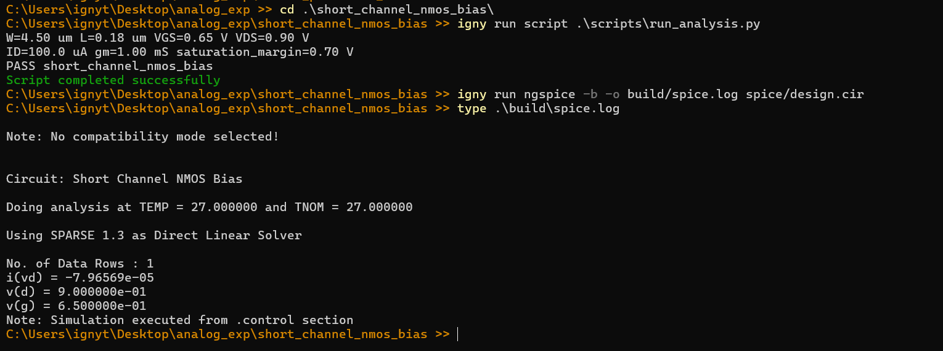
EXPERIMENT 2 · PROPERLY BIASED SHORT-CHANNEL NMOSFET
Ignytion io
EXPERIMENT 02 · (contd.)
CRUCIBLE EXECUTION
RESULT
The selected width supports the target 100 µA drain current with a 0.70 V saturation margin - properly biased for the stated operating point.
✓
Experiment 2 - PASS
Key result: ID=100.0 µA, gm=1.00 mS, margin 0.70 V.
© 2026 Ignytion IO · ignytion.io
July 2026 · Version 1.0
07 / 16

Slide 8
EXPERIMENT 3 · CMOS AND PSEUDO-NMOS 2-INPUT NAND GATE
Ignytion io
EXPERIMENT 03 · LOGIC FAMILIES
CMOS and Pseudo-nMOS 2-Input NAND Gate
AIM
Design a 2-input NAND in complementary CMOS and pseudo-nMOS, then compare truth-table behaviour and the static low-level output.
THEORY
A complementary CMOS NAND uses a parallel pMOS pull-up and a series nMOS pull-down; the output is low only when both inputs are high.
Pseudo-nMOS replaces the pull-up with an always-on weak pMOS load, cutting device count but making VOL depend on the pull-up / pull-down strength ratio.
DESIGN RELATION
APPARATUS
Y = !(A · B)
VOL depends on pMOS-load / nMOS-stack ratio
run_analysis.py
design.cir
ngspice
PROCEDURE
cd experiment_folder
igny workspace create --env analog_experiments
igny run script run_analysis.py
igny run ngspice -b -o build/spice.log spice/design.cir
type .\build\spice.log
ANALYTICAL VERIFICATION
SPICE RUN
$ igny run script run_analysis.py
A=0 B=0 CMOS=1 pseudo_nmos=1.800 V
A=1 B=1 CMOS=0 pseudo_nmos=0.212 V
PASS cmos_pseudo_nmos_nand
$ igny run ngspice -b -o build/spice.log spice/design.cir
v(y1) = 2.413333e-09
v(y2) = 4.067857e-01
Tool 'ngspice' completed successfully
© 2026 Ignytion IO · ignytion.io
July 2026 · Version 1.0
08 / 16

Slide 9
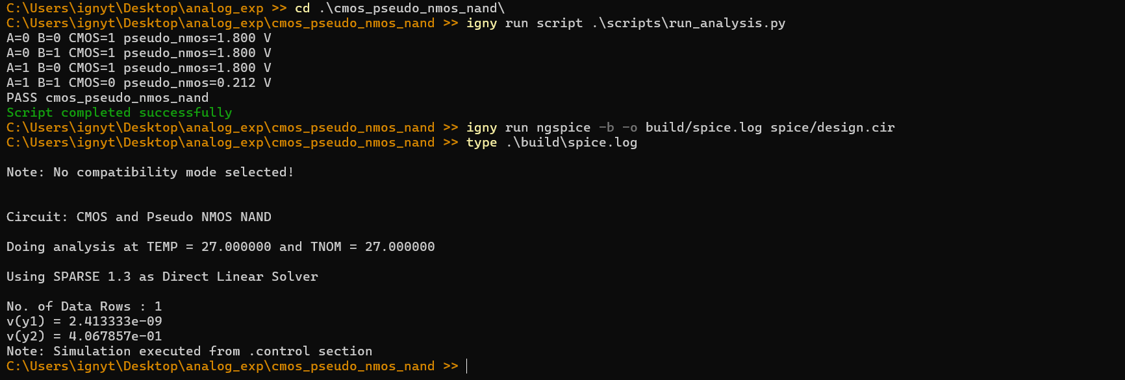
EXPERIMENT 3 · CMOS AND PSEUDO-NMOS 2-INPUT NAND GATE
Ignytion io
EXPERIMENT 03 · (contd.)
CRUCIBLE EXECUTION
RESULT
Both styles implement NAND. Pseudo-nMOS holds 1.800 V for pull-up cases and reaches 0.212 V when both inputs are high.
✓
Experiment 3 - PASS
Key result: Pseudo-nMOS low output 0.212 V.
© 2026 Ignytion IO · ignytion.io
July 2026 · Version 1.0
09 / 16

Slide 10
EXPERIMENT 4 · COMMON-SOURCE AMPLIFIER
Ignytion io
EXPERIMENT 04 · ANALOG GAIN STAGE
Common-Source Amplifier
AIM
Design a resistively loaded nMOS common-source amplifier and verify its bias point, small-signal voltage gain, output headroom and dominant-pole estimate.
THEORY
The common-source stage converts input gate-voltage variation into an inverted drain-voltage swing.
The output quiescent voltage must stay inside a useful swing, while drain-node capacitance and output resistance set a dominant-pole estimate.
DESIGN RELATION
APPARATUS
Av = −gm · (RD ∥ ro)
run_analysis.py
design.cir
ngspice
PROCEDURE
cd experiment_folder
igny workspace create --env analog_experiments
igny run script run_analysis.py
igny run ngspice -b -o build/spice.log spice/design.cir
type .\build\spice.log
ANALYTICAL VERIFICATION
SPICE RUN
$ igny run script run_analysis.py
gm=1.00 mS ro=125.0 kOhm gain=-6.90 V/V
VoutQ=1.05 V pole=230.8 MHz
PASS common_source_amplifier
$ igny run ngspice -b -o build/spice.log spice/design.cir
v(out) = 1.300673e+00
Tool 'ngspice' completed successfully
© 2026 Ignytion IO · ignytion.io
July 2026 · Version 1.0
10 / 16

Slide 11
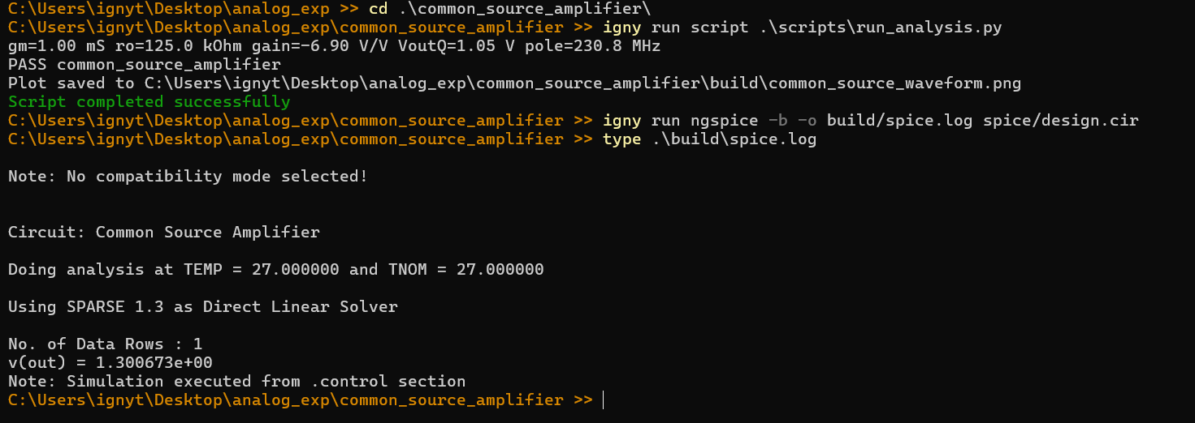
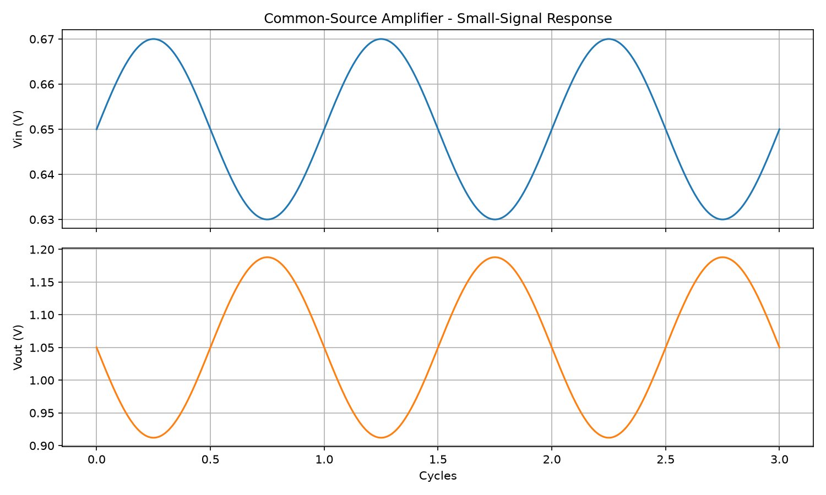
EXPERIMENT 4 · COMMON-SOURCE AMPLIFIER
Ignytion io
EXPERIMENT 04 · (contd.)
CRUCIBLE EXECUTION
PLOT GENERATED ON CRUCIBLE
RESULT
The amplifier reaches −6.90 V/V gain with a 1.05 V output quiescent point and an estimated 230.8 MHz dominant pole. plot() renders the inverted small-signal waveform.
✓
Experiment 4 - PASS
Key result: Gain −6.90 V/V, pole 230.8 MHz.
© 2026 Ignytion IO · ignytion.io
July 2026 · Version 1.0
11 / 16

Slide 12
EXPERIMENT 5 · CMOS DIFFERENTIAL AMPLIFIER
Ignytion io
EXPERIMENT 05 · DIFFERENTIAL ANALOG STAGE
CMOS Differential Amplifier
AIM
Design a CMOS differential amplifier and estimate differential gain, common-mode gain, CMRR and input common-mode range.
THEORY
A differential amplifier responds to input difference while rejecting common-mode motion. Key checks are differential gain, tail biasing, common-mode range and CMRR.
The flow computes differential and common-mode gain, reports CMRR in dB, and verifies headroom against the bias assumptions.
DESIGN RELATION
APPARATUS
CMRR = | Ad / Acm |
run_analysis.py
design.cir
ngspice
PROCEDURE
cd experiment_folder
igny workspace create --env analog_experiments
igny run script run_analysis.py
igny run ngspice -b -o build/spice.log spice/design.cir
type .\build\spice.log
ANALYTICAL VERIFICATION
SPICE RUN
$ igny run script run_analysis.py
Ad=-5.73 V/V Acm=-0.0057 CMRR=60.0 dB
VCM=[0.85,1.65] V
PASS cmos_differential_amplifier
$ igny run ngspice -b -o build/spice.log spice/design.cir
v(outp) = 2.691222e-01
v(outn) = 1.119067e+00
Tool 'ngspice' completed successfully
© 2026 Ignytion IO · ignytion.io
July 2026 · Version 1.0
12 / 16

Slide 13
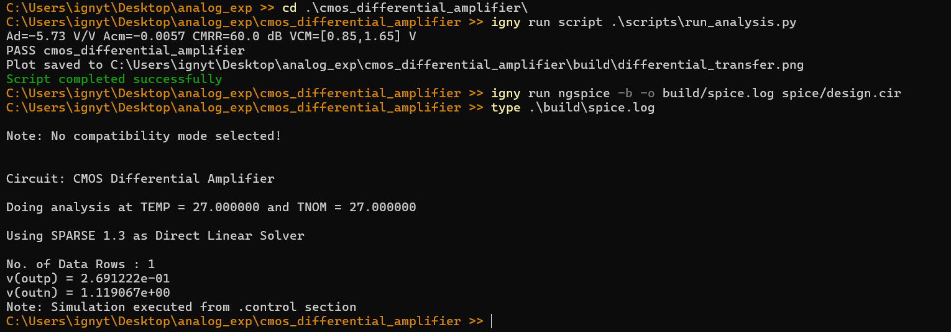
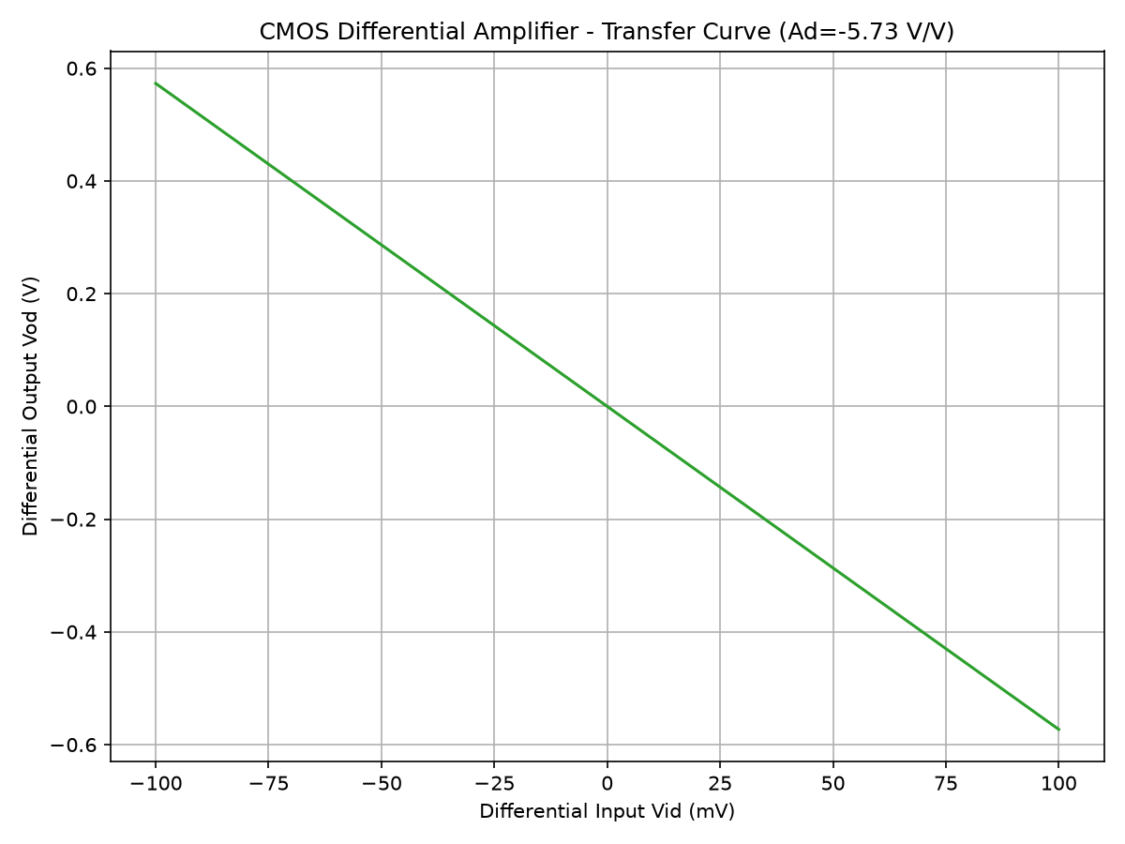
EXPERIMENT 5 · CMOS DIFFERENTIAL AMPLIFIER
Ignytion io
EXPERIMENT 05 · (contd.)
CRUCIBLE EXECUTION
PLOT GENERATED ON CRUCIBLE
RESULT
The amplifier reaches −5.73 V/V differential gain with 60.0 dB CMRR and a valid 0.85–1.65 V input common-mode range. plot() renders the Vod–Vid transfer curve.
✓
Experiment 5 - PASS
Key result: Gain −5.73 V/V, CMRR 60.0 dB.
© 2026 Ignytion IO · ignytion.io
July 2026 · Version 1.0
13 / 16

Slide 14
EXPERIMENT 6 · CMOS OP-AMP SQUARE-WAVE GENERATOR
Ignytion io
EXPERIMENT 06 · OSCILLATOR
CMOS Op-Amp Square-Wave Generator
AIM
Design an op-amp relaxation oscillator that produces a square wave above 1 MHz, and verify it in an interactive ngspice transient run.
THEORY
The circuit is a Schmitt-trigger relaxation oscillator: a capacitor charges and discharges between thresholds set by the feedback factor around a mid-supply reference.
The chosen R and C give a frequency above 1 MHz at a near-50% duty cycle; the clamped comparator holds the output between the rails so it oscillates instead of diverging.
DESIGN RELATION
APPARATUS
f = 1 / ( 2·R·C·ln((1+β)/(1−β)) )
run_analysis.py
design.cir
ngspice
PROCEDURE
cd experiment_folder
igny workspace create --env analog_experiments
igny run script run_analysis.py
igny run ngspice -o build/spice.log spice/design.cir
ANALYTICAL VERIFICATION
SPICE RUN
$ igny run script run_analysis.py
R=8.20 kOhm C=50.0 pF beta=0.50
freq=1.110 MHz duty=0.50
PASS opamp_square_wave_generator
$ igny run ngspice -o build/spice.log spice/design.cir
Transient run - .control opens plot v(out)
Sustained square wave, 0 <-> 1.8 V
© 2026 Ignytion IO · ignytion.io
July 2026 · Version 1.0
14 / 16

Slide 15
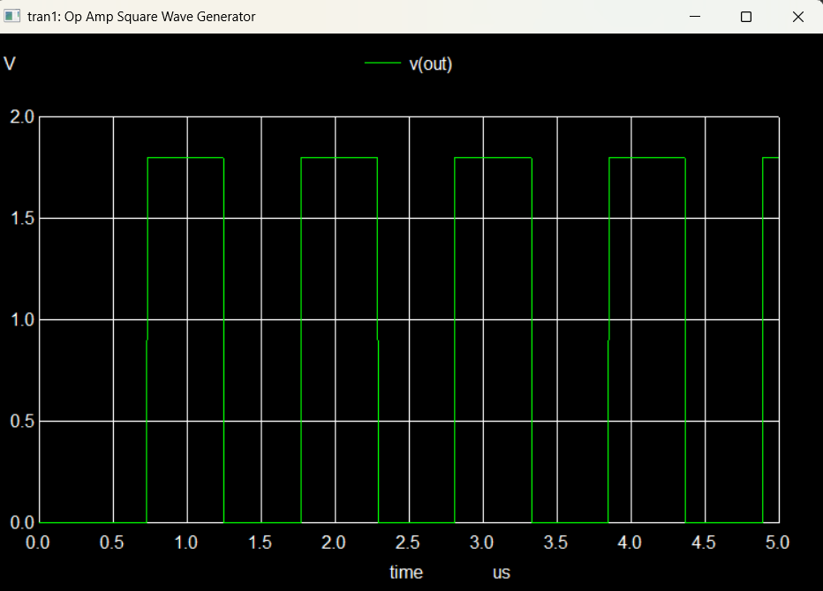
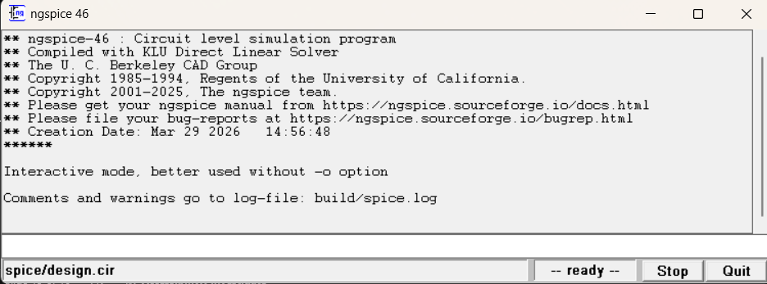
EXPERIMENT 6 · CMOS OP-AMP SQUARE-WAVE GENERATOR
Ignytion io
EXPERIMENT 06 · (contd.)
CRUCIBLE EXECUTION
SQUARE WAVE OUTPUT
NGSPICE GUI
RESULT
The RC network gives a 1.110 MHz oscillation at ~50% duty. Run without -b so the .control / plot block opens the live square-wave waveform in the ngspice GUI.
✓
Experiment 6 - PASS
Key result: Frequency 1.110 MHz, duty 0.50.
© 2026 Ignytion IO · ignytion.io
July 2026 · Version 1.0
15 / 16

Slide 16
ANALOG CMOS EXPERIMENTS · TECHNICAL LAB NOTE
Ignytion io
SUMMARY
Summary of Results
# | EXPERIMENT | KEY RESULT | STATUS
1 | MOSFET Parameter Extraction | Cox=7.458e-03 F/m², kn=3.356e-04 A/V² | ✓ PASS
2 | Properly Biased Short-Channel nMOSFET | ID=100.0 µA, gm=1.00 mS, margin 0.70 V | ✓ PASS
3 | CMOS and Pseudo-nMOS 2-Input NAND Gate | Pseudo-nMOS low output 0.212 V | ✓ PASS
4 | Common-Source Amplifier | Gain −6.90 V/V, pole 230.8 MHz | ✓ PASS
5 | CMOS Differential Amplifier | Gain −5.73 V/V, CMRR 60.0 dB | ✓ PASS
6 | CMOS Op-Amp Square-Wave Generator | Frequency 1.110 MHz, duty 0.50 | ✓ PASS
All six analog CMOS experiments run successfully through the Crucible CLI. Each pairs design-equation verification with SPICE simulation, tied to a named environment so any engineer can reproduce the lab with identical tool versions - design collateral, simulator execution and environment state kept together in one reproducible workflow.
© 2026 Ignytion IO · ignytion.io
July 2026 · Version 1.0
16 / 16

