Slide 1

Ignytion io
IGNYTION IO · TECHNICAL LAB NOTE
From SPICE to GDS:
a SKY130 Amplifier
Two transistors, an external bias, and a checked physical implementation
An inverter can amplify a small analogue signal when its input is biased near the transition region. This note follows a SKY130 CMOS inverter from transistor simulation through layout, design-rule checking, schematic equivalence, and capacitance extraction. It reports the measured gain and the dependencies needed to repeat this local experiment.
Ignytion IO · ignytion.io
CRUCIBLE PLATFORM SERIES · OCTOBER 2026

Slide 2
SKY130 INVERTER AMPLIFIER · TECHNICAL LAB NOTE
Ignytion io
SECTION 01
What this experiment establishes
A 1 mV peak input at 1 kHz produces an inverted output of approximately 135 mV peak. Both the schematic and extracted circuit pass the declared numerical checks.
CHECK
OBSERVED RESULT
STATE
Schematic AC gain
135.86 V/V at 1 kHz
✓ PASS
Extracted AC gain
135.86 V/V at 1 kHz
✓ PASS
Magic DRC
0 reported errors
✓ PASS
Netgen LVS
2 devices · 4 nets · unique match
✓ PASS
Negative controls
Open gate and corrupt waves rejected
✓ PASS
Read the scope before using the numbers
This is a TT, 27 °C, 1.8 V educational experiment with a 100 fF ideal load. The extracted model includes capacitance. It excludes interconnect resistance, process variation, and fabricated-silicon measurements.
Crucible is beta. Its environment records the managed tools used here. A separately acquired Tcl-capable Magic build supplies the layout generator because the installed classic binary cannot execute the PDK scripts.
© 2026 Ignytion IO · ignytion.io
October 2026 · Version 1.0
02 / 12

Slide 3
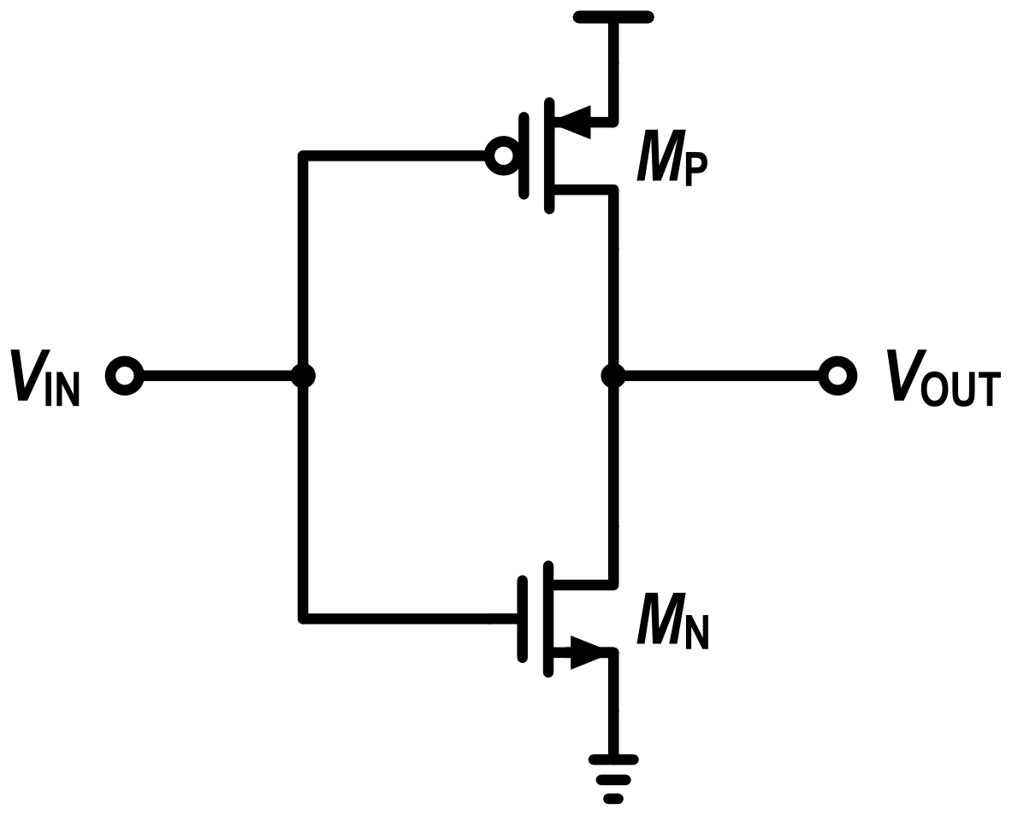
SKY130 INVERTER AMPLIFIER · TECHNICAL LAB NOTE
Ignytion io
SECTION 02
How the amplifier works
The PMOS transistor pulls the output towards the supply. The NMOS pulls it towards ground. Both gates receive the same input.
Figure 1 · CMOS inverter amplifier · body terminals tied to their source supplies
DEVICE
W / L
MODEL
MN
2 / 0.5 µm
SKY130 1.8 V NMOS
MP
6 / 0.5 µm
SKY130 1.8 V PMOS
Near the transition, a higher input strengthens the NMOS and weakens the PMOS. The output falls. The steep negative slope becomes inverting voltage gain for a sufficiently small signal.
The source supplies are 1.8 V and ground. Ideal sources set the input bias; the bias circuit and 100 fF output load are outside the layout.
© 2026 Ignytion IO · ignytion.io
October 2026 · Version 1.0
03 / 12

Slide 4
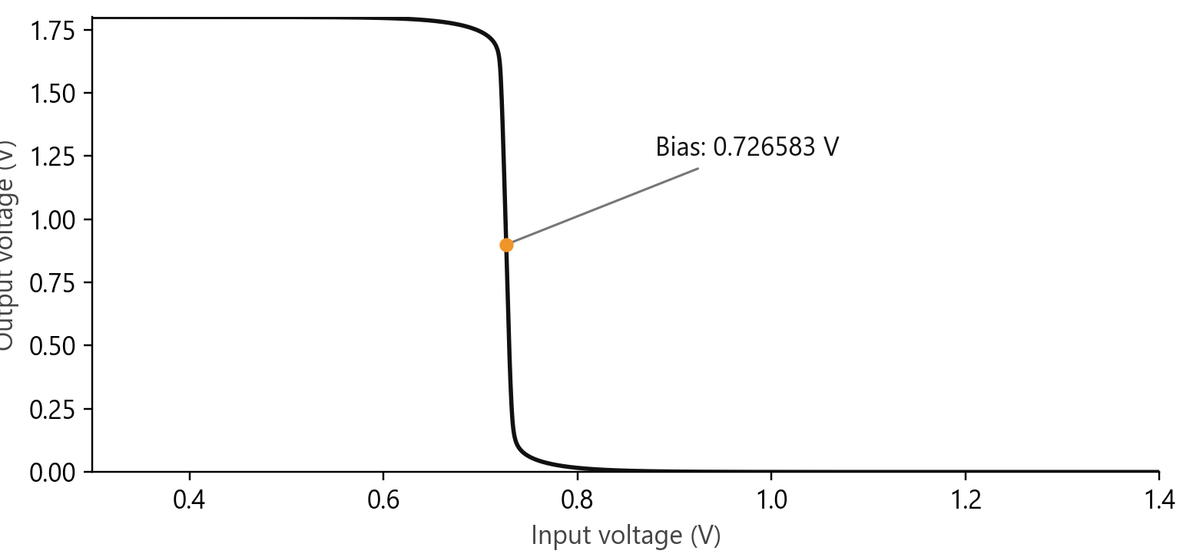
SKY130 INVERTER AMPLIFIER · TECHNICAL LAB NOTE
Ignytion io
SECTION 03
Find the operating point
The DC sweep varies the input from 0.3 V to 1.4 V in 0.5 mV steps. Linear interpolation locates the input that places the output at half the supply.
D C T R A N S F E R · S C H E M A T I C S I M U L A T I O N
QUANTITY
MEASURED VALUE
Selected input bias
0.726583174 V
Schematic output
0.899991742 V
Supply current
6.528463 µA
A separate operating-point simulation checks the interpolated bias. Its output is within the predeclared 20 mV window around 0.9 V. The narrow transition makes external bias accuracy significant.
© 2026 Ignytion IO · ignytion.io
October 2026 · Version 1.0
04 / 12

Slide 5
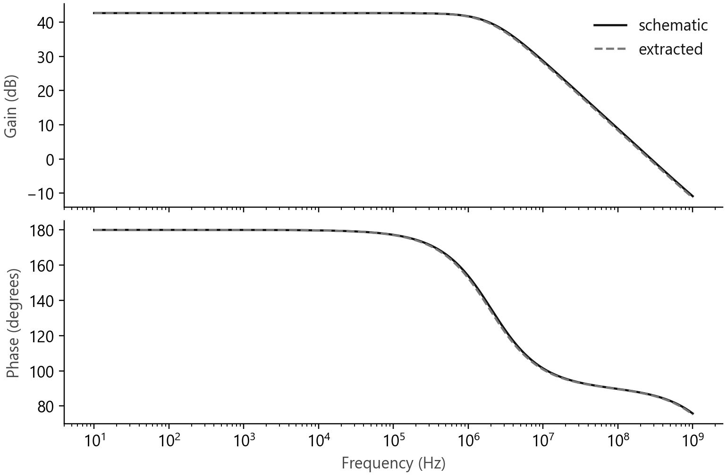
SKY130 INVERTER AMPLIFIER · TECHNICAL LAB NOTE
Ignytion io
SECTION 04
Measure small-signal gain
AC analysis linearises the devices around the operating point. A unit AC input makes the output magnitude equal to the voltage-gain magnitude.
A C R E S P O N S E · S A M E B I A S A N D L O A D
At 1 kHz, the schematic gain is 135.86 V/V. The extracted gain rounds to the same value. The phase is approximately 180°, consistent with inversion.
The curves nearly overlap at low frequency. The frequency sweep shows the capacitive roll-off; these results are specific to this circuit and load. No gain-bandwidth or stability guarantee is inferred for another application.
© 2026 Ignytion IO · ignytion.io
October 2026 · Version 1.0
05 / 12

Slide 6
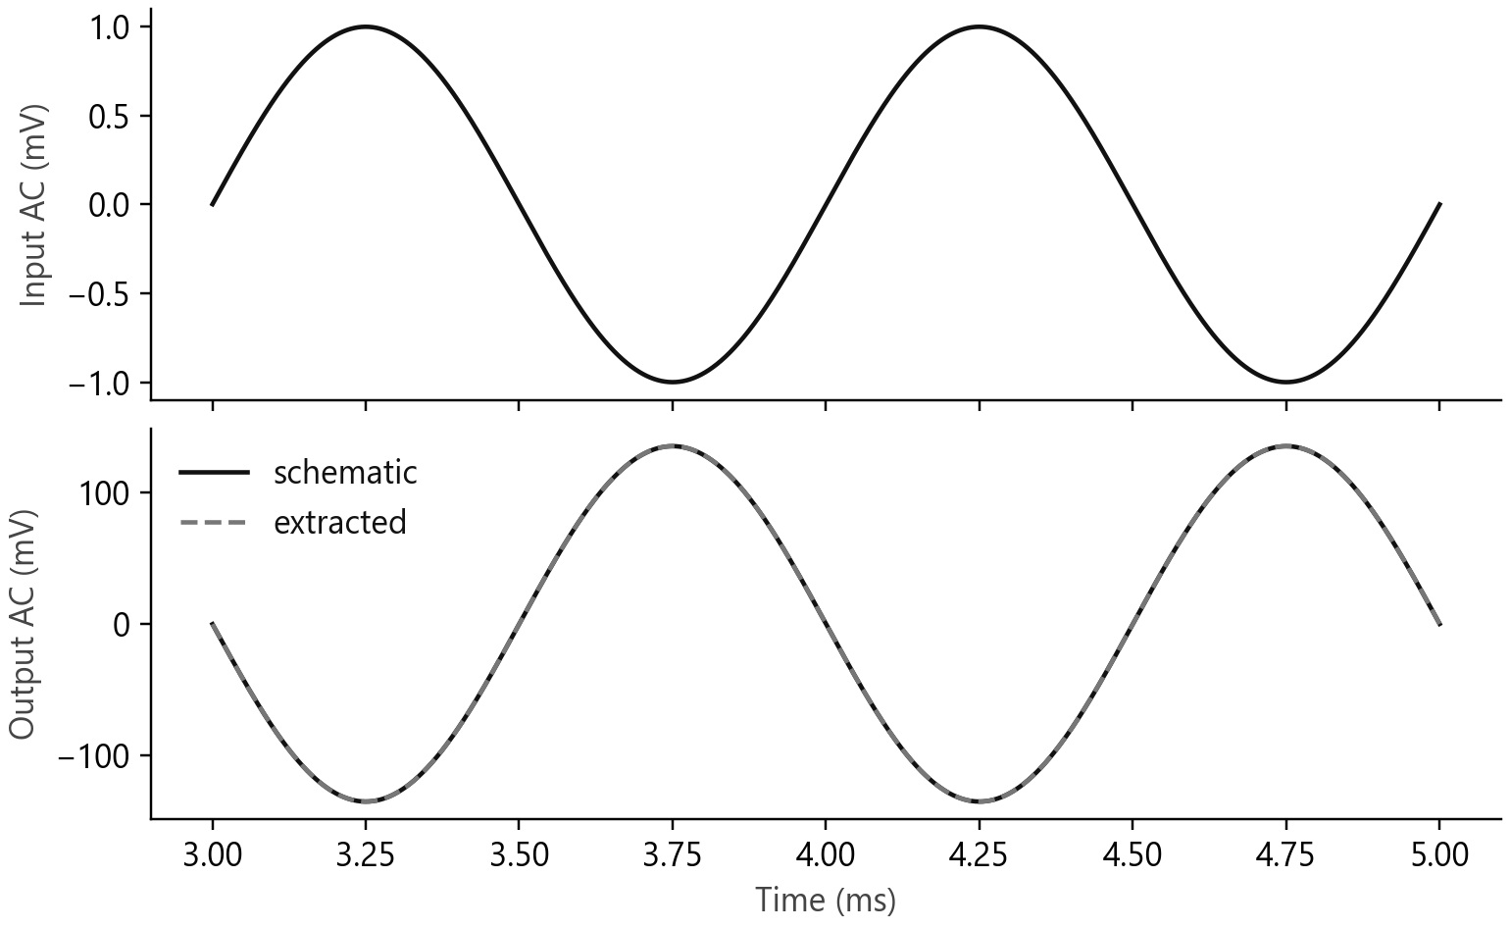
SKY130 INVERTER AMPLIFIER · TECHNICAL LAB NOTE
Ignytion io
SECTION 05
Check a real waveform in simulation
Transient analysis applies a 1 mV peak sine wave at 1 kHz for 5 ms. A sine-and-cosine fit over the final 2 ms measures amplitude and polarity after settling.
T R A N S I E N T R E S P O N S E · F I N A L T W O P E R I O D S
The signed schematic gain is -135.463 V/V, and the output fundamental is 135.463 mV peak. The fitted gain differs from the AC magnitude by less than the declared 10% limit.
Flattening the output or reversing its polarity makes the same observer fail. This checks that completion of the simulator alone cannot produce a passing verdict.
© 2026 Ignytion IO · ignytion.io
October 2026 · Version 1.0
06 / 12

Slide 7
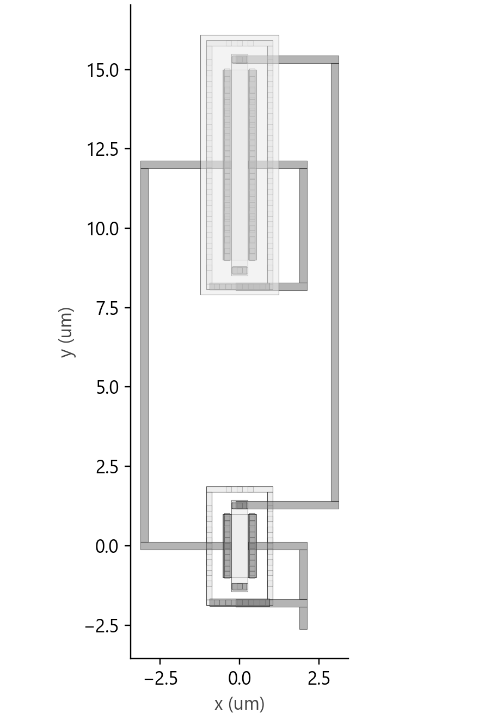
SKY130 INVERTER AMPLIFIER · TECHNICAL LAB NOTE
Ignytion io
SECTION 06
Connect the physical devices
The layout uses native SKY130 device generators with substrate and well contacts. Metal 1 joins the gates, joins the drains, and connects each source to its body supply.
D E C O D E D G D S G E O M E T R Y · M I C R O M E T R E S
The overview is decoded from the actual GDS stream. It uses neutral layer shading for readability. Four ports identify input, output, supply, and ground; the testbench components are external.
The GDS contains 3 cells. Its bounding box is approximately 6.24 × 18.72 µm. This is a demonstration layout without pads, ESD structures, or a fabrication integration wrapper.
© 2026 Ignytion IO · ignytion.io
October 2026 · Version 1.0
07 / 12

Slide 8
SKY130 INVERTER AMPLIFIER · TECHNICAL LAB NOTE
Ignytion io
SECTION 07
Verify geometry and connectivity
Design-rule checking (DRC) checks layout geometry. Layout versus schematic (LVS) compares extracted connectivity and device properties against the schematic. Each needs its own evidence.
AMPLIFIER_DRC_COUNT 0
No errors found.
Final result: Circuits match uniquely.
Circuit 1 contains 2 devices, Circuit 2 contains 2 devices.
Circuit 1 contains 4 nets, Circuit 2 contains 4 nets.
These are trimmed lines from the final Magic and Netgen logs. The Python checker also decodes the GDS and verifies the named top cell and non-empty geometry.
CONTROL
REQUIRED OBSERVATION
PMOS gate disconnected
LVS mismatch in the saved control report
Flat output waveform
Numerical observer rejects lost gain
Output polarity reversed
Numerical observer rejects lost inversion
Open-PDK checks have a defined boundary
The reported zero DRC errors refer to this Magic deck and this layout. A unique LVS match establishes this two-device circuit comparison. Neither result is foundry signoff or tapeout approval.
© 2026 Ignytion IO · ignytion.io
October 2026 · Version 1.0
08 / 12

Slide 9
SKY130 INVERTER AMPLIFIER · TECHNICAL LAB NOTE
Ignytion io
SECTION 08
Compare the extracted circuit
Magic extraction produces five parasitic capacitors between the circuit nets. The extracted transistor netlist also records device diffusion areas and perimeters.
METRIC
SCHEMATIC
EXTRACTED
Output bias
0.899992 V
0.899992 V
Gain at 1 kHz
135.857249 V/V
135.857247 V/V
Transient gain
-135.462722
-135.462718
Supply current
6.528463 µA
6.528463 µA
The low-frequency gain change is below the declared 20% limit. The gain is reported to six decimals here to show the comparison, without implying that the transistor model predicts silicon to that precision.
This flow performs capacitance extraction. It does not run interconnect-resistance extraction. The frequency-domain difference is therefore a bounded capacitive comparison, and further extraction would be needed for an RC claim.
© 2026 Ignytion IO · ignytion.io
October 2026 · Version 1.0
09 / 12

Slide 10
SKY130 INVERTER AMPLIFIER · TECHNICAL LAB NOTE
Ignytion io
SECTION 09
Repeat the local experiment
Use the existing WSL project workspace. The shell scripts select the project environment explicitly. Their dependency paths are recorded rather than treated as portable installation defaults.
# Start inside the Analog_SPICE_to_GDS folder in WSL.
igny init
bash scripts/run.sh prepare
bash scripts/run.sh sim
bash scripts/run.sh layout > results/layout.log 2>&1
bash scripts/run.sh lvs > results/netgen.log 2>&1
bash scripts/run.sh characterise
On the Windows host, the independent artifact checker uses Python with NumPy and KLayout. These are analysis dependencies, separate from the managed simulator and LVS tools.
python scripts/verify.py simulation
AMPLIFIER_SIMULATION_VERIFIED_WITH_NEGATIVE_CONTROLS
python scripts/verify.py physical
AMPLIFIER_PHYSICAL_ARTIFACTS_VERIFIED
The scripts and raw tables are the reproduction record. A new machine also needs the pinned PDK, the Tcl-capable Magic payload, FFTW, and the host analysis libraries. Clean-machine reproduction has not been tested.
© 2026 Ignytion IO · ignytion.io
October 2026 · Version 1.0
10 / 12

Slide 11
SKY130 INVERTER AMPLIFIER · TECHNICAL LAB NOTE
Ignytion io
SECTION 10
Dependencies and evidence
DEPENDENCIES.json records file hashes and local provenance. The workspace lock records the three managed bindings. A lock entry for classic Magic does not pin the separate Tcl build used here.
DEPENDENCY
ACTUAL USE
ngspice 46
Managed transistor simulation
Netgen 1.5.323
Managed schematic comparison
Magic 8.3.682 with Tcl
Separately acquired layout/extraction payload
SKY130 revision
1689ac3f2dc7… · exact identity in manifest
FFTW runtime
Existing local library copied into build/runtime
NumPy and KLayout
Host numerical checks and GDS decoding
The active PDK lacked corner include files. The experiment uses another local revision containing the required models. It loads the NMOS and PMOS TT model families, their mismatch parameters with statistical switches disabled, and the supplied layout-dependent parameters.
A project-specific Magic startup file resolves the PDK paths and enables the finer grid expected by the generator. The first coarse-grid attempts failed DRC; the final layout was regenerated and checked at the correct grid.
E V I D E N C E F I L E S
Raw sweep, AC, and transient tables sit in results/. The final GDS, editable Magic views, LVS netlist, and capacitive netlist sit in build/. Numerical and physical summaries are regenerated from those artifacts.
© 2026 Ignytion IO · ignytion.io
October 2026 · Version 1.0
11 / 12

Slide 12
SKY130 INVERTER AMPLIFIER · TECHNICAL LAB NOTE
Ignytion io
SECTION 11
Limits and source notes
The measured result is an externally biased inverter amplifier at one operating condition. It provides a small physical-verification example that can be inspected and rerun locally.
No process-corner sweep, temperature sweep, mismatch study, noise analysis, distortion specification, bias servo, resistive extraction, ESD integration, or fabricated-silicon measurement is covered. The apparent numerical precision of the tables must not be read as manufacturing accuracy.
S O U R C E N O T E S
SKY130 device documentation
https://skywater-pdk.readthedocs.io/en/main/rules/device-details.html
Open PDKs · SKY130 Magic generators
https://github.com/fossi-foundation/open-pdks/blob/main/sky130/magic/sky130.tcl
ngspice documentation
https://ngspice.sourceforge.io/docs.html
Magic documentation
http://opencircuitdesign.com/magic/
Netgen documentation
http://opencircuitdesign.com/netgen/
The figures and result tables in this note come from the local experiment dated 27 October 2026. Tool projects and PDK authors retain credit for their work. No third-party endorsement is implied.
Next engineering step
A bias circuit and a PVT study would be needed before selecting this topology for a specified application. Those activities require their own requirements and evidence.
© 2026 Ignytion IO · ignytion.io
October 2026 · Version 1.0
12 / 12

