Slide 1

IGNYTION IO · TECHNICAL LAB NOTE
Ignytion io
ASIC Design & Verification on a Reproducible Workbench
RTL Simulation and Logic Synthesis, End-to-End on Crucible
Simulate a 4-bit counter, view its waveform, and synthesize an RTL design into a standard-cell gate-level netlist — every step driven by the Crucible CLI ( igny ), in one reproducible workspace, with no manual tool installation.
#
EXPERIMENT
TOOLS (VIA igny)
RESULT
1
RTL simulation + waveform
iverilog, vvp, gtkwave
✓ PASS
2
Logic synthesis → gate netlist
yosys + Nangate .lib
✓ PASS
Two experiments, both passing, both run entirely through igny
Ignytion IO · ignytion.io
CRUCIBLE PLATFORM SERIES · JUNE 2026

Slide 2
ASIC DESIGN & VERIFICATION · TECHNICAL LAB NOTE
Ignytion io
T A B L E O F C O N T E N T S
01
Executive Summary
3
02
The Reference Design
4
03
Crucible Workspace Setup
4
04
Experiment 1 — RTL Simulation and Waveform
5
05
Experiment 2 — Logic Synthesis into a Gate-Level Netlist
7
06
Conclusion
8
© 2026 Ignytion IO · ignytion.io
June 2026 · Version 1.0
02 / 09

Slide 3
ASIC DESIGN & VERIFICATION · TECHNICAL LAB NOTE
Ignytion io
E X E C U T I V E S U M M A R Y
Executive Summary
Hardware verification and synthesis normally depend on a hand-assembled toolchain — a simulator, a waveform viewer, a synthesis engine, and a standard-cell library — each installed and version-matched by hand. That setup is fragile and rarely reproduces across machines.
This lab note demonstrates the same flow run on a managed workbench. Using Crucible (igny ), we stand up an isolated environment, install three catalogued open-source tools, and run a complete Counter ASIC flow: simulate a 4-bit counter against its testbench, view the resulting waveform, and synthesize an RTL design into a gate-level netlist mapped to the Nangate standard-cell library — all without installing a single tool by hand.
Two experiments, both passing, both run entirely through igny:
#
EXPERIMENT
TOOLS (VIA igny)
RESULT
1
RTL simulation + waveform
iverilog, vvp, gtkwave
✓ PASS
counter verified, count.vcd produced
2
Logic synthesis → gate netlist
yosys + Nangate .lib
✓ PASS
synth_example.v produced
© 2026 Ignytion IO · ignytion.io
June 2026 · Version 1.0
03 / 09

Slide 4
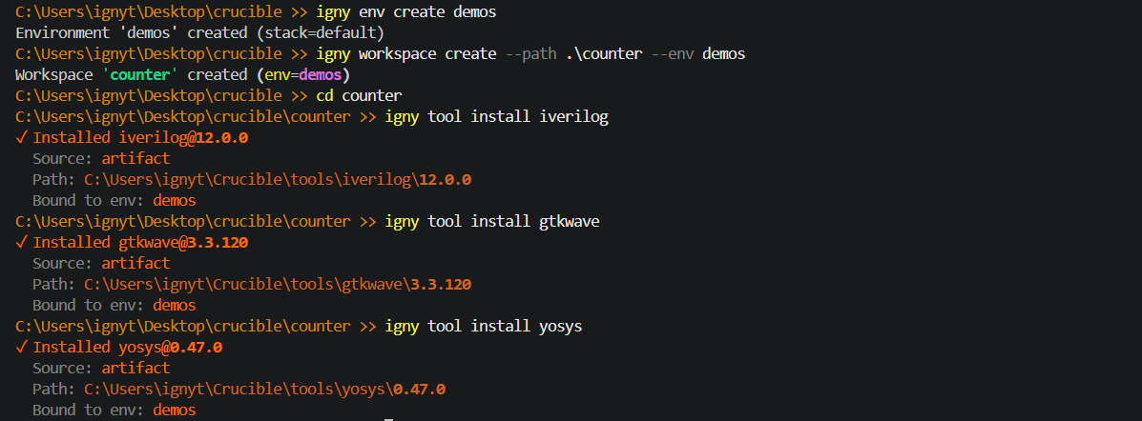
ASIC DESIGN & VERIFICATION · TECHNICAL LAB NOTE
Ignytion io
S E C T I O N 2
The Reference Design
Two small, self-contained Verilog designs — one for simulation, one for synthesis.
S Y S T E M S P E C I F I C A T I O N
COMPONENT
DETAIL
DUT (sim)
Mycounter — 4-bit synchronous up-counter with synchronous reset
Testbench
Testbench.v — clock/reset stimulus, VCD dump, $monitor console trace
DUT (synth)
top — 2:1 multiplexer feeding a clocked register
Cell library
NangateOpenCellLibrary_typical.lib (open 45 nm, for mapping)
Workbench
Crucible CLI (igny), Community tier
S E C T I O N 3
Crucible Workspace Setup
All tools — iverilog (which provides vvp), gtkwave, and yosys — are in the Crucible catalog. One environment, one workspace, three installs:
How igny run works: arguments after the binary name are passed verbatim to the tool. Because iverilog declares provides = ["iverilog", "vvp"], igny run vvp … works with no separate install. Always run from the workspace root (the folder containing crucible.toml).
© 2026 Ignytion IO · ignytion.io
June 2026 · Version 1.0
04 / 09

Slide 5
ASIC DESIGN & VERIFICATION · TECHNICAL LAB NOTE
Ignytion io
S E C T I O N 4
Experiment 1 — RTL Simulation and Waveform
O B J E C T I V E
Compile a 4-bit counter against its testbench, run the simulation, and confirm correct count-and-reset behaviour on the waveform.
D E S I G N U N D E R T E S T — MYCOUNTER.V
module Mycounter(CLK, RST, OUT);
input CLK, RST;
output [3:0] OUT;
reg [3:0] OUT;
always @(posedge CLK) begin
if (RST == 1'b1) OUT <= 4'b0000;
else OUT <= OUT + 1; // count up, wraps 15 → 0
end
endmodule
S T I M U L U S — TESTBENCH.V
TIME (NS)
EVENT
0
Clock=0, Reset=1 — counter held in reset
100
Reset=0 — counting begins
2100
Reset=1 — counter forced back to 0
2500
$finish — simulation ends
Clock toggles every 50 ns (always #50 Clock=~Clock) → period = 100 ns. $dumpfile("count.vcd") + $dumpvars capture all signals; $monitor prints time, Clock, Reset, Count on every change.
© 2026 Ignytion IO · ignytion.io
June 2026 · Version 1.0
05 / 09

Slide 6
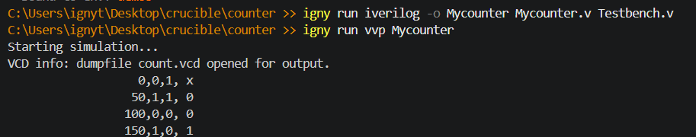
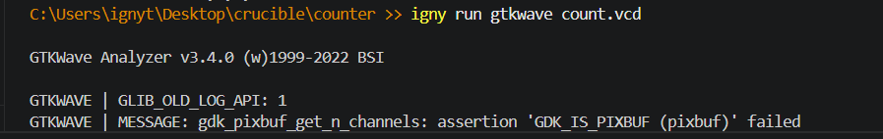
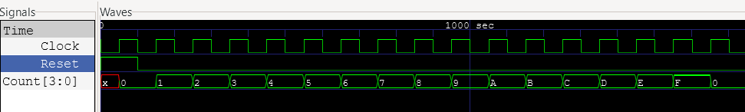
ASIC DESIGN & VERIFICATION · TECHNICAL LAB NOTE
Ignytion io
S E C T I O N 4 ( C O N T .. )
P R O C E D U R E
W A V E F O R M S
R E S U L T S
—
The $monitor console trace shows Count holding at 0 while Reset=1, then incrementing 0, 1, 2, … , 15 and wrapping, until the reset at t=2100 drives it back to 0.
—
vvp terminates with Testbench.v:15: $finish called at 2500.
—
Artifacts produced: Mycounter (compiled simulation) and count.vcd.
—
GTKWave renders OUT[3:0] ramping 0→15 repeatedly between the two reset pulses; both reset edges drive it to 0.
✓
Experiment 1 — PASS
The write-compile-simulate-view cycle runs end-to-end through igny . The counter behaves exactly as specified.
A R T I F A C T S P R O D U C E D
Mycounter
count.vcd
Compiled simulation binary (iverilog output)
Value Change Dump — waveform data for GTKWave
© 2026 Ignytion IO · ignytion.io
June 2026 · Version 1.0
06 / 09

Slide 7
ASIC DESIGN & VERIFICATION · TECHNICAL LAB NOTE
Ignytion io
S E C T I O N 5
Experiment 2 — Logic Synthesis into a Gate-Level Netlist
O B J E C T I V E
Synthesize the RTL design top.v into a gate-level netlist mapped to the Nangate standard-cell library, using Yosys.
D E S I G N T O S Y N T H E S I Z E — TOP.V
module top(a, b, clk, select, out);
input a, b, clk, select;
output out;
reg out;
wire y;
assign y = (select) ? b : a; // 2:1 multiplexer (combinational)
always @(posedge clk)
out <= y; // register → maps to a D flip-flop
endmodule
Synthesis converts this behavioural RTL into real cells: the assign becomes gate logic; the always @(posedge clk) becomes a D flip-flop.
S Y N T H E S I S S C R I P T — YOSYS_COMMANDS.TCL
STEP
COMMAND
ACTION
1
read_verilog top.v
Parse the RTL source
2
hierarchy -check -top top
Elaborate hierarchy, set the top module
3
proc
Convert always/if/case processes into muxes + registers
4
techmap
Map to Yosys's internal generic gate library
5
dfflibmap -liberty …Nangate….lib
Map flip-flops to Nangate library cells
6
abc -liberty …Nangate….lib
Optimize + map combinational logic to Nangate cells
7
clean
Remove unused cells and wires
8
write_verilog -noattr synth_example.v
Emit the gate-level netlist
P R O C E D U R E
# synthesize → synth_example.v igny run yosys -s yosys_commands.tcl
© 2026 Ignytion IO · ignytion.io
June 2026 · Version 1.0
07 / 09

Slide 8
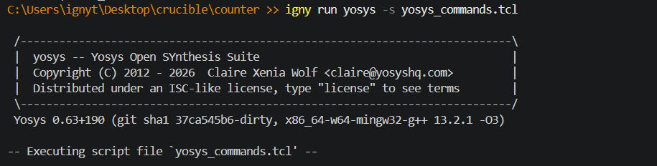
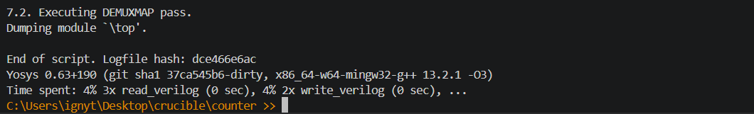
ASIC DESIGN & VERIFICATION · TECHNICAL LAB NOTE
Ignytion io
CRUCIBLE SYNTHESIS OUPTUT
R E S U L T S
—
Yosys prints per-step statistics; after dfflibmap/abc it reports the cell count and area of the mapped design.
—
synth_example.v expresses the design purely in Nangate standard cells — a D flip-flop plus the gates implementing the 2:1 mux — instead of behavioural RTL.
✓
Experiment 2 — PASS
top.v is synthesized into a Nangate-mapped gate-level netlist.
© 2026 Ignytion IO · ignytion.io
June 2026 · Version 1.0
08/ 09

Slide 9
ASIC DESIGN & VERIFICATION · TECHNICAL LAB NOTE
Ignytion io
S E C T I O N 6
Conclusion
Counter Experiment takes an RTL design through simulation → waveform inspection → logic synthesis , the core front-to-mid steps of an ASIC flow — and runs the whole thing through a single Crucible workspace. No tool is installed by hand.
F U L L - C O M M A N D S E Q U E N C E
# workspace setup igny init
igny env create demos
igny workspace create --path ./counter --env demos
cd counter
igny tool install iverilog
igny tool install gtkwave
igny tool install yosys
# experiment 1 — rtl simulation igny run iverilog -o Mycounter Mycounter.v Testbench.v
igny run vvp Mycounter
igny run gtkwave count.vcd
# experiment 2 — logic synthesis igny run yosys -s yosys_commands.tcl
© 2026 Ignytion IO · ignytion.io
June 2026 · Version 1.0
09/ 09

