Slide 1
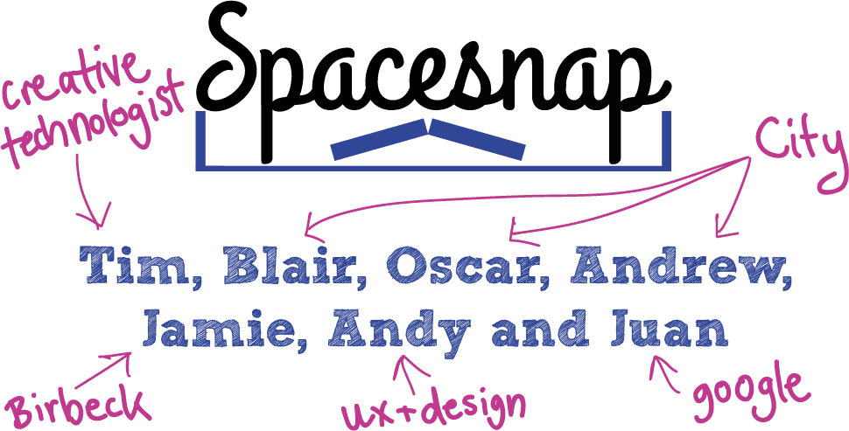

Slide 2
Tim, Blair, Oscar, Andrew, Jamie,
James, Andy and Juan.

Slide 3
Tim, Blair, Oscar, Andrew, Jamie,
James, Andy and Juan.
Creative
technologist
City
Imperial
City
City
Birkbeck
Google
Ux and design

Slide 4
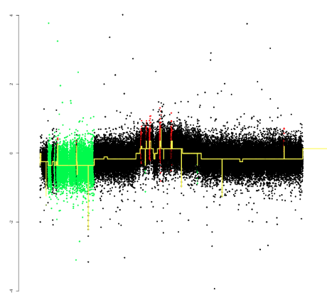
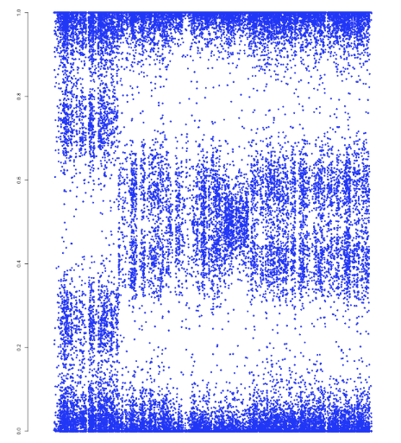

Slide 5
Two sets of data = two solutions =
two mini teams

Slide 6
Two sets of data = two solutions =
two mini teams

Slide 7
Two sets of data = two solutions =
two mini teams

Slide 8
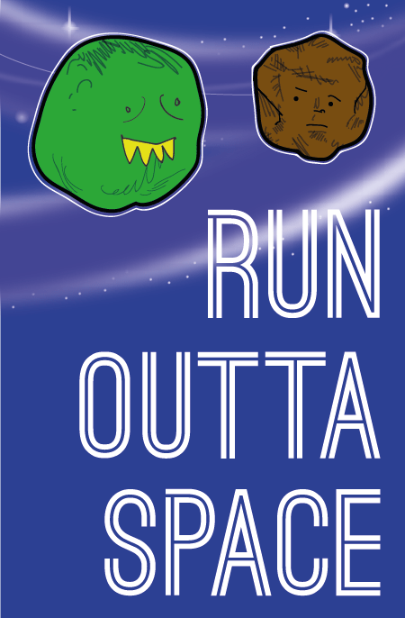
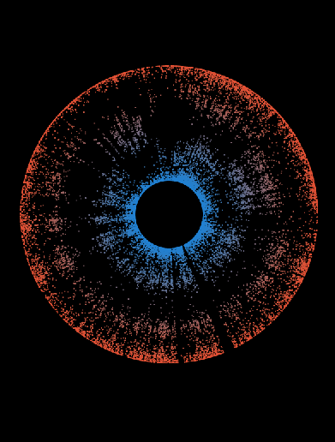
Gene
snap

Slide 9

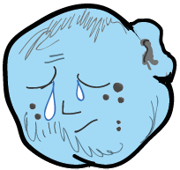
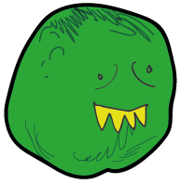
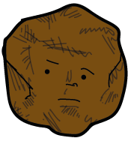

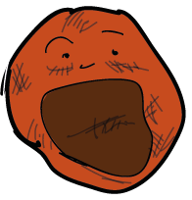
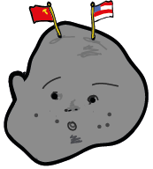

Slide 10
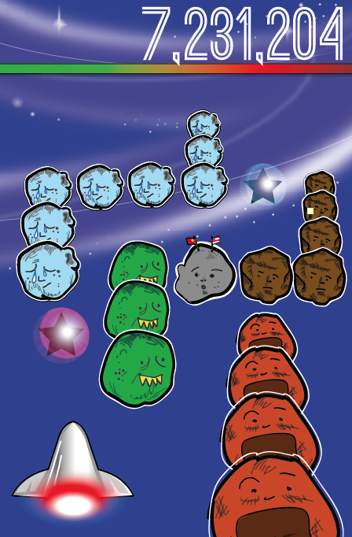

Slide 11
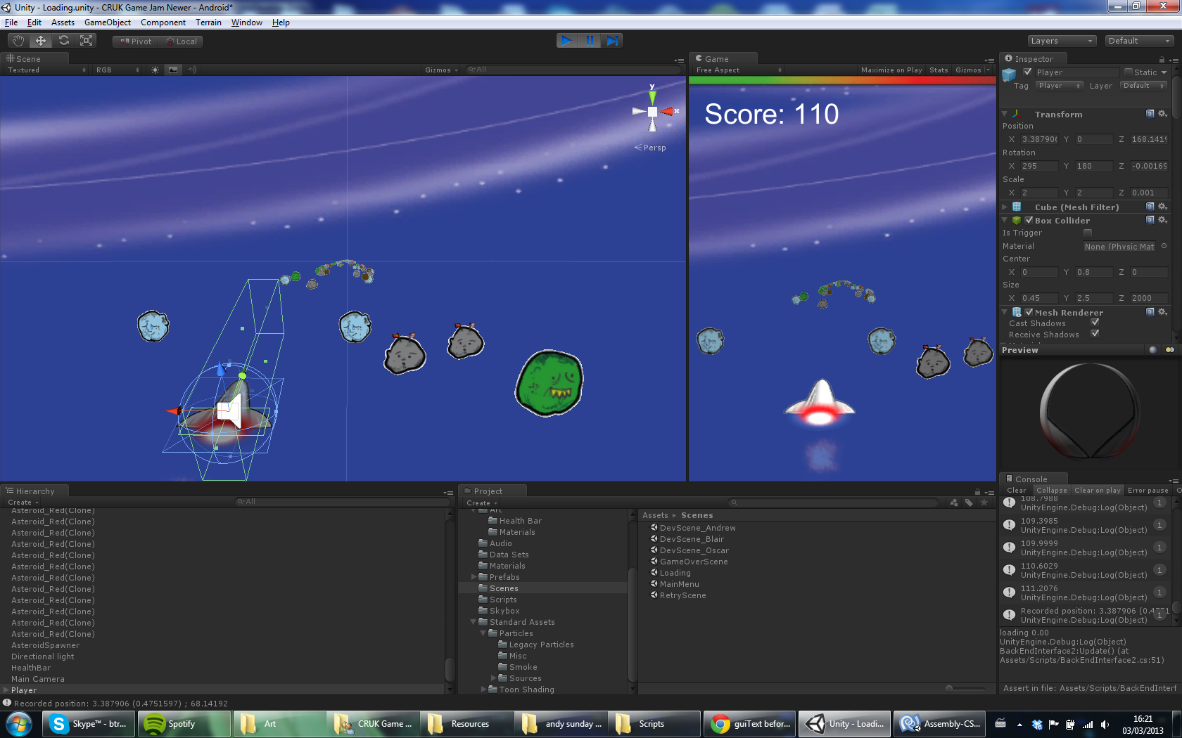

Slide 12
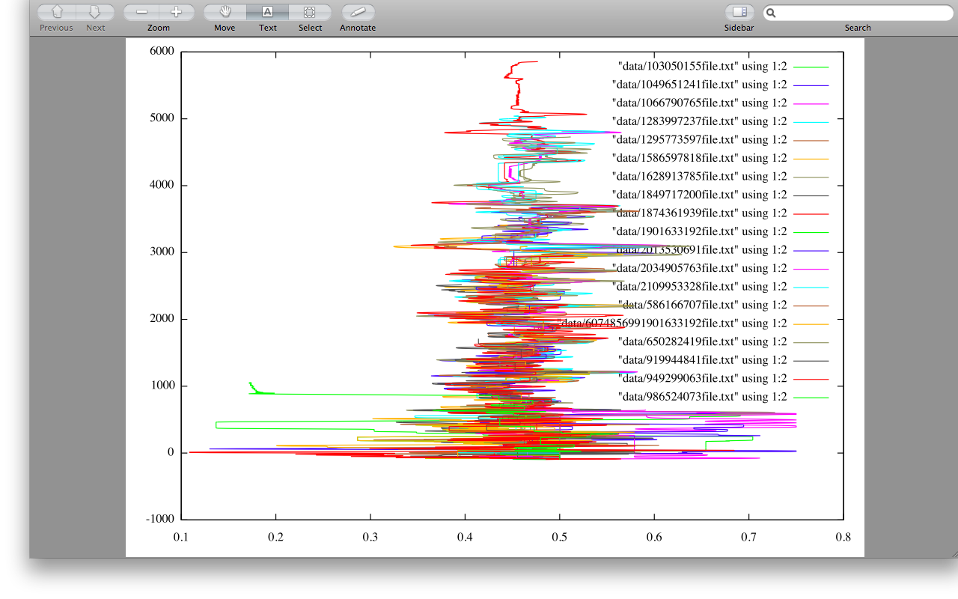

Slide 13
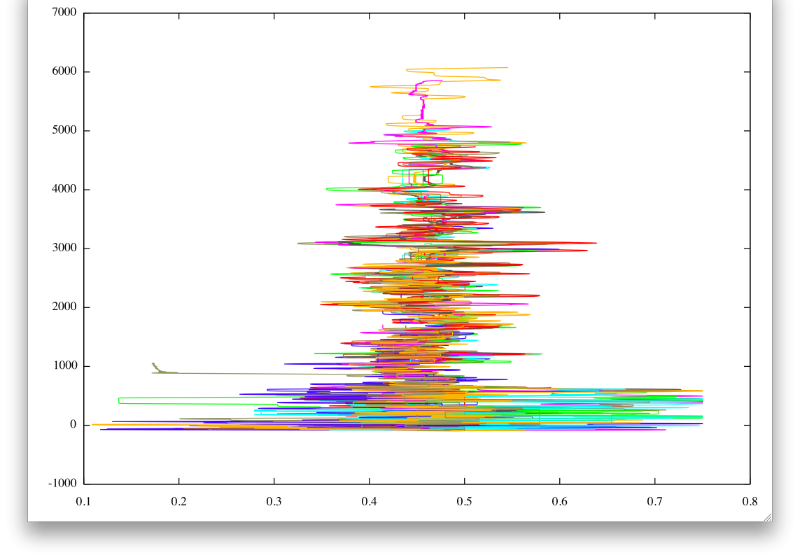

Slide 14
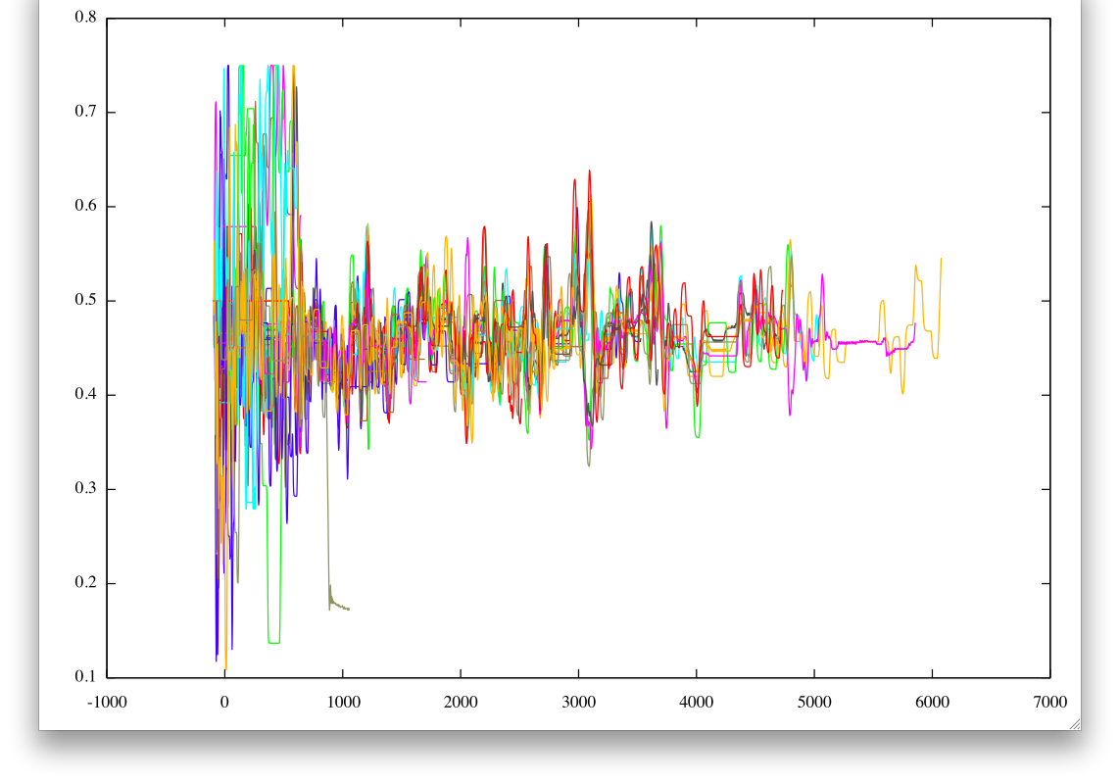

Slide 15


ghost ship
(challenge friends or past players)

Slide 16
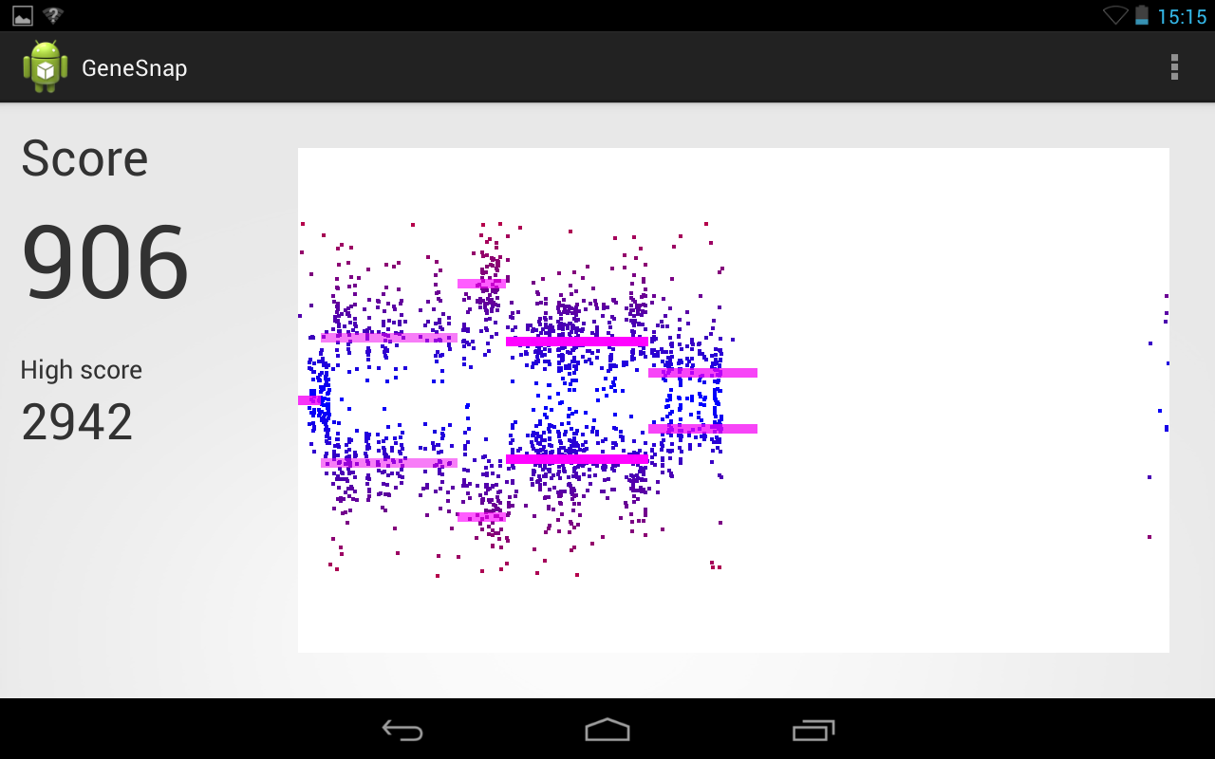

Slide 17
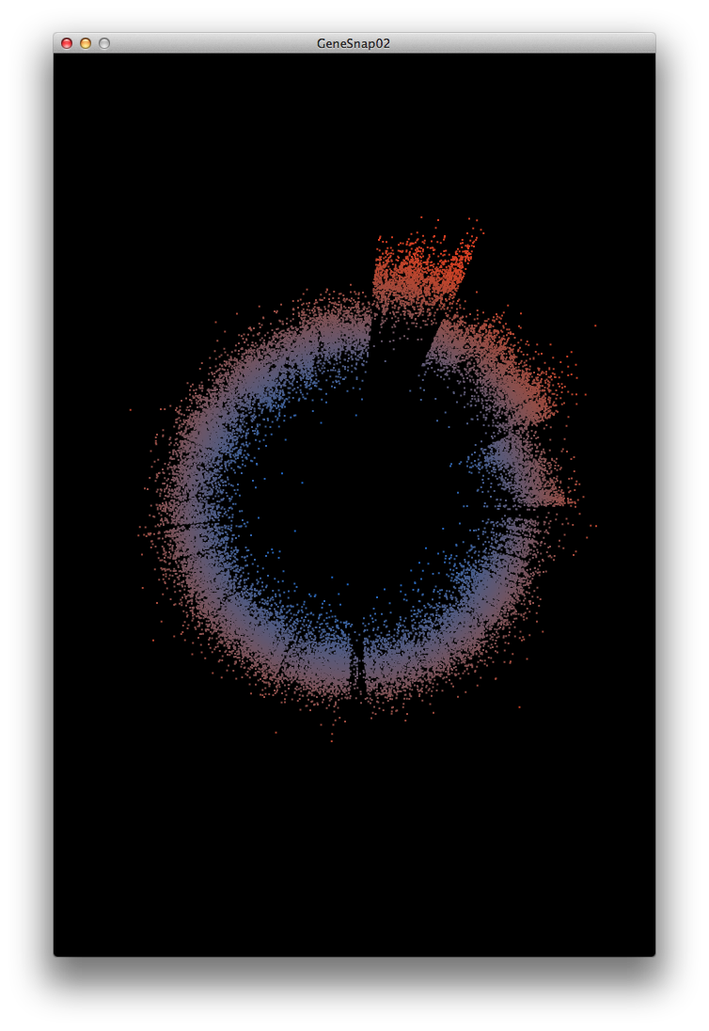
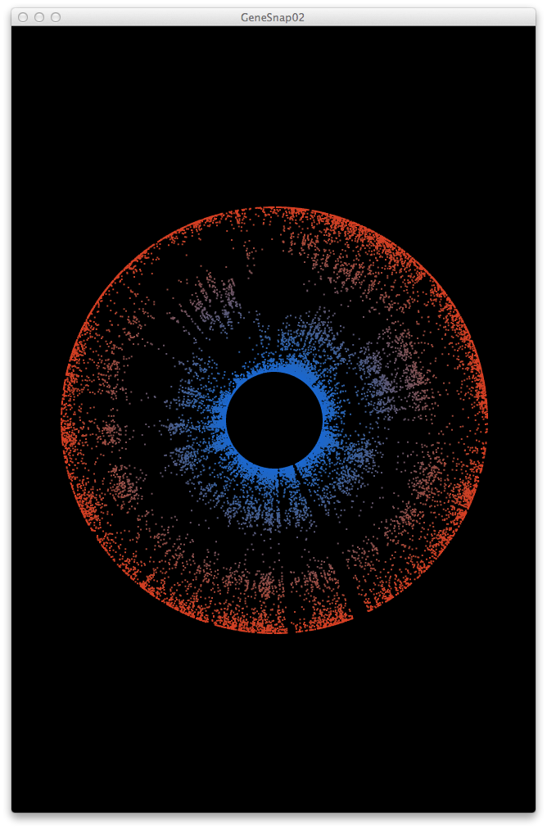

Slide 18
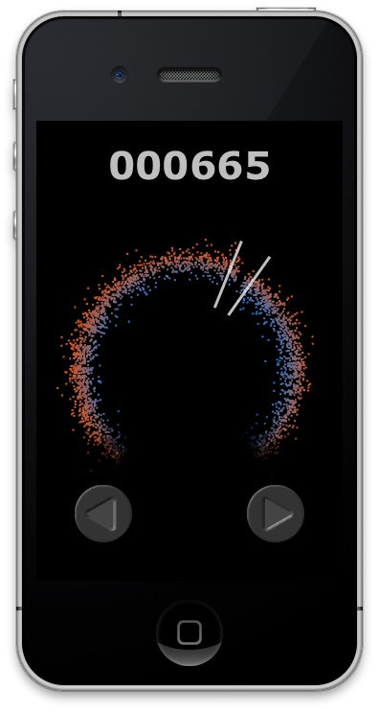

Slide 19
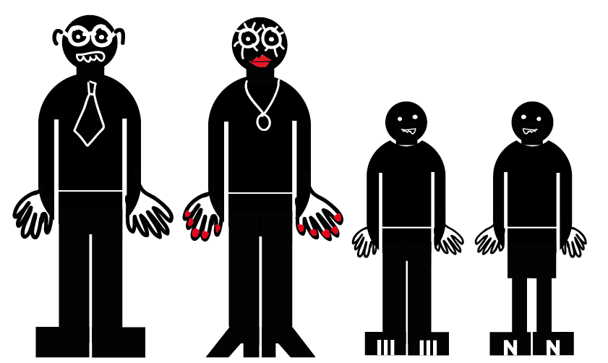
Re-skinning
For different audiences (everybody)

Slide 20
Re-skinning
For different audiences (everybody)
I like doing things for charity
= classic snap game

Slide 21
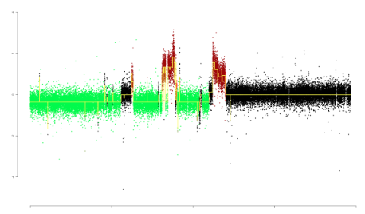
Re-skinning
For different audiences (everybody)
I like doing the gardening

Slide 22
Re-skinning
For different audiences (everybody)
I like doing the gardening
(this looks like grass)

Slide 23
Re-skinning
For different audiences (everybody)
We like
killing things =
‘Run outta
space’ game

Slide 24
Social
(challenge & gift friends)
“Would you like to play a game?”

Slide 25
Social
(challenge & gift friends)
“No”

Slide 26
Social
(challenge & gift friends)
“Oh go on.”

Slide 27
Social
(challenge & gift friends)
“Ok.”

Slide 28
Social
(challenge & gift friends)
“Bet you can’t beat my score!”

Slide 29
Social
(challenge & gift friends)
“Oh!”

Slide 30
Social
(challenge & gift friends)
“I’ve sent you a super-space-ace-boost.”

Slide 31
Social
(challenge & gift friends)
“Eh?”

Slide 32
Social
(challenge & gift friends)
“Oh great!”

