Slide 1


SMART INDIA HACKATHON 2025
Problem Statement ID –25174
Problem Statement Title-Neural Net based Android Application for Real-Time Fish Catch Identification, Health, and Volume Estimation
Theme-Space Technology
PS Category- Software
Team ID:-86439
Team Name –TeamAqua RoversXT

Slide 2
Fish_Lens
.
TeamAqua
RoversXT
Proposed Solution
AN APP THAT COULD PEROFRM :
Fish Identification –
A CNN-based model will classify fish species, helping fishermen avoid miscatch and unnecessary deadweight.
Health/Freshness Check –
Analyze fish color and texture from images using image processing and a K-NN classifier to predict freshness.
Length & Weight Estimation –
Measure fish length/area from the image using OpenCV.
Apply a species-specific formula to estimate weight based on the identified species.
Offline Functionality –
With TensorFlow Lite + SQLite/JSON, the app will work without internet, ensuring fishermen in remote areas can still access accurate results.
UNIQUENESS
Health Estimator Based on Image
Weight Estimator
Geo-Tagging
Offline –
Work in remote areas with poor signals.

Slide 3
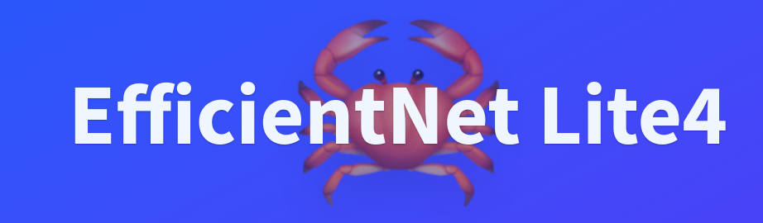

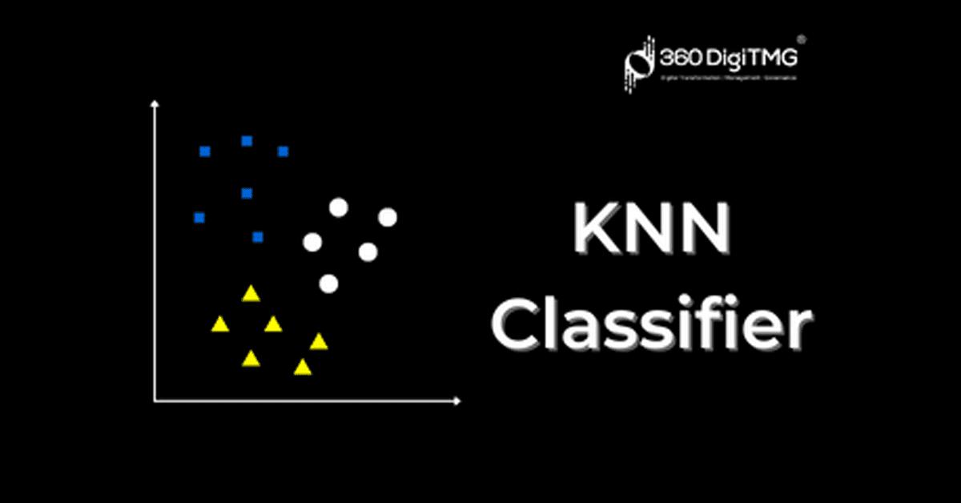





TECHNICAL APPROACH
TeamAqua
RoversXT
:
Phone Camera (Flutter)
Capture fish images quickly
YOLOv8-Tiny / MobileNet-SSD
– Locate fish bounding boxes
MobileNetV3 / EfficientNet-Lite –
Classify fish species accurately
OpenCV + K-NN Classifier –
Predict fish freshness reliably
Image Capturing
Fish Detection
Species
Identification
Freshness
/Health
Check
Length&
Weight
Estimation
Aggregation & Output
Data Storage & Geo-tagging
User Interface and Reporting
Mobile App Logic –
Summarize counts and scores
Tensor Flow Lite for offline functioning
Flutter–
Display results to user
OpenCV + Species Formula –
Measure and estimate weight
SQLite / JSON + GPS APIs –
Save results with location

Slide 4
FEASIBILITY AND VIABILITY
TeamAqua
RoversXT
CHALLENGES AND SOLUTIONS
Misidentification Due To Limited Datasets
Data Augmentation & Transfer Learning -
Reference Object + YOLO/OpenCV Segmentation
Provides scale and precise masks for accurate measurements
Slow Interface & High Battery Usage
TensorFlow Lite + Model Quantization
Optimizes model for mobile, enabling fast and efficient runtime
Errors with multiple /overlapping Fish
YOLOv8-Tiny Multi-Object Detection
Inaccurate freshness/health estimation
Ensemble Classifiers & Standardized Lighting
Improves model robustness, reducing misidentification
Detects multiple fish accurately, improving count and weight
Combines multiple features to increase freshness prediction accuracy
Incorrect Length & Weight Estimators
FEASIBILITY
Existing Tech:
CNNs, YOLO, MobileNet, TensorFlow Lite, and OpenCV can run on mobile.
Offline:
TensorFlow Lite + SQLite/JSON enables offline predictions and storage.
Feature Integration:
Species ID, freshness, weight, and geotagging combined in one app.
Hardware:
Modern smartphones have enough CPU/GPU for lightweight models.

Slide 5
IMPACT AND BENEFITS
TeamAqua
RoversXT
Fishermen
Supply Chain
Improves traceability and compliance with quality standards for global trade.
Market/Buyers
Guarantees verified fish quality and weight, reducing disputes and ensuring consistent supply.
Govt.Agencies
Provides geotagged, timestamped data to monitor quotas and prevent illegal fishing.
Ensures accurate species , freshness, and weight for better pricing and reduced losses.

Slide 6
RESEARCH AND REFERENCES
TeamAqua
RoversXT
Research papers:
https://arxiv.org/pdf/1909.02710
https://www.researchgate.net/publication/355515838_WikiFish_Mobile_App_for_Fish_Species_Recognition_Using_Deep_Convolutional_Neural_Networks
https://www.ijert.org/research/detection-of-fish-freshness-using-image-processing-IJERTCONV5IS09042.pdf
Websites:
https://www.cmfri.org.in/
https://nfdb.gov.in/PDF/Fish%20&%20Fisheries%20of%20India/1.Fish%20and%20Fisheries%20of%20India.pdf
Dataset sources:
https://www.kaggle.com/code/akdagmelih/multiplelinear-regression-fish-weight-estimation
https://www.kaggle.com/code/ybifoundation/fish-weight-prediction
https://www.kaggle.com/datasets/utpolkantidas/fresh-water-fish-disease-dataset
https://www.kaggle.com/datasets/markdaniellampa/fish-dataset
https://www.kaggle.com/datasets/vipullrathod/fish-market
https://www.kaggle.com/code/nitinchoudhary012/fish-weight-prediction

