Slide 1






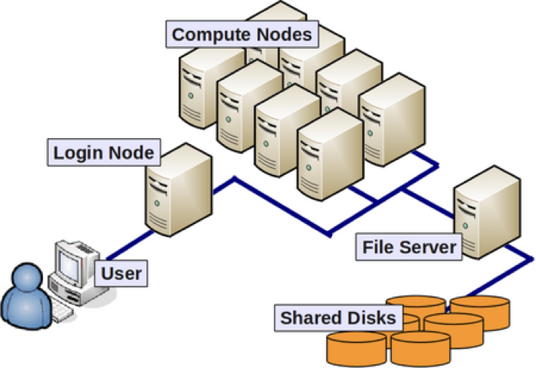
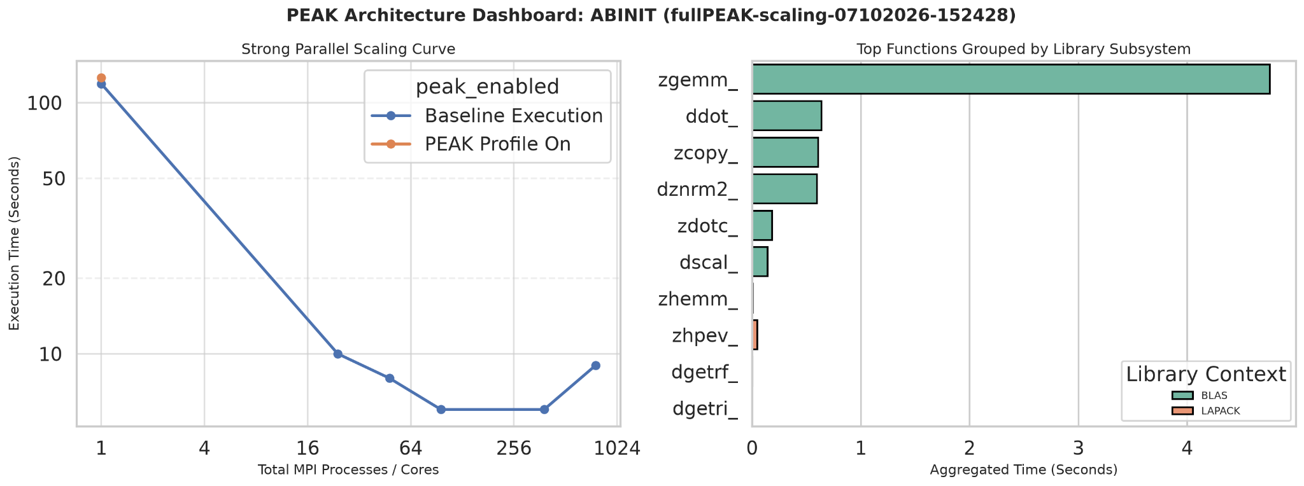
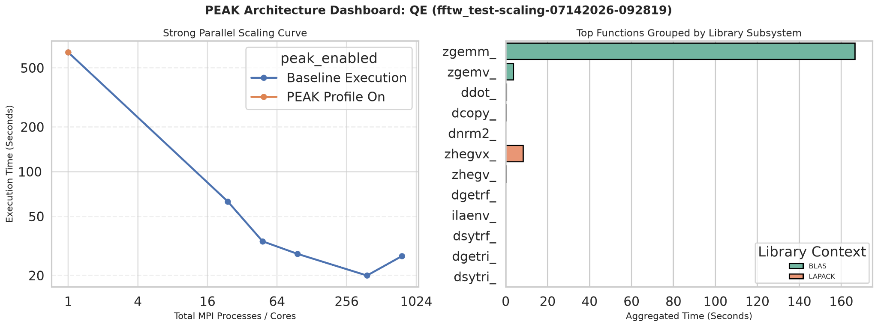
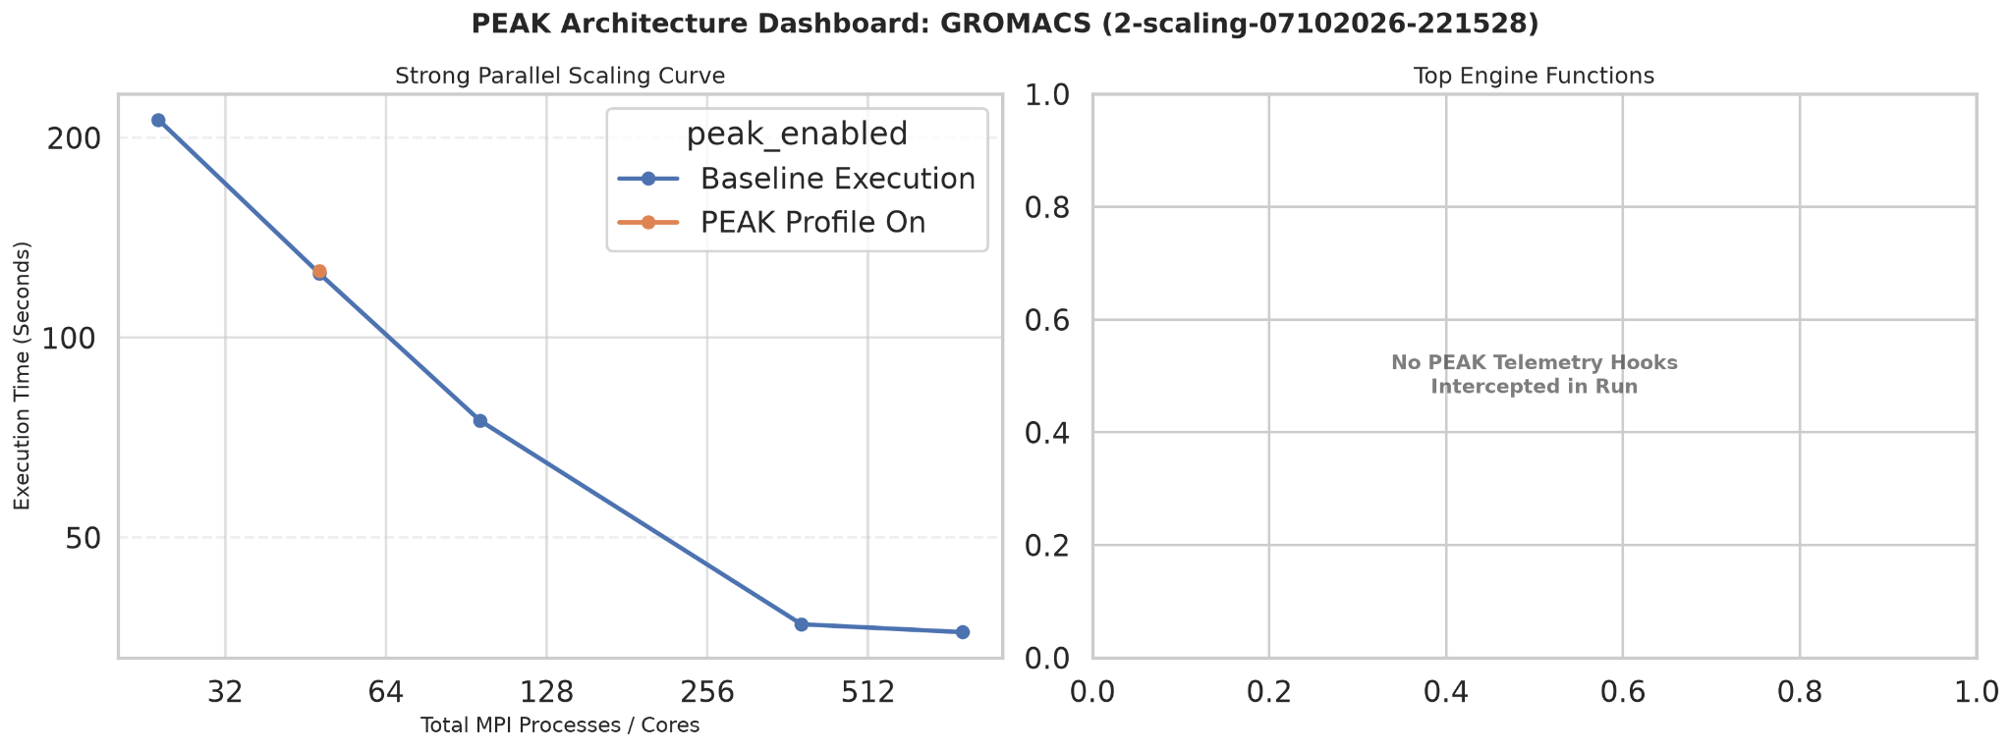
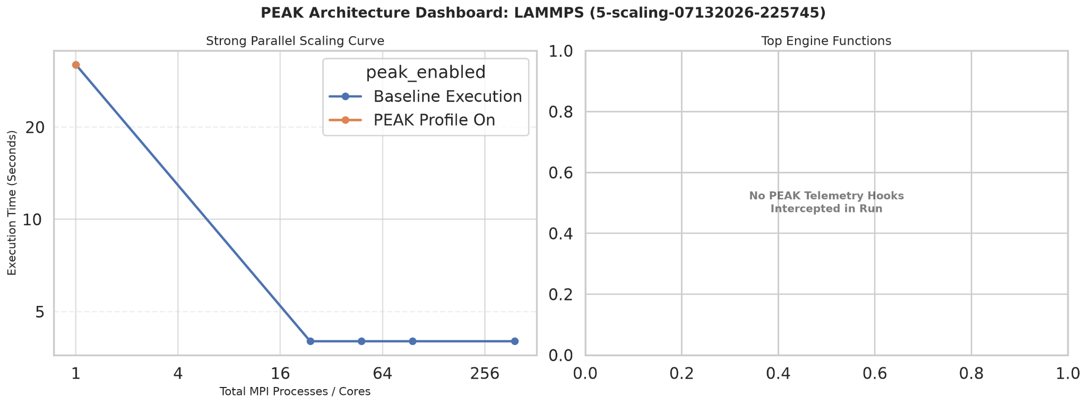
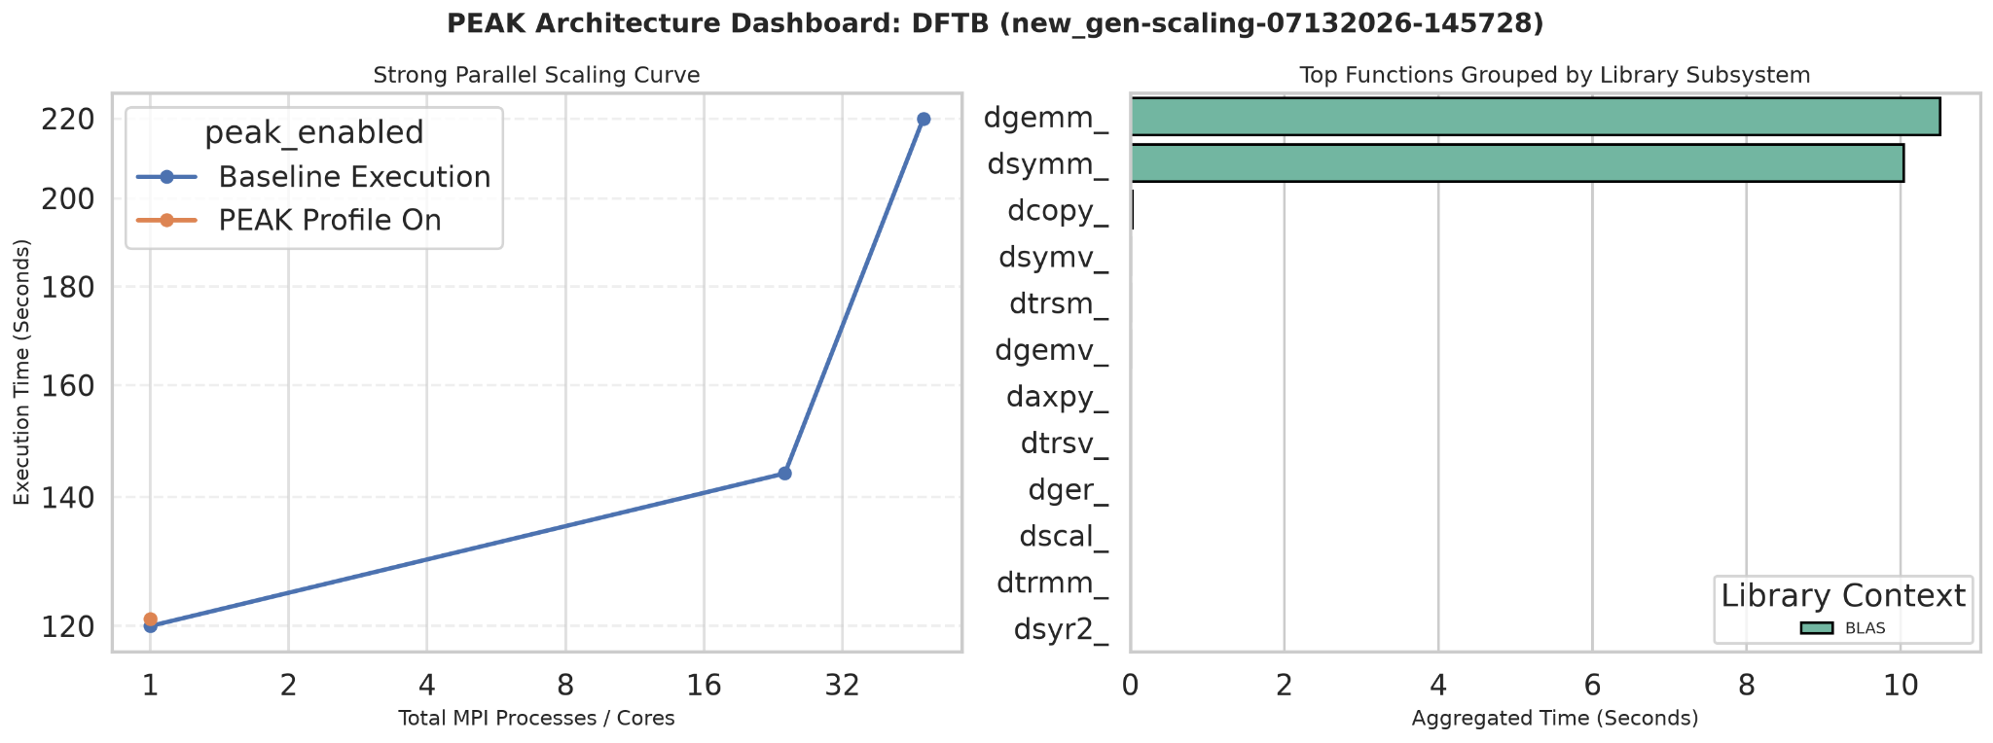

Measuring HPC Efficiency with PEAK:
How Well Do Your Tools Use Super-Computer Resources?
Caleb Wiyninger | Dr. Chun-Yaung Lu (Albert) | Dr. Yinzhi Wang (Ian)
Texas Advanced Computing Center | The University of Texas at Austin | Oklahoma City University
Background
Problem
Methodology
High Performance Computing (HPC) systems are critical research infrastructure that allow for the large levels of data processing required by modern science. They are built from many networked computers called nodes, each with dozens of CPU cores.
Because of this architecture, scientific applications must be specifically designed to take advantage of the resources available across nodes and cores, or performance suffers.
The Performance Evaluation Analysis Kit (PEAK) is a tool that allows the user to analyze function calls, where compute time is spent, and how the targeted program utilizes popular mathematical libraries such as BLAS (Basic Linear Algebra Subprograms), LAPACK (Linear Algebra PACKage), and FFTW (Fastest Fourier Transform in the West).
The goal of this study is to analyze popular scientific software used by researchers on the Frontera supercomputer for materials science, chemistry, and molecular simulation, and more, benchmarking its performance under different scaling conditions and its reliance on popular mathematical libraries via PEAK.
In order to optimize for HPC environments, many things must be known about a program:
Dependencies: What other software and libraries the program depends on.
Bottlenecks: Where a majority of compute time is spent.
Scaling: How different levels and methods of scaling impact the program.
Performance Impacts: What variables impact the program's performance in what way.
Select: Programs selected from Frontera's most-used software list.
Build: TACC modules and custom made build scripts were used to keep binaries reproducible.
Test: One representative test case / input chosen or created per program.
Automate: Automated scripts generate scaling jobs, plus one PEAK-enabled job per program.
Run: Jobs run on the Stampede3 HPC system.
Analyze: Timing and PEAK data collected for analysis.
ABINIT
Quantum Espresso
GROMACS
Simulates how electrons and atoms behave in materials, using quantum mechanics to predict a material's structure, energy, and properties.
Quantum-mechanical materials simulation package, solving the same kind of problem as ABINIT with a different underlying computational method.
Simulates the motion and interactions of biomolecules like proteins and lipids, widely used to study biological and chemical processes.
LAMMPS
DFTB+
Takeaways
Simulates how large numbers of atoms and molecules move and interact over time (molecular dynamics), commonly used to study materials at the atomic scale.
A faster, approximate alternative to full quantum-mechanical simulation.
ABINIT scaled effectively from 1 → 384 tasks (119s → 6s), but got slightly worse at 768 tasks (9s). This is most likely due to inter-node communication overhead.
QE is a similar story: scales well up to 384 tasks (636s → 20s), then degrades at 768 tasks (27s).
LAMMPS plateaus fast (32s → 4s by 24 tasks) and stays flat through 384 tasks. The program or test case seems to impose a hard limit on what resources the program allows itself to attempt to use.
GROMACS scaled the best out of the group, successfully taking advantage of all the resources we gave it.
LAMMPS and GROMACS yield no BLAS/LAPACK/FFTW hits from PEAK.
DFTB+ performed worse with more resources and outright crashed when multiple nodes were introduced.
Limitations
Future Work
References,
Acknowledgments,
Contact, Suggestions,
and Resources
TODO:
QR Code
To cover a broad survey of Frontera's most-used programs, a breadth-first approach was taken over deep per-program investigation, leaving room to resolve profiling issues and test more permutations for deeper insight.
For the programs that yielded no PEAK results, it is likely due to how they were compiled. Rebuilding the programs under different configurations may yield PEAK results.
Diagnose why LAMMPS/GROMACS show no BLAS/LAPACK/FFTW PEAK hits.
Diagnose the causes of DFTB+ results.
Add more test cases per program.
Continue to build out a list of actionable programs.
Continue to profile programs on our list.

