Slide 1
Predicting Population Movement Using Transition Matrices
Problem: if a fixed share of people move between regions each year, where will everyone live in the long run?
Group 14 · MTH2802 Linear Algebra & Differential Equations
Mansi Awasthi (250450) · Prince Kumar Yadav (250500) · Shobhit Rai (250557) · Ishank Chauhan (250406)
Instructor: Dr. Luckshay Batra · BML Munjal University
Notes:
Say the problem in one sentence. Four regions: Delhi, Gurugram, Noida, Faridabad. One step = one year.

Slide 2
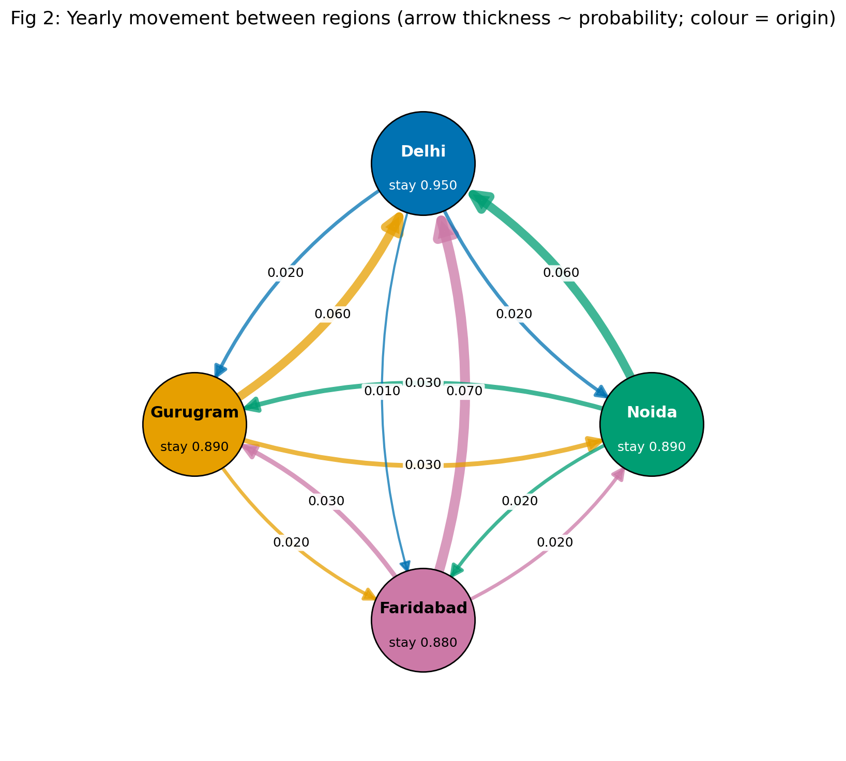
The model: a column-stochastic matrix
4 regions, 1 step = 1 year
P[i][j]: from region j to region i; every column sums to 1
x(k+1) = P x(k), so x(k) = P^k x(0)
Start: Census 2011 district totals (verified)
P is SIMULATED (no public yearly city-to-city flow data)
Group 14 · MTH2802 · Transition probabilities simulated; populations Census 2011
Notes:
P[i][j] = probability that someone in region j this year is in region i next year. Columns sum to 1. x_{k+1} = P x_k. Probabilities are simulated; populations approximate.

Slide 3
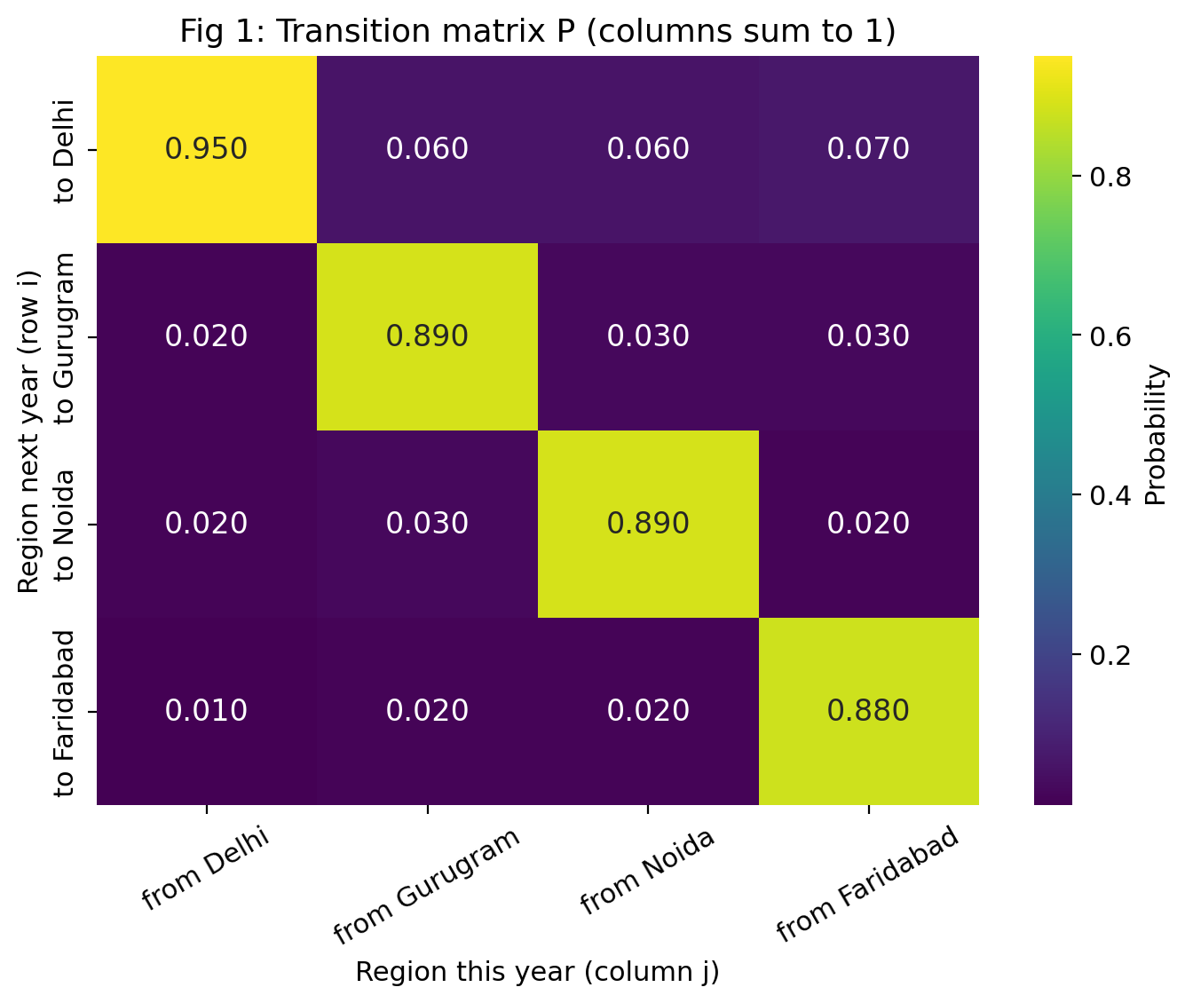
The transition matrix P
0.88 – 0.95
retention (diagonal) in every region
All > 0
so P is regular (P¹ already positive)
Real, distinct
eigenvalues → clean diagonalisation
Group 14 · MTH2802 · Transition probabilities simulated; populations Census 2011
Notes:
Large diagonal = most people stay. Delhi has the highest retention 0.95. All entries positive so P is regular. Eigenvalues real and distinct.

Slide 4
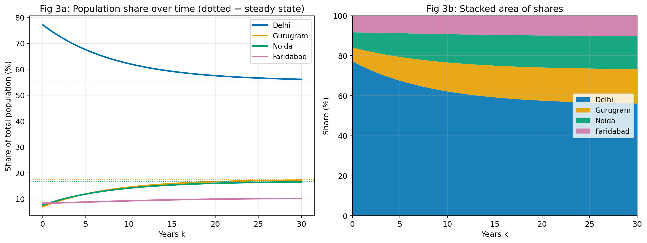
Results: 30-year projection
77% → 56%
Delhi share, year 0 → 30
7% → 17%
Gurugram share, year 0 → 30
Total population stays constant (column sums = 1). P^50 has nearly identical columns.
Group 14 · MTH2802 · Transition probabilities simulated; populations Census 2011
Notes:
Total constant. Delhi falls from 77% to 56% by year 30 under simulated flows; this is an artefact of the closed model, not a forecast.

Slide 5
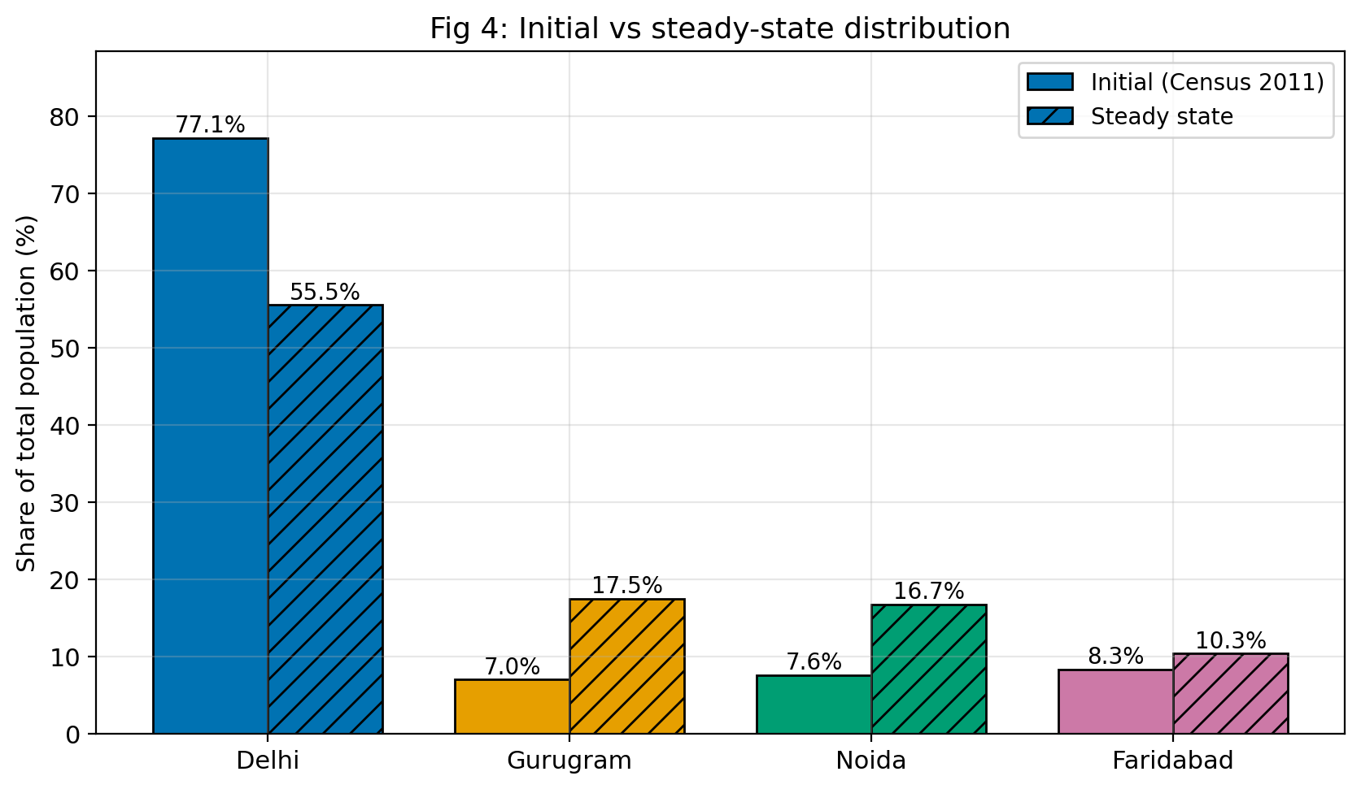
Steady state and eigen-analysis
Steady state
Delhi 55.5% · Gurugram 17.5% · Noida 16.7% · Faridabad 10.3%
Three methods agree (< 10⁻⁸)
eigenvector · linear system · P²⁰⁰
Eigenvalues of P
1.0000, 0.8862, 0.8638, 0.8600
|λ₂| = 0.8862 → within 1% in 32 yrs (theory 33)
P = V D V⁻¹, so Pⁿ = V Dⁿ V⁻¹: only λ = 1 survives
Group 14 · MTH2802 · Transition probabilities simulated; populations Census 2011
Notes:
Three methods: eigenvector, Gaussian elimination, P^200 – all within 1e-8. P = V D V^-1. lambda=1 survives, others decay. |lambda_2| controls speed.

Slide 6
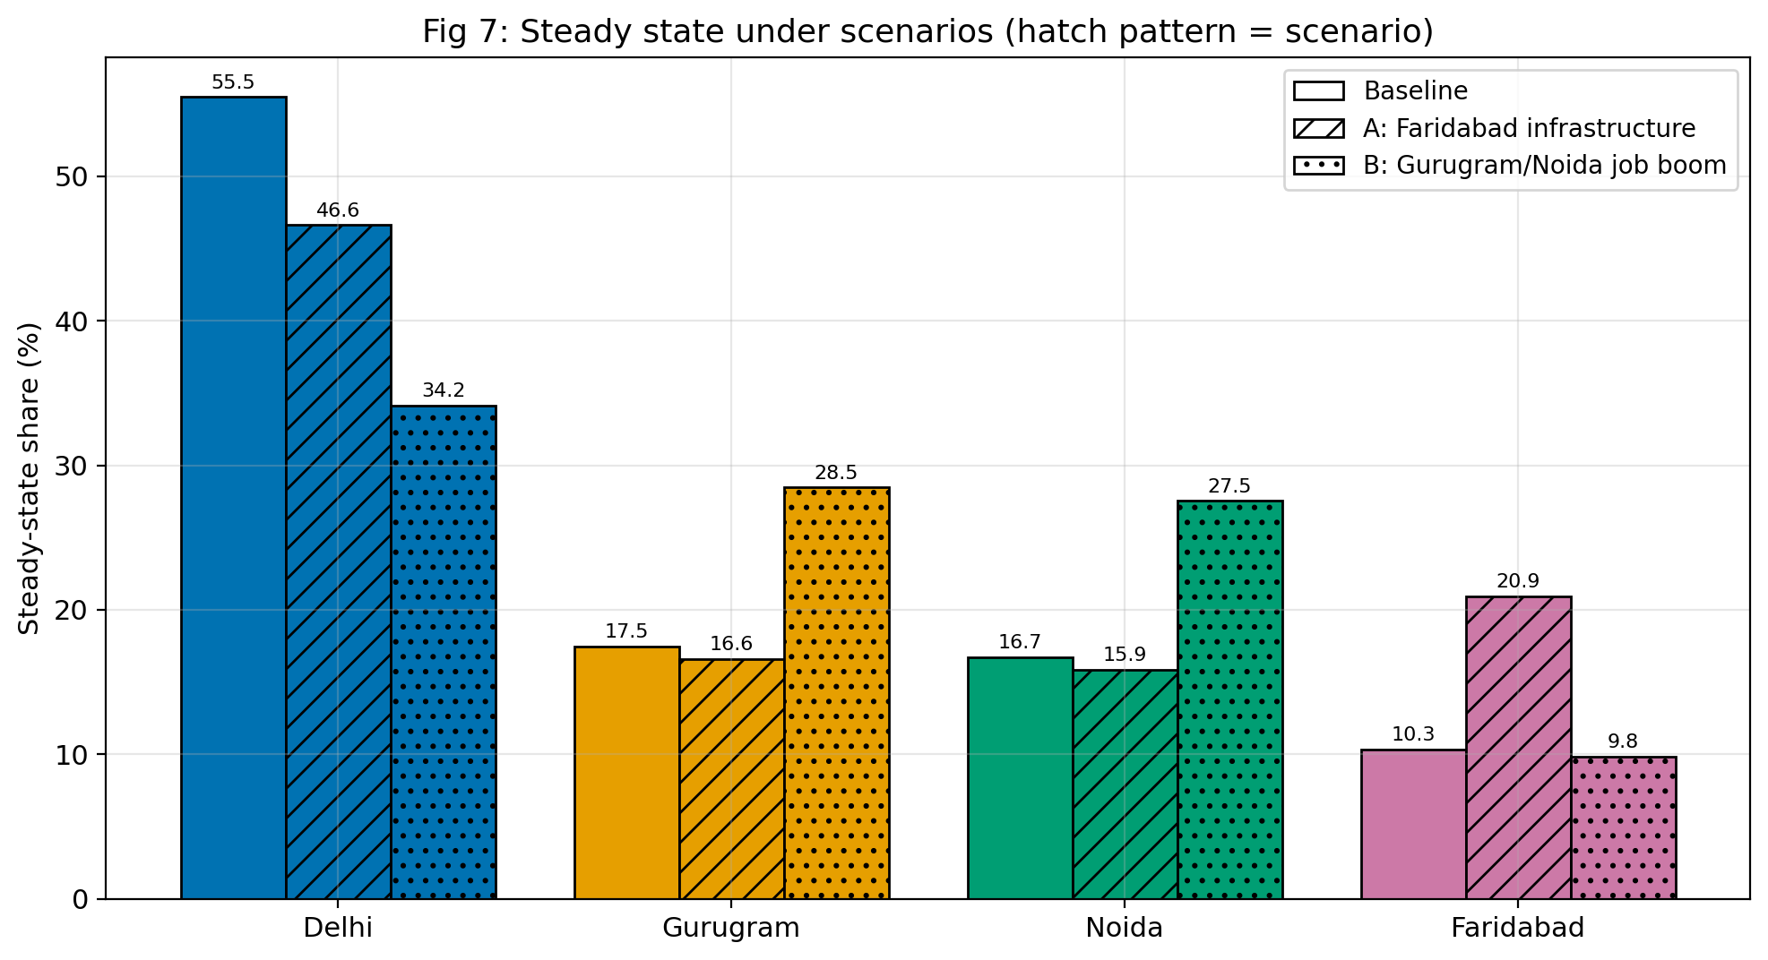
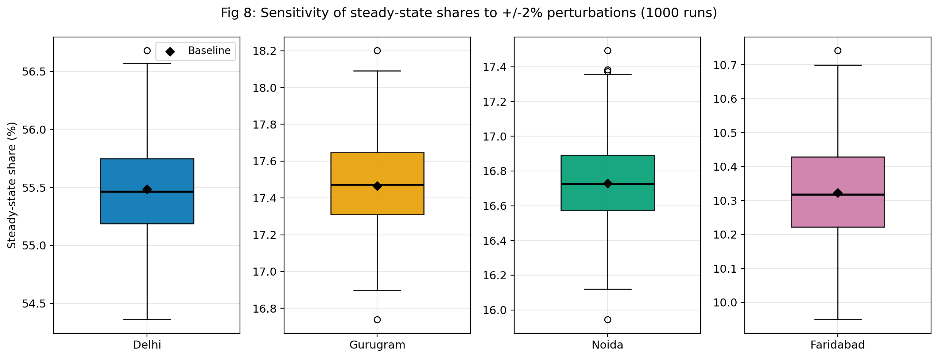
Scenarios and sensitivity
A: Faridabad 10.3% → 20.9%
B: Gurugram 28.5%, Noida 27.5%
Max change from ±2% noise: 1.20 pp (robust)
|λ₂|: baseline 0.8862, A 0.9015, B 0.8950
Group 14 · MTH2802 · Transition probabilities simulated; populations Census 2011
Notes:
A: Faridabad retention up and inflow up. B: job boom pulls Delhi movers to Gurugram and Noida. Sensitivity: 1000 runs of +/-2% on each entry, then renormalise columns.

Slide 7
Limitations
Closed system: no births, deaths or outside migration
Constant P: real probabilities change with time and policy
Memoryless: next move depends only on current region
Probabilities are simulated; populations are Census 2011
Not regular? An absorbing state or periodic chain has no unique steady state
Real data would add outside regions and time-varying P
Group 14 · MTH2802 · Transition probabilities simulated; populations Census 2011
Notes:
Closed system, constant P, memoryless, simulated data. If P is not regular: absorbing state or periodic chain – no unique steady state.

Slide 8
Conclusion
A regular transition matrix gives a unique steady state, whatever the start
Three independent methods agree on it
λ = 1 survives; |λ₂| sets the speed of convergence
Scenarios shift the long-run shares; ±2% noise barely does
The method is real; the probabilities are simulated
Notes:
Close with: the method is real, the data is simulated.

