Slide 1

UART3 테스트
CRZ Technology

Slide 2
Mango-M32F2 UART3 테스트

Slide 3
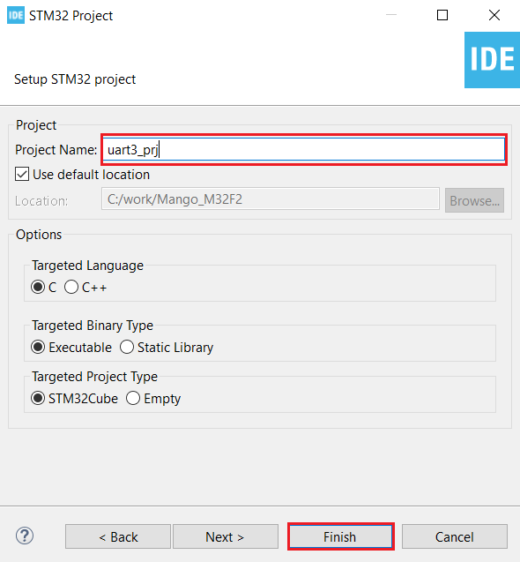
STM32CubeIDE 프로젝트 생성
Project Name으로 “uart3_prj” 입력 후 “Finish” 클릭.

Slide 4

UART3 pinmap
UART3 – PC10 / PC11

Slide 5
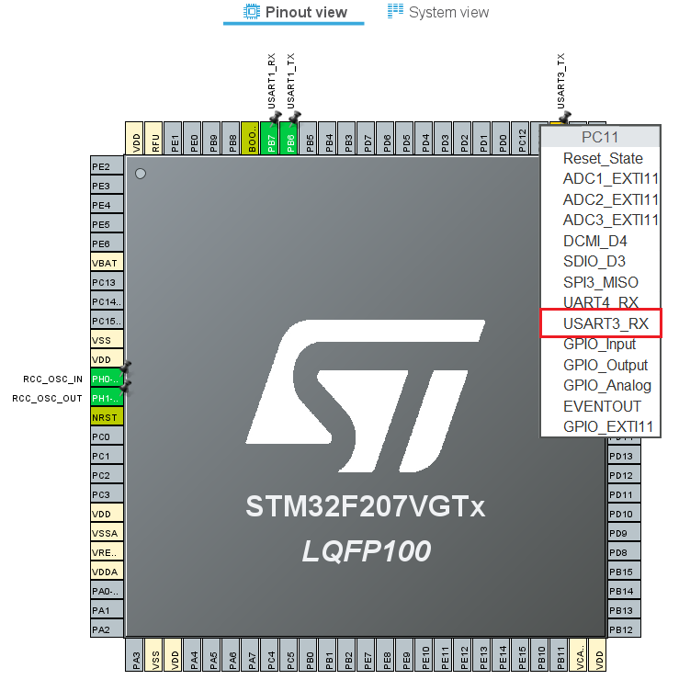
Pinout view
PC10 – USART3_TX, PC11 – USART3_RX 선택.

Slide 6
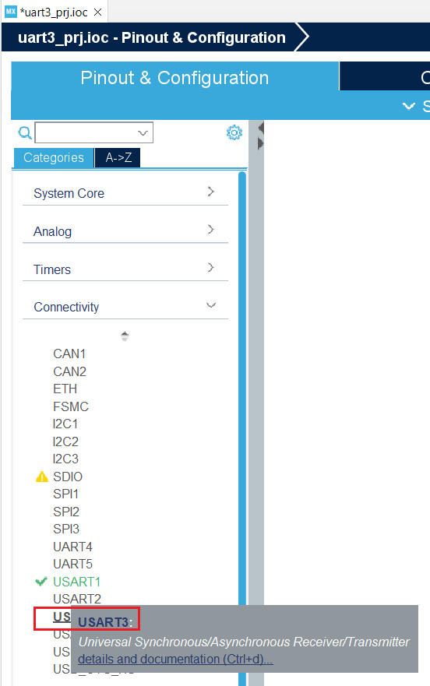
UART3 설정
“Connectivity“ 클릭, “USART3” 클릭.

Slide 7
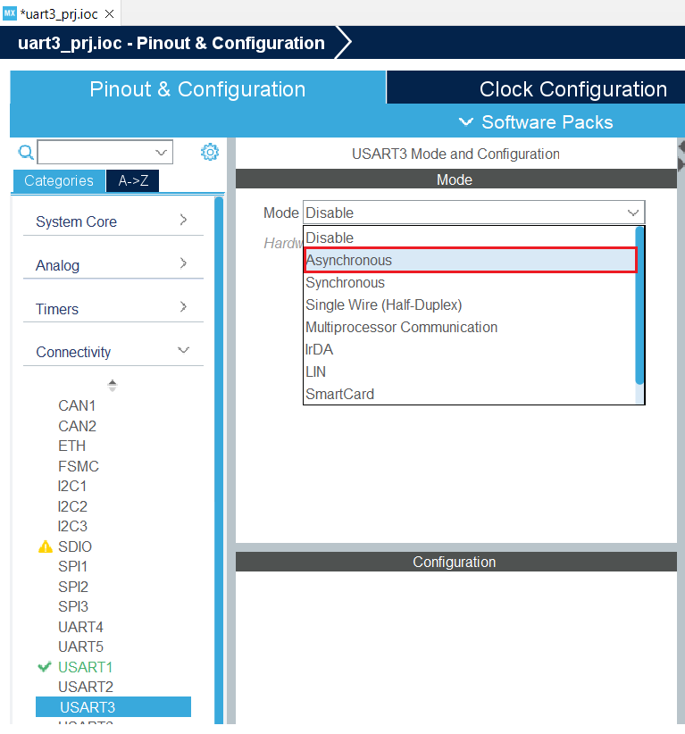
UART3 설정
“Mode“, “Asynchronous” 클릭.

Slide 8
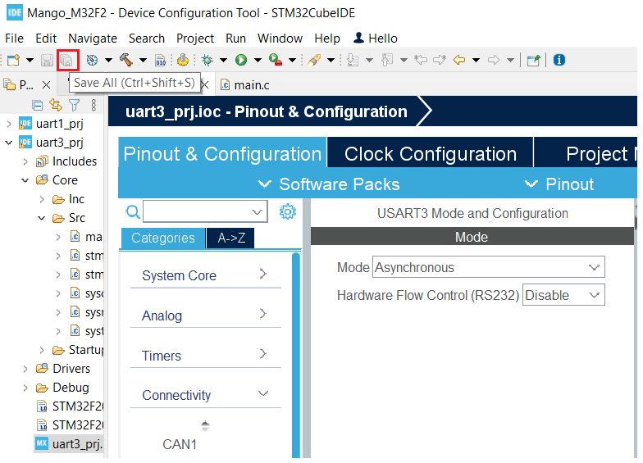
UART3 Test Project
“Save All“클릭, Code Generation.

Slide 9
UART3 Test Project
core/src/main.c 편집
printf() – UART3, overwrite _write() function
/* Private user code ---------------------------------------------------------*/
/* USER CODE BEGIN 0 */
#define hUART huart3
int _write( int32_t file , uint8_t *ptr , int32_t len )
{
/* Implement your write code here, this is used by puts and printf for example */
for ( int16_t i = 0 ; i < len ; ++i )
{
HAL_UART_Transmit( &hUART, ptr++, 1, 100);
}
return len;
}
/* USER CODE END 0 */
/* USER CODE BEGIN 2 */
int count = 0;
printf(“UART3 test\r\n");
/* USER CODE END 2 */
/* Infinite loop */
/* USER CODE BEGIN WHILE */
while (1)
{
printf("count=%d\r\n", count++);
HAL_Delay(1000);
/* USER CODE END WHILE */
/* USER CODE BEGIN 3 */
}
/* USER CODE END 3 */

Slide 10
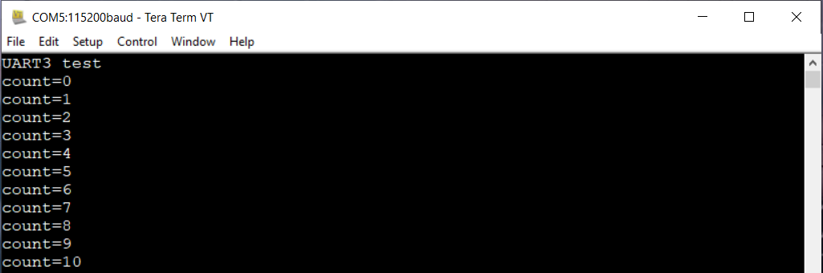
Test 결과 확인
3핀 serial cable을 UART3에 연결하고 Flash Loader로 다운로드.
3핀 serial cable을 UART3에 연결하고 결과 확인.

