Slide 1
Switch It Up
A game to benefit children with autism spectrum disorder
David Cheng
Danielle Connolly
Claire Rehfuss
Tyler Simpson
University of Michigan, Ann Arbor

Slide 2
Introduction
Engr 100 Section 650
Gaming for the Greater Good
Autism spectrum disorder
Three releases
April 21, 2015

Slide 3









Switch It Up!

Slide 4
Introduction
Design and development
Gameplay
Results

Slide 5
Autism Spectrum Disorder
Social withdrawal
Trouble managing emotions
Upset by changes in routine

Slide 6
Treatment
Minimize maladaptive behaviors
Operant conditioning

Slide 7


Criteria and Constraints
Autism Spectrum Disorder
Timebox

Slide 8
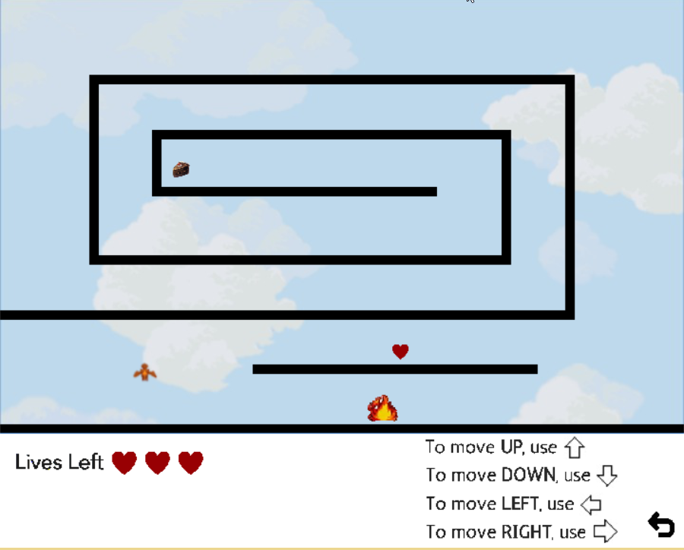

Slide 9
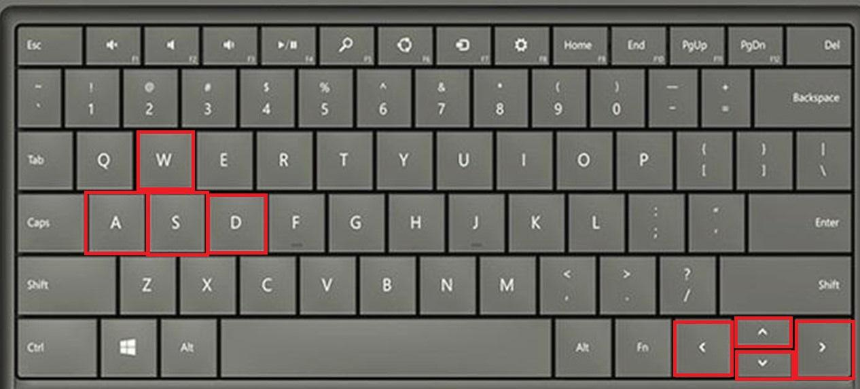

Slide 10
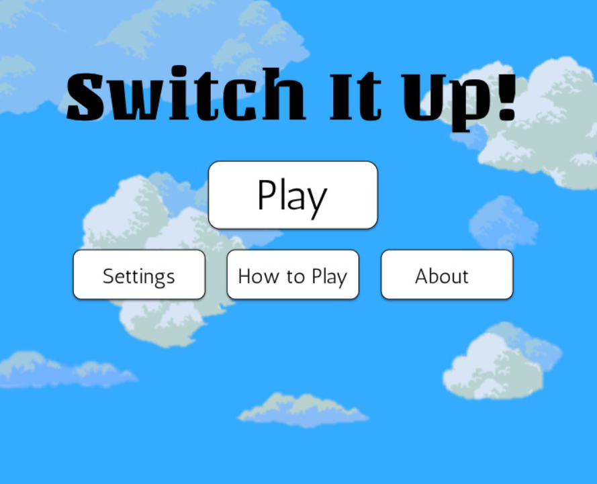

Slide 11
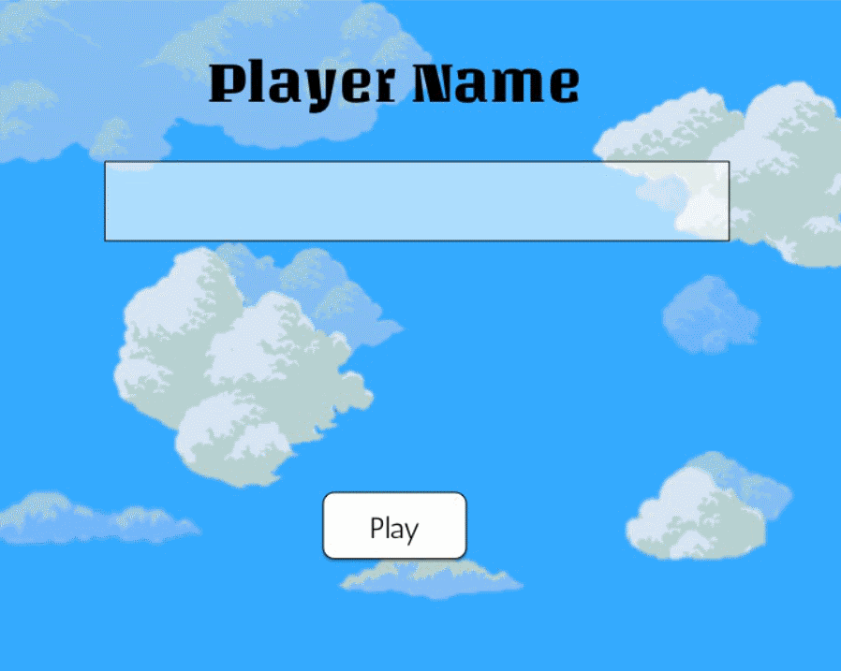

Slide 12
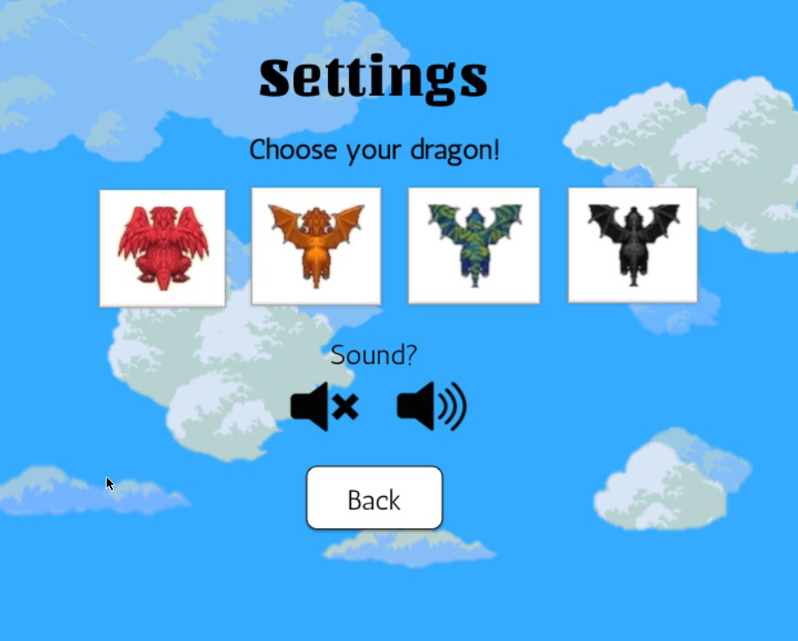

Slide 13
Development and Testing
Alpha Release
Beta Release
Final Release

Slide 14
Alpha Release: Ground Work
Moving Avatar
Graphics
Key Mapping Function
Sample Mazes

Slide 15
Beta Release: Adding Complexity
Fixing Collisions
Dynamic Hints
Hazards
Sounds
Avatar Customization
Multiple Mazes

Slide 16
Final Release: Finishing Touches
Final Level
Adding Name Customization
Cheat Codes
Bonus Items

Slide 17
Further Improvements
Develop more key mapping and maps
Improve maze and dragon graphics
Add more customizations
Develop the backstory

Slide 18
Conclusion
Switch It Up helps children with ASD cope with change
Changing key mapping
Various maze layouts
Features other aspects to improve gameplay
Graphics
Sounds
Interactive items
Customization
Feedback
Fulfilled the criteria and followed the constraints

Slide 19
Any Questions?

