Slide 1


A Talk About Partially Observable Markov Decision Processes
Notes:
照片为学生拍摄的礼堂

Slide 2
Aircraft Collision Avoidance System

Slide 3
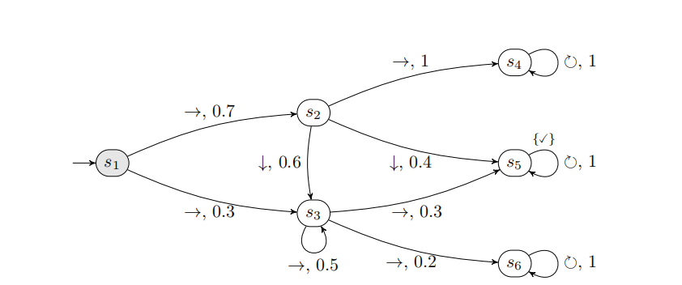
An Example

Slide 4
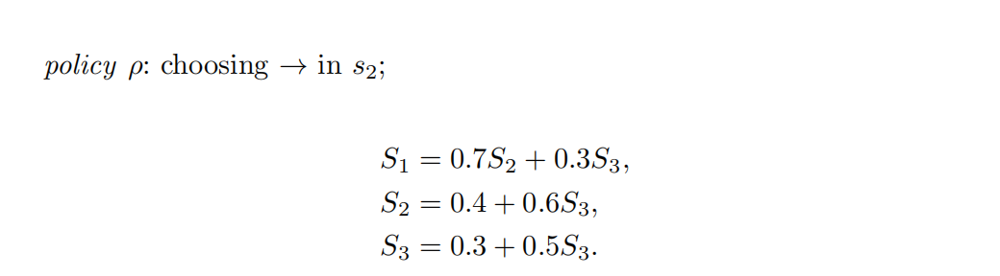
An Example

Slide 5
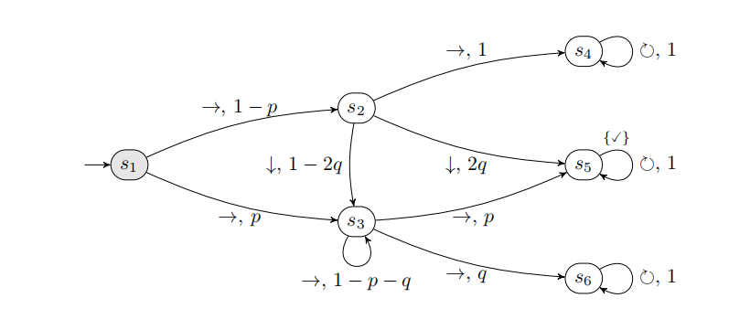
Parametric Models
In many cases, giving a specific polynomial can be quite challenging.
Can we use a simple polynomial to approximate it?

Slide 6

02
Scenario Optimization Problem and PAC Approximation

Slide 7

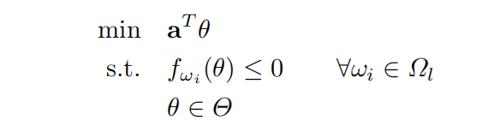
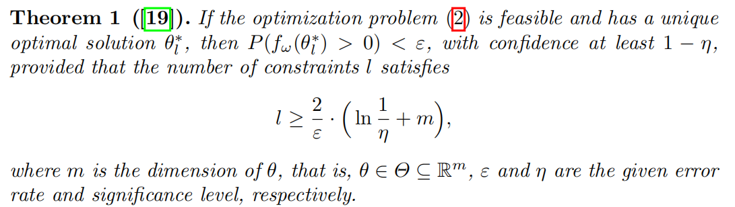
Scenario Optimization Problem

Slide 8
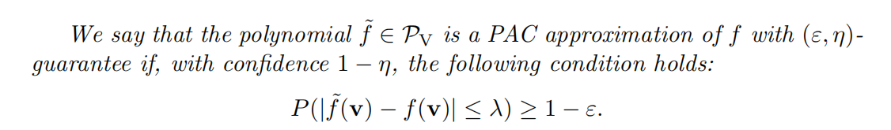
PAC Approximation

Slide 9
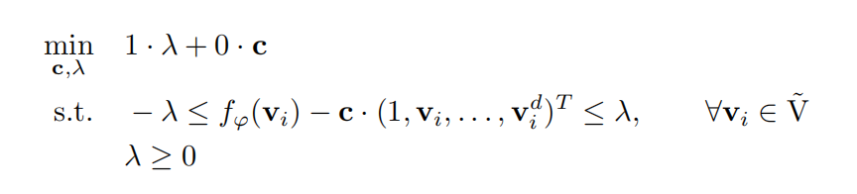
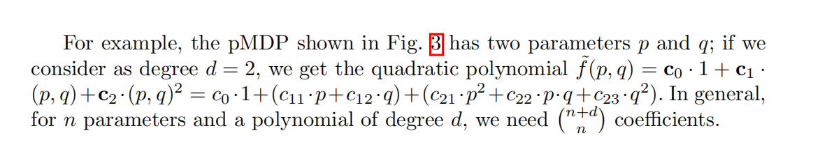
What polynomial do we use to approximate?

Slide 10
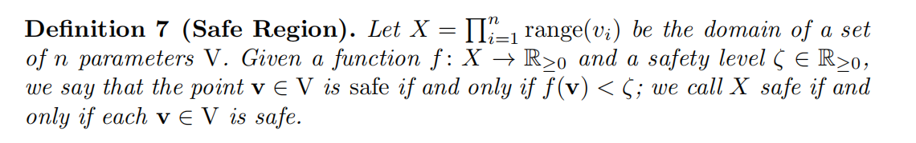
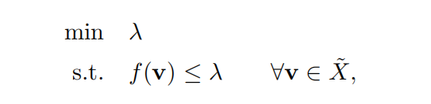
PRCTL Property Analysis

Slide 11
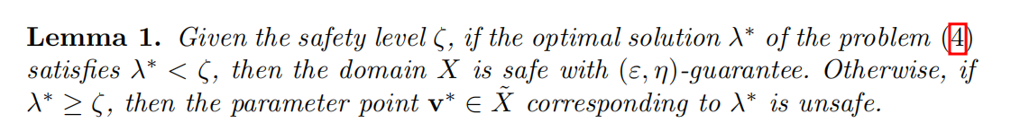
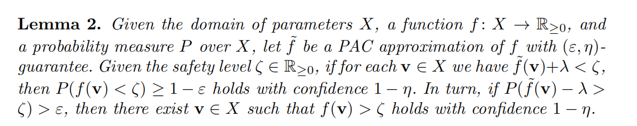
PRCTL Property Analysis

Slide 12
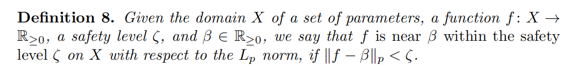
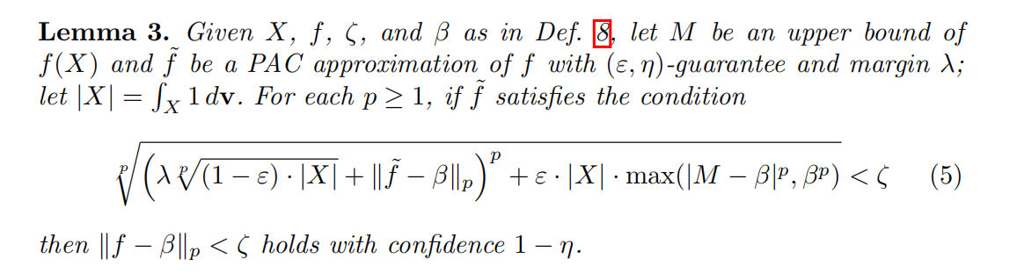
PRCTL Property Analysis

Slide 13
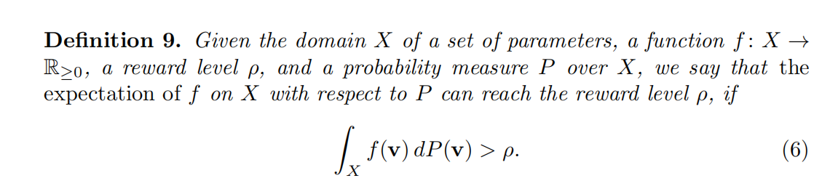
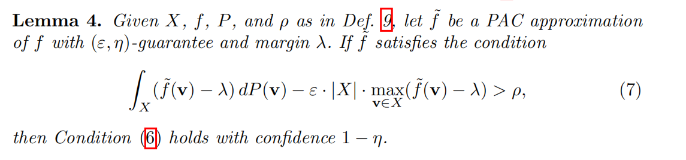
Extension to Reward Models

Slide 14
03
Exprimental Results

Slide 15
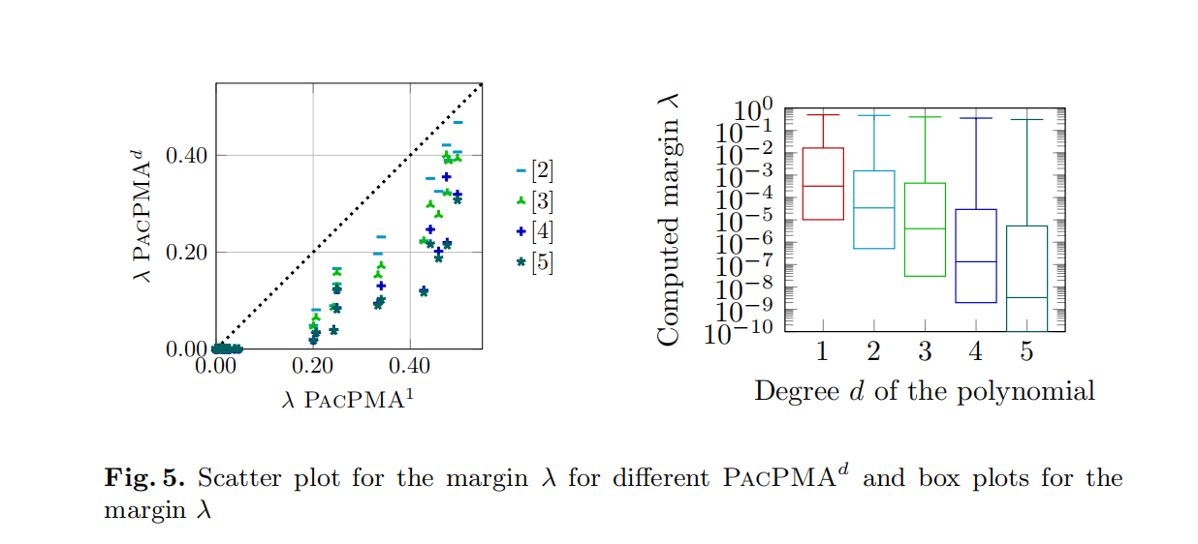
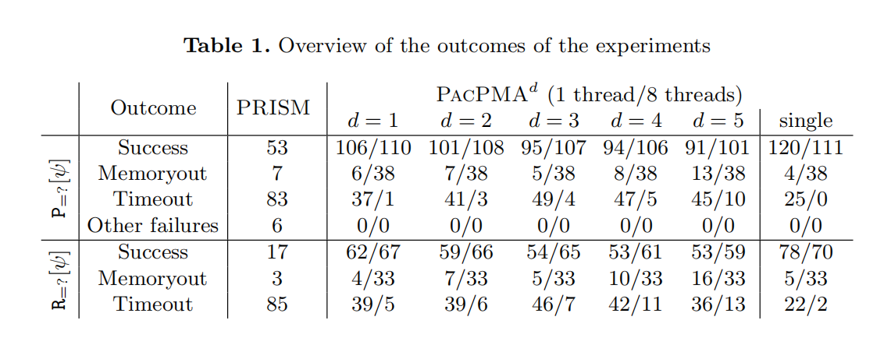
Exprimental Results

Slide 16




