Slide 1


Scenario Approach for Parametric Markov Models
迟智名
Notes:
照片为学生拍摄的礼堂

Slide 2

01
Definition

Slide 3
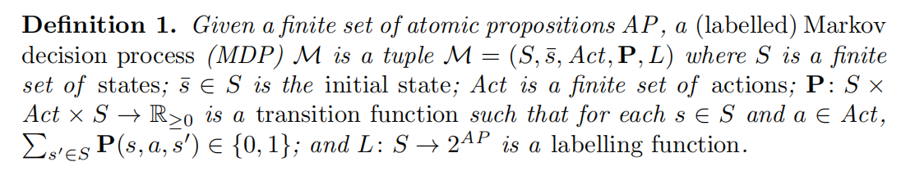
Markov Decision Process

Slide 4
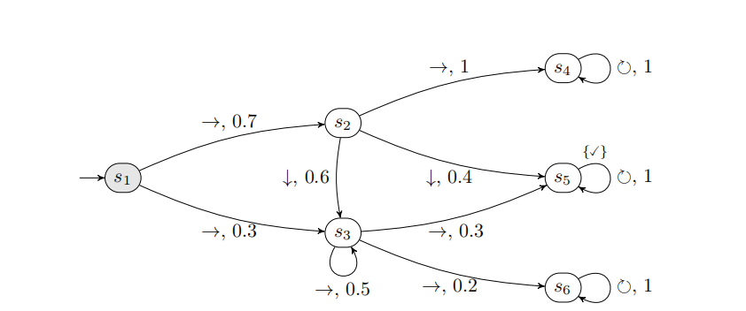
An Example

Slide 5
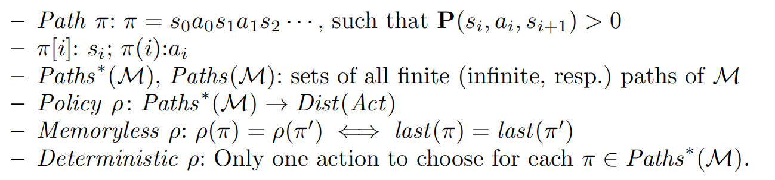
Some Definitions

Slide 6
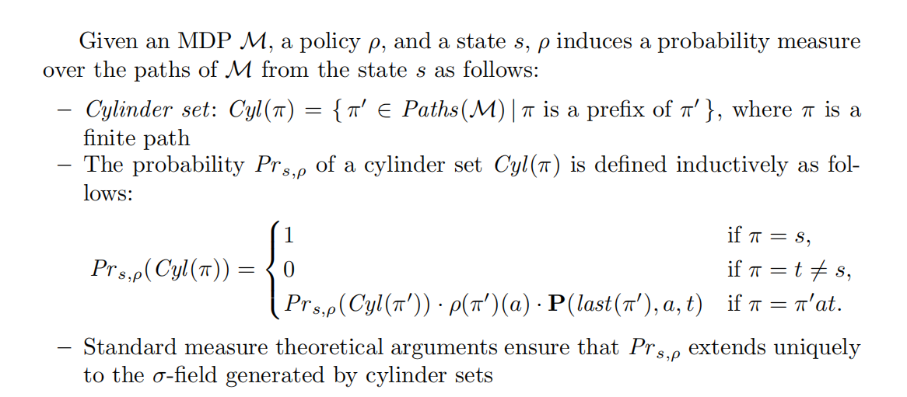
Probability Measure of Path

Slide 7
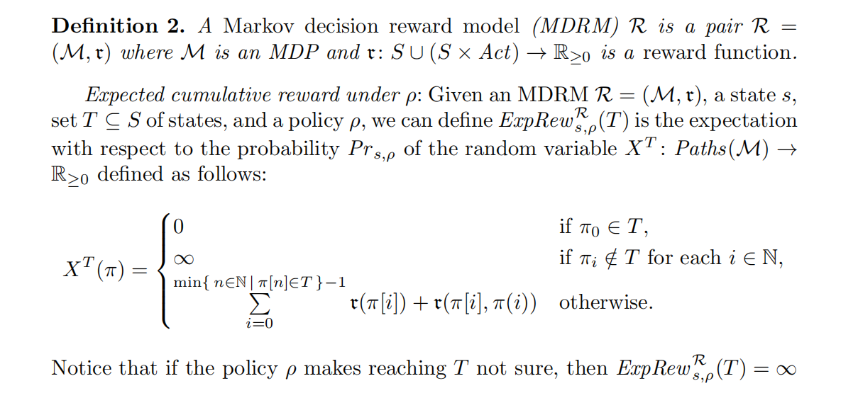
Reward Structure

Slide 8

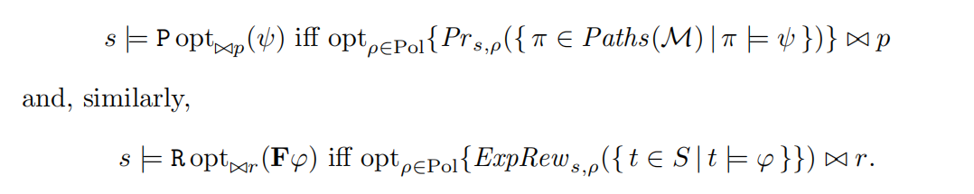
Probabilistic Reward Logic PRCTL
Syntax:
Semantics:

Slide 9
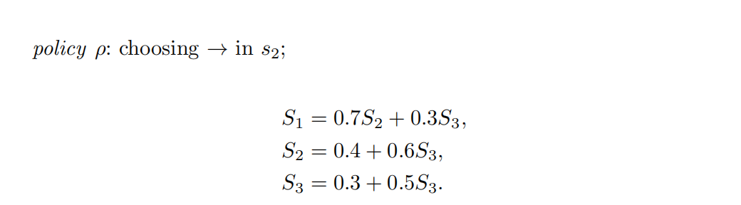
An Example

Slide 10
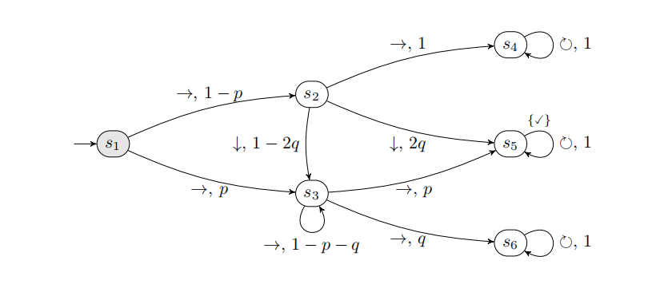
Parametric Models
In many cases, giving a specific polynomial can be quite challenging.
Can we use a simple polynomial to approximate it?

Slide 11
02
Scenario Optimization Problem and PAC Approximation

Slide 12

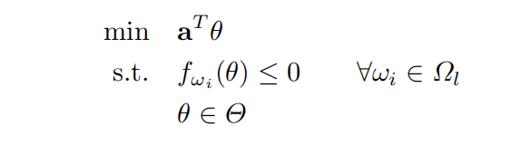
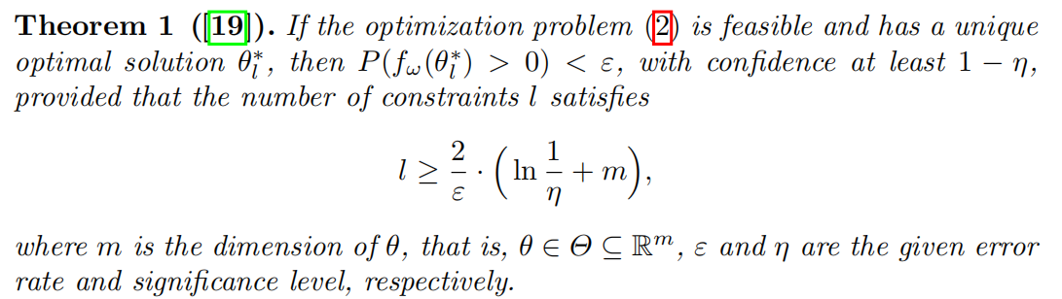
Scenario Optimization Problem

Slide 13
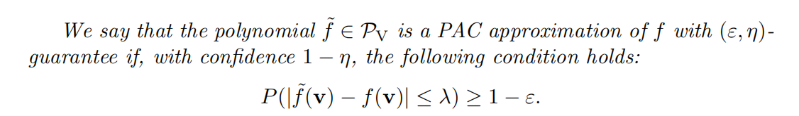
PAC Approximation

Slide 14
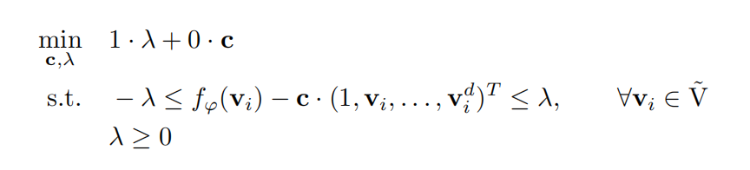
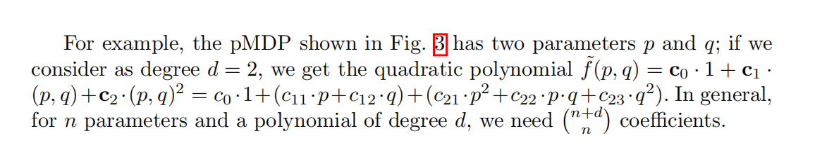
What polynomial do we use to approximate?

Slide 15
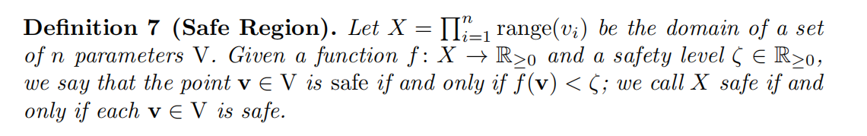
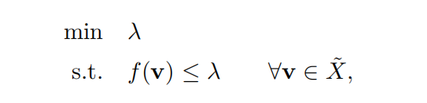
PRCTL Property Analysis

Slide 16
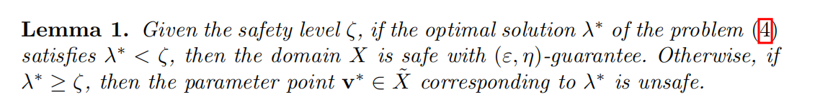
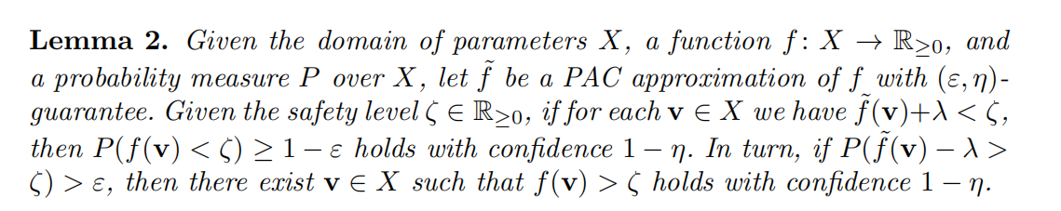
PRCTL Property Analysis

Slide 17
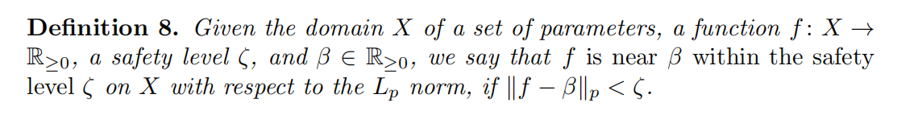
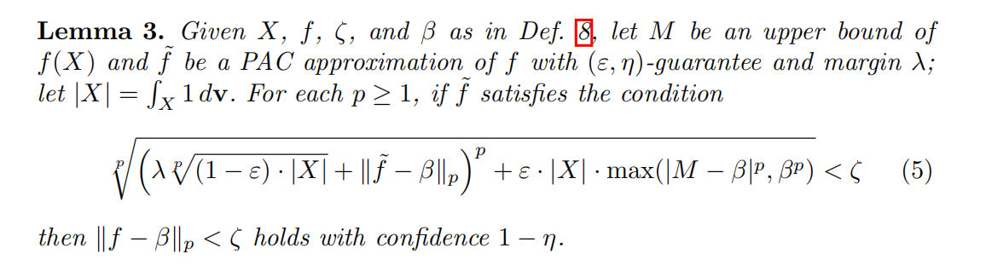
PRCTL Property Analysis

Slide 18
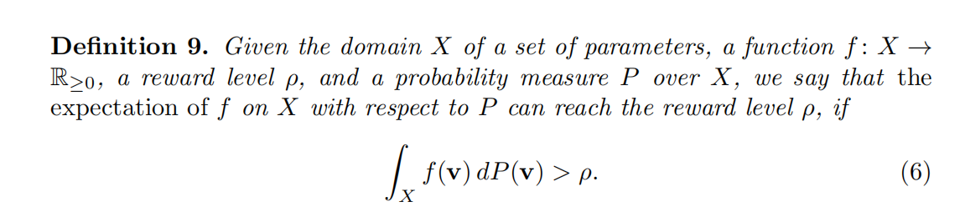
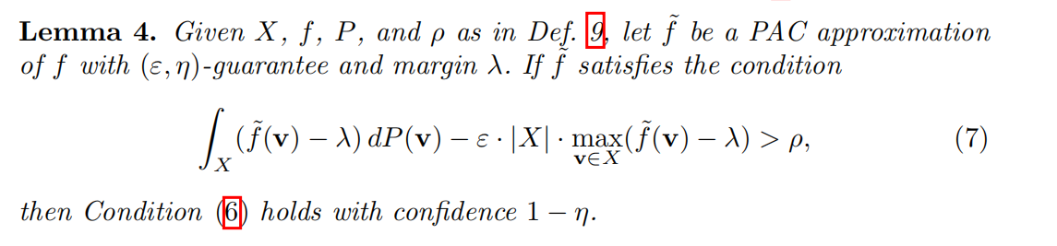
Extension to Reward Models

Slide 19
03
Exprimental Results

Slide 20
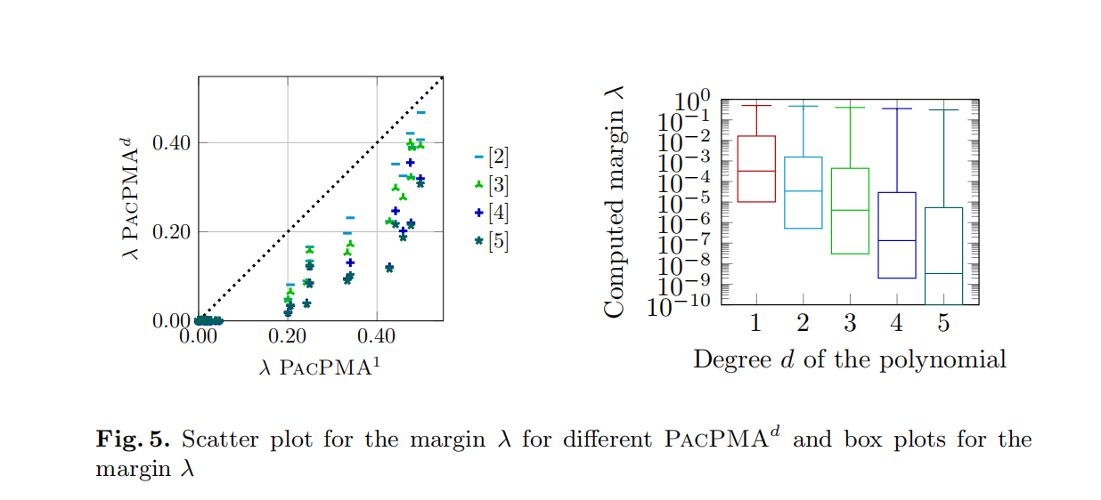
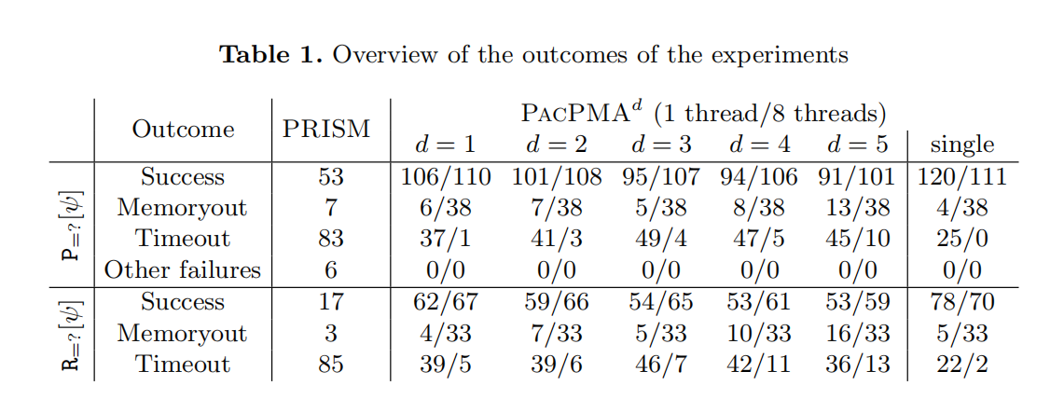
Exprimental Results

Slide 21




