Slide 1


Scenario Approach for Parametric Markov Models
迟智名
Notes:
照片为学生拍摄的礼堂

Slide 2

01
Definition

Slide 3
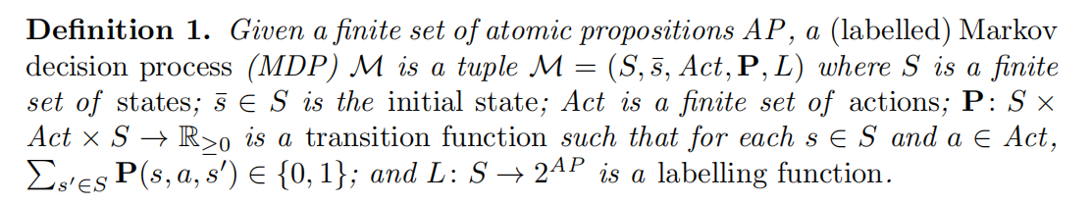
Markov Decision Process

Slide 4
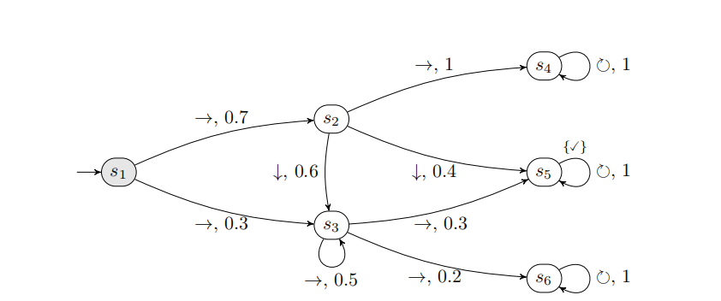
An Example

Slide 5
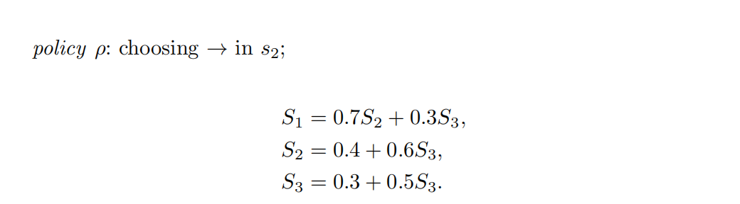
An Example

Slide 6
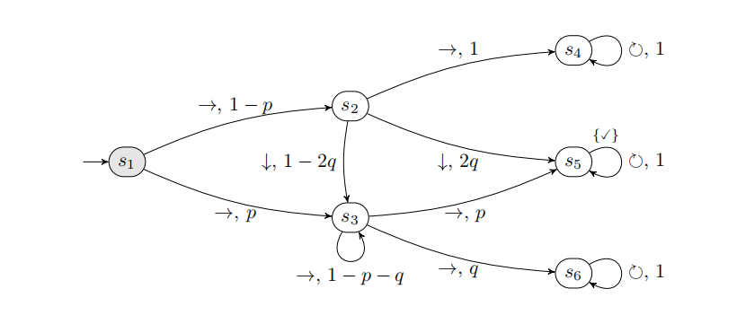
Parametric Models
In many cases, giving a specific polynomial can be quite challenging.
Can we use a simple polynomial to approximate it?

Slide 7
02
Scenario Optimization Problem and PAC Approximation

Slide 8

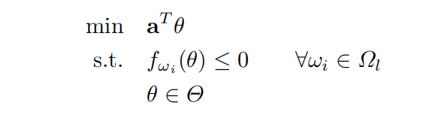
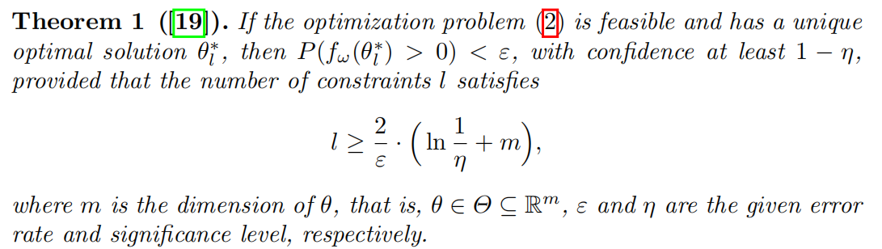
Scenario Optimization Problem

Slide 9
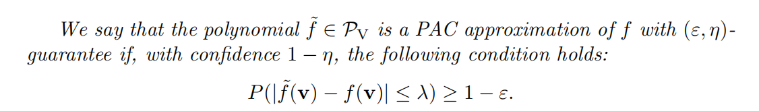
PAC Approximation

Slide 10
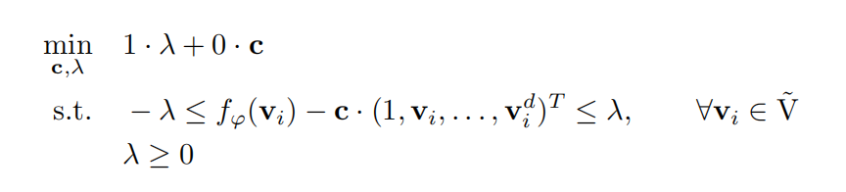
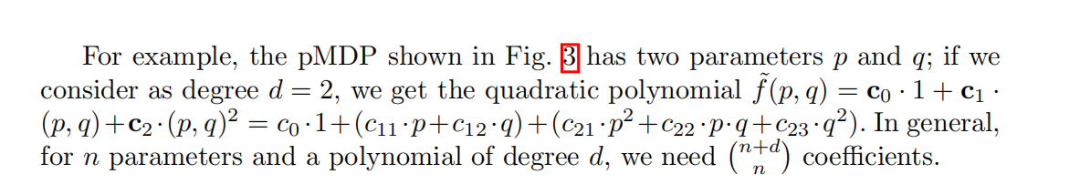
What polynomial do we use to approximate?

Slide 11
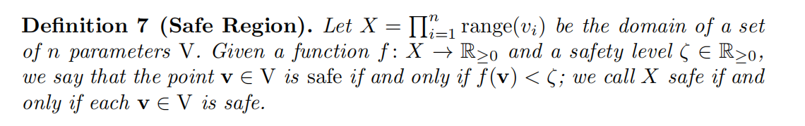
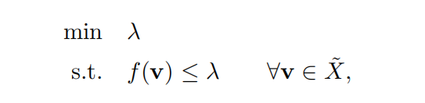
PRCTL Property Analysis

Slide 12
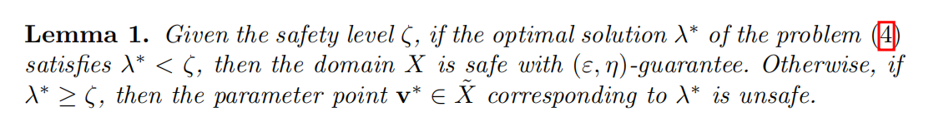
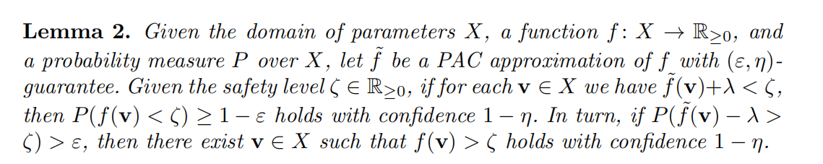
PRCTL Property Analysis

Slide 13
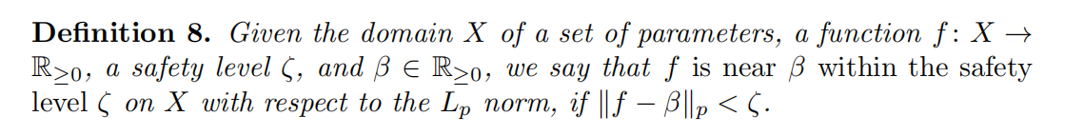
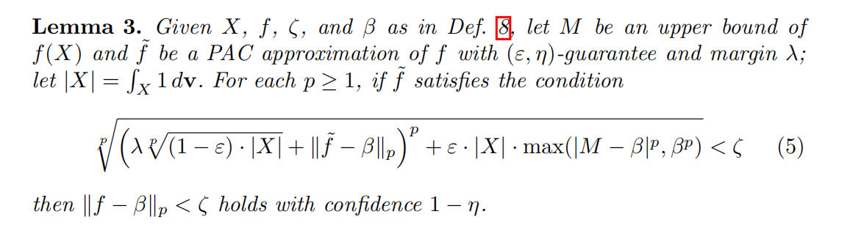
PRCTL Property Analysis

Slide 14
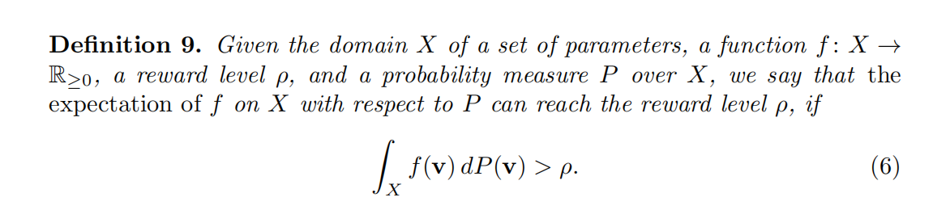
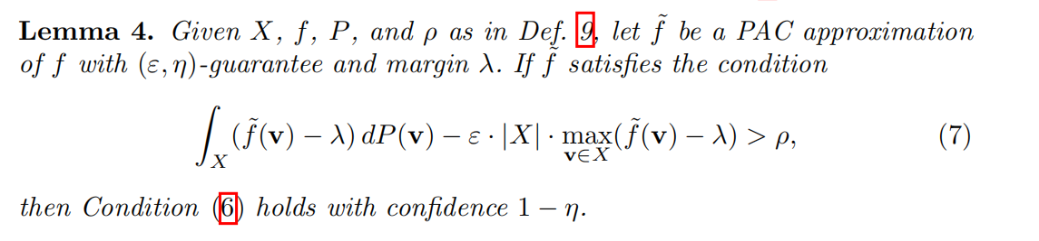
Extension to Reward Models

Slide 15
03
Exprimental Results

Slide 16
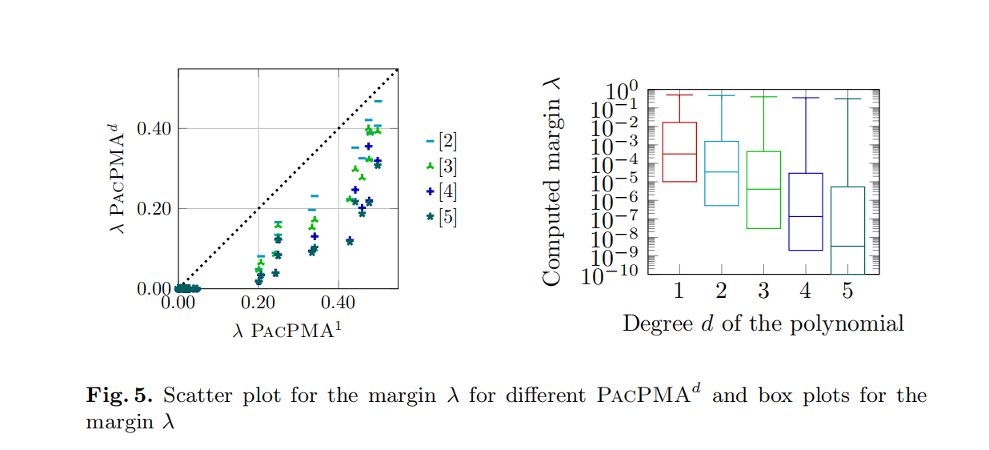
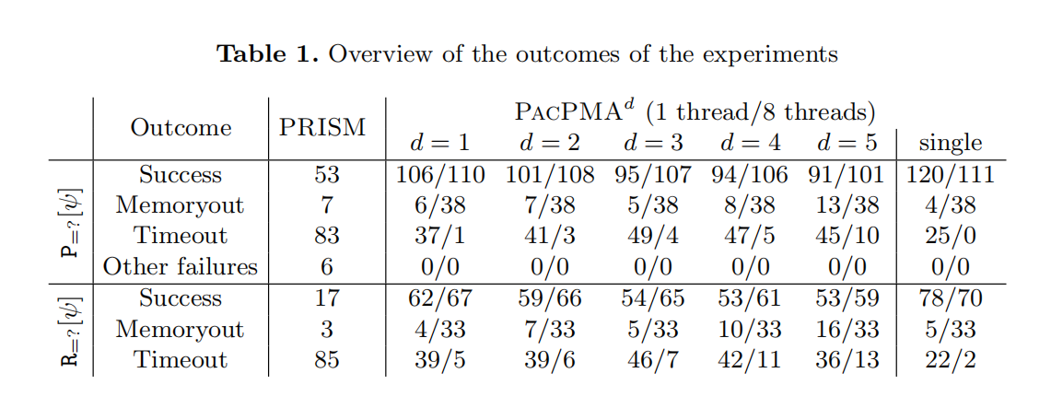
Exprimental Results

Slide 17




