Slide 1
Dans Frappes
We put the frap in frappe!

Slide 2


Aggies solutions inc.
Reagan Baxter
Frontend Designer/developer
Jason Crandall
Database manger/developer
Joshua Frerichs
Documenter/developer
Spencer Lingwall
Backend Designer/developer

Slide 3
Project Overview
The Phase four scrum master should present an overview of the project. Identify the major design decisions and explain how those decisions reflected the team’s (desired?) abilities while satisfying the most important requirements. How the team adapted agile (scrum) practices into improved productivity should be analyzed, and a final burn down chart should be included. Explain why the project is ready to move into deployment, including a discussion of the correctness of the code and description of the testing phase. Teams with 5 member should have two presenters in this section.

Slide 4
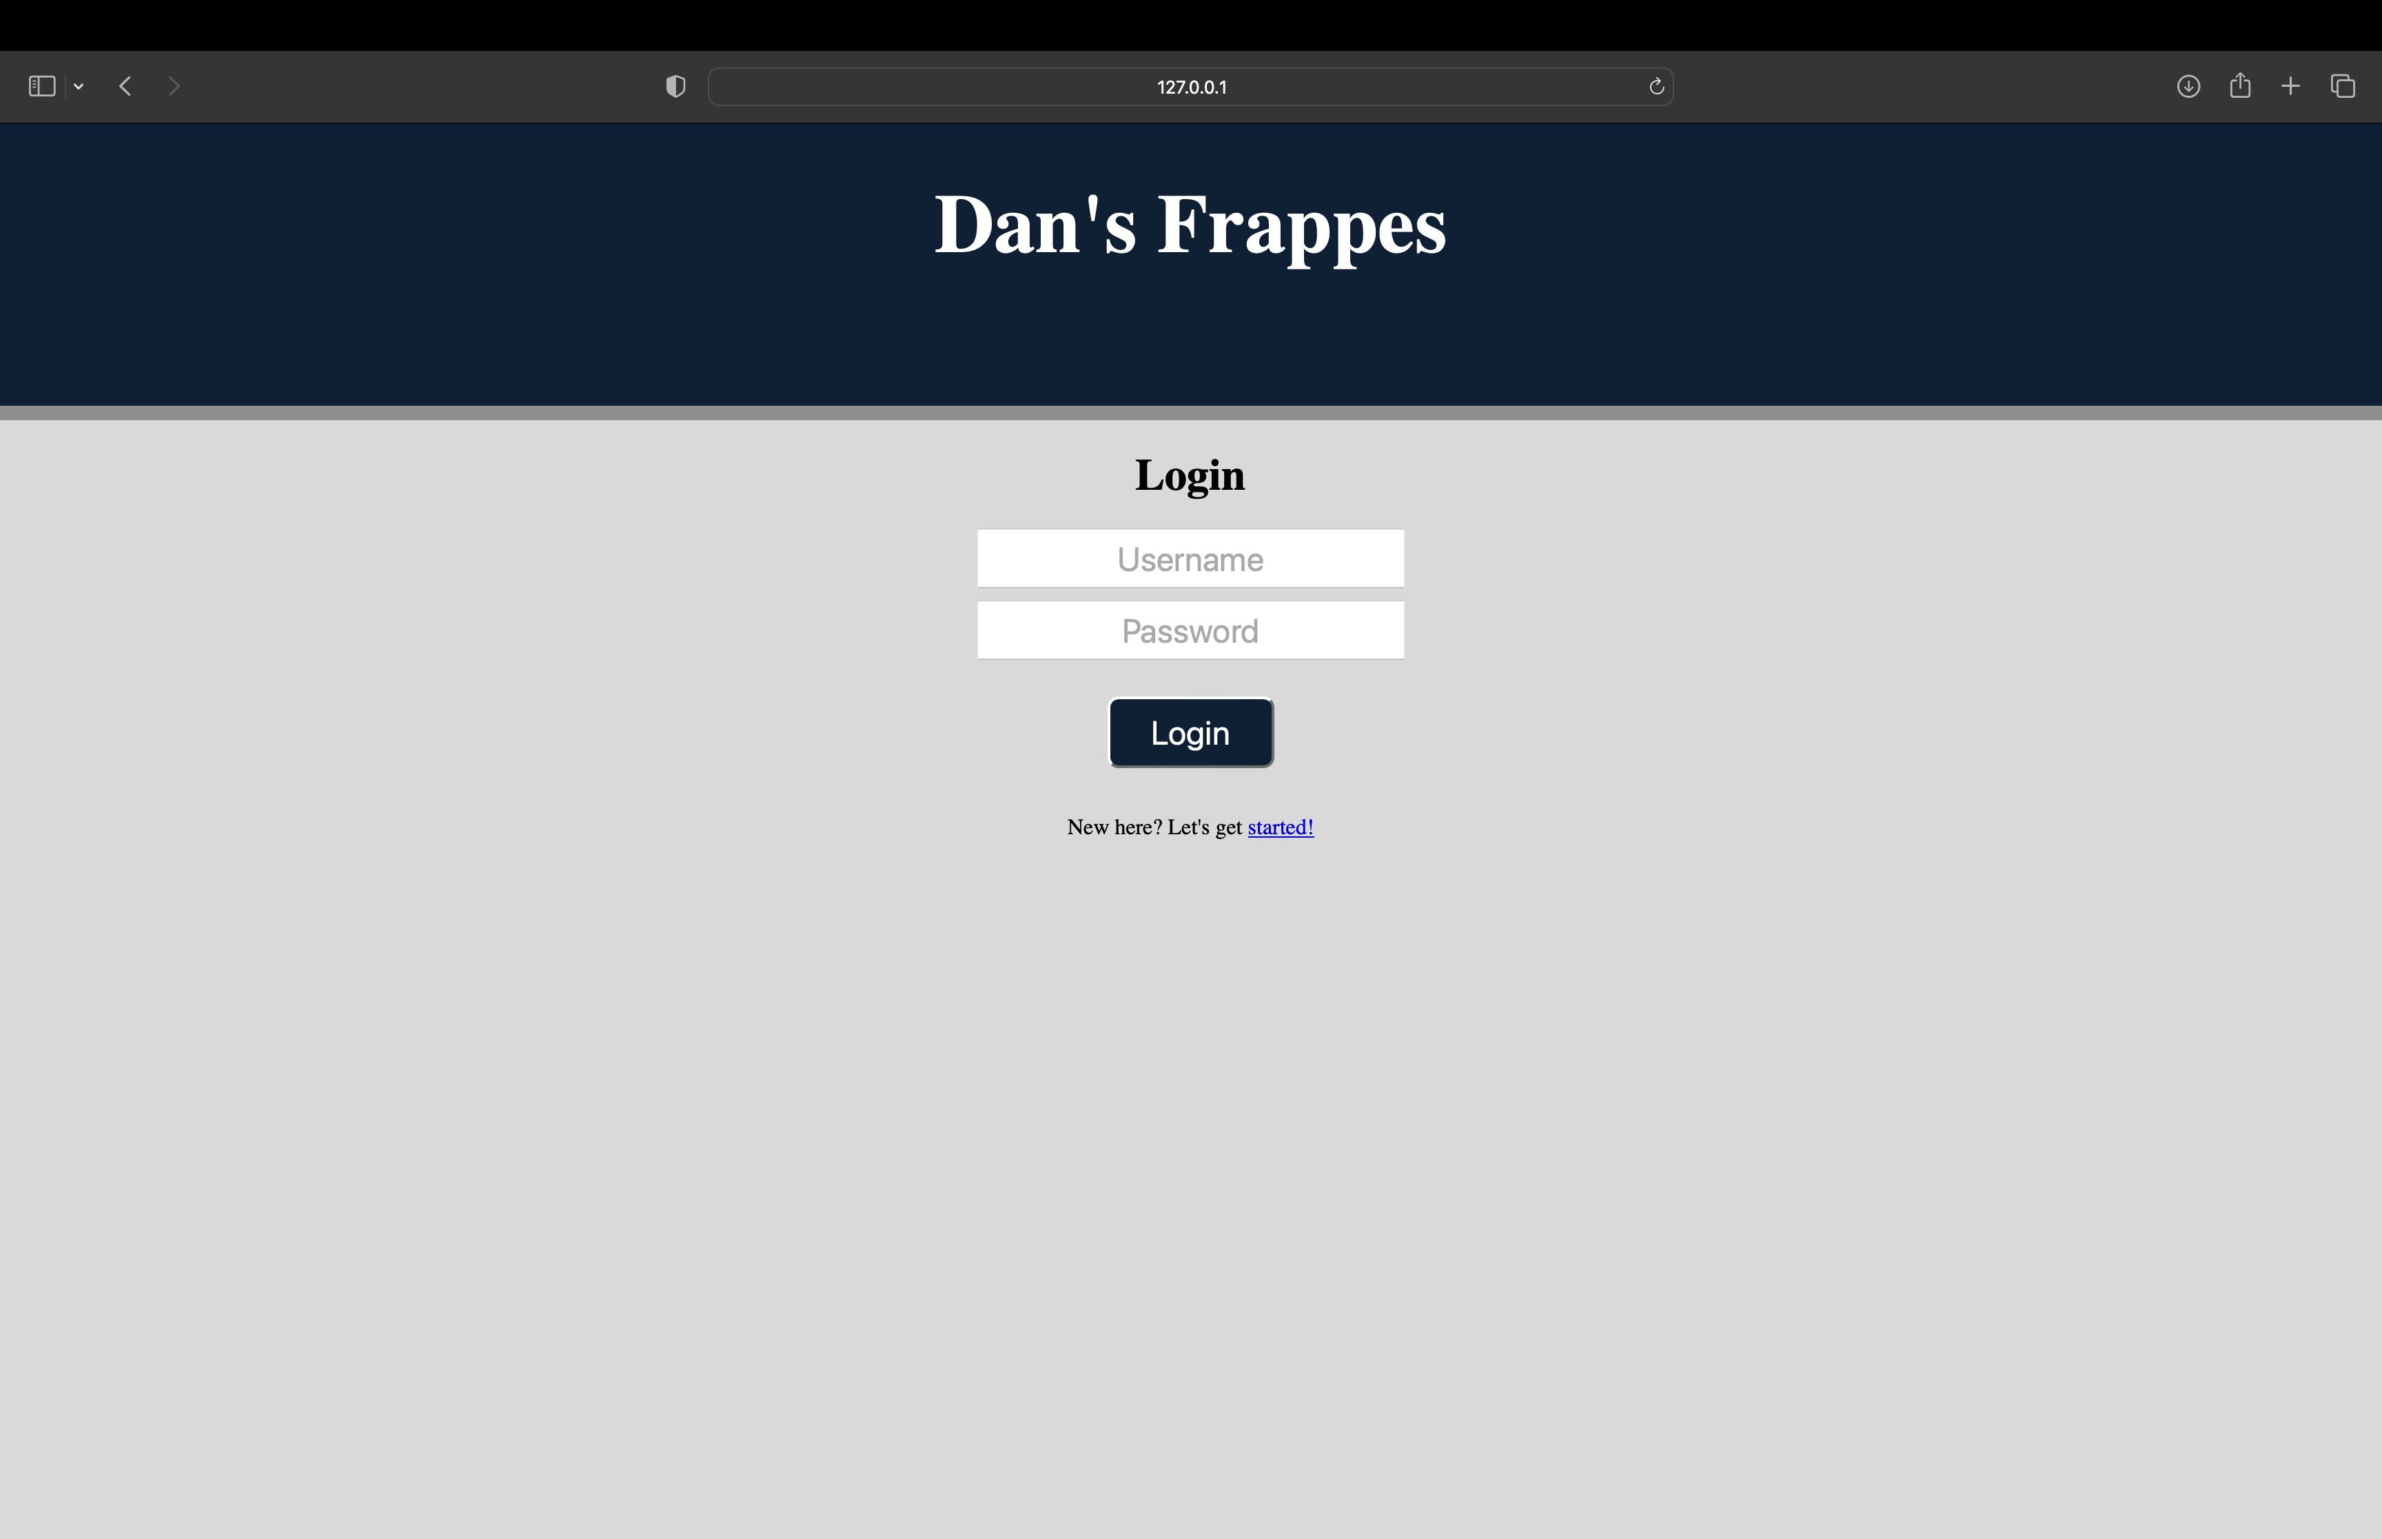
Account Creation/User editing

Slide 5
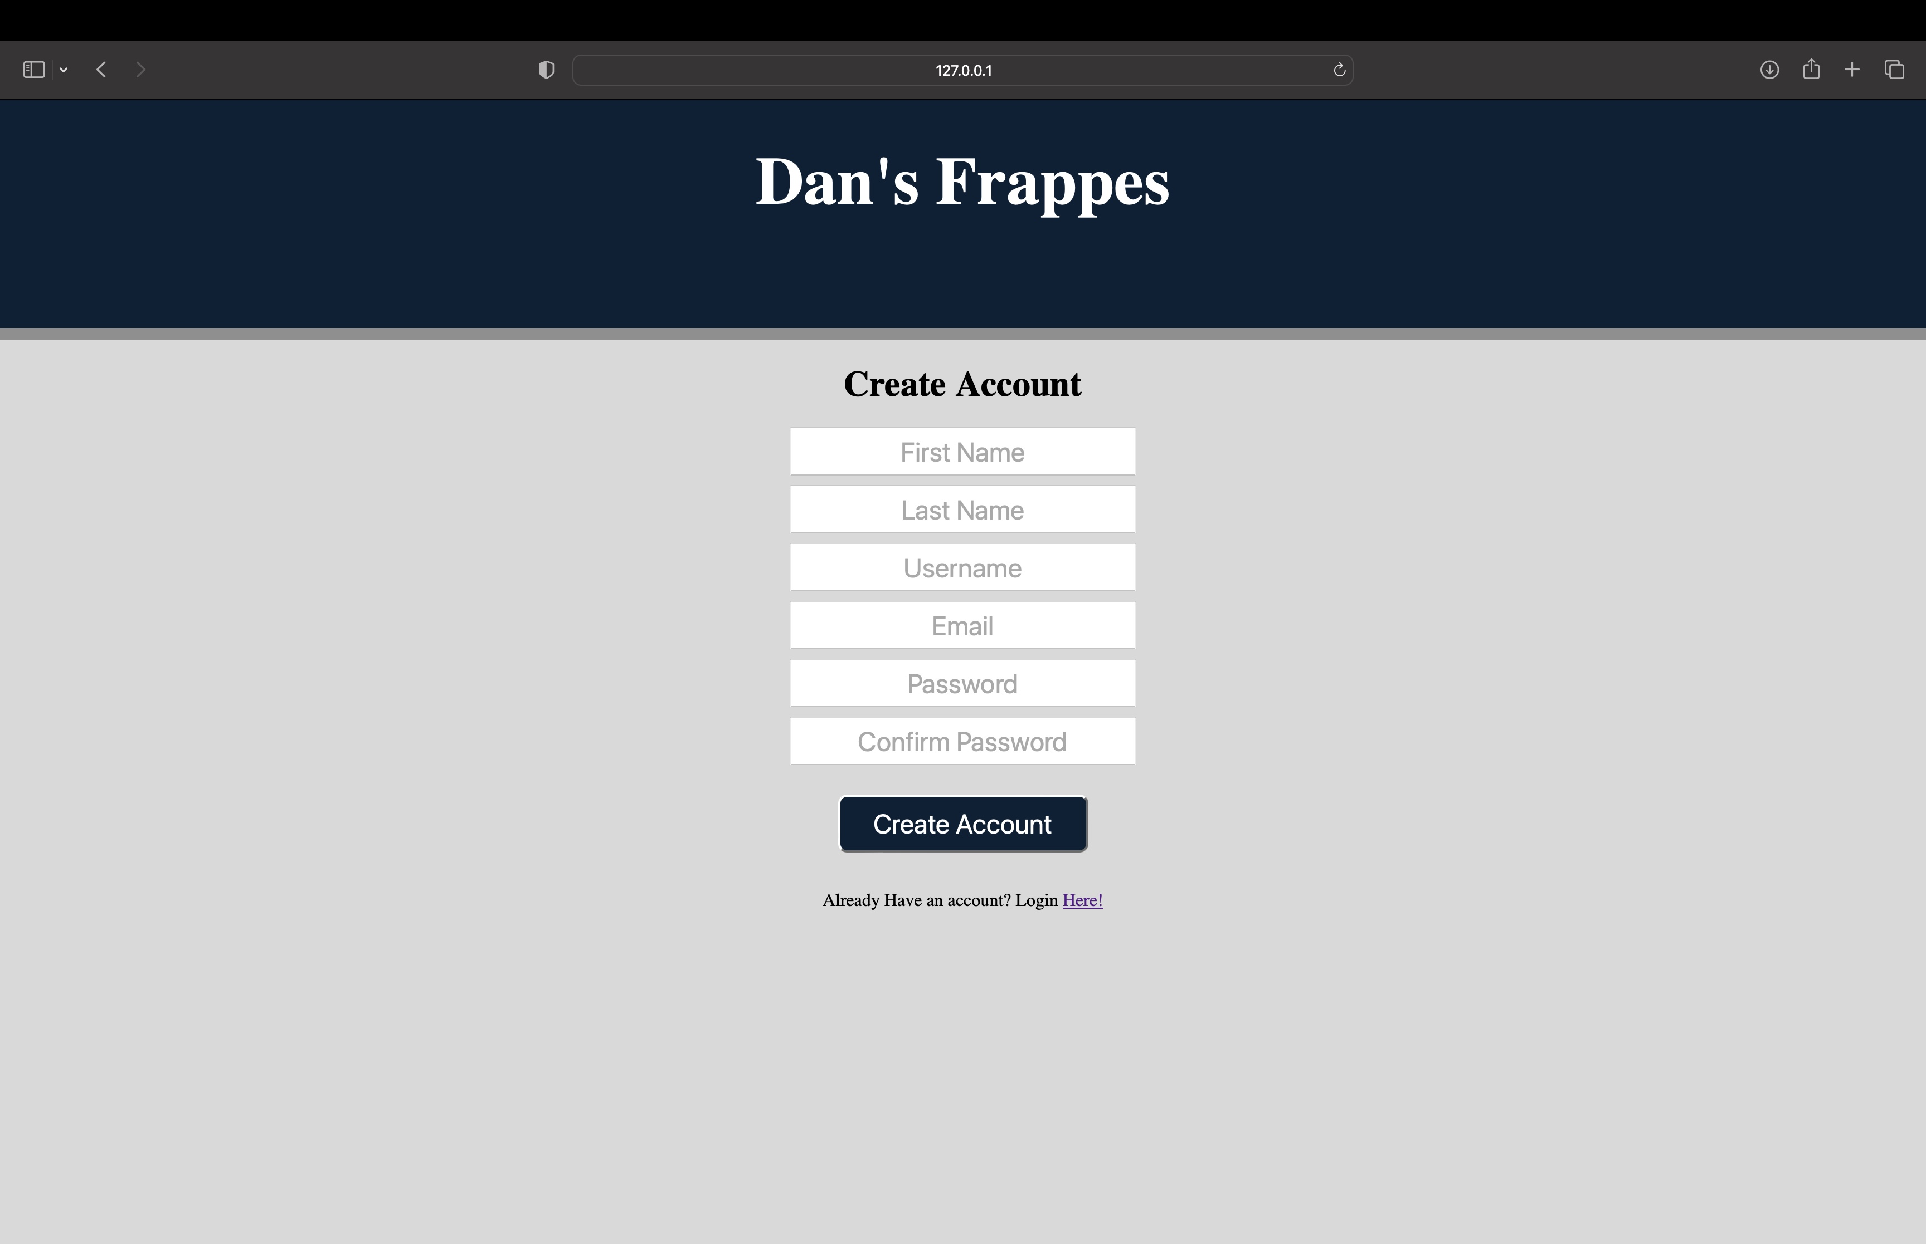
Account Creation/User editing

Slide 6
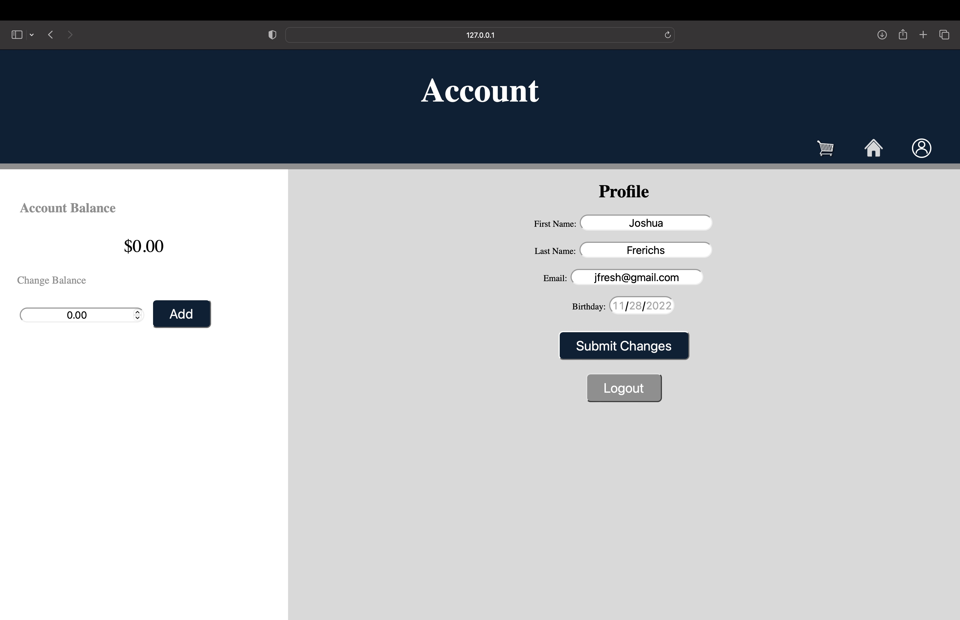
Account Creation/User editing

Slide 7
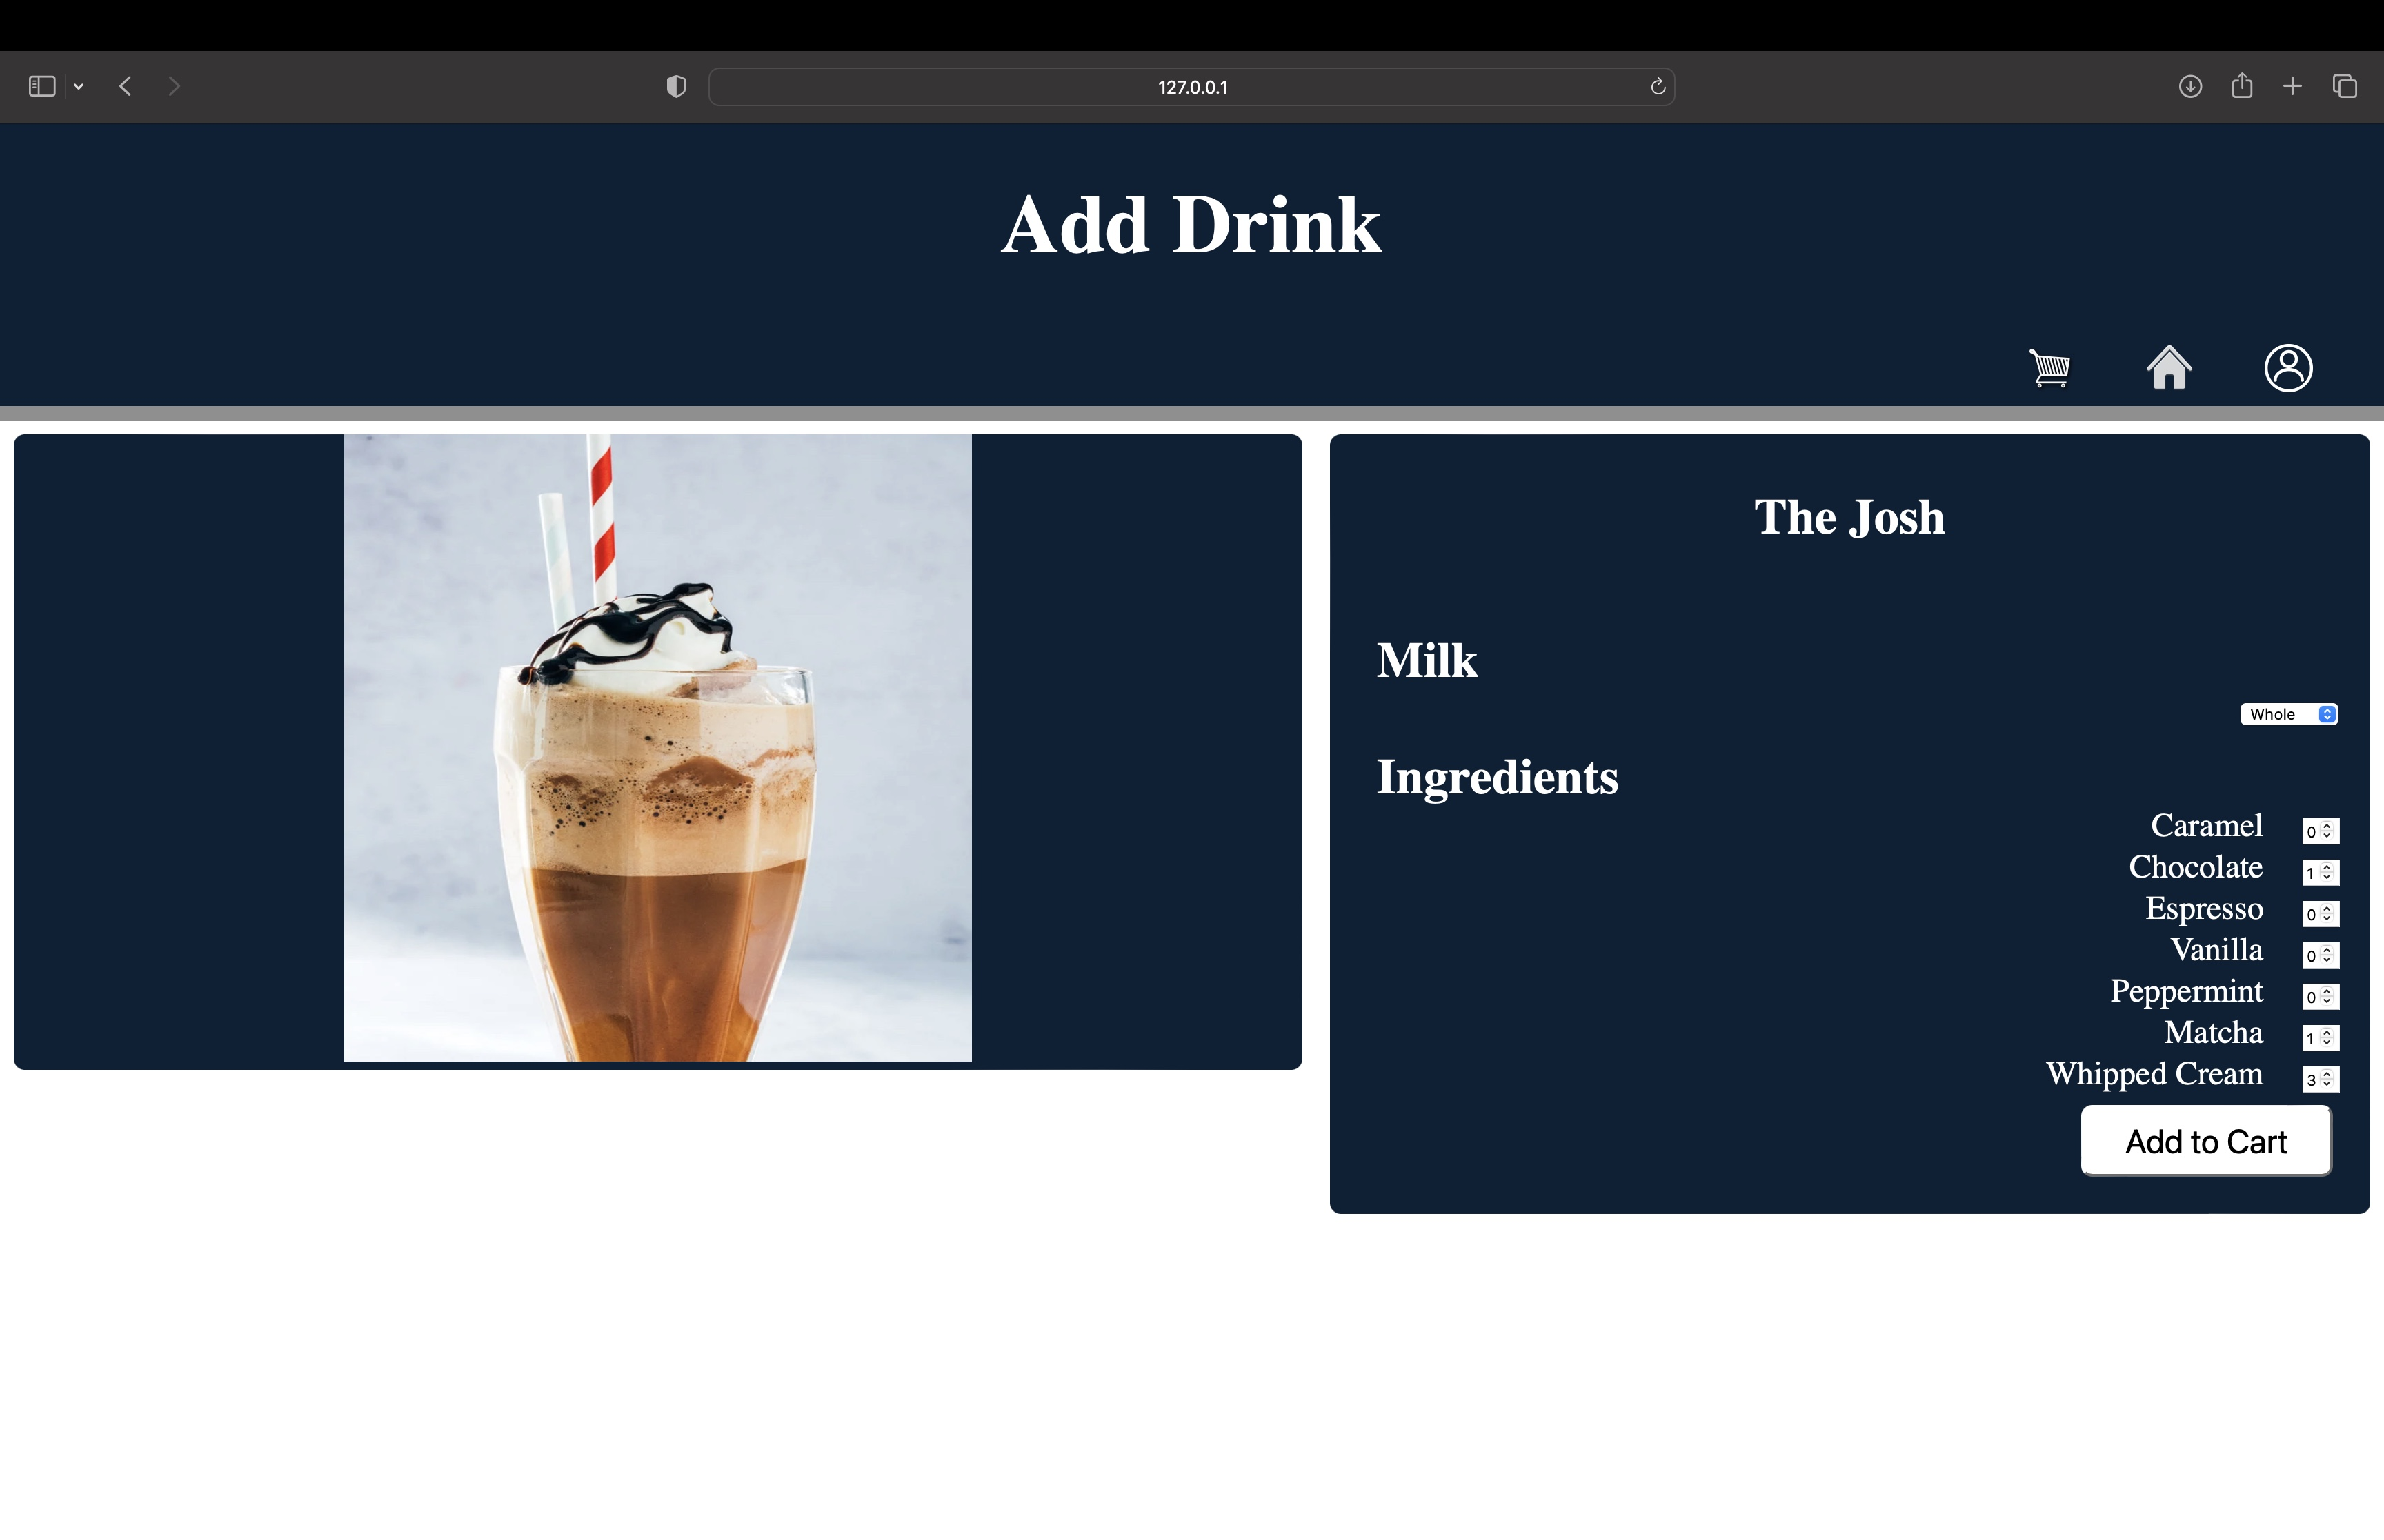
Order Placement

Slide 8
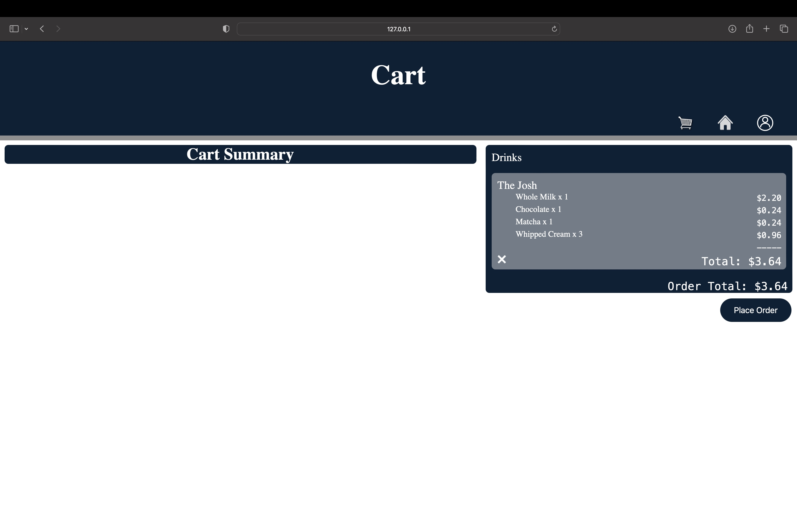
Order Placement

Slide 9
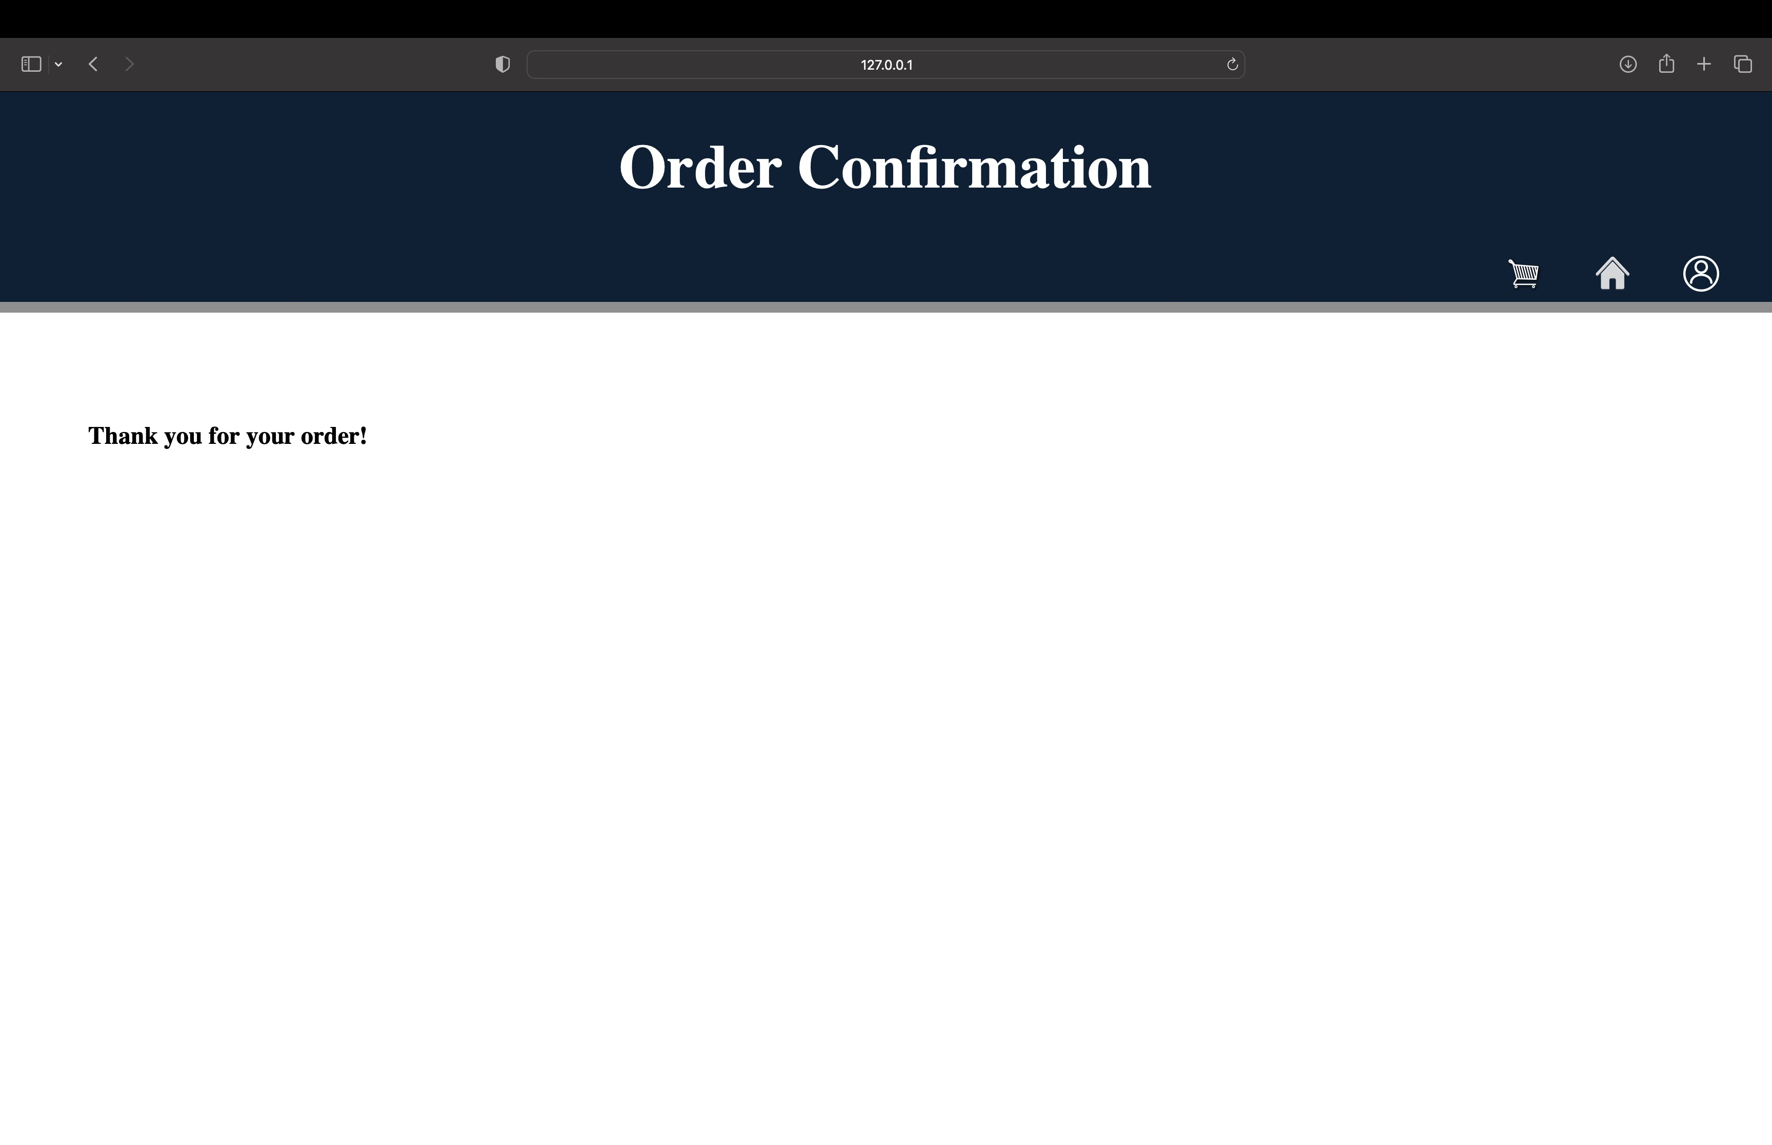
Order Placement

Slide 10
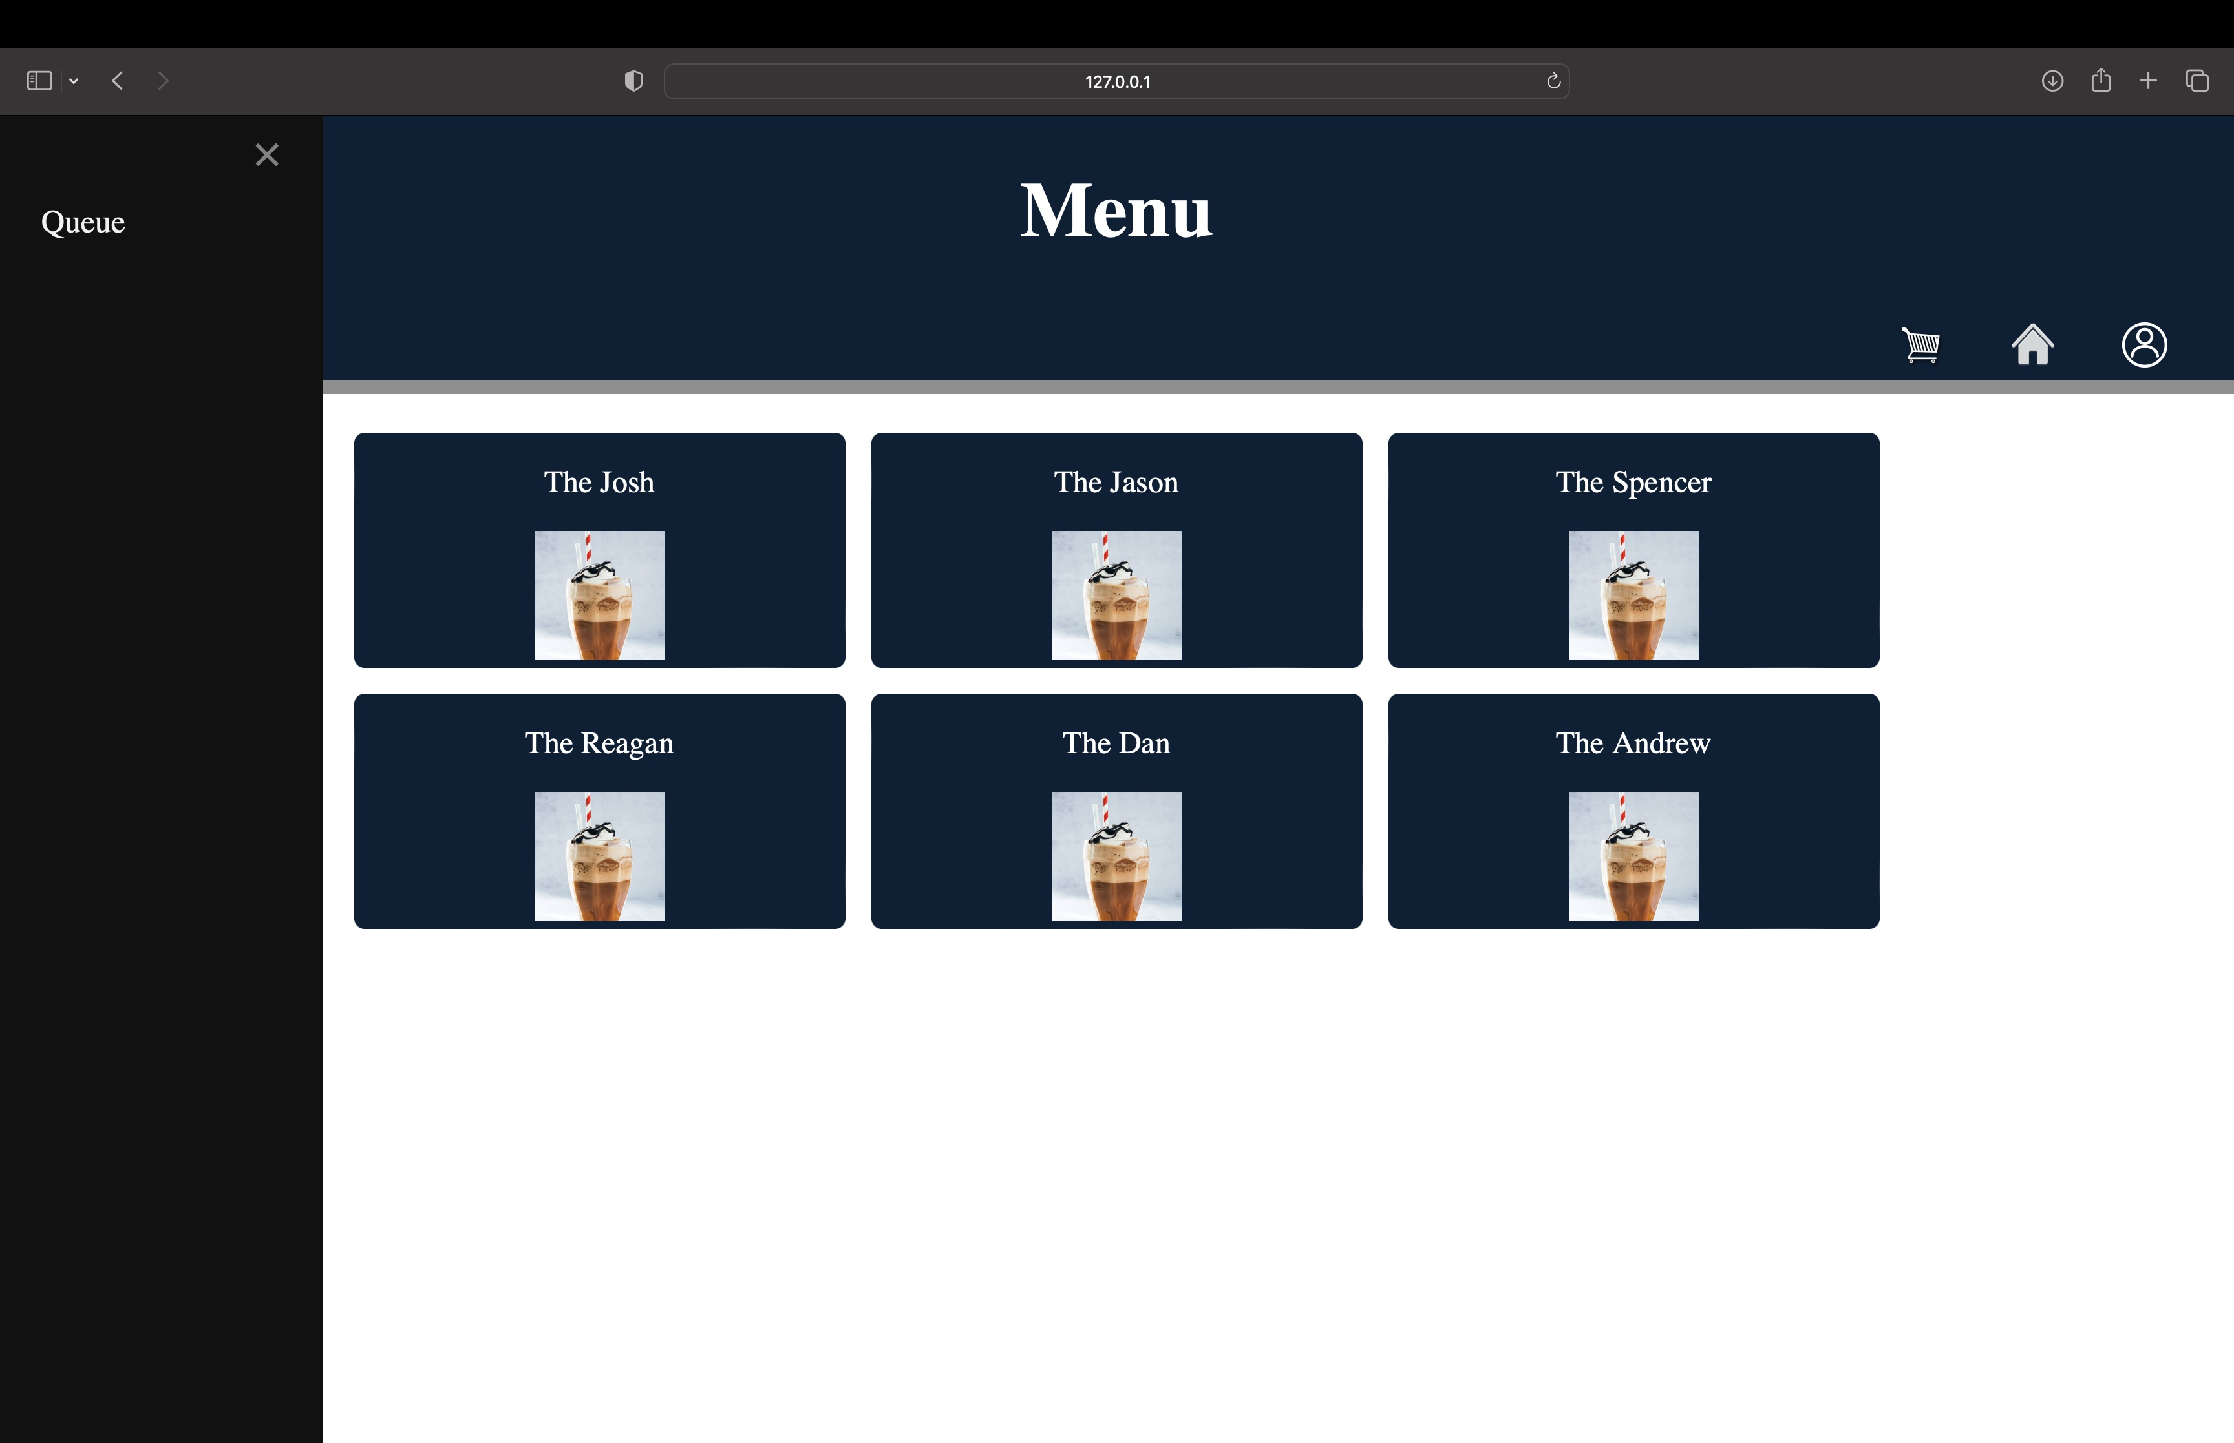
Order Processing

Slide 11
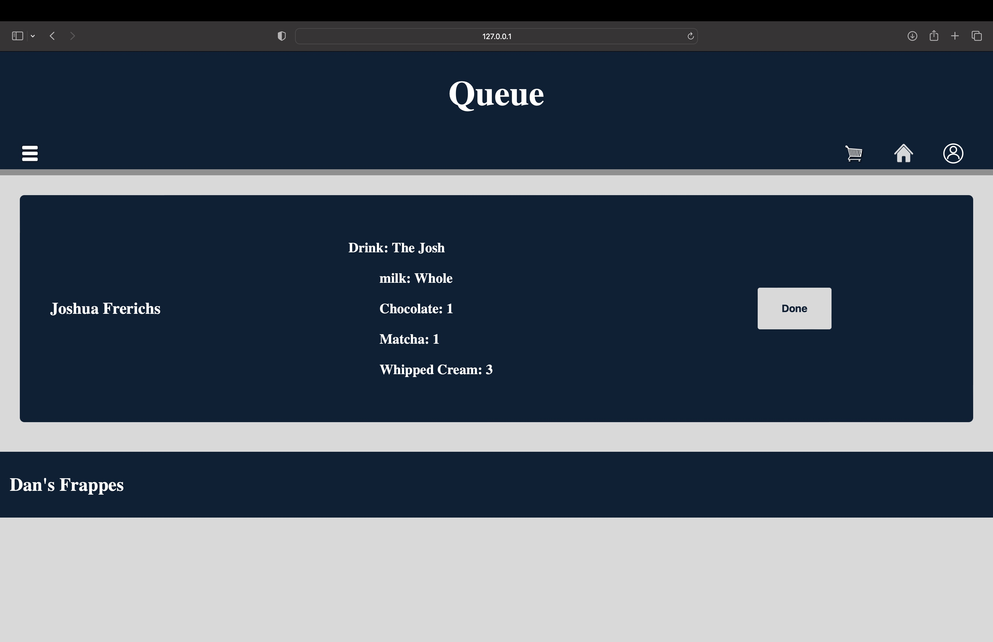
Order Processing

Slide 12
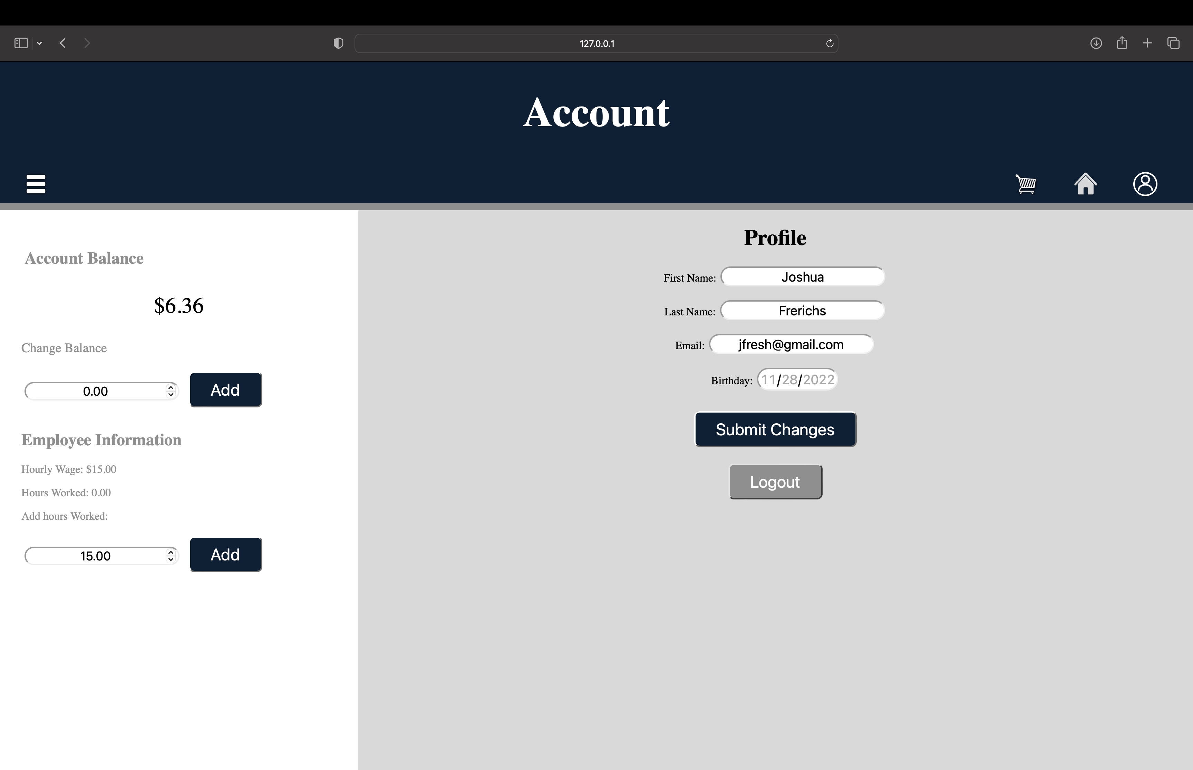
Order Processing

Slide 13
Resources
A minimum of 5 references for the most helpful resources used during this project. Team’s may include multiple citation slides (not counted towards the limit / slide requirement) without titles and the last one with a title. Make the title of the final slide “Questions?”

Slide 14
Screen Capture 1

Slide 15
Screen Capture 2

Slide 16
Screen Capture 3

Slide 17
Screen Capture 4

Slide 18
Burn Down Chart
Create a large burn-down chart of every task undertaken in this project. Identify if the task belonged to Requirements Gathering, High-level Design, Low-level Design, Development, or Testing. Include both the expected (linear) line and the jagged actual line. Calculate the team’s velocity both per sprint and for the project as a whole. (Your team my have to review (make up) what the original time estimates were and calculate the actual time these things took.

