Slide 1

Dans Frappes
We put the frap in frappe!

Slide 2


Aggie Solutions inc.
Reagan Baxter
Frontend Designer/developer
Jason Crandall
Database manger/developer
Joshua Frerichs
Documenter/developer
Spencer Lingwall
Backend Designer/developer

Slide 3

Project Overview
Major decisions included:
High level design
Color Scheme
Low level data processing – framework – database
Overall, we were very unified in our decisions based on our capabilities
Tasks initially were split up into two teams, this failed so we all became full stack developers fulfilling requirements based on pages and views
At first, we were a little slow as we started off with GitHub project management and moved to JIRA soon after we realized the features were lacking
Testing was primarily with input values and submissions, making sure no non-numerical inputs could be placed in orders
Project is ready for deployment due to:
correct data flow and server response
preventive input measures so we don’t get absurd or incorrect values for orders (these were tested)
Site being fully functional, no weird pieces that don’t have a place

Slide 4

Requirements Development

Slide 5
Requirement 1.1
The system requires users to authenticate before allowing access to system features
1.1.1. On account creation, users must provide a name, unique username, and password
1.1.2. For future logins, the user must enter the created username and password correctly

Slide 6
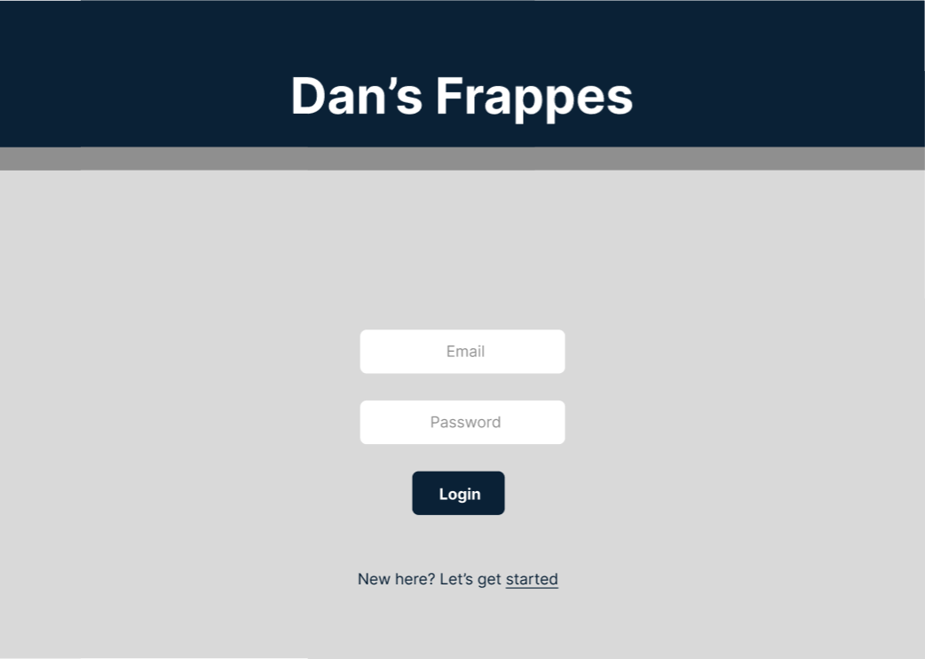
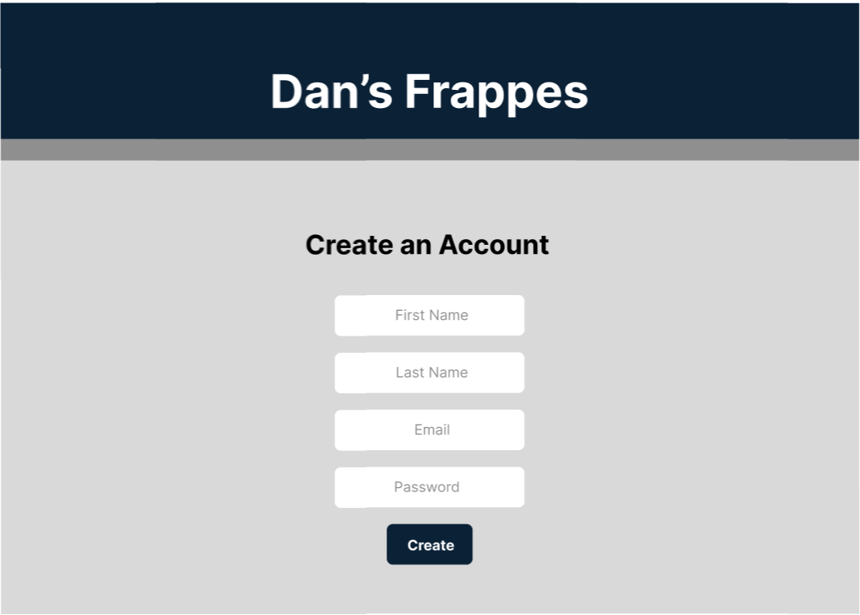
Prototyping
The first step in fulfilling this requirement was creating a wireframe of the login view. Reagan created these in Figma.
https://www.figma.com/file/KnMlbKGJ03BnBJoLSkvVsu/Dan's-Frappes?node-id=0%3A1&t=XwZ0SQVAOcgrZZJT-1

Slide 7
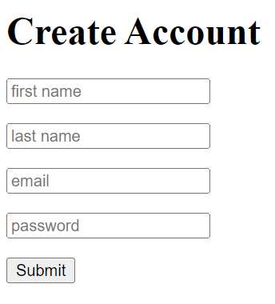
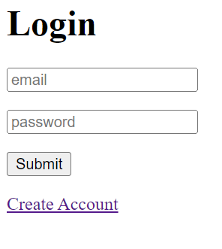
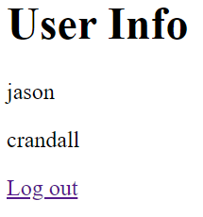
Prototyping cont.
At the same time the wireframes were being made, Jason created a high-fidelity prototype for account creation and authentication.
This was a simple HTML page that focused on saving users in a database.

Slide 8
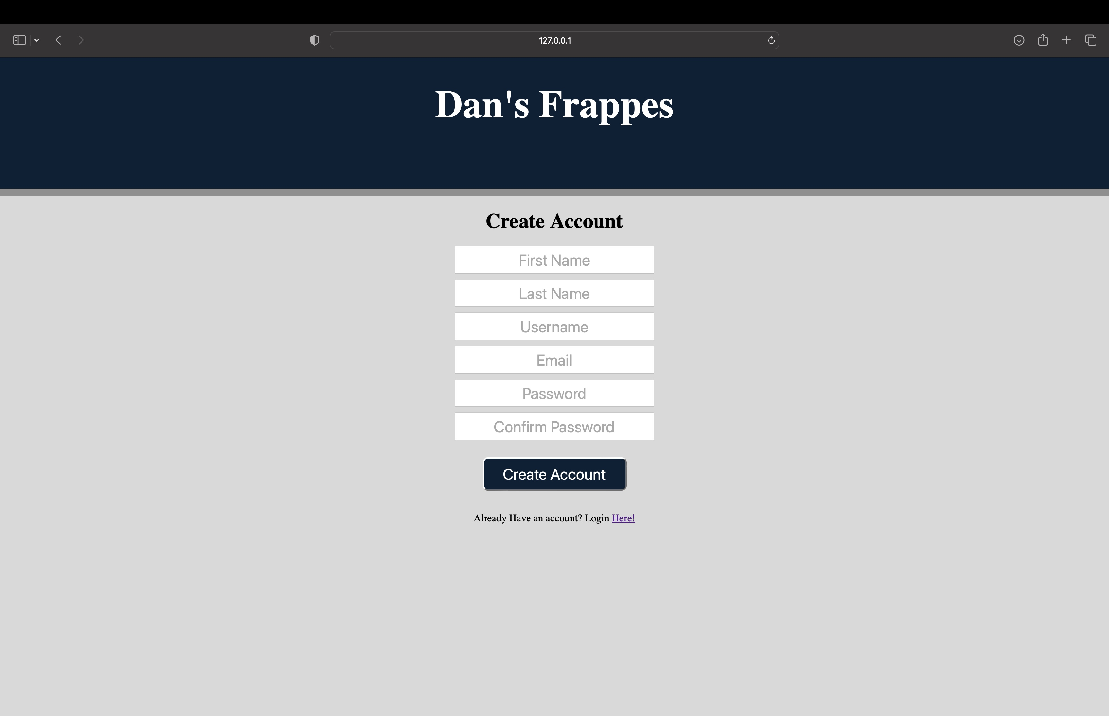
Implementation
The implementation of the login screen ended up being very similar to the prototypes, except that it used a new UserAccount table in the database.
Spencer created the login and create account pages and connected them to the backend.

Slide 9
Requirement 3.1
Contains the menu items and all drink customizations available
3.1.1. Provides a way to confirm order and keep shopping

Slide 10
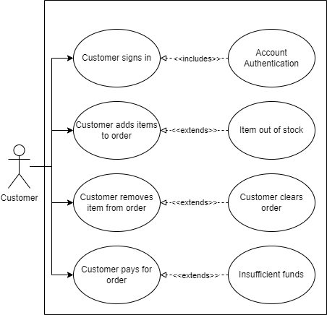
Use-case Diagrams
Customer is signed in
Customer can add/edit items and drinks
Customer can remove items and drinks
Customer can pay for the order

Slide 11
Prototyping
Like with the login page, Reagan started by creating a wireframe for the menu pages.
https://www.figma.com/file/KnMlbKGJ03BnBJoLSkvVsu/Dan's-Frappes?node-id=0%3A1&t=XwZ0SQVAOcgrZZJT-1

Slide 12
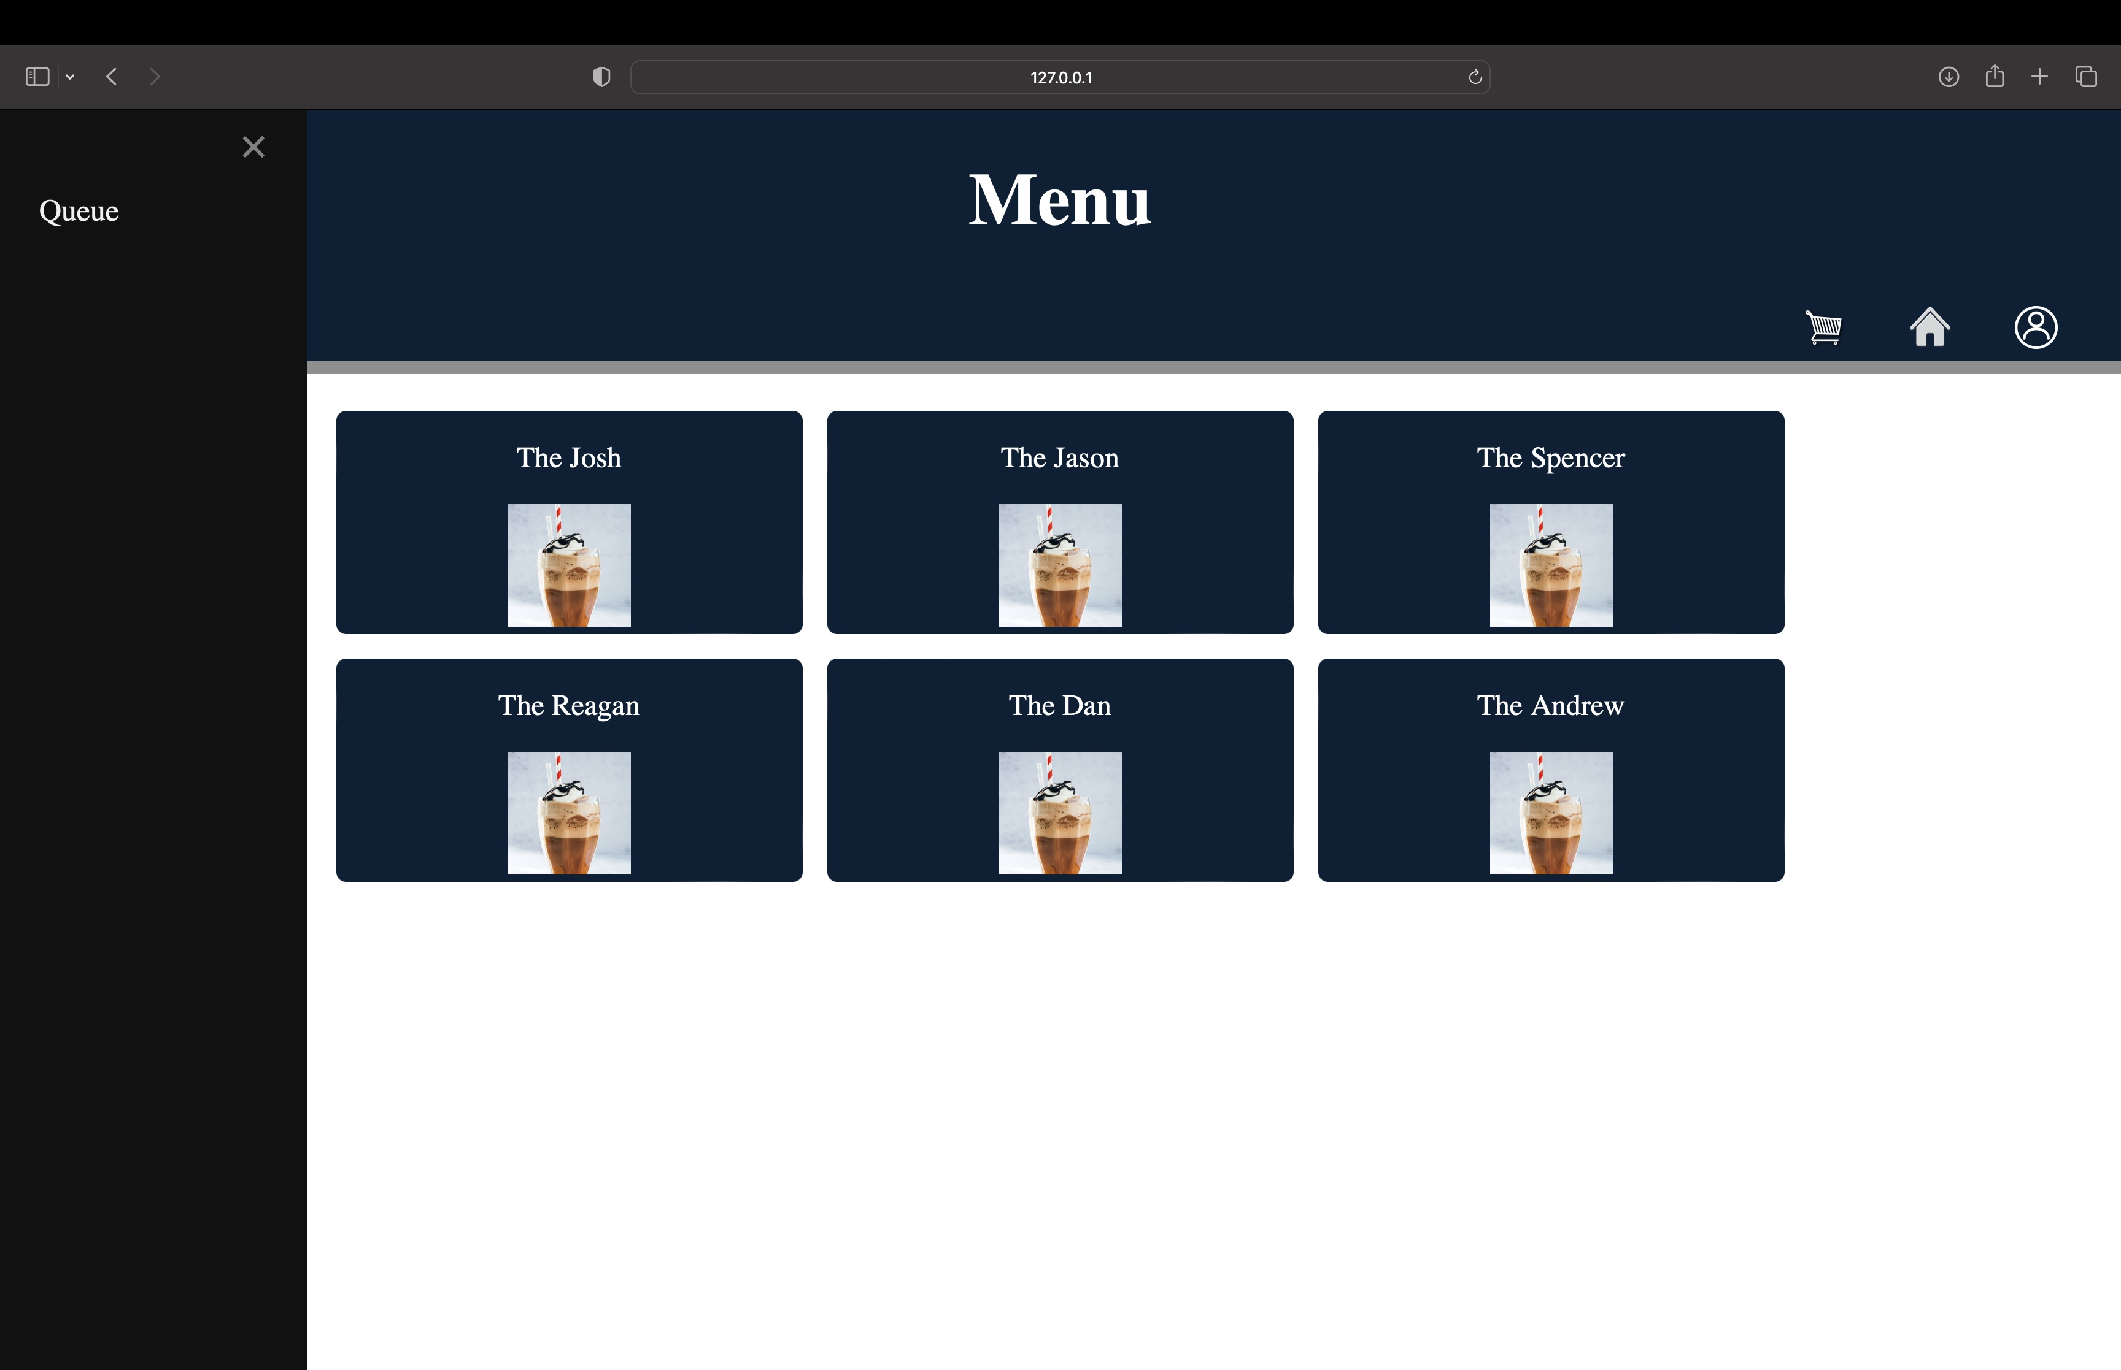
Menu Implementation
Jason and Josh worked at the library on designing a menu. They both drew designs on a whiteboard to try different layouts.
They then spent time on the CSS and implementing the Django template.

Slide 13
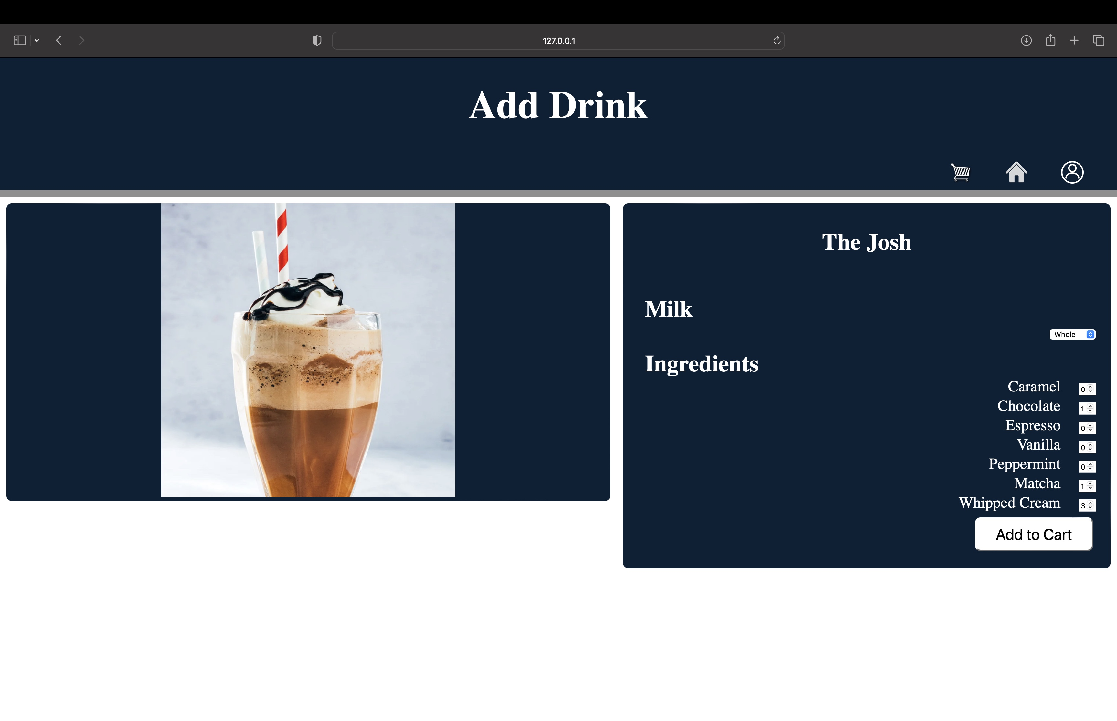
Customization Implementation
At the same time as the menu, Josh and Jason drew possible UI designs on a whiteboard for the drink customization page.
Jason designed the database tables for drinks and orders. Both use JSON to serialize a list of ingredients, in addition to cost information and a name.

Slide 14
Requirement 5.2
Employee Management
5.2.1. Allow manager to hire and terminate employees
5.2.2. Allow manager to pay Employees based on hours worked

Slide 15
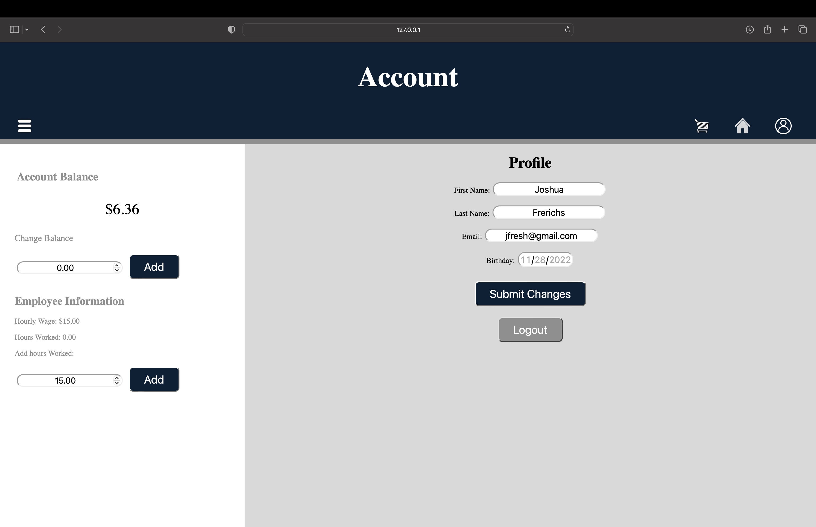
Employee View
Employee can see wage
Employee can add hours

Slide 16
Account Creation/User editing
The new user is given a list of inputs
If the user did not mean to click create, they can go back to the login page below the create account button

Slide 17
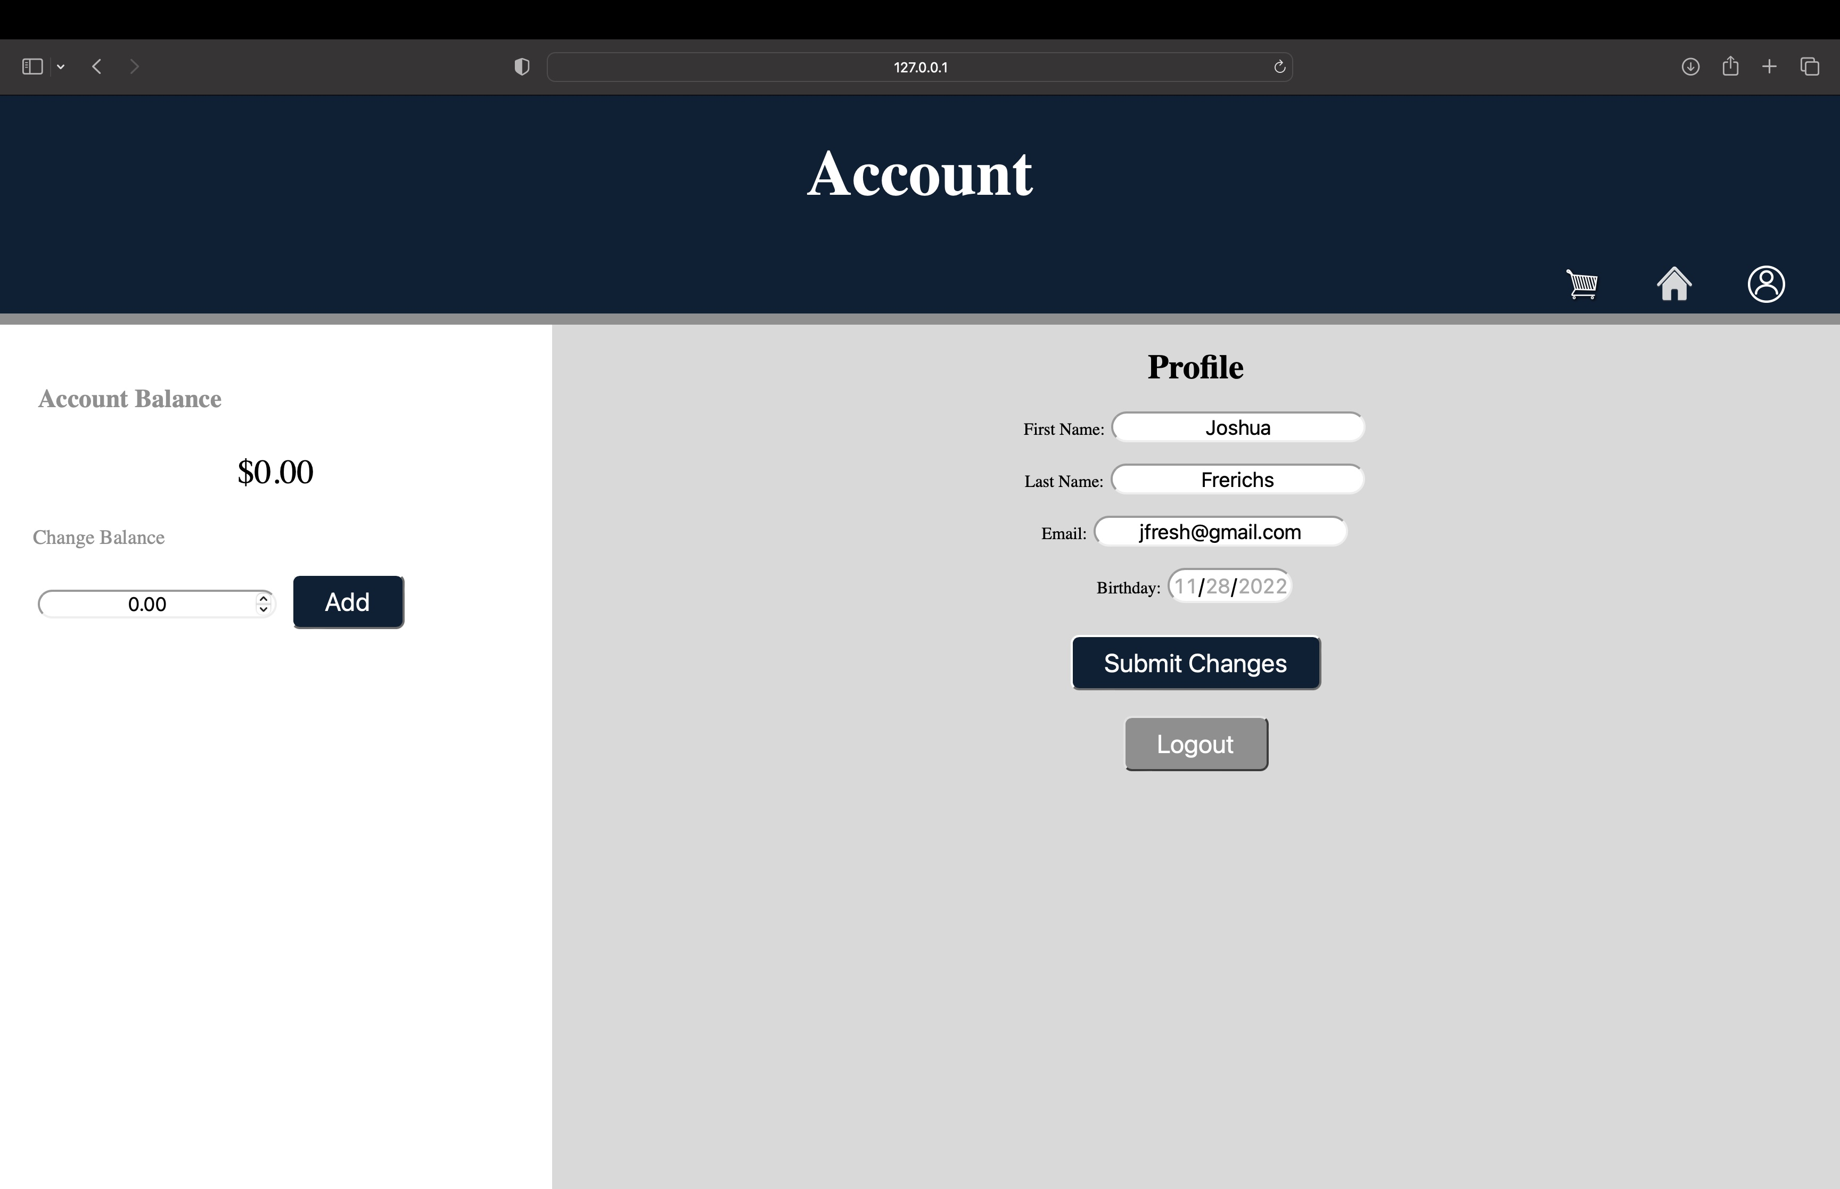
Account Creation/User editing
The user can edit their personal information and save the changes
The user can add funds to their account
The user can also logout from this page

Slide 18
Requirement 4.1.1
Order Placement
4.1.1 Allow user to place order
4.1.1 Puts order in a queue

Slide 19
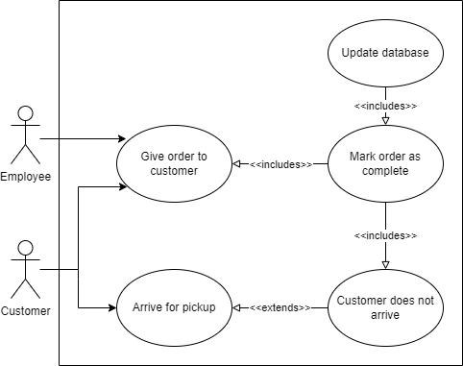
Use Case Diagram for Order Processing
Once an order is in the queue the employee can see it
The employee can process the order by saying it is fulfilled
The order is removed from the queue

Slide 20
Order Placement
User has drinks to select and then it takes them to the edit drink page
Variety of drinks to choose from and more can be added to database to populate as a menu item

Slide 21
Order Placement
Can put whatever they want in their drink
Add to cart puts the drink and toppings in an order queue

Slide 22
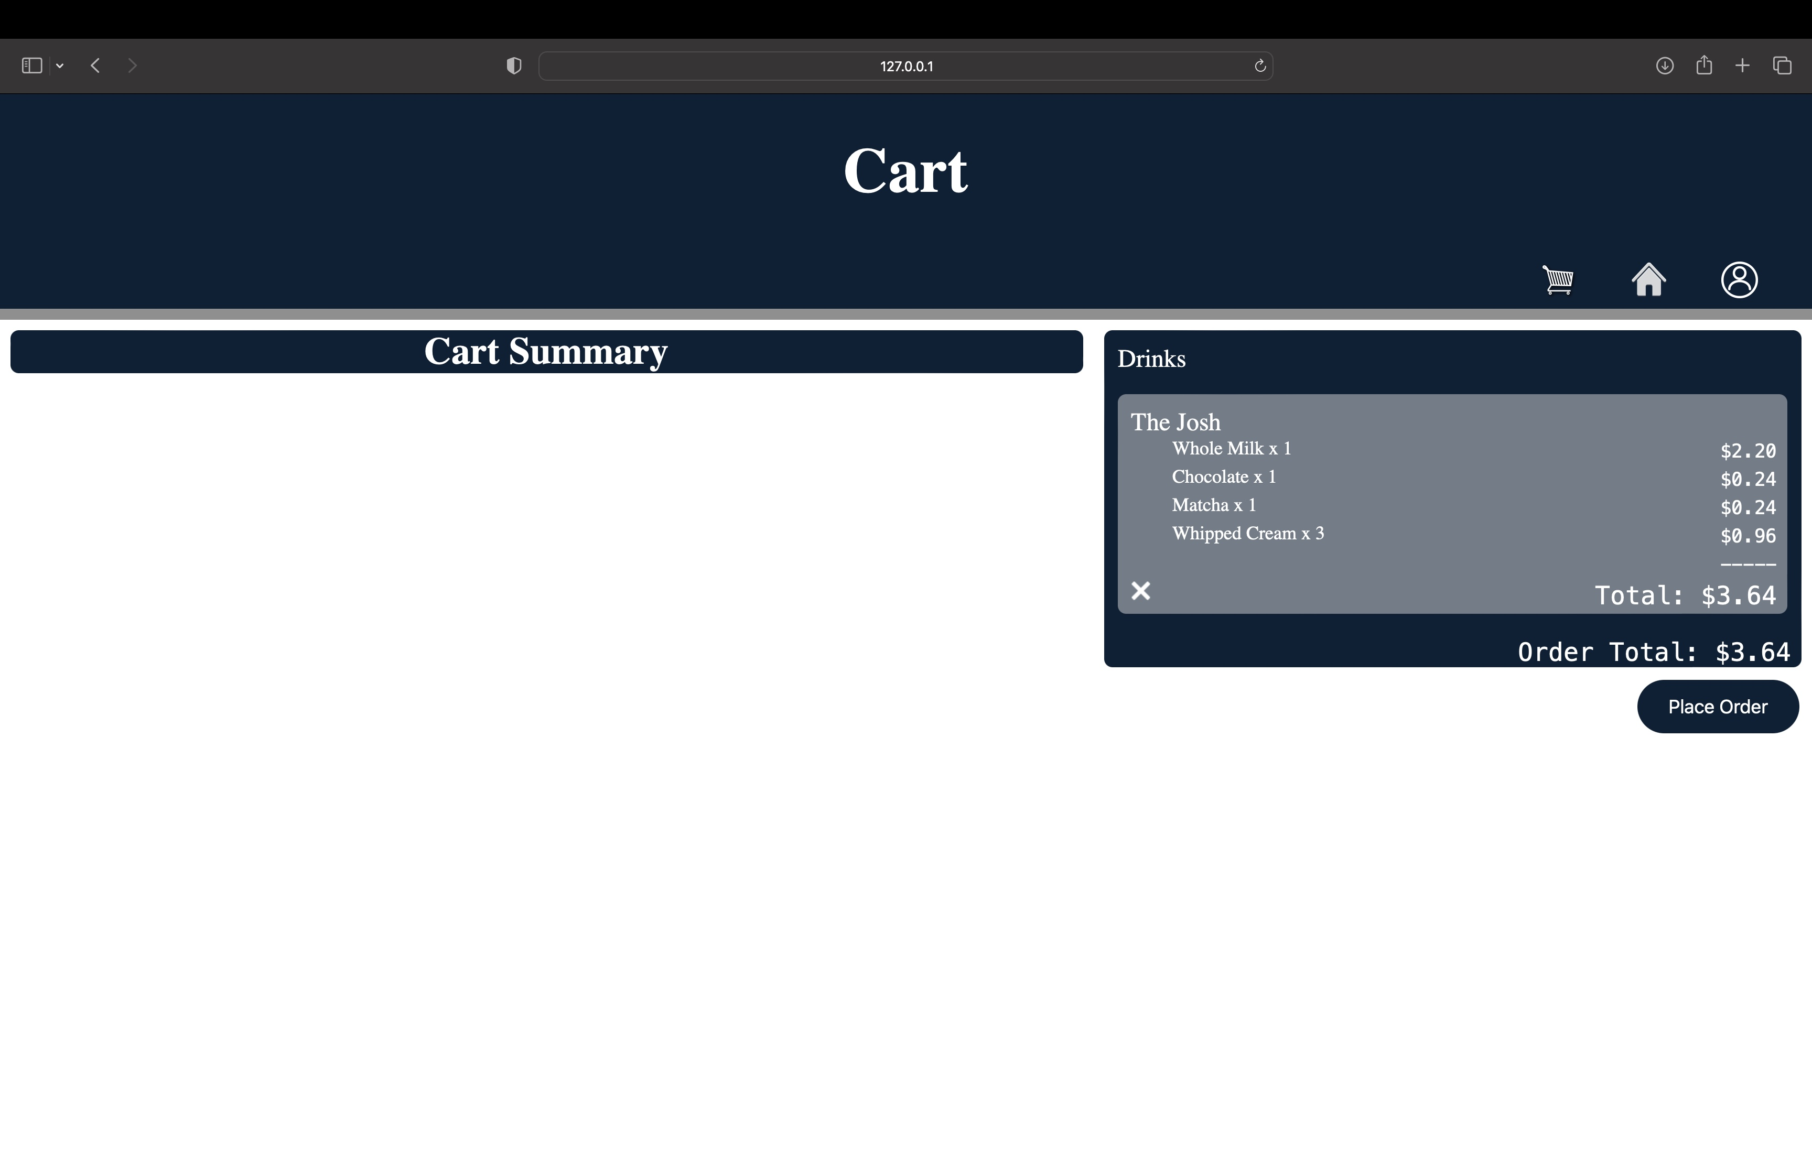
Order Placement
User can see cart summary
User can remove drinks
User can place order

Slide 23
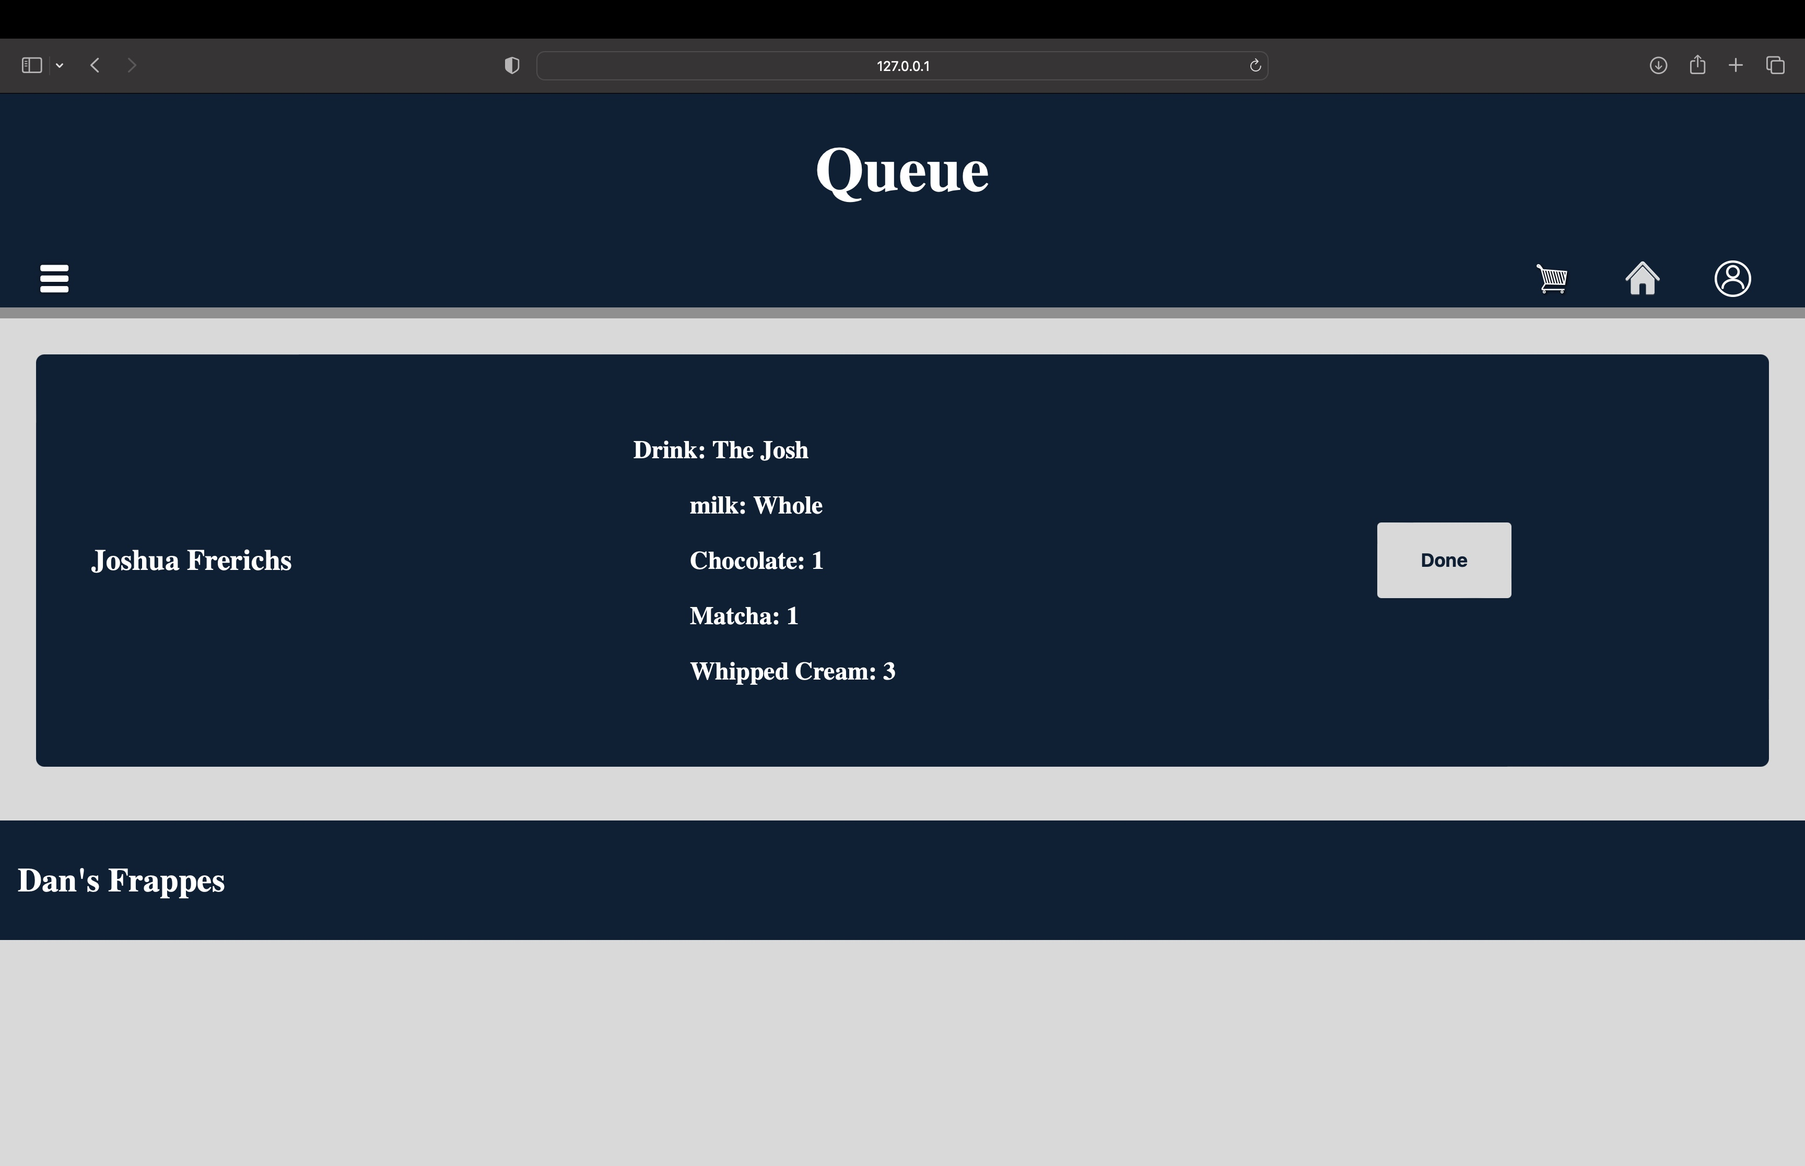
Order Processing
Employee can view order
Employee can fulfill order by selecting done when drink is made and given to customer

Slide 24
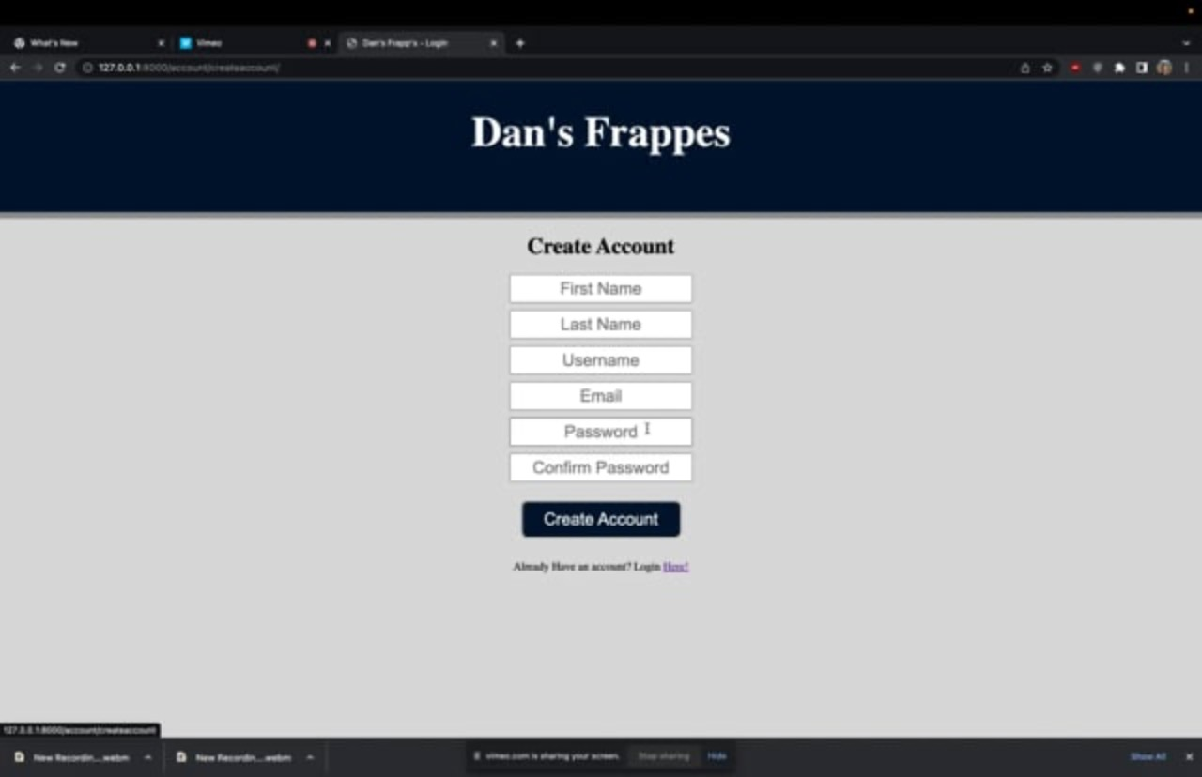
Screen Capture Video 1: Making/Editing and User Account

Slide 25
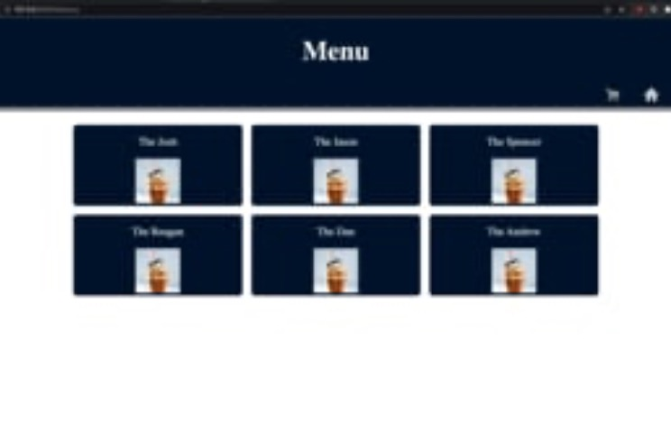
Screen Capture Video 2: Placing and Order

Slide 26
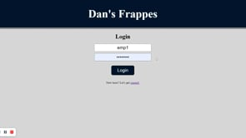
Screen Capture 3: Employee Processing an Order

Slide 27
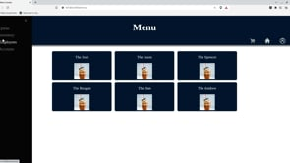
Screen Capture Video 4: Inventory

Slide 28
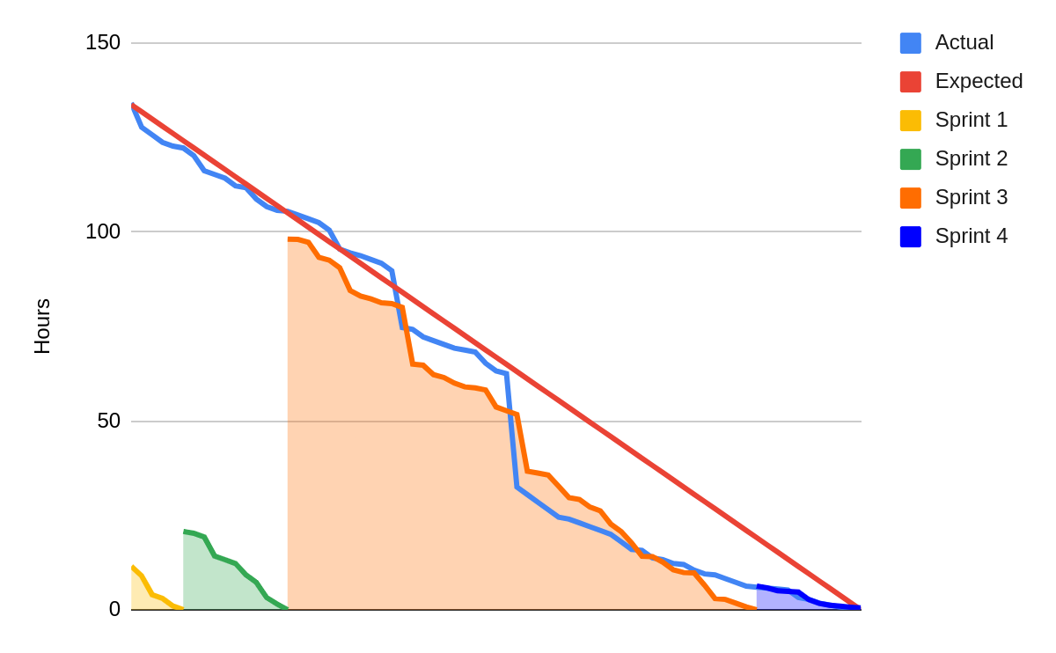
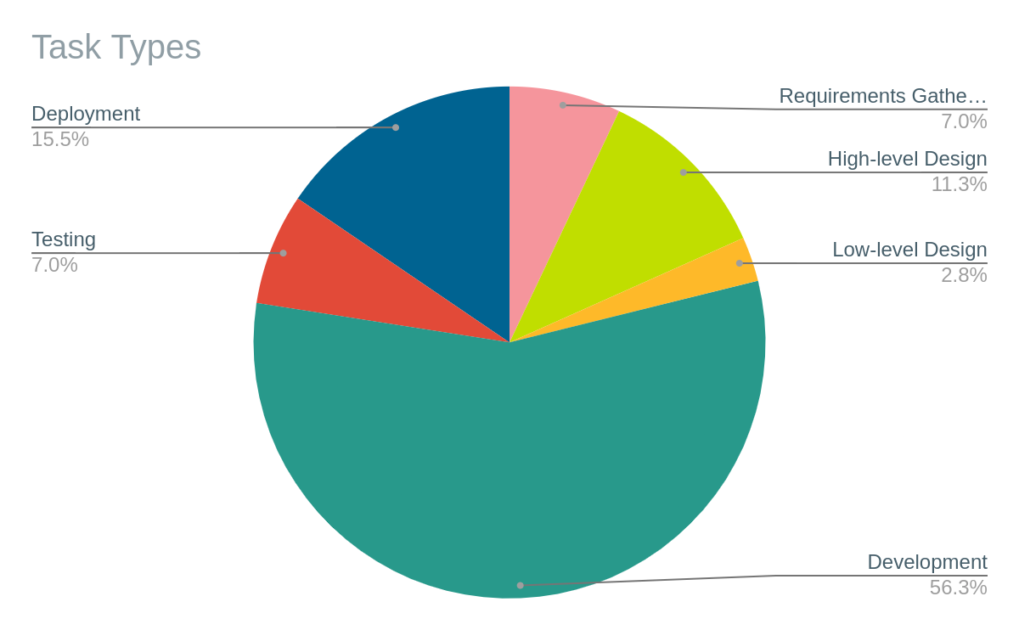
Burn Down Chart and Task Distribution

Slide 29
Resources
Tools
https://github.com/
Jira | Issue & Project Tracking Software | Atlassian
https://www.figma.com/
Links we found useful
A Complete Guide to Flexbox | CSS-Tricks - CSS-Tricks
https://docs.djangoproject.com/en/4.1/ref/models/fields/

Slide 30

Questions?

