Slide 1
Designing and Building a Two–Tier Client-Server Webapp with React, Django, and Postgres
Frappy
Visual Design (Frontend)- Dylan Spencer
Interactivity and Integration (Frontend) - Jacob Fitzgerald
Databases & API (Backend) - Dalyn Dalton
Dataflow (Frontend) - Spencer Peterson

Slide 2
Major Decisions
System Model
Software Stack
Work Split
Meeting Times/Methods

Slide 3
System Model
Familiarity
Ease of Design
Ease of Development
Skill Development
Basically Our Only Choice
Two-Tier Client Server Architecture (WebApp)
Notes:
When starting out, basically the first thing we decided on was our system model. It was basically decided on from the start, because you pretty gave us the option between that and a monolithic structure. We decided that, since we’ve all worked with some sort of client server set up before, it would make the development process go smoother if we went with that. We also talked about how it would be relevant to the field of WebDev. When it came to choosing our client, there were two real options: a mobile app or a webapp. Some of us had a bit of experience with Android development coming from the UI class, and decided that it wasn’t worth losing brain cells over.

Slide 4
Software Stack
Multiple Options (Vue, React, etc.)
Little Experience from Everyone
Wanted to Try “Industry Standards”
Thought Typescript Would be Better
Familiar With Django
Python is Easy
React, Typescript, Django, and Postgres
Notes:
After deciding on our architecture, we had to decide on our stack. After our first meeting, we initially agreed to Vue.js and Django, as everyone had experience with them from the WebDev class. After we were able to talk some more, however, it became clear that no one besides Dylan knew anything about frontend dev, and he worked with react. Also, we figured that learning some TypeScript would be good experience if any of us ever ended up in webdev. Since we’d all heard good things about react, we decided to try it out. When it came to backends, we were all familiar with Django, and python is extremely easy to write code in, so we decided that it’d be good for ease of use.

Slide 5
Work Split
Never Explicitly Stated
Meant to be More Flexible
Team Experience
3 Frontend - 1 Backend
Notes:
Two of our members were somewhat experienced with topics that would help out in this project. Dalyn was very familiar with databases, and dylan worked with React for his job, so it was pretty much decided from the get go that they’d be on front-end and back-end respectively. Spencer and I originally planned to flex around, working on whatever needed attention, but we primarily ended up as front-end devs. This is mostly because the front end required quite a bit more work, and that Dayln pretty much had the entire framework for the back end set up early on, making it less effective for other people to “hop-on”.

Slide 6
Meetings
Followed the Class Suggestion
Some Members Had Experience
Everyone Familiar With Discord
Discord Was Free
Github Projects Was Free
Bi-Daily Scrums
Discord
Notes:
We basically chose all of our collaboration tools based on what was free. Since we were already using git/github, we decided on github projects since it was free. None of us had real experience with project boards, so this ended up being a mistake, because several much better alternatives became clear to us later in the semester. We chose discord because it’s discord and we’re CS students, it’s basically required. We decided to meet in person when possible, and when not possible, just use the discord for stand-ups. Some of our team members had experience with SCRUM, but actual practices differed slightly. We also ended up using discord to collaborate when we needed to work together on certain parts of the project or documentations, or if we just needed help with a few extra things.

Slide 7
Agile (SCRUM)
Resolve Conflicts
Increase Understanding
Split Work
Determine Direction
Team Building
Notes:
For the most part, SCRUM meetings were used to decide the general direction of the project and split up work. During planning meetings, we’d decide on the amount of work we wanted to complete, and would make sure to each assign ourselves a few tasks before we left. This meant that we were able to productively use the time in between meetings to get individual work accomplished. Another big part of the meetings was conflict resolution. A lot of this was just simple bug solving, or clarification on the overall design of the project. While we did have comprehensive documentation in place before we began, it’s impossible to anticipate everything, and slightly different views on how certain features should work would often lead to bugs and other issues. Additionally, as many of us weren’t fully familiar with the stack we were using, it was a great opportunity to exchange ideas and information on how to get things done. Finally, the use of SCRUM meetings allowed us to get a better understanding of each other as software developers, which made it much easier to work with each others code.

Slide 8
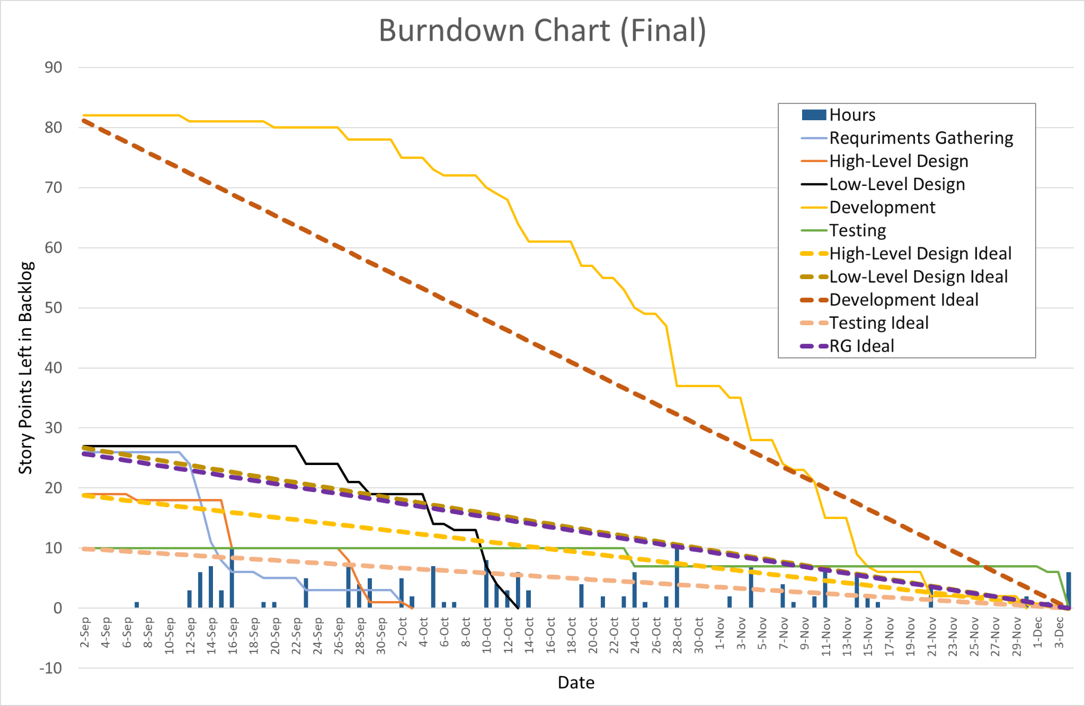
Burn Down Chart
Velocities
Sprint 0: 30 pts
Sprint 1: 28 pts
Sprint 2: 26 pts
Sprint 3: 32 pts
Sprint 4: 36
Spring 5: 7
Whole: 159
Notes:
Ugly Boi

Slide 9
Deployment (Correctness)
All In One App
Manager
Pay Employees
Edit Menu
Edit Inventory
Edit Accounts
Employee
Log hours
Order For Customers
Complete Orders
View Orders in Progress
Customers
View and Edit Account
Add to Balance
Order Drinks
View Order History
Notes:
Overall, our goal of creating an all in one WebApp experience for Managers, Employees, and Customers for Frappy’s has been fulfilled. Managers are able to track employee hours and pay them for time worked. They can edit accounts, inventory, and menus. Employee’s are able to track their hours, order for customers, view customer orders, and complete customer orders. Customers are able to view/edit their accounts, manage their own account balance, view their order history, and, most importantly, order and customize drinks. Overall, this means that the Frappy website will be able to fulfill every role it was built to.

Slide 10
Deployment (Correctness) Cont.
Functionality
Navigation
Protected Views
Account Login
Persistent Login
Persistence
Stored User Data
Hours
Balance
Order History
Stored Menu Data
Drinks
Names
Markups
Stored Ingredient Data
Type
Price
Quantity
Order Date
Notes:
When it comes to usability, our website has easy navigation via a sidebar. This navigation is also protected, so that only Managers are able to access and edit vital information. This protection also extends to the backend, with a token system ensuring that user data is protected, and that passwords are encrypted. This means that only authorized users are able to make changes to critical store functions. This login is also persistent, lasting for up to a week before a users token expires, or until they decided to manually log out. Finally, the entire system is set up to use a functional database backend, meaning all data is persistent.

Slide 11
Deployment (Testing)
Unit Testing
Dataflow System Testing
Ad-hoc System Testing
Peer/Code Review
Notes:
Overall, we tried to follow the same processes as a professional development environment, as far as time and resources permitted. Unit testing was implemented early on, which ended up being somewhat of a mistake, as the evolving design of the application meant that many unit tests were broken. Unit tests were fixed and reworked at the end, so that they could provide some level of assurance that the system was functioning as intended. A large part of testing happened after the development phase ended, using dataflow techniques. Team members would go over the expected usage of the application from the perspective of a user, employee, or manager, in several different situations in order to ensure functionality. Code review was used on every part of the project, and was required before any changes could be merged in. Finally, a lot of bugs were found and fixed via ad-hoc system testing, and team collaboration. When other members of the team would try and interact with code that wasn’t theirs, they’d often attempt unique interactions, giving us valuable insight into edge-case behavior.

Slide 12
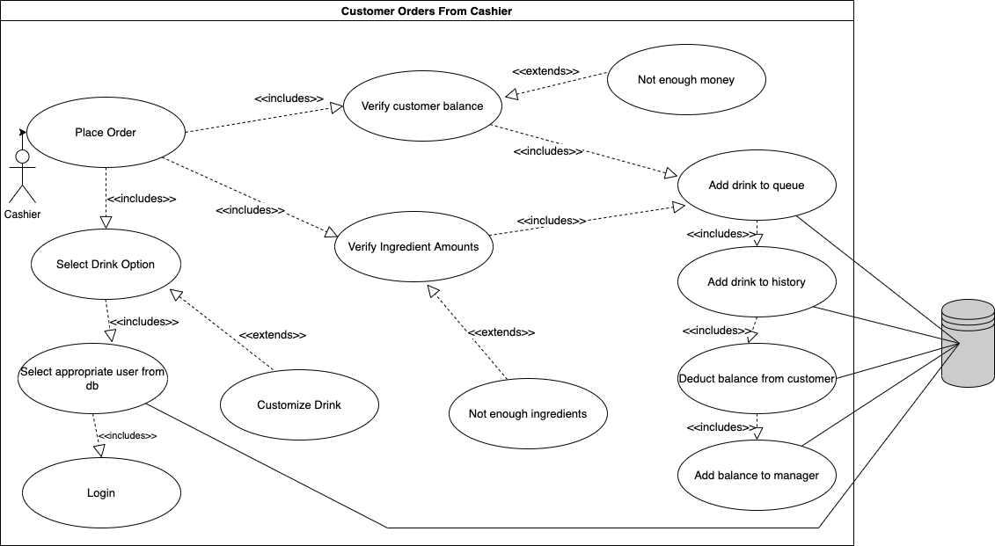
Requirement: Cashier can customize and order drinks on behalf of user
The cashier must be able to order drinks on behalf of a user. The cashier must be able to select from any drinks available on the menu and should be able to customize the drink however the customer wants. The cashier must then be able to verify the users account and order the drink on behalf of the user. The order must be submitted to the database if the customer has enough money to pay for the drink and there is enough stock to complete the order.
The requirement is listed in the docs folder in the requirement_definition.md document. This requirement is the first requirement listed under what functions a cashier should be able to perform

Slide 13
Requirement: Cashier can customize and order drinks on behalf of user
Design Choices:
We wanted a fairly straightforward design that is easy to use. Bearing this in mind we went with a design that is native to how any regular customer would order a frappe. This would help reduce the training required for anyone who is already familiar with using the website as a customer. In order for a cashier to order on behalf of a user, they only have 1 extra step which is to enter in the users email to verify their account. To differentiate tasks between employees, only the cashier is able to order on behalf of a user and the barista cannot since they are busy making the drinks. The manager is also able to order on behalf of a user since the manager should have all the features of the application available to them.

Slide 14
Requirement: Cashier can customize and order drinks on behalf of user
Below is a list of scrum tasks required to fulfill the requirement. The tasks are roughly laid out in the order for which they were needed to be completed in order to fulfill the requirement. The scrum tasks are laid out with the issue number (if applicable), the title of the ticket and the team member who completed the task and the dependencies of the task
Scrum Tasks:
Frappy#98 Database - Set Up User Accounts Model (dalyn) [depends on none]
Frappy#97 Database - Set Up Ingredients Model (dalyn) [depends on none]
Frappy#103 Database - Set Up Menu Model (dalyn) [depends on Frappy#97]
Frappy#77 Design Page - Menu (spencer) [depends on Frappy#103]
Frappy#78 Design Customer Page - Make An Order (Drink Customization Page) (spencer) [depends on Frappy#77]
Frappy#94 Cart (spencer) [depends on Frappy#77]
Frappy#109 Setup Account login and create new user on backend (dylan, dalyn) [depends on Frappy#98]
Frappy#74 Style login page (create users) (dylan) [depends on Frappy#109]
Frappy Database - Set Up Orders (dalyn) [depends on Frappy#103]
Frappy#129 Backend - Submit Drink Orders (dalyn) [depends on Frappe Database - Set Up Orders]
Frappy#138 Frontend - Submit Drink Order (spencer) [depends on Frappy#129, Frappy#94]
Frappy#113 Barista Take Order Modal (spencer) [depends on Frappy#138, Frappy#94]
Frappy#124 Barista - Hook Up Api (spencer) [depends on Frappy#113, Frappy#129, Frappy#103, Frappy - Set Up Orders]
Frappy#128 Menu - Cashier Order For User (dylan) [depends on Frappy#113]
Frappy#168 Order drink on behalf of user (spencer, dalyn) [depends on Frappy#74]

Slide 15
Requirement: Cashier can customize and order drinks on behalf of user
Testing Procedures:
Ordering on behalf of a user requires many working parts. A lot of testing was done by using the website and looking for bugs and edge cases (trying to order on behalf of a user who has no money, ordering on behalf of a user that doesn’t exist, ordering on behalf of a user who is also an employee, etc.) Of course one of the best actions to take is to write unit tests to test code for correctness before merging it into the main branch. In order to test the components that are involved in this process we have tests for both the frontend and backend.
Frontend:
Navigate to the src/frontend/ folder and run ‘npm run test’
Backend:
Navigate to the src/server/frappe folder and run ‘python manage.py test’

Slide 16
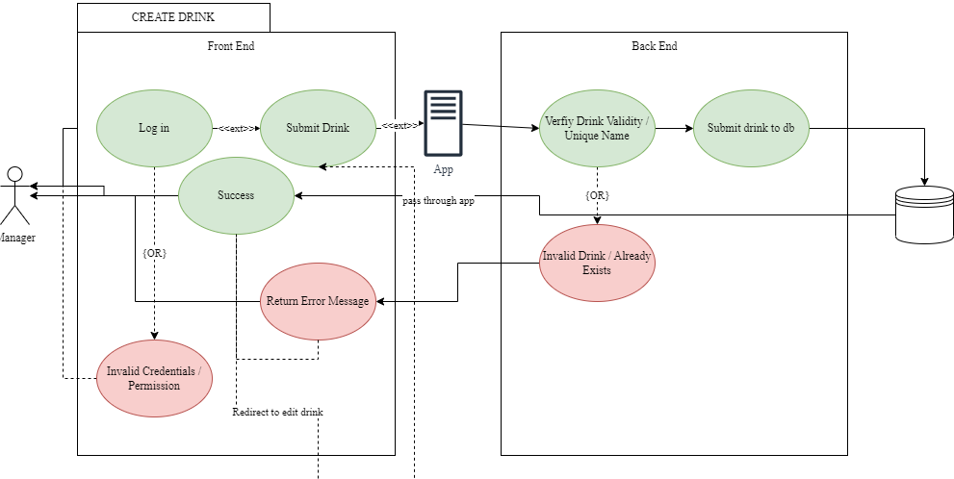
Requirement: Manager can add to & edit Menu Items
To build our menu, the manager creates a dummy drink with the ingredients that they would like in their new drink. They then submit this pseudo-order, alongside menu specific attributes such as the markup pricing, name, photo, and availability.
The database then takes the order, verifies the attributes, and then stores the menu item as specified as a Frappe order using the FrappAPI to communicate with the front-end.
Notes:
This also includes some specific checks for building out the extras using the same verification model that users run when submitting a drink order.

Slide 17
Requirement: Manager can add to & edit Menu Items
The main hurdle encountered when creating this feature was in the way that we handled our models.
Because we chose a strict relational database (Postgres), our struggle was defining the Frappe object in a way that the menu can both reference and depend on its creation.
Our solution allows us to reuse the Frappe model to validate and customize our menu items, while still maintaining data safety.
Notes:
This also includes some specific checks for building out the extras using the same verification model that users run when submitting a drink order.

Slide 18
Requirement: Manager can add to & edit Menu Items
Some of the key parts to getting this working.
Scary Bugs and nice endpoints #152
Dalyn
Manager Edit Menu page #149
Dylan & Dalyn
Get menu information from dan, and design the menu #79
Spencer & Dalyn
77 design page menu #93
Dalyn & Spencer
Notes:
This also includes some specific checks for building out the extras using the same verification model that users run when submitting a drink order.

Slide 19
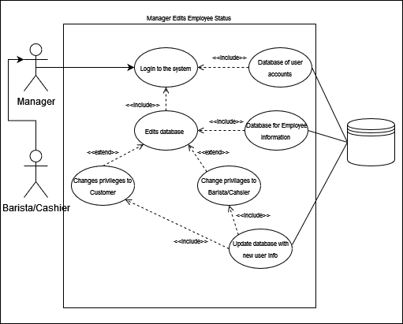
Manager Edits Accounts
Based on the requirements, our system has 4 different types of users: Customers, Baristas, Cashiers, and a single Manager. A user’s role can only be changed by the Manager, therefore the Manager must be able to edit all account roles. The manager must be able to hire employees and fire employees. The manager must not be able to create another manager.
Life-Cycle:
Designed a wireframe for the UI of the page to edit accounts
Created a database table of all user accounts with optional employee info
Created a database table of all employee accounts with boolean values for each role.
Designed the fronted with mock user data based on the database tables
Created an endpoint for the manager to change an account based on their ID
Connected frontend and backend, replacing mock data with database data.

Slide 20
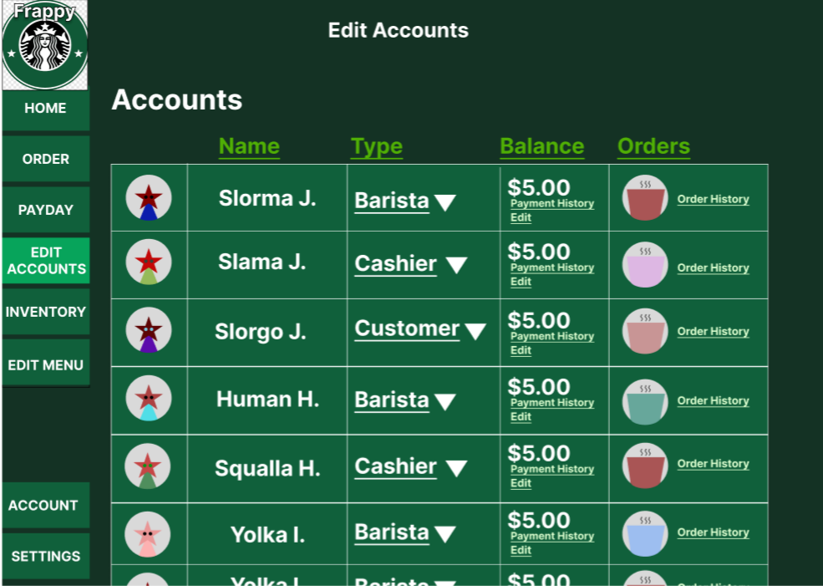
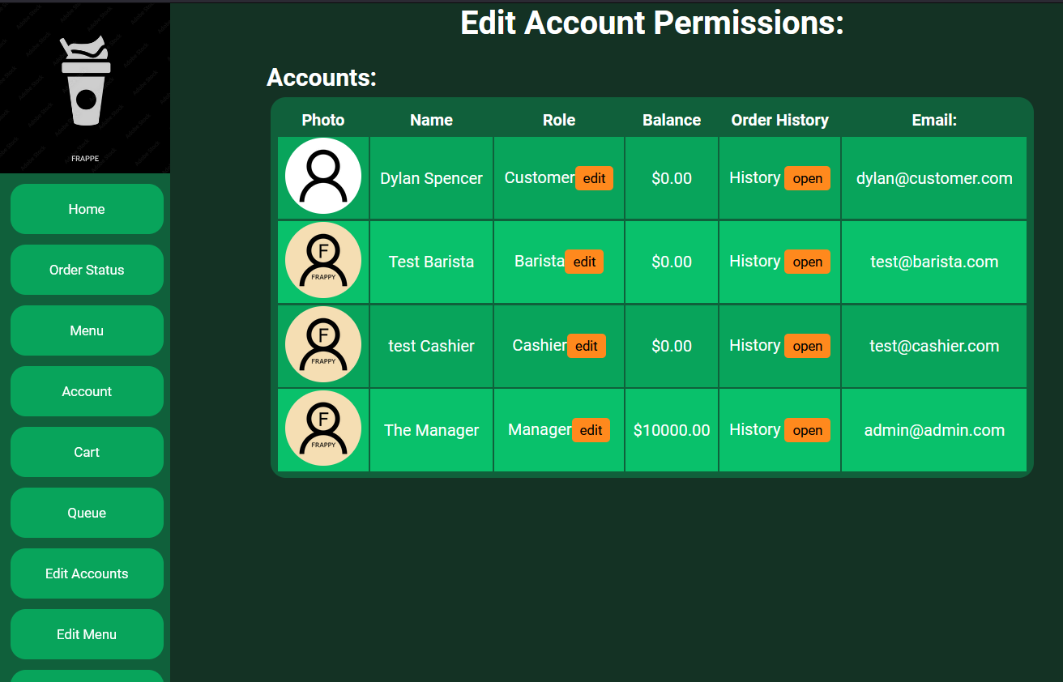
Manager Edits Accounts
Design Choices:
Chose to only have one manager, to keep their account as the shops account
Chose to not allow manager to edit other account balances for security purposes.
Chose to not allow the deletion of an account, but to transfer employees back to customers when fired. This will simplify transition from employees to non-employees and vice versa.
Chose a simple UI and built in options for manager simplification.
Wireframe prototype
Final product

Slide 21
Manager Edit Accounts
Scrum Task Breakdown:
Frappy #50 Class Diagram – Login dataflow (Dalyn) [depends on none]
Frappy#52 Low-fidelity prototype 2 - Wireframe for Manager pages (Dylan and Jacob) [depends on none]
Frappy#74 Login Page - Make login page with mock data (Dylan) [depends on #28 and demo]
Frappy#90 Make NavBar for pages (Dylan) [depends on #52]
Frappy#98 Database - Set Up User Accounts Model (dalyn) [depends on none]
Frappy#109 Set up account login and Create new user with backend (Dalyn) [depends on #109]
Frappy#116 Manager Edit Accounts page (Dylan) [depends on #109 and #52]
Frappy#131 Backend - Display Account Type (Current_User) (Dalyn) [depends on #98]

Slide 22
Manager Edit Accounts
Testing Procedures:
The Manager Edit Accounts requirement uses a lot of frontend and backend interaction. Everytime the page is loaded, all the account populate from the backend, and when an user’s “account role” is changed, things need to be updated, changed, or deleted from the database. Because of this we have frontend and backend tests for the entire application, including the manager edit accounts functionality. The tests can be run with the following instructions.
Frontend:
Navigate to the src/frontend/ folder and run ‘npm run test’
Backend:
Navigate to the src/server/frappe folder and run ‘python manage.py test’

Slide 23
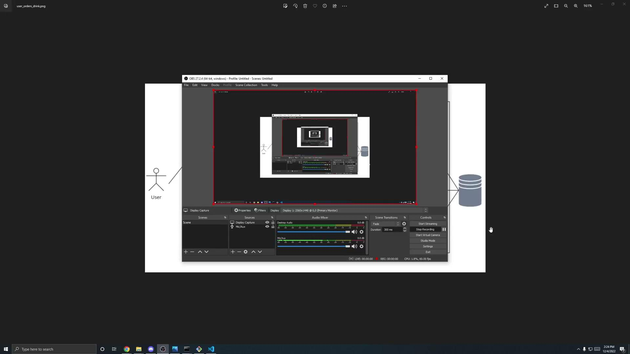
Video 1: User Orders a Drink

Slide 24
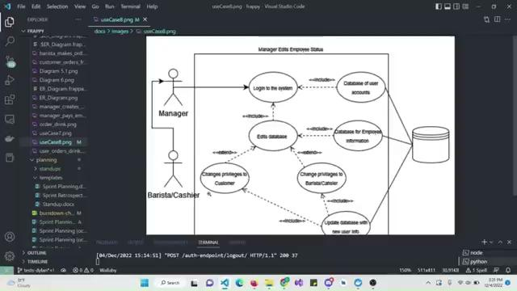
Video 2: Manager Edits Inventory

Slide 25
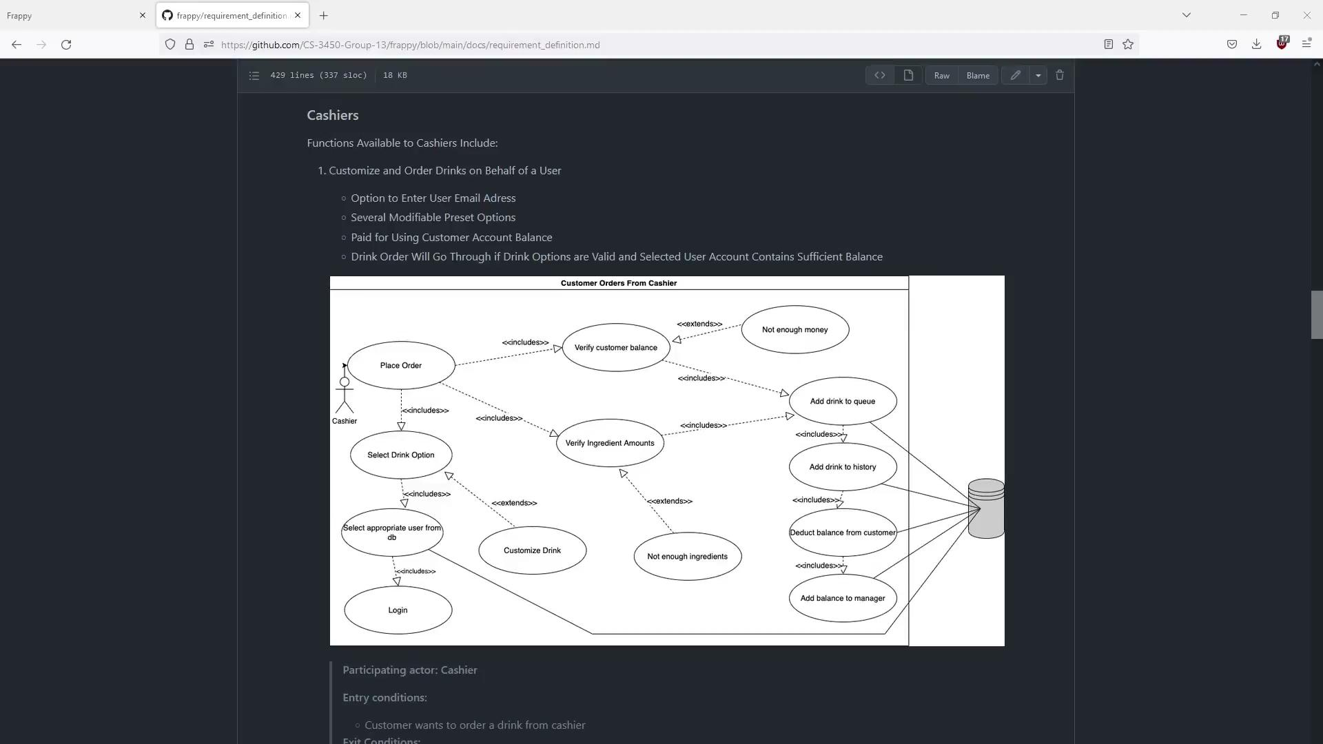
Video 3: Cashier Orders for Customer

Slide 26
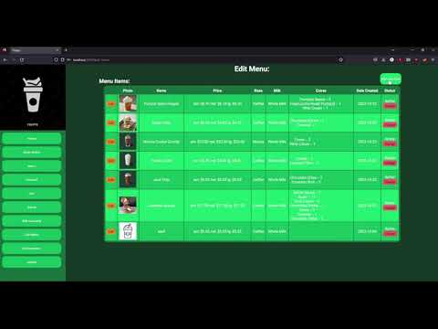
Video 4: Manger Creates Menu Item

Slide 27
Resources
https://www.django-rest-framework.org/
https://reactjs.org/docs/hooks-intro.html
https://www.robinwieruch.de/react-testing-library/
https://css-tricks.com/snippets/css/a-guide-to-flexbox/
https://reactjs.org/docs/hooks-effect.html
https://reactcommunity.org/react-modal/

Slide 28
Questions?

