Slide 1
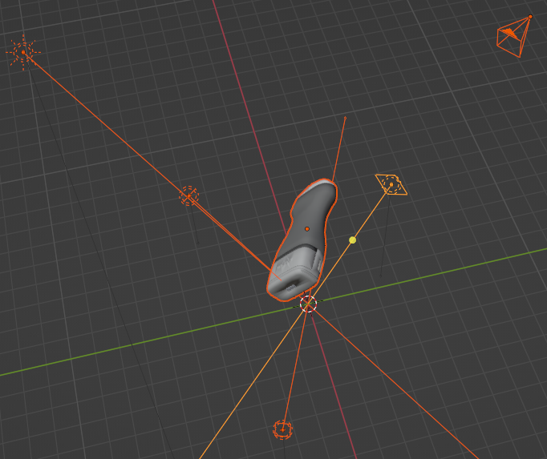
camera
Light Source
probe

Slide 2
x
Weight Layer
F(x)
relu
X
identity
Weight Layer
F(x) + x
relu

Slide 3
input
ConvBNReLU
MaxPooling
ConvBNReLU
ConvBNReLU
ConvBN
ConvBN
×48
…
ConvBNReLU
ConvBNReLU
ConvBN
ConvBN
Activation
GlobalPooling
Dense
output

