Slide 1










$$m_{i−1}$$
$$m_{i}$$
$$m_{i+1}$$
$$⋯$$
$$⋯$$
$$k_{i},L_{i}$$
$$k_{i+1},L_{i+1}$$
$$x_{i−1}$$
$$x_{i}$$
$$x_{i+1}$$

Slide 2






$$m_{i−1}$$
$$m_{i}$$
$$m_{i+1}$$
$$⋯$$
$$⋯$$
$$k_{i},L_{i}$$
$$k_{i+1},L_{i+1}$$
$$x_{i−1}$$

Slide 3









$$k,L_{0}$$
$$x_{0}$$
$$x_{4}$$
$$m$$
$$m$$
$$m$$
$$x_{1}\left(t\right)$$
$$x_{3}\left(t\right)$$
$$x_{2}\left(t\right)$$

Slide 4
$$k,L_{0}$$
$$x_{0}$$
$$x_{4}$$
$$m$$
$$m$$
$$m$$
$$x_{1}\left(t\right)$$
$$x_{3}\left(t\right)$$
$$x_{2}\left(t\right)$$

Slide 5

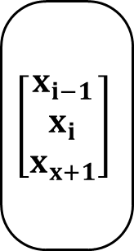
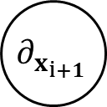
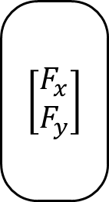
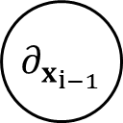
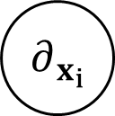

$$k$$
$$∂_{x_{i−1}}$$
$$\left[\begin{matrix}x_{i−1} \\ x_{i} \\ x_{x+1}\end{matrix}\right]$$
$$\left[\begin{matrix}F_{x} \\ F_{y}\end{matrix}\right]$$
$$ℒ_{PINN}$$
$$∂_{x_{i}}$$
$$∂_{x_{i+1}}$$

Slide 6
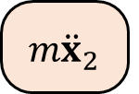


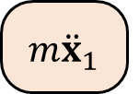
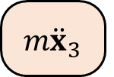


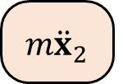



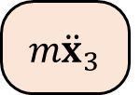

$$x_{0}$$
$$x_{4}$$
$$x_{1}$$
$$x_{3}$$
$$x_{2}$$
$$t=t+Δt$$
$$m{\ddot{x}}_{1}$$
$$m{\ddot{x}}_{2}$$
$$m{\ddot{x}}_{3}$$
$\text{ODE} \text{solve}$ (scipy.solve_ivp)
$$m{\ddot{x}}_{1}$$
$$m{\ddot{x}}_{2}$$
$$m{\ddot{x}}_{3}$$

Slide 7
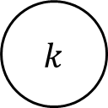
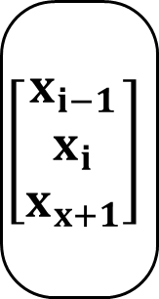
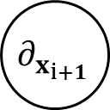
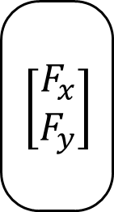
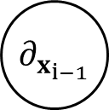
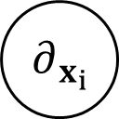

$$k$$
$$∂_{x_{i−1}}$$
$$\left[\begin{matrix}x_{i−1} \\ x_{i} \\ x_{x+1}\end{matrix}\right]$$
$$\left[\begin{matrix}F_{x} \\ F_{y}\end{matrix}\right]$$
$$ℒ_{PINN}$$
$$∂_{x_{i}}$$
$$∂_{x_{i+1}}$$

Slide 8
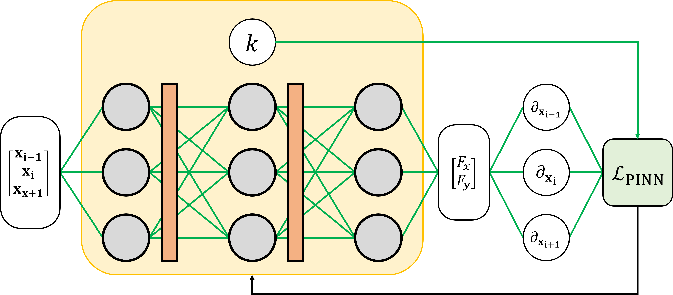
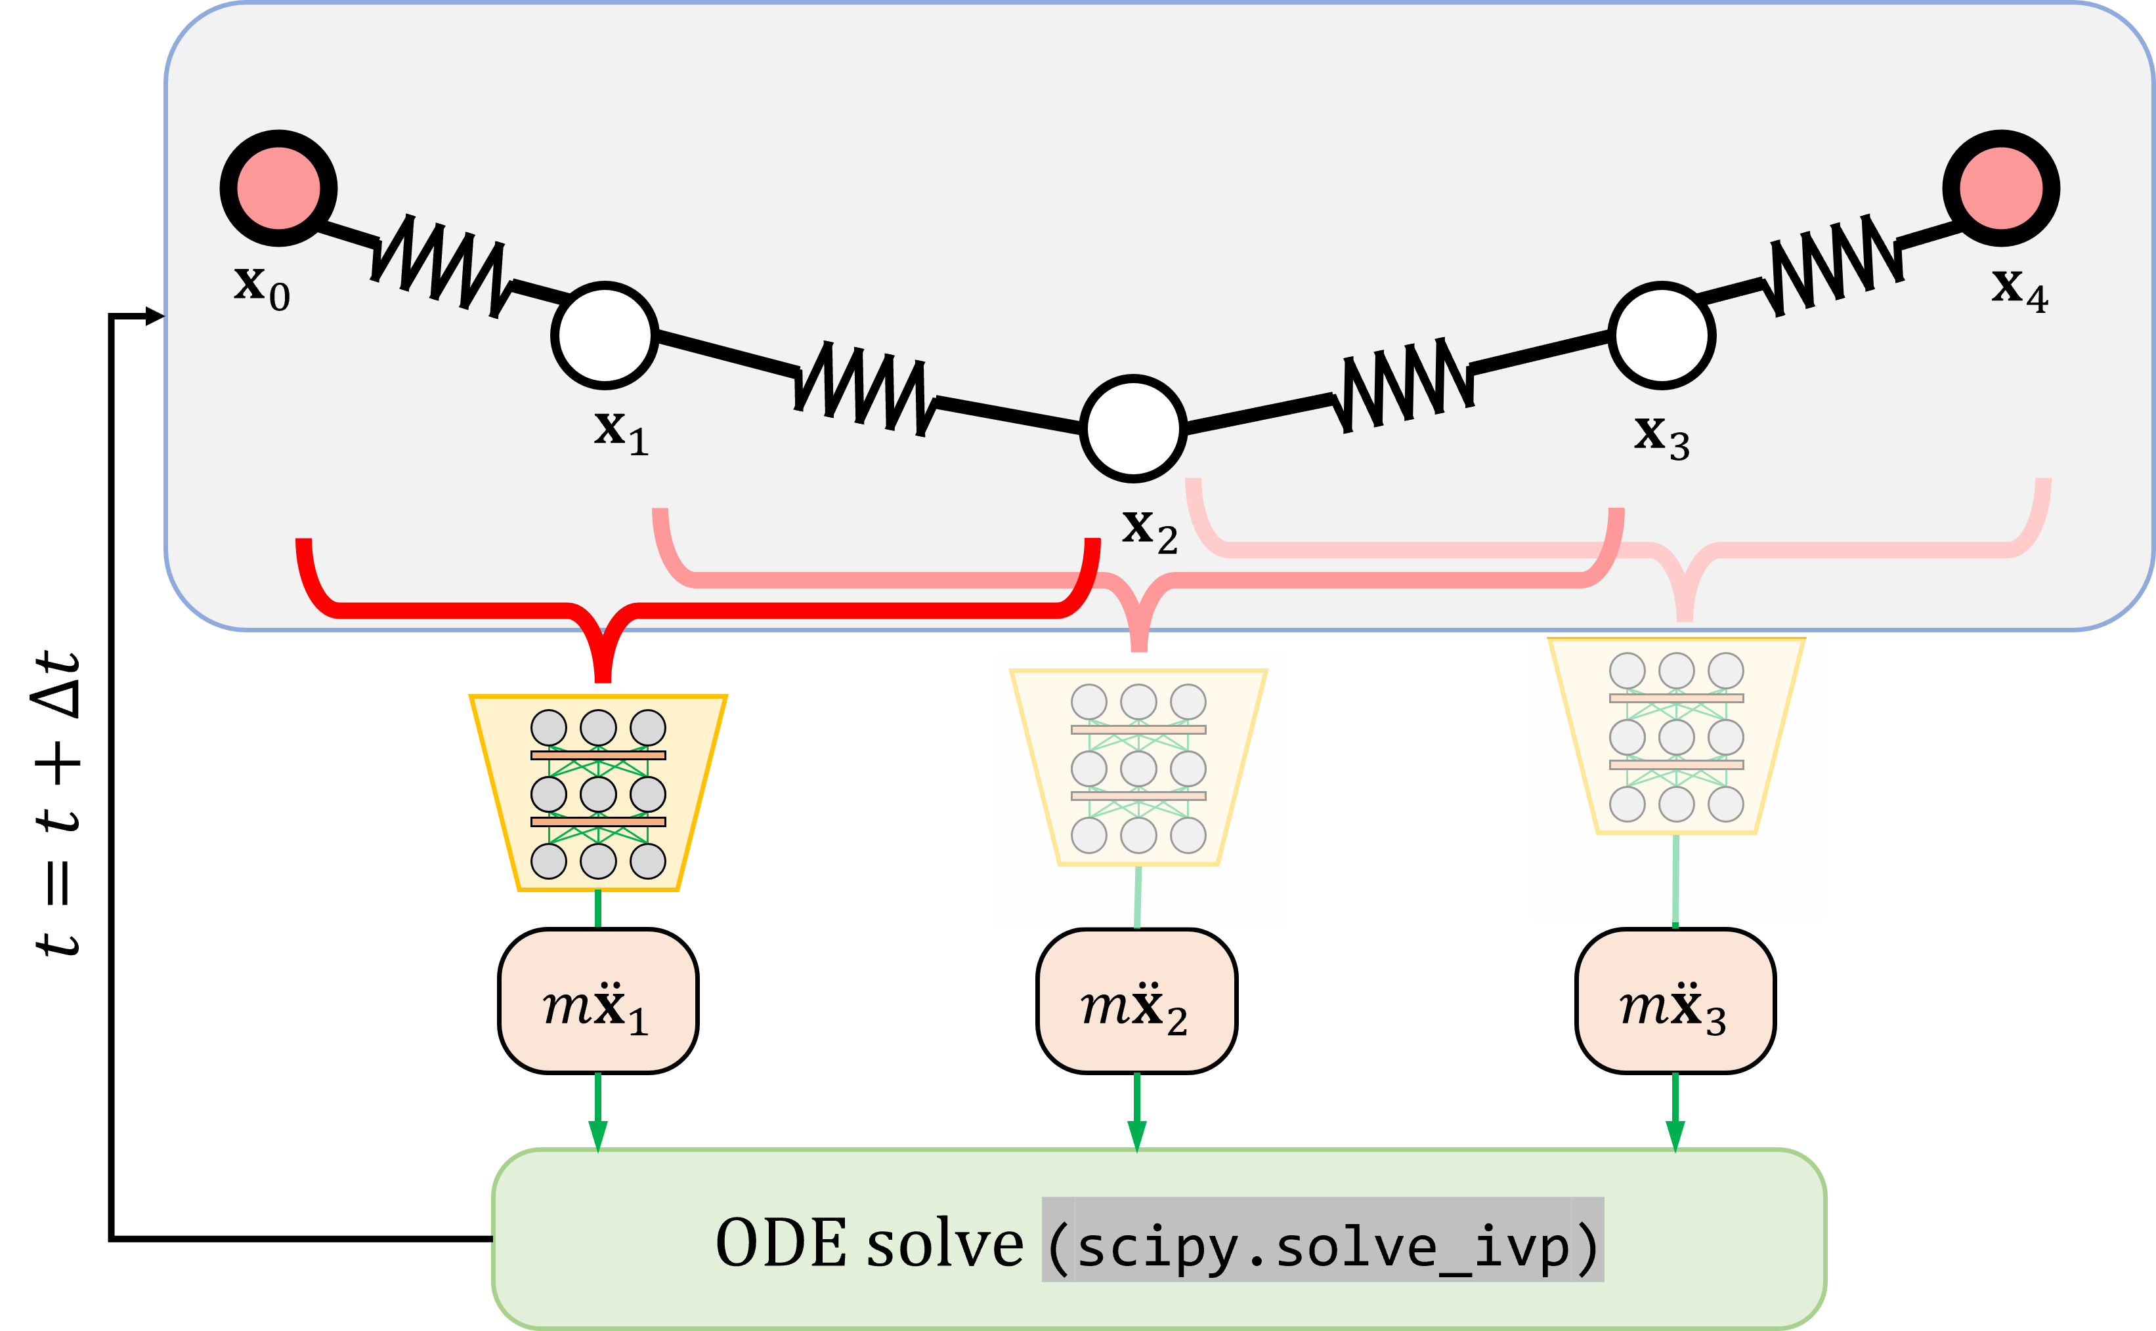
(a)
(b)

