Slide 1
Matlab package for R
Presentation by Lucas Jeay-Bizot
Class CS 510

Slide 2
Preliminary steps
Please go to https://github.com/lucasjeaybizot/PresentationCS510_MatlabPackage_R
You will find there a git repository with information on the matlab package for R
Notes:
Maybe this link can be sent in the zoom chat by copy and paste: https://github.com/lucasjeaybizot/PresentationCS510_MatlabPackage_R

Slide 3
What is it ?
This package was designed by P. Roebuck in June 2014
This package simulates a set of useful MATLAB functions in R
Package website: http://cran.r-project.org/package=matlab
Notes:
Same as before, this link can be copy/pasted in the chat: http://cran.r-project.org/package=matlab
Orally: Matlab is another programming language – being able to simulate some of its functions in R can simply interoperative coding or projects involving members with diverse coding backgrounds.

Slide 4
How to install it ?
Run the command install.packages(“matlab”) in Rstudio
Alternatively you can run the install_package.R script available in the github repository
Before using it in a session, call library(“matlab”)

Slide 5
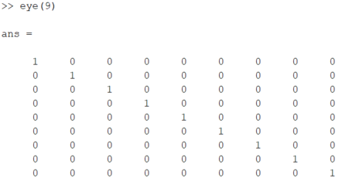
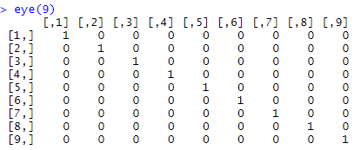
What does it do ? - 1
It allows you to use a large set of matlab functions in R (full list available here: (https://cran.r-project.org/web/packages/matlab/matlab.pdf )
For instance the eye() function in matlab can now be run in R
In R
In MATLAB
Notes:
Same as before, this link can be copy/pasted in the chat: https://cran.r-project.org/web/packages/matlab/matlab.pdf
eye(n) creates an n-by-n identity matrix

Slide 6



What does it do ? - 2
Another example is the matlab function linspace()
Or the function primes()
In R
In MATLAB
In R
In MATLAB
Notes:
linspace(a,b,c) gives a vector of steps in the linear spacing ranging from a to b in c number of steps
primes(n) gives the list of primes smaller than or equal to n

Slide 7
How to translate MATLAB to R ?
Some key differences:
Assigning variables
In MATLAB: “=“
In R: “<-”
Commenting code
In Matlab: “%”
In R: “#”
Otherwise, you can just write identically each function included in the package in both languages
Notes:
Underline the point that even with this package the code cannot just be copy and pasted and that some features (like “=“ and “%”) need to be accounted for in the translation

Slide 8
Where can I find out more about it ?
You can visit the github repository: https://github.com/lucasjeaybizot/PresentationCS510_MatlabPackage_R
Open examples.R to find a list of the packages’ functions and accompanying examples
Open exercise.R to practice using the repository a little

Slide 9
Exercise.R walkthrough solution
Convert the code below from MATLAB to R using the matlab package in R:
A = magic(6);
A = reshape(A,2,18);
B = numel(A);
C = factor(B);
D = isprime(C);
The line by line code in R:
library(“matlab”)
A <- magic(6)
A <- reshape(A,2,18)
B <- numel(A)
C <- factors(B)
D <- isprime(C)
Notes:
If time allows, ask for participation from the audience
Orally:
Animation 1: remember to upload the library in order to be able to access its functions
Animation 2: ‘=‘ in R becomes ‘<-’ and ‘;’ disappears
Animation 4: factor() is an exception in this toolbox, to avoid ambiguous usage, in the toolbox it has to be translated to factors()
Animation 5: in the code file the ‘%’ also have to be converted to ‘#’
Underline the simplicity of the translation from MATLAB to R → thus the usefulness of the toolbox

Slide 10
Similar packages
R.matlab: permits to read and write mat files from within R as well as call MATLAB
Reticulate: R interface to python
Notes:
These other packages might be useful for people who really want to work on projects that will involve more than one programming language.
For instance the R.matlab will enable the usage of files across both platforms. The reticulate package will work similarly as it will allow to call python in R.

Slide 11
Thank You!

