Slide 1
Programming 01 01 - Introduction

Slide 2
Administrivia
Dr Andy Guest
a.guest@yorksj.ac.uk
Tel – (01904) (62)6524
Keep Checking
e-mail
moodle

Slide 3
Useful Books
These are not required, you may find them useful. You should find them all in the library
Java for Everyone, Horstmann, C. (2010), Wiley
Introduction to Java Programming, Liang, Y.D. (2012), Comprehensive Version. 9th ed. Pearson Education
Head First Java, Sierra, K., and Bates, B. (2005), O’Reilly Media
Think Java, Downey, A. B.
Thinking In Java 4th Edition, Eckel, B. (2006), Prentice Hall

Slide 4
Module Goals
To learn basic concepts of programming in the context of software development:
write algorithms to solve problems
implement algorithms using the Java programming language
learn the basics of the object oriented programming paradigm
run, compile and debug your solutions

Slide 5
Programming
Programming is a knowledge and a skill
Knowledge
from these lectures, from books, etc.
Skill
from coding, coding and more coding

Slide 6
Module Outline
Core Concepts (2-3 Weeks)
Tool Introduction
Eclipse, Git-Hub
A small number of coding things to learn
Variables, if(), for(), output, methods, arrays, testing
Practice, Practice, Practice!
Lots of practice at using the core concepts
Some more advanced concepts along the way

Slide 7
Assessment
Portfolio of exercises
Submitted at the end of the module
Each exercise consists of
Task sheet
Describes what needs to be done
Marking sheet
Describes how the exercise will be marked
For each exercise you will submit
Worksheet and code
Submitted through Moodle

Slide 8
Assessment Notes
Work submitted up to a week late will be capped at a mark of 40%
Work over a week late will not be marked and result in a mark of 0%
Cheating and plagiarism (submitting someone else’s work as your own) is taken very seriously.
Submitting flawed work on time is better than submitting late
Submitting late is better than submitting nothing
Submitting nothing is better than cheating

Slide 9
Tools
Eclipse
IDE Integrated Development Environment
Application for writing, testing, debugging and compiling code
Github
Online source code management
Store your code online, access it anywhere
Download sample code for the module

Slide 10
Eclipse
Eclipse is freely available at
https://www.eclipse.org/ide/
Available for Windows, Mac & Linux
Eclipse Guides
https://www.tutorialspoint.com/eclipse/
https://www.tutorialspoint.com/eclipse/eclipse_quick_guide.htm

Slide 11
GitHub
Online Source Code Management
Version Control
Hosted on university servers
https://git.yorkdc.net:8888/
User name and password same as computing network account
GitHub Guides
https://guides.github.com/

Slide 12
Module Goals
To learn basic concepts of programming in the context of software development:
write algorithms to solve problems
implement algorithms using the Java programming language
learn the basics of the object oriented programming paradigm
run, compile and debug your solutions

Slide 13
Algorithms
What is an algorithm?
An algorithm is a step-by-step sequence of instructions that solve a problem.
An algorithm is like a recipe: it contains a list of ingredients (called variables) and a list of directions (called statements).

Slide 14
Algorithm Example
Making coffee
Fill kettle with water
Put kettle on to boil
Get mug
Add teaspoon of coffee powder to mug
If want_sugar then add sugar to mug
If want_milk then add milk to mug
If kettle has finished boiling then add hot water to mug
Stir
Drink

Slide 15
Pseudocode
fill_kettle(water)
boil_kettle()
get_mug()
prepare_mug(coffee, milk, sugar)
if kettle_boiled == true then
pour_hot_water_in_mug()
stir_coffee()
drink_coffee()

Slide 16
Flowcharts
Kettle
Boiled?
Fill Kettle
Boil Kettle Kettle
Yes
Yes
Pour Water In Mug
Mug
Ready?
Prepare Mug
Add Coffee
Add Milk
Stir
Add Sugar

Slide 17
Java
Java is a high level, object oriented programming language
Object Oriented Programming (OOP) is the topic of Programming 02 next semester
But we need to know a little about OOP to really understand how Java works

Slide 18
Objects
In OOP languages, like Java, programs are made up of objects that interact with each other.
Objects contain information (data) and can do things (methods)
data can be numbers, text, can even be more objects
methods are sections of code
Objects
interact with each other using their methods
are defined by templates called classes

Slide 19
Object Algorithm Example
kettle.fill(water)
kettle.boil()
mug.add(coffee, sugar, milk)
kettle.pour(mug)
mug.stir()
me.drink_from(mug)
Three objects – kettle, mug, me
Methods – fill, boil, add, pour, stir, drink_from
Data – water, coffee, sugar, milk
Objects used as data – kettle.pour(mug), me.drink_from(mug)

Slide 20
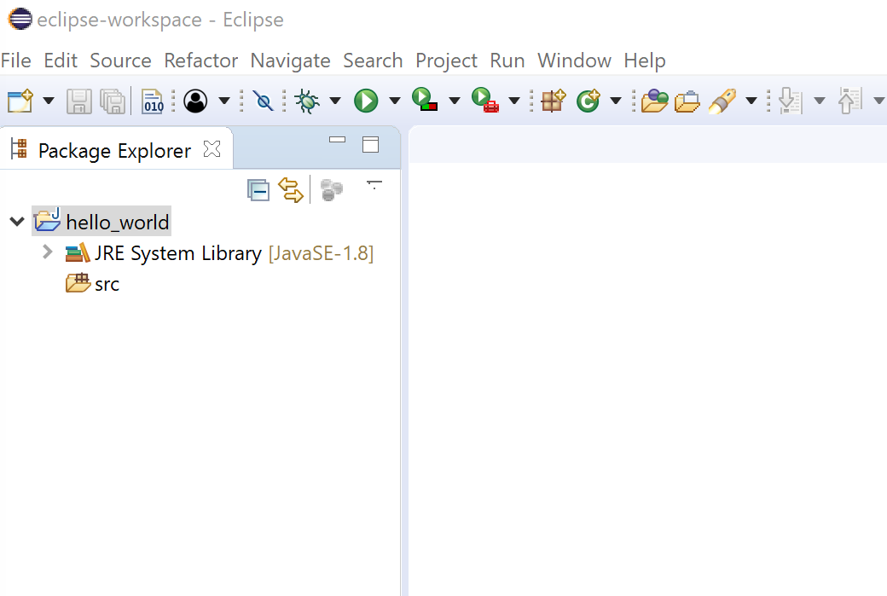
Getting Started With Java
Start up Eclipse
(Accept workspace location, click launch)
File > New > Java Project
Enter project name as hello_world
Click Finish
Should see something like this

Slide 21
First Java Class
Creating a new class can be done in a number of different ways.
File > New > Class
Or
Right click on src folder > New > Class
Or
Click on the new class button in the tool bar
(looks like a green circle with a C and a + in)

Slide 22
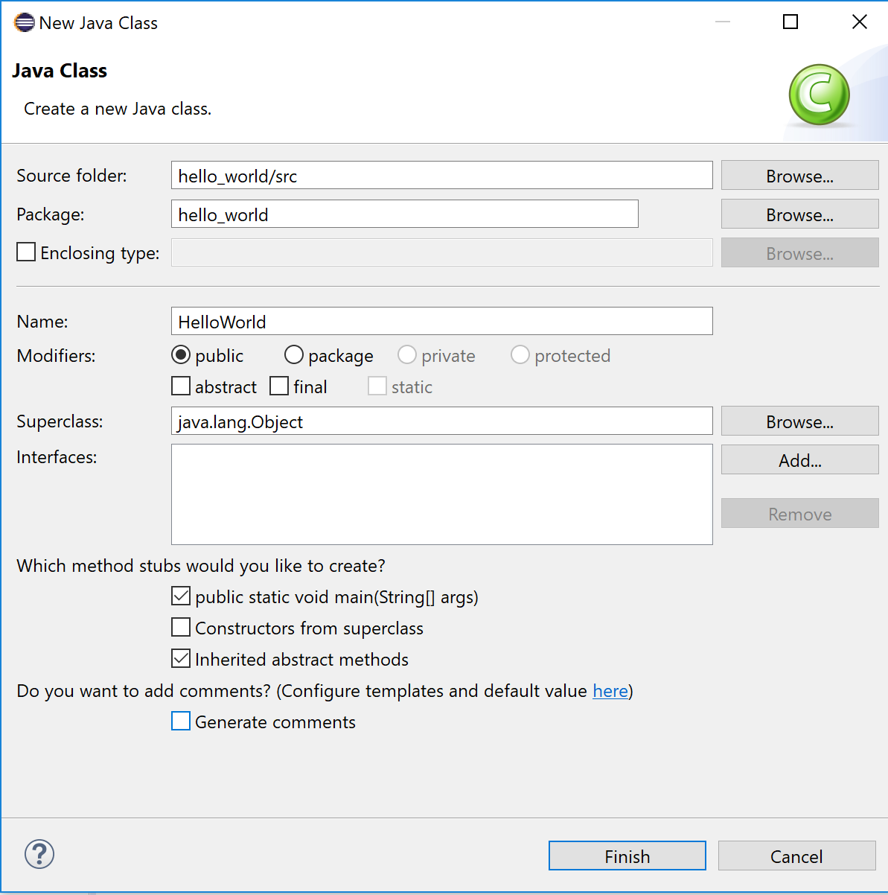
First Java Class
Fill in the window like this
Make sure you tick the boxes as shown
Then click Finish

Slide 23
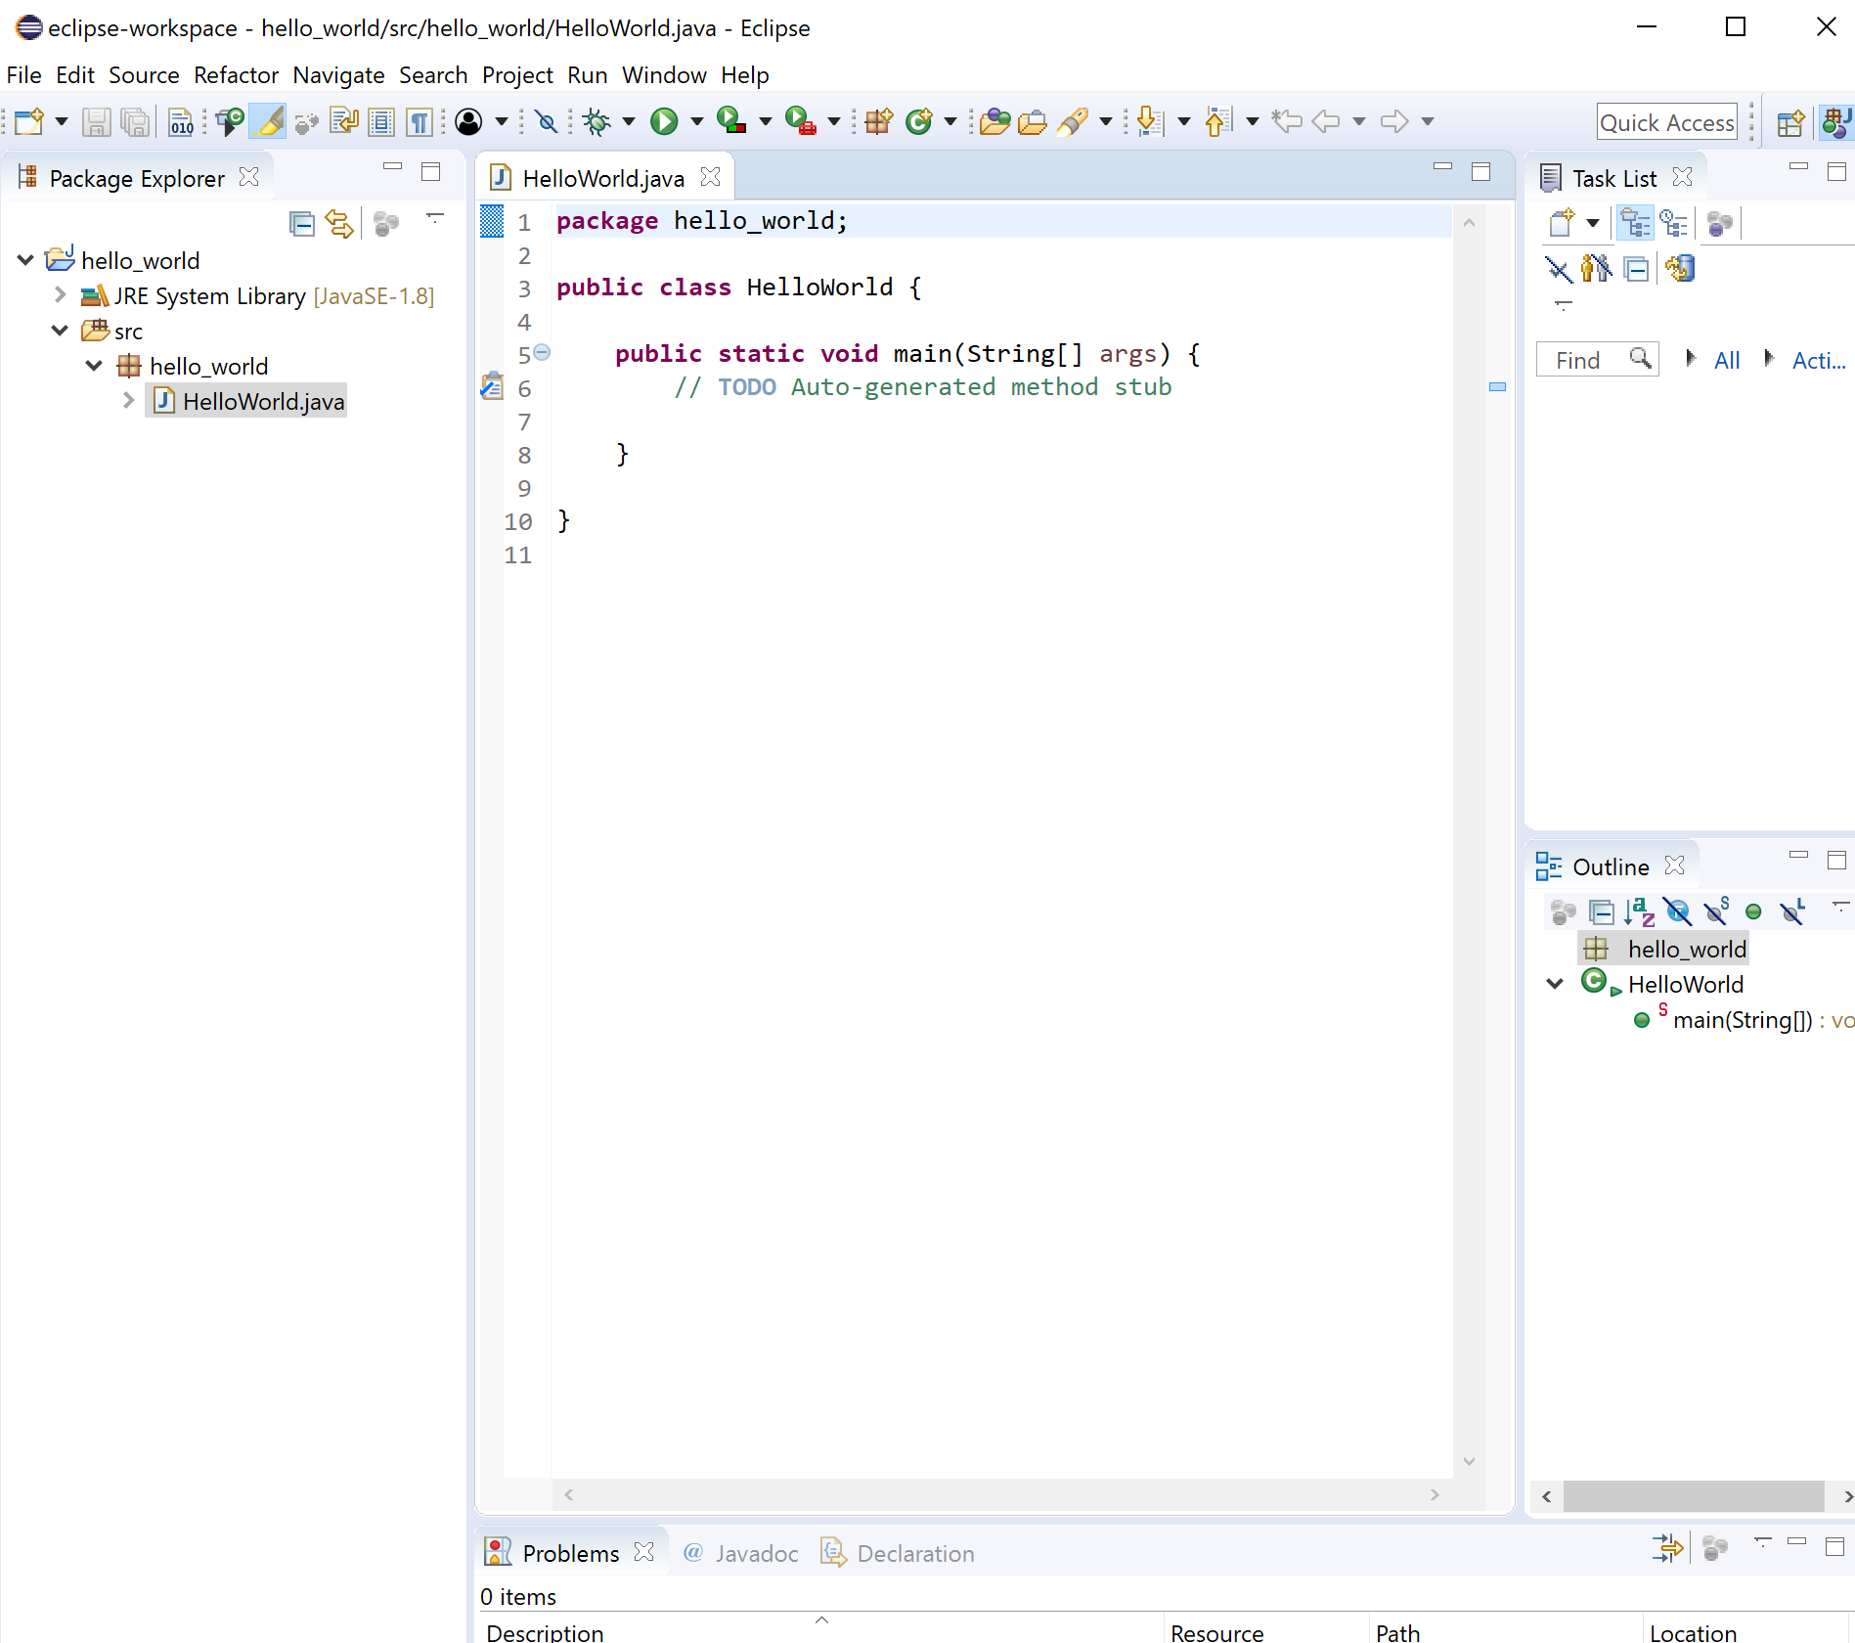
First Java Class
Should see (something like)this

Slide 24
First Java Class
Should see (something like)this

Slide 25
Hello World
The traditional first program!
public class HelloWorld
{
public static void main(String[] args)
{
System.out.println("Hello, World");
}
}

Slide 26
Running Hello World
Make sure you save your program first!
Eclipse can be set up to do this automatically
Press the tool bar button that is a green circle with a triangle in (looks like a play button)
Or
From the Run menu select Run
Or
Press Ctrl F11
Or
A number of other ways..
This will be a running theme
Output of “Hello World” should be visible in the console window at the bottom of the Eclipse window

Slide 27
Hello World
public class HelloWorld
{
public static void main(String[] args)
{
System.out.println("Hello, World");
}
}
Creates a new class. At this point you just need to know is that all code has to be in a class.

Slide 28
Hello World
public class HelloWorld
{
public static void main(String[] args)
{
System.out.println("Hello, World");
}
}
main is the starting point of any console based Java application.
It is where the code starts running from.

Slide 29
Hello World
public class HelloWorld
{
public static void main(String[] args)
{
System.out.println("Hello, World");
}
}
System.out.println() is a Java operation that outputs a string to the console window.

Slide 30
Comments
Code can get pretty tricky to understand especially if
Someone else wrote it, or
You wrote it a long time ago
We use comments to add notes to help explain
// Single line comments look like this
/* Multi-line
Comments look like this
*/
Eclipse, by default, colours comments green

Slide 31
Variables – Primitive Types
Almost every program will require us to store and process data.
Data can be stored in many different ways, the simplest are primitive variables.
These primitives can each store a single piece of data of a specific type
int, byte, short, long, float, double, boolean, char, String

Slide 32
Primitive Variable – Declaration
Before we can use a variable we need to create it, we call this declaring the variable
We do this in the format
<type> <identifier> [ = <value>];
<type> it the type of variable and defines what type of data it holds
<identifier> is the variable name, chosen by the programmer
The part in square brackets [] is optional. It is used to initialise the variable when it is created

Slide 33
Primitive Variable – Identifiers
The identifier is the variable name, chosen by the programmer
Can contain only alphabetic, numeric, underscore or $ symbols
Cannot start with a number
By convention we use camel case, all words in an identifier (except the first) begin with a capital letter. (e.g. aReallyReallyLongVariableName)
Java is case sensitive – firstName and firstname are not the same

Slide 34
Primitive Variable - int
int is used to store integer values. Whole numbers with no fractional parts.
Positive, negative or zero
int anInteger = 10;
int myAge = 45;

Slide 35
Primitive Variable - double
double is used to store real values. Numbers with fractional parts. (or may have)
Positive, negative or zero
double aDouble = 7.8;
double myAge = 45.0;

Slide 36
Primitive Variable - boolean
boolean is used to store a value of true or false
boolean javaIsFun = true;

Slide 37
(Not A) Primitive Variable - String
String is used to store text
String greeting = “Hello World!”;
Not actually a primitive.
There is a primitive called a char which stores a single text character. A string is an array (a collection) of chars.
But for now think of it as like a primitive

Slide 38
Using Variables
Variables can be used in calculations
int anAnswer = aNumber + anotherNumber;
They can be used in methods
System.out.println(“Hello World”);
String outputString = “Hello World);
System.out.println(outputString);
They can be used in comparisons
if ( myAge < 50 )
{
System.out.println(“Still young!”);
}

Slide 39
Console Output
We’ve already seen output
System.out.println(“Hello World”);
We can also use
System.out.print(“Hello”);
To write to the console and not add a new line
System.out.print(“Hello ”);
System.out.println(“World”);
Gives the same output as the “Hello World” line above

Slide 40
Console Input
import java.util.Scanner;
class GetInputFromUser {
public static void main(String args[])
{
int a;
float b;
String s;
Scanner in = new Scanner(System.in);
System.out.println("Enter a string"); s = in.nextLine();
System.out.println("You entered string " + s);
System.out.println("Enter an integer"); a = in.nextInt();
System.out.println("You entered integer " + a);
System.out.println("Enter a float"); b = in.nextFloat();
System.out.println("You entered float " + b);
}
}

Slide 41
Console Input
import java.util.Scanner; (1)
int a; float b; String s;
Scanner in = new Scanner(System.in); (2)
System.out.println("Enter a string"); s = in.nextLine();
System.out.println("You entered string " + s);
System.out.println("Enter an integer"); a = in.nextInt();
System.out.println("You entered integer " + a);
System.out.println("Enter a float"); b = in.nextFloat();
System.out.println("You entered float " + b);
(1) Loads the library containing Scanner
(2) Creates a Scanner object called in

Slide 42
Console Input
System.out.println("Enter a string");
s = in.nextLine(); (1)
System.out.println("You entered string " + s);
System.out.println("Enter an integer");
a = in.nextInt(); (2)
System.out.println("You entered integer " + a);
System.out.println("Enter a float");
b = in.nextFloat(); (3)
System.out.println("You entered float " + b);
(1) Reads all text from the console until enter is pressed and stores that text in a String variable called s
(2) Reads all text from the console until enter is pressed and stores that text in a int variable called a
(3) Reads all text from the console until enter is pressed and stores that text in a float variable called b
Note that in (2) and (3) you need to enter a number correctly, there is no error checking!

Slide 43
if
The if statement is used to test if a condition is true, and if it is true then run some code.
if (myAge>18)
{
System.out.println(“Beer!”);
}

Slide 44
if else
The if statement can be used to select between two options
if (myAge>18)
{
System.out.println(“Beer!”);
}
else
{
System.out.println(“No Beer!”);
}

Slide 45
if else if
The if statement can also be used to select between more than two options
if (myAge<18)
{
System.out.println(“No Beer!”);
}
else if(myAge<30)
{
System.out.println(“Lots of Beer!”);
}
else {
System.out.println(“A Little Beer!”);
}
The first statement that is true, and only the first statement that is true, matches.

Slide 46
Comparison Operators
== equal to (not a single =!)
!= not equal to
<,> greater than, less than
>=, greater than or equal to
<= less than or equal to

Slide 47
Worked Example Output the larger of two variables
int number1 = 5;
int number2 = 7;
if (number1>number2)
{
system.out.println(number1);
}
else
{
system.out.println(number2);
}

Slide 48
Summary
Module Goals & Overview
What an algorithm is / looks like
First Java application
Simple variable types
Console Input & Output
The If Statement
Comparison Operators

Slide 49
Exercises
Write an application that outputs “Welcome to YSJ”
Write an application that asks for the user’s name and outputs “Hello <name>”
Write an application which reads in two integers and outputs the largest

