Slide 1
Gait Phase Classification
Brian Székely and Ponkoj Chandra Shill

Slide 2
Outline
Problem Statement
Limitation of Previous Approaches
Proposed Architecture
Any new building blocks, layers, loss functions
All other loss functions or objective functions
Dataset
Hyper-parameters
Qualitative Evaluation
Quantitative Evaluation
Summary and Future Improvements

Slide 3

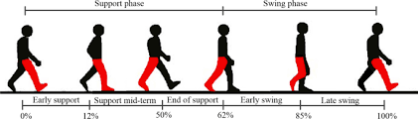
Problem Definition
Bouchrika el al., 2011; Iwama et al., 2013
Notes:
Walking is a basic motor behavior that we partake in everyday
Can be used in person identification
Prior use cases in surveillance, forensics, and criminal investigations
Gait can be segregated into distinct phases

Slide 4
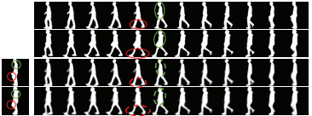
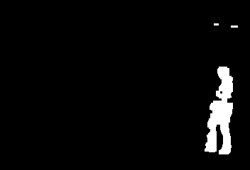
Limitation of Previous Approaches
Xu et al., 2020
Notes:
Gait recognition research used silhouette sequences
Prior research uses a video with a gait sequence
Problem with this: temporal partial occlusion
Latency for real-time applications
Stride length difference
NO prior research on stride cycle timing
NO gait classification - important for gait disorders to understand how affected a certain part of the stride is (example DropHip)
Why are the previous models/methods not adequate?
Which architectures have been applied to this task before (any previous state-of-the-arts model)?

Slide 5
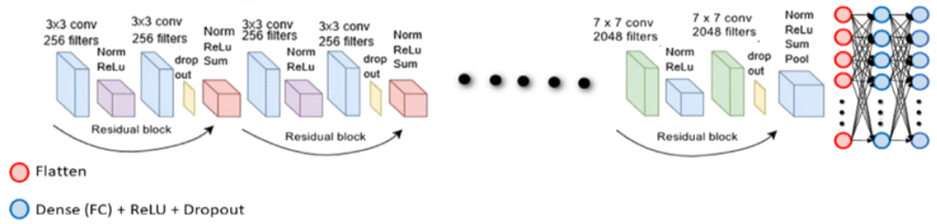
Baseline Models
ResNet-152V2
  ResNet-152V2 is a variant of the Residual Network (ResNet) architecture.
  152 layers
  bottleneck blocks, which reduce the computational cost by using 1x1 and 3x3 convolutional layers.
  Pretrained with ImageNet with Tensorflow
Bilal et al., 2022
Notes:
PONKOJ

Slide 6
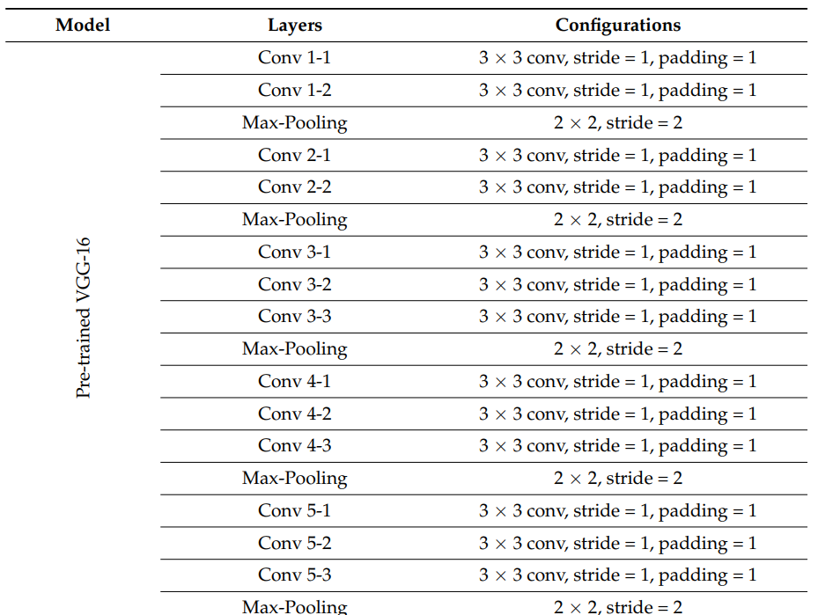
Baseline Models
VGG16
  series of 13 convolutional layers, followed by pooling layers and 3 fully connected layers.
  138M parameters.
  Small Filter 3*3
  Pretrained with ImageNet
  Tensorflow
Mogan et al., 2022

Slide 7
New Building Blocks/Loss Functions etc.
ResNet-152V2
  Add 256 node layer, LeakyRelu
  3x3 kernel
  Batch Normalization
  2x2 Max Pooling
  Flatten
  3 node Dense layer with sigmoid activation
  Categorical cross entropy loss
  Adam optimizer
  weights initialized from ImageNet

Slide 8
New Building Blocks/Loss Functions etc.
VGG16
  Flatten
  Add 2 dense 256 node layers with LeakyRelu
  50% dropout - reduce overfitting
  3 node Dense layer with sigmoid activation
  Categorical cross entropy loss
  Adam optimizer
  weights initialized from ImageNet

Slide 9



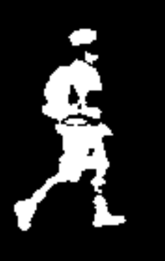
Datasets
CASIA A and C datasets (Center for Biometrics and Security Research)
  10296 images from A (4879 images) and C (5417 images)
  training/validation/test (75/15/10; 10296 images) from 90° view point
Classify
  3 phases: heel strike, toe-off, other
Xu et al., 2020; Yao et al, 2021

Slide 10
Hyper-parameters
ResNet-152V2 and VGG16
  Early Stopping (patience=15)
  100 epochs
  learning rate=0.001
  batch size=64
  optimizer=Adam
  loss=category loss entropy

Slide 11
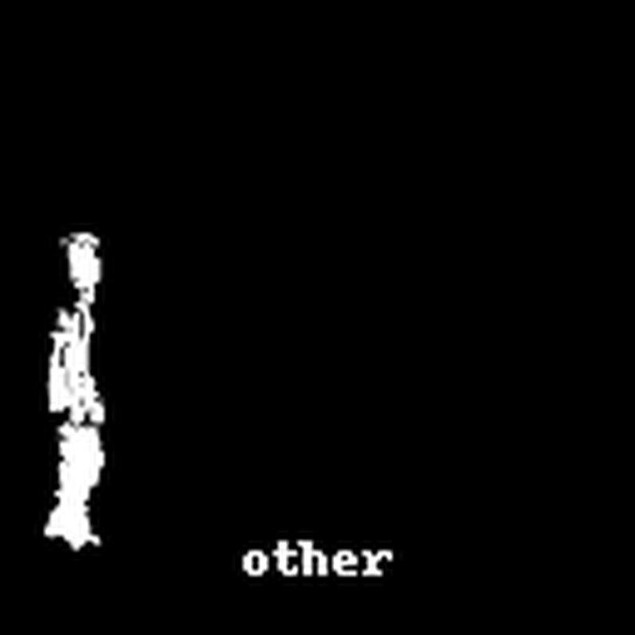
Qualitative Evaluation
Baseline ResNet - dataset c

Slide 12
Qualitative Evaluation
Baseline VGG - combined
Baseline ResNet - combined

Slide 13
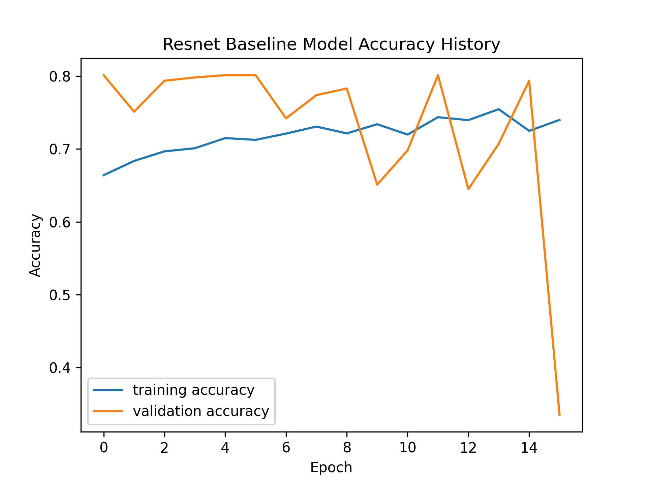
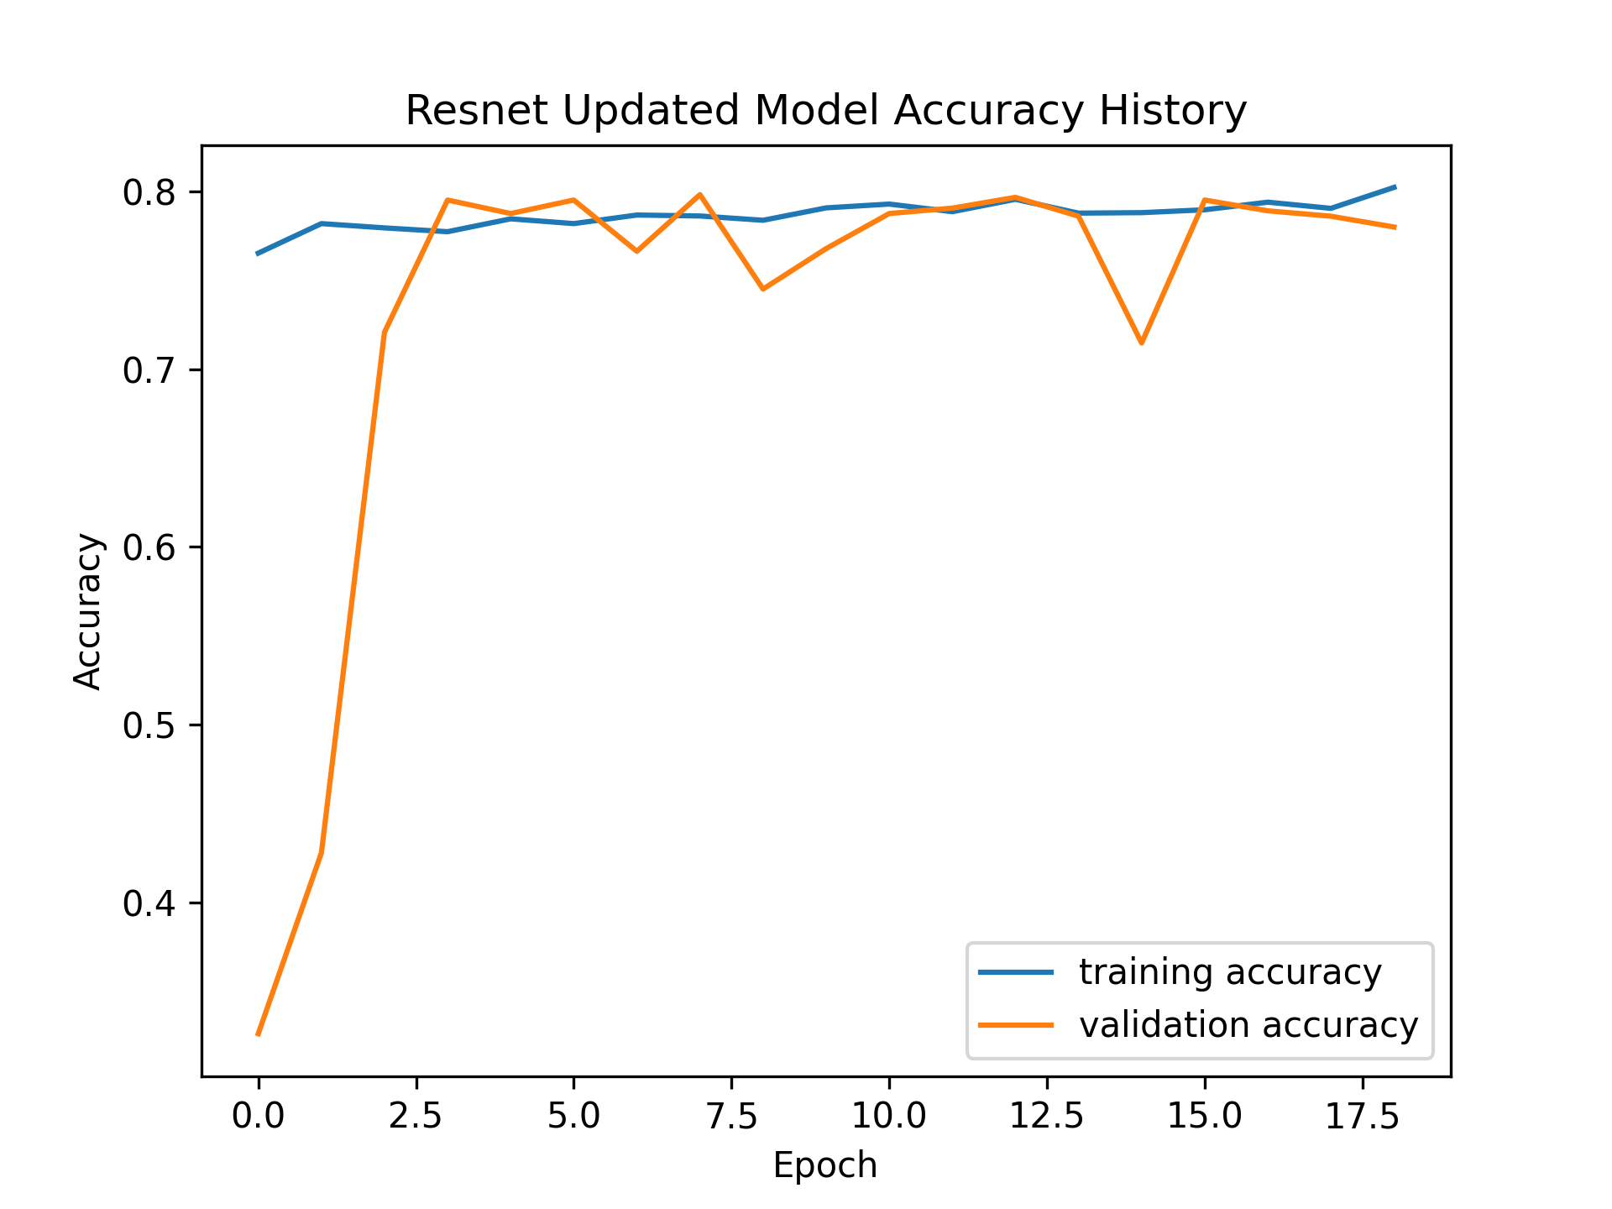
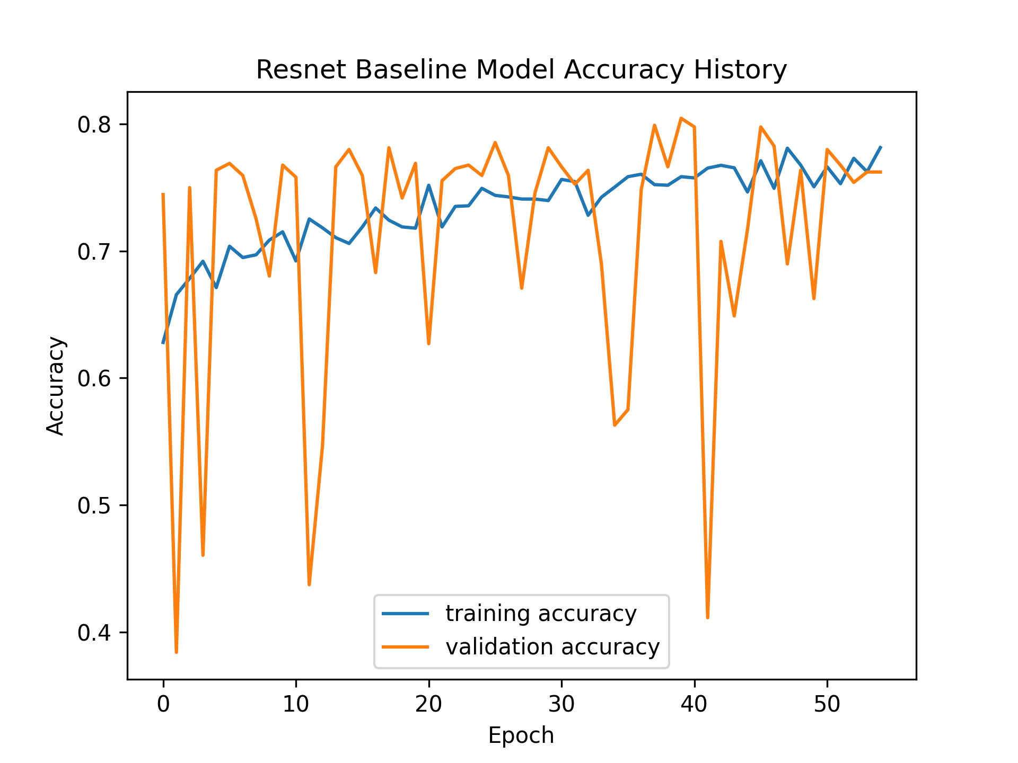
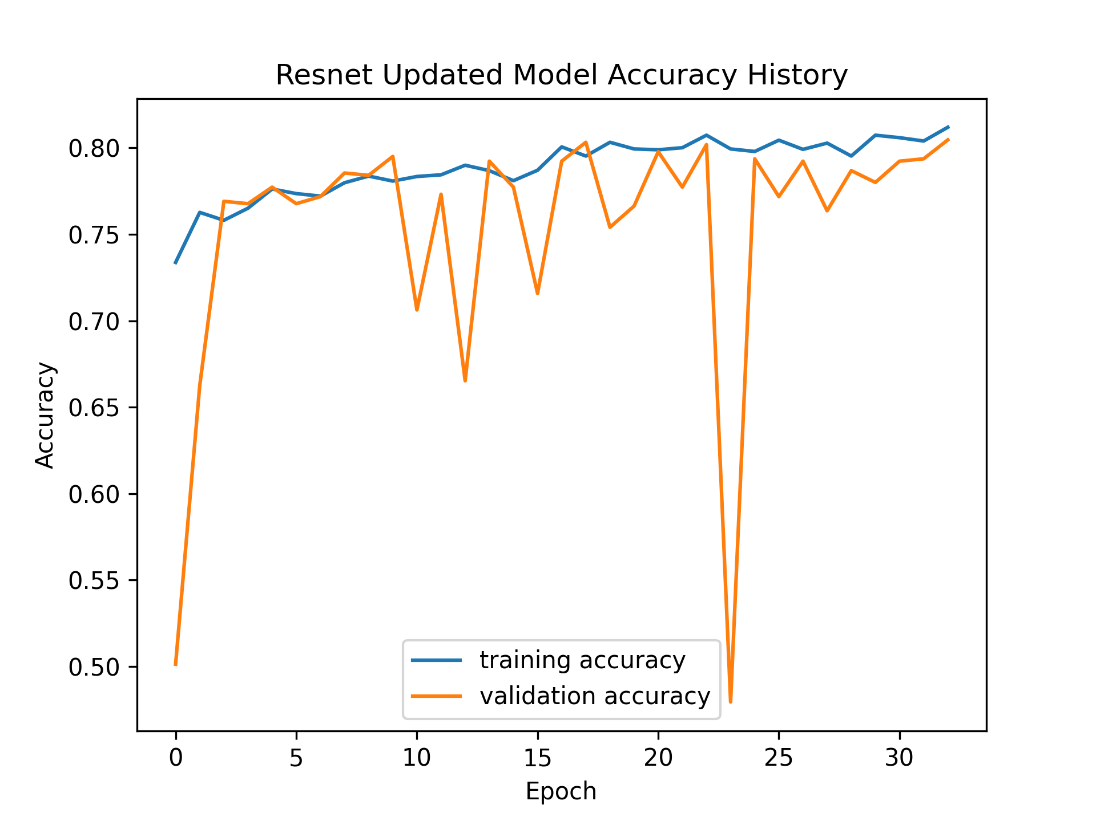
Qualitative Evaluation
Baseline and Updated ResNet Accuracy
dataset a
dataset c

Slide 14
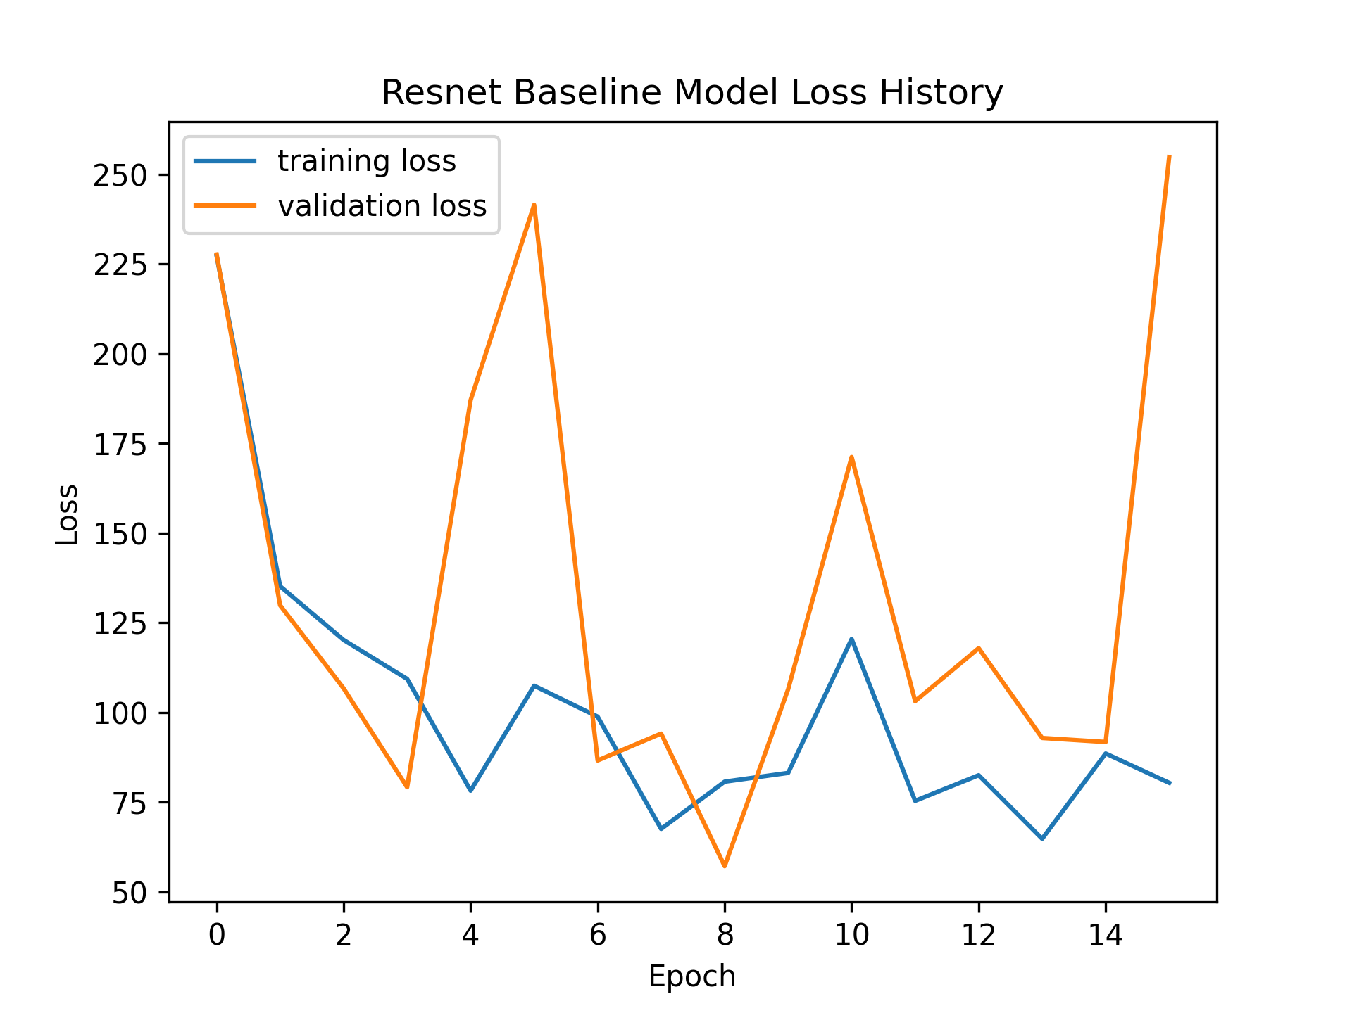
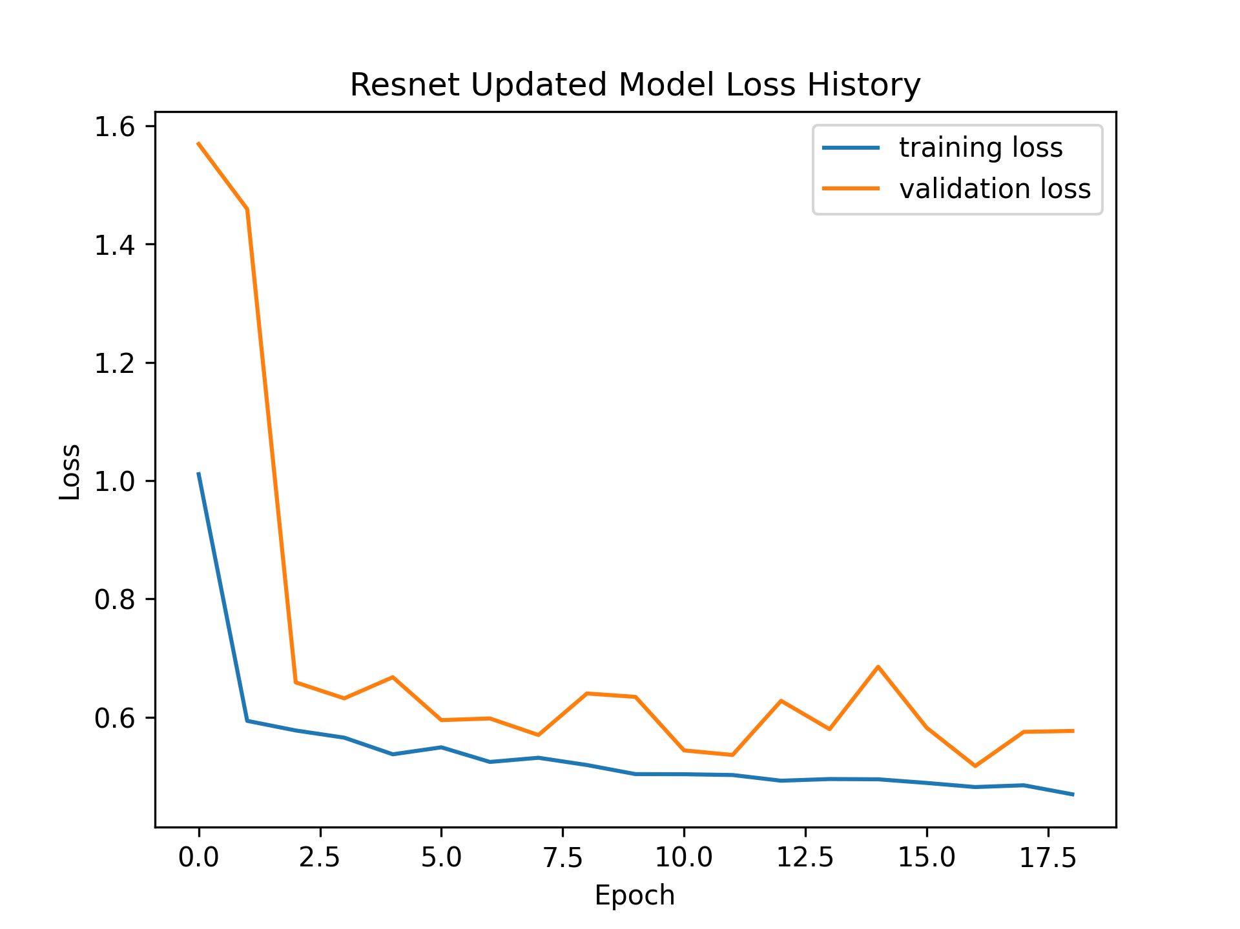
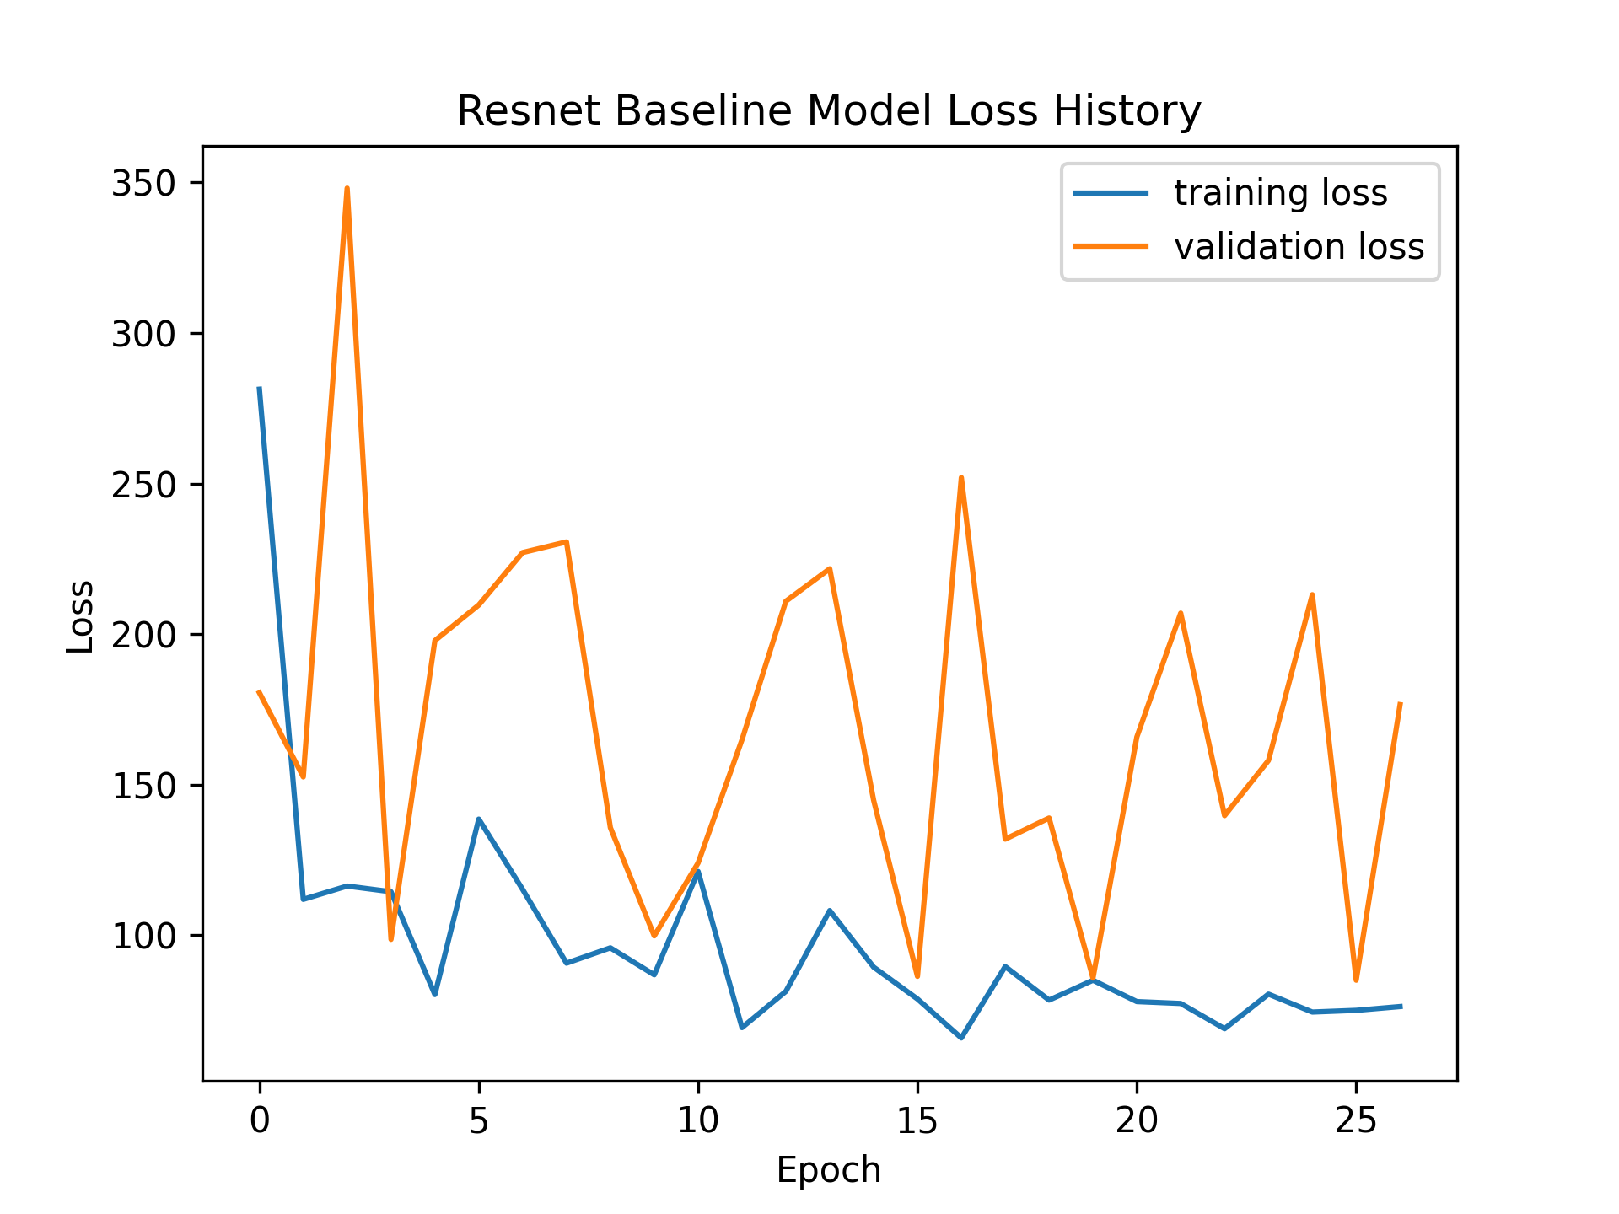
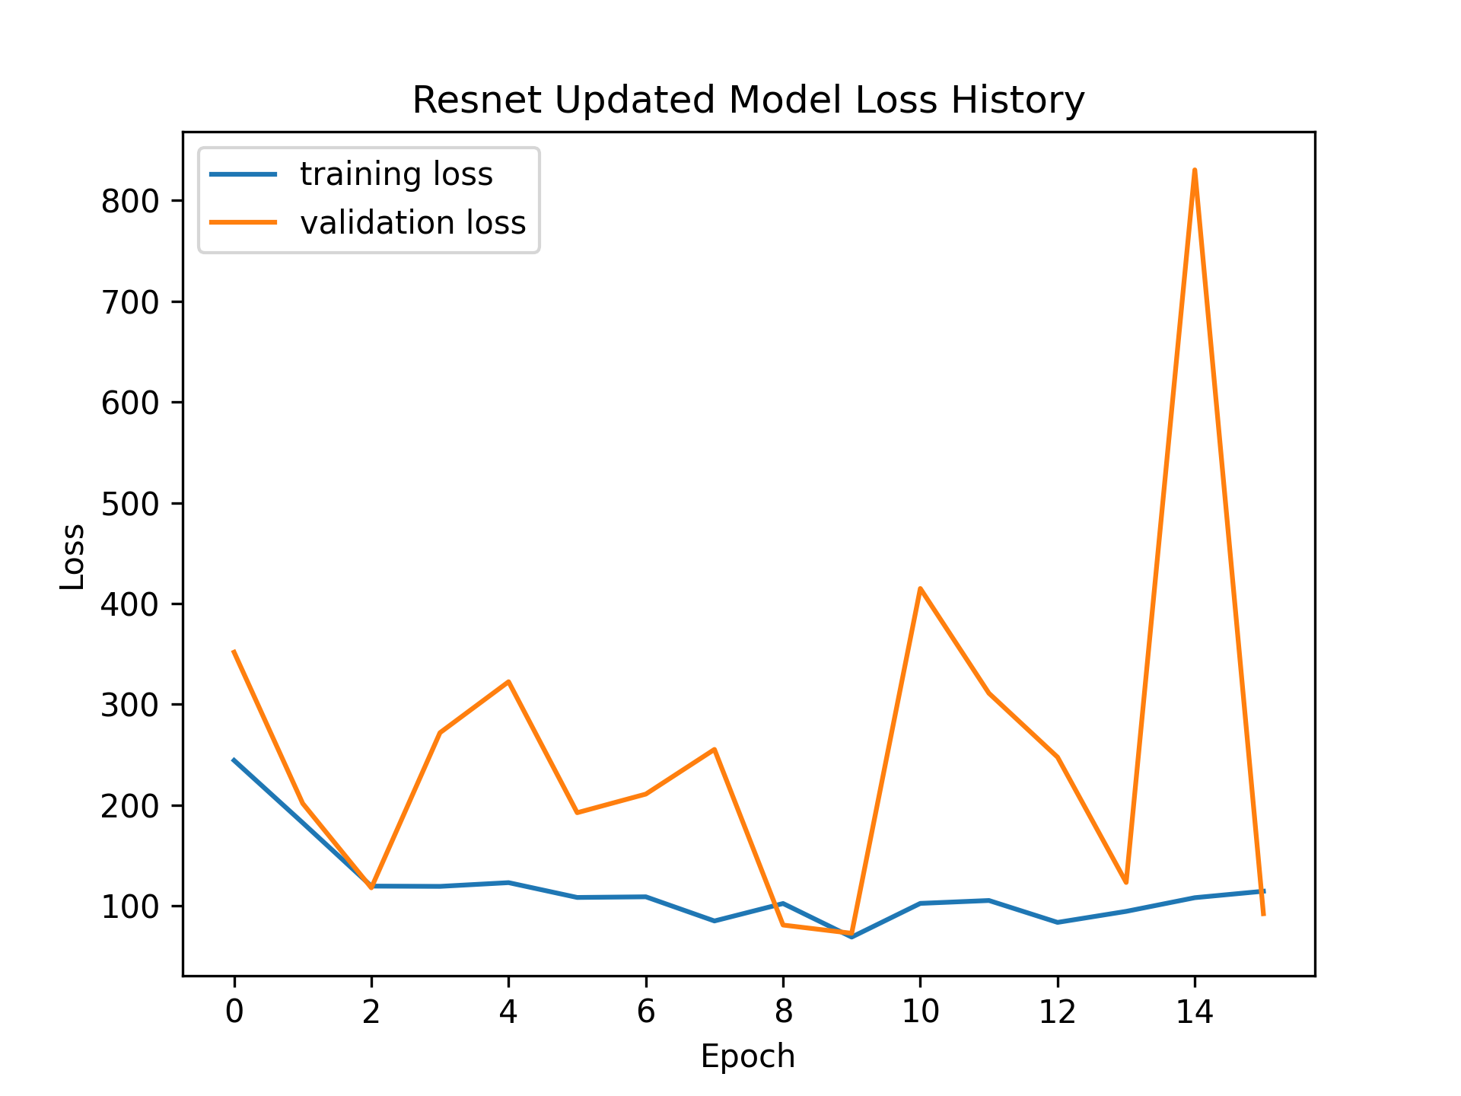
Qualitative Evaluation
Baseline and Updated ResNet Loss
dataset a
dataset c

Slide 15
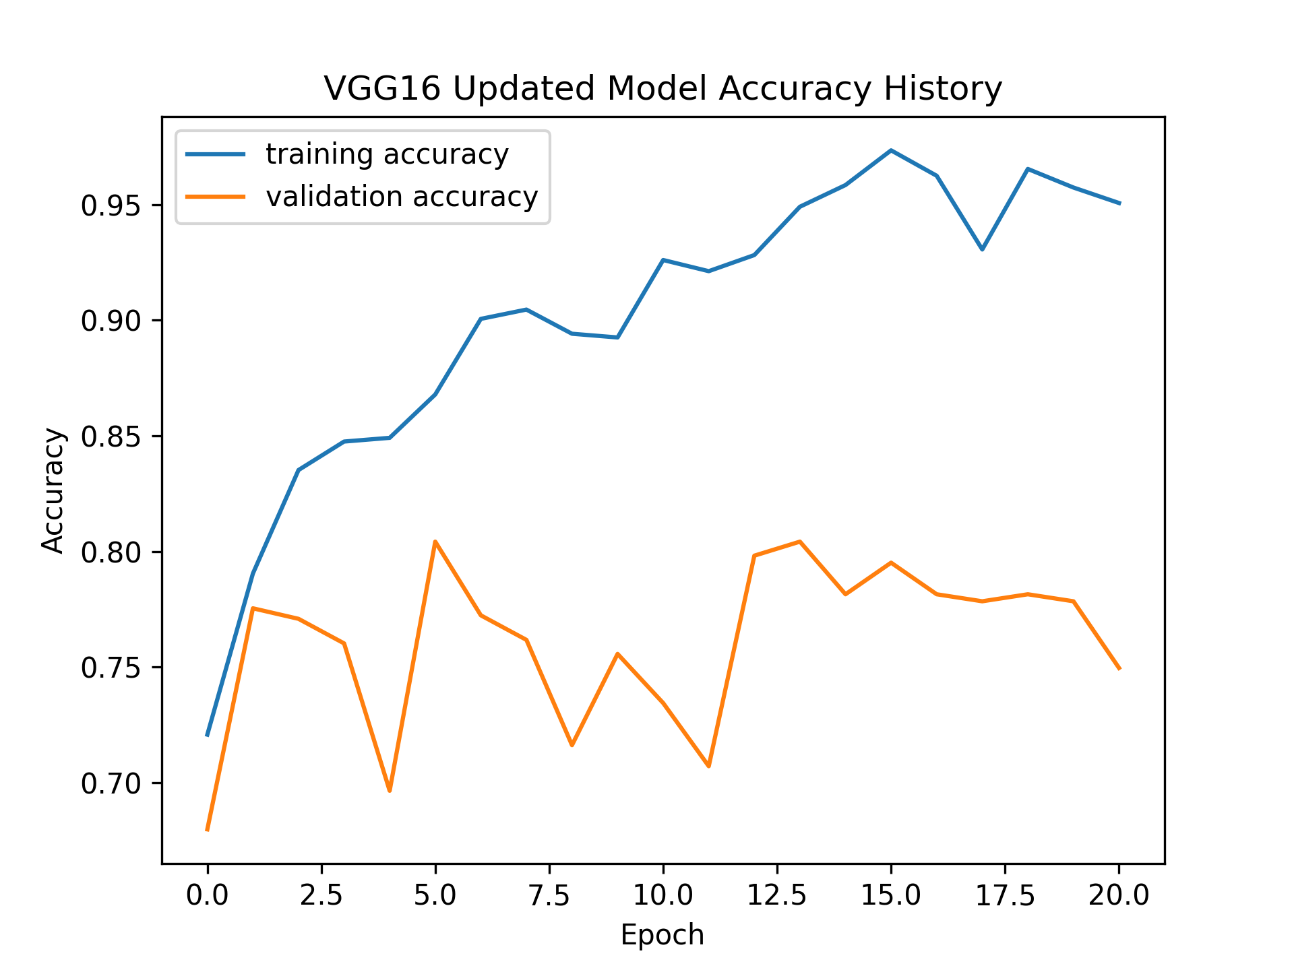
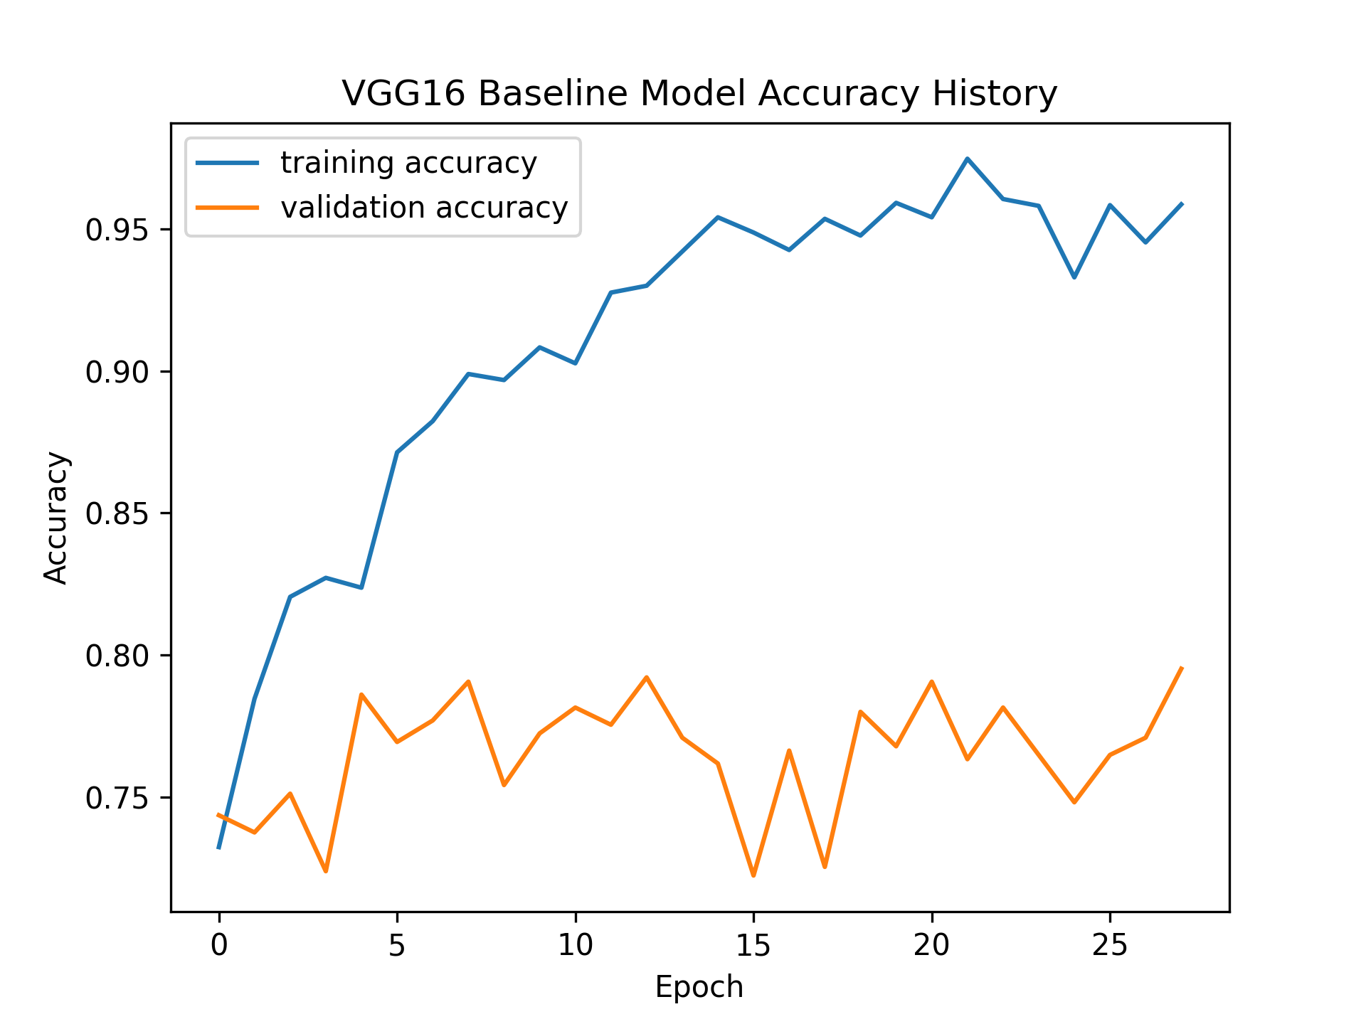
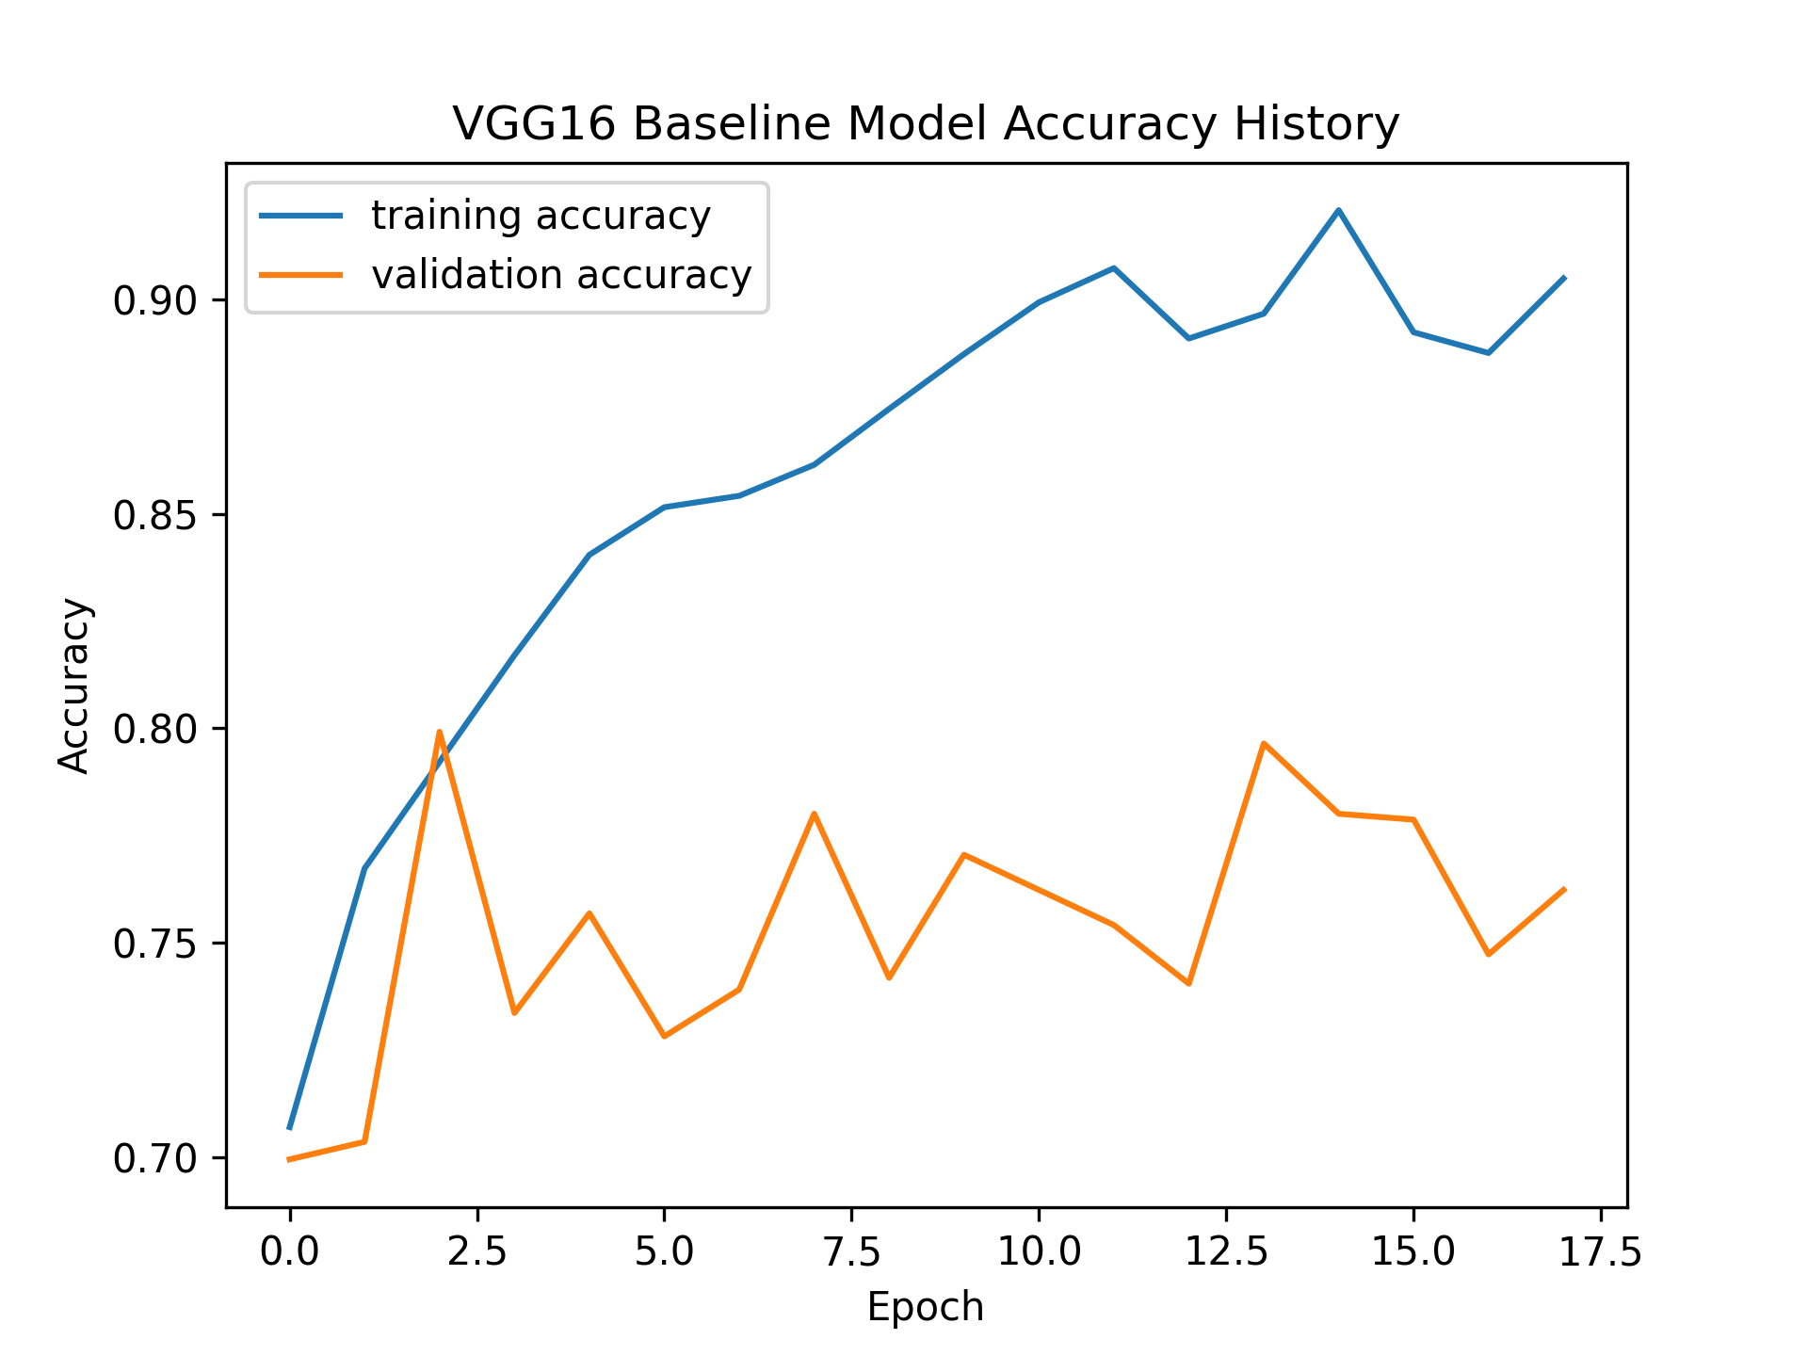
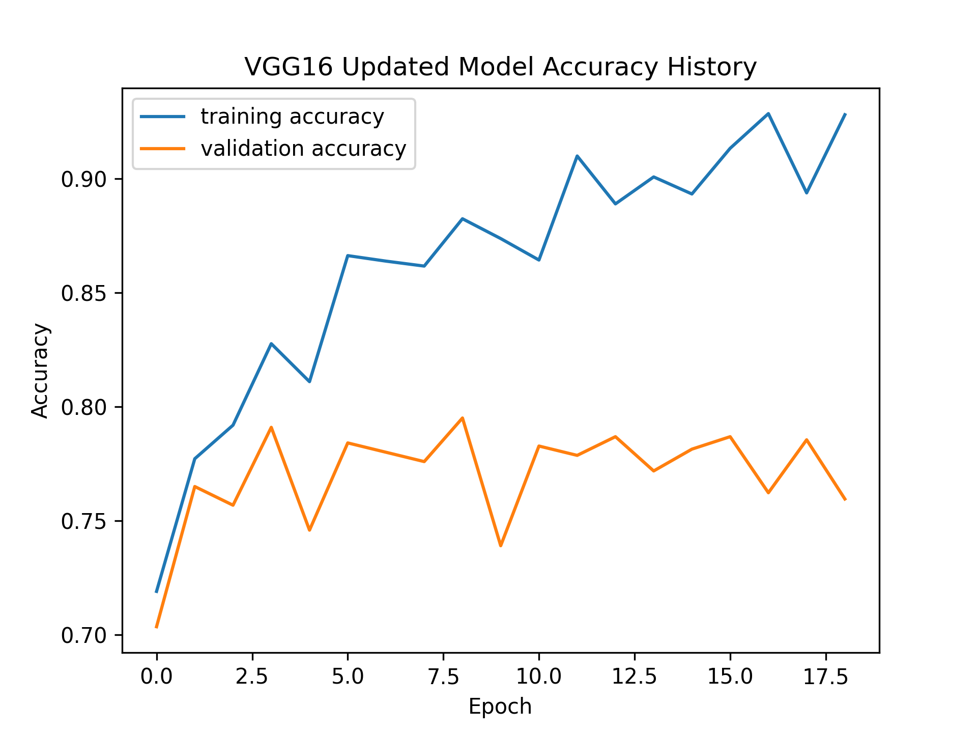
Qualitative Evaluation
Baseline and Updated VGG Accuracy
dataset a
dataset c

Slide 16
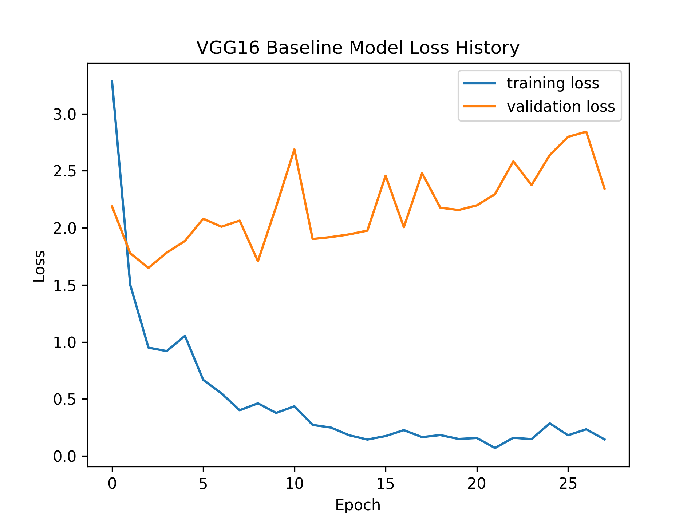
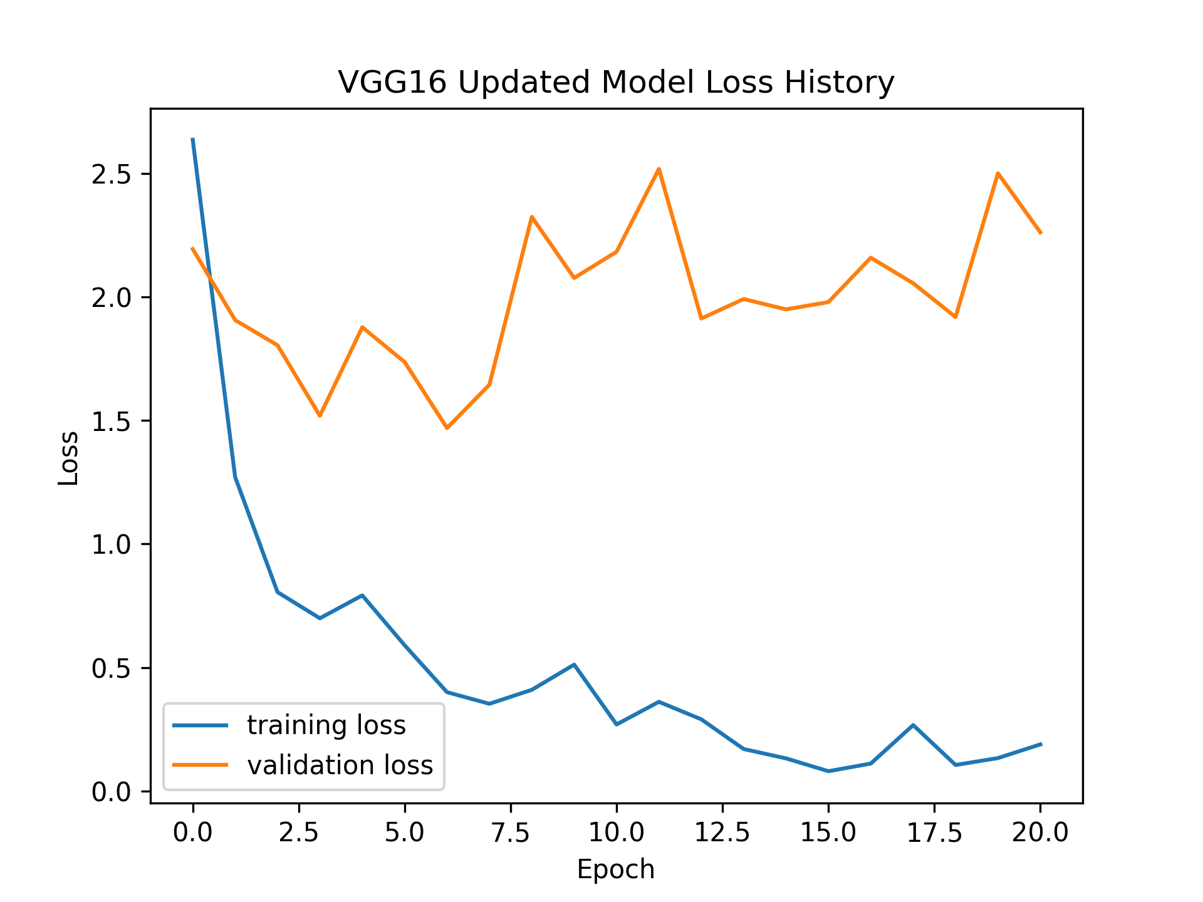
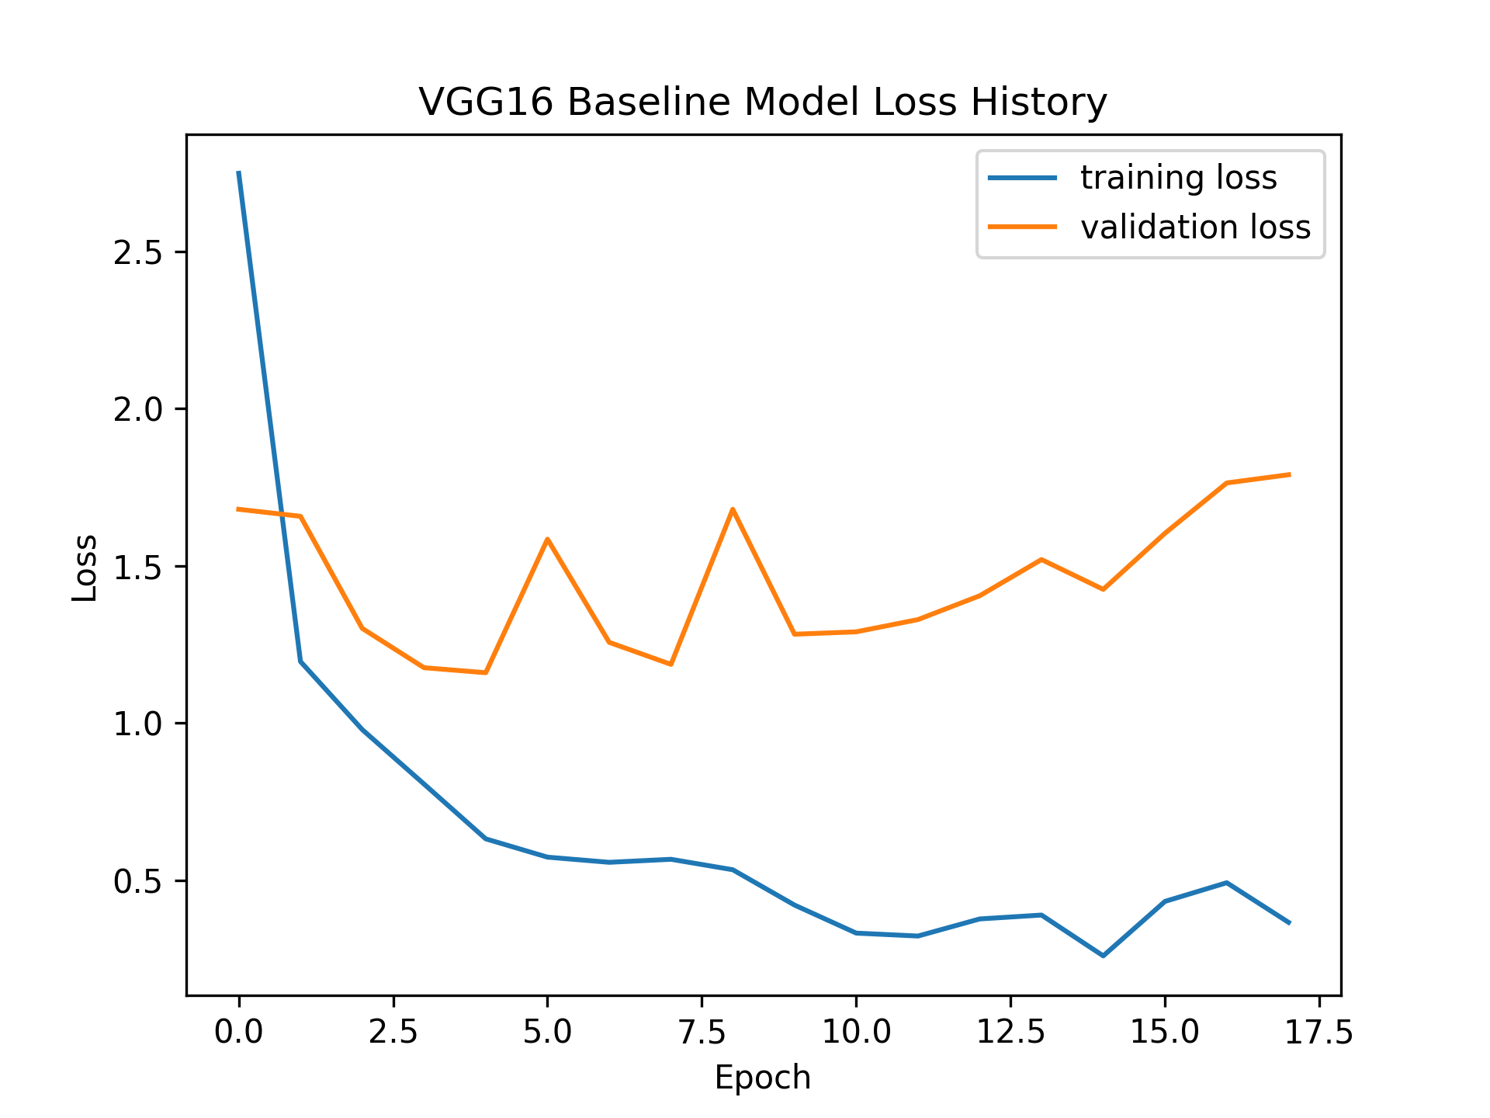
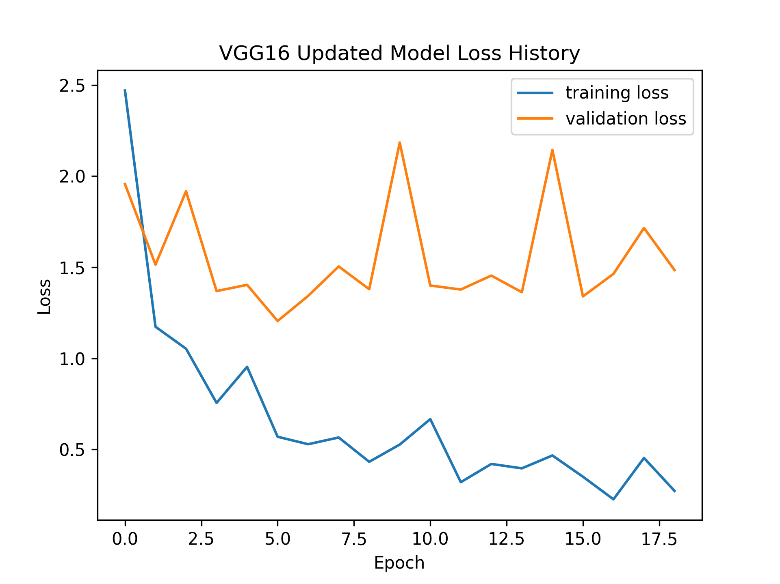
Qualitative Evaluation
Baseline and Updated VGG Loss dataset a
dataset a
dataset c

Slide 17
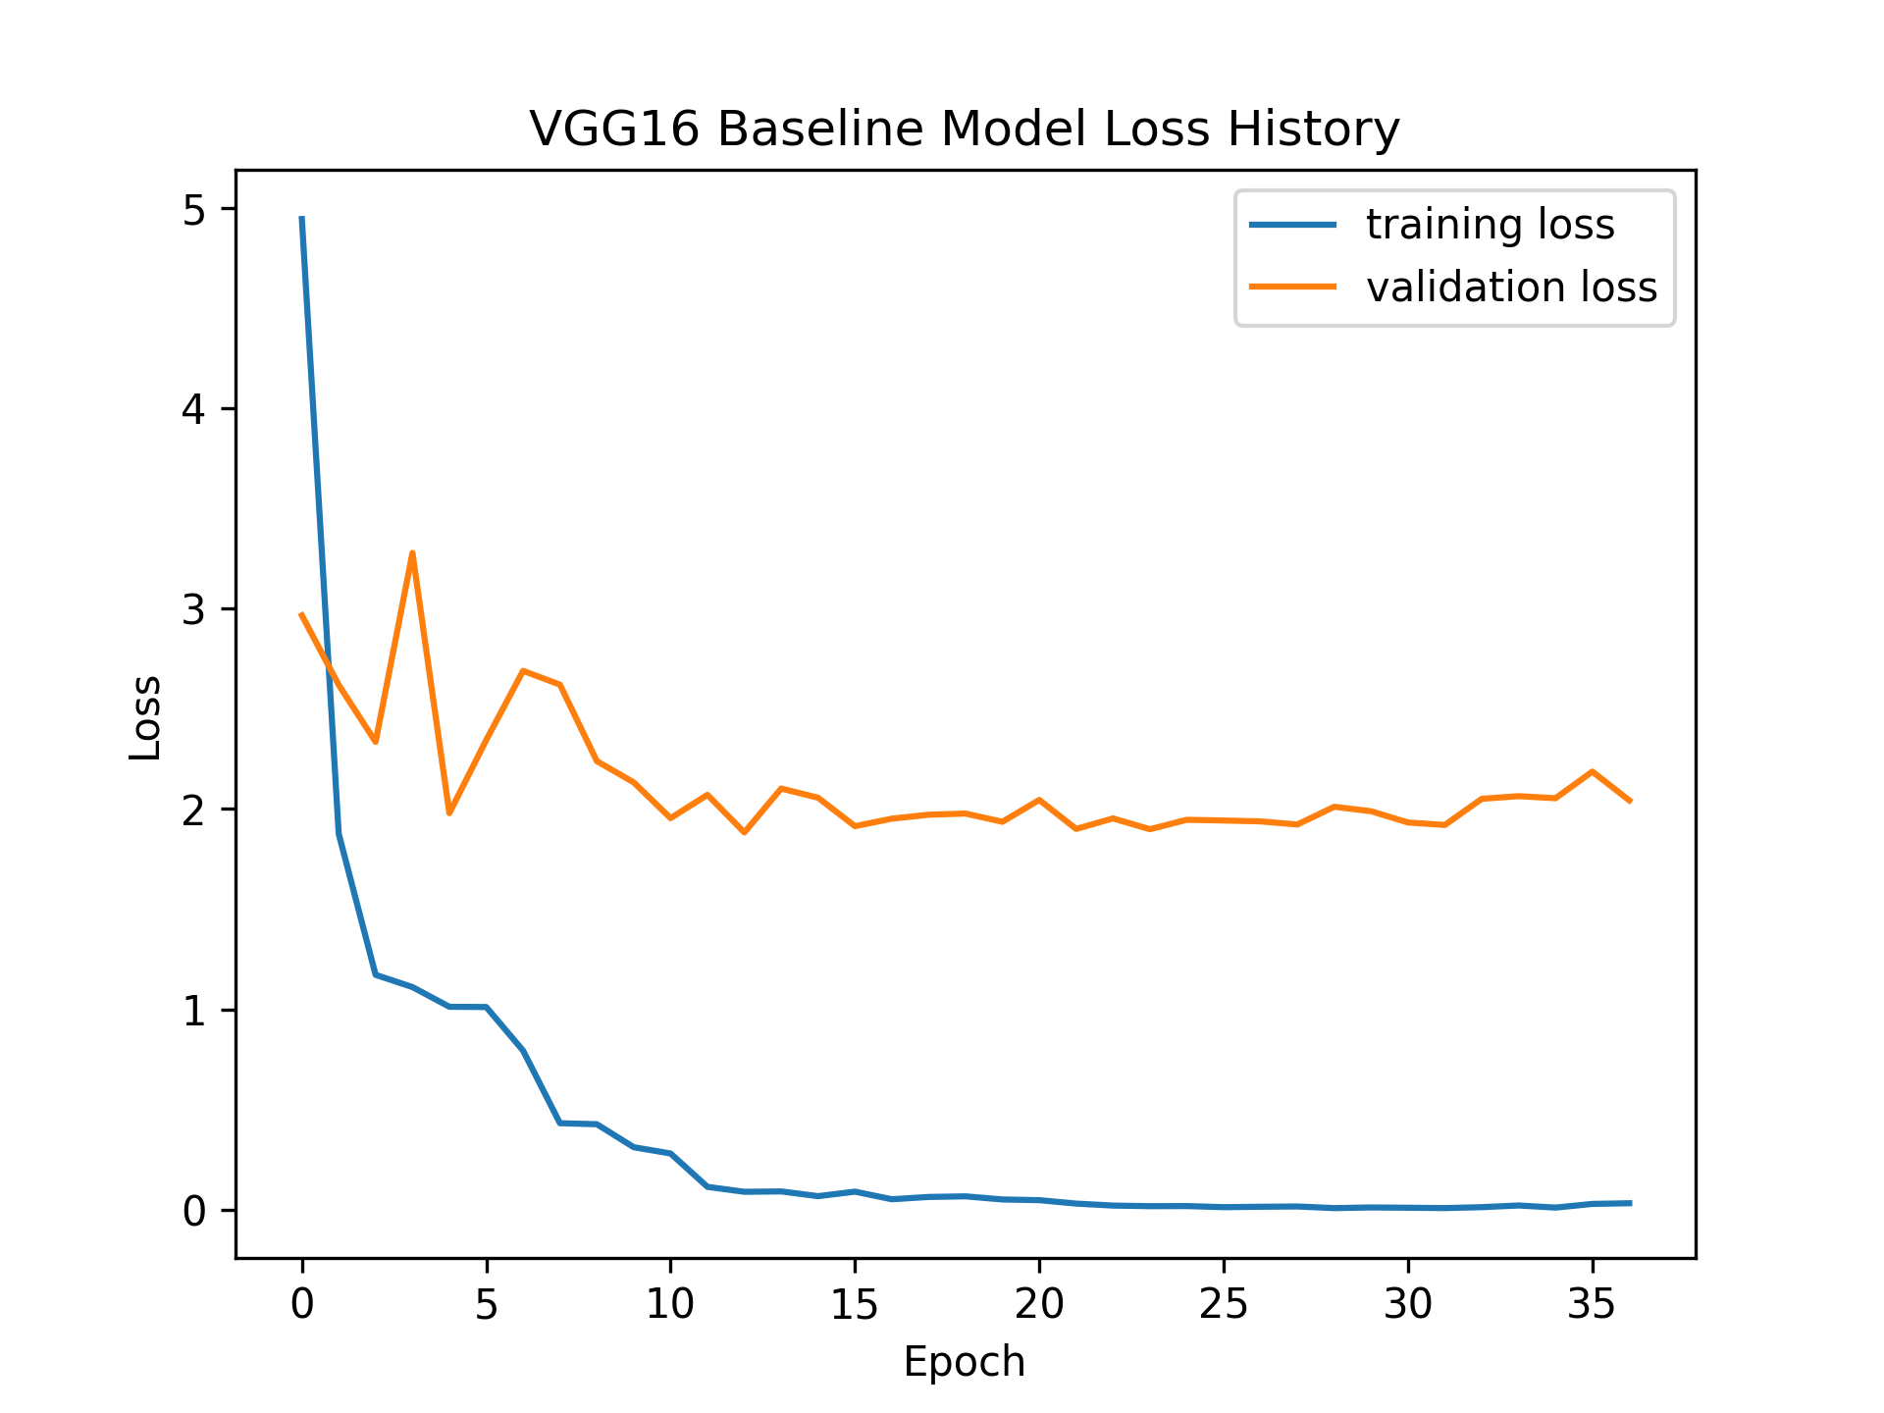
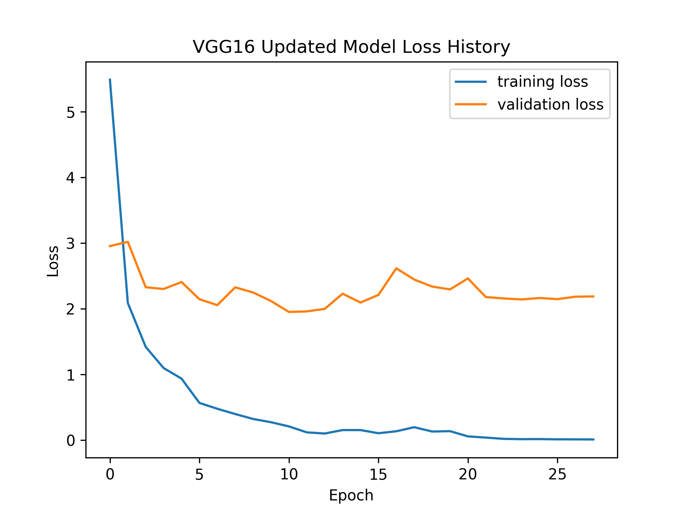
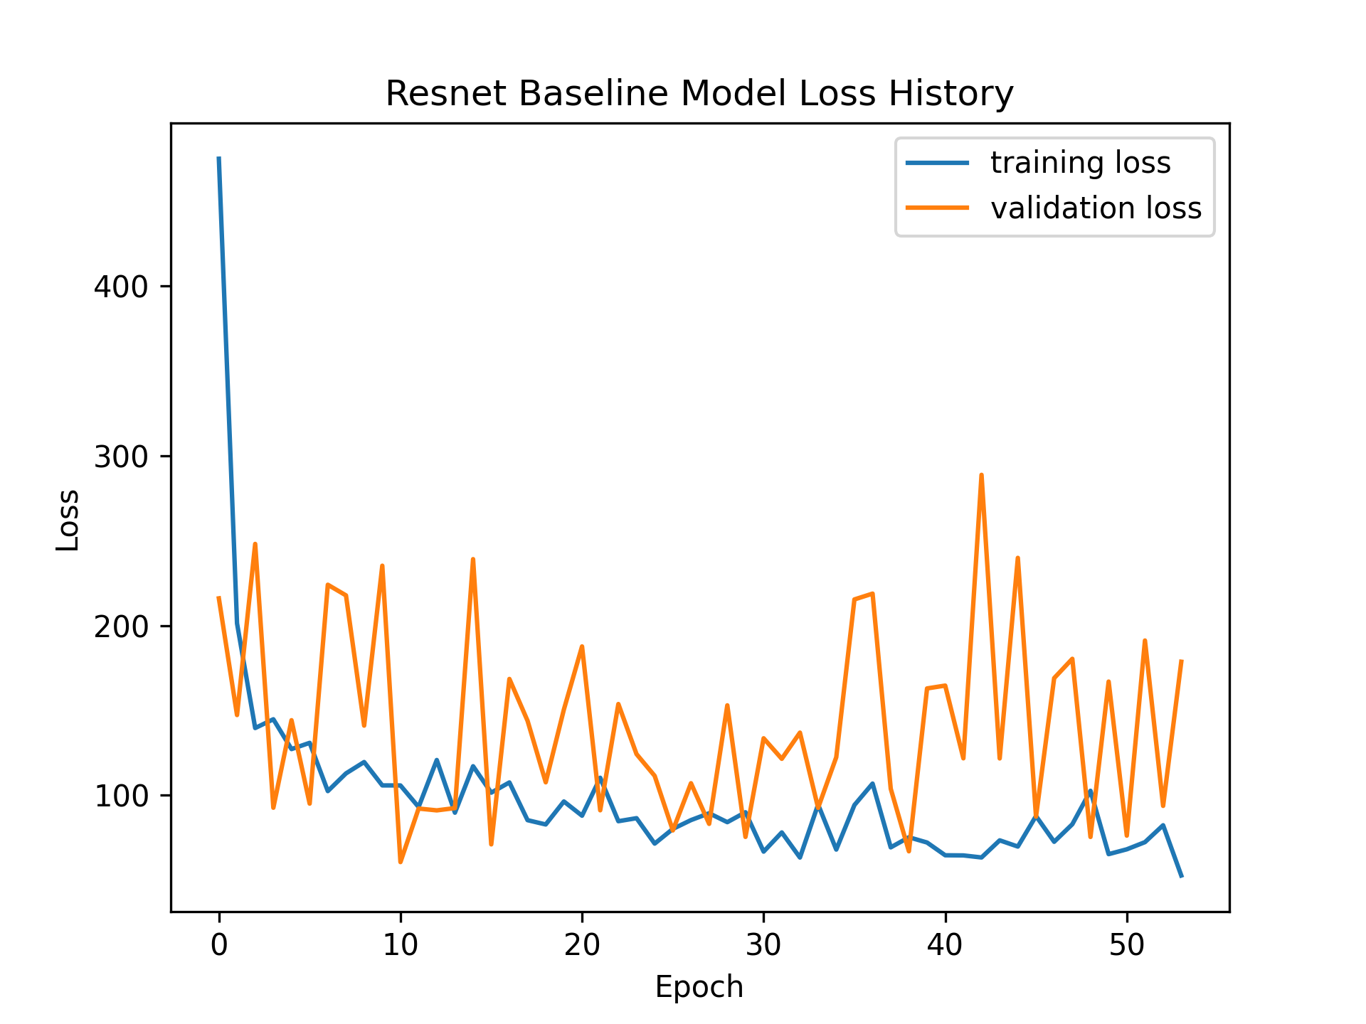
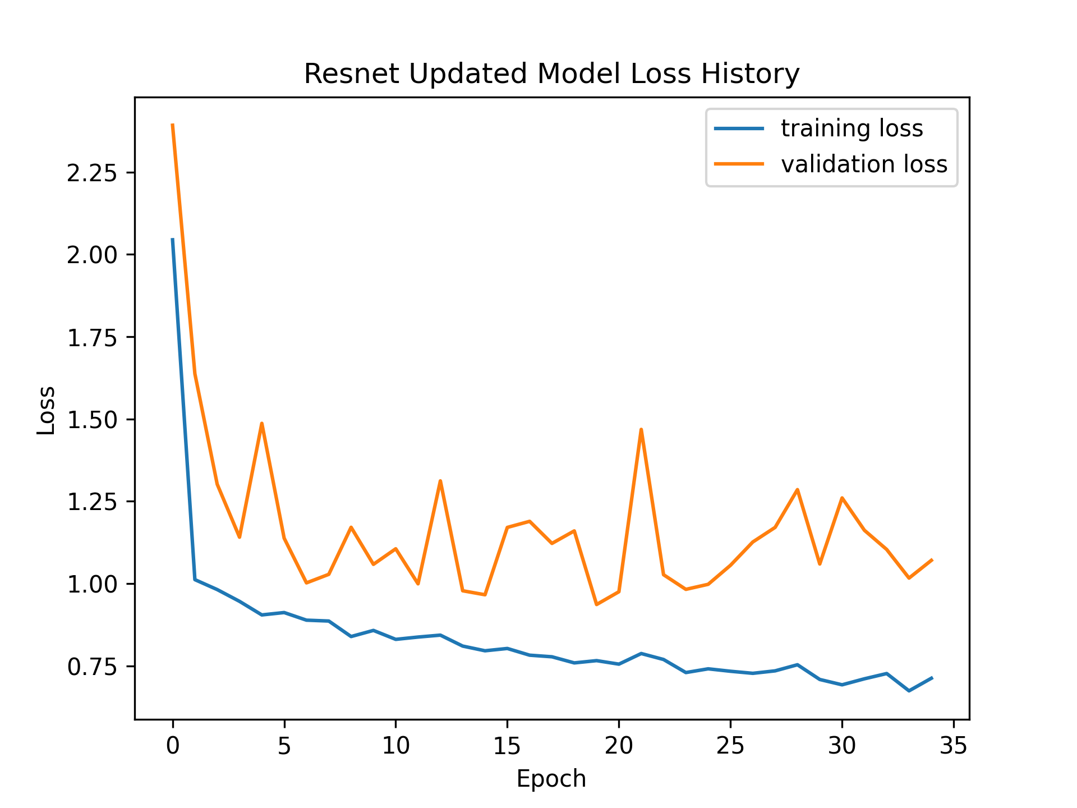
Qualitative Evaluation
ResNet and VGG Loss combined datasets

Slide 18
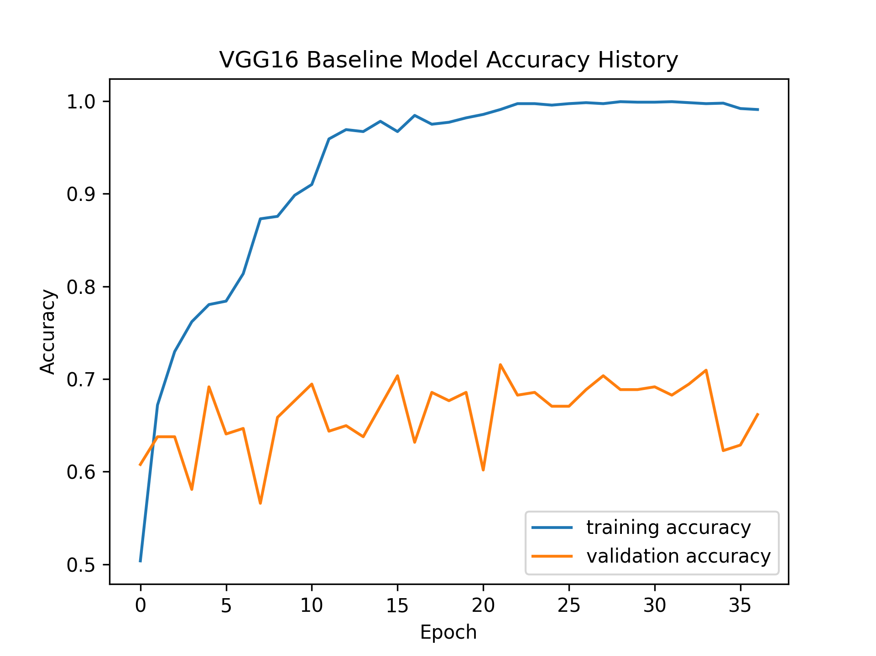
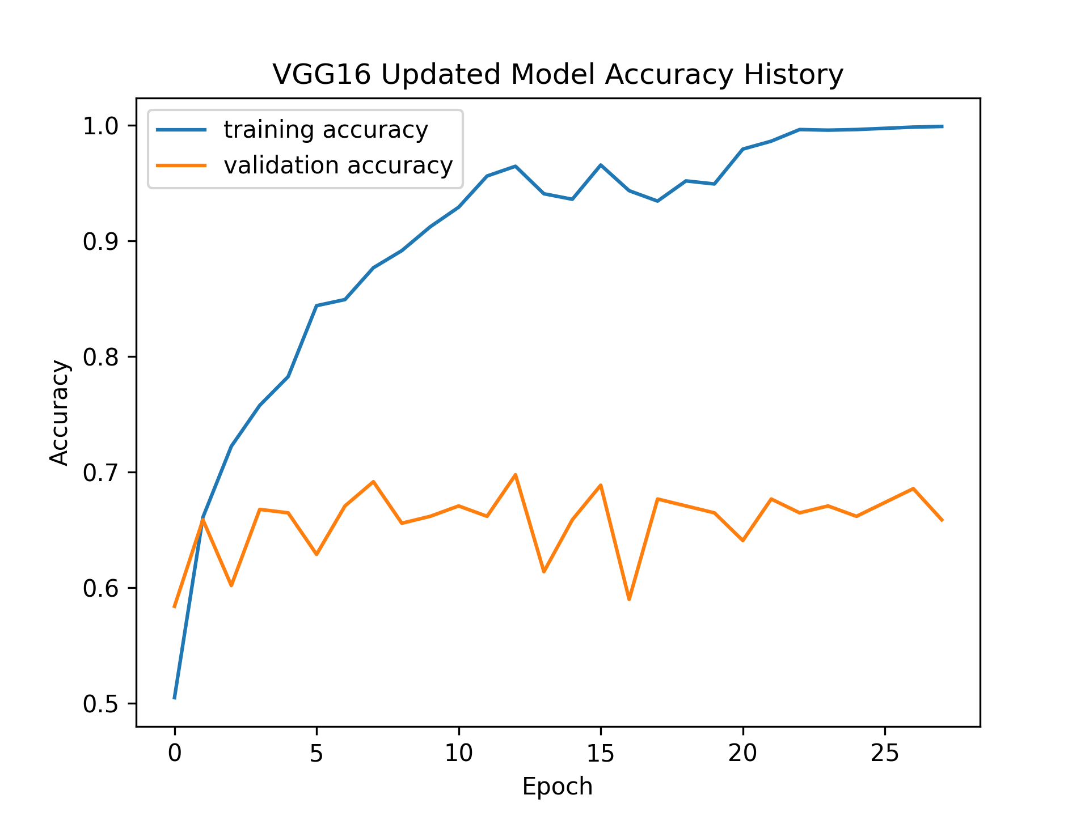
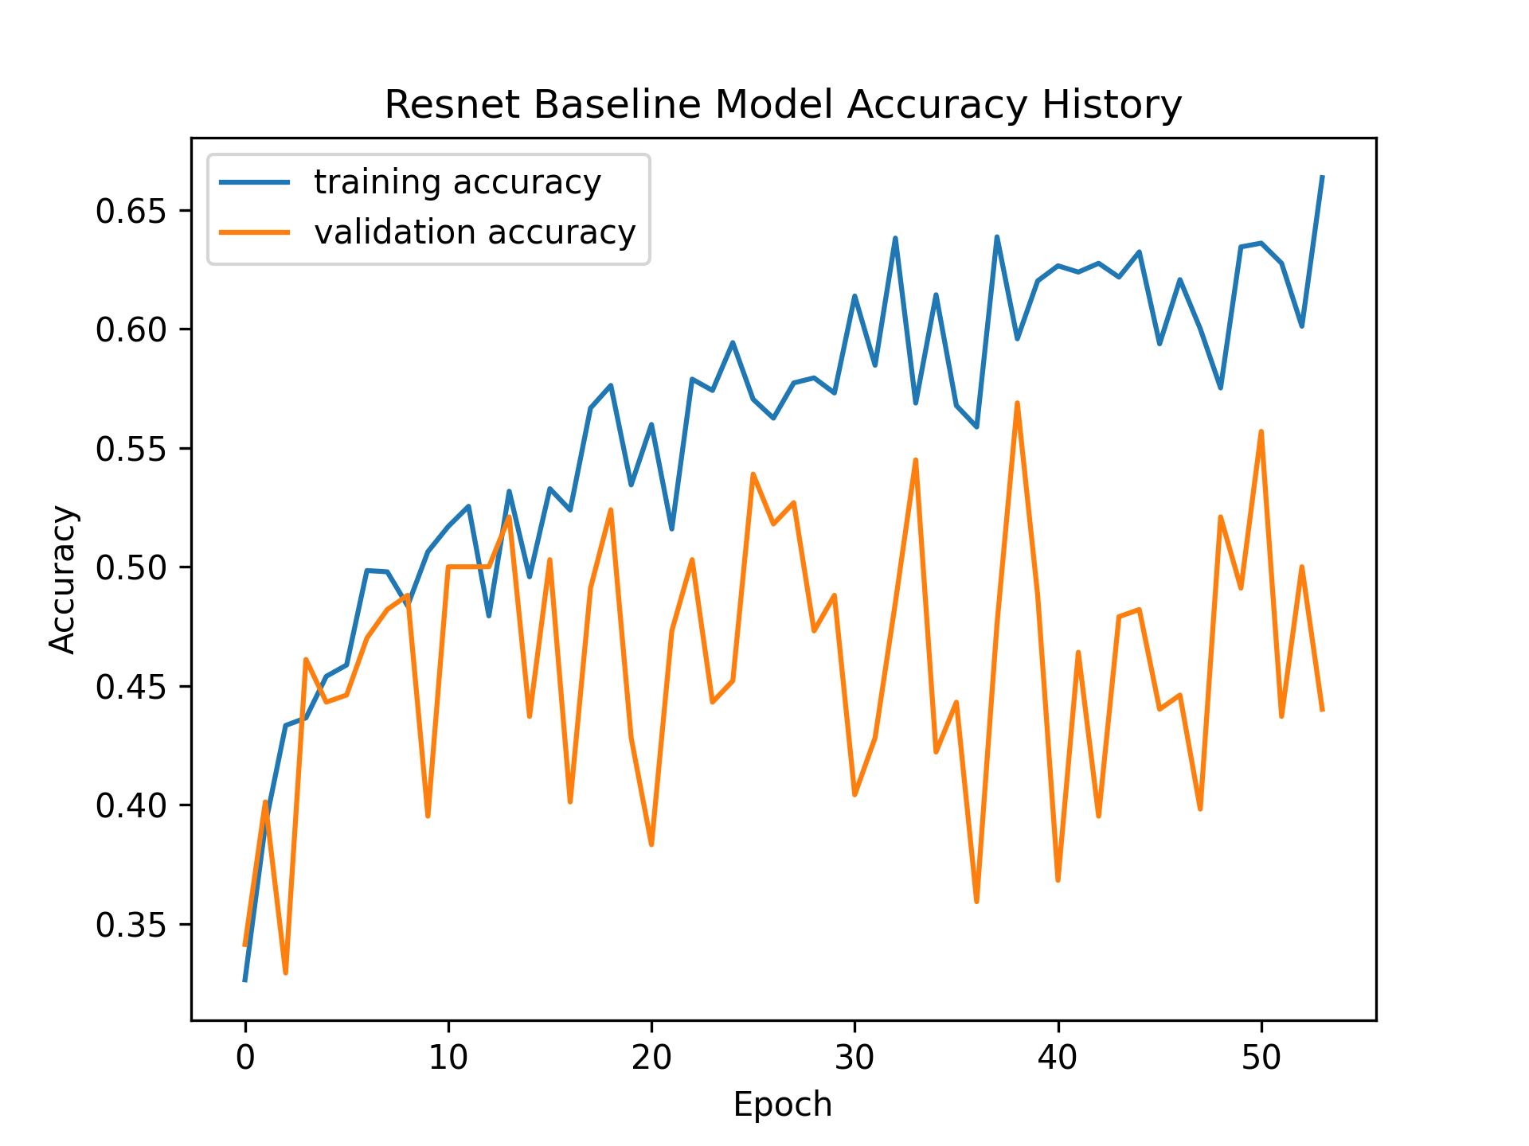
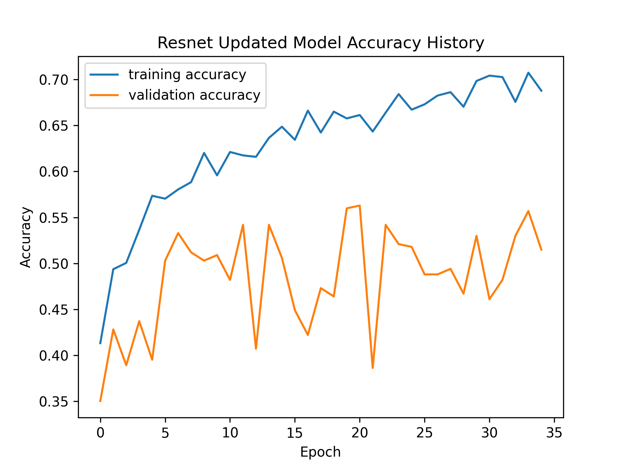
Qualitative Evaluation
ResNet and VGG Accuracies combined datasets

Slide 19
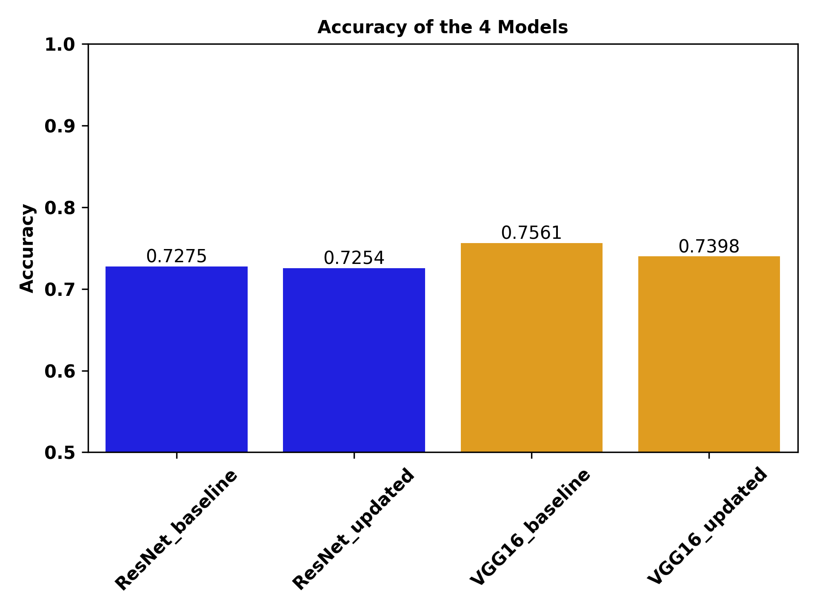
Accuracy Outcomes Dataset a
4879 samples
  440 heel strike
  608 toe off
  3831 other
PONKOJ

Slide 20
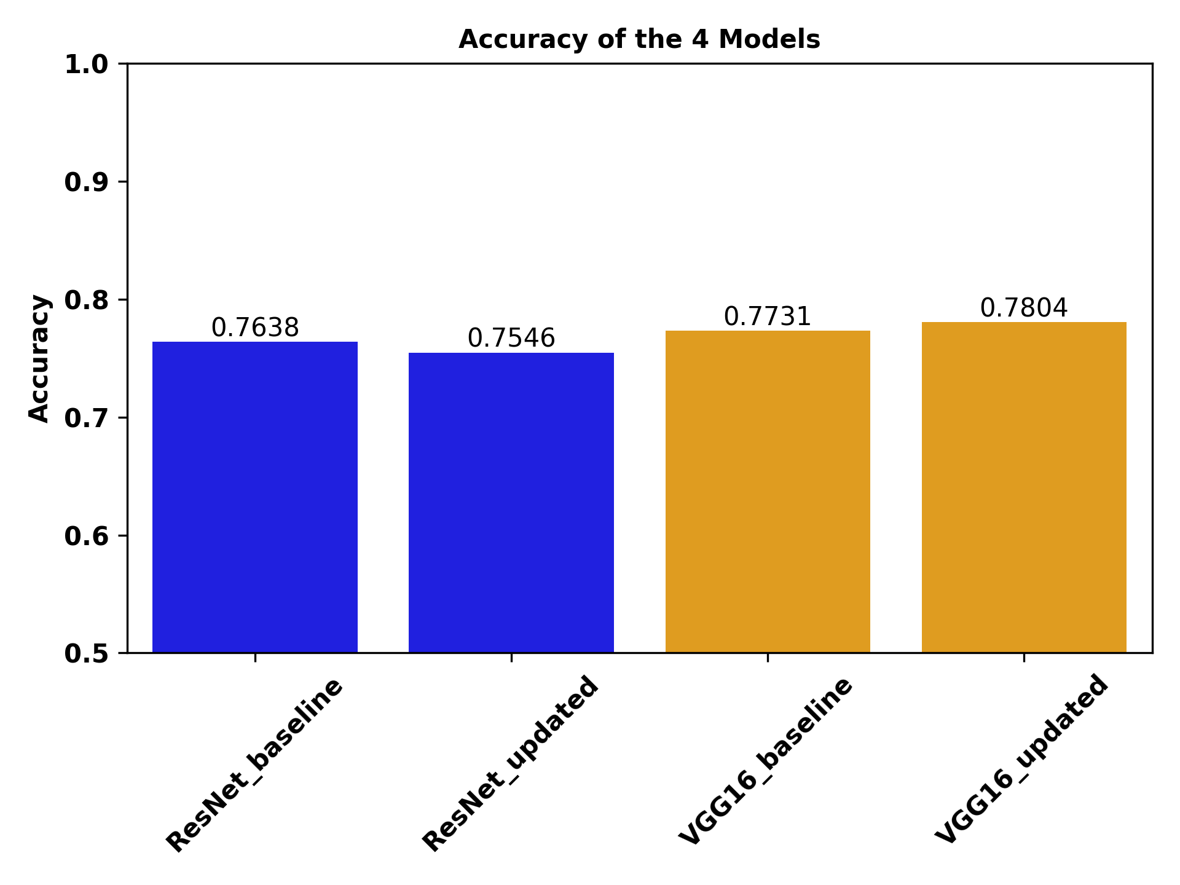
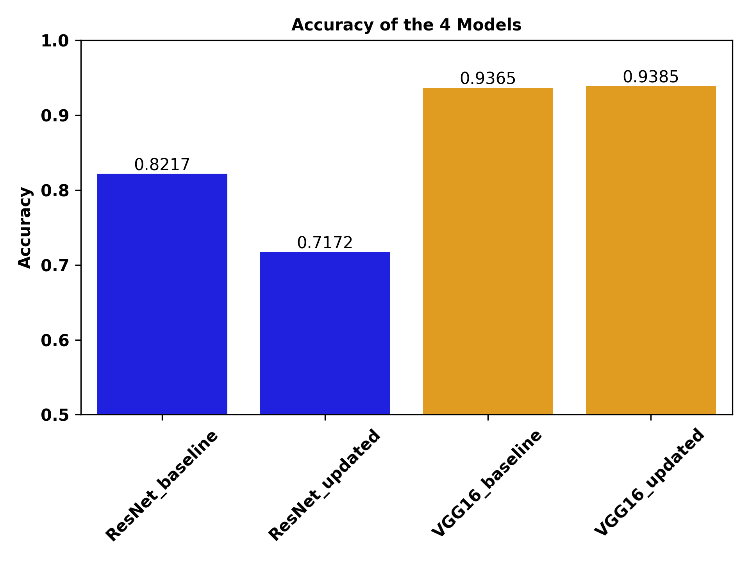
Accuracy Outcomes Dataset c
5417 samples
  440 heel strike
  844 toe off
  4133 other
PONKOJ

Slide 21
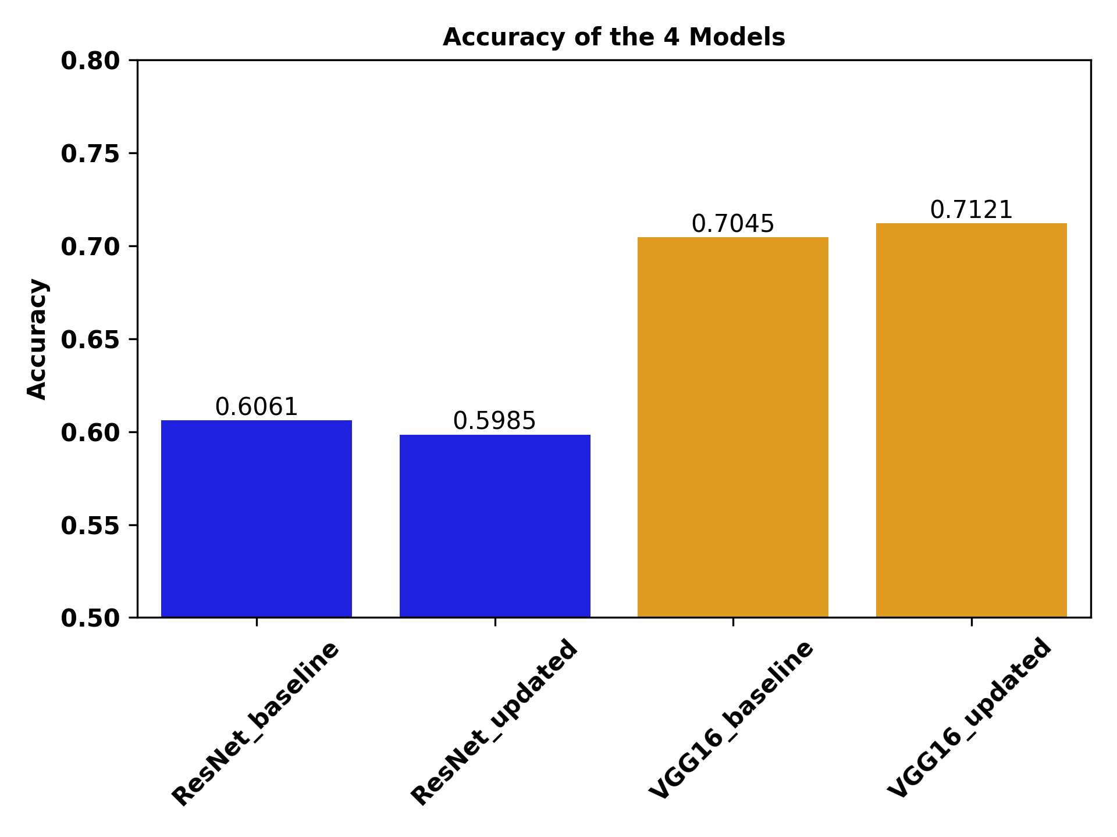
Accuracy Equal Samples between Classes
Dataset a
Equal sampling distribution

Slide 22
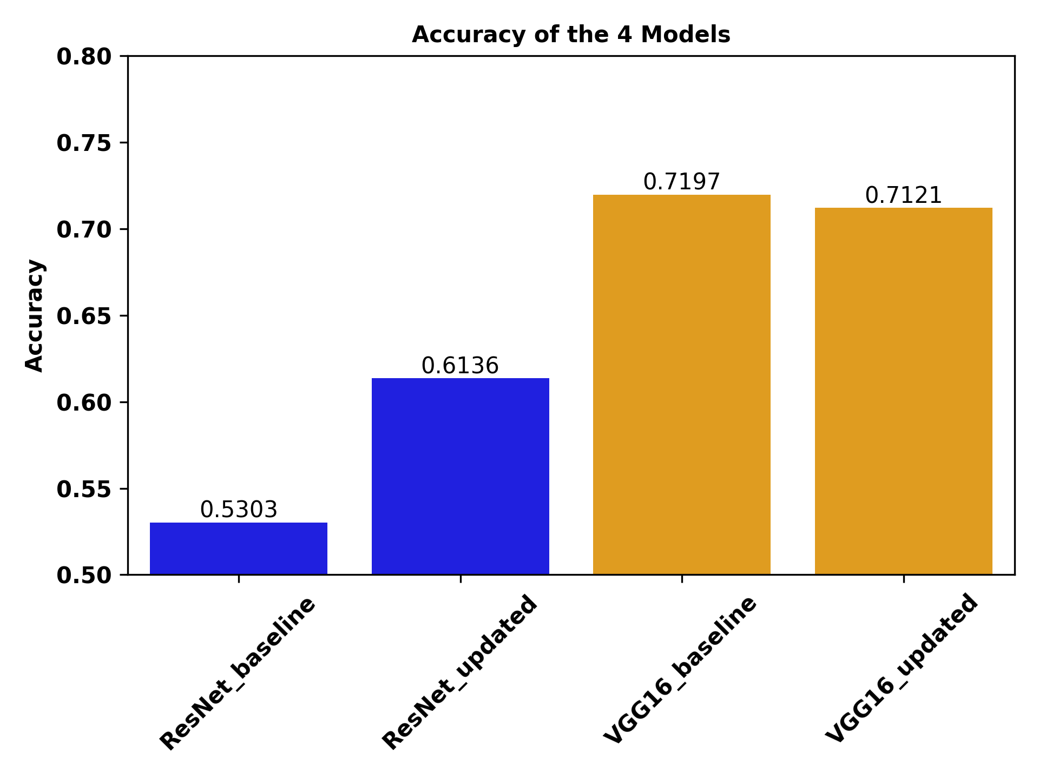
Accuracy Equal Samples between Classes
Dataset c
Equal sampling distribution

Slide 23
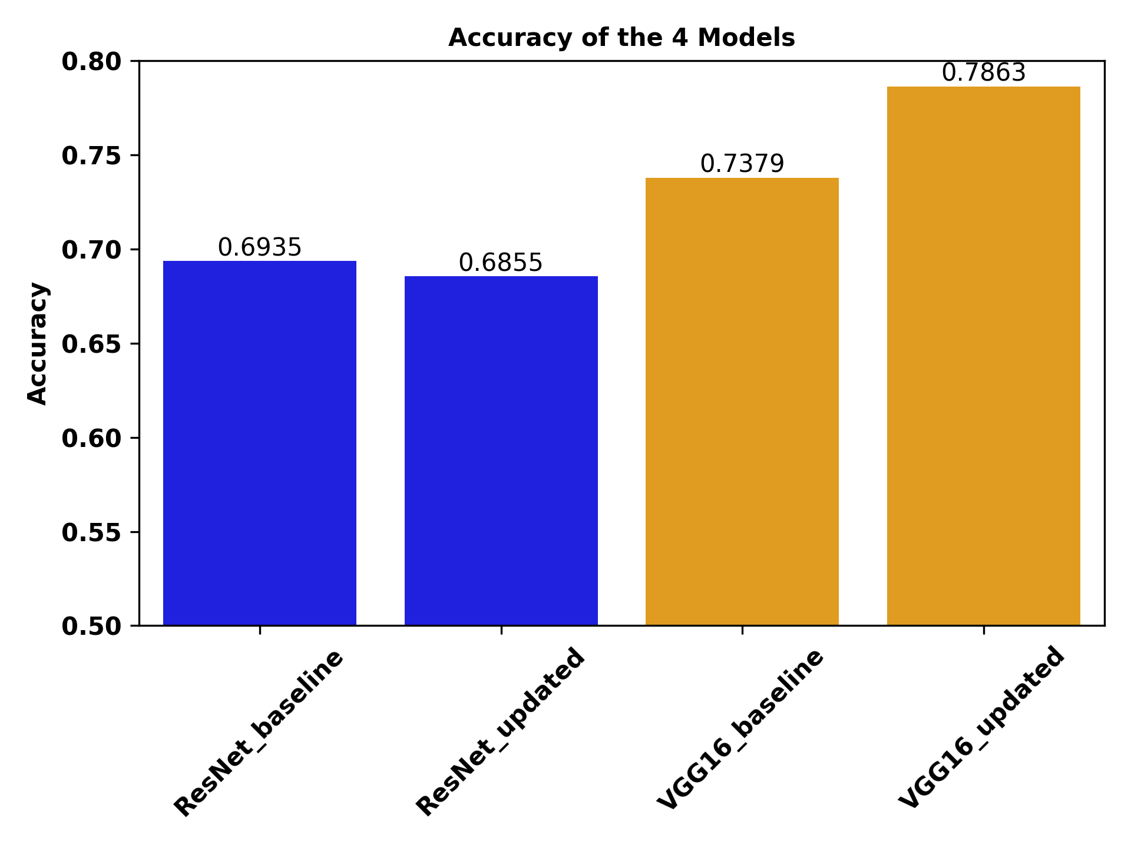
Accuracy Equal Samples between Classes
Combined Dataset a and c
Equal sampling distribution

Slide 24
Summary and Future Improvements
Novel in that we are the first to classify the phase of the human stride cycle
helpful for stride cycle timing analysis
  Do not need to use things like IMUs or motion capture
Data quality is an issue
Better datasets and more data
Only images from 90 degree view point
Standardized labeling

Slide 25

Questions/References
Bilal, Muhammad, Muazzam Maqsood, Sadaf Yasmin, Najam Ul Hasan, and Seungmin Rho. 2022. “A Transfer Learning-Based Efficient Spatiotemporal Human Action Recognition Framework for Long and Overlapping Action Classes.” The Journal of Supercomputing 78 (2): 2873–2908.
Iwashita, Yumi, Koji Uchino, and Ryo Kurazume. 2013. “Gait-Based Person Identification Robust to Changes in Appearance.” Sensors 13 (6): 7884–7901.
Mogan, Jashila Nair, Chin Poo Lee, Kian Ming Lim, and Kalaiarasi Sonai Muthu. 2022. “VGG16-MLP: Gait Recognition with Fine-Tuned VGG-16 and Multilayer Perceptron.” NATO Advanced Science Institutes Series E: Applied Sciences 12 (15): 7639.
Xu, Chi, Yasushi Makihara, Xiang Li, Yasushi Yagi, and Jianfeng Lu. 2020. “Gait Recognition from a Single Image Using a Phase-Aware Gait Cycle Reconstruction Network.” In Computer Vision – ECCV 2020, 386–403. Springer International Publishing.
Yao, Lingxiang, Worapan Kusakunniran, Qiang Wu, and Jian Zhang. 2021. “Gait Recognition Using a Few Gait Frames.” PeerJ. Computer Science 7 (March): e382.
other

