Slide 1

DAYANANDA SAGAR UNIVERSITY
SCHOOL OF ENGINEERING
Department of CSE
(ARTIFICIAL INTELLIGENCE AND MACHINE LEARNING)
SKIN CANCER DETECTION USING ARTIFICIAL INTELLIGENCE
Under the Supervision
Dr. Mude Nagarjuna Naik
Presented By :
Chilaka Sai Raghavendra(ENG22AM0085)
Avutala Dhruvish Reddy(ENG22AM0078)
Venkata Durga Sai D(ENG22AM0067)
Nallamalli Venkata Kushal(ENG22AM0116)

Slide 2
Abstract
Problem Statement
Introduction
Overview
Social/Environmental Impact
State of the Art work(Literature Review)
Design Workflow
Implementation
References

Slide 3
ABSTRACT
Why this﻿ work: Telling melanoma apart from common moles can be tricky for doctors, delaying early detection.
What we plan to do: Develop a deep learning algorithm to analyze skin lesions.
Approach: Train on dermoscopic images to identify features that differentiate melanoma from benign nevi and seborrheic keratoses.
Expected Outcome: AI tool to potentially improve accuracy and efficiency in melanoma detection.

Slide 4
Problem Statement
Dermatologists face the challenge of accurately differentiating malignant melanoma from benign moles (nevi) and seborrheic keratoses during skin examinations.
This uncertainty can lead to delayed diagnoses of melanoma, a potentially deadly form of skin cancer.
EXAMPLE:
Problem: A patient notices a suspicious mole on their arm. They're unsure if it's a harmless freckle or potentially cancerous melanoma.
Solution: AI analysis of close-up photos can quickly flag suspicious lesions, potentially leading to earlier melanoma detection and better patient outcomes.

Slide 5
Introduction
Melanoma: Deadliest form of skin cancer requiring early detection for successful treatment.
Melanoma ranked 32nd spot in India as per yearly incidence and recorded 3,916 cases (0.3% of all cases) as per GLOBOCAN 2020 data
This project aims to develop a foundational step towards an AI tool for dermatologists.
We will design a deep learning algorithm to visually analyze skin lesions, focusing on differentiating malignant melanoma from two common benign look-alikes: moles (nevi) and seborrheic keratoses.
Assumption: Access to a substantial dataset of dermoscopic images for training the AI algorithm.

Slide 6
Social Impact
Improved Public Health: Early and accurate melanoma detection can potentially save lives by enabling timely treatment.
Reduced healthcare costs: Early melanoma detection through AI can potentially reduce overall healthcare costs by minimizing unnecessary biopsies and catching cancers at a more treatable stage.
Empowering patients: AI tools can empower patients to take charge of their skin health by enabling them to monitor suspicious lesions at home and prompting them to seek professional evaluation when needed
Standardization of Diagnosis: AI analysis might help standardize melanoma diagnoses across healthcare settings, reducing inconsistencies and potentially improving overall accuracy.

Slide 7
STATE OF THE ART-WORK
Paper Title and Author Name | Conference /Journal Name and year | Technology used | Results | What you infer
1.Automatic Imaging System With Decision Support for Inspection of Pigmented Skin Lesions and Melanoma Diagnosis
” IEEE by Jose Fernandez Alcon, Calina Ciuhu
IEEE Journal of Selected Topics in Signal Processing, 2009
Combining the outcome of the image classification with context knowledge
The segmentation results were validated against manual and gave higher Accuracy
we understood how exactly datasets classify the inputs and result in higher accuracy
2.Learning openCV, O’Reilly Media by G.Bradski and A.Kaehler
2008
OpenCV and Python Language
Proficiency in using OpenCV
we understood the OpenCV library
3. Early diagnosis of skin cancer based on segmentation and measurement of vascularization and pigmentation in Nevoscope images, by G. Zouridakis, M.Doshi, N. Mullani
International Conference of the IEEE Engineerning in Medicine and Biology,2004
Using huge datasets for classifying Melonoma
Estimation of the personal risk of melanoma
Classification of Melanoma and Common Skin Lesions

Slide 8
Design Workflow
Dataset
preprocessing data
Building Model
Compiling Model
Training
Validation
Training Accuracy
Validation Accuracy

Slide 9
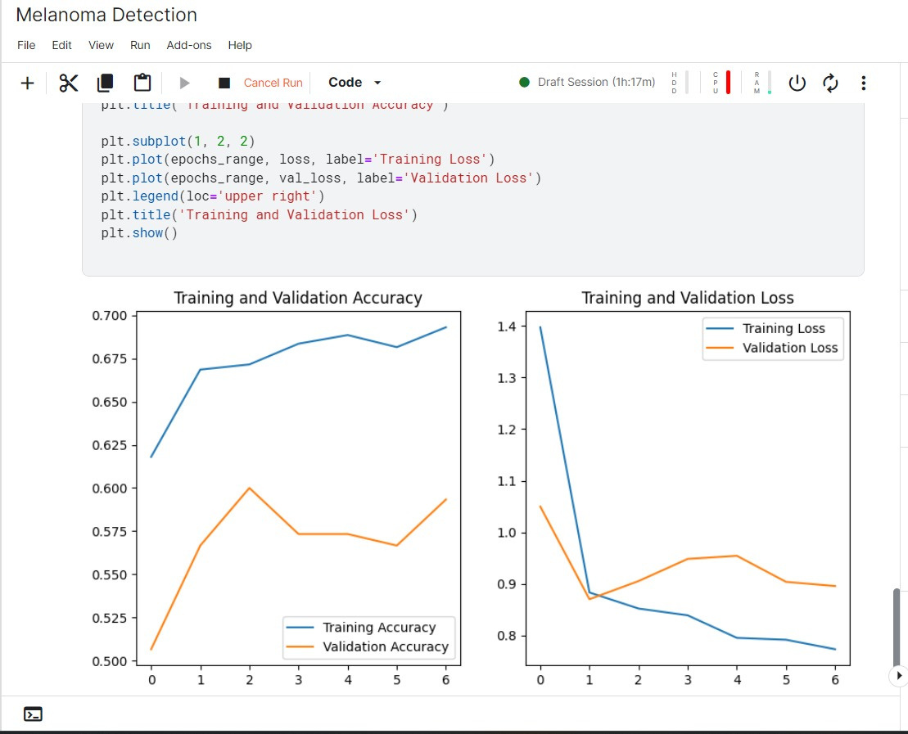
Previous Training and Validation graphs

Slide 10
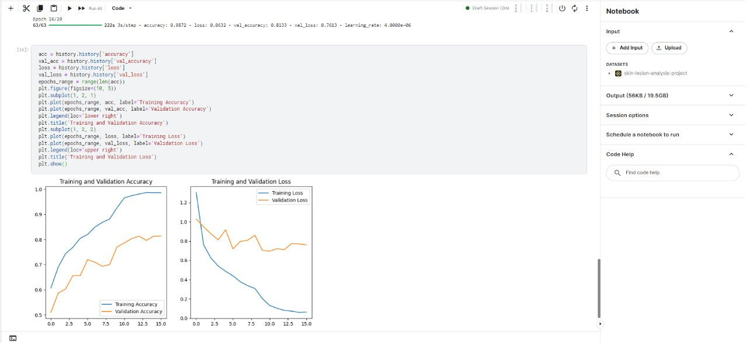
Current Training and Validation graphs

Slide 11
References
SJ Merrill, M Subramanian and DE Godar, "Worldwide cutaneous malignant melanoma incidences analyzed by sex age and skin type over time (1955–2007): is HPV infection of androgenic hair follicular melanocytes a risk factor for developing melanoma exclusively in people of Europeanancestry?", Dermatoendocrinol, vol. 8, pp. e1215391, 2016.
A Wainstein, SM Algarra, L Bastholt, G Cinat, L Demidov, JJ Grob et al., "Melanoma early detection and awareness: how countries developing melanoma awareness programs could benefit from melanoma-proficient countries", Am J Ther, vol. 22, pp. 37-43, 2015.
L Ferrándiz, T Ojeda-Vila, A Corrales et al., "Internet-Based skin cancer screening using clinical images alone or in conjunction with dermoscopic images: a randomized teledermoscopy trial", J Am Acad Dermatol, vol. 76, pp. 676-82, 2017.
Shubhangi Solanki, Uday Pratap Singh, Siddharth Singh Chouhan, “Brain Tumor Detection and Classification Using Inteeligence Techniques: An Overview”, vol. 11, pp. 12870-12886, 2023

Slide 12
THANK YOU

