Slide 1
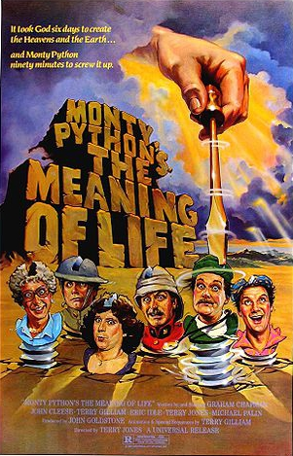
Introduction to Python
Origins
Nature of Python
Importance of Python
Example

Slide 2

What is Python?
Invented by Guido van Rossum in late 1980s in Netherlands.
General purpose, high level language intended to be straightforward to read and write.
Supports OOP, imperative and functional programming.
Dynamic type system and automatic memory management
Has large, comprehensive standard library
Python is interpreted
  Can type a little instruction and process it immediately at the command (or shell) prompt

Slide 3
History
Early Python – descendant of ABC that would appeal to UNIX/C programmers
Python 2.0 released in 2000 had major new features
  Garbage collector
  Support for Unicode
Python 3.0 – major, backwards-incompatible release in 2008
Now Python – many major features have been backported to the backwards compatible 2.6 and 2.7

Slide 4
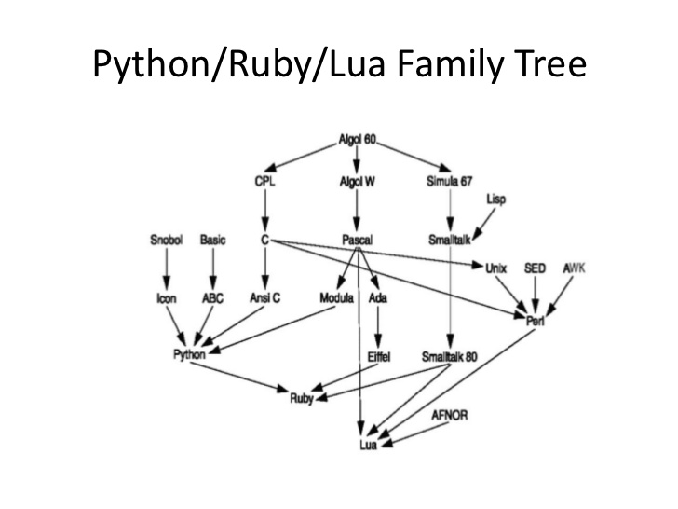

Slide 5
Language and Programs
Simple language
  a beginner can write small useful programs (unlike Perl – only one way to do things)
  Sparser, less-cluttered grammar
Extensible language
  focuses on mechanisms to extend the programming language, compiler and runtime environment
  Over 65K packages
    GUIs, web frameworks, multimedia, DBS, networking, test frameworks, system admin, scientific computing, text processing and image processing, etc.

Slide 6
Central Characteristics
Environment variables - defined by language implementation, not defined by user, but accessible
Program variables are implicitly declared
  type is inferred by compiler based on name syntax or content
  Starts with letter and followed by letters, numbers or _
Numeric types- int, long, float and complex, Booleans are a subtype of int
str– popular type in Python, easily converts to/from float
float (‘3.14’) → 3.14 and str(3.14) → ‘3.14’

Slide 7
A first Script
>>> print 'Hello world!'
Hello world!

Slide 8
A Second Script
>>> x = 6
>>> print x
6
>>> y = x * 7
>>> print y
42
>>>

Slide 9
Programs
Typing commands into the Python interpreter is great way to experiment, but not recommended for solving complex problems
Use a text editor to write Python instructions and save to a file.
Convention is to use the extension .py
To execute, at the command prompt your can view and run the program.

Slide 10
Example
csev$ cat hello.py
print ('Hello world!’)
csev$ python hello.py
Hello world!
csev$

Slide 11
Another example
name = input('Enter file:')
handle = open(name, 'r')
text = handle.read()
words = text.split()
counts = dict()
for word in words:
counts[word] = counts.get(word,0) + 1
bigcount = None
bigword = None
for word,count in counts.items():
if bigcount is None or count > bigcount:
bigword = word
bigcount = count
print (bigword, bigcount)

Slide 12
Getting Python
https://www.continuum.io/downloads
http://docs.continuum.io/anaconda/install
http://docs.continuum.io/anaconda/index

Slide 13
Learning Resources
Python wiki (home page) Python is a interpretive programming language that is about as easy to learn as any. It is heavily used by computer scientist as well as researchers in the other STEM areas. Biology, Physics and Engineering are popular areas where this is applied.
PythonLearn Tutorial (includes videos, powerpoints etc)
Book:Python for Informatics by Charles Severance.
Book:Think Python by Allen Downey
Python Tutorial by UDEMY
Python Lectures by Pattis (These are really a nice collection of lectures that are worth reading)
Python is in Visual Studio 2013. You can use Ubuntu (see ubuntu notes)

