Slide 1
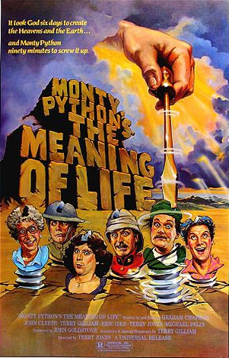
Python Basics
Values, Types, Variables, Expressions
Assignments
I/O
Control Structures

Slide 2
Values, Types and Variables
1, 2, 3.14 and ‘Hello, World!’ are values
Values belong to types: int, float, str, bool …
If you aren’t sure what type something is you can ask
>>> type (3.2) → <type ‘float’>
>>> type (True) → <type ‘bool’>
An assignment statement creates new variables at run-time
>>> n = 17
>>> type (n) → <type ‘int’>
A variable name starts with letter, followed by 0 or more letters, digits or _
Choose an incorrect variable name, get error
>>> more@ = 1000 → Syntax error: invalid syntax

Slide 3
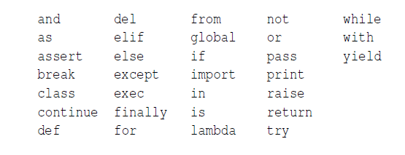
31 Reserved Words

Slide 4
Statements
Unit of code the interpreter executes and if there is a result, shows it
Seen the print and the assignment
Several statements are a script
>>> print 1
>>> x =2
>>> print x
Produces the output
1
2

Slide 5
Operators
Operators are special symbols representing operations (such as, addition, multiplication, etc.)
+ - * / ** (exponentiation)
Values they operate on are called operands
If both operands are integers, performs integer operation in Python 2.7
>>> minutes = 59
>>>print minutes / 60
0
In Python 3.0 // is integer division, otherwise does floating point division
Modulus operator 7 % 3 → 1

Slide 6
Expressions
An expression is a combination of values, operands and operators
If you type an expression in interactive mode, it will show you the result
>>> 1 + 1
2
Order of operations PEMDAS

Slide 7
String Operations
+ is concatenation
>>> print ‘100’ + ‘150’
100150
Python has a "string format" operator %. This functions analogous to printf format strings in C
"foo=%s bar=%d" % ("blah", 2) → "foo=blah bar=2"
In Python 3 and 2.6+, this was supplemented by the format() method of the str class
"foo={0} bar={1}".format("blah", 2).

Slide 8
Input
raw_input gets input from keyboard
>>> name = raw_input (‘What is your name?\n’)
Chuck
>>> print name
Chuck
>>> speed = raw_input(‘How fast were you going?\n)
23
>>> int (speed)
>>> print speed + 5
28
If user types in a non-integer → ValueError: invalid literal for int( )
In Python 3.0 this function is input

Slide 9
Comments #
#compute the percentage of the hour that has elapsed
percentage = int ( (float(minutes) / 60) * 100)
Or
percentage = int ((float (minutes)/60) * 100 ) #percentage of hour
Don’t do this!
v = 5 #assign 5 to v
Better – use a good variable name
velocity = 5

Slide 10
Boolean Expressions
Expression that is either true or false
Comparison operator == != < > <= >= is and is not
Three logical operators and or and not
>>>not (True) → False
0 is interpreted as false
Any nonzero number is interpreted as True
>>> 17 and True → True
Comparisons may be chained, for example a <= b <= c
.

Slide 11
Conditional statements
if x > 0:
print ‘x is positive’j #NOTE indentation!!!
if x % 2 = 0:
print ‘x is even’
else:
print ‘x is odd’
if x > 0:
print ‘x is positive’
elif x < 0: #NOTE elif
print ‘x is negative’
else
print ‘x is zero’

Slide 12
Nested Conditionals
Indentation is IMPORTANT
if x == y:
print ‘x is same as y’
else:
if x < y:
print ‘x is less than y’
else:
print ‘x is greater than y’

Slide 13
Nested Conditionals
Indentation is IMPORTANT
if x == y:
print ‘x is same as y’
else:
if x < y:
print ‘x is less than y’
else:
print ‘x is greater than y’
Gives an error
IndentationError: unindent does not match any outer indentation level

Slide 14
Error Conditionals - try/catch
strtemp = input (‘Enter Fahrenheit temperature: ‘)
try:
fahr = float (strtemp)
cel = (fahr - 32.0) * 5.0 /9.0
print cel
except:
print (‘Please enter a number’)

Slide 15
Short Circuiting
Expressions are evaluated left to right
If nothing to be gained from evaluating further (because value already known), it short circuits
if num != 0 and sum / num > 0 :
print (sum / num)
else:
print (‘Cannot do division’)

Slide 16
switch
Python doesn’t have one
Can fake with an array or dictionary or lambdas
More on that later

