Slide 1
Requirements Engineering
Elicit requirements from customer
  Information and control needs, product function and behavior, overall product performance, design and interfacing constraints, etc.
  Id customer’s need, evaluate system concept for feasibility, economic and tech analysis
Allocate function and behavior to HW, SW, data, and people

Slide 2
Requirements Analysis
Bridges system analysis and software design
Requirements provide SW designer with representation of information and functions easily translated to data, architecture, interface, and procedural design
Requirements provide means to assess quality

Slide 3
Requirements Analysis Tasks
Problem recognition
  Analyst studies system specs, software plan, reviews scope, establishes communication paths
Evaluation and synthesis of information
  Study extracted functions (externally observable objects, behaviors)
  Understand behavior in terms of events that affect system, interface and uncover design constraints
  Synthesize solutions
  Focus on what not how
Modeling
  Better understand data and control flow (DFDs, CFDs)
  Function processing and behavioral operation and info content
  Serves as basis for specification

Slide 4
Specification
  Serves as criteria for testing activities
  Can serve as a preliminary user manual
Review
  Requirement analysis documents (specification and user’s manual or prototype)
  Software project plan reassessed

Slide 5
Types of Requirements
User Requirements
  Statements in natural language plus diagrams of the services the system provides as well as operational constraints. Written for customers.
System Requirements
  More detailed specifications of user requirements
  A structured document setting out detailed descriptions of the system services. Written as a contract between client and contractor.
Specification
  A detailed software description which can serve as a basis for a design or an implementation. Written for designers.

Slide 6
The Requirements Document
The requirements document is the official statement of what is required of the system developers
Should include both a definition and a specification of requirements
It is NOT a design document. As far as possible, it should set of WHAT the system should do rather than HOW it should do it

Slide 7
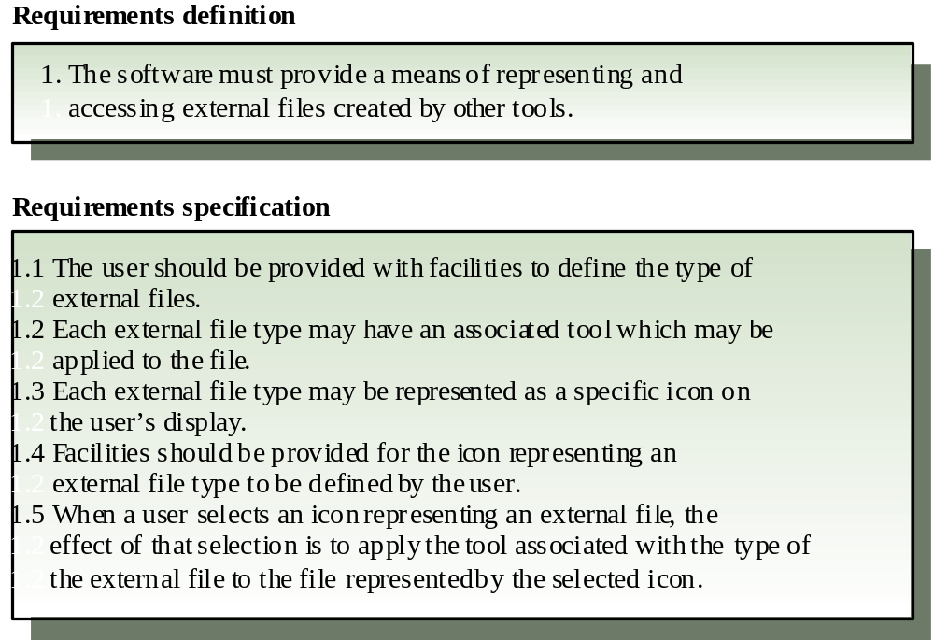
Definitions and specifications

Slide 8
Functional and Non-functional requirements
Functional requirements
  Statements of services the system should provide, how the system should react to particular inputs and how the system should behave in particular situations.
Non-functional requirements
  Constraints on the services or functions offered by the system such as timing constraints, constraints on the development process, standards, etc.
Domain requirements
  Requirements that come from the application domain of the system and that reflect characteristics of that domain

Slide 9
Requirements completeness and consistency
In principle requirements should be both complete and consistent
Complete
  They should include descriptions of all facilities required
Consistent
  There should be no conflicts or contradictions in the descriptions of the system facilities
In practice, it is impossible to produce a complete and consistent requirements document

Slide 10
Steps in Requirements Engineering
Domain understanding
Requirements elicitation
Requirements analysis and negotiation
System modeling
Requirements validation
Requirements management
Effort on Analysis 10-20%
Who: Analyst w/mgmt and technical staff of customer and system developer

Slide 11
Requirements Elicitation
Initial contact with customer
  Context-free questions
    People: Who requested? Who uses?
    Feasibility: Economic benefit of solution?
    Another source for solution?
    Characterize usage scenarios and “good” output
    What problems will this solution address?
    Describe environment the solution is used in
    Special performance issues or constraints
    Right person to answer questions and how
Discussion on FAST and Prototyping to elicit requirements

Slide 12
FAST – Facilitated Application Specification Techniques
  (when memos, formal position papers, docs, QA sessions don’t work)
  Team-oriented approach
  Customer and developer
  Goal: id problem, propose elements of solution, negotiate different approaches, specify preliminary set of solution requirements
  Neutral site
  Rules for preparation and participation established
  Agenda suggested
  Facilitator appointed
  Definition mechanism (worksheets, flipcharts, boards)

Slide 13
FAST
Review request days before meeting
  Make a list of objects part of environment
    Surrounding system, produced by system, used by system
  List of operations (processes and functions) that manipulate or interact with objects
  List constraints and performance criteria
Meeting
  Each presents list for critique/discussion
  Create combined list (no deletions)
  Discussion (shorten, lengthen, reword)

Slide 14
FAST
Subteams -> mini-specifications
  Develop, present
Combine draft (one or more will be assigned task of pulling materials together and writing it up)

Slide 15
Requirements document structure
Introduction
Glossary
User requirements definition
System architecture
System requirements specification
System models
System evolution
Appendices
Index

Slide 16
Guidelines
Specification outline (one in text and one in handout)
Guidelines
  Representation FORMAT and content relevant to problem
    Use a standard format for all requirements
  General OUTLINE developed
    Info within specification NESTED
    Use text highlighting to identify key parts
  Symbology, language DEFINED
    Use consistent language.
    Avoid the use of computer jargon
  RESTRICT number of diagrams and notational forms
  REVISABLE
  REVIEW

Slide 17
Prototyping
Forms of prototypes varies depending on forms of analysis
  Paper spec of SW from functional analysis or requirements gathering through FAST
  Coded prototype (not fully functional!)
  Preliminary user manual
  Story boards

Slide 18
Steps in Prototyping
1. Determine if project is good candidate
  App area, complexity, customer and project characteristics
  If dynamic visual displays
  Evolutionary prototyping
    heavy human interaction or combinatorial processing development
  Throwaway prototyping
    Conceptual development
2. Need abbreviated representation of requirements and 3. design spec
  Focus on top level issues
4. Prototype created, tested, refined
  (could be paper, storyboard)
5. Present prototype to customer
6. Repeat 4 and 5

Slide 19
Prototyping
Purpose: establish formal reqs or provide continuum resulting in evolutionary development of production software
RAPID Prototyping requires tool
  4GTs
  Reusable software components
  Formal spec/prototyping environments

