Slide 1

Featurama
Ioannis Batsios
Michael McCulloch
Christopher Thacker
Hieu Vo
Jamie Weathers

Slide 2
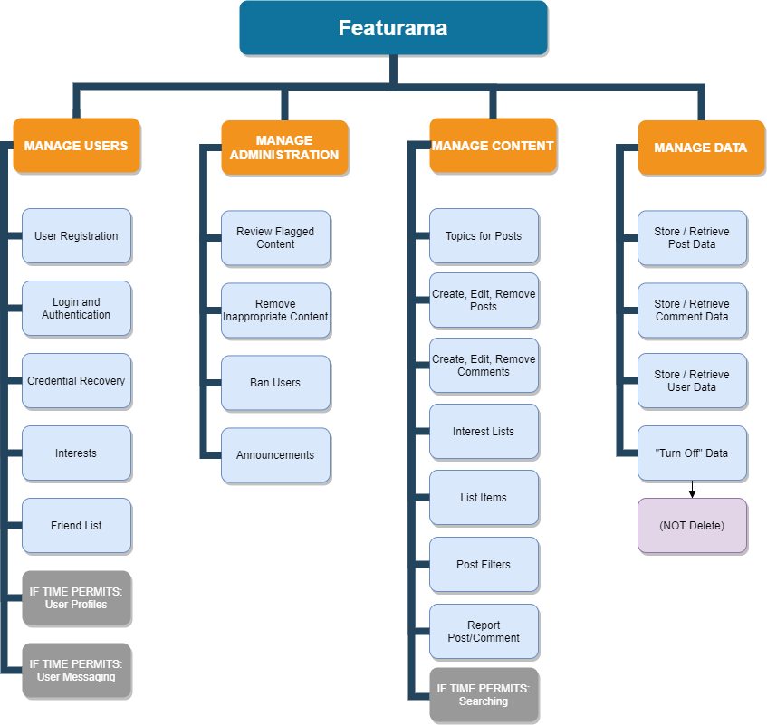
Data Data Model Diagram
Major Subsystems

Slide 3
Priorities
Content
Data
Users
Admins
Extras
Teams
Front-end
Ioannis
Michael
Back-end
Chris
Hieu
Jamie

Slide 4
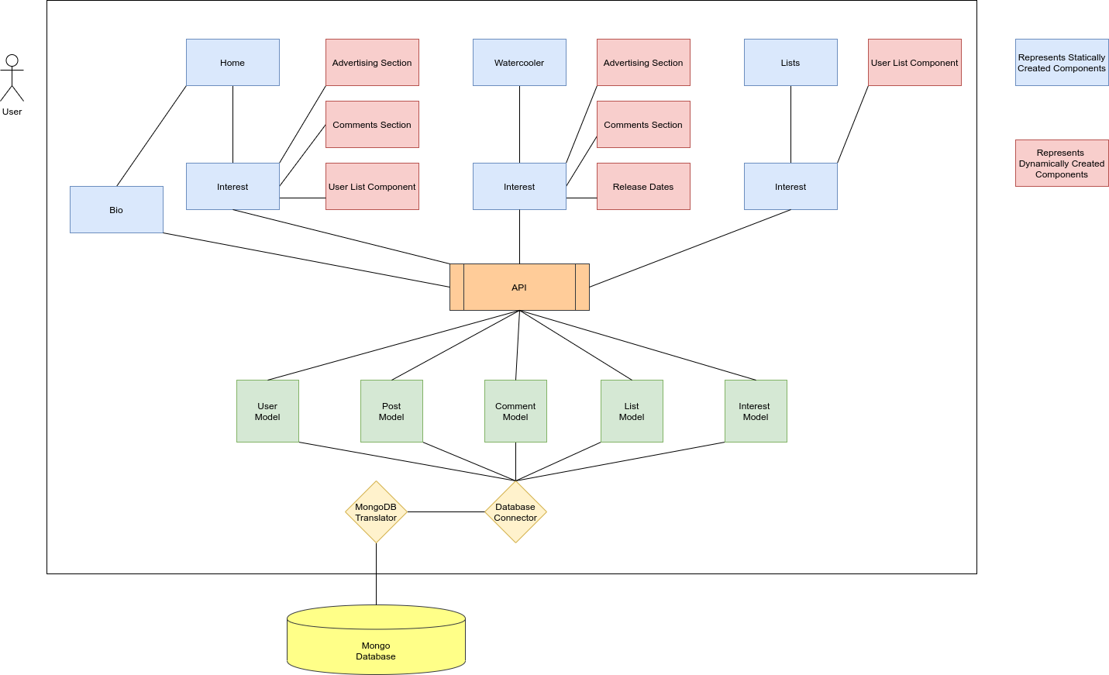
Data Data Model Diagram
Data Model Diagram

Slide 5
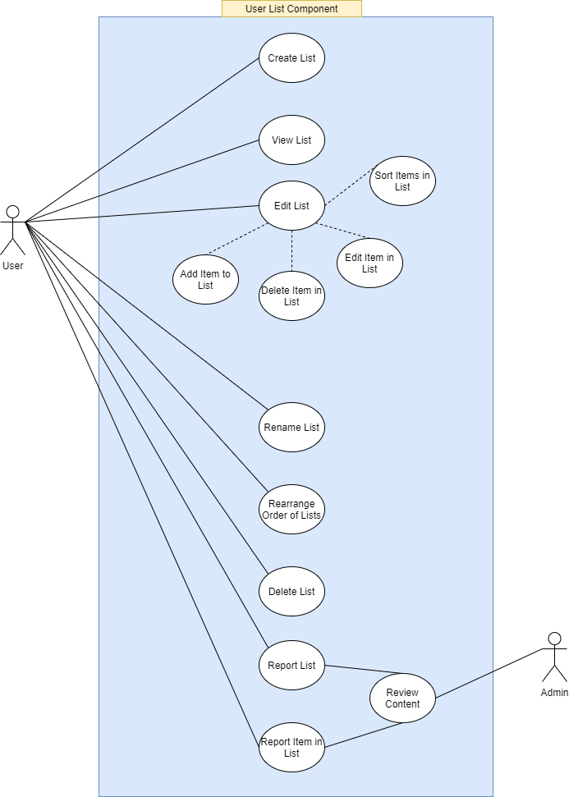
Use Case for
List Component

Slide 6
Implementation Constraints
Time | Money | Quality
April 24th is coming fast. | None (free servers we hope!) | MVP (god willing)
Constraints
Project Constraints
Users | Admin
Can not modify layout Can not load data files Can not create interests Can not delete content (only hide) | Can not modify layout Can not add interests Can not ban users Can not delete data from database Can not access database

Slide 7
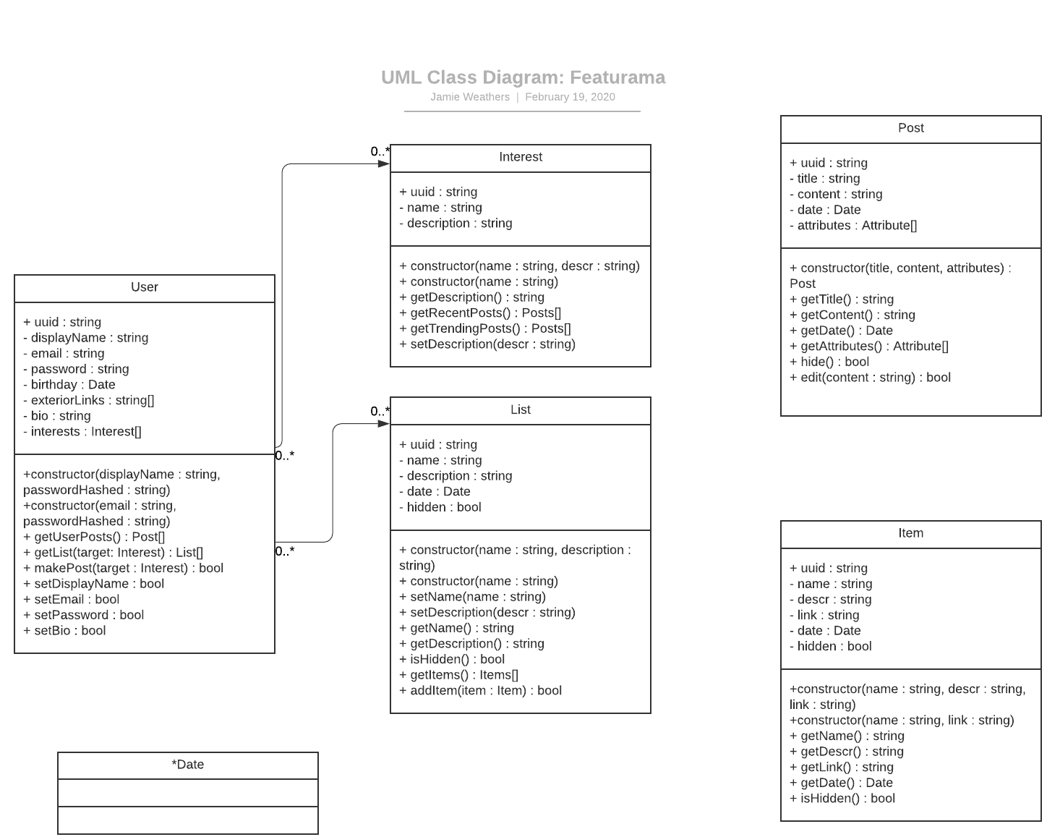
UML Diagram

Slide 8
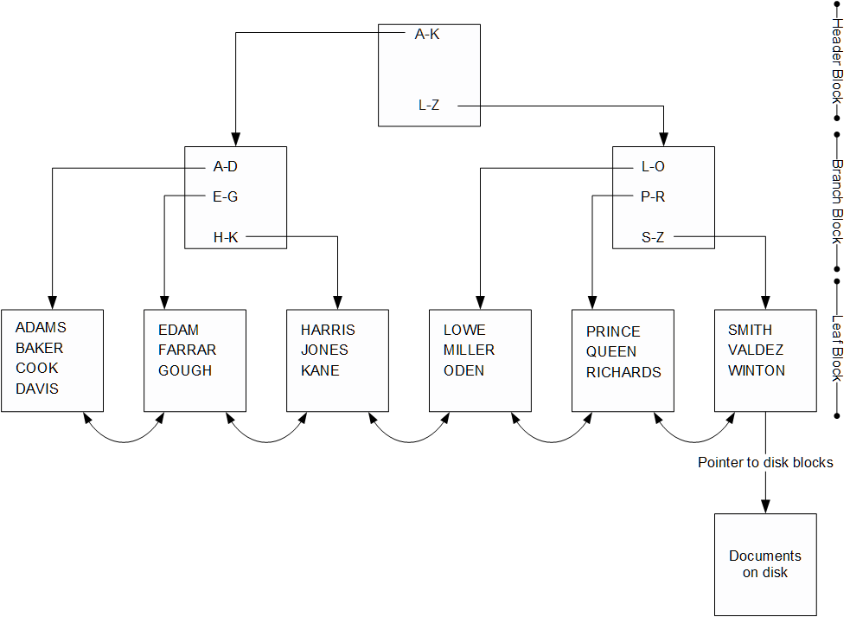
Database System Time Complexity
O(log(n)) = log2 (1,000,000) = 20
O(n) =1000000
O(log(n)) VS O(n)

Slide 9
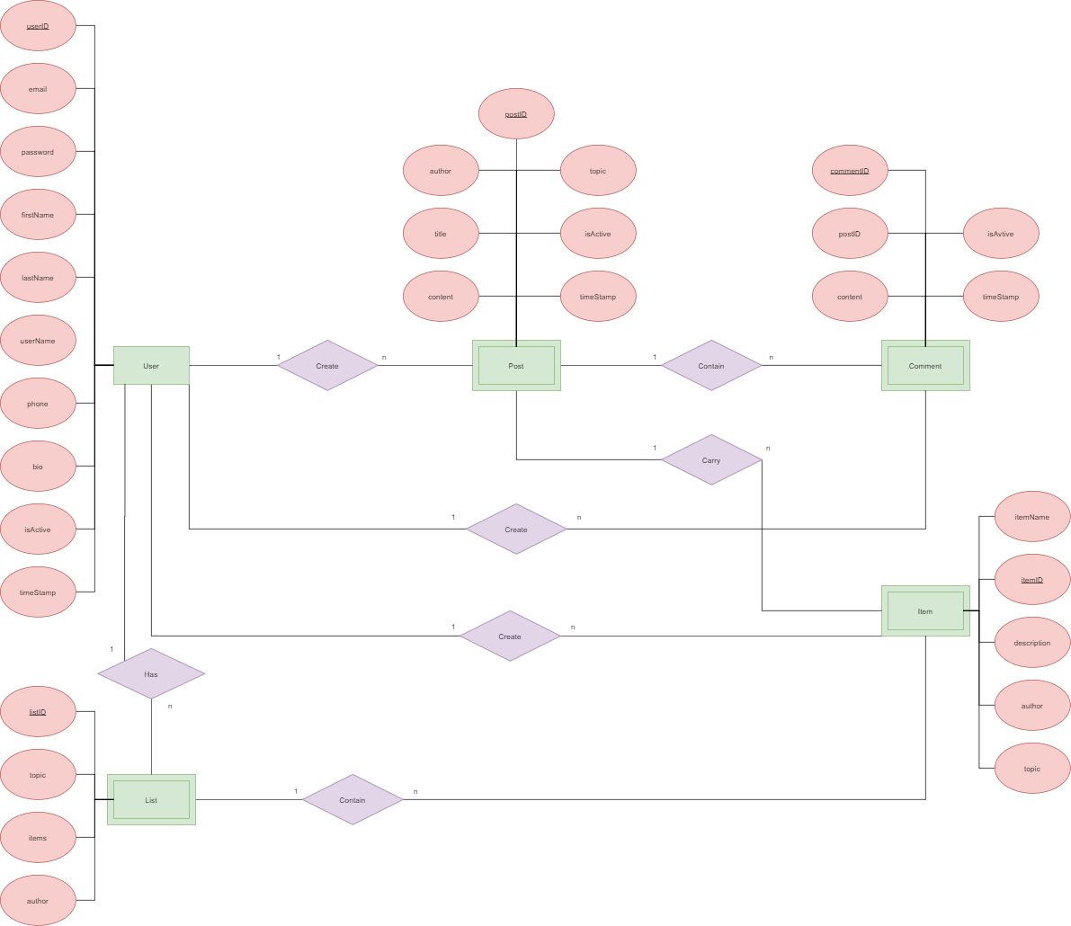
Database/
ER Diagrams

Slide 10
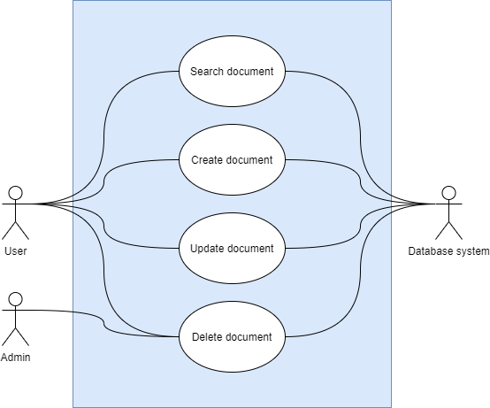
Database/Use-Case

Slide 11
Data Dictionary
Home
Bio
Interests
Lists
Watercooler
Interests
Posts
Comments
Lists
Interests
Items
Hyperlinks

Slide 12
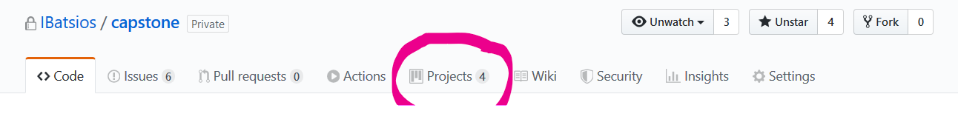
Scrum
Github makes Sprint logs easy
Create a project
Can import templates or create your own
Plan scrum meetings
Weekly
Daily

Slide 13
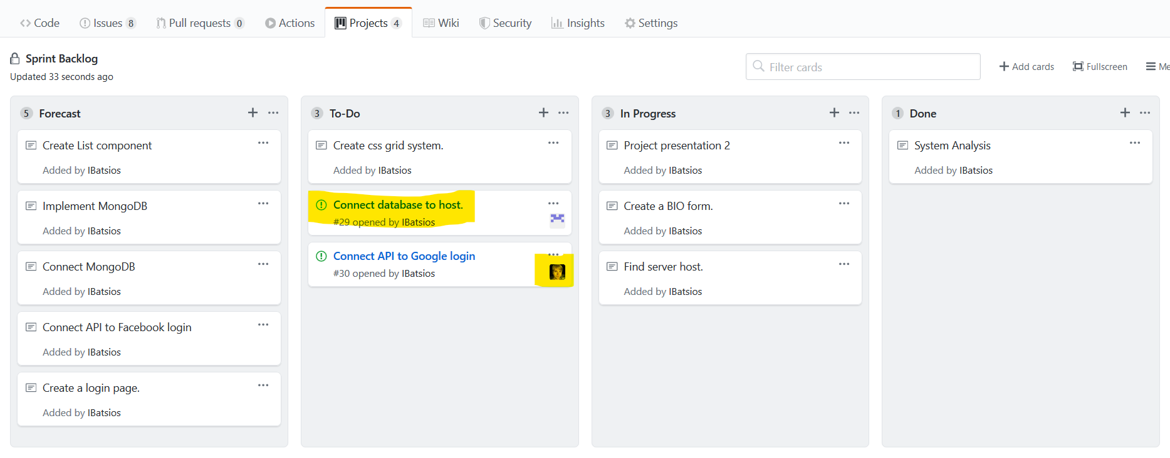
Sprint Backlogs
Can open issues from the Sprint
Have to assign from Issues

Slide 14
Thank you
Questions?

